Slide 1
PATRIOTS
FOR EUROPE

Slide 2
STRUCTURE
01
02
03
Background
1st article
2nd article
Basic information about the political group
Is EU being undermined from within? in France24
‘Patriots’ and Putin in National Review
04
05
06
3rd article
Questions
Vocabulary
Let’s have a discussion about Patriots for Europe
What words did we learn from the articles
Orbán isn’t as isolated as you think in Politico

Slide 3
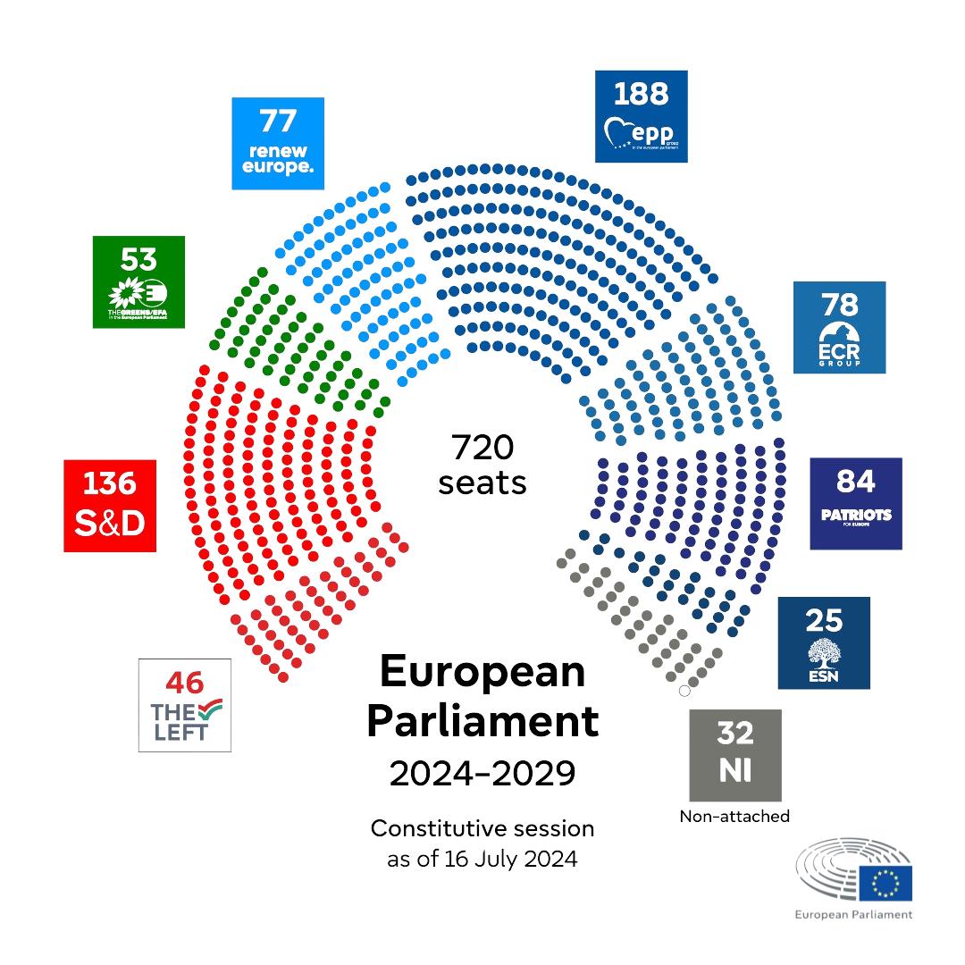
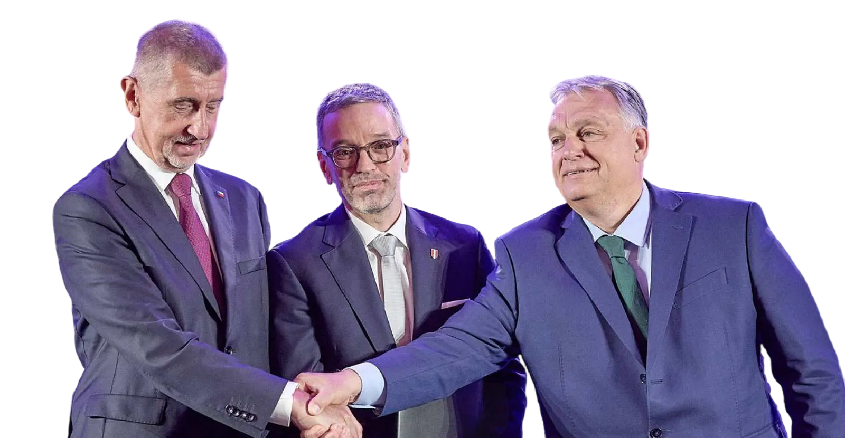
BACKGROUND INFORMATION
right-wing political group
founded by Fidesz, ANO and FPÖ on 8th of July 2024
group president: Jordan Bardella

Slide 4
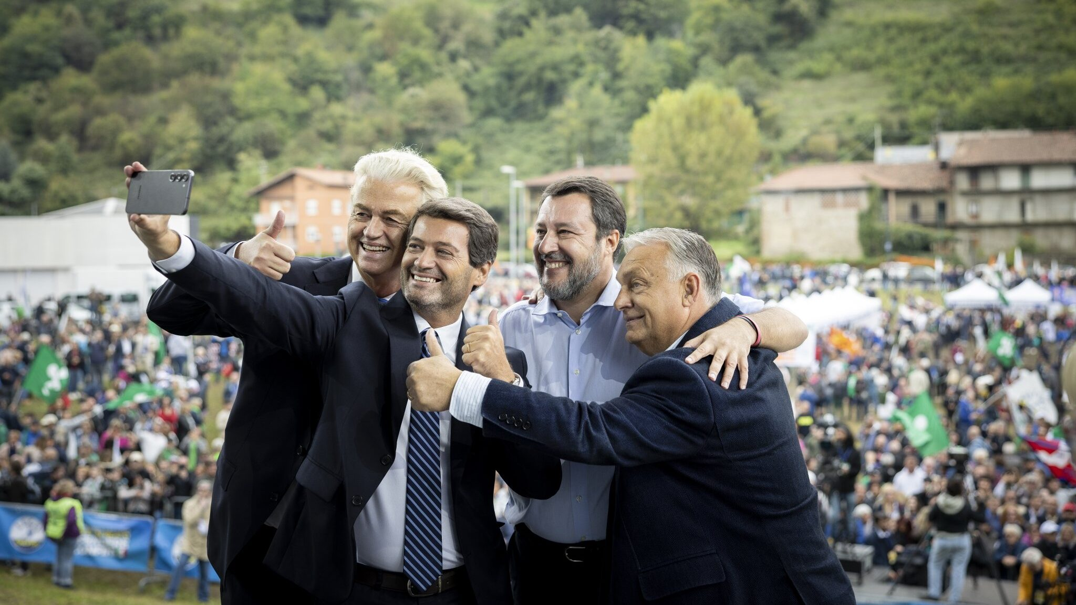
MANIFESTO AND GOALS
strong and sovereign nations
fight against illegal migration
preserving European culture
revision of Green Deal

Slide 5
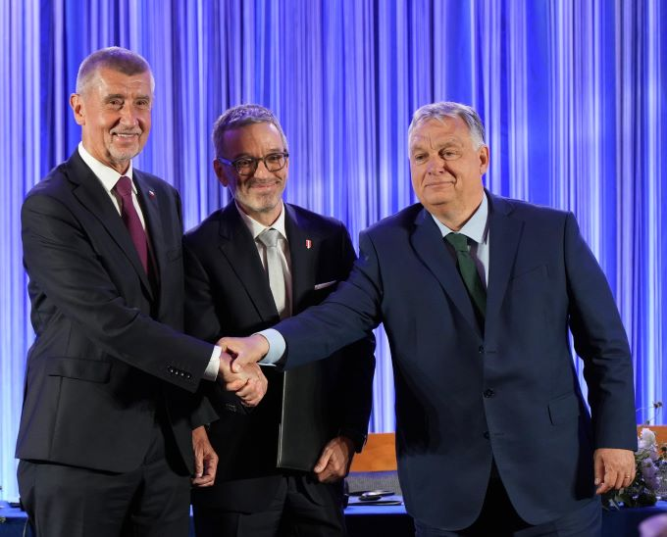
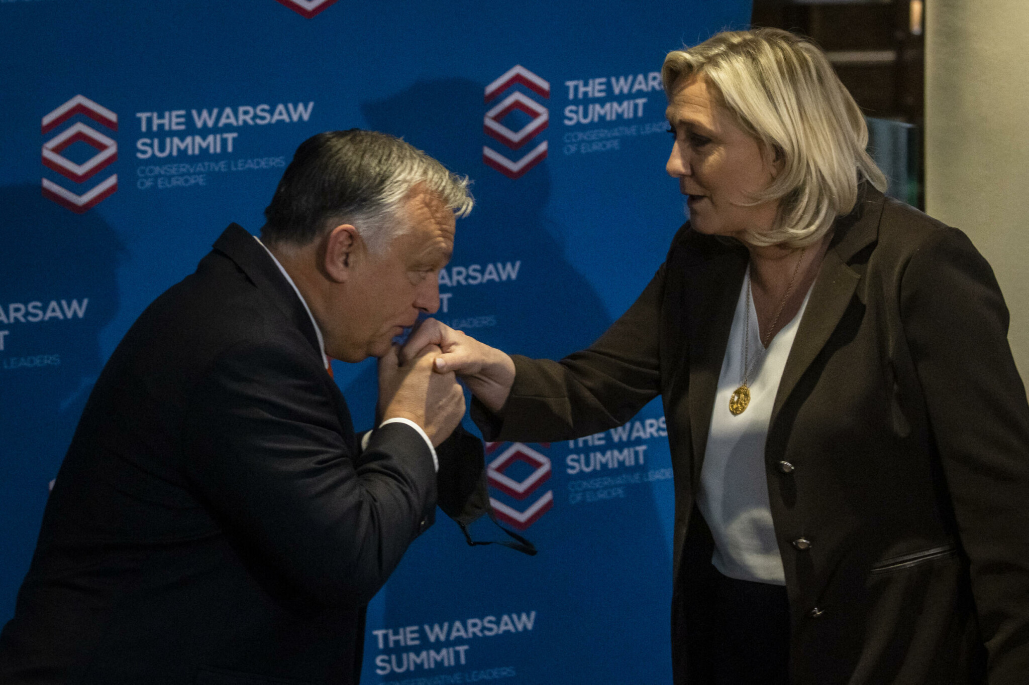
IS THE EU BEING UNDERMINED FROM WITHIN?
formation of a powerful far-right bloc
opposition to centralized EU power
strategic positioning against established leaders
potential shift EU policy debates

Slide 6
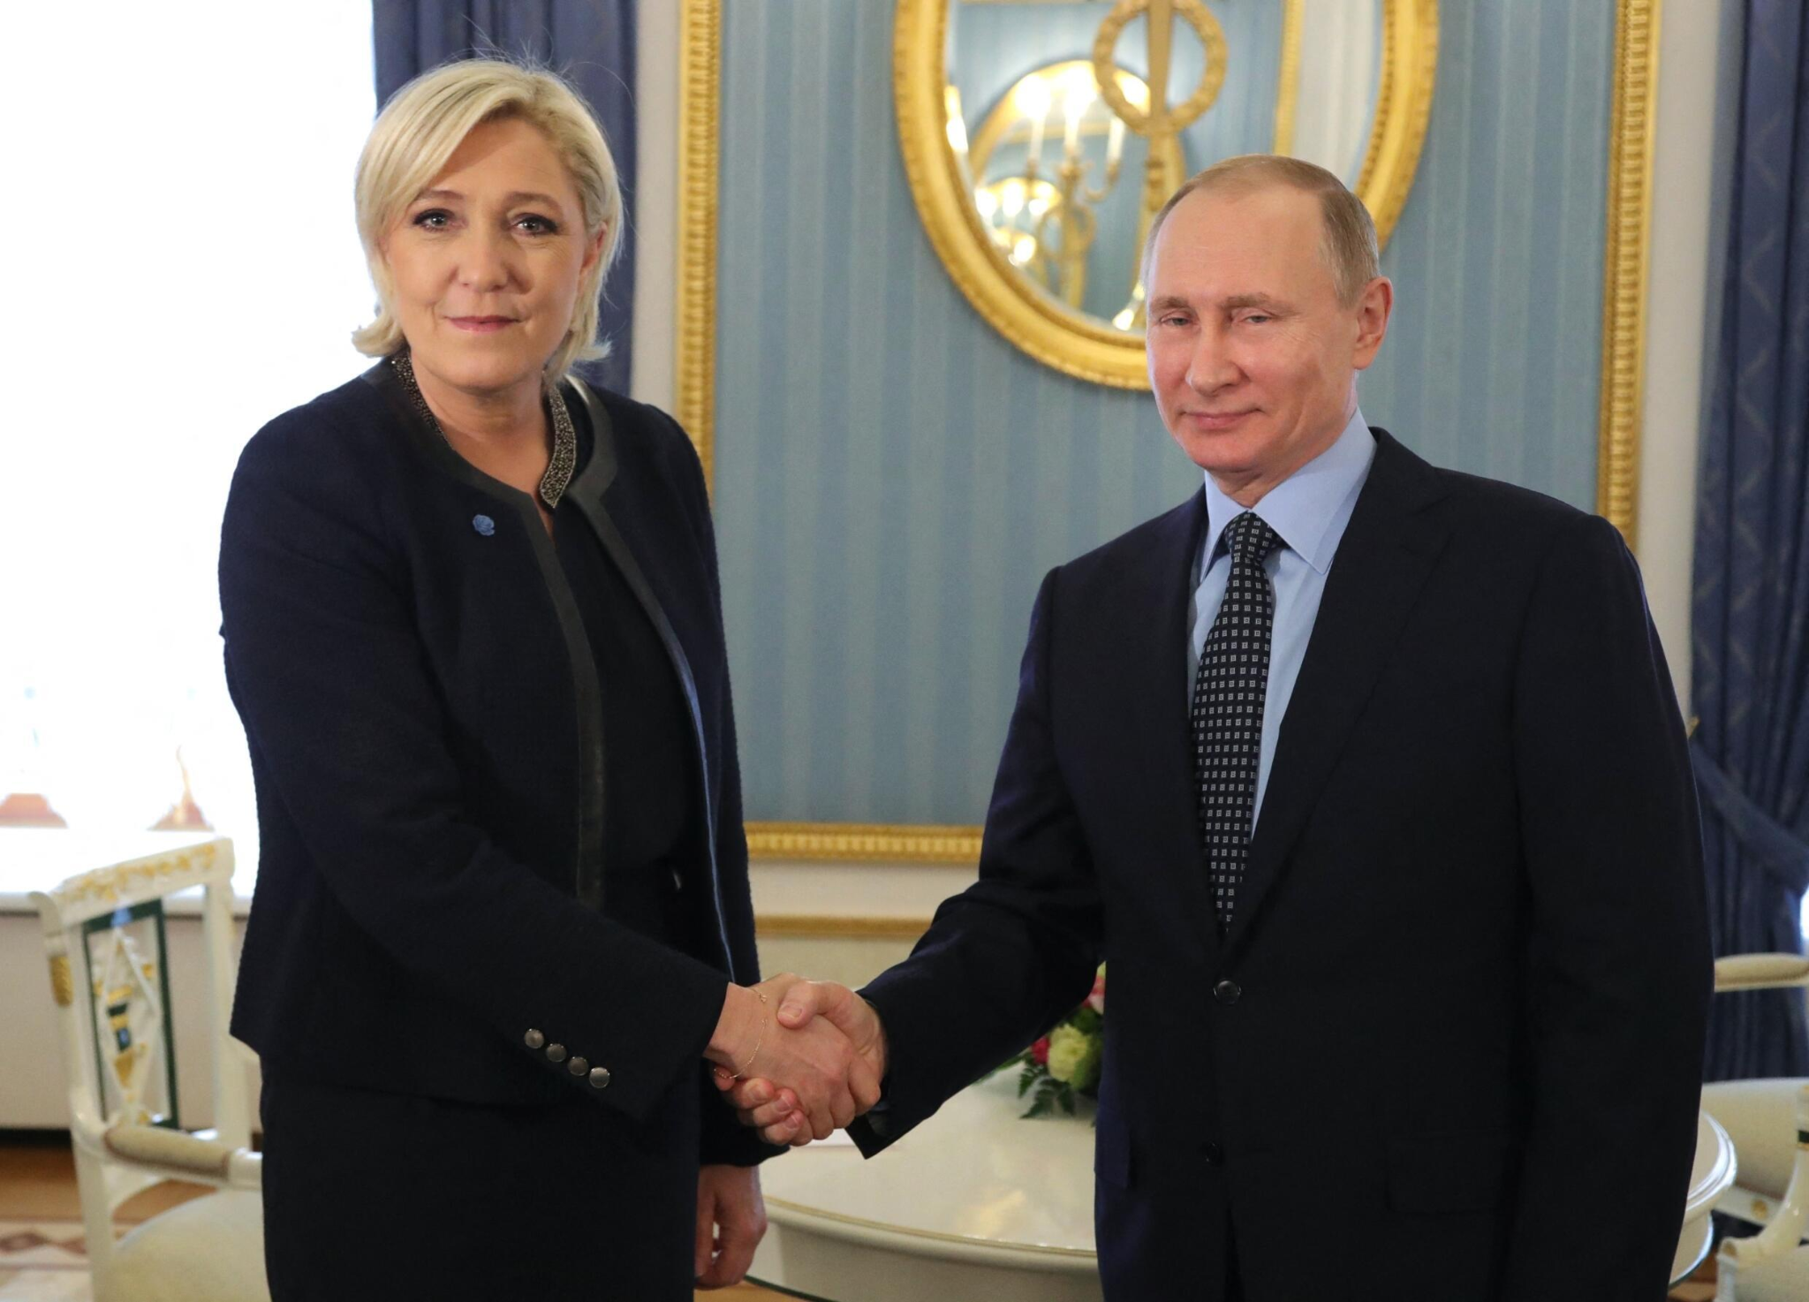
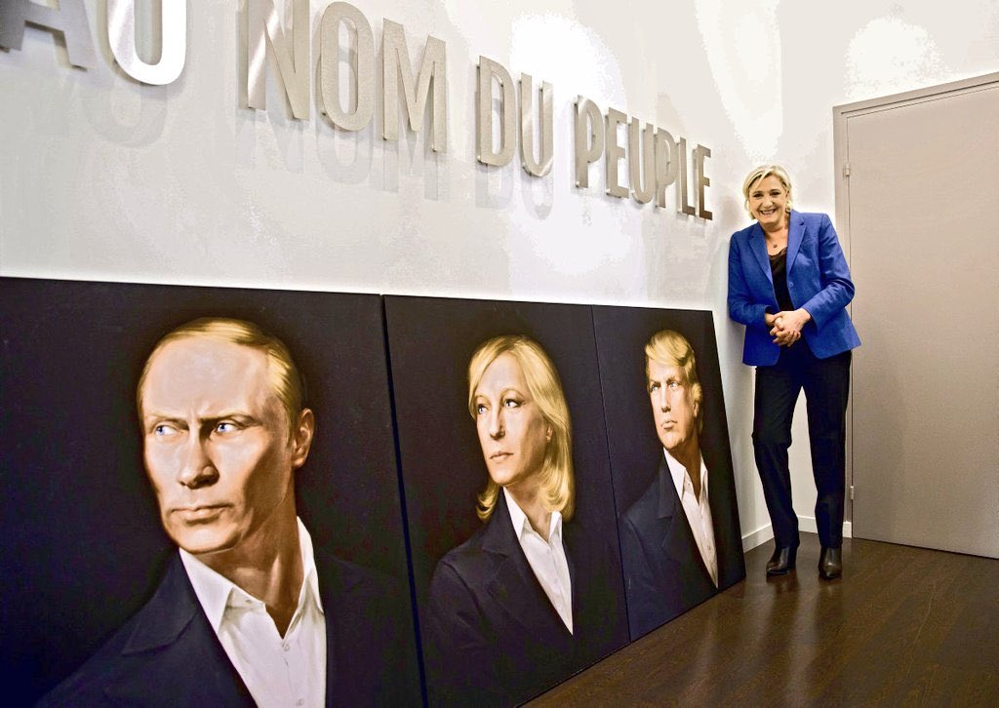
‘PATRIOTS’ AND PUTIN
alliance which comprises most of the illiberal Right in Europe
Marine Le Pen
has been funded by Putin
campaign pamphlets with a photo of her and Putin
posing with the trinity

Slide 7
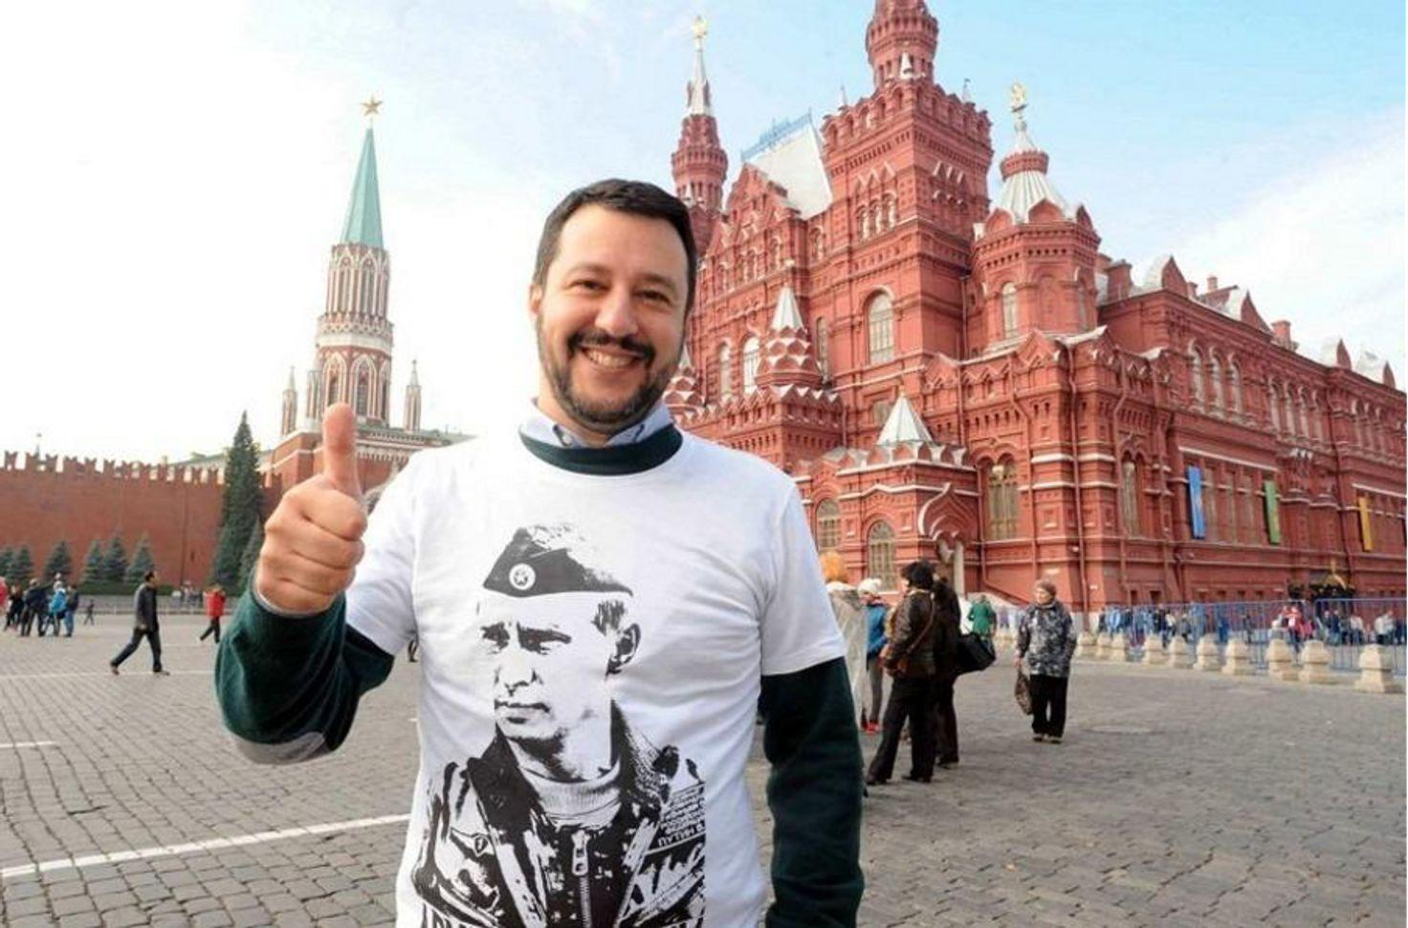
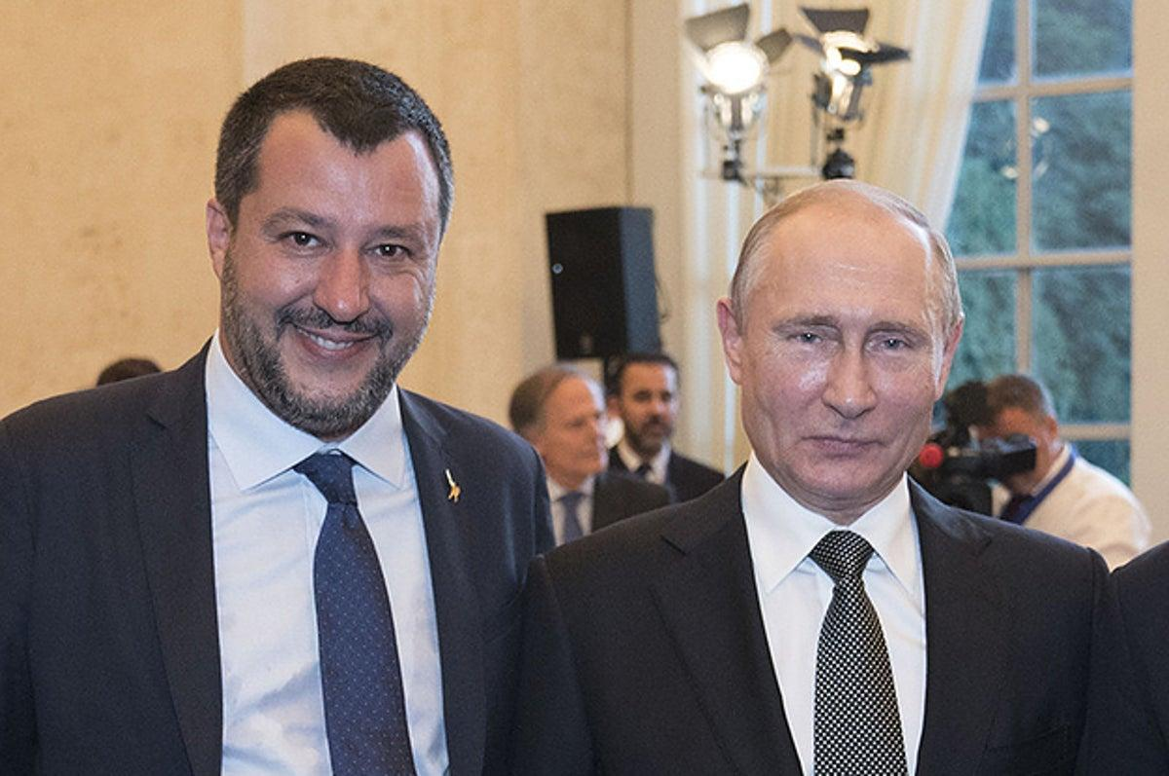
‘PATRIOTS’ AND PUTIN
alliance which comprises most of the illiberal Right in Europe
Matteo Salvini
established a “Friends of Putin” group in the Italian parliament
signed a “friendship and cooperation” agreement with Putin 3 years lates

Slide 8
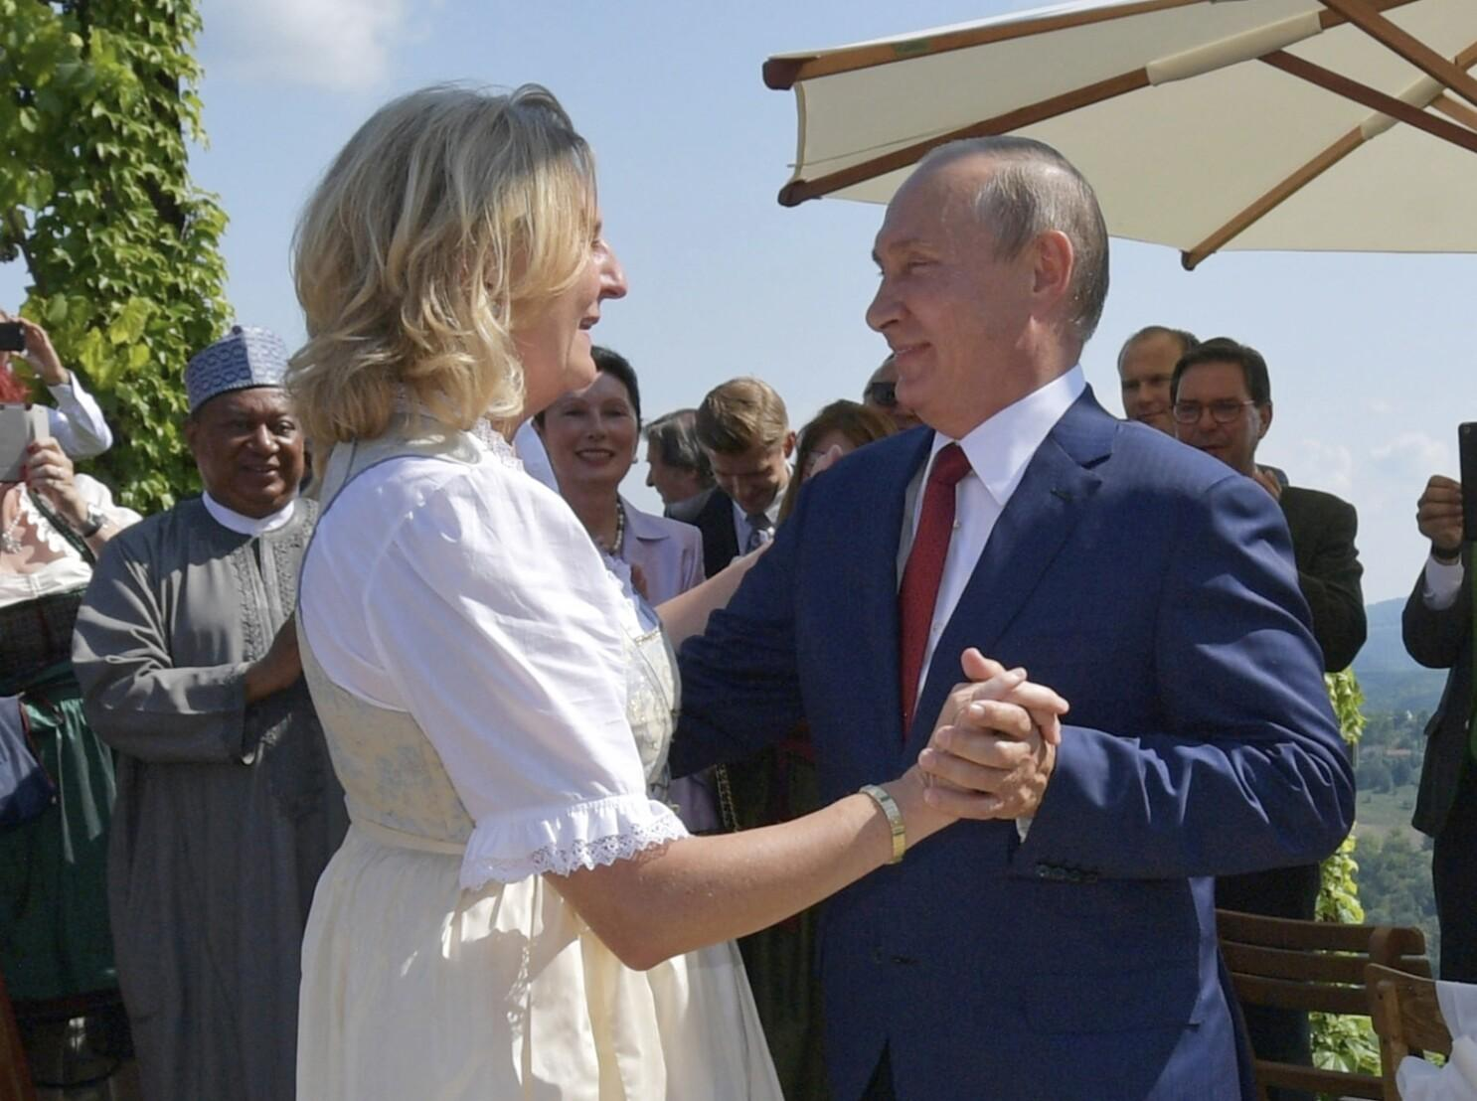
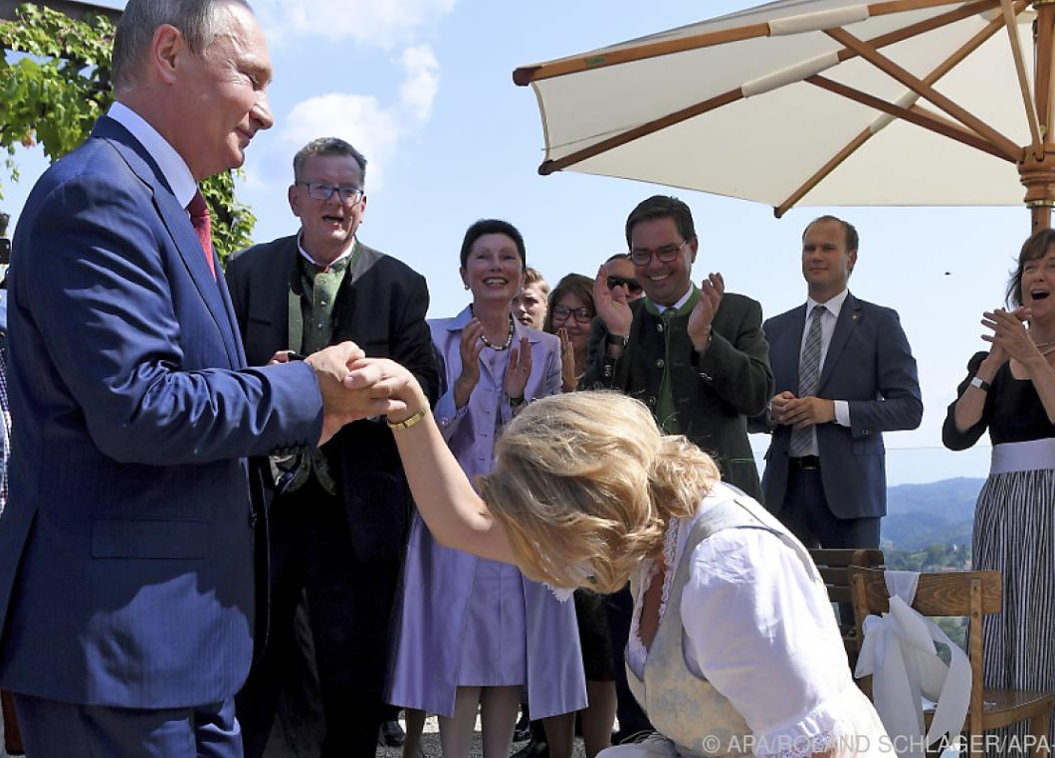
‘PATRIOTS’ AND PUTIN
alliance which comprises most of the illiberal Right in Europe
Karin Kneissl
joined the board of Rosneft
blogged for RT
invited Putin to her wedding
lives in Russia

Slide 9
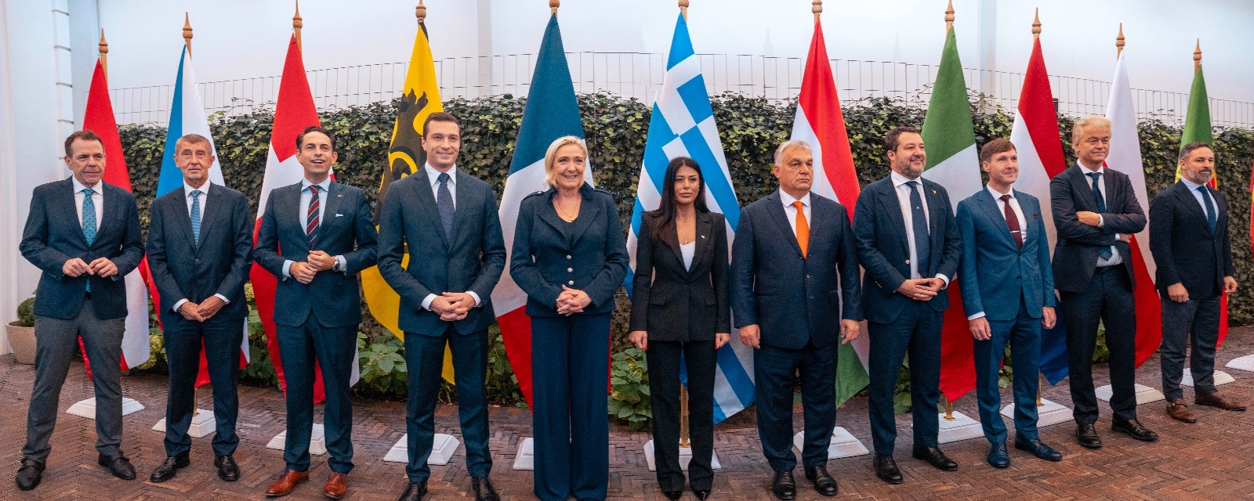
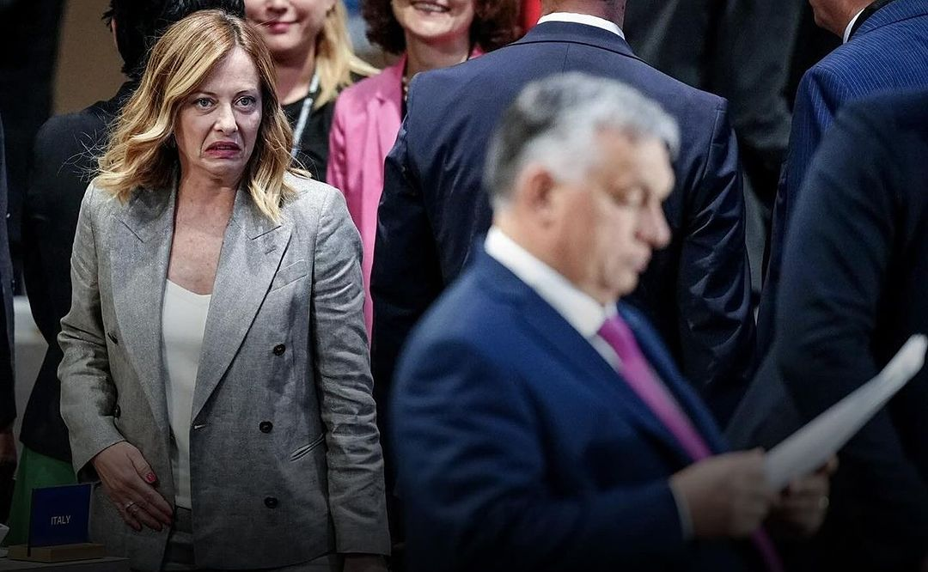
ORBÁN ISN’T AS ISOLATED AS YOU THINK
reorganized far right
working towards a Europe of nation states
challenge to Meloni’s pragmatic populism
0 committee chairs or leadership positions

Slide 10
Do you think that the concerns about Patriots for Europe being pro-Russian are relevant? Why?

Slide 11
What do you think about
the potential future of
Patriots for Europe?

Slide 12
Is it right to block Patriots for Europe from getting any positions in the Parliament?

Slide 13
Why is patriotism nowadays connected to the far-right? Can centrist parties take it back?

Slide 14
Is the rise of the Patriots for Europe
a legitimate expression of democratic euroscepticism, or does it pose a threat to
the core values of the EU?

Slide 15
Can the Patriots for Europe, with
its far-right, nationalist agenda, gain enough influence to significantly alter
EU policies?

Slide 16
VOCABULARY
deputy prime minister - can take the position of acting prime minister when the prime minister is temporarily absent
luminary - a person that inspires or influences others
pulp - crush into a shapeless mass
pamphlet - a small booklet containing information about a single subject
to relegate - to send into exile
to straddle - to sit on / support both sides
snap election - an election announced earlier / suddenly
to exert - to use something (influence) to achieve something

Slide 17
VOCABULARY
diktats - orders imposed by those in power
leadership battle - competition for control in a group
deprived of influence - lacking power to make changes
radical populist parties - groups wanting major political changes, focusing on nationalism
fifth column - a secret group weakening a larger group from within.
veto players - people whose agreement is needed for decisions

Slide 18
KAHOOT
LET’S PLAY!

Slide 19
THANK YOU
FOR YOUR ATTENTION

Slide 20
SOURCES
ALJAZEERA, 2024. ‘Patriots for Europe’: Hungary’s Orban announces new EU Parliament alliance [online]. [cit. 2024-10-19]. Dostupné z: https://www.aljazeera.com/news/2024/6/30/patriots-for-europe-hungarys-orban-announces-new-eu-parliament-alliance
NATIONAL REVIEW, 2024. ‘Patriots’ and Putin [online]. [cit. 2024-10-19]. Dostupné z: https://www.nationalreview.com/corner/patriots-and-putin/
RAHMAN, Mujtaba, 2024. Orbán isn’t as isolated as you think. In: Politico [online]. 06.08.2024 [cit. 2024-10-20]. Dostupné z: https://www.politico.eu/article/viktor-orban-not-isolated-as-you-think/
SEIBT, Sébastian, 2024. Le Pen, Orban and the ‘Patriots for Europe’: Is the EU being undermined from within. In: France 24 [online]. 09.07.2024 [cit. 2024-10-19]. Dostupné z: https://www.france24.com/en/europe/20240709-le-pen-orban-and-the-patriots-for-europe-is-the-eu-being-undermined-from-within.

