Slide 1
THE BREXIT AFTERMATH
reconnection to EU
Katarína Valúchová, Prokop Janák

Slide 2
table of contents
  introduction
  first article
  second article
  questions
  vocabulary
  kahoot

Slide 3
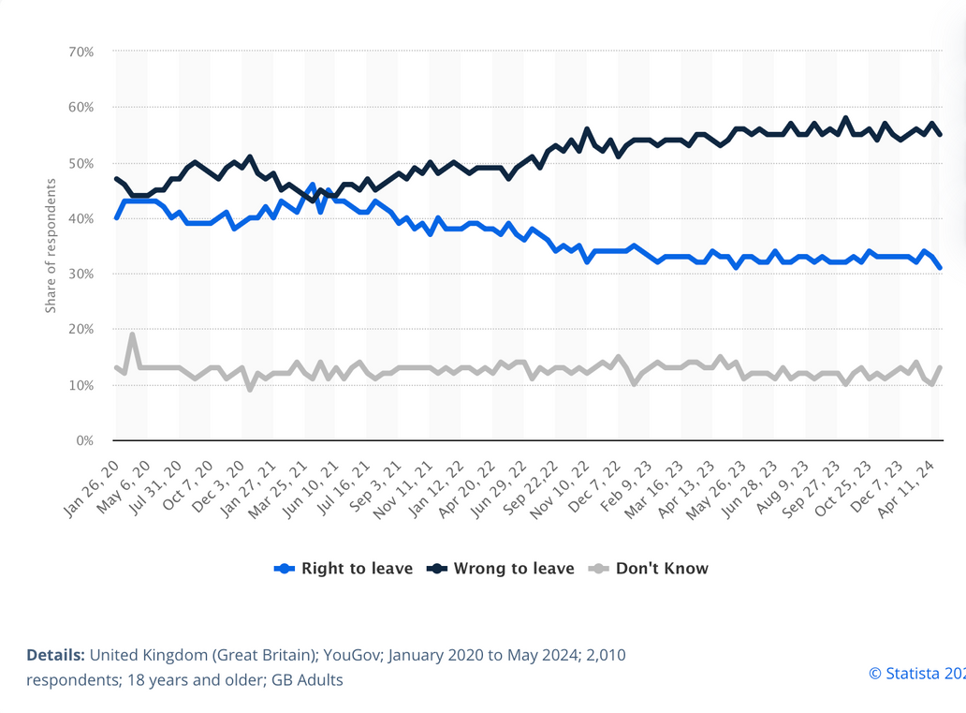
introduction
UK left the EU in 2020, what are the results
  unique set of institutional frameworks
  formal relationship: the Withdrawal Agreement; the Trade and Cooperation Agreement
    each creates a committee structure
  15% of people think the benefits of Brexit have outweighed the negatives
  what do the parties think?
statista 2024

Slide 4

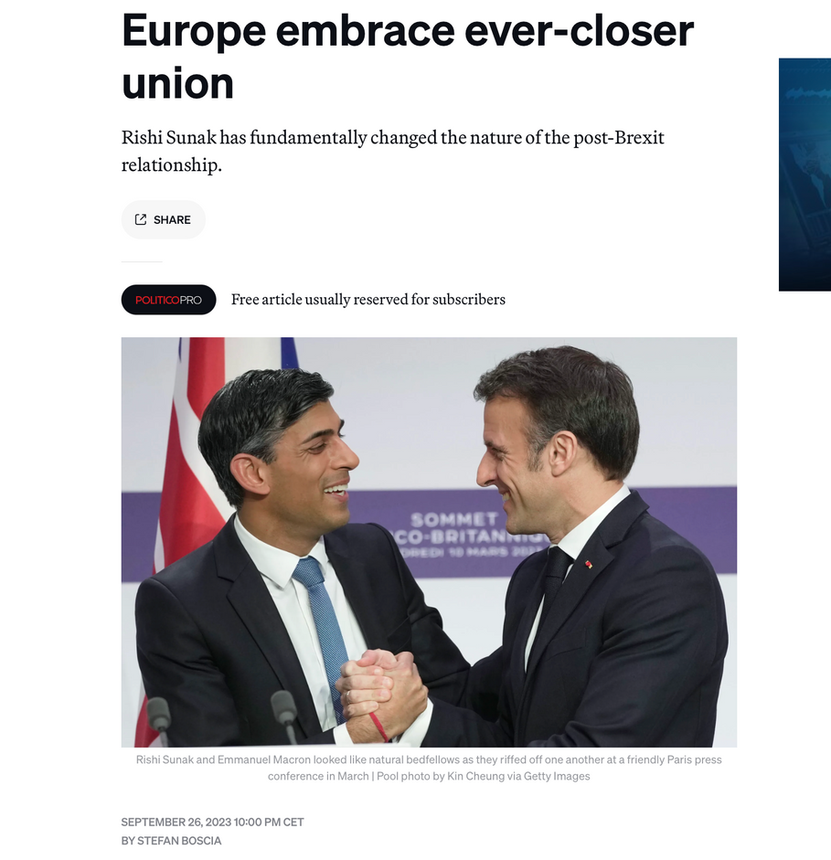
Europe embrace ever-closer union
  Newly established agreements
  Renewed relationships
  Future negotiations
  Experts opinion

Slide 5

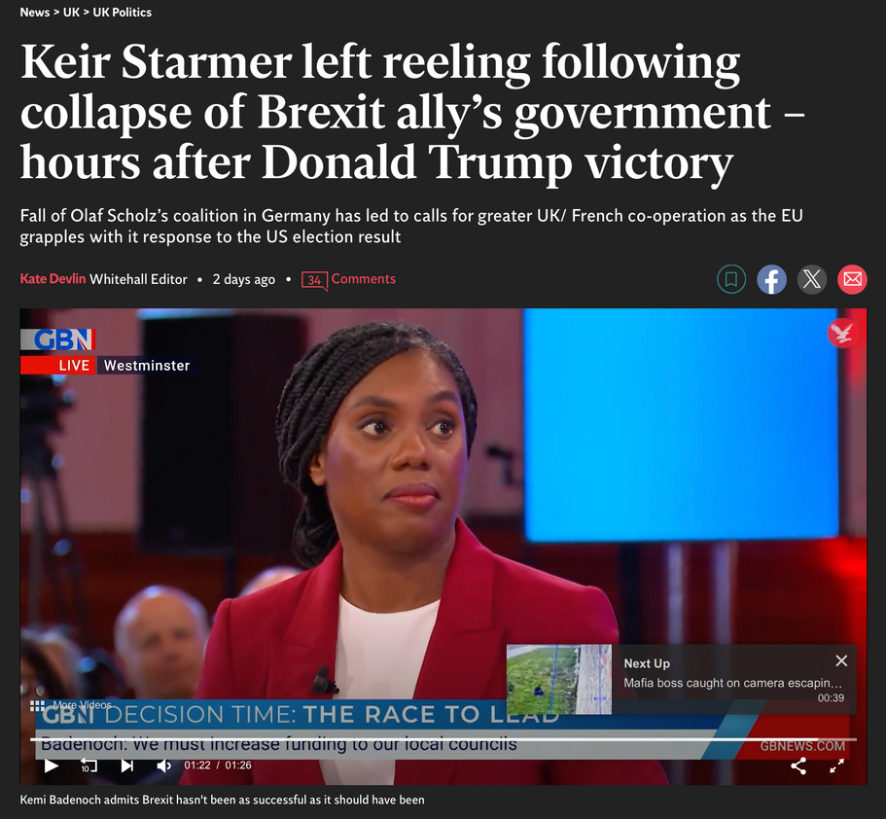
Keir Starmer left reeling following collapse of Brexit ally’s government – hours after Donald Trump victory
  close working relation with Olaf Scholtz
  major strengthening of Europe’s security
  german government’s collapse
  democrats loss in the US

Slide 6
Do you think Starmer will prioritize transatlantic relations, now that Trump is back in office?

Slide 7
Did the Lisbon Treaty effectively open the door for the UK to leave or was Brexit simply a matter of time regardless of the treaty?

Slide 8
Do you think that there can be a compromise in future negotiations, where both EU and UK are satisfied with the results?

Slide 9
Do you think a more pro-brexit, neutral or anti-brexit UK officials are better for the future communication between UK and EU?

Slide 10
vocabulary
Demagogue “a political leader who gains support by appealing to people's emotions, fears, and prejudices rather than using reasoned arguments.“
Frontbencher “a senior member of a government or opposition party, typically sitting in the front rows of the parliamentary chamber.“
Imminent “something that is about to happen very soon, likely to occur immediately or in the near future.“
Pay-as-you-go “is a system where services or goods are paid for as they are used, rather than through a pre-payment or subscription.“
Renegotiation “refers to the process of revisiting and altering the terms of an agreement or contract“.

Slide 11
sources
Boscia, S. (2023, September 27). After Brexit, Britain and Europe embrace ever-closer union. POLITICO. https://www.politico.eu/article/eu-uk-relations-rishi-sunak-brexit/
Devlin, K. (2024, November 7). Keir Starmer left reeling from collapse of Brexit ally’s government – hours after Donald Trump victory. The Independent. https://www.independent.co.uk/news/uk/politics/brexit-uk-starmer-germany-government-collapse-b2643050.html
YouGov. (May 2, 2024). In hindsight, do you think Britain was right or wrong to vote to leave the European Union (January 2020 to May 2024) [Graph]. In Statista. Retrieved November 12, 2024, from https://www.statista.com/statistics/987347/brexit-opinion-poll/
Davies, C., & Kassim, H. (2023). How does the EU organise and manage its relationship with the UK post-Brexit? [Online]. Uk In A Changing Europe. Retrieved from https://ukandeu.ac.uk/explainers/how-does-the-eu-organise-and-manage-its-relationship-with-the-uk-post-brexit/
Cross, M., & Briant, N. (2024). Brexit: What has changed in eight years? [Online]. Bbc. Retrieved from https://www.bbc.com/news/articles/cv22y0jvd4do

