Slide 2
Tisza Party
Tomáš Üveges

Slide 3
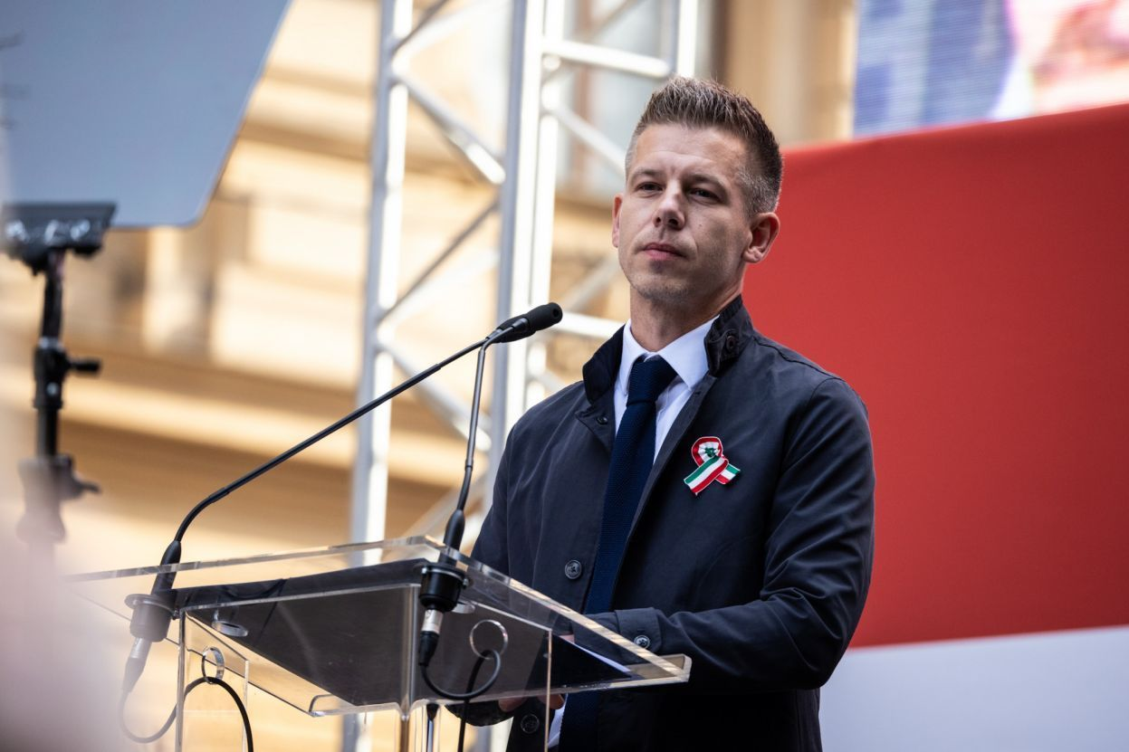
History of Tisza
founded in 2021, but did not participate in elections
overtaken by Péter Magyar’s Talpra Magyar movement in April 2024
participated in first elections in 2024
new leadership since July 2024
Notes:
The party's name is derived from a major Hungarian river, Tisza, and is also an abbreviation of the words "Tisztelet és Szabadság" (Respect and Freedom). It was founded in the city of Eger, Hungary, with the aim of appealing to undecided voters. The party toured the country, rejected state funding, and according to its financial report, collected only around €500 in donations. They ultimately did not participate in the 2022 elections. The party remained largely dormant until it was taken over by Péter Magyar, the ex-husband of a former Justice Minister from the ruling Fidesz party. We will discuss Péter Magyar in more detail on the next slide, but an interesting fact: his surname "Magyar" means "Hungarian." His movement, Talpra Magyar, translates to "On your feet, Hungarian!" This phrase is part of the opening lines of The National Poem by Sándor Petőfi, recited on March 15, 1848, on the steps of the Hungarian National Museum. It is said to have inspired the Hungarian Revolution of 1848, which briefly freed Hungary from absolutism and introduced significant reforms to the feudal system.
Fittingly, Péter Magyar announced the formation of his movement on March 15, during a large demonstration. Due to the then upcoming European elections, he didn’t have time to register a new party early enough for it to participate, so he held discussions with different parties. His movement essentially integrated into Tisza. The party participated in its first election this year.

Slide 4
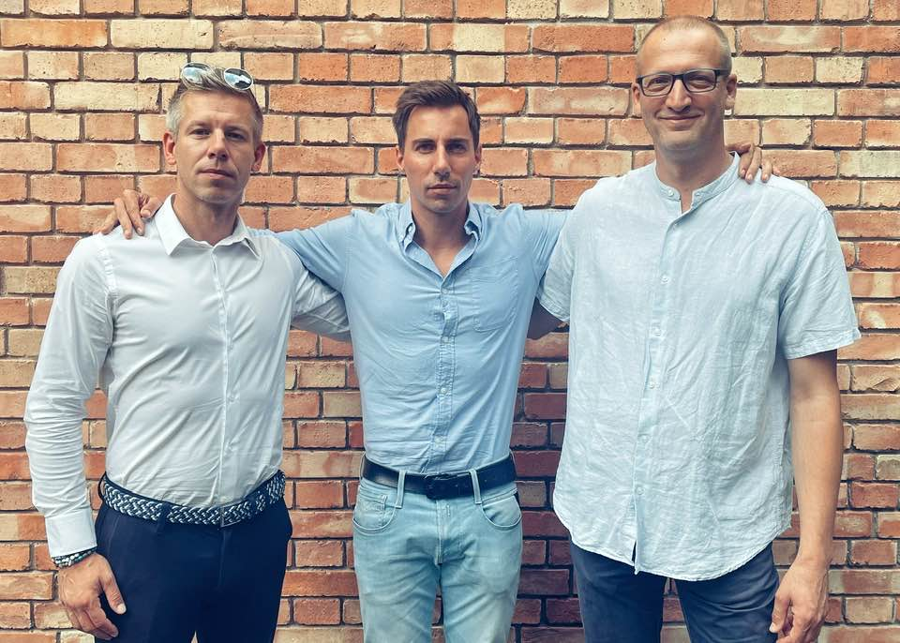
Leading Tisza politicians
president Péter Magyar
vice-presidents
Márk Radnai (operational leader)
Zoltán Tarr (head of EP delegation)
honorary president Attila Szabó

Slide 5
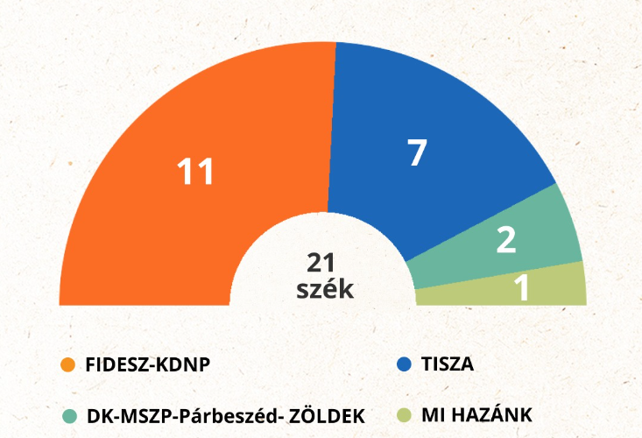
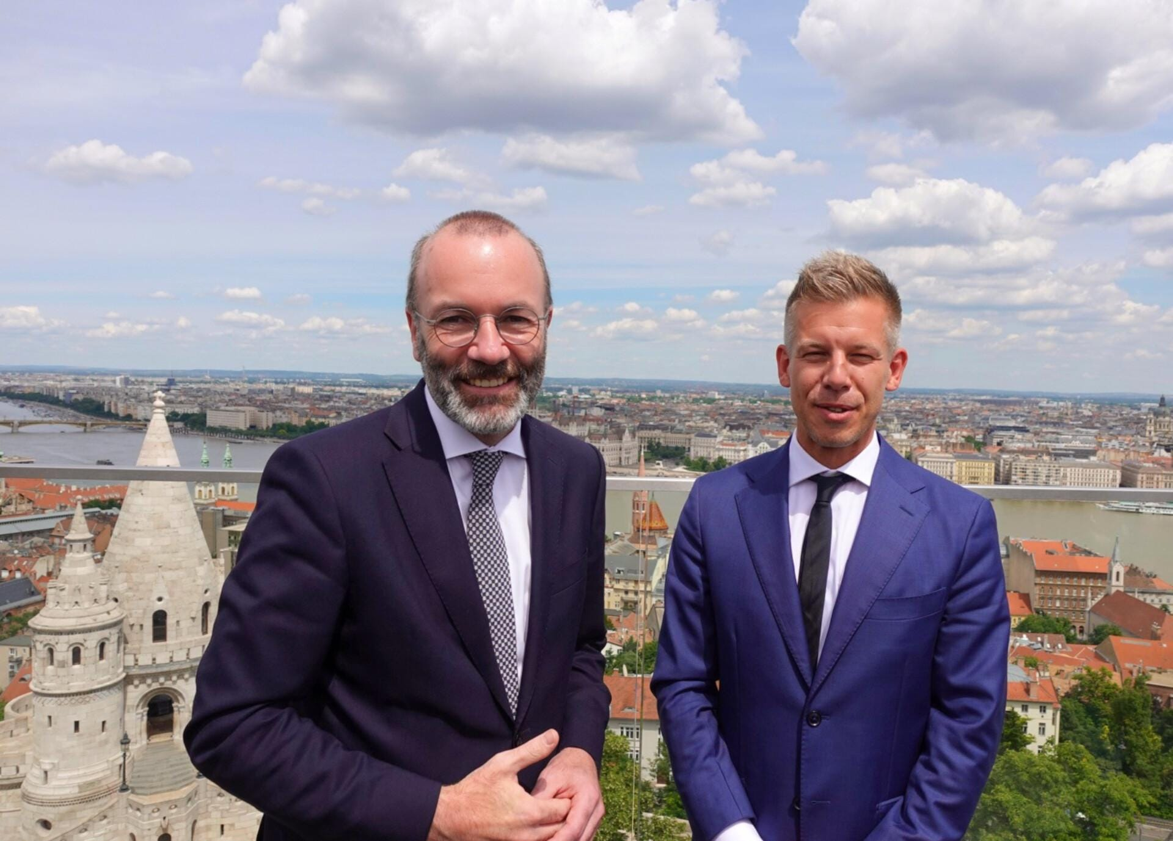
European elections 2024 for Tisza
some candidates were selected through a public call for nominations
managed to receive 29.6% of the vote - joined the EPP
holds multiple positions in the European Parliament
Vice-Chair of the European Parliament's Committee on Constitutional Affairs

Slide 6
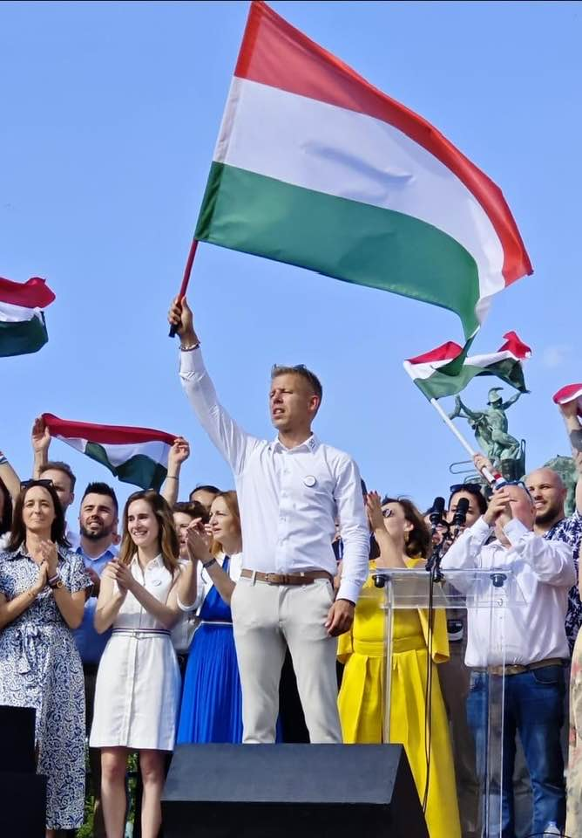
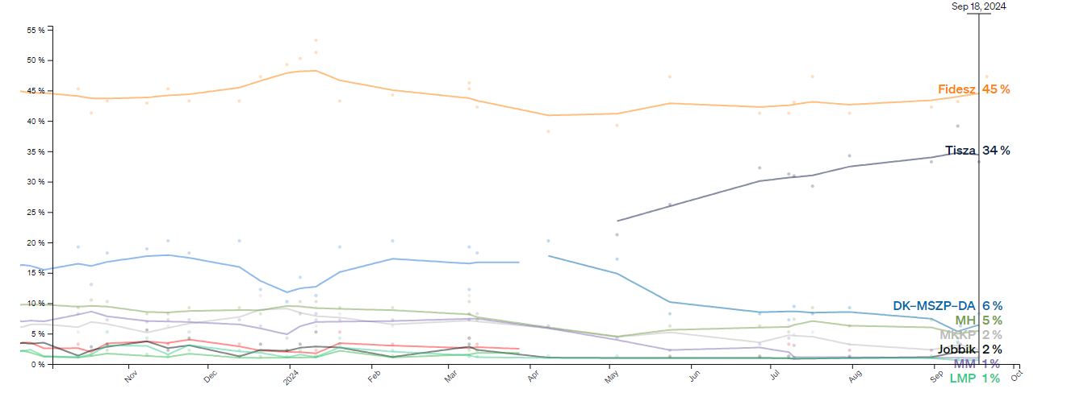
Tisza in the national politics
no seats in Parliament
10 seats in Budapest’s General Assembly
strong opposition to Orbán
crushed the existing opposition
building the movement
demonstrations

Slide 7
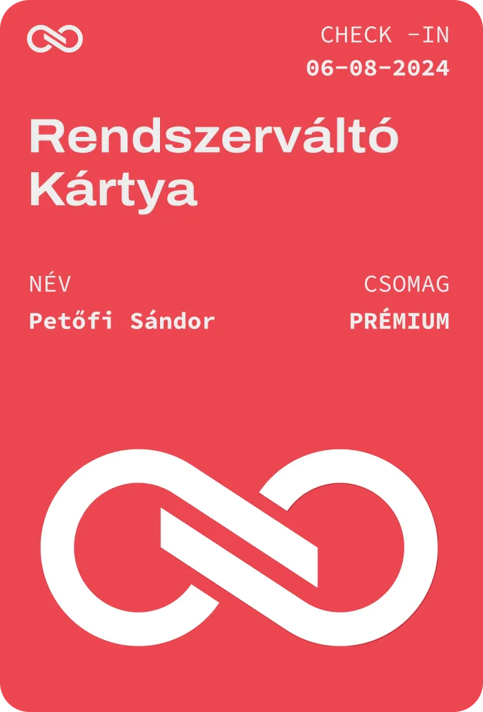
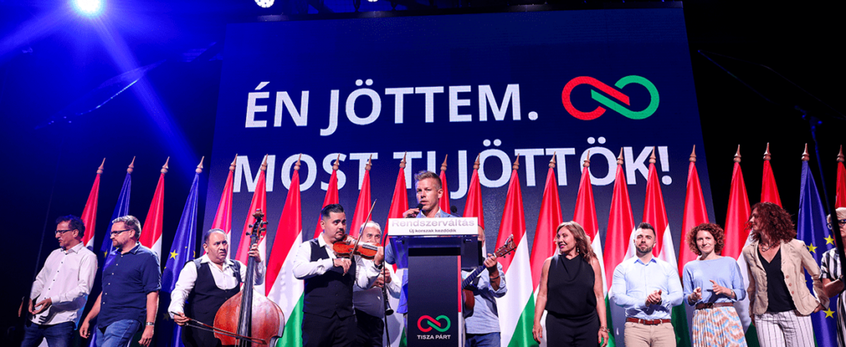
Political programme of Tisza
centre-right conservative populists
main points
double family allowances and increase of pensions for low-income seniors
only 2 terms in office for Parliament
abolish the propaganda ministry (Minister of PM's Cabinet Office) and create ministries for health, education and environment
anomalies - opposing sending weapons to Ukraine

Slide 8
Is populism the right approach to counter illiberalism?

Slide 9
Thank you

Slide 10
Resources
https://telex.hu/belfold/2024/03/15/magyar-peter-marcius-15-zaszlobontas-part
https://telex.hu/belfold/2024/04/10/magyar-peter-partja-valasztasi-bizottsag-nyilvantartasba-vetel
https://telex.hu/belfold/2024/03/15/magyar-peter-marcius-15-zaszlobontas-part
https://magyartisza.hu/tisza-part-21-pontja
https://rtl.hu/europa/2024/07/23/magyar-peter-bizottsagi-alelnok-lett-az-europai-parlamentben
https://www.politico.eu/article/european-peoples-party-hungary-weapons-war-in-ukraine-aid-peter-magyar/
https://www.politico.eu/europe-poll-of-polls/hungary/
https://studyinhungary.hu/blog/sandor-petofi-the-revolutionary-poet-was-born-200-years-ago
Images
https://egriugyek.hu/eger-ugye/egerben-alapitottak-uj-partot-deak-boldizsarek-a-tisza-parttal-a-parlamentbe-vagynak-mind-a-106-korzetben-lesz-jeloltjuk
https://www.facebook.com/photo/?fbid=8428390723861968&set=a.115525025148621
https://www.facebook.com/photo.php?fbid=8851858468181856&set=pb.100000733720126.-2207520000&type=3&locale=hu_HU
https://fovarosunk.info/2024/07/07/magyar-peter-a-rendszervaltas-elokeszitesenek-korszaka-jon/
https://www.facebook.com/photo.php?fbid=873890678107094&id=100064585093978&set=a.599581588871339

