Slide 1
Slovakia - State building between national myths and the ethics of dissent
Gábor Oláh
Central Europe: Politics and Society

Slide 2
Notes:
EVENT
What is an event?
Recognized and unrecognized
Personal vs collective
Reportable and unreportable
Exceptional, extraordinary
Visible and unvisible
Marshall Sahlins: rupture
Threre must be achange in the structure of the society
Transformation of society
What kind of event was 1989?
Bourdieu and his theory of various types of capital is needed to understand the transformation

Slide 3
Notes:
Nature of 1989
Ivo Možný – Proč tak snadno
PišTánek – Rivers of Babylon – the role of the underworld, how they found their place in the 90´s
Good bye Lenin:
The events are shown and not shown, changes needed
The personal trauma of the mother - characteristic for the whole generation, abandoned by the régime that they believed in
Creation of an alternative socialism, socialism with human face, all what they wanted
Nostalgia and Ostalgia
Something that is gone or never was
Leaning to the past
Picturing the past to the present and envisioning to the future

Slide 4
Notes:
Representation of the event of 1989
Beasley-Murray argues that 1989 was representable and unrepresentable in the same time
It was a struggle for the right to live a normal life
There is a resistance against representation
Representation and grand stories make events huge and important, exceptional..
Because it was a search for normativity and pre-revolution process was slow, there is a lack of grand stories
1989 has to be understood as the story precisely about not telling grand stories

Slide 5
Notes:
What is normativity? What is chaos and order? Elementary orientation tool in the world
If we look at the events of post WW 2 and communism, we see the struggle exceptional vs bureucratic system, taking place of the organized modernity – Peter Wagner
Exceptionality became the norm
Supression of individual iniciative became the norm
Conventions became the norm
After 1956, 1968 – normalization
Occupation as abnormality
Battle of control over the normal + ideological content

Slide 6
Notes:
Dissent and Havel
The power of the powerless
Letter to Gustáv Husák
Telling perfect analysis of the society, how people feel
Description of the situation where the norm became corruption, the lack of respect for norms became the norm

Slide 7
The entire political practice of the present regime [ ... ] confirms that those concepts which were always crucial for its programme – order, calm, consolidation, ‘guiding the nation out of its crisis’, ‘halting disruption’, ‘assuaging hot tempers’, and so on – have finally acquired the same lethal meaning that they have for every regime committed to entropy [ ... ]. True enough, the country is calm. Calm as a morgue or a grave; would you not say? (1991b: 72)

Slide 8
Notes:
Is there a myth of CEU?
What makes it unique?
Experience with communism
Cultural capital – the role of intellectuals in politics and the lack of traditional elite
Interrupted experience with modernity but experience with socialist modernity

Slide 9
Notes:
CIVIC SOCIETY
Civic society vs centralized bureucracy
Advantage and disadvantage of anti-political politics
The idea was to create a system opposite to the communist, cetralized bureucracy, less alienating political order.
Focus on community
„Living in truth“ – plurality from below, naive ideology
Idea that everyone is capable of living in truth, but we seeit is easy to manipulate

Slide 10
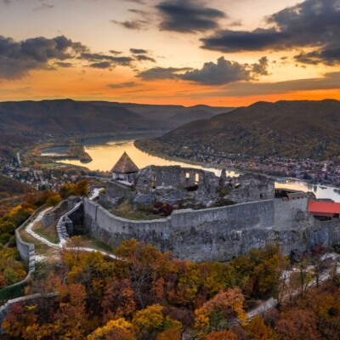
The Myth of Central Europe
Anti-political politics
Anti-foundationalism and pluralism
Valorization of cultural diversity
Ethic of dissent

