Slide 1


AI in Security: Applications and Ethics
15.10.2024
GLCb2028 Artificial Intelligence in Political Science and Security Studies
Jan KLEINER
jkleiner@mail.muni.cz

Slide 2
Literature
Mahsur, N. (2019). AI in Military Enabling Applications. CSS Analyses in Security Policy, 251. https://doi.org/10.3929/ethz-b-000367663
Pedron, S. M., & da Cruz, J. D. A. (2020). The future of wars: Artificial intelligence (ai) and lethal autonomous weapon systems (laws). International Journal of Security Studies, 2(1), 2.

Slide 3
Presentation outline
PolSci and AI generally and its origins.
PolSci examples of communication research.
AI and cybersecurity.
LAWS.
Migration.
Wargames and theory (preparation for the incoming seminars).
  In 2 weeks – we will add intelligence analysis tools and design a proper wargame.

Slide 4
PolSci and AI generally (Duffy & Tucker, 1995)
Early applications of AI in research focused on constructing choice models in foreign-policy decision contexts.
Other applications:
  Production systems,
  computational text analysis,
  logic programming and computer learning,
  conflict simulation and predicting outcomes in international conflicts via machine learning.
AI + computer vision + natural language processing + sentiment analysis → set to transform society, the economy, and politics (Efthymiou-Egleton, Egleton & Sidiropoulos, 2020).
AI can create new ways of (researchable) communication (alphabets, iconographics, languages etc.) (Mueller & Massaron, 2021).
Notes:
Computer vision is a field of artificial intelligence that focuses on enabling computers to understand and interpret visual information from images or videos.
Natural Language Processing (NLP) is a field of artificial intelligence that focuses on enabling computers to understand, interpret, and generate human language. It involves developing algorithms and techniques that allow machines to process and analyze text or speech data. NLP encompasses tasks such as language translation, sentiment analysis, text classification, information extraction, and question answering. It aims to bridge the gap between human language and machine understanding.

Slide 5
Three examples of PolSci (communication) research
1. Can AI communication tools increase legislative responsiveness and trust in democratic institutions? (Kreps & Jakesh, 2023).
  Recent.
2. Artificial intelligence and European identity: the European Commission’s struggle for reconciliation (von Essen & Osseewarde, 2023).
  Recent.
3. Rise of the Machines? Examining the Influence of Social Bots on a Political Discussion Network (Hagen et al., 2022).
  Cited (30x – SCOPUS).

Slide 6
AI tools and responsiveness and trust in democratic institutions (Kreps & Jakesh, 2023)
Legislative correspondence generated by AI with human oversight may be received favorably by constituents and increase trust and legislative responsiveness compared to generic auto-responses.
Poorly performing AI may damage confidence in legislators.
Still unclear specific impact of AI to political communication.
Technologies like ChatGPT could streamline democratic processes rather than destabilize them → BUT: authors do not mention dis/mis/information or propaganda threats (cf. Hagen et al., 2022).
HITL and SITL concepts (Rahwan, 2018).

Slide 7
EU´s approach to AI (von Essen & Osseewarde, 2023)
The European Commission aims to develop European version of AI, but its communication efforts may not be sufficient to generate trust in AI among the European public.
The EC frames European AI as trustworthy and human-centric, based on European values and historical success, but fails to connect its claims to specific European values
Notes:
European AI refers to the version of artificial intelligence that is being developed and promoted by the European Commission (EC) as distinctively European.
European AI is an approach to AI in general not a concrete application.

Slide 8
Social bots´ impact on political discussion network (Hagen et al., 2022)
Social bots (automated accounts on social media), often utilize AI techniques to generate content, interact with users, spread information etc.
Social bots can significantly impact political discussion networks by creating the appearance of virtual communities, attenuating the influence of traditional actors, and amplifying pro-Trump messaging.
Bots are often utilized by actors with ideological positions reflective of a small subset of the public (e.g., the far-right).
The potential for spreading misinformation, which undermines democratic processes.

Slide 9
AI and Cybersecurity (Bonfanti et al., 2021)
AI as an underdeveloped field in social sciences (AI politics research years behind the cybersecurity politics one).
Inter and transdisciplinary (decisions and research in one discipline transpires into other ones).
Well suited for cyber defense and offense + influence ops.
„…in what ways will AI enhance the protection of individuals, organizations, nations, and their cyber-dependent assets from hostile threat actors?
How will it introduce novel vulnerabilities and enable additional typologies of actions?
How will it induce cyber-security stakeholders to adapt to changing risk scenarios and opportunities?“ (p. 226).

Slide 10
LAWS (Sauer, 2021)
Lethal autonomous weapons systems.
Autonomy vs. automation – no consensus on delineation → e.g., functionalists: machine instead of human performing the task.
„kill chain“ = finding, fixing, tracking, selecting, and engaging the target (+ assessing the aftereffects).
Autonomy incl. critical functions is not new, but AI scales it up heavily.
Incentives – no fear, emotions, fatigue, mercy, speed of (re)action etc.
Technological, ethical, legal, strategic criticism.
  E.g., „the accountability gap“ (p. 241) – someone has to be accountable for war actions.
Notes:
Red = critical functions by ICRC.

Slide 11
Migration (Everuss, 2021)
New fields like digital migration studies.
Digitization of borders historically led by USA and EU.
Biometrics → „…actionable inferences about personality, intent, emotional state, social conformity, sexual orientation, and many other… attributes“ (Crampton, 2019: 55).

Slide 12
AI and Wargames (Knack and Powell, 2023)
Red Teaming in general (political/security/other simulations, table-tops -> identification of gaps in a strategy, SWOT analyses, policy analyses etc.).
  Narrow (safe) usage: Repetitive tasks within sims and wargames (background info creation, automatic translation/transcription, textual data analysis, visuals etc.).
  High-risk usage: Red team, game manager etc.
Low cost/questionable reliability.
Better on tactical/operational level than on the strategic one.

Slide 13
Wargame theory – introduction I (Appleget et. al, 2020)
Usually a sponsor – sets goals and timeframe.
Sole purpose is to collect analytic data to answer sponsor´s (research) questions – data determine wargame´s success → well tought-out data collection plan is needed!
Roadmap = data collection and management plan (DCMP).
Not just for combat/conflict scenarios, but for Analysis of alternatives (AoA) – e.g., M1A2 Abrams and its replacement options.
+ pedagogic, research tool.

Slide 14
Wargame theory – introduction II (Appleget et. al, 2020)
Course of action wargaming.
BOGGSAT = "bunch of guys and gals sitting around a table„.
Vs.
Seminar wargames - designed around the DCMP (Decision-Centric Methodology Process) and have a structured approach.
Quantitative/qualitative/hybrid models.
Strong role of probability and chance (dice rolls) + conditioned probability (e.g., missile interception of Iron Dome AA system – informed by statistics).

Slide 15
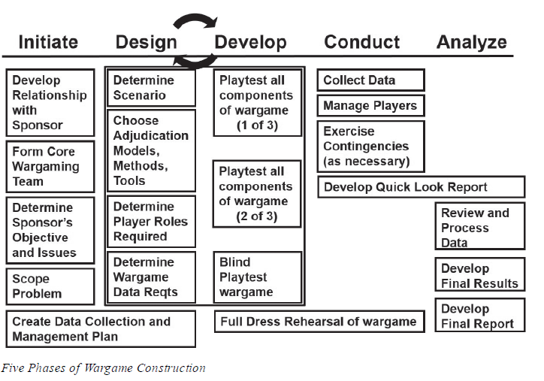
Source: Appleget et al. (2020, p. 73).

Slide 16
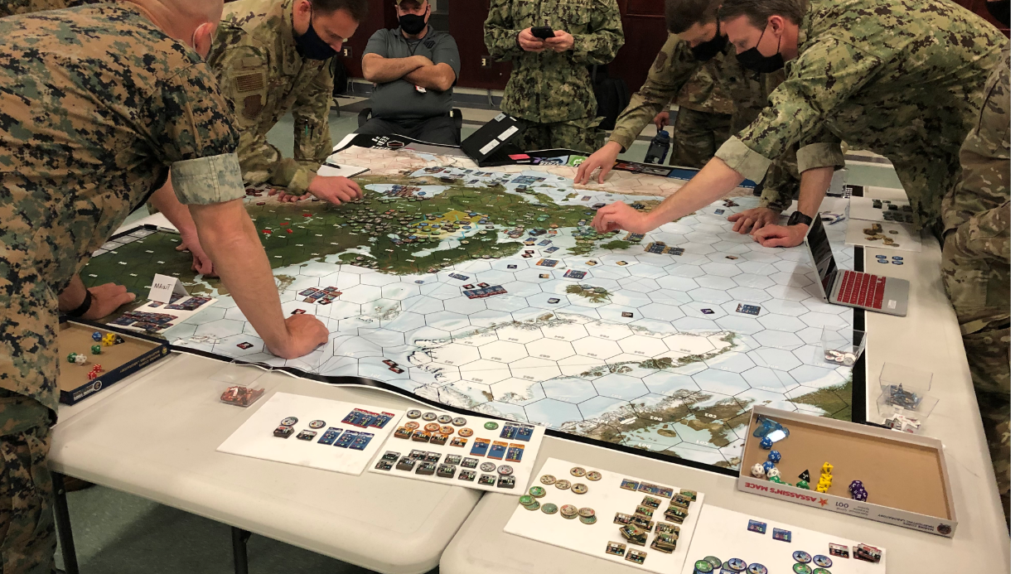
Let´s do some BOGGSAT wargame!
What are your areas of research interest?

Slide 17
References I
Appleget, J. Burks, R. & Cameron, F. (2020). The Craft of Wargaming – A Detailed Planning Guide for Defense Planners and Analysts. Annapolis: Naval Institute Press. ISBN 9781682473771
Bonfanti, M. E., Cavelty M. D., Wenger, A. (2021). Artificial intelligence and cyber-security. In: Elliott, A. (Ed.). (2021). The Routledge Social Science Handbook of AI (1st ed.). Routledge. https://doi.org/10.4324/9780429198533.
Duffy, G., & Tucker, S. A. (1995). Political Science: Artificial Intelligence Applications. Social Science Computer Review, 13(1), 1–20. https://doi.org/10.1177/089443939501300101.
Efthymiou-Egleton, I. P., Egleton, T. W. E., & Sidiropoulos, S. (2020). Artificial Intelligence (AI) in Politics: Should Political AI be Controlled?. International Journal of Innovative Science and Research Technology, 5(2).
Everuss, L. AI, Smart Borders and Migration. In: Elliott, A. (Ed.). (2021). The Routledge Social Science Handbook of AI (1st ed.). Routledge. https://doi.org/10.4324/9780429198533.

Slide 18
References II
Hagen, L., Neely, S., Keller, T. E., Scharf, R., & Vasquez, F. E. (2022). Rise of the Machines? Examining the Influence of Social Bots on a Political Discussion Network. Social Science Computer Review, 40(2), 264–287. https://doi.org/10.1177/0894439320908190
Knack, A. & Powell, R. (2023). Artificial Intelligence in Wargaming An evidence-based assessment of AI applications. The Alan Turing Institute.
Kreps, S., & Jakesch, M. (2023). Can AI communication tools increase legislative responsiveness and trust in democratic institutions? Government Information Quarterly, 40(3), 101829. https://doi.org/10.1016/j.giq.2023.101829
Mueller, J. P. & Massaron, L. (2021). Artificial Intelligence for Dummies. Hoboken: John Wiley and Sons, Inc.
Sauer, F. (2021). Lethal autonomous weapons systems In: Elliott, A. (Ed.). (2021). The Routledge Social Science Handbook of AI (1st ed.). Routledge. https://doi.org/10.4324/9780429198533.
von Essen, L., & Ossewaarde, M. (2023). Artificial intelligence and European identity: the European Commission’s struggle for reconciliation. European Politics and Society, 1–28. https://doi.org/10.1080/23745118.2023.2244385

Slide 19
Thank you for your attention.
Questions?
Jan KLEINER
jkleiner@mail.muni.cz

