Slide 1
Accountability in Monitoring and Evaluation (M&E): Challenges and Best Practices
A Critical Perspective for University Students

Slide 2

… Why Accountability Matters in M&E?
Crucial principle that is aimed at:
  Improved project performance
  Enhanced resource allocation
  Trust-building

Slide 3
What is Accountability (in M&E)?
Upwards
Downwards
Horizontal
ACCOUNTABILITY
No single definition, but according to OECD – 3 dimensions:
  An obligation to demonstrate that work complies with agreed rules and standards.
  A requirement to report fairly and accurately on performance results according to specified roles, responsibilities and plans.
  An obligation to show that any work carried out under contract is legally consistent with that contract.
Self

Slide 4
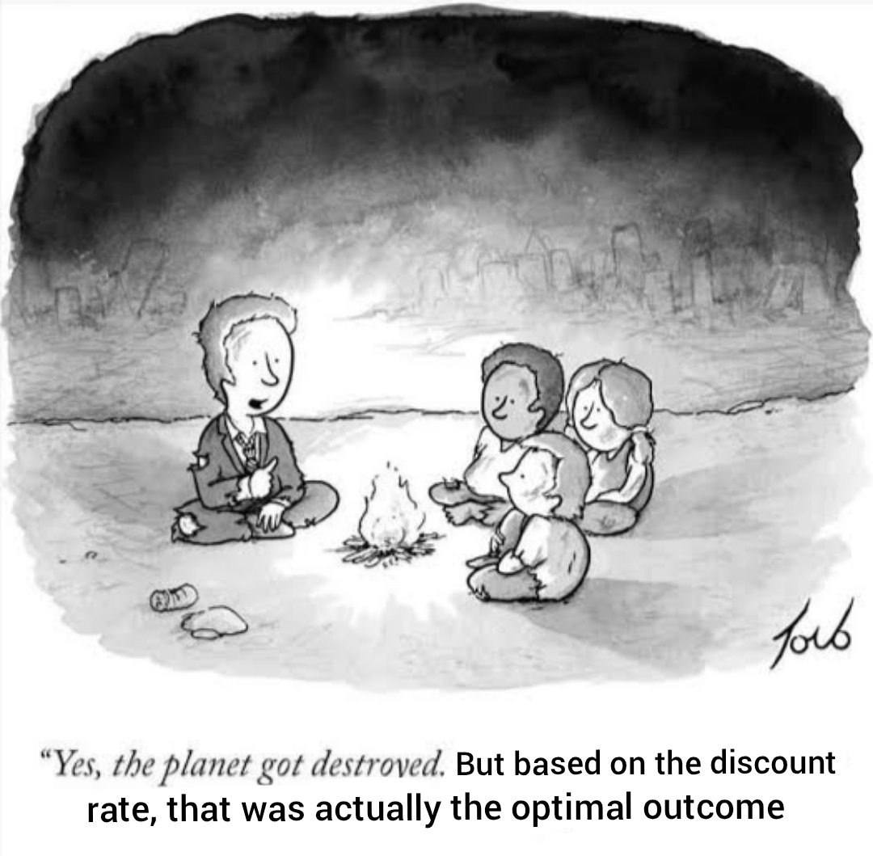
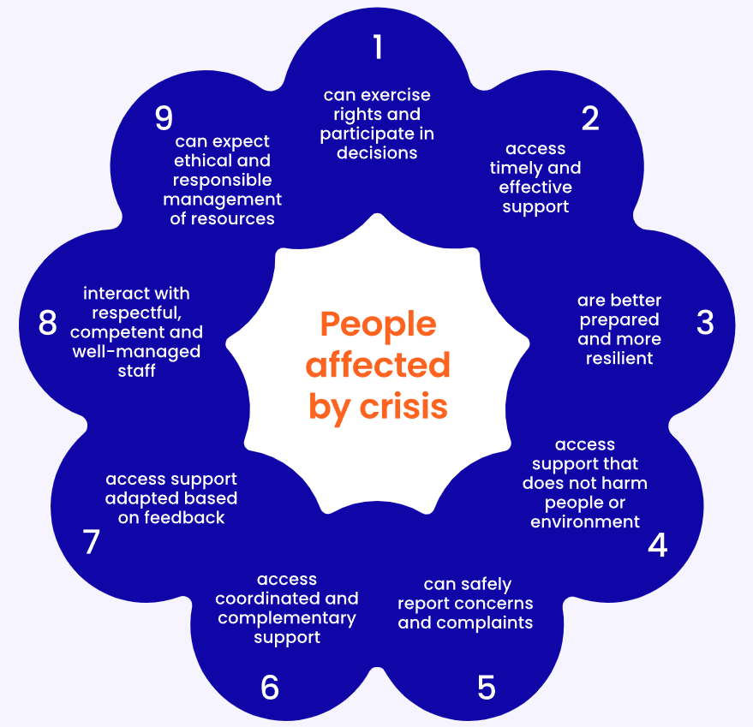

Upwards Accountability
Core Humanitarian Standards
Compliance with donor regulations, contract and/or other legal requirements, ethical or other standards.
Financial accountability
  How money was spent
  Cost-benefit analysis
Accountability for short-term outcomes
Accountability for longer-term outcomes/impact
Notes:
Why is accountability for results (outcomes and impact) challenging and may require careful management?
NGOs may carry out innovative or experimental work & outcomes cannot be easily guaranteed
NGOs may make only a small contribution to impact, especially if the subject of their attention is influenced by socio-economic and political environment, other actors, etc.
Work in volatile or uncertain environments = outcomes may be contested, hard or too costly to measure (especially impact) or beyond NGO’s control
Outcomes and especially impact may not be seen until long after a project
What may happen if accountability requirement is not managed properly? What may NGOs’ negative coping strategies be?
Possible answers: NGOs may be tempted to avoid risk; only carry out work that can easily be measured; set targets that can easily be reached; continue reporting against objectives or indicators that are obsolete; hide failures; ignore unexpected or negative change; and/or focus more on activity and short-term change than on longer-term, sustainable changes, etc.

Slide 5
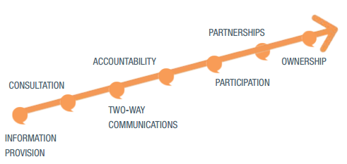
Downwards Accountability
A.K.A.: Accountability to Affected People (AAP) = the process of taking account of, and being held accountable by, different stakeholders, and primarily those who are affected by the exercise of such power.
More challenging than other forms of accountability
  Power disbalance
  Lack of or less penalties for non-compliance
  Stakeholder are too many and too diverse for systematic reporting
Degrees of empowerment
Dayna Brown & Antonio Donini, ALNAP, 2014
Notes:
Why do you think this form of accountability is more challenging? How?

Slide 6


Horizontal & Self Accountability
“You cannot be accountable if you do not learn. And you need to know how well you live up to performance expectations in order to learn. The tug of war between learning and accountability is nonsensical. They need each other.” (Irene Guijt, 2010)
Consideration of context
Threshold of evidence
Focus on results and/or process
Approaches, methodologies & tools
Cost
Abuse of M&E
Learning
Accountability

Slide 7
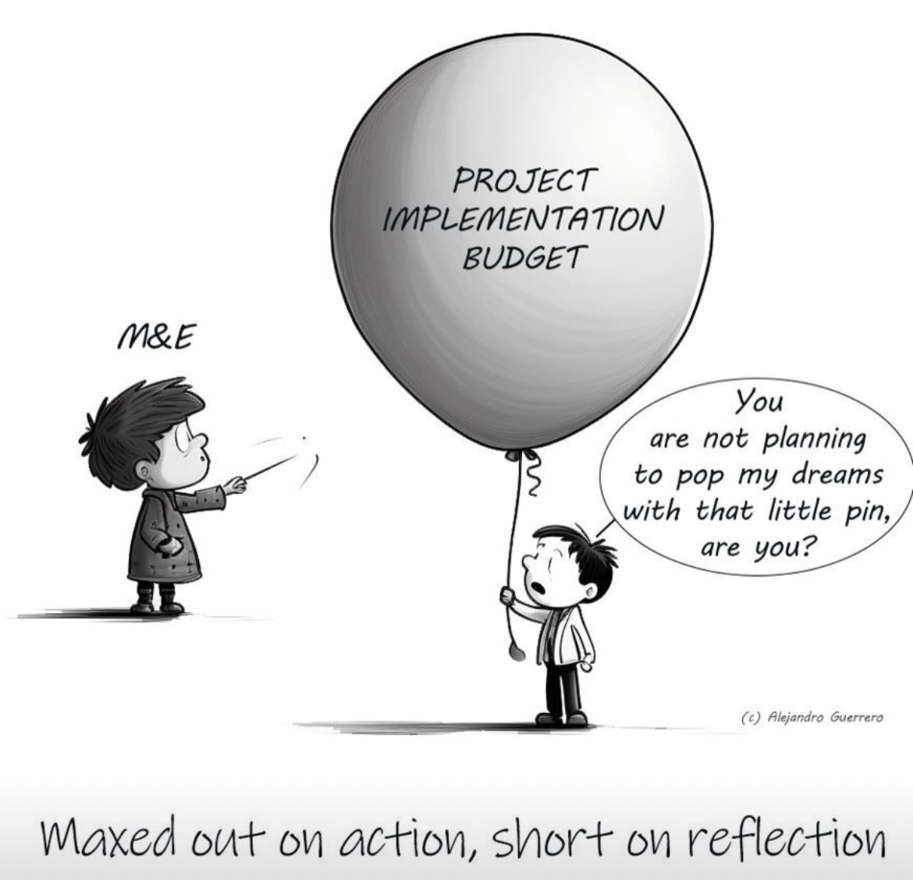
Other Common Challenges
Lack of clear roles and responsibilities
Limited resources and capacity
Political and Institutional barriers
Data quality and integrity issues
Weak feedback mechanisms

Slide 8
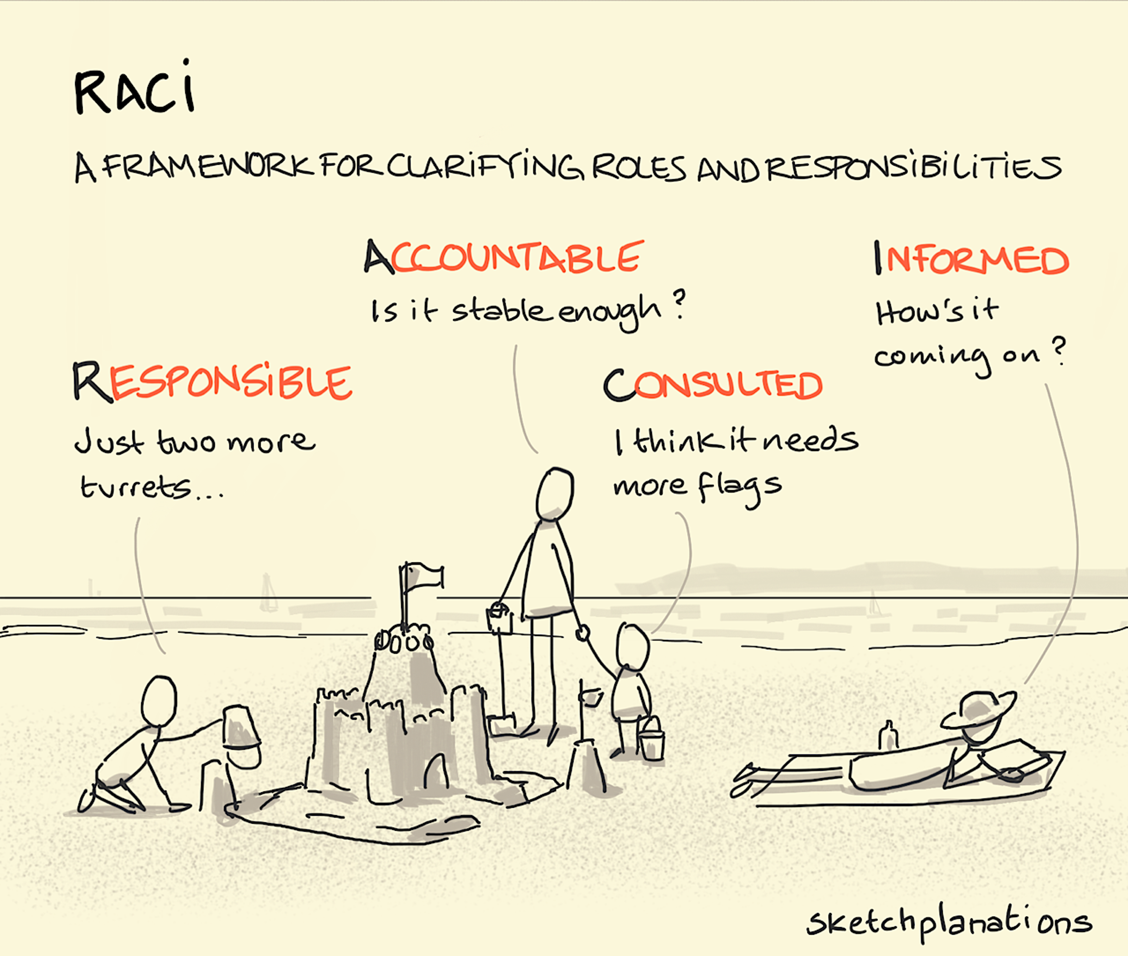
Best practices for promoting accountability in M&E (1)
Clear definition of roles and responsibilities
  Ensure all stakeholders understand their roles and the importance of their contributions
  Assign accountability at every level of M&E process
Strengthening data collection and verification
  Use reliable and consistent methods for data collection
  Regular audits and independent evaluations to verify data accuracy
Participatory M&E and stakeholder engagement
  Involve beneficiaries and local communities in M&E processes
  Ensure beneficiaries/local communities’ feedback is integrated into project assessments

Slide 9
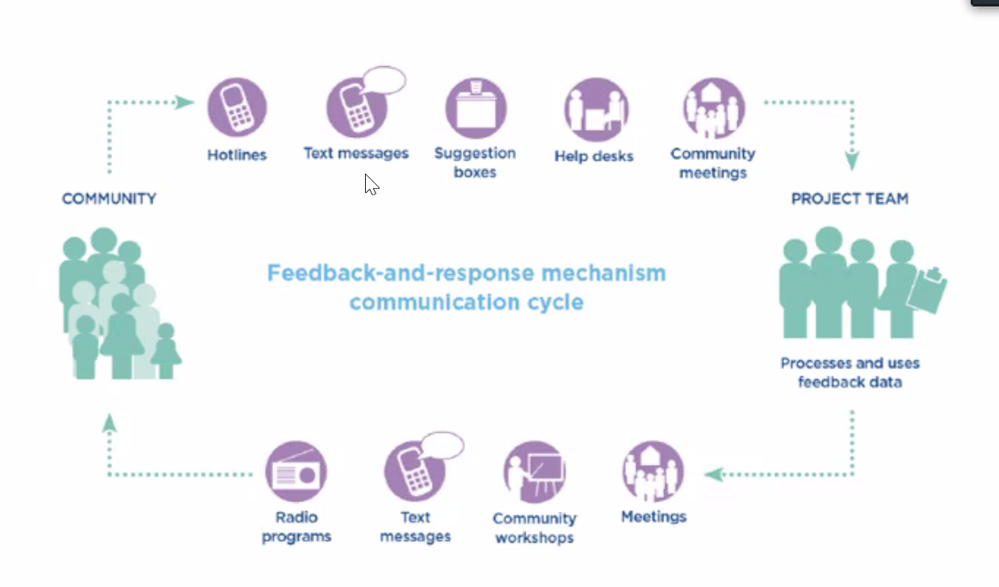
Best practices for promoting accountability in M&E (2)
Develop robust feedback (response) mechanisms
  Create channels for stakeholders to voice concerns and provide input on project progress
  Implement regular reviews and mid-course corrections based on feedback
Building capacity
  Provide adequate training and resources to staff involved in M&E
  Foster a culture of learning and accountability across the project cycle
Ensure transparency in reporting
  Share findings and outcomes openly with all stakeholders, including donors, communities and government bodies
  Use accessible formats to present results and allow for easy scrutiny

Slide 10
Ethical Considerations in M&E Accountability
Informed consent: Ensure that all participants in M&E activities are fully aware of the purpose and use of the data collected
Confidentiality and data protection: Safeguard sensitive information, particularly for vulnerable populations
Avoiding conflict of interest: Ensure that evaluators and data collectors are independent and aware of biases.

Slide 11
Thank you!
Serhiy Ponomaryov
MEAL Manager
Polish Humanitarian Action
serhiy.ponomaryov@pah.org.pl
serhiyponomaryov@gmail.com

