Slide 1
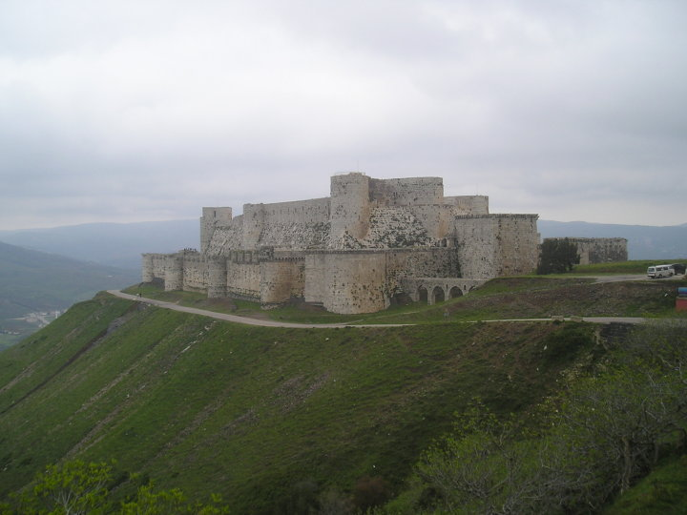
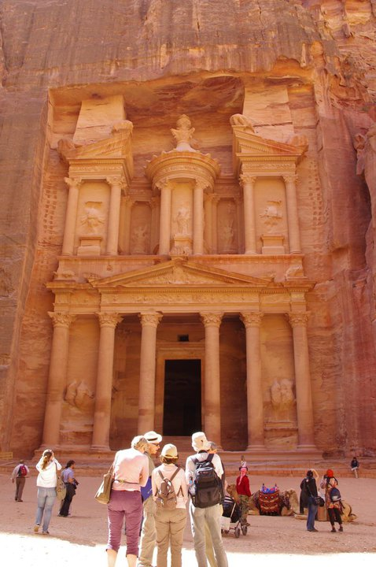
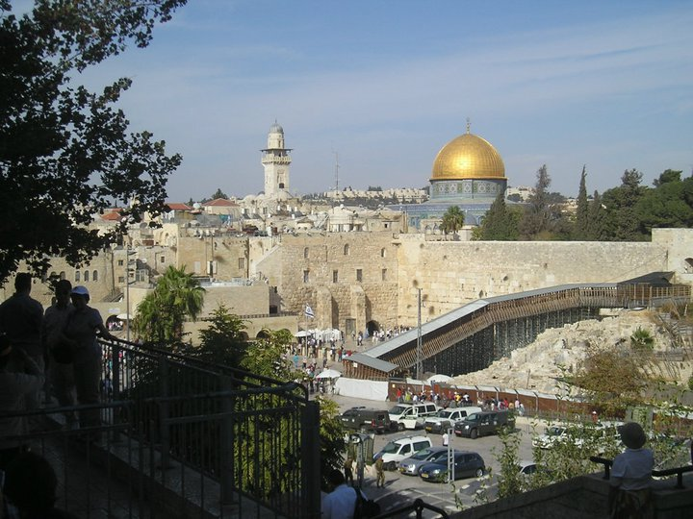
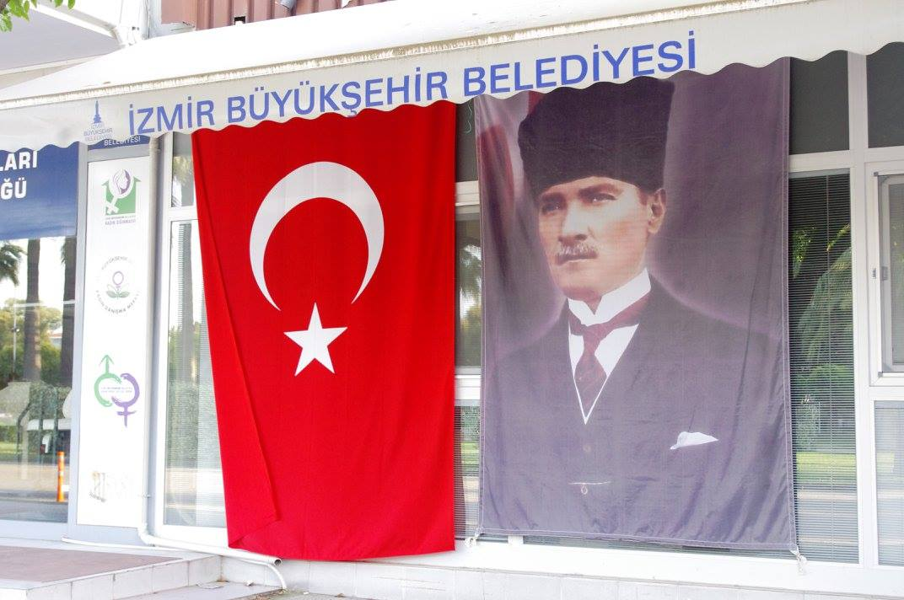
POLTICS AND SOCIETY
IN THE MIDDLE EAST
Mgr. Eva Taterova, M.A., Ph.D.
Faculty of Social Studies
Masaryk University

Slide 2
COURSE OVERVIEW
Online MS Teams:
Credits: 4 ECTS
Lecturer: Mgr. Eva Taterova, M.A., Ph.D. (evataterova@gmail.com)

Slide 3
COURSE SCHEDULE
September 21: Introduction. scope of the course, organization of the course, and course requirements
October 5: Middle East: the basic terminology, geography, demography
October 12: History of Middle East before 1945
October 19: Arab-Israeli Conflict I
October 26: Arab-Israeli conflict II
November 2: Iran: From Western Ally to Islamic Republic

Slide 4
COURSE SCHEDULE
November 9: Political Development of Lebanon
November 16: Midterm, movie
November 23: Post Cold War Conflicts in the Middle East
November 30: War in Syria
December 7: Current Events in the Middle East
December 14: Final Exam

Slide 5
COURSE ACTIVITIES
Midterm: November 16, online essay on a given topic 40 points
Final Exam: December + January, 6 open questions, 60 points

Slide 6
GRADES
A 92 - 100
B 84 - 91
C 76 - 83
D 68 - 75
E 60 - 67
F less than 60 points

Slide 7
THANK YOU FOR YOUR ATTENTION

