Slide 1
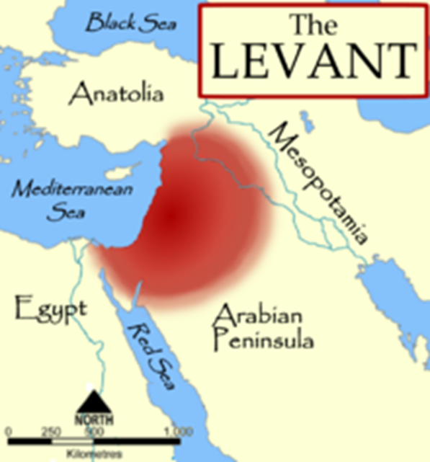
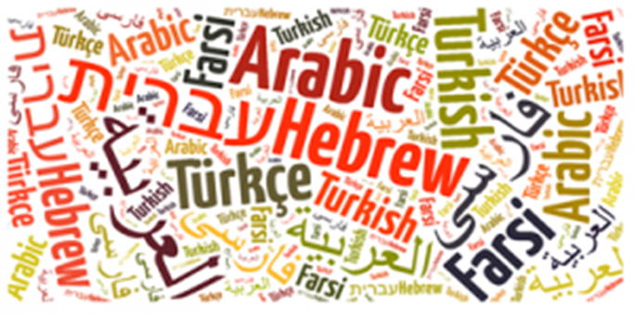
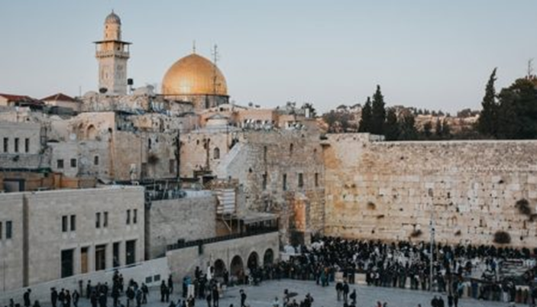
Middle East: the basic terminology, geography, demography, AnCIENT HISTORY
Mgr. Eva Taterova, M.A., Ph.D.
Faculty of Social Studies
Masaryk University

Slide 2
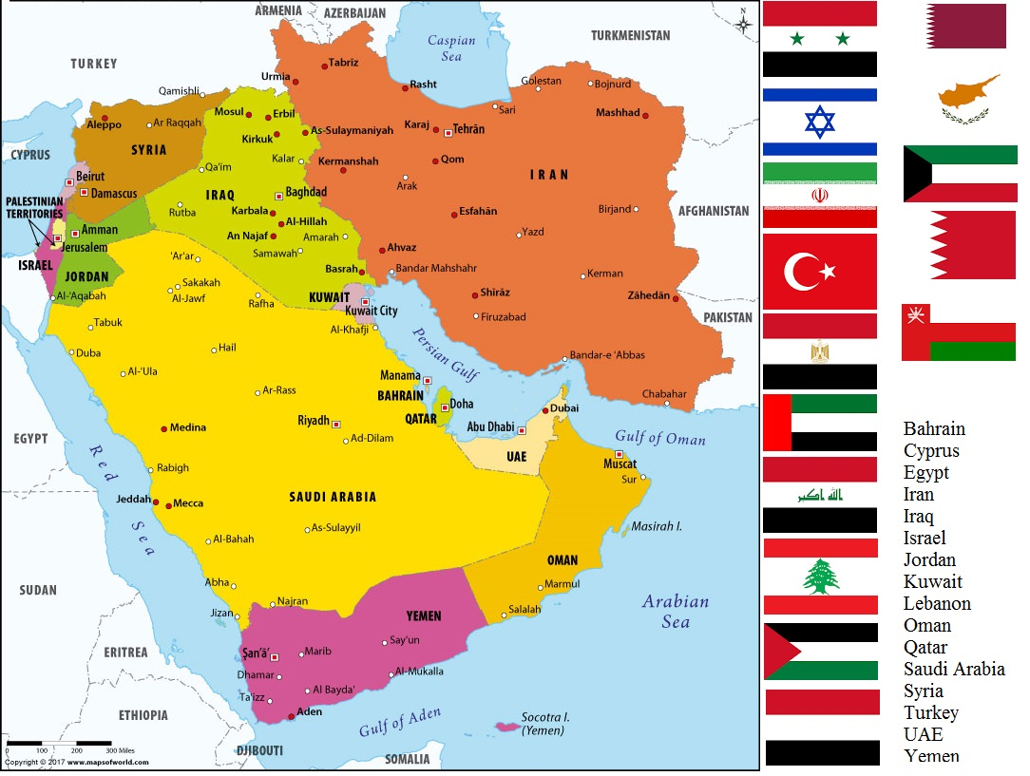

Slide 3
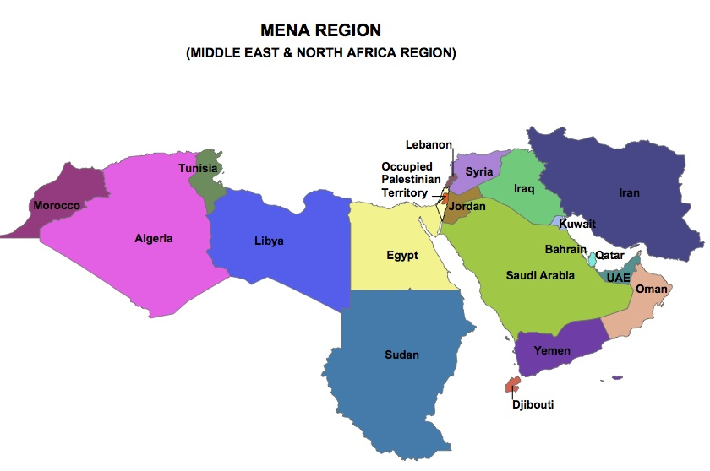

Slide 4
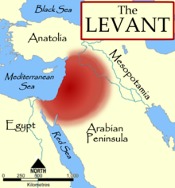
BASIC TERMINOLOGY
No consensus about the terminology.
Historically, Near East referred to the territory of whole Ottoman Empire while Middle East was used for the whole region of Arab peninsula, Afghanistan + the countries of southern and central Asia.
Orient – a label for countries of Near, Middle and Far East – today quite negative connotations (book „Orientalism“ by Edward Said from 1978).
The Levant – eastern Mediterranean (Israel/Palestine, Lebanon, Syria, Jordan, northern Iraq).
Nowadays the prevailing definition says that "it is a region located on the border between southwest Asia, northern Africa, and Europe".
The terms Near and Middle East are usually used simultaneously.
The unifying factors: similar historical development, religion, culture, language.

Slide 5

DEMOGRAPHY OF MIDDLE EAST
Estimated population in 2018: 411 million people.
Great diversity regarding ethnicity, languages, religion.
Main ethnic groups: Arab, Turks, Kurds, Jews, Berbers.
Main languages: Arabic (different slangs), Turkish, Kurdish, Persian, Hebrew.
Countries with biggest populations: Iran, Turkey, Iraq, Saudi Arabia, Yemen
Main religions: Islam, Christianity, Judaism.

Slide 6
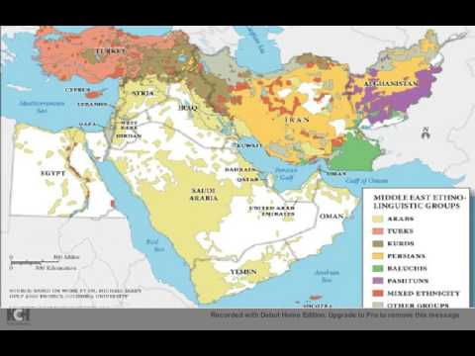
MIDDLE EAST ETHNO-LINGUISTIC GROUPS

Slide 7
MIDDLE EAST: INTRODUCTORY STATISTICS
Countries with biggest population in 2017
Iran | 81,824,270
Turkey | 79,414,269
Iraq | 37,056,169
Saudi Arabia | 27,752,316
Yemen | 26,737,317
Major religious groups in 2010
Islam | 317,070,000
Christianity | 12,710,000
Judaism | 5,630,000
Unaffilliated | 2,100,000
Hinduism | 1,720,000
Richest Countries of the Middle East (GDP) in 2017
Qatar | 124,900 USD
Kuwait | 69,700 USD
United Arab Emirates | 68,200 USD
Saudi Arabia | 55,300 USD
Bahrain | 51,800 USD
Poorest Countries of the Middle East (GDP) in 2017
Afghanistan | 1,900
Yemen | 2,300
Syria | 2,900
Pakistan | 5,400
Jordan | 12,500

Slide 8
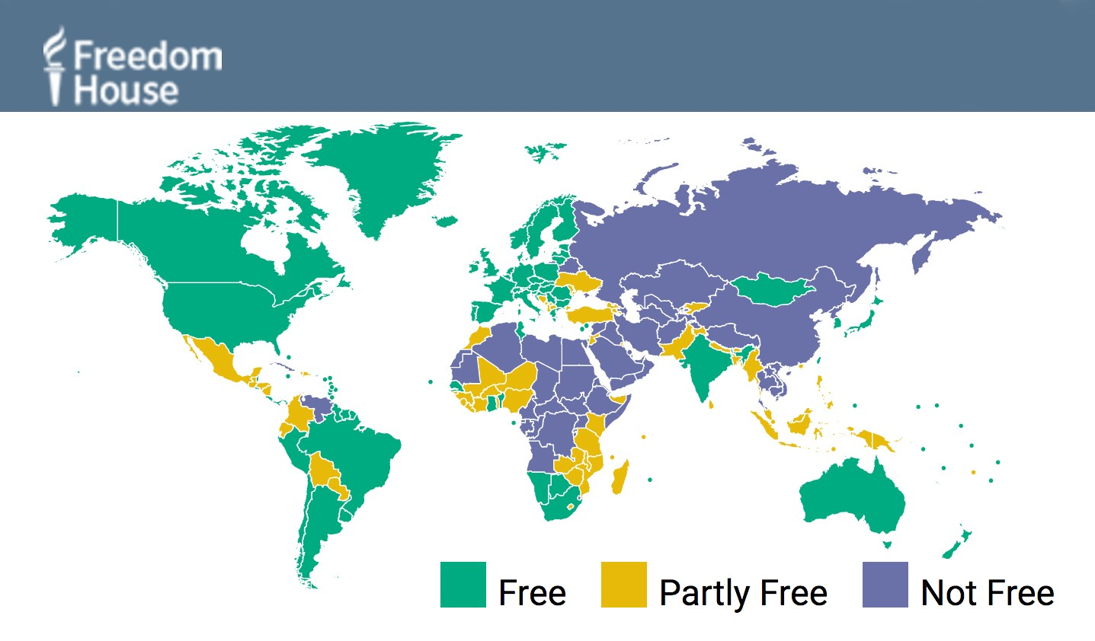
DEMOCRACY IN THE MIDDLE EAST 2017

Slide 9

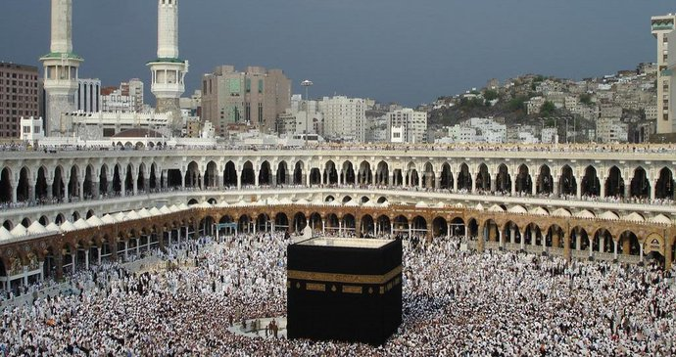
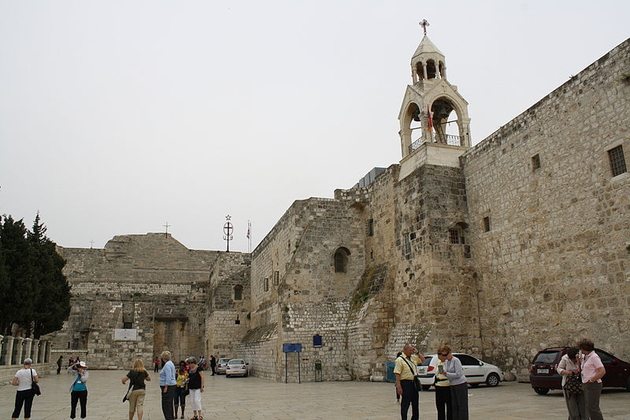
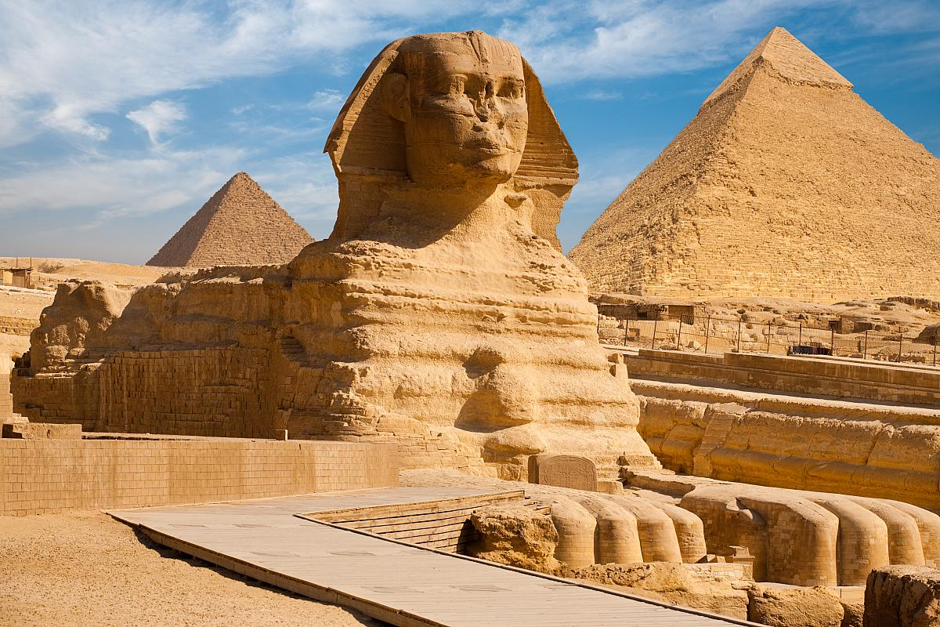
RELIGIONS OF THE MIDDLE EAST

Slide 10
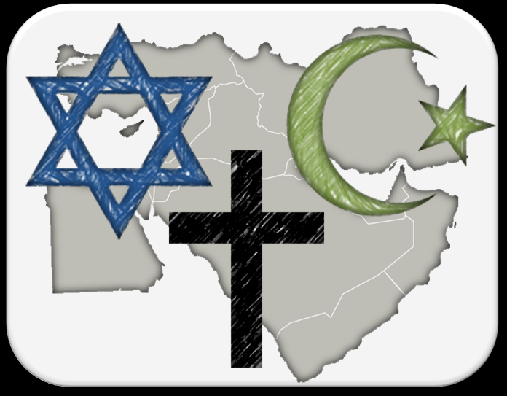
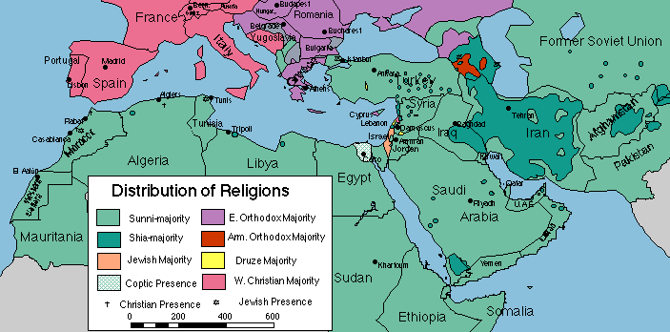
RELIGIONS OF THE MIDDLE EAST
Many religions have got their origins in the Middle East.
Religions of the book: Judaism, Christianity, Islam – three monoteistic religions.
In the past there was a lot of religious tolerance, nowadays religion is often a source of conflict.

Slide 11
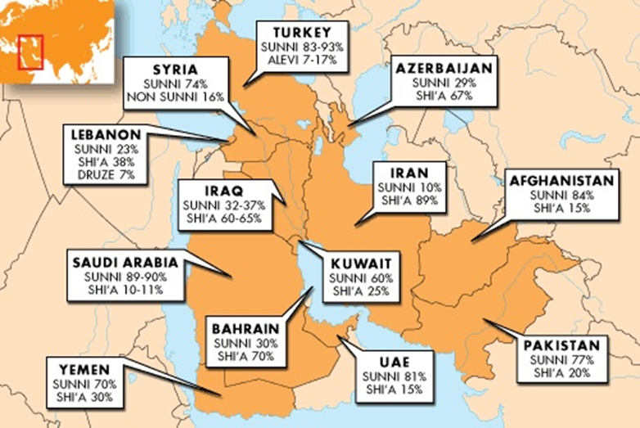
ISLAM
5 pillars of Islam:
  Shahada: Faith
  Salah: Prayer
  Zakāt: Charity
  Sawm: Fasting (Ramadan)
  Hajj: pilgrimage to Mecca
Significant dispute between Shia Muslims and Sunni Muslims.

Slide 12
THANK YOU FOR YOUR ATTENTION

