Slide 1
Wrap up session
IREn5019 No war, no Peace: Frozen Conflicts in the Caucasus
18.12.2024.

Slide 2
What is conflict resolution in South Caucasus?
Issues at stake have not changed.
• Geopolitical competition has strengthened – the role of external actors.
• The impact of war in Ukraine.
• Fractured region with weak ties and regional identity –incoherent and mutually exclusive and fractured policies –risk of spill over.

Slide 3
What is conflict resolution in South Caucasus
25 years resistance to conflict resolution
In 1992 Russian – Georgian - Ossetian peacekeeping force.
In 1994 CIS Collective Peacekeeping Forces
The Geneva International Discussions – no strategic vision
The Minsk Group of the Organization for Security and Co-operation in Europe: Basic Principles but no tactical levers of interactions.

Slide 4
Russian peacekeeping operations in Karabakh
In AZ: threat to the sovereignty and independence
In Armenia: not too much attention
For the first time humanitarian actions in Russian peacekeeping: included 15 Separate Motorized Rifle Brigade of the Central Military District. General Andrei Volkol – head of the mission, 1960 peacekeepers, plus emergency servicemen around 4000, ninety armoured vehicles and 380 motor vehicles (BTR-82A, “Tigr” and “Typhoons”, 8 MI-8 and MI-24 helicopters).
Russian-Turkish Monitoring Centre
Interdepartmental Humanitarian Response Centre established by a decree of the Russian president. Plus the Centre for Humanitarian demining, the Centre for the Reconciliation of Opposing Sides, the Centre for Transport Support, the Centre for Medical Support and and the Centre for Trade and Household Support.

Slide 5
Russian peacekeeping operations in Karabakh
Problems:
Russian geopolitical interests in the region – sphere of influence.
Not clear mandate
Lack of UN authorisation
Lack of peacebuilding efforts
Concerns regarding personnel and armament.

Slide 6
EU: engagement without recognition
EU applies multiple approaches: monitoring and early response, dialog and confidence building and political negotiations.
Core principle - engagement without recognition.
It is significant to support positive incentives for cooperation , education, capacity-building projects, inclusive approaches to civil society, supporting and focusing on practical and needs-driven engagement in the field of development and capacity building, facilitate knowledge exchange – cross regional dialog.

Slide 7
EU initiatives in Nagorno-Karabakh conflict
Initially, the EU's significant peacebuilding initiative in the Armenia-Azerbaijan conflict appeared to have the Kremlin's approval.
In December 2021, a month after the hotline's establishment, Brussels organized the inaugural summit of Armenian and Azerbaijani leaders. Russia did not raise objections, anticipating that the meeting would support its own peace initiatives.
But after Ukraine - the EU and Russia increasingly viewed their mediation endeavours as competitive. Two months after the invasion, in April, when Azerbaijani and Armenian leaders announced the commencement of formal peace talks at an EU-hosted meeting, Moscow accused Brussels of attempting to sideline it from South Caucasus diplomacy.
In response, Moscow withdrew from the Organization for Security and Co-operation in Europe (OSCE) Minsk Group, a forum co-chaired by Russia, the U.S., and France, which had worked for a quarter-century to address the Nagorno-Karabakh conflict with limited success. As the EU moved forward, regular phone calls between Russian President Vladimir Putin and Michel to discuss the crisis dwindled.

Slide 8
EU initiatives in Nagorno-Karabakh conflict
In a bid to take advantage of the distractions resulting from the Ukraine situation, Baku expedited negotiations, which unfolded rapidly.
At an EU-arranged summit in Brussels on August 31, the leaders of both nations agreed that their foreign ministers would meet within a month to formulate drafts for a potential peace treaty.
As part of these negotiations, the parties publicly affirmed their dedication to finalizing an agreement by the conclusion of 2022.

Slide 9
EEMA
Amid Russia's involvement in Ukraine, the EU has assumed a significant role in mediating between Armenia and Azerbaijan for the past two years.
This is driven by economic and strategic considerations, aiming to stabilize the South Caucasus and mitigate challenges in energy trade with Azerbaijan.
However, the success of these diplomatic efforts is at risk if the parties continue to engage in increasingly lethal armed confrontations. Brussels demonstrated its political by establishing a monitoring mission EEMA.

Slide 10
Why Did Russian Peacekeepers Leave Karabakh?
Russian troops entered Karabakh after the 2020 ceasefire agreement.
Azerbaijan’s 2023 military operations restored control over the region.
Factors Behind Russia’s Withdrawal:
Turkey’s Influence: NATO-member Turkey’s strong military and diplomatic support for Azerbaijan.
Russia-Azerbaijan Relations:
  Economic ties: Russia relies on Azerbaijan for energy transit and trade.
  Political alignment: Azerbaijan balances relations with Russia while avoiding Western alliances.

Slide 11
Armenia’s Shift from Russia
Armenia criticized CSTO for failing to respond, prompting a pivot to the West.
Security Diversification:
  Military ties with India ($1.5 billion contracts).
  EU civilian monitoring missions.
  Deepening cooperation with France, Greece, and the U.S.
Public Opinion Shift:
41% of Armenians now view Russia as a threat (up from a decade ago).
Conclusion: Armenia seeks Western alternatives but faces constraints.

Slide 12
Russia’s Role in the South Caucasus
Strategic Priorities:
South Caucasus as Russia’s sphere of influence.
Leverages “frozen conflicts” (e.g., Abkhazia, South Ossetia) to maintain control.
Challenges to Influence:
Turkey’s regional role: Strong ties with Azerbaijan.
Economic Pressures: Western sanctions after Ukraine war.
Local Agency: Armenia and Azerbaijan balance relations with multiple actors.
Outcome: Russia prioritizes strategic partners while avoiding direct conflicts

Slide 13
Economic Dynamics in the South Caucasus
Russia-Azerbaijan Economic Relations:
Key energy projects: Baku–Novorossiysk pipeline ensures oil transit via Russia.
Trade ties: $6.2 billion Russian investments in Azerbaijan.
Armenia’s Dependence on Russia:
Russian gas and energy dominate Armenia’s economy.
Post-2022 war: Armenia’s exports to Russia increased significantly.
Implication:
Economic interdependence limits the geopolitical choices of small states like Armenia.

Slide 14
Armenia’s Western Pivot vs. Practical Constraints
Strategic Realignment:
Armenia deepens ties with the EU, U.S., and India.
EU monitoring missions provide limited security.
Constraints:
Economic Dependence: Armenia relies heavily on Russian trade, energy, and investment.
Geopolitical Risks: A drastic pivot may provoke Russian retaliation.
Global Trends: Rising multipolarity (BRICS, China, Iran) pressures Armenia to diversify alliances.
Conclusion: Armenia’s foreign policy remains pragmatic, balancing security and economic needs.

Slide 15
Georgia’s Dangerous Geopolitical Gamble
Georgia’s foreign policy is caught between Euro-Atlantic integration and Russian influence.
2024 parliamentary elections deepened political polarization:
  Georgian Dream (GD) party frames itself as the protector of peace.
  Opposition accuses GD of aligning with Russia.
President Zurabishvili claims Georgia faces a “Russian special operation” to undermine democracy.
Implications:
Domestic instability increases susceptibility to Russian influence.
Western isolation risks GD consolidating ties with Eurasian powers.

Slide 16
Geopolitical Narrative in Georgia
Election Narratives:
GD: “War vs. Peace” – opposition’s victory = conflict with Russia.
Opposition: “Europe vs. Russia” – Georgia’s future lies with the EU.
Civil society: “Democracy vs. Authoritarianism” – fears of Russian-style governance.
Territorial Issues:
GD hinted at peaceful reintegration of South Ossetia and Abkhazia.
Speculations on a Russian-backed “confederation model” with occupied regions.
Key Challenge:
Balancing sovereignty while managing relations with Russia.

Slide 17
Georgia’s Multi-Vector Foreign Policy
Policy Overview:
Georgia attempts to balance ties between Russia, the EU, and regional actors.
Shift toward China and Eurasian partners.
Key Challenges:
Western Isolation: Strained relations with the EU and U.S.
Internal Division: Political polarization weakens Georgia’s diplomatic coherence.
Russia’s Leverage: Energy dependence, territorial disputes, and political narratives favor Moscow.
Outcome: Georgia’s balancing act becomes increasingly fragile.

Slide 18
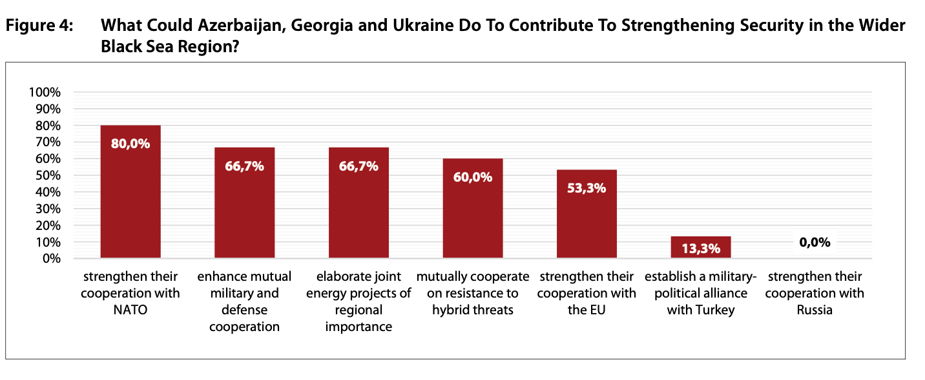

Slide 19
Scenarios
Scenario 1: A Georgian geopolitical dream
Russian defeat in Ukraine, opportunity to become EU member.
Scenario 2: Georgia’s nightmare
Russian victory- dilemma for Georgia: fight or become a Russian satellite state. Recognition of Abkhazia and South Ossetia? Social unrest and instabilities, massive emigration and brain drain.
Scenario 3: Kremlin’s geopolitical aim: Ukraine “recognizing new realities”
Frozen conflict - “recognize new realities” i.e. independence of Donetsk and Lugansk as well as annexation of Crimea. These territories will provide Moscow with persistent leverage to influence Ukrainian politics and sabotage the country’s pro-Western foreign policy.”
Scenario 4: NATO-Russia conflict

Slide 20
Conclusion – The South Caucasus at a Crossroads
Regional Dynamics:
Russia seeks to maintain dominance while managing Turkish influence.
Georgia struggles to balance Euro-Atlantic aspirations with Russian pressure.
Armenia cautiously pivots westward but remains economically tethered to Russia.
The South Caucasus exemplifies the challenges of small states in a multipolar world.
Russia’s declining influence creates opportunities and risks for regional actors.
Western actors face dilemmas in balancing strategic interests with normative values.
The region’s future hinges on how effectively small states navigate external pressures and internal divisions.

Slide 21
Q & A

