Slide 1
Crisis Bargaining:
Manipulating Risk

Slide 2
When does war occur?
When there’s a shift in the balance of power
Preventive or Revisionist War
When one or both sides believe they can win with a first strike
Miscalculation of capabilities and/or resolve

Slide 3
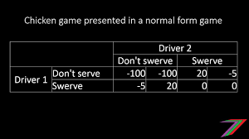
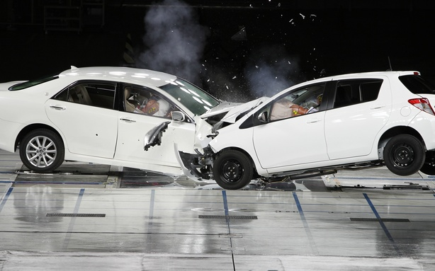
The Theoretical Dilemma
The Game of Chicken—or Brinksmanship
There is a dispute between parties
Neither side wants war
Both sides understand the other side doesn’t want war
Neither wants to concede
Both know things can get out of control
How much risk will you accept?

Slide 4
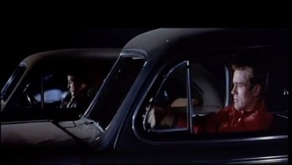
The Movie Version
https://www.youtube.com/watch?v=BGtEp7zFdrc

Slide 5
How can one communicate a willingness to risk?
Think about Estonia?
Think about Taiwan?

Slide 6
How to communicate risk?
What is at stake? Who has more at stake?
  Why doesn’t US intervene in Hungary in 1956?
  Why doesn’t US intervene in Berlin in 1961?
How do you communicate resolve?
  “Tying your hands”: Restrict your own choices
    Audience Costs
  “Paying to Play” : Place more at risk
  The Tripwire
The incentive to miscommunicate

Slide 7
Other Tactics
Try to gain time
Try to place the onus for risk on the other side
“Provide an off-ramp”

Slide 8
THE CRISIS
The situation on October 15, 1962
Soviets substantially increase military assistance to Cuba through summer
  Khrushchev had promised he would use nuclear weapons
United States notices buildup
  Increases pressure for military removal of Castro
  Kennedy statement of September 5
Soviet Union: Fearful of US invasion Sea-to Air Missiles on Cuban coast Tactical Cruise missiles –FKR Missiles, Smaller tactical nuclear missiles
Intermediate Range Missiles and Warheads in early October

Slide 9
The Decision to Blockade
Discovery of Missiles on October 15: President informed Oct. 16
The Excomm: Close set of advisers
  Four plans:
    Surgical strike
    Massive air strike
    Invasion
    Blockade
The Positions:
President Kennedy: Initially for surgical air
  When told it would not remove missiles, for massive air strike
  Finally to blockade
October 20:
  Air Strike: Robert Kennedy, Dillon, Bundy, McCone, Acheson, Taylor
  Blockade: MacNamara, Rusk, Thompson, Ball.

Slide 10
The Debate:
Gen. Maxwell Taylor, Joint Chiefs of Staff:
General Taylor said that the principal argument he wished to make was that now was the time to act because this would be the last chance we would have to destroy these missiles. If we did not act now, the missiles would be camouflaged in such a way as to make it impossible for us to find them. Therefore, if they were not destroyed, we would have to live with them with all the consequent problems for the defense of the United States.

Slide 11
The Debate
Robert McNamara:
Secretary McNamara concluded by explaining that following the blockade, the United States would negotiate for the removal of the strategic missiles from Cuba. He said we would have to be prepared to accept the withdrawal of United States strategic missiles from Turkey and Italy and possibly agreement to limit our use of Guantanamo to a specified limited time. He added that we could obtain the removal of the missiles from Cuba only if we were prepared to offer something in return during negotiations. He opposed as too risky the suggestion that we should issue an ultimatum to the effect that we would order an air attack on Cuba if the missiles were not removed. He said he was prepared to tell Khrushchev we consider the missiles in Cuba as Soviet missiles and that if they were used against us, we would retaliate by launching missiles against the USSR.

Slide 12
Steps after the Blockade
The President made clear that in the United Nations we should emphasize the subterranean nature of the missile buildup in Cuba. Only if we were asked would we respond that we were prepared to talk about the withdrawal of missiles from Italy and Turkey. In such an eventuality, the President pointed out that we would have to make clear to the Italians and the Turks that withdrawing strategic missiles was not a retreat and that we would be prepared to replace these missiles by providing a more effective deterrent, such as the assignment of Polaris submarines

Slide 13
The Time Line:
October 22: Kennedy announces blockade
Khrushchev decides not to authorize Pliyev to use tactical nukes, for now
October 23: US implements blockade
Aleksandrov with nuclear warheads slips under the wire
Most other ships stop, but oil tanker Bucharest is allowed to continue
October 25: Khrushchev announces to Presidium that will have to remove missiles: But not right away
Soviet agents in Washington get hints of likely invasion
Khrushchev sends first letter about deal (Kennedy receives it later)

Slide 14
The Time Line (cont)
October 26: Excomm meets in the morning, sees no success in blockade:
MacNamara, Dillon, Bundy, McCone, Taylor all want military action, Kennedy says wait
Castro says war is imminent: he allows anti-aircraft fighters to shoot
He sends letter to Khrushchev regarding nuclear response
Soviets send authorization to Pliyev to use force,
Khrushchev now doesn’t expect war, sends letter with Turkey
https://vimeo.com/237232989

Slide 15
October 27, 1962
Khrushchev’s second letter arrives in Washington arrives, Excomm discusses it’s meaning. Most, including MacNamara, suggests war is likely---JFK continually asks for time, thinks about Turkey deal
U-2 shot down in Cuba by Soviet SAM
Excomm decides to ignore second letter, respond publicly to first
Robert Kennedy visits Dobrynin, makes secret promise about Turkey
If that doesn’t work, John Kennedy suggests he is willing to make public trade of missiles in Cuba and Turkey
October 28: Khrushchev makes radio announcement, crisis ends

Slide 16
Personality: The Transcripts of October 27
Kennedy makes the decisions
He doesn’t talk much about domestic politics here
He is concerned that it is the Western Hemisphere
He is very concerned about US credibility with NATO, Turkey
He is very concerned about world opinion
He is less concerned than others about looking weak
He is very concerned about looking for time, for more options
He is more willing than the others to make a trade on Turkey’s missiles

Slide 17
How dangerous was it?
Decision-making on both sides was prudent Decision for blockade, decision not to let Pliyev use nukes. Kennedy and Khrushchev both more careful than many of advisers
Bureaucratic miscommunications: U-2 problem
International Miscommunications: Feliksov-Scoli communications
Tactical Miscommunications: Submarine B-59

Slide 18
October 22, 1962:
Letter to Khrushchev:
In our discussions and exchanges on Berlin and other international questions, the one thing that has most concerned me has been the possibility that your Government would not correctly understand the will and determination of the United States in any given situation, since I have not assumed that you or any other sane man would, in this nuclear age, deliberately plunge the world into war which it is crystal clear no country could win and which could only result in catastrophic consequences to the whole world, including the aggressor.

Slide 19
October 23
Khrushchev letter to Kennedy, October 23
You wish to compel us to renounce the rights that every sovereign state enjoys, you are trying to legislate in questions of international law, and you are violating the universally accepted norms of that law. And you are doing all this not only out of hatred for the Cuban people and its government, but also because of considerations of the election campaign in the United States. What morality, what law can justify such an approach by the American Government to international affairs? No such morality or law can be found, because the actions of the United States with regard to Cuba constitute outright banditry or, if you like, the folly of degenerate imperialism. Unfortunately, such folly can bring grave suffering to the peoples of all countries, and to no lesser degree to the American people themselves, since the United States has completely lost its former isolation with the advent of modern types of armament.

Slide 20
October 26: The Crisis Becomes More Tense
Castro to Khrushchev
If the second variant takes place and the imperialists invade Cuba with the aim of occupying it, the dangers of their aggressive policy are so great that after such an invasion the Soviet Union must never allow circumstances in which the imperialists could carry out a nuclear first strike against it. I tell you this because I believe that the imperialists' aggressiveness makes them extremely dangerous, and that if they manage to carry out an invasion of Cuba--a brutal act in violation of universal and moral law--then that would be the moment to eliminate this danger forever, in an act of the most legitimate self-defense. However harsh and terrible the solution, there would be no other.

Slide 21
Khrushchev to Castro, October 30
We have lived through a very grave moment, a global thermonuclear war could have broken out. Of course the United States would have suffered enormous losses, but the Soviet Union and the whole socialist bloc would have also suffered greatly. It is even difficult to say how things would have ended for the Cuban people. First of all, Cuba would have burned in the fires of war. Without a doubt the Cuban people would have fought courageously but, also without a doubt, the Cuban people would have perished heroically. We struggle against imperialism, not in order to die, but to draw on all of our potential, to lose as little as possible, and later to win more, so as to be a victor and make communism triumph.

Slide 22
October 26
Khrushchev to Kennedy
If, however, you have not lost your self-control and sensibly conceive what this might lead to, then, Mr. President, we and you ought not now to pull on the ends of the rope in which you have tied the knot of war, because the more the two of us pull, the tighter that knot will be tied. And a moment may come when that knot will be tied so tight that even he who tied it will not have the strength to untie it, and then it will be necessary to cut that knot, and what that would mean is not for me to explain to you, because you yourself understand perfectly of what terrible forces our countries dispose.

Slide 23
Writing Break:
The standard explanation for the successful explanation of the Cuban Missile Crisis in the United States, at least until the end of the cold war, was that Kennedy took a strong position and Khrushchev backed down (due perhaps to US local superiority, US nuclear superiority, or to Kennedy's willingness to take greater risks). Do you think this interpretation holds up? WHy or why not?

Slide 24
Kennedy’s Position:
  Sphere of influence
  Public opinion
  US Security
  Nato, Latin American and their opinion, notions of reliability
  Prevent war
  Desire for time
  Actively tries to reduce risk
  In end, weakness was less important than avoiding war
  He had a lot of military options

Slide 25
Khrushchev’s Position
Strengthen Soviet leadership of socialism
Few options
His choice with regard to blockade
Pressure from Cuba
Didn’t care about public opinion
He didn’t want war

