Slide 1
Maoism and central planning
China in the World Economy, autumn 2024

Slide 2
Questions from last lecture

Slide 3
Questions from last lecture
Which two rivers are connected by the Grand Canal?

Slide 4
Questions from last lecture
Which two rivers are connected by the Grand Canal?
In terms of north vs. south, which part of China is traditionally more commercial + populous?

Slide 5
Questions from last lecture
Which two rivers are connected by the Grand Canal?
In terms of north vs. south, which part of China is traditionally more commercial + populous?
Why has the capital historically been located in the north?

Slide 6
Questions from last lecture
What was the tributary system and which states were involved in it?

Slide 7
Questions from last lecture
What was the tributary system and which states were involved in it?
What was demanded of China in the „unequal treaties“?

Slide 8
Questions from last lecture
What was the tributary system and which states were involved in it?
What was demanded of China in the „unequal treaties“?
Who were China‘s last dynasty? When were they overthrown?

Slide 9
Questions from last lecture
What was the tributary system and which states were involved in it?
What was demanded of China in the „unequal treaties“?
Who were China‘s last dynasty? When were they overthrown?
What was (and is) the Kuomintang? Who was its first leader?

Slide 10
Today
The intellectual journey of Marxism thought from Karl Marx to Mao Zedong
The structure of the Chinese Communist Party
Central planning as an economic systém
The CCP‘s rise to power and Maoist rule of China (1949 – 1976)

Slide 11
Marxism
An attempt to interpret developments in the West – industrial revolution + political revolutions

Slide 12
Liberals: „Great, we have won!“

Slide 13
Liberals: „Great, we have won!“
Socialists: „Is this really all what we wanted?“

Slide 14
Karl Marx
Philosophy of history – teleological development towards more advanced modes of society

Slide 15
Karl Marx
Philosophy of history – teleological development towards more advanced modes of society
A theory of society‘s past and future development, which is both inevitable and desirable
From the standpoint of 1870 or so

Slide 16
Karl Marx
Philosophy of history – teleological development towards more advanced modes of society
A theory of society‘s past and future development, which is both inevitable and desirable
From the standpoint of 1870 or so
Historical materialism – structure and superstructure

Slide 17
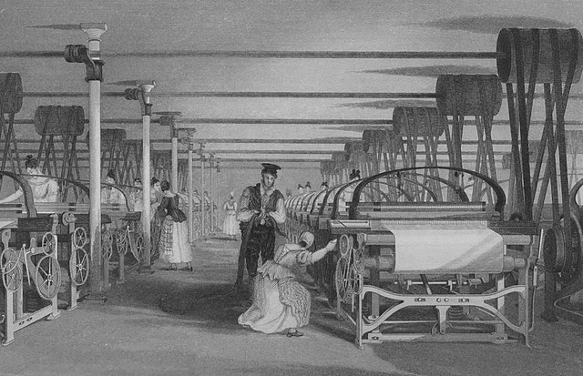

Slide 18
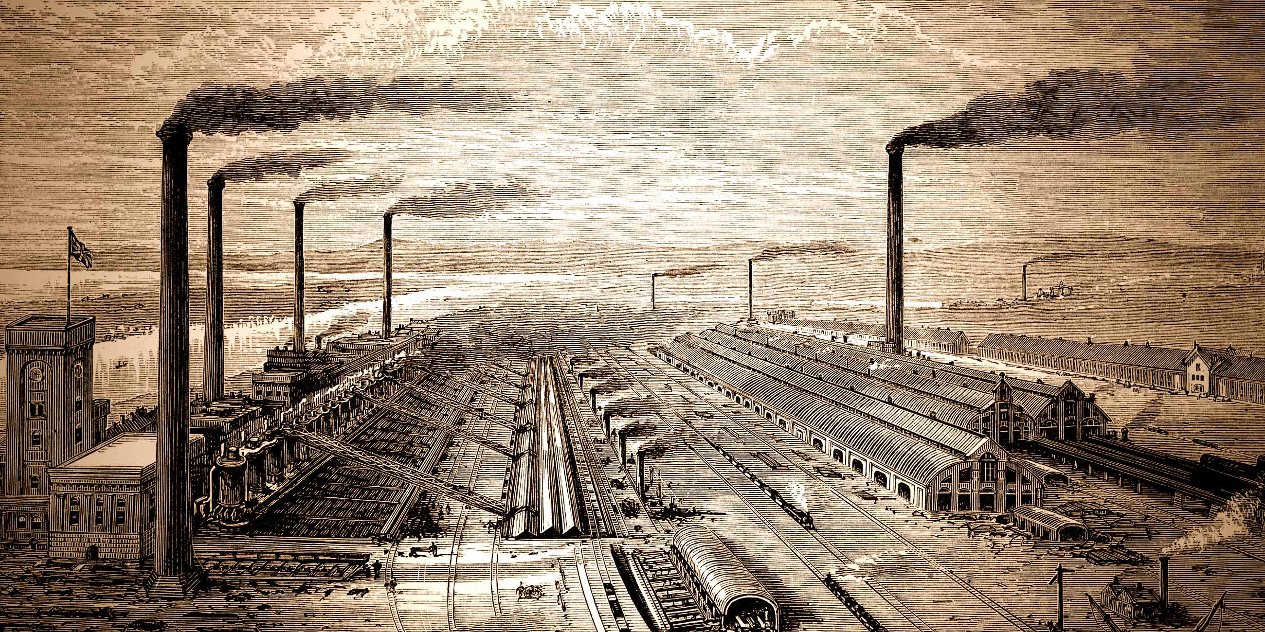

Slide 19
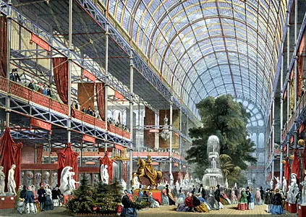

Slide 20
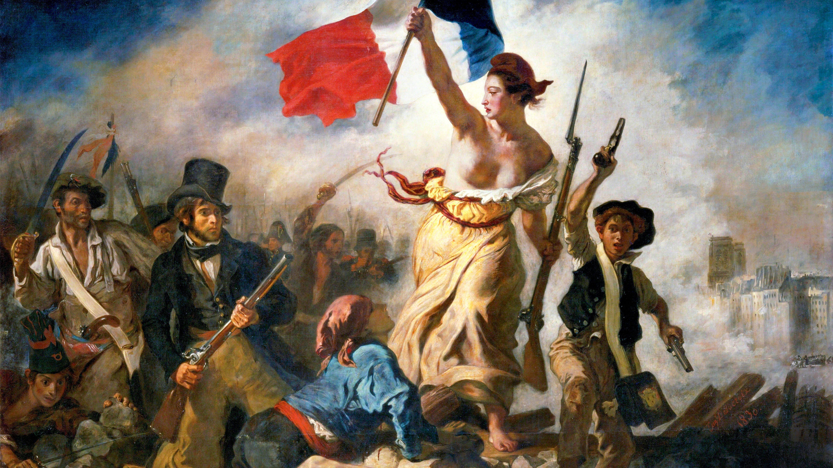

Slide 21
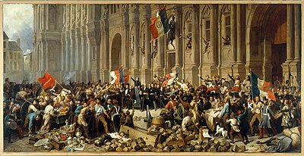

Slide 22
Karl Marx
„Theory of two revolutions“

Slide 23
Karl Marx
„Theory of two revolutions“ (or two-stage revolution)
Feudal system – land as the most important resource > landowners as the ruling class

Slide 24
Karl Marx
„Theory of two revolutions“ (or two-stage revolution)
Feudal system – land as the most important resource > landowners as the ruling class
Exploitative and inefficient, almost no sustained economic growth

Slide 25
Karl Marx
Bourgeois entrepreneurs will gradually become richer than the land-owning nobility
Eventually, they will overthrow the monarchy and impose a liberal regime

Slide 26
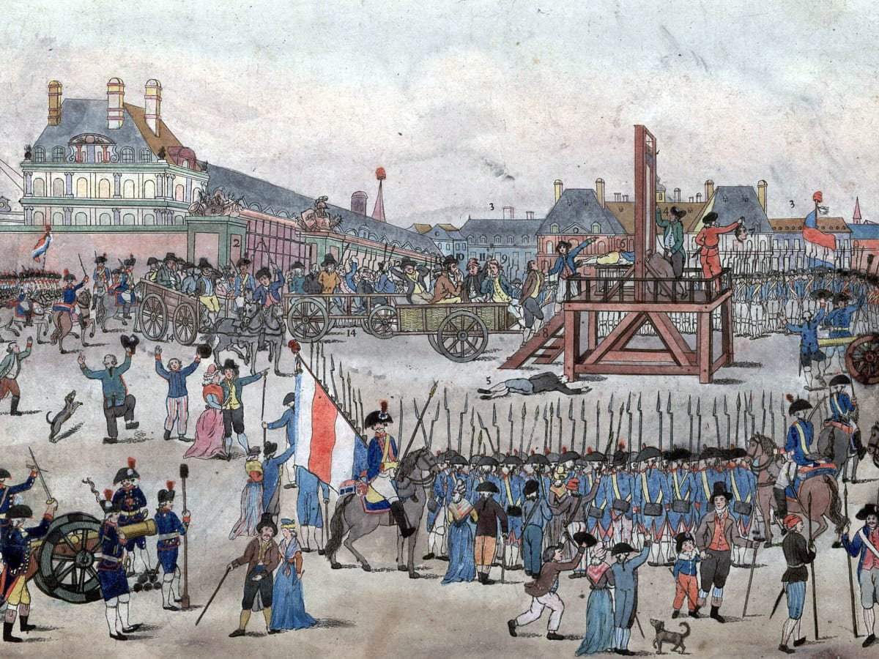

Slide 27
Karl Marx
Bourgeois entrepreneurs will gradually become richer than the land-owning nobility
Eventually, they will overthrow the monarchy and impose a liberal régime
= at first a change in the economic structure, than a change in the political superstructure

Slide 28
Karl Marx
Bourgeois entrepreneurs will gradually become richer than the land-owning nobility
Eventually, they will overthrow the monarchy and impose a liberal régime
= at first a change in the economic structure, than a change in the political superstructure

Slide 29
Karl Marx
= „first revolution“ = transition from feudalism to capitalism

Slide 30
Karl Marx
Is this good or not?

Slide 31
Karl Marx
Is this good or not?
Yes!

Slide 32
Karl Marx
Capitalism = improvement – technological progress and accumulation of wealth

Slide 33
Karl Marx
Capitalism = improvement – technological progress and accumulation of wealth
Capitalists compete to effectively use labor and new technologies to serve their customers

Slide 34
Karl Marx
Capitalism = improvement – technological progress and accumulation of wealth
Capitalists compete to effectively use labor and new technologies to serve their customers
Significantly more efficient than feudalism

Slide 35
Karl Marx
Capitalism = improvement – technological progress and accumulation of wealth
Capitalists compete to effectively use labor and new technologies to serve their customers
Significantly more efficient than feudalism
But also even more exploitative – humans have no other value than as workers – objectification, commodification

Slide 36
Karl Marx
> accumulation of wealth in the hands of the elite, impoverishment of everyone else

Slide 37
Karl Marx
> accumulation of wealth in the hands of the elite, impoverishment of everyone else
Ruthless competition will bankrupt most capitalists

Slide 38
Karl Marx
> accumulation of wealth in the hands of the elite, impoverishment of everyone else
Ruthless competition will bankrupt most capitalists
In the end, there will be only a few giant corporations + millions of destitute workers

Slide 39
Karl Marx
> accumulation of wealth in the hands of the elite, impoverishment of everyone else
Ruthless competition will bankrupt most capitalists
In the end, there will be only a few giant corporations + millions of destitute workers
= few people will actually support the régime!

Slide 40
Karl Marx
> accumulation of wealth in the hands of the elite, impoverishment of everyone else
Ruthless competition will bankrupt most capitalists
In the end, there will be only a few giant corporations + millions of destitute workers
= few people will actually support the régime!
The workers will overthrow the few remaining capitalists and establish communism

Slide 41
Karl Marx
= „second revolution“ > transition from capitalism to communism
In the future, not in Marx‘ lifetime!

Slide 42
Karl Marx
„Dictatorship of the proletariat“ – the many will overthrow the few
= majority rule!

Slide 43
Karl Marx
„Dictatorship of the proletariat“ – the many will overthrow the few
= majority rule!
The revolution will be led by the masses

Slide 44
Karl Marx
It is hard to say what exactly will happen

Slide 45
Karl Marx
It is hard to say what exactly will happen
But in general – the vast amount of wealth produced by capitalism will be enough to ensure welfare for everyone
Technology will have reached such a stage that people will only work a few hours a week

Slide 46
Karl Marx
Why cannot a society go from pre-modern agricultural state straight to communism?

Slide 47
Karl Marx
Why cannot a society go from pre-modern agricultural state straight to communism?
Because there would be no wealth to redistribute!

Slide 48
Karl Marx
Capitalism is a necessary stage through which every human society must pass

Slide 49
Karl Marx
Capitalism is a necessary stage through which every human society must pass
Therefore, every society must at first have the liberal, bourgeois revolution

Slide 50
Karl Marx
Communist revolutions will happen in the richest, most advanced societies on Earth, as the next step of civilization

Slide 51
Karl Marx
Communist revolutions will happen in the richest, most advanced societies on Earth, as the next step of civilization
> Germany, Britain, or the United States

Slide 52
Lenin and Trotsky
Active politicians who expected to personally lead the revolution

Slide 53
Lenin and Trotsky
Active politicians who expected to personally lead the revolution
Russia – Europe‘s economic periphery, still at the feudal stage > „How can we have a communist revolution here?“

Slide 54
Lenin and Trotsky
Poorer countries follow a different path (x Marx)

Slide 55
Lenin and Trotsky
Poorer countries follow a different path (x Marx)
> investment comes from foreign capitalists and the state

Slide 56
Lenin and Trotsky
Poorer countries follow a different path (x Marx)
> investment comes from foreign capitalists and the state
> there is no bourgeoisie to establish capitalism and liberal democracy!

Slide 57
Lenin and Trotsky
Poorer countries follow a different path (x Marx)
> investment comes from foreign capitalists and the state
> there is no bourgeoisie to establish capitalism and liberal democracy!
> the first revolution will not happen on its own -> no natural path towards Communism

Slide 58
Lenin and Trotsky
Exchange with rich countries will only enrich the traditional, conservative elite

Slide 59
Lenin and Trotsky
Exchange with rich countries will only enrich the traditional, conservative elite
For example, aristocratic landowners in Russia will export food to rich countries > they will make money and hold power indefinitely

Slide 60
Lenin and Trotsky
Exchange with rich countries will only enrich the traditional, conservative elite
For example, aristocratic landowners in Russia will export food to rich countries > they will make money and hold power indefinitely
Similar situation – European colonies, Latin America
= globalization tends to freeze the social hierarchy in poor countries and lock them into being producers of natural resources

Slide 61
Lenin and Trotsky
Exchange with rich countries will only enrich the traditional, conservative elite
For example, aristocratic landowners in Russia will export food to rich countries > they will make money and hold power indefinitely
Similar situation – European colonies, Latin America
= globalization tends to freeze the social hierarchy in poor countries and lock them into being producers of natural resources
> Immanuel Wallerstein, World System Theory

Slide 62
Lenin and Trotsky
> poor countries don‘t follow the same path as the West

Slide 63
Lenin and Trotsky
> poor countries don‘t follow the same path as the West
They are not going to transition to Western-style capitalism

Slide 64
Lenin and Trotsky
> poor countries don‘t follow the same path as the West
They are not going to transition to Western-style capitalism
> they will not have a bottom-up socialist revolution either

Slide 65
Lenin and Trotsky
> poor countries don‘t follow the same path as the West
They are not going to transition to Western-style capitalism
> they will not have a bottom-up socialist revolution either
> the capitalist (and liberal democratic) stage must be bypassed

Slide 66
Lenin and Trotsky
Russia (and China!) – urban workers in the few existing modern industries are a minority

Slide 67
Lenin and Trotsky
Russia (and China!) – urban workers in the few existing modern industries are a minority
Who made up the bulk of the population?

Slide 68
Lenin and Trotsky
Russia (and China!) – urban workers in the few existing modern industries are a minority
Who made up the bulk of the population?
Peasants!

Slide 69
Lenin and Trotsky
Russia (and China!) – urban workers in the few existing modern industries are a minority
Who made up the bulk of the population?
Peasants – who are conservative and will never rise up

Slide 70
Lenin and Trotsky
Socialism cannot come via a popular revolt
> workers must become organized and carry out a coup d‘etat

Slide 71
Lenin and Trotsky
Socialism cannot come via a popular revolt
> workers must become organized and carry out a coup d‘etat
If this happens on the world periphery, it will destroy all of capitalism, because the rich nations are dependent on exploiting poor countries

Slide 72
Lenin and Trotsky
Communist party – extremely important – it will unify the workers and carry out the coup
„Leninism“, „party vanguardism“

Slide 73
Lenin and Trotsky
Communist party – extremely important – it will unify the workers and carry out the coup
„Leninism“, „party vanguardism“
The party must be disciplined and centrally led = „democratic centralism“

Slide 74
Lenin and Trotsky
Communist party – extremely important – it will unify the workers and carry out the coup
„Leninism“, „party vanguardism“
The party must be disciplined and centrally led = „democratic centralism“
= decision inside the party are made democratically, but once they are made, they are binding

Slide 75
Lenin and Trotsky
„Party-state“
Upon assuming power, the Party becomes superior to official constitutional structures, which have no real power

Slide 76
Lenin and Trotsky
„Party-state“
Upon assuming power, the Party becomes superior to official constitutional structures, which have no real power
USSR – theoretically a loose federation, held together by the Party > dissolved when Communism ended

Slide 77
Lenin and Trotsky
„Party-state“
Upon assuming power, the Party becomes superior to official constitutional structures, which have no real power
USSR – theoretically a loose federation, held together by the Party > dissolved when Communism ended
Most officials simultaneously hold both governmental and Party positions > the leadership can give them orders through Party mechanism

Slide 78
Lenin and Trotsky
Marx – the Party is cool, but the revolution will be driven by structural forces
Lenin – the Party is a crucial historical instrument that will drive peripheral societies towards modernity

Slide 79
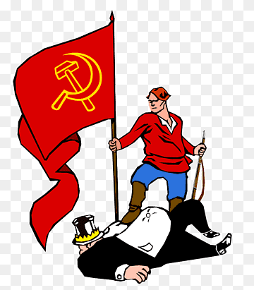
Lenin and Trotsky
„Dictatorship of the proletariat“

Slide 80
Lenin and Trotsky
„Dictatorship of the proletariat“
– Marx though that almost everyone will be a worker at this stage, so the revolution will simply mean majority rule

Slide 81
Lenin and Trotsky
„Dictatorship of the proletariat“
– Marx though that almost everyone will be a worker at this stage, so the revolution will simply mean majority rule
x Lenin: one-party rule
„nothing other than power which is totally unlimited by any laws, totally unrestrained by absolutely any rules, and based directly on force.”

Slide 82
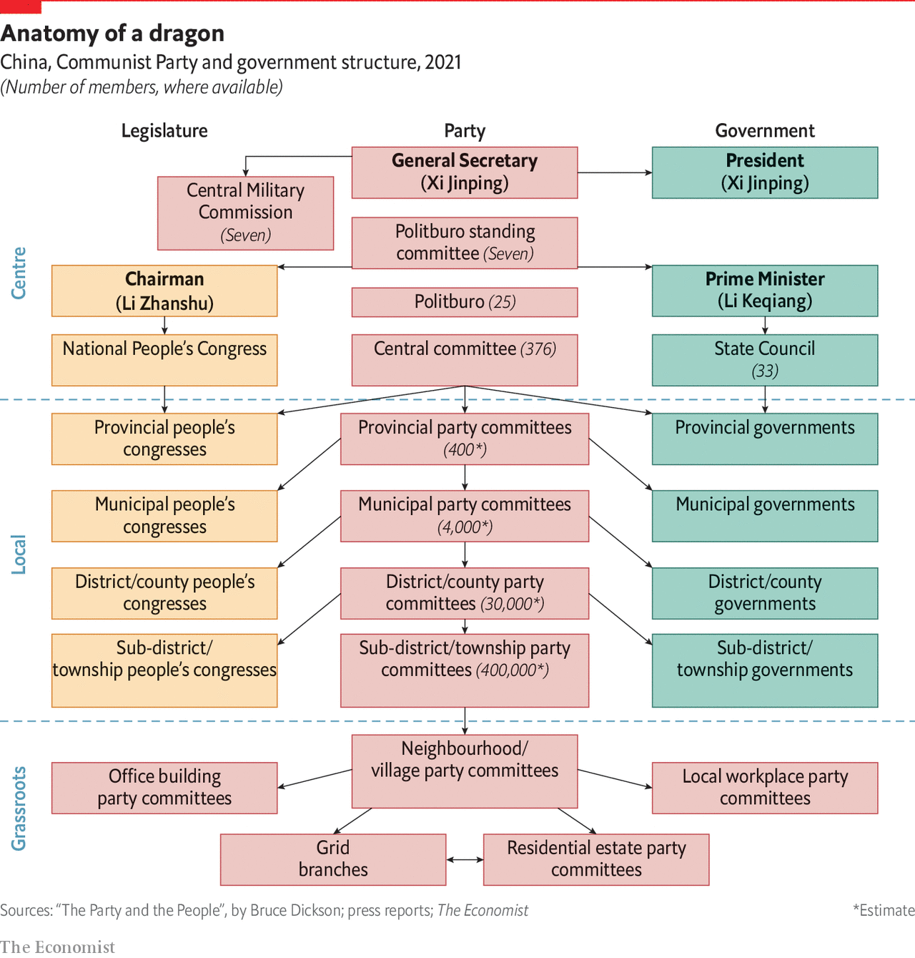
Democratic centralism in China

Slide 83
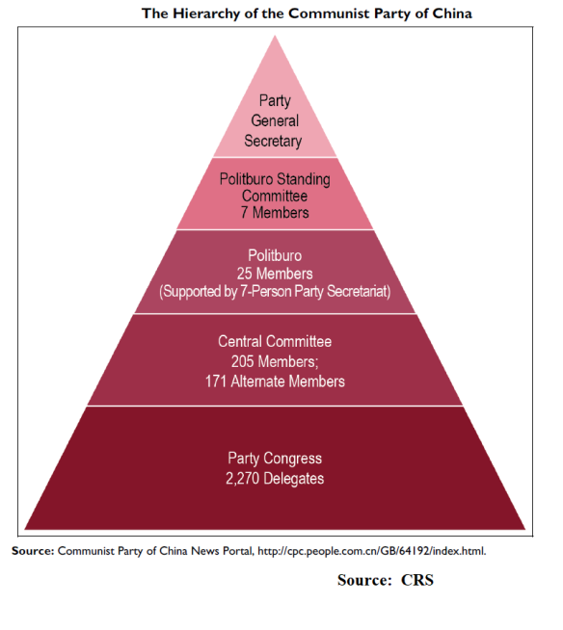
Democratic centralism in China

Slide 84
Democratic centralism in China
Theory – lower levels of the Party („the people“) elect the upper echelons = inter-party democracy, meritocracy
The thus chosen leadership then makes a decision, which is meticulously implemented by millions of loyal members

Slide 85
Democratic centralism in China

Slide 86
Democratic centralism in China
Reality – almost the exact opposite!

Slide 87
Democratic centralism in China
Reality – almost the exact opposite!
Real power lies at the level of Politburo / Standing Committee / General Secretary
Influence shifts based on personal patronage networks, informal friendships etc

Slide 88
Democratic centralism in China

Slide 89
Democratic centralism in China
Reality – almost the exact opposite!
Real power lies at the level of Politburo / Standing Committee / General Secretary
Influence shifts based on personal patronage networks, informal friendships etc
These bodies themselves chose who is going to sit on them and replace retiring members > lower level is told whom they should elect

Slide 90
Democratic centralism in China
But local and provincial party leaders are often powerful and can sometimes succesfully resist the centre + make policy decisions

Slide 91
Back to the origins of Communism ☺

Slide 92
Central planning
Then the Party must stay in power and oversee the industrialization = the state will do what capitalists did in the West

Slide 93
Central planning
Then the Party must stay in power and oversee the industrialization = the state will do what capitalists did in the West
> central planning

Slide 94
Central planning
„Where is the capital necessary for investment going to come from?“

Slide 95
Central planning
„Where is the capital necessary for investment going to come from?“
Wealth must be extracted from peasants and invested into developing modern industry

Slide 96
Central planning
„Where is the capital necessary for investment going to come from?“
Wealth must be extracted from peasants and invested into developing modern industry
> regulated prices – artificially low prices for agricultural products, high prices for agricultural equipment
Outright confiscation of harvests

Slide 97
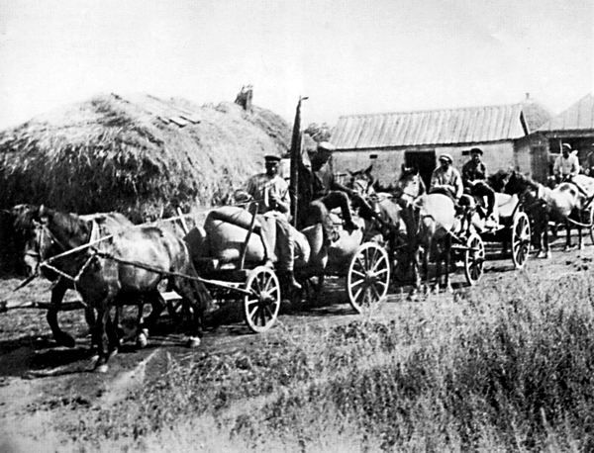

Slide 98
Central planning
„Where is the capital necessary for investment going to come from?“
Wealth must be extracted from peasants and invested into developing modern industry
> regulated prices – artificially low prices for agricultural products, high prices for agricultural equipment
Outright confiscation of harvests
> black market, peasant uprisings > harsh punishments

Slide 99
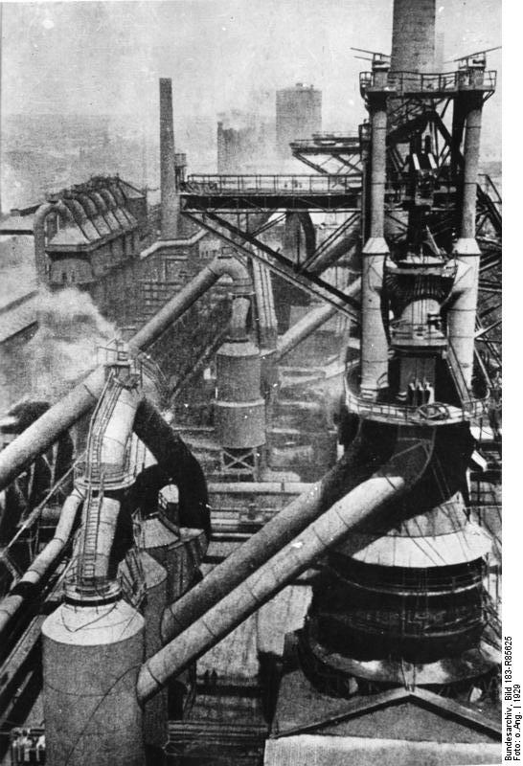

Slide 100
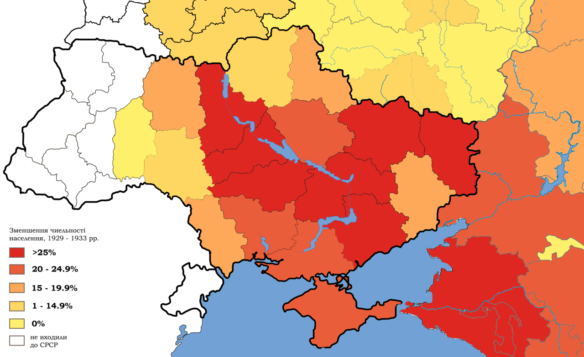

Slide 101
„Foreign tourists in Russia stand in silent amazement before the gigantic enterprises created there, as they stand before the pyramids, for example. Only seldom does the thought occur to them what enslavement, what lowering of human self-esteem was connected with the construction of those gigantic establishments.“
- Karl Kautsky

Slide 102
How central planning works
Imagine all of society like a single corporation, or a military
> giant rationing system controlled from the centre

Slide 103
How central planning works
Imagine all of society like a single corporation, or a military
> giant rationing system controlled from the centre
No markets - state-owned companies are supplied with resources and given orders on what to do with them

Slide 104
How central planning works
Imagine all of society like a single corporation, or a military
> giant rationing system controlled from the centre
No markets - state-owned companies are supplied with resources and given orders on what to do with them
Prices – artificially, bureaucratically imposed

Slide 105
How central planning works
Ideal plan – get rid of money altogether and function only via rationing
Banks – unnecessary – everyone will be given what they need, loans are not needed

Slide 106
How central planning works
Ideal plan – get rid of money altogether and function only via rationing
Banks – unnecessary – everyone will be given what they need, loans are not needed
Attempted by Lenin during War Communism (1917-1921), later given up

Slide 107
How central planning works
What about international trade?

Slide 108
How central planning works
What about international trade?
Problem – world market prices vs. domestic artificial prices
> free trade would destroy the system!

Slide 109
How central planning works
What about international trade?
Problem – world market prices vs. domestic artificial prices
> free trade would destroy the system!
Solution – foreign trade companies – monopoly power to trade with the rest of the world

Slide 110
How central planning works
What about international trade?
Problem – world market prices vs. domestic artificial prices
> free trade would destroy the system!
Solution – foreign trade companies – monopoly power to trade with the rest of the world
Import and export – part of the central plan!

Slide 111
How central planning works
What about international trade?
Problem – world market prices vs. domestic artificial prices
> free trade would destroy the system!
Solution – foreign trade companies – monopoly power to trade with the rest of the world
Import and export – part of the central plan!
Problem – constant lack of foreign exchange

Slide 112
Central planning
A believe that central planning will outcome capitalism

Slide 113
Central planning
A believe that central planning will outcome capitalism
Capitalists behave in a way that is individually rational but collectively irrational

Slide 114
Central planning
A believe that central planning will outcome capitalism
Capitalists behave in a way that is individually rational but collectively irrational
= they spend money on advertising their product and making it more attractive than the competition
= „race to the bottom“ situations

Slide 115
Central planning
A believe that central planning will outcome capitalism
Capitalists behave in a way that is individually rational but collectively irrational
= they spend money on advertising their product and making it more attractive than the competition
= „race to the bottom“ situations
In a communist society, all these resources would be invested more productively ☺

Slide 116
Central planning
NEP

Slide 117
Central planning
Russian Civil War (1917-1921) > War Communism
= Attempt to stamp out money and all private transactions

Slide 118
Central planning
Russian Civil War (1917-1921) > War Communism
= Attempt to stamp out money and all private transactions
Allowed Bolsheviks to mobilize resources and defeat Whites, but unpopular > peasant uprisings

Slide 119
Central planning
Russian Civil War (1917-1921) > War Communism
= Attempt to stamp out money and all private transactions
Allowed Bolsheviks to mobilize resources and defeat Whites, but unpopular > peasant uprisings
> New Economic Policy (NEP, 1923-1928) = market-oriented reform > small business allowed!

Slide 120
Central planning
Russian Civil War (1917-1921) > War Communism
= Attempt to stamp out money and all private transactions
Allowed Bolsheviks to mobilize resources and defeat Whites, but unpopular > peasant uprisings
> New Economic Policy (NEP, 1923-1928) = market-oriented reform > small business allowed!
1928 – Stalin – end of NEP, start of Five Year plans
= blueprint for China and other communist countries

Slide 121
Central planning
NEP proved that it‘s possible for a Communist party to stay in power in a market economy and even to turn back the reforms if it wishes to

Slide 122
Central planning
NEP proved that it‘s possible for a Communist party to stay in power in a market economy and even to turn back the reforms if it wishes to (…)

Slide 123
Central planning
NEP proved that it‘s possible for a Communist party to stay in power in a market economy and even to turn back the reforms if it wishes to (…)
x „Fukuyamist neoliberalism“

Slide 124
Pros and cons of central planning

Slide 125
Pros and cons of central planning
Difficulty of finding out what‘s valuable in absence of prices

Slide 126
Pros and cons of central planning
Difficulty of finding out what‘s valuable in absence of prices
> focus on tangible targets – fertilizer, steel, concrete
> neglect of things which are harder to measure (services etc.)

Slide 127
Pros and cons of central planning
Difficulty of finding out what‘s valuable in absence of prices
> focus on tangible targets – fertilizer, steel, concrete
> neglect of things which are harder to measure (services etc.)
Bad management of resources > environmental damage!

Slide 128
Pros and cons of central planning
Difficulty of finding out what‘s valuable in absence of prices
> focus on tangible targets – fertilizer, steel, concrete
> neglect of things which are harder to measure (services etc.)
Bad management of resources > environmental damage!
No competition and no bankruptcies > no pressure to make products and services attractive to buyers > low quality + little choice

Slide 129
Pros and cons of central planning
Good at adopting existing techniques and replicating them throughout the economy > catching up

Slide 130
Pros and cons of central planning
Good at adopting existing techniques and replicating them throughout the economy > catching up
Bad at independent innovation

Slide 131
Pros and cons of central planning
Good at adopting existing techniques and replicating them throughout the economy > catching up
Bad at independent innovation
> as communist countries neared the technological frontier, growth stalled
> problem for all state-dominated economies (China…?)

Slide 132
China
WWI – shattering of the Western-dominated capitalist world order
Worldwide loss of faith in the old system + Russian revolution = people embrace new ideologies

Slide 133
China
WWI – shattering of the Western-dominated capitalist world order
Worldwide loss of faith in the old system + Russian revolution = people embrace new ideologies
May Fourth Movement - loss of faith in traditional elites (landowners and scholars), modern nationalism, populism, radical politics, new culture – literature in simple Chinese

Slide 134
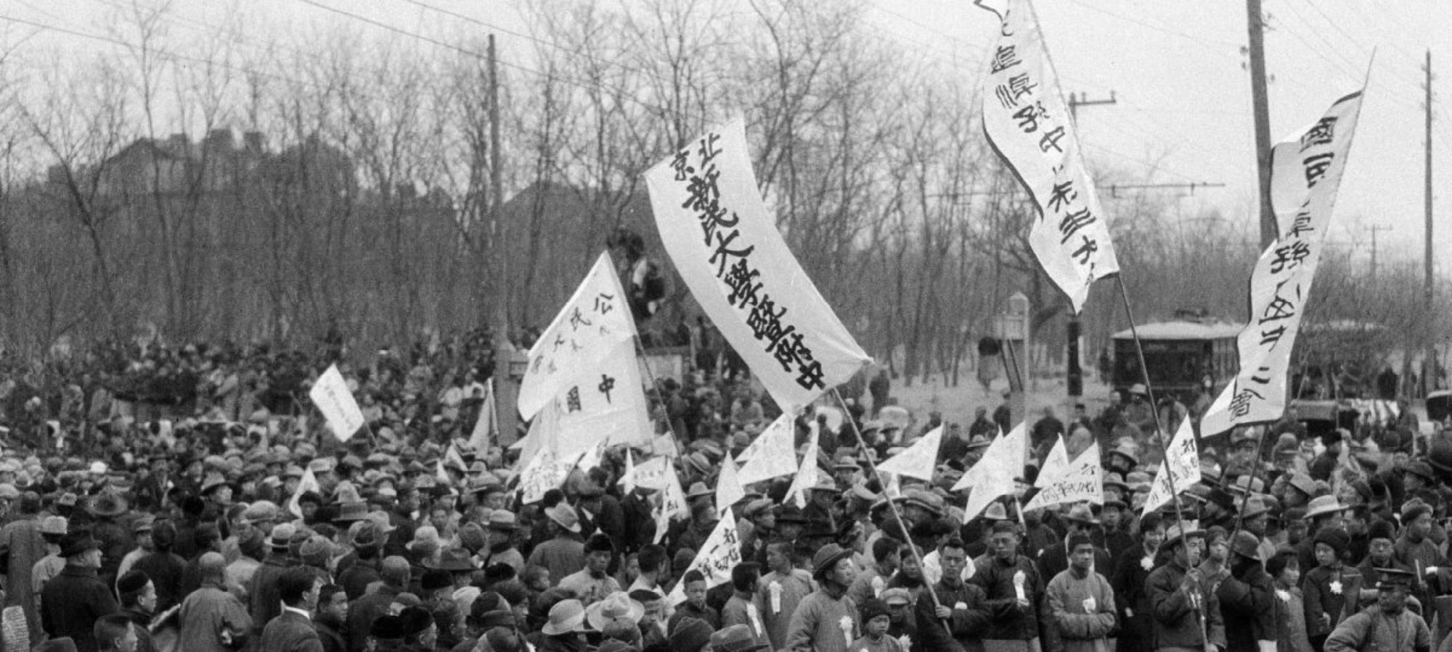

Slide 135
May Fourth Movement
Desire to fulfill the promise of the Republic
> injection of new energy and momentum into the KMT

Slide 136
May Fourth Movement
Desire to fulfill the promise of the Republic
> injection of new energy and momentum into the KMT
Intellectual habitat in which the CCP was founded

Slide 137
The Chinese Communist Party
1921
Initially – a smaller sibling of the Kuomintang

Slide 138
The Chinese Communist Party
1921
Initially – a smaller sibling of the Kuomintang
Theory of two revolutions
„1911 was the first revolution, the Kuomintang is the party of the Chinese bourgeoisie“

Slide 139
The Chinese Communist Party
1921
Initially – a smaller sibling of the Kuomintang
Theory of two revolutions
„1911 was the first revolution, the Kuomintang is the party of the Chinese bourgeoisie“
„We must help the Kuomintang to develop capitalism first“

Slide 140
The Chinese Communist Party
1921
Initially – a smaller sibling of the Kuomintang
Theory of two revolutions
„1911 was the first revolution, the Kuomintang is the party of the Chinese bourgeoisie“
„We must help the Kuomintang to develop capitalism first“
= Soviet advice + opinion of Chinese orthodox Marxists

Slide 141
Maoism
Mao Zedong (*1893) – unorthodox theory

Slide 142
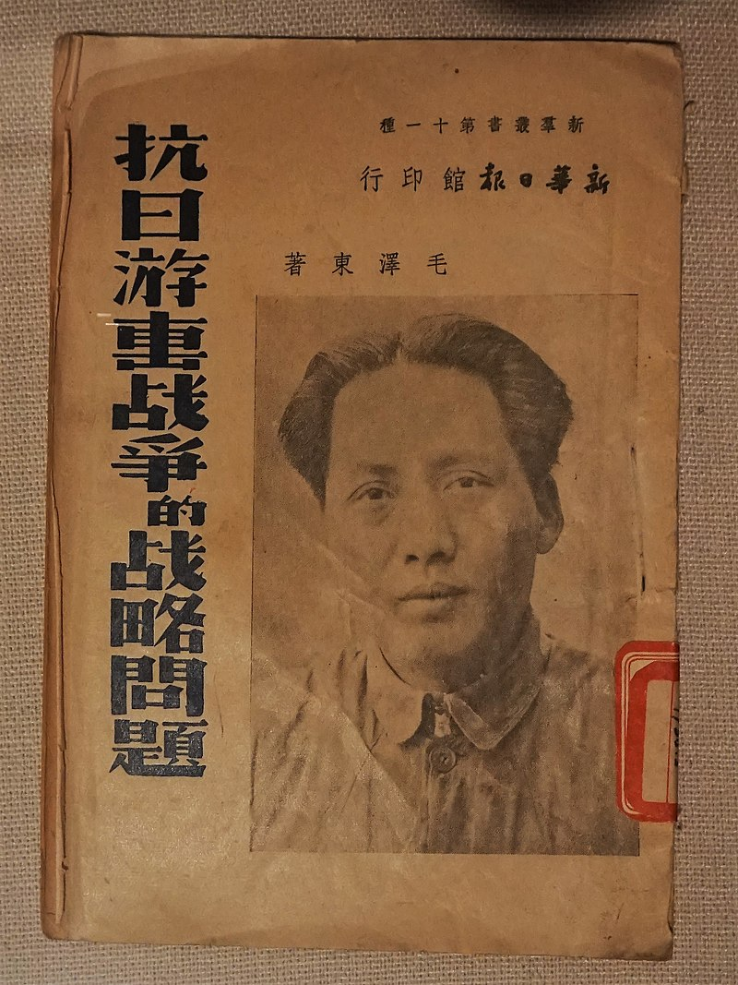

Slide 143
Maoism
Mao Zedong (*1893) – unorthodox theory
> the Party should organize peasants instead of urban workers

Slide 144
Maoism
Mao Zedong (*1893) – unorthodox theory
> the Party should organize peasants instead of urban workers
> a prolonged rural guerilla war against landlords and the KMT

Slide 145
Maoism
Mao Zedong (*1893) – unorthodox theory
> the Party should organize peasants instead of urban workers
> a prolonged rural guerilla war against landlords and the KMT
= „Maoism“

Slide 146
Maoism
Mao Zedong (*1893) – unorthodox theory
> the Party should organize peasants instead of urban workers
> a prolonged rural guerilla war against landlords and the KMT
= „Maoism“
At first seen as a fringe position

Slide 147
Marx – short mass revolution by workers – who are the majority
Lenin – short armed insurrection by workers, who are a minority
Mao – long armed insurrection by peasants, who are the majority

Slide 148
The Chinese Communist Party
CCP – compliant at first, the KMT turned against them after the Northern Expedition (1927)

Slide 149
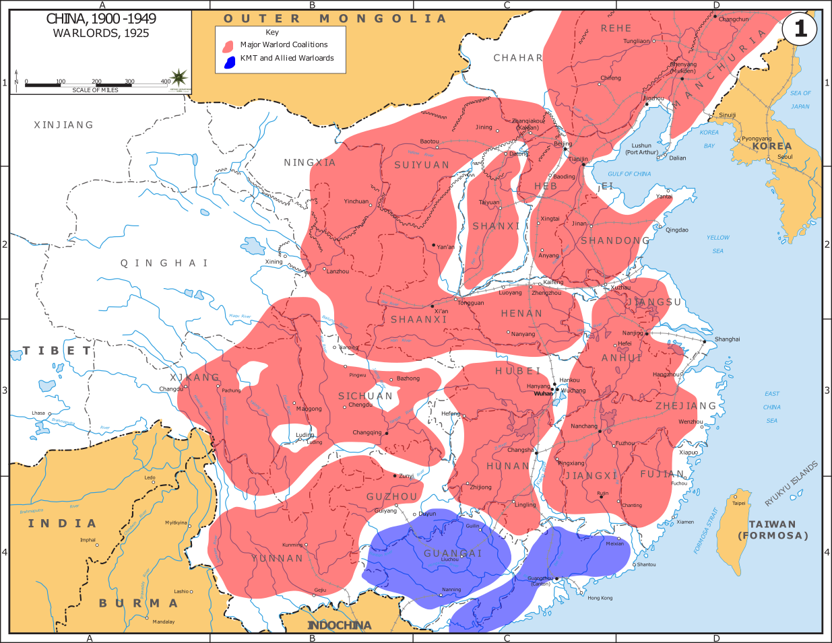

Slide 150
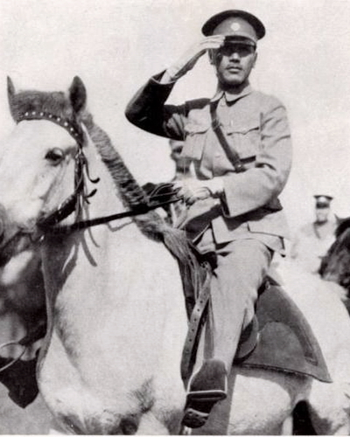

Slide 151
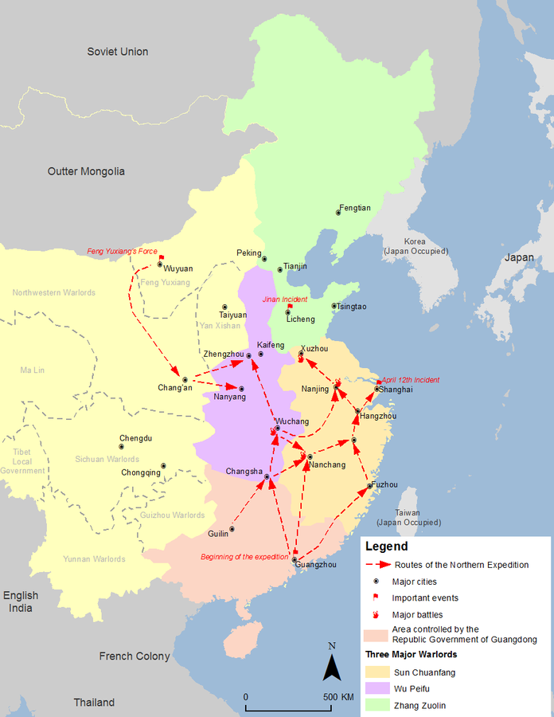

Slide 152
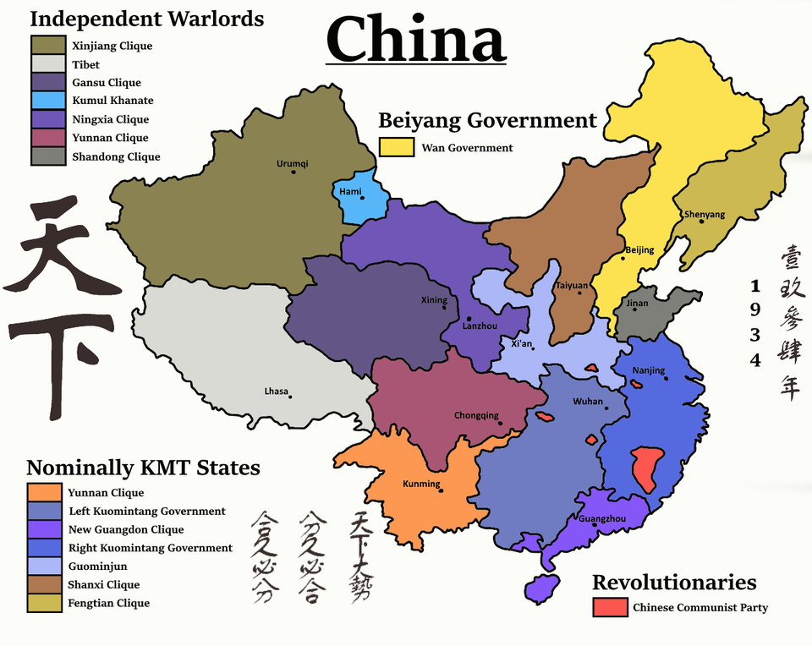

Slide 153
The Chinese Communist Party
CCP – compliant at first, the KMT turned against them after the Northern Expedition (1927) > white terror against Communists

Slide 154
The Chinese Communist Party
CCP – compliant at first, the KMT turned against them after the Northern Expedition (1927) > white terror against Communists
> Mao‘s position vindicated

Slide 155
The Chinese Communist Party
CCP – compliant at first, the KMT turned against them after the Northern Expedition (1927) > white terror against Communists
> Mao‘s position vindicated
> a rural guerilla is actually necessary – cities (with workers) are controlled by the KMT

Slide 156
The Chinese Communist Party
Long March (1934-1935) > to the north of China where the KMT was less powerful

Slide 157
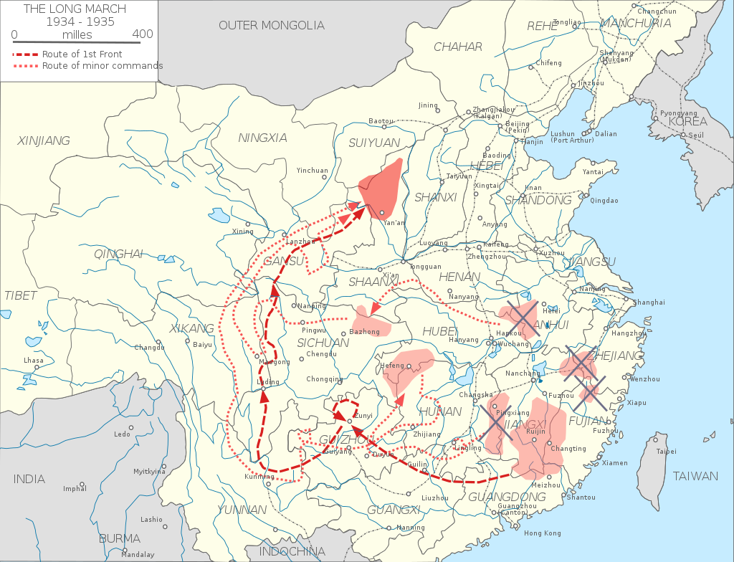

Slide 158
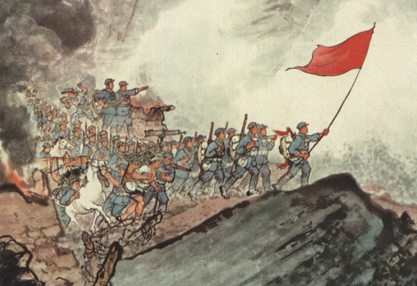

Slide 159
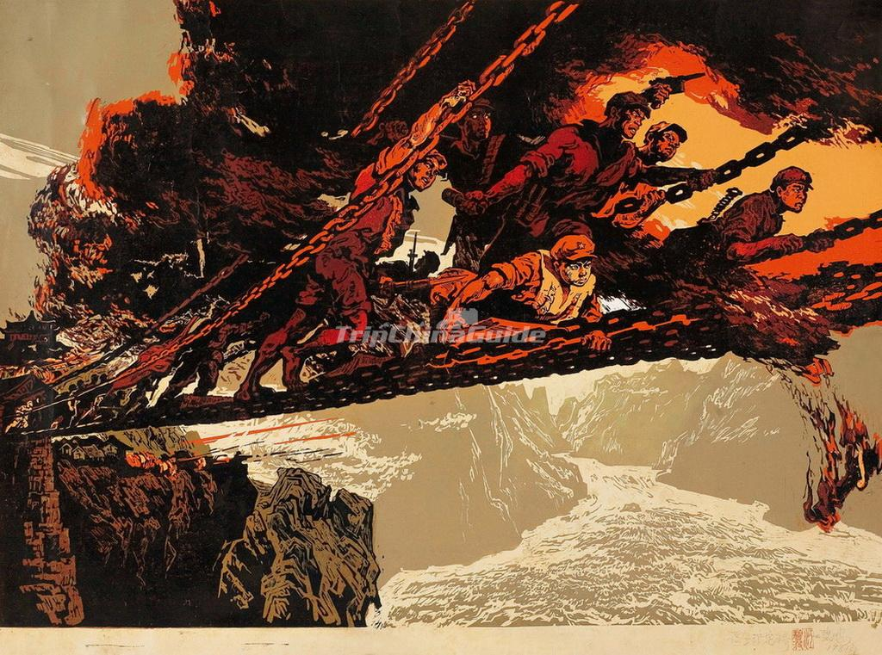

Slide 160
The Chinese Communist Party
Long March (1934-1935) > to the north of China where the KMT was less powerful
Most leaders of the CCP died during the KMT crackdown, or during the march
> Mao emerged as the undisputed leader

Slide 161
WWII
Communists patiently built their movement, avoided major battles with the Japanese

Slide 162
WWII
Communists patiently built their movement, avoided major battles with the Japanese
„Long struggle“ – „It is necessary to preserve our strength for the final showdown against the Nationalists“
> this will be the fight that really matters

Slide 163
WWII
Seat of the party – Yan‘an – far away from any danger

Slide 164
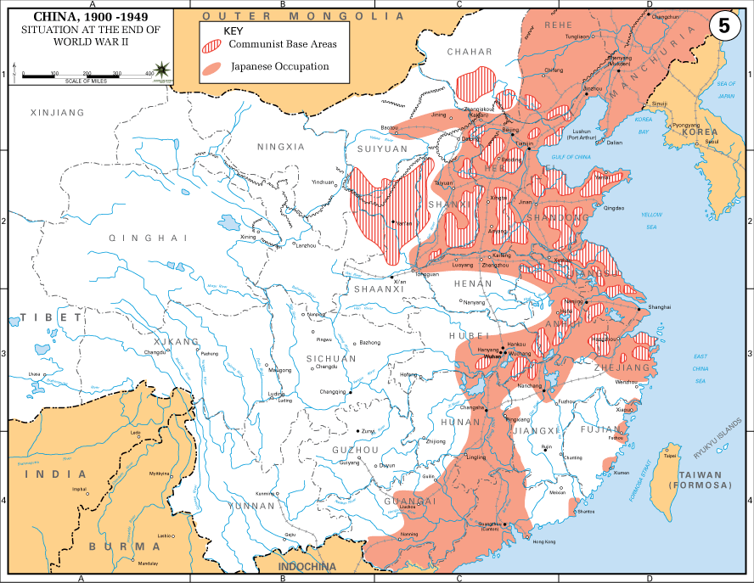

Slide 165
WWII
Seat of the party – Yan‘an – far away from any danger
„Yan'an Rectification Movement“ – 1942-45 – Mao‘s cult of personality, suppression of dissent within the party, Maoism as the official ideology

Slide 166
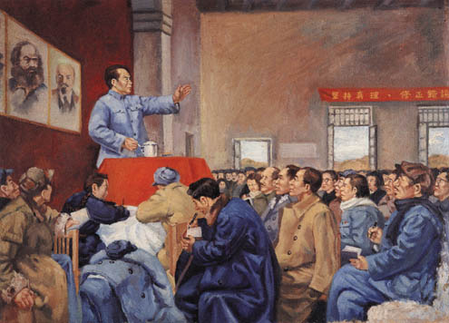

Slide 167
WWII
Seat of the party – Yan‘an – far away from any danger
„Yan'an Rectification Movement“ – 1942-45 – Mao‘s cult of personality, suppression of dissent within the party, Maoism as the official ideology
= blueprint for future purges

Slide 168
WWII
„thought reform“, „though realignment“

Slide 169
WWII
„thought reform“, „though realignment“
= confession of one‘s mistakes during combative sessions > opponents driven to suicide

Slide 170
Communist victory
1946-1949 – Civil war – communist victory over the exhausted, overextended and corrupt KMT in 1949

Slide 171
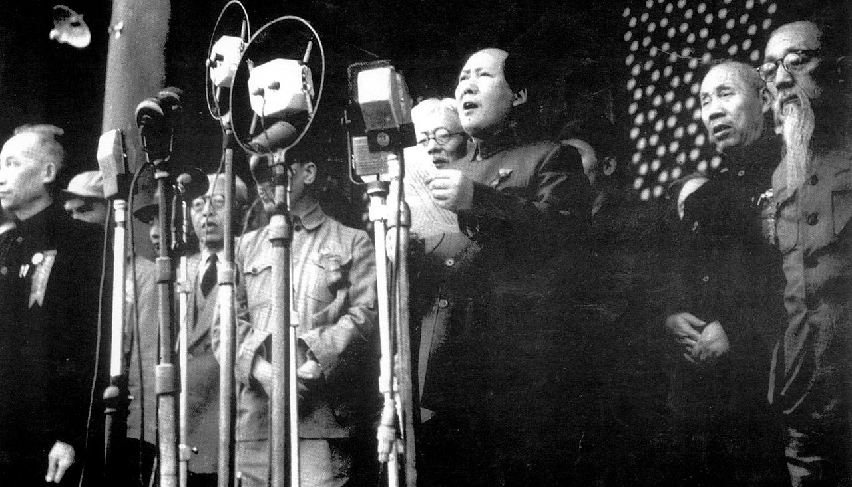

Slide 172
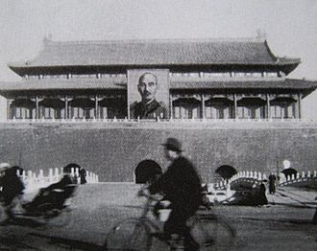

Slide 173
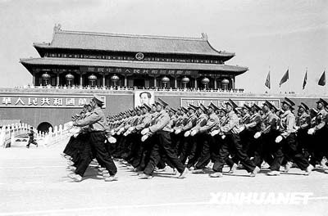

Slide 174
Communist victory
Communist promises
1) Carry out a land reform

Slide 175
Communist victory
Inequality of land ownership – the main problem in all of East Asia

Slide 176
Communist victory
Inequality of land ownership – the main problem in all of East Asia
Brutal exploitation of peasants > poverty and resentment
KMT – allied itself with the landlords

Slide 177
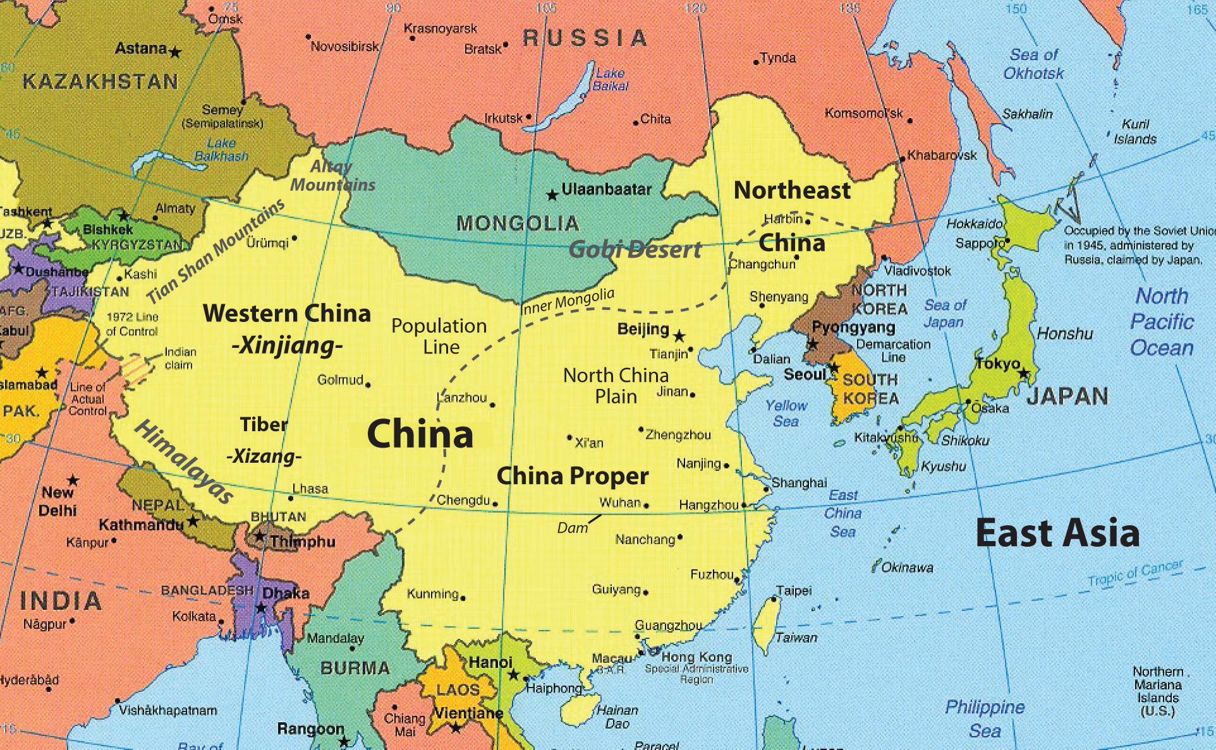

Slide 178
Korea, Japan, Taiwan – land reforms „from above“ – carried out by the conservative regimes to avoid revolution – US pressure!

Slide 179
Korea, Japan, Taiwan – land reforms „from above“ – carried out by the conservative regimes to avoid revolution – US pressure!
> „blank slate“ > start of a successful capitalist development!

Slide 180
Communist victory
Communist promises
1) Carry out a land reform

Slide 181
Communist victory
Communist promises
1) Carry out a land reform
2) Entrepreneurship is going to remain allowed

Slide 182
Communist victory
Communist promises
1) Carry out a land reform
2) Entrepreneurship is going to remain allowed
3) Create democracy and pluralism! – CCP will lead a broad coalition of progressive parties and movements

Slide 183
Communist victory
Communist promises
1) Carry out a land reform
2) Entrepreneurship is going to remain allowed
3) Create democracy and pluralism! – CCP will lead a broad coation of progressive parties and movements
CCP will thus finish what was started in 1911, Mao is the true heir of Sun Yat Sen!

Slide 184
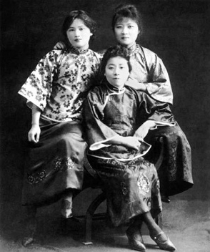

Slide 185
Compare this with: communists in Czechoslovakia

Slide 186
Compare this with: communists in Czechoslovakia
- land reform ✔️

Slide 187
Compare this with: communists in Czechoslovakia
- land reform ✔️
- socialism different from the Soviet model – gradual path, no threat for small businesses ✔️

Slide 188
Compare this with: communists in Czechoslovakia
- land reform ✔️
- socialism different from the Soviet model – gradual path, no threat for small businesses ✔️
- democracy – „National Front“ coalition ✔️

Slide 189
Compare this with: communists in Czechoslovakia
- land reform ✔️
- socialism different from the Soviet model – gradual path, no threat for small businesses ✔️
- democracy – „National Front“ coalition ✔️
= fulfillment of the dream of the republic from 1918! ✔️

Slide 190
First years of the PRC - 1949-1953
Massacre of landlords > circa 2 million victims

Slide 191
First years of the PRC - 1949-1953
Not full central planning yet!

Slide 192
First years of the PRC - 1949-1953
Not full central planning yet!
Industry – slow nationalization of companies
Agriculture – independent farmers – pressure to form cooperatives – not collective ownership

Slide 193
First years of the PRC - 1949-1953
Not full central planning yet!
Industry – slow nationalization of companies
Agriculture – independent farmers – pressure to form cooperatives – not collective ownership
Recovery from all the wars, participation in Korea > the CCP was not strong enough to control all of the economy

Slide 194
First Five Year Plan (1953-1957)

Slide 195
First Five Year Plan (1953-1957)
Soviet model, Soviet equipment, Soviet advisors

Slide 196
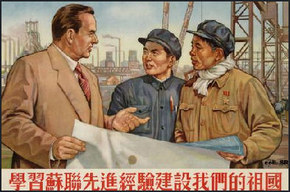
First Five Year Plan (1953-1957)
Soviet model, Soviet equipment, Soviet advisors

Slide 197
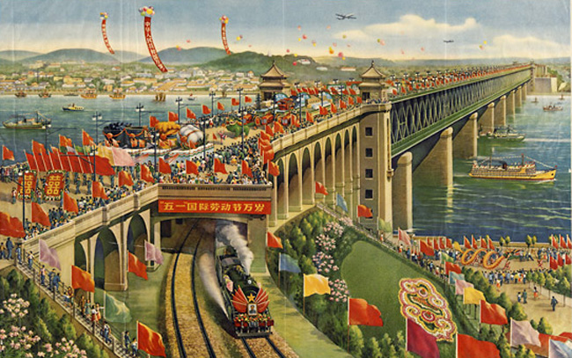

Slide 198
First Five Year Plan (1953-1957)
Soviet model, Soviet equipment, Soviet advisors
Centralized, hierarchical, technocratic

Slide 199
First Five Year Plan (1953-1957)
Soviet model, Soviet equipment, Soviet advisors
Centralized, hierarchical, technocratic
Main point – develop modern industry at the expense of agriculture

Slide 200
First Five Year Plan (1953-1957)
Soviet model, Soviet equipment, Soviet advisors
Centralized, hierarchical, technocratic
Main point – develop modern industry at the expense of agriculture
Full nationalization of industry, collective farming

Slide 201
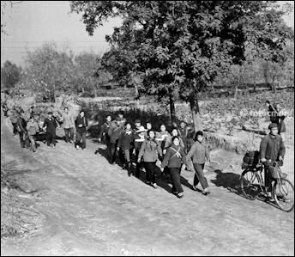

Slide 202
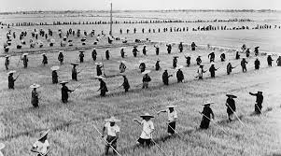

Slide 203
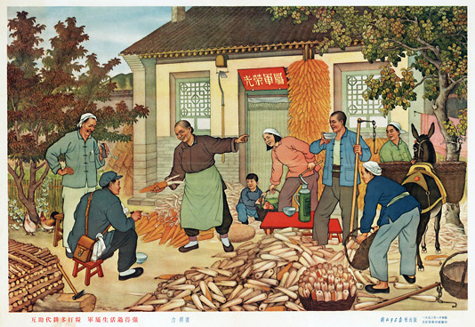

Slide 204
First Five Year Plan (1953-1957)
Progress in industry, but stagnation in agriculture

Slide 205
First Five Year Plan (1953-1957)
Progress in industry, but stagnation in agriculture
Mao – that‘s not good enough!

Slide 206
First Five Year Plan (1953-1957)
Progress in industry, but stagnation in agriculture
Mao – that‘s not good enough!
1957 – turn in a more radical direction

Slide 207
First Five Year Plan (1953-1957)
Progress in industry, but stagnation in agriculture
Mao – that‘s not good enough!
1957 – turn in a more radical direction
Hundred Flowers Campaign – „you can criticize us without fear“

Slide 208
First Five Year Plan (1953-1957)
Progress in industry, but stagnation in agriculture
Mao – that‘s not good enough!
1957 – turn in a more radical direction
Hundred Flowers Campaign – „you can criticize us without fear“
Anti-Rightist Campaign – another purge; full one-party state; led by Deng Xiaoping!

Slide 209
„Great Leap Forward“ (1958-1962)
Basic idea – simultaneous progress in cities and the countryside

Slide 210
„Great Leap Forward“ (1958-1962)
Basic idea – simultaneous progress in cities and the countryside
Local patriotic and ideological enthusiasm will replace Soviet-style centralized technocracy

Slide 211
„Great Leap Forward“ (1958-1962)
Basic idea – simultaneous progress in cities and the countryside
Local patriotic and ideological enthusiasm will replace Soviet-style centralized technocracy
Local party leaders should heroically struggle to achieve great results

Slide 212
„Great Leap Forward“ (1958-1962)
Basic idea – simultaneous progress in cities and the countryside
Local patriotic and ideological enthusiasm will replace Soviet-style centralized technocracy
Local party leaders should heroically struggle to achieve great results
Abolition of private land ownership, farms to be fused into large scale „village communes“

Slide 213
„Great Leap Forward“ (1958-1962)
Basic idea – simultaneous progress in cities and the countryside
Local patriotic and ideological enthusiasm will replace Soviet-style centralized technocracy
Local party leaders should heroically struggle to achieve great results
Abolition of private land ownership, farms to be fused into large scale „village communes“
Small industrialization carried out by these village communes

Slide 214
„Great Leap Forward“ (1958-1962)
Communes were supposed to produce their own steel

Slide 215
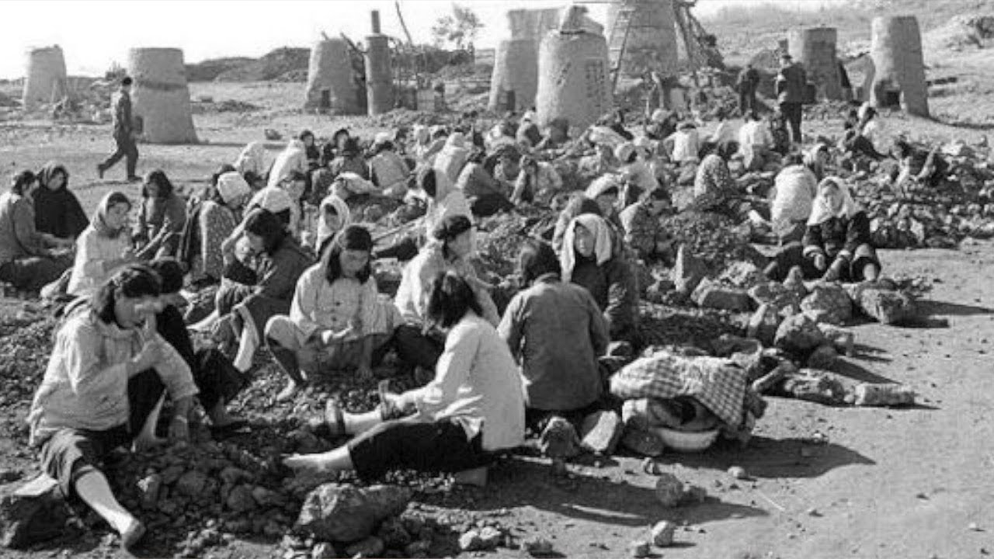

Slide 216
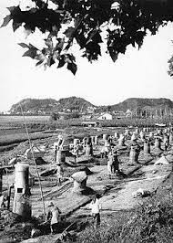

Slide 217
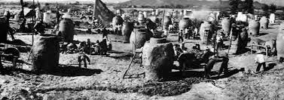

Slide 218
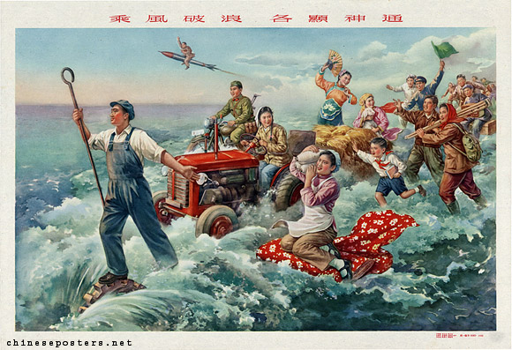

Slide 219
„Great Leap Forward“ (1958-1962)
Communes were supposed to produce their own steel
„They probably have a lot of spare workers who aren‘t doing anything valuable, let‘s force them to work in manufacturing“

Slide 220
„Great Leap Forward“ (1958-1962)
Communes were supposed to produce their own steel
„They probably have a lot of spare workers who aren‘t doing anything valuable, let‘s force them to work in manufacturing“
People fulfilled their quotas by melting down tools and reforging them into useless, low-quality iron

Slide 221
„Great Leap Forward“ (1958-1962)
Unrealistic production quotas > all the food was forcibly confiscated

Slide 222
„Great Leap Forward“ (1958-1962)
Unrealistic production quotas > all the food was forcibly confiscated
Biggest famine in China‘s history – 30 million deaths

Slide 223
„Great Leap Forward“ (1958-1962)
The program had to be called off in 1962

Slide 224
„Agriculture first“ (1962-1966)
Intermezzo - more pragmatic policies aimed at repairing the damage

Slide 225
„Agriculture first“ (1962-1966)
Intermezzo - more pragmatic policies aimed at repairing the damage
Less ideology, more management
Material rewards

Slide 226
„Agriculture first“ (1962-1966)
> alleviate the hunger and poverty of rural villages > higher prices for agricultural products

Slide 227
„Agriculture first“ (1962-1966)
> alleviate the hunger and poverty of rural villages > higher prices for agricultural products
Industrial firms – mostly remained under local control, but run in a more professional manner

Slide 228
„Agriculture first“ (1962-1966)
> alleviate the hunger and poverty of rural villages > higher prices for agricultural products
Industrial firms – mostly remained under local control, but run in a more professional manner
Basic economic model until 1978

Slide 229
„Agriculture first“ (1962-1966)
Except for the first Five Year plan, China never had true Soviet-style central planning

Slide 230
„Agriculture first“ (1962-1966)
Except for the first Five Year plan, China never had true Soviet-style central planning
Decision making was divided between different levers of party and government

Slide 231
„Agriculture first“ (1962-1966)
Except for the first Five Year plan, China never had true Soviet-style central planning
Decision making was divided between different levers of party and government
Typically, many enterprises were controlled on the provincial level etc.

Slide 232
„Agriculture first“ (1962-1966)
Except for the first Five Year plan, China never had true Soviet-style central planning
Decision making was divided between different levers of party and government
Typically, many enterprises were controlled on the provincial level etc.
> opaque system, it is difficult to say who is in charge of what

Slide 233
Cultural Revolution (1966-1976)
Mao was partially discredited by the Great Leap Forward and faced opposition inside the party (Deng Xiaoping)

Slide 234
Cultural Revolution (1966-1976)
Mao was partially discredited by the Great Leap Forward and faced opposition inside the party (Deng Xiaoping)
Attempt to turn Mao into a mere figurehead and create a more technocratic and collective leadership

Slide 235
Cultural Revolution (1966-1976)
Mao was partially discredited by the Great Leap Forward and faced opposition inside the party (Deng Xiaoping)
Attempt to turn Mao into a mere figurehead and create a more technocratic and collective leadership
Abroad – deconstruction of Stalin‘s cult of personality, more „boring“ and less bloody rule in the USSR

Slide 236
Cultural Revolution (1966-1976)
Cultural Revolution – attack on intellectuals and party bureaucrats

Slide 237
Cultural Revolution (1966-1976)
Cultural Revolution – attack on intellectuals and party bureaucrats – Mao‘s opponents

Slide 238
Cultural Revolution (1966-1976)
Cultural Revolution – attack on intellectuals and party bureaucrats – Mao‘s opponents
Officially: attempt to prevent the Communist party from becoming a new elite – permanent revolution

Slide 239
Cultural Revolution (1966-1976)
Red Brigades – groups of fanatical young comrades

Slide 240
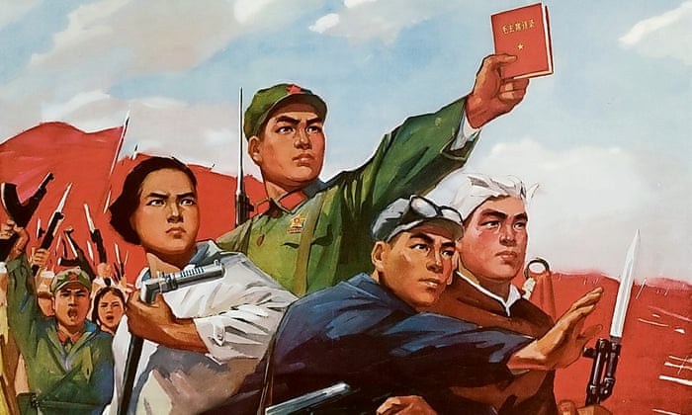

Slide 241
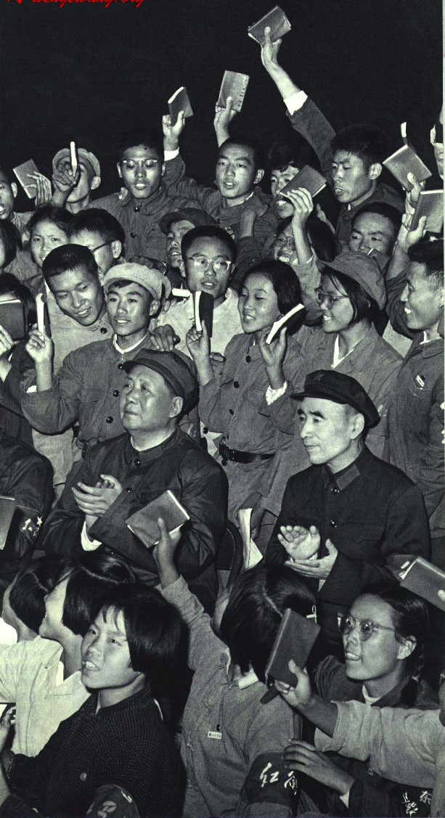

Slide 242
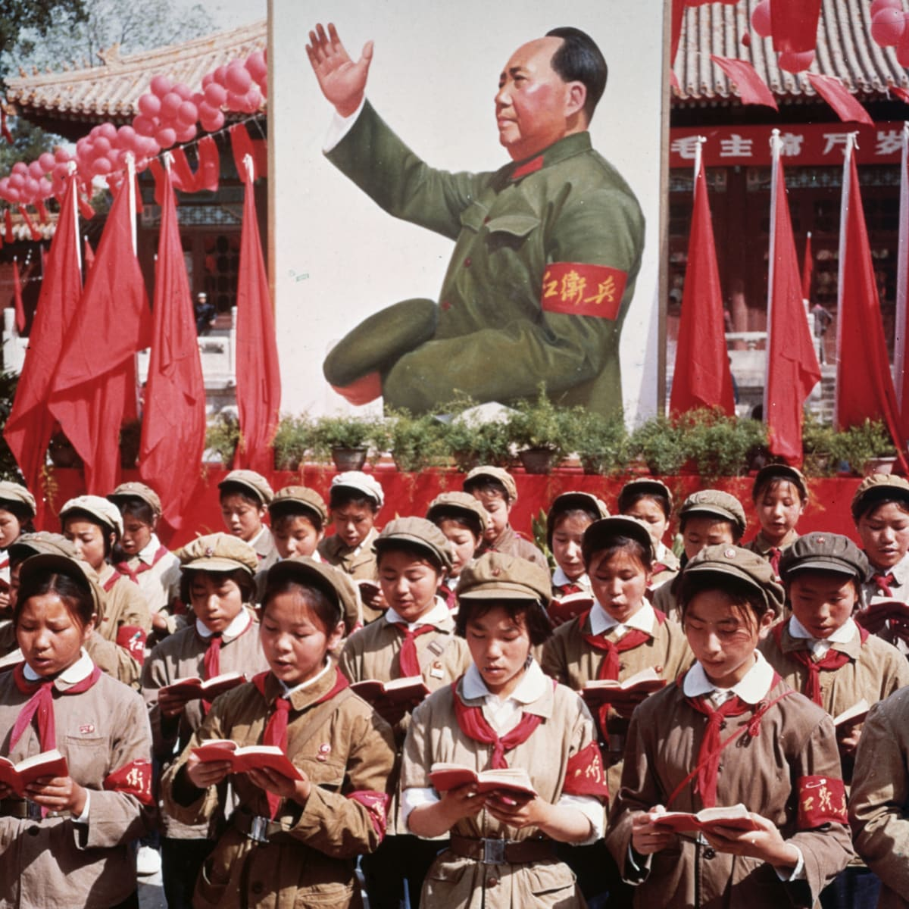

Slide 243
Cultural Revolution (1966-1976)
Red Brigades – groups of fanatical young comrades > attacks on „bourgeois elements“ etc., taking over of factories

Slide 244
Cultural Revolution (1966-1976)
Red Brigades – groups of fanatical young comrades > attacks on „bourgeois elements“ etc., taking over of factories
Destruction of Chinese cultural heritage („old thinking“)

Slide 245
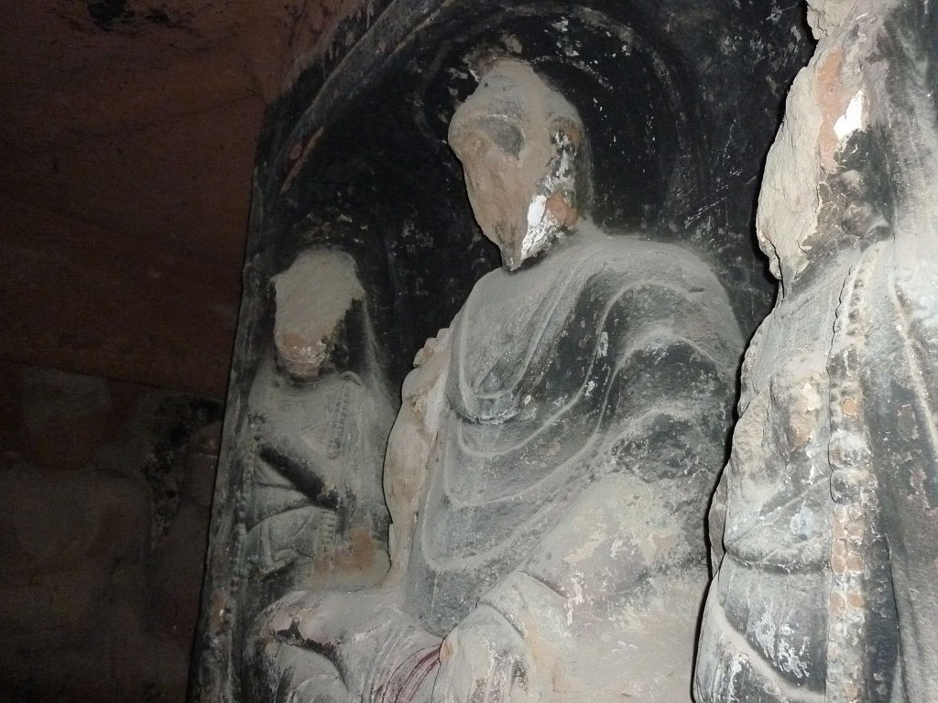

Slide 246
Cultural Revolution (1966-1976)
Red Brigades – groups of fanatical young comrades > attacks on „bourgeois elements“ etc., taking over of factories
Destruction of Chinese cultural heritage („old thinking“)
„Sending down“ – young intellectuals sent to work in villages > waste of talent and potential

Slide 247
Cultural Revolution (1966-1976)
Red Brigades – groups of fanatical young comrades > attacks on „bourgeois elements“ etc., taking over of factories
Destruction of Chinese cultural heritage („old thinking“)
„Sending down“ – young intellectuals sent to work in villages > waste of talent and potential
„Self-criticism“ – public humiliation and torture

Slide 248
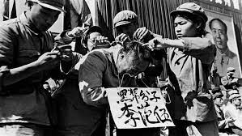

Slide 249
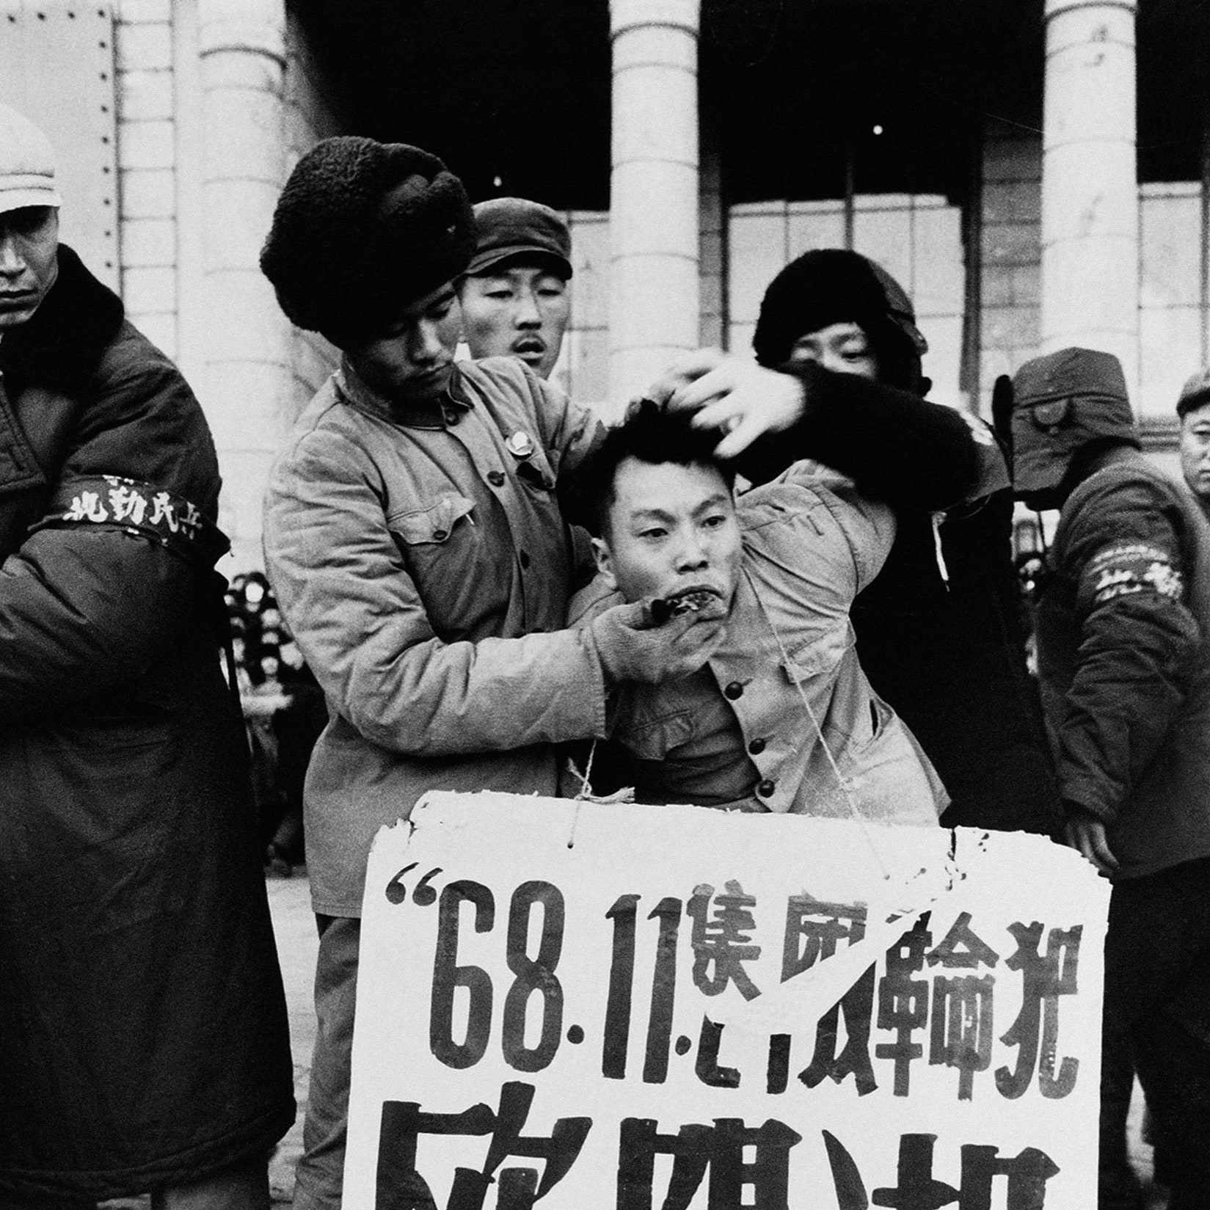

Slide 250
Cultural Revolution (1966-1976)
1968 – the army had to move in to rein in the Red Brigades

Slide 251
Cultural Revolution (1966-1976)
Officially no major change to the economic model – but omnipresent chaos and radicalism

Slide 252
Cultural Revolution (1966-1976)
Officially no major change to the economic model – but omnipresent chaos and radicalism
Mao‘s final years (1970-76) – the situation slowly calmed down

Slide 253
“Had Mao died in 1956, his achievements would have been immortal. Had he died in 1966, he would still have been a great man but flawed. But he died in 1976. Alas, what can one say?”

Slide 254
Mao‘s final years
Power struggle between pragmatists (Deng and Zhou Enlai) and hardcore Maoists (Gang of Four – Mao‘s wife)

Slide 255
Mao‘s final years
Power struggle between pragmatists (Deng and Zhou Enlai) and hardcore Maoists (Gang of Four – Mao‘s wife)
Material incentives and focus on economic performance vs. ideological purity and revolutionary zeal

Slide 256
Mao‘s final years
Power struggle between pragmatists (Deng and Zhou Enlai) and hardcore Maoists (Gang of Four – Mao‘s wife)
Material incentives and focus on economic performance vs. ideological purity and revolutionary zeal
Both Mao and Zhou died in 1976

Slide 257
Mao‘s final years
Power struggle between pragmatists (Deng and Zhou Enlai) and hardcore Maoists (Gang of Four – Mao‘s wife)
Material incentives and focus on economic performance vs. ideological purity and revolutionary zeal
Both Mao and Zhou died in 1976
Brief interregnum, Deng‘s faction emerged victorious in 1978

Slide 258
Mao‘s final years
Power struggle between pragmatists (Deng and Zhou Enlai) and hardcore Maoists (Gang of Four – Mao‘s wife)
Material incentives and focus on economic performance vs. ideological purity and revolutionary zeal
Both Mao and Zhou died in 1976
Brief interregnum, Deng‘s faction emerged victorious in 1978
„Gang of Four“ – blamed for the excesses of the Cultural Revolution so that Mao himself could be absolved of all responsibility

Slide 259
Results of Maoism
Success in decreasing extreme poverty, illiteracy, child mortality

Slide 260
Results of Maoism
Success in decreasing extreme poverty, illiteracy, child mortality
Growth from a very low starting point + ability to mobilize and direct resources > some basic industrialization

Slide 261
Results of Maoism
Success in decreasing extreme poverty, illiteracy, child mortality
Growth from a very low starting point + ability to mobilize and direct resources > some basic industrialization
Great power status abroad

Slide 262
Results of Maoism
Success in decreasing extreme poverty, illiteracy, child mortality
Growth from a very low starting point + ability to mobilize and direct resources > some basic industrialization
Great power status abroad
But, obviously, also famine and death, trauma, destruction of institutions…

Slide 263
Next time – economic reforms after 1978

