Slide 1
Reforms after 1978
China in the World Economy, autumn 2024

Slide 2
Questions from last time
How was Maoism distinctive from Marxism and Leninism?

Slide 3
Questions from last time
How was Maoism distinctive from Marxism and Leninism?
What is the doctrine of „democratic centralism?“

Slide 4
Questions from last time
How was Maoism distinctive from Marxism and Leninism?
What is the doctrine of „democratic centralism?“
Name the most important institutions of the Chinese Communist Party.

Slide 5
Questions from last time
How was Maoism distinctive from Marxism and Leninism?
What is the doctrine of „democratic centralism?“
Name the most important institutions of the Chinese Communist Party.
What are the supposed advantages of central planning?

Slide 6
Questions from last time
How was Maoism distinctive from Marxism and Leninism?
What is the doctrine of „democratic centralism?“
Name the most important institutions of the Chinese Communist Party.
What are the supposed advantages of central planning?
Which sector of the economy did Communist governments typically tried to develop at the expense of which other sector?

Slide 7
Questions from last time
How were prices created under central planning?

Slide 8
Questions from last time
How were prices created under central planning?
How did China conduct trade under central planning?

Slide 9
Questions from last time
How were prices created under central planning?
How did China conduct trade under central planning?
Which types of industries or sectors are typically neglected under central planning? Which ones are heavily supported?

Slide 10
Today
Brief run through the Maoist period
Reforms in the late 1970‘s and 1980‘s – transition towards a market economy
The Tiananmen interlude

Slide 11
Literature

Slide 12
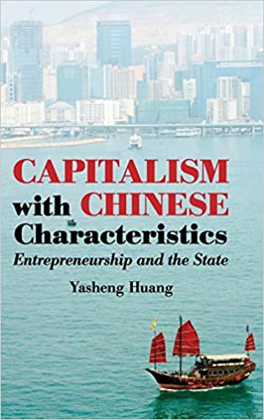

Slide 13
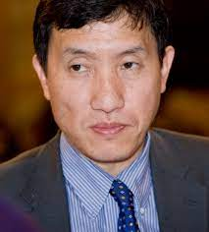

Slide 14
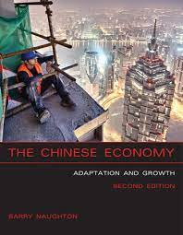

Slide 15
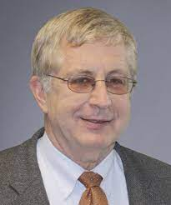

Slide 16
First years of the PRC - 1949-1953

Slide 17
First years of the PRC - 1949-1953
Massacre of landlords > circa 2 million victims

Slide 18
First years of the PRC - 1949-1953
Not full central planning yet!

Slide 19
First years of the PRC - 1949-1953
Not full central planning yet!
Industry – slow nationalization of companies
Agriculture – independent farmers – pressure to form cooperatives – not collective ownership

Slide 20
First years of the PRC - 1949-1953
Not full central planning yet!
Industry – slow nationalization of companies
Agriculture – independent farmers – pressure to form cooperatives – not collective ownership
Participation in Korea > the CCP was not strong enough to control all of the economy

Slide 21
First Five Year Plan (1953-1957)

Slide 22
First Five Year Plan (1953-1957)
Soviet model, Soviet equipment, Soviet advisors

Slide 23
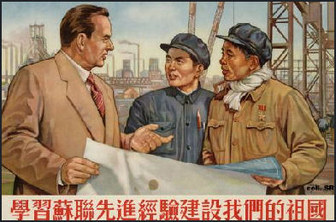
First Five Year Plan (1953-1957)
Soviet model, Soviet equipment, Soviet advisors

Slide 24
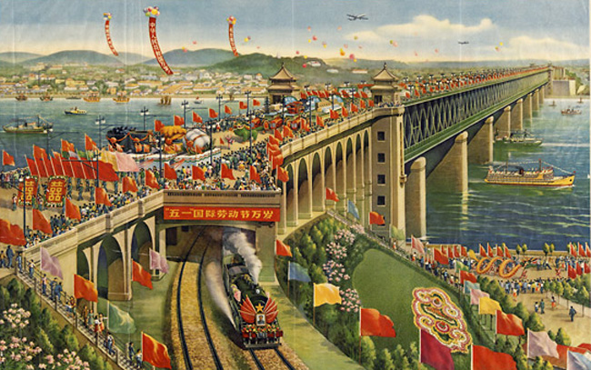

Slide 25
First Five Year Plan (1953-1957)
Soviet model, Soviet equipment, Soviet advisors
Centralized, hierarchical, technocratic

Slide 26
First Five Year Plan (1953-1957)
Soviet model, Soviet equipment, Soviet advisors
Centralized, hierarchical, technocratic
Main point – develop modern industry at the expense of agriculture

Slide 27
First Five Year Plan (1953-1957)
Soviet model, Soviet equipment, Soviet advisors
Centralized, hierarchical, technocratic
Main point – develop modern industry at the expense of agriculture
Full nationalization of industry, collective farming

Slide 28
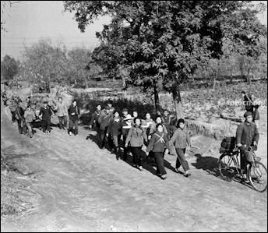

Slide 29
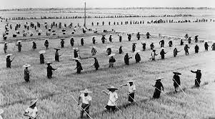

Slide 30
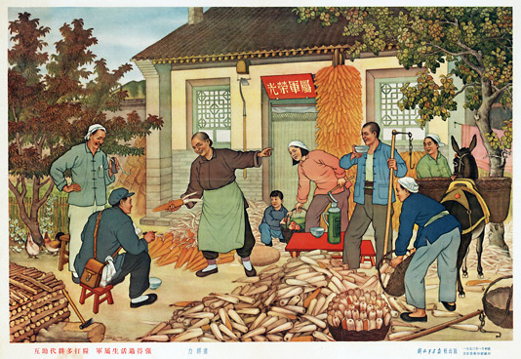

Slide 31
First Five Year Plan (1953-1957)
Progress in industry, but stagnation in agriculture

Slide 32
First Five Year Plan (1953-1957)
Progress in industry, but stagnation in agriculture
Mao – that‘s not good enough!

Slide 33
First Five Year Plan (1953-1957)
Progress in industry, but stagnation in agriculture
Mao – that‘s not good enough!
1957 – turn in a more radical direction

Slide 34
First Five Year Plan (1953-1957)
Progress in industry, but stagnation in agriculture
Mao – that‘s not good enough!
1957 – turn in a more radical direction
Hundred Flowers Campaign – „you can criticize us without fear“

Slide 35
First Five Year Plan (1953-1957)
Progress in industry, but stagnation in agriculture
Mao – that‘s not good enough!
1957 – turn in a more radical direction
Hundred Flowers Campaign – „you can criticize us without fear“
Anti-Rightist Campaign – another purge; full one-party state; led by Deng Xiaoping!

Slide 36
„Great Leap Forward“ (1958-1962)
Basic idea – simultaneous progress in cities and the countryside

Slide 37
„Great Leap Forward“ (1958-1962)
Basic idea – simultaneous progress in cities and the countryside
Local patriotic and ideological enthusiasm will replace Soviet-style centralized technocracy

Slide 38
„Great Leap Forward“ (1958-1962)
Basic idea – simultaneous progress in cities and the countryside
Local patriotic and ideological enthusiasm will replace Soviet-style centralized technocracy
Local party leaders should heroically struggle to achieve great results

Slide 39
„Great Leap Forward“ (1958-1962)
Basic idea – simultaneous progress in cities and the countryside
Local patriotic and ideological enthusiasm will replace Soviet-style centralized technocracy
Local party leaders should heroically struggle to achieve great results
Abolition of private land ownership, farms to be fused into large scale „village communes“

Slide 40
„Great Leap Forward“ (1958-1962)
Basic idea – simultaneous progress in cities and the countryside
Local patriotic and ideological enthusiasm will replace Soviet-style centralized technocracy
Local party leaders should heroically struggle to achieve great results
Abolition of private land ownership, farms to be fused into large scale „village communes“
Small industrialization carried out by these village communes

Slide 41
„Great Leap Forward“ (1958-1962)
Communes were supposed to produce their own steel

Slide 42
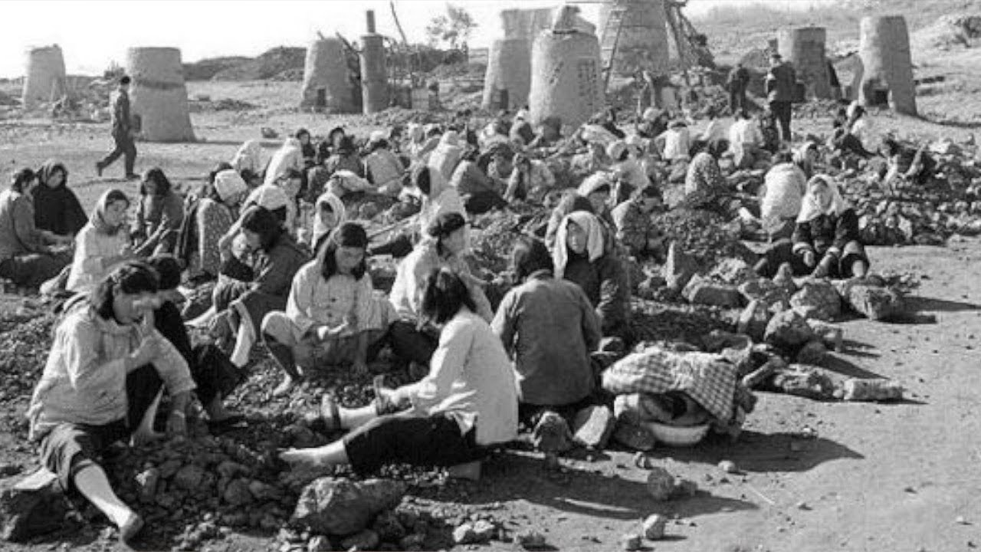

Slide 43
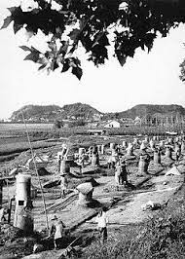

Slide 44
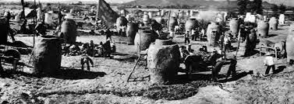

Slide 45
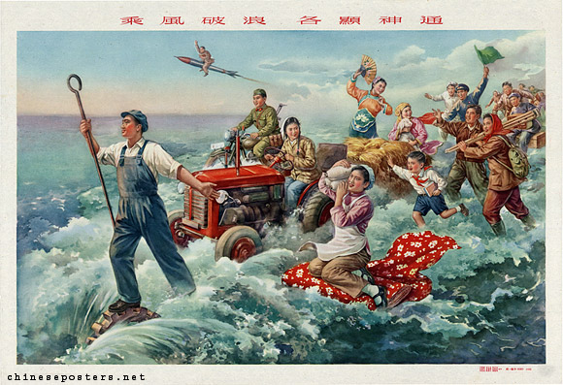

Slide 46
„Great Leap Forward“ (1958-1962)
Communes were supposed to produce their own steel
„They probably have a lot of spare workers who aren‘t doing anything valuable, let‘s force them to work in manufacturing“

Slide 47
„Great Leap Forward“ (1958-1962)
Communes were supposed to produce their own steel
„They probably have a lot of spare workers who aren‘t doing anything valuable, let‘s force them to work in manufacturing“
People fulfilled their quotas by melting down tools and reforging them into useless, low-quality iron

Slide 48
„Great Leap Forward“ (1958-1962)
Unrealistic production quotas > all the food was forcibly confiscated

Slide 49
„Great Leap Forward“ (1958-1962)
Unrealistic production quotas > all the food was forcibly confiscated
Biggest famine in China‘s history – 30 million deaths

Slide 50
„Great Leap Forward“ (1958-1962)
The program had to be called off in 1962

Slide 51
„Agriculture first“ (1962-1966)
Intermezzo - more pragmatic policies aimed at repairing the damage

Slide 52
„Agriculture first“ (1962-1966)
Intermezzo - more pragmatic policies aimed at repairing the damage
Less ideology, more management
Material rewards

Slide 53
„Agriculture first“ (1962-1966)
> alleviate the hunger and poverty of rural villages > higher prices for agricultural products

Slide 54
„Agriculture first“ (1962-1966)
> alleviate the hunger and poverty of rural villages > higher prices for agricultural products
Industrial firms – mostly remained under local control, but run in a more professional manner

Slide 55
„Agriculture first“ (1962-1966)
> alleviate the hunger and poverty of rural villages > higher prices for agricultural products
Industrial firms – mostly remained under local control, but run in a more professional manner
Basic economic model until 1978

Slide 56
„Agriculture first“ (1962-1966)
Except for the first Five Year plan, China never had true Soviet-style central planning

Slide 57
„Agriculture first“ (1962-1966)
Except for the first Five Year plan, China never had true Soviet-style central planning
Decision making was divided between different levers of party and government

Slide 58
„Agriculture first“ (1962-1966)
Except for the first Five Year plan, China never had true Soviet-style central planning
Decision making was divided between different levers of party and government
Typically, many enterprises were controlled on the provincial level etc.

Slide 59
„Agriculture first“ (1962-1966)
Except for the first Five Year plan, China never had true Soviet-style central planning
Decision making was divided between different levers of party and government
Typically, many enterprises were controlled on the provincial level etc.
> opaque system, it is difficult to say who is in charge of what

Slide 60
Cultural Revolution (1966-1976)
Mao was partially discredited by the Great Leap Forward and faced opposition inside the party (Deng Xiaoping)

Slide 61
Cultural Revolution (1966-1976)
Mao was partially discredited by the Great Leap Forward and faced opposition inside the party (Deng Xiaoping)
Attempt to turn Mao into a mere figurehead and create a more technocratic and collective leadership

Slide 62
Cultural Revolution (1966-1976)
Mao was partially discredited by the Great Leap Forward and faced opposition inside the party (Deng Xiaoping)
Attempt to turn Mao into a mere figurehead and create a more technocratic and collective leadership
Abroad – deconstruction of Stalin‘s cult of personality, more „boring“ and less bloody rule in the USSR

Slide 63
Cultural Revolution (1966-1976)
Cultural Revolution – attack on intellectuals and party bureaucrats

Slide 64
Cultural Revolution (1966-1976)
Cultural Revolution – attack on intellectuals and party bureaucrats – Mao‘s opponents

Slide 65
Cultural Revolution (1966-1976)
Cultural Revolution – attack on intellectuals and party bureaucrats – Mao‘s opponents
Officially: attempt to prevent the Communist party from becoming a new elite – permanent revolution

Slide 66
Cultural Revolution (1966-1976)
Red Brigades – groups of fanatical young comrades

Slide 67
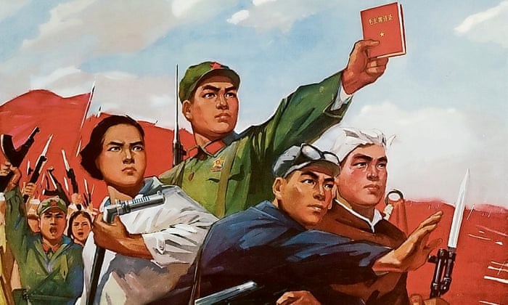

Slide 68
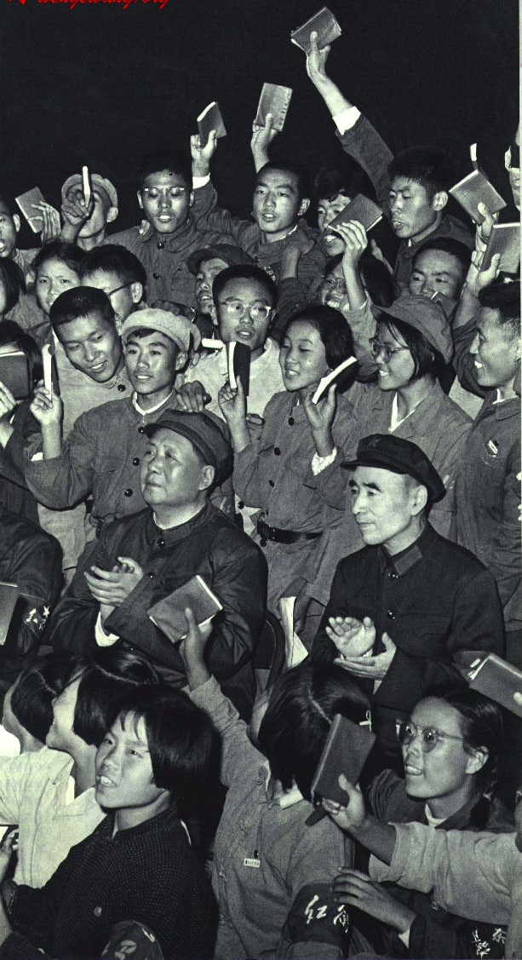

Slide 69
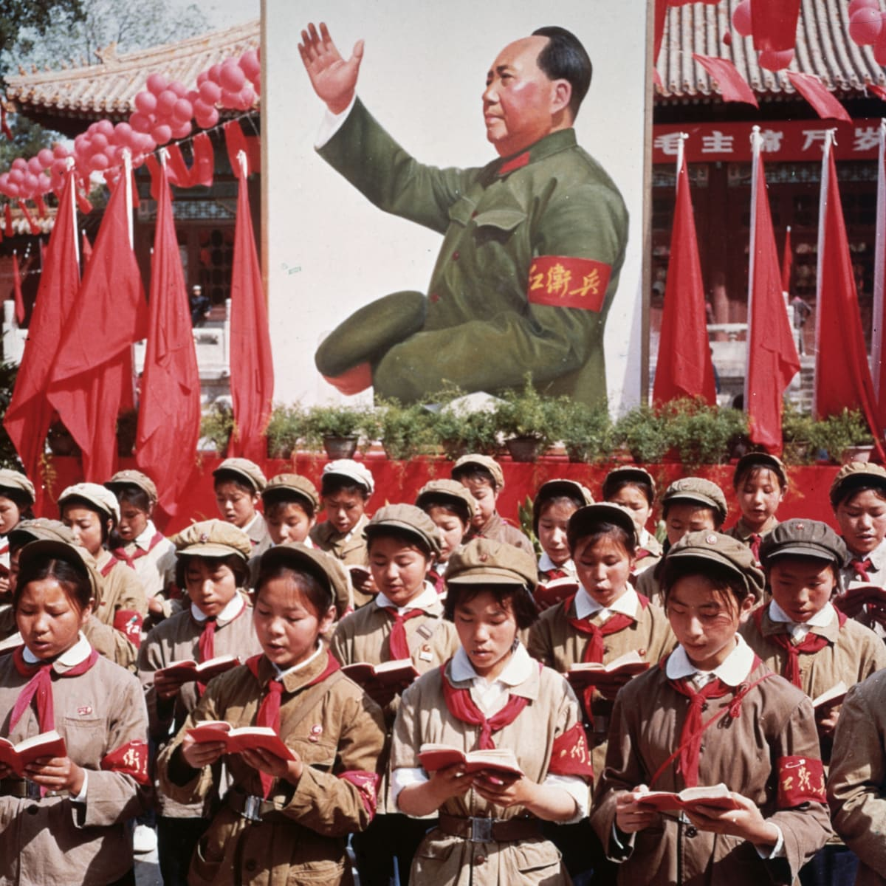

Slide 70
Cultural Revolution (1966-1976)
Red Brigades – groups of fanatical young comrades > attacks on „bourgeois elements“ etc., taking over of factories

Slide 71
Cultural Revolution (1966-1976)
Red Brigades – groups of fanatical young comrades > attacks on „bourgeois elements“ etc., taking over of factories
Destruction of Chinese cultural heritage („old thinking“)

Slide 72
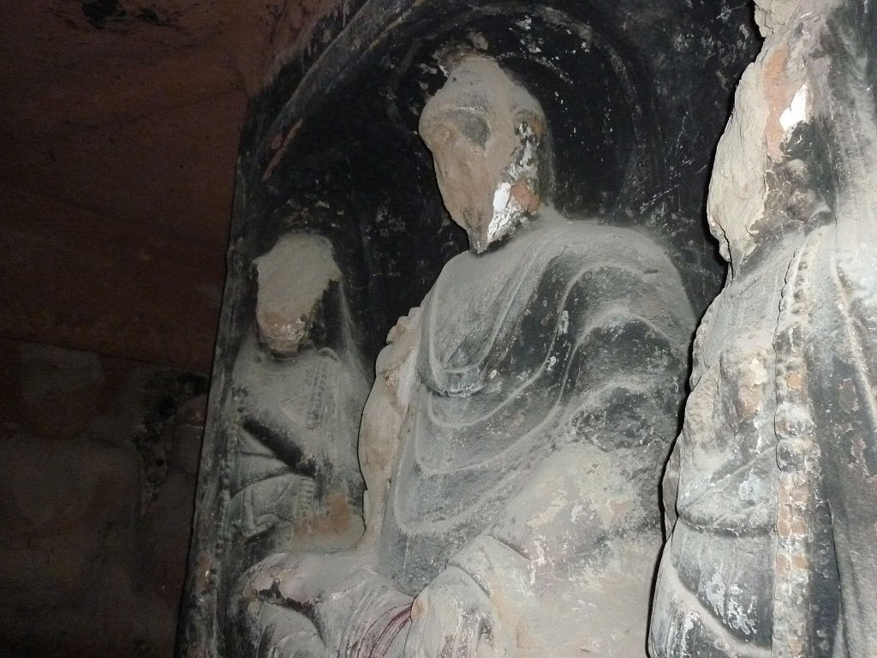

Slide 73
Cultural Revolution (1966-1976)
Red Brigades – groups of fanatical young comrades > attacks on „bourgeois elements“ etc., taking over of factories
Destruction of Chinese cultural heritage („old thinking“)
„Sending down“ – young intellectuals sent to work in villages > waste of talent and potential

Slide 74
Cultural Revolution (1966-1976)
Red Brigades – groups of fanatical young comrades > attacks on „bourgeois elements“ etc., taking over of factories
Destruction of Chinese cultural heritage („old thinking“)
„Sending down“ – young intellectuals sent to work in villages > waste of talent and potential
„Self-criticism“ – public humiliation and torture

Slide 75
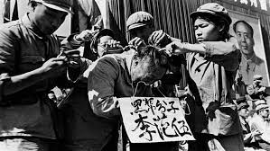

Slide 76
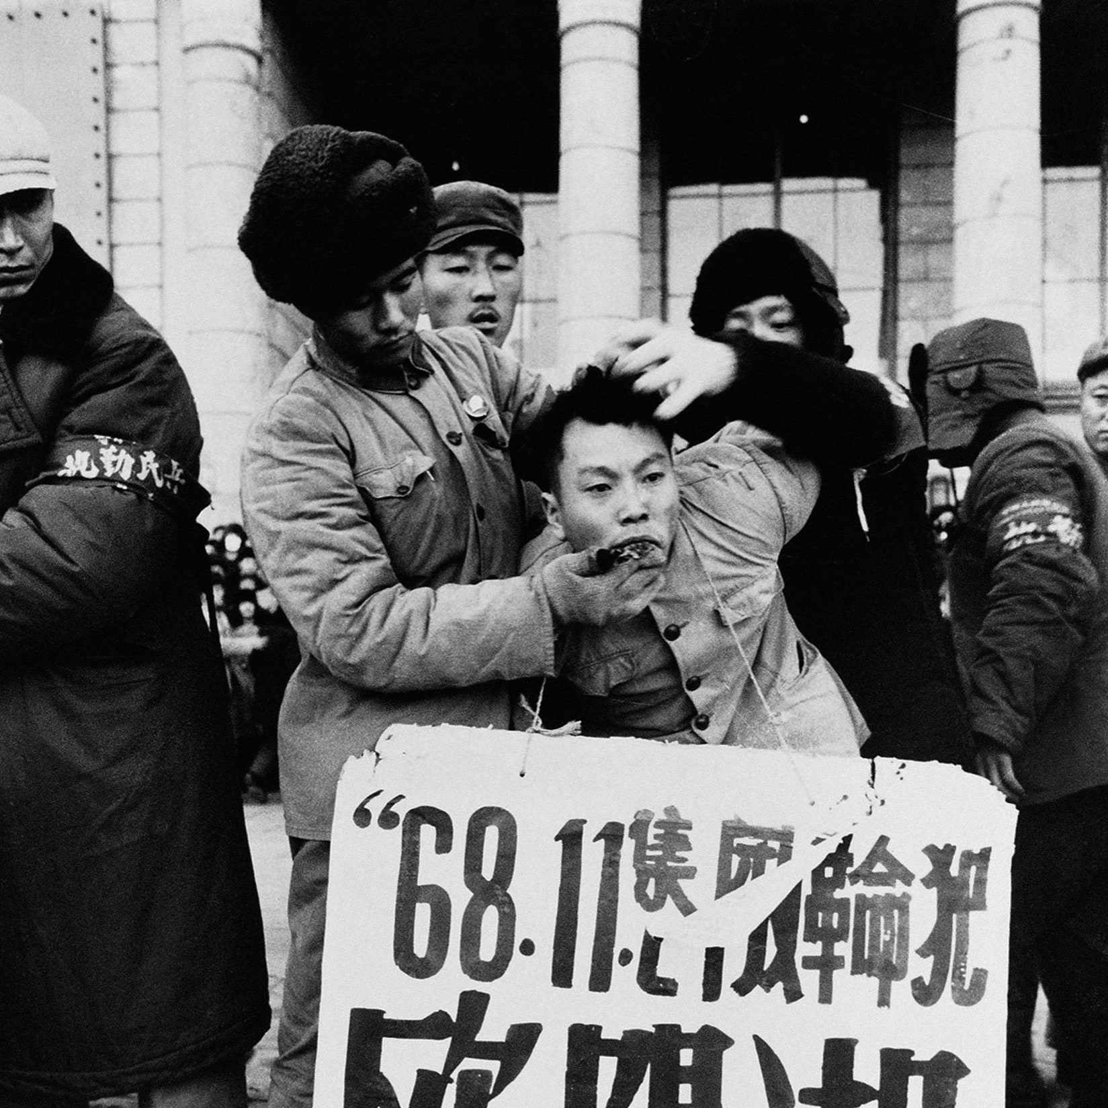

Slide 77
Cultural Revolution (1966-1976)
1968 – the army had to move in to rein in the Red Brigades

Slide 78
Cultural Revolution (1966-1976)
Officially no major change to the economic model – but omnipresent chaos and radicalism

Slide 79
Cultural Revolution (1966-1976)
Officially no major change to the economic model – but omnipresent chaos and radicalism
Mao‘s final years (1970-76) – the situation slowly calmed down

Slide 80
“Had Mao died in 1956, his achievements would have been immortal. Had he died in 1966, he would still have been a great man but flawed. But he died in 1976. Alas, what can one say?”

Slide 81
Mao‘s final years
Power struggle between pragmatists (Deng and Zhou Enlai) and hardcore Maoists (Gang of Four – Mao‘s wife)

Slide 82
Mao‘s final years
Power struggle between pragmatists (Deng and Zhou Enlai) and hardcore Maoists (Gang of Four – Mao‘s wife)
Material incentives and focus on economic performance vs. ideological purity and revolutionary zeal

Slide 83
Mao‘s final years
Power struggle between pragmatists (Deng and Zhou Enlai) and hardcore Maoists (Gang of Four – Mao‘s wife)
Material incentives and focus on economic performance vs. ideological purity and revolutionary zeal
Both Mao and Zhou died in 1976

Slide 84
Mao‘s final years
Power struggle between pragmatists (Deng and Zhou Enlai) and hardcore Maoists (Gang of Four – Mao‘s wife)
Material incentives and focus on economic performance vs. ideological purity and revolutionary zeal
Both Mao and Zhou died in 1976
Brief interregnum, Deng‘s faction emerged victorious in 1978

Slide 85
Mao‘s final years
Power struggle between pragmatists (Deng and Zhou Enlai) and hardcore Maoists (Gang of Four – Mao‘s wife)
Material incentives and focus on economic performance vs. ideological purity and revolutionary zeal
Both Mao and Zhou died in 1976
Brief interregnum, Deng‘s faction emerged victorious in 1978
„Gang of Four“ – blamed for the excesses of the Cultural Revolution so that Mao himself could be absolved of all responsibility

Slide 86
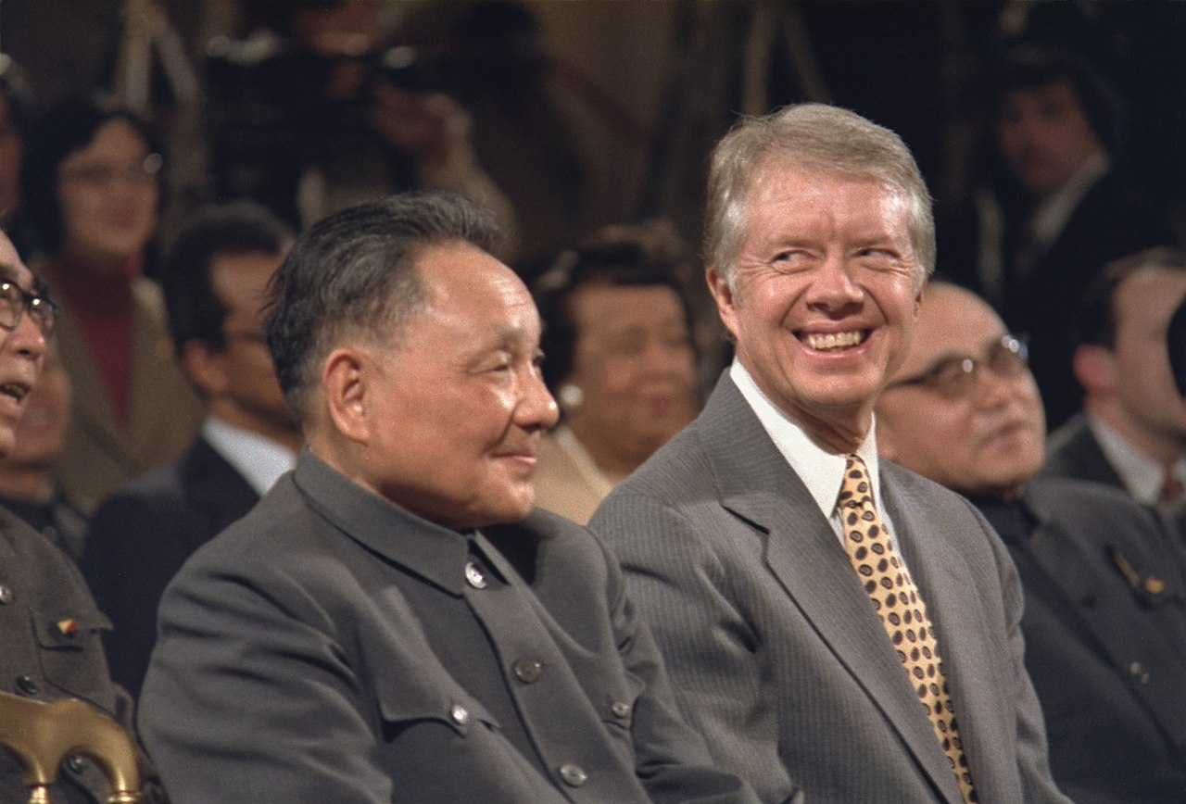

Slide 87
China‘s situation in 1978
GDP per capita – similar to India and sub-Saharan Africa
Overpopulation

Slide 88
China‘s situation in 1978
GDP per capita – similar to India and sub-Saharan Africa
Overpopulation
The Party itself was ravaged by years of purges
> bad economic data!

Slide 89
China‘s situation in 1978
GDP per capita – similar to India and sub-Saharan Africa
Overpopulation
The Party itself was ravaged by years of purges
> bad economic data!
Some excellent centers of learning and science – but small, isolated, decimated by the Cultural Revolution

Slide 90
China‘s situation in 1978
Unhealthy focus on heavy industry and military technologies

Slide 91
China‘s situation in 1978
Cities – complete state ownership, zero room for enterprise
= not centers of commerce but bastions of the Party

Slide 92
China‘s situation in 1978
Cities – complete state ownership, zero room for enterprise
= not centers of commerce but bastions of the Party
Rural areas – somewhat looser rule, farmers were sometimes allowed to de facto own plots of land
Most of the land was still collective, though

Slide 93
China‘s situation in 1978
Foreign trade – extreme isolation, focus on autarky

Slide 94
China‘s situation in 1978
Foreign trade – extreme isolation, focus on autarky
Result of the break with the USSR in the 1960s

Slide 95
China‘s situation in 1978
Foreign trade – extreme isolation, focus on autarky
Result of the break with the USSR in the 1960s
„Double air-lock“ – tight control of both currency and the movement of goods

Slide 96
China‘s situation in 1978
Foreign trade – extreme isolation, focus on autarky
Result of the break with the USSR in the 1960s
„Double air-lock“ – tight control of both currency and the movement of goods
12 monopoly state trading-enterprises – bridges between China‘s regulated prices and the world market

Slide 97
China‘s situation in 1978
Need to import technology

Slide 98
China‘s situation in 1978
Need to import technology
= machines and the know-how embodied in them (= capital goods)
> reverse engineering

Slide 99
China‘s situation in 1978
Need to import technology
= machines and the know-how embodied in them (= capital goods)
> reverse engineering
It would be ideal to purchase whole assembly lines etc.

Slide 100
China‘s situation in 1978
Need to import technology
= machines and the know-how embodied in them (= capital goods)
> reverse engineering
It would be ideal to purchase whole assembly lines etc.
Problem – need for foreign exchange (dollars, yens, pounds)

Slide 101
China‘s situation in 1978
How does a country gain foreign exchange?

Slide 102
China‘s situation in 1978
How does a country gain foreign exchange?
Export!

Slide 103
China‘s situation in 1978
How does a country gain foreign exchange?
Export!
Developing countries – food, natural resources, textiles

Slide 104
China‘s situation in 1978
How does a country gain foreign exchange?
Export!
Developing countries – food, natural resources, textiles
China – barely above subsistence > „What can we export?“

Slide 105
China‘s situation in 1978
How does a country gain foreign exchange?
Export!
Developing countries – food, natural resources, textiles
China – barely above subsistence > „What can we export?“
Oil (!)

Slide 106
China‘s situation in 1978
How does a country gain foreign exchange?
Export!
Developing countries – food, natural resources, textiles
China – barely above subsistence > „What can we export?“
Oil (!) > then we can afford to purchase equipment from Western Europe and Japan

Slide 107
China‘s situation in 1978
How does a country gain foreign exchange?
Export!
Developing countries – food, natural resources, textiles
China – barely above subsistence > „What can we export?“
Oil (!) > then we can afford to purchase equipment from Western Europe and Japan
Oil production didn‘t work out > need to boost other exports

Slide 108
China‘s situation in 1978
„averted oil curse“ – lack of oil production forced China into reforms that led to far more significant growth than oil could ever deliver

Slide 109
China‘s situation in 1978
„averted oil curse“ – lack of oil production forced China into reforms that led to far more significant growth than oil could ever deliver
Similar in other East Asian countries

Slide 110
China‘s situation in 1978
How does a country gain foreign exchange?
Export!
Loans > dangerous debt denominated in a foreign currency

Slide 111
China‘s situation in 1978
How does a country gain foreign exchange?
Export!
Loans > dangerous debt denominated in a foreign currency
Exchanging money in currency markets – weakens the domestic currency

Slide 112
Balance of payments
Trade surplus

Slide 113
Balance of payments
Trade surplus > foreign exchange reserves grow

Slide 114
Balance of payments
Trade surplus > foreign exchange reserves grow > country becomes a net foreign investor

Slide 115
Balance of payments
Trade surplus > foreign exchange reserves grow > country becomes a net foreign investor
Trade deficit

Slide 116
Balance of payments
Trade surplus > foreign exchange reserves grow > country becomes a net foreign investor
Trade deficit > the opposite

Slide 117
Balance of payments
Trade surplus > foreign exchange reserves grow > country becomes a net foreign investor
Trade deficit > the opposite > the country typically goes into debt

Slide 118
Balance of payments
Trade surplus > foreign exchange reserves grow > country becomes a net foreign investor
Trade deficit > the opposite > the country typically goes into debt
= „double deficit“

Slide 119
Balance of payments
Formal terminology: current account and capital account

Slide 120
Balance of payments
Formal terminology: current account and capital account
NX = NFI

Slide 121
Structure of GDP
GDP = C + I + G + NX

Slide 122
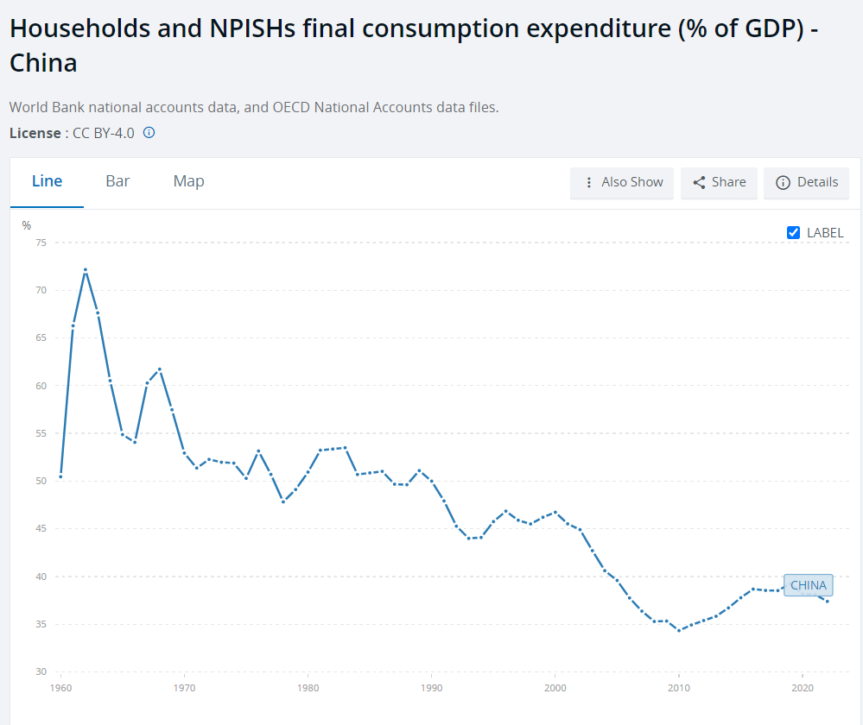
Structure of GDP

Slide 123
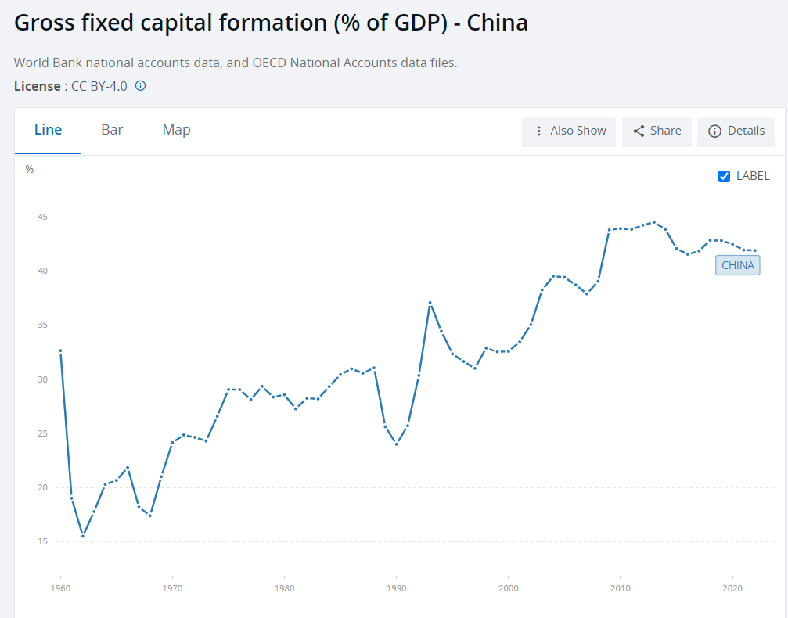
Structure of GDP

Slide 124
Structure of GDP
United States:
I = 18 %
C = 68 %

Slide 125
Structure of GDP
S = I + FI

Slide 126
Reforms

Slide 127
Reforms - agriculture
Major overhaul of the rural economy
Huang – the most significant and drastic reform

Slide 128
Reforms - agriculture
Major overhaul of the rural economy
Most collective land was distributed back among the peasants (= what they hoped for in 1949!)

Slide 129
Reforms - agriculture
Major overhaul of the rural economy
Most collective land was distributed back among the peasants (= what they hoped for in 1949!)
Legalization of enterprise > farmers can further process their products – turn cotton into clothes, or milk into yogurt, etc.

Slide 130
Reforms - agriculture
Major overhaul of the rural economy
Most collective land was distributed back among the peasants (= what they hoped for in 1949!)
Legalization of enterprise > farmers can further process their products – turn cotton into clothes, or milk into yogurt, etc.
> „township and village enterprises“ (TVEs) – formally public, de facto usually private

Slide 131
Reforms - agriculture
Major overhaul of the rural economy
Most collective land was distributed back among the peasants (= what they hoped for in 1949!)
Legalization of enterprise > farmers can further process their products – turn cotton into clothes, or milk into yogurt, etc.
> „township and village enterprises“ (TVEs) – formally public, de facto usually private
Local banks and funds – collection of savings, investment

Slide 132
Reforms - agriculture
Rural sector – became far more commercial than the cities during the 1980‘s!
Poverty alleviation, lifting people out of agriculture

Slide 133
Reforms - agriculture
Rural sector – became far more commercial than the cities during the 1980‘s!
Poverty alleviation, lifting people out of agriculture
Small-scale industrialization – (what the Great Leap Forward hoped for!)

Slide 134
Reforms - agriculture
Rural sector – became far more commercial than the cities during the 1980‘s!
Poverty alleviation, lifting people out of agriculture
Small-scale industrialization – (what the Great Leap Forward hoped for!)
Rural areas were no longer squeezed for cash by the state

Slide 135
Reforms - agriculture
Rural sector – became far more commercial than the cities during the 1980‘s!
Poverty alleviation, lifting people out of agriculture
Small-scale industrialization – (what the Great Leap Forward hoped for!)
Rural areas were no longer squeezed for cash by the state
Some successful entrepreneurs moved into the cities

Slide 136
Reforms – urban areas
„Dual-prices“

Slide 137
Reforms – urban areas
„Dual-prices“ – state-owned enterprises (SOEs) must fulfill the plan, then they can sell any surplus products and keep the profits

Slide 138
Reforms – urban areas
„Dual-prices“ – state-owned enterprises (SOEs) must fulfill the plan, then they can sell any surplus products and keep the profits
> official prices within the plan + market prices

Slide 139
Reforms – urban areas
„Dual-prices“ – state-owned enterprises (SOEs) must fulfill the plan, then they can sell any surplus products and keep the profits
> official prices within the plan + market prices
Hybrid firms – a university or research center can start an enterprises and commercialize some invention made there

Slide 140
Reforms – urban areas
„Dual-prices“ – state-owned enterprises (SOEs) must fulfill the plan, then they can sell any surplus products and keep the profits
> official prices within the plan + market prices
Hybrid firms – a university or research center can start an enterprises and commercialize some invention made there
Far fewer true private enterprises than in the countryside!

Slide 141
Reforms – urban areas
„Dual-prices“ – state-owned enterprises (SOEs) must fulfill the plan, then they can sell any surplus products and keep the profits
> official prices within the plan + market prices
Hybrid firms – a university or research center can start an enterprises and commercialize some invention made there
Far fewer true private enterprises than in the countryside!
Few privatizations – the private sector grew next to the state sector

Slide 142
Reforms – urban areas
Increased motivation and production

Slide 143
Reforms – urban areas
Increased motivation and production
Significant corruption – typical result of intermingling of private and public resources and interests

Slide 144
Reforms – foreign trade
Special economic zones (SEZs)

Slide 145
Reforms – foreign trade
Special economic zones (SEZs)
– Goungdong and Fujien
= close to Hong Kong and Taiwan

Slide 146
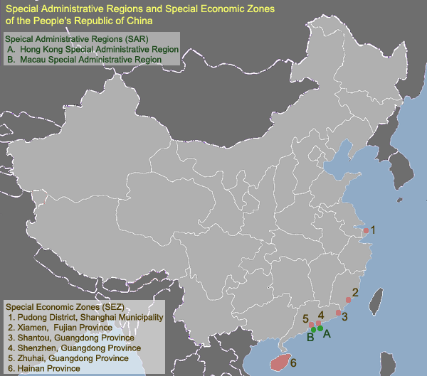

Slide 147
Reforms – foreign trade
Special economic zones (SEZs)
– Goungdong and Fujien
= close to Hong Kong and Taiwan
HK had bigger exports that all of China in 1978 (!)

Slide 148
Reforms – foreign trade
Special economic zones (SEZs)
= special legal regime allowing the use cheap Chinese labour force to work for Taiwanese and HK companies

Slide 149
Reforms – foreign trade
Special economic zones (SEZs)
= special legal regime allowing the use cheap Chinese labour force to work for Taiwanese and HK companies
Textile industry, later more sophisticated products – electronics

Slide 150
Reforms – foreign trade
Special economic zones (SEZs)
= special legal regime allowing the use cheap Chinese labour force to work for Taiwanese and HK companies
Textile industry, later more sophisticated products – electronics
FDI, export

Slide 151
Reforms – foreign trade
Not a major source of growth in the 1980s!
The economy was still relatively closed, most trade was domestic

Slide 152
Reforms – foreign trade
Not a major source of growth in the 1980s!
The economy was still relatively closed, most trade was domestic
Trade with HK and Taiwan raised revenue necessary to finance imports

Slide 153
Reforms – foreign trade
Not a major source of growth in the 1980s!
The economy was still relatively closed, most trade was domestic
Trade with HK and Taiwan raised revenue necessary to finance imports
„Export processing“ – all the stuff Taiwanese companies make in China has to be exported

Slide 154
Reforms – foreign trade
Not a major source of growth in the 1980s!
The economy was still relatively closed, most trade was domestic
Trade with HK and Taiwan raised revenue necessary to finance imports
„Export processing“ – all the stuff Taiwanese companies make in China has to be exported – so it does not compete with Chinese companies

Slide 155
Reforms – foreign trade
Outside of EPZs – more firms were given the right to trade outside the original 12 monopolies
- but still restricted to specially designated SOEs!

Slide 156
Reforms – foreign trade
Outside of EPZs – more firms were given the right to trade outside the original 12 monopolies
- but still restricted to specially designated SOEs!
„Canalization“ – if you want to import something, a firm with foreign trade rights must do it for you

Slide 157
The Tiananmen interlude
1980s- discussion about political reform

Slide 158
The Tiananmen interlude
1980s- discussion about political reform
Deng – „party elder“ – informal influence
Desire to separate the Party and the state, introduce term-limits for officials

Slide 159
The Tiananmen interlude
1980s- discussion about political reform
Deng – „party elder“ – informal influence
Desire to separate the Party and the state, introduce term-limits for officials
CCP leadership was meant to be collective (x Mao)

Slide 160
The Tiananmen interlude
1980s- discussion about political reform
Deng – „party elder“ – informal influence
Desire to separate the Party and the state, introduce term-limits for officials
CCP leadership was meant to be collective (x Mao)
Feud between reformists and „conservatives“

Slide 161
The Tiananmen interlude
1980s- discussion about political reform
Deng – „party elder“ – informal influence
Desire to separate the Party and the state, introduce term-limits for officials
CCP leadership was meant to be collective (x Mao)
Feud between reformists and „conservatives“
General Secretary – Hu Yaobang, followed by Zhao Ziyang – both favored some form of political liberalization

Slide 162
The Tiananmen interlude
Hu – dismissed because of pressure of conservatives in 1987
Died in early 1989
Demonstrations in large Chinese cities – calls for more political reforms (also economic demands – lower inequality etc.)

Slide 163
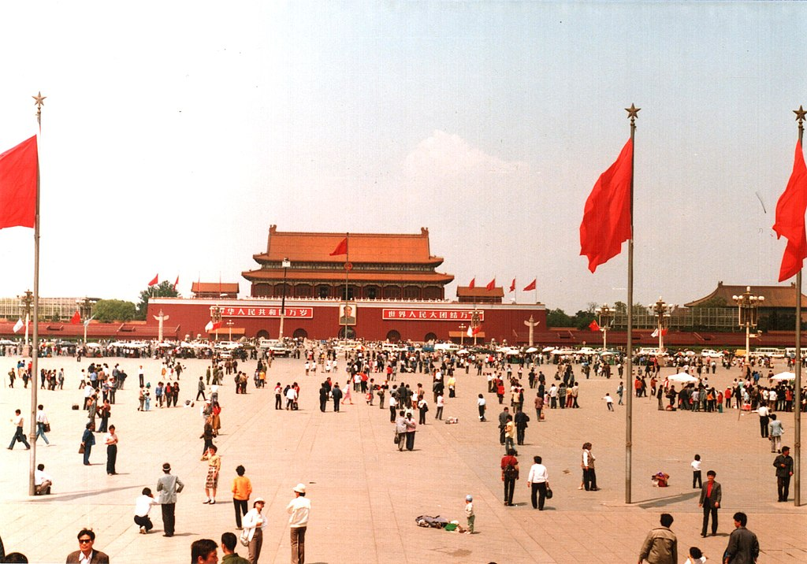

Slide 164
The Tiananmen interlude
CCP – more behind the scenes infighting

Slide 165
The Tiananmen interlude
CCP – more behind the scenes infighting
General Secretary Zhao – supported the protesters
Prime minister Li – favored a harsh crackdown

Slide 166
The Tiananmen interlude
CCP – more behind the scenes infighting
General Secretary Zhao – supported the protesters
Prime minister Li – favored a harsh crackdown
Deng (chairman of the military committee!) – undecided, in the end he reluctantly joined the conservatives

Slide 167
The Tiananmen interlude
CCP – more behind the scenes infighting
General Secretary Zhao – supported the protesters
Prime minister Li – favored a harsh crackdown
Deng (chairman of the military committee!) – undecided, in the end he reluctantly joined the conservatives
> martial law, army units gathered around Beijing
„June the 4th incident“ – massacre of protesters

Slide 168
The Tiananmen interlude
CCP – more behind the scenes infighting
General Secretary Zhao – supported the protesters
Prime minister Li – favored a harsh crackdown
Deng (chairman of the military committee!) – undecided, in the end he reluctantly joined the conservatives
> martial law, army units gathered around Beijing
„June the 4th incident“ – massacre of protesters
Followed by (less violent) crackdowns in other cities

Slide 169
The Tiananmen interlude
Party conservatives led by Li Peng seized power, Zhao dismissed – spent the rest of his life under house arrest
Attempt to overturn the economic reforms – central planning briefly reinstated!

Slide 170
The Tiananmen interlude
The ability of the CCP to brutally crush the protest movement and get away with it without a wider uprising / civil war is a testament to the robustness of its power

Slide 171
The Tiananmen interlude
The ability of the CCP to brutally crush the protest movement and get away with it without a wider uprising / civil war is a testament to the robustness of its power
Meanwhile – demoralized Communist regimes in Eastern Europe collapsed with barely a whimper…

Slide 172
Next time
Continuing reforms in the 1990s
The early 2000s – China‘s most capitalist moment
The fallout from the 2008 Financial Crisis
Xi Jinping, China‘s technological ambitions

