Slide 1
The BRI around the world
China in the World Economy, autumn 2024

Slide 2
Questions from last time
1) How is the BRI related to China‘s previous current account surpluses?

Slide 3
Questions from last time
1) How is the BRI related to China‘s previous current account surpluses?
2) How is the BRI tied to China‘s response to the 2008 Financial crisis?

Slide 4
Questions from last time
1) How is the BRI related to China‘s previous current account surpluses?
2) How is the BRI tied to China‘s response to the 2008 Financial crisis?
3) Can the BRI be considered as FDI?

Slide 5
Questions from last time
1) How is the BRI related to China‘s previous current account surpluses?
2) How is the BRI tied to China‘s response to the 2008 Financial crisis?
3) Can the BRI be considered as FDI?
4) Are the interest rates in BRI loans higher or lower compared to commercial loans and concessional loans?

Slide 6
Questions from last time
1) How is the BRI related to China‘s previous current account surpluses?
2) How is the BRI tied to China‘s response to the 2008 Financial crisis?
3) Can the BRI be considered as FDI?
4) Are the interest rates in BRI loans higher or lower compared to commercial loans and concessional loans?
5) What types of conditions are frequently attached to BRI loans?

Slide 7
The BRI around the world

Slide 8
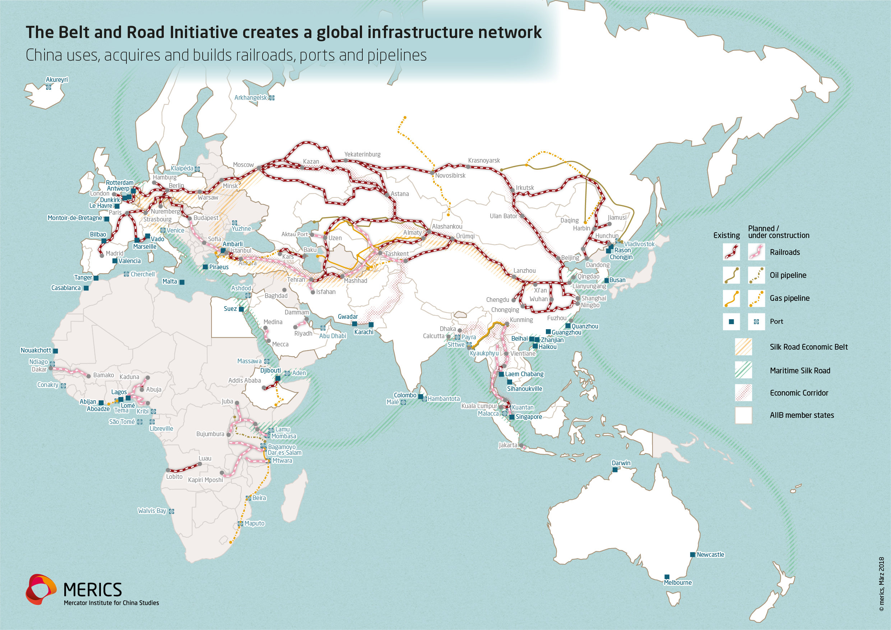

Slide 9
The BRI around the world
The focus is on:
1) Infrastructure (railways, ports, highways, airports; oil and gas pipelines)

Slide 10
The BRI around the world
The focus is on:
1) Infrastructure (railways, ports, highways, airports; oil and gas pipelines)
2) Energy (coal, hydro, solar and nuclear power stations)

Slide 11
The BRI around the world
The focus is on:
1) Infrastructure (railways, ports, highways, airports; oil and gas pipelines)
2) Energy (coal, hydro, solar and nuclear power stations)
3) Resource extraction (rare metals and minerals)

Slide 12
The BRI around the world
The focus is on:
1) Infrastructure (railways, ports, highways, airports; oil and gas pipelines)
2) Energy (coal, hydro, solar and nuclear power stations)
3) Resource extraction (rare metals and minerals)
+ random activities by Chinese businesses pretending to be a part of BRI – gambling etc.

Slide 13
Southeast Asia and the Indian Ocean

Slide 14
Southeast Asia and the Indian Ocean
China‘s geopolitical ambition
– to avoid chokepoints where the US navy could impose a blockade during war (= mainly the strait of Malacca)

Slide 15
Southeast Asia and the Indian Ocean
China‘s geopolitical ambition
– to avoid chokepoints where the US navy could impose a blockade during war (= mainly the strait of Malacca)
– isolate India

Slide 16
Southeast Asia and the Indian Ocean
China‘s geopolitical ambition
– to avoid chokepoints where the US navy could impose a blockade during war (= mainly the strait of Malacca)
– isolate India
– secure a maritime trade route to the Middle East and Europe

Slide 17
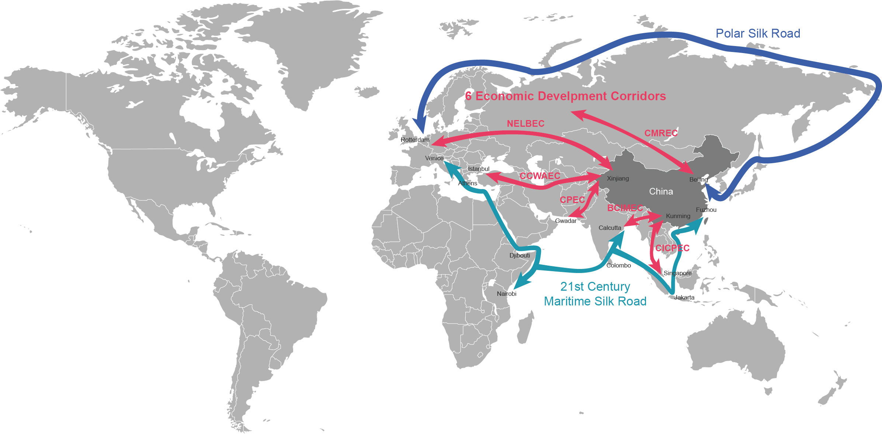

Slide 18
Southeast Asia and the Indian Ocean
Plans – canal through Malayan peninsula (in Thai territory), railway passage in Malaysia

Slide 19
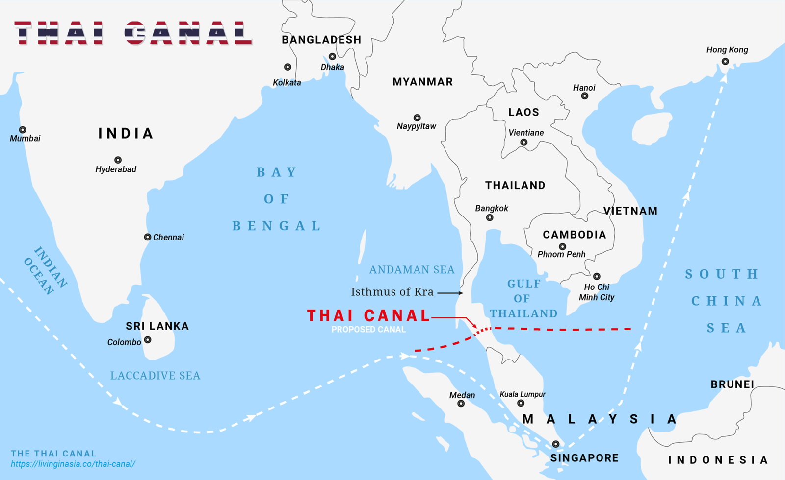

Slide 20
Southeast Asia and the Indian Ocean
Plans – canal through Malaysian peninsula (in Thai territory), railway passage in Malaysia
„String of pearls“ – alleged Chinese plan to build a network of ports and bases to control – feared by India and the US

Slide 21
Southeast Asia and the Indian Ocean
Plans – canal through Malaysian peninsula (in Thai territory), railway passage in Malaysia
- nothing is in fact happening
„String of pearls“ – alleged Chinese plan to build a network of ports and bases to control – feared by India and the US
- debatable whether China is actually attempting to do that

Slide 22
Southeast Asia and the Indian Ocean
Actual Chinese activities – less grandiose, more economic in motivation, more ad hoc depending on the local government

Slide 23
Southeast Asia and the Indian Ocean
Actual Chinese activities – less grandiose, more economic in motivation, more ad hoc depending on the local government
Still, the desire to diversify trade routes away from the Strait of Malacca and to isolate India appears to play some role

Slide 24
Southeast Asia
Main ambition in continental South East Asia: Kunming-Singapore railway network

Slide 25
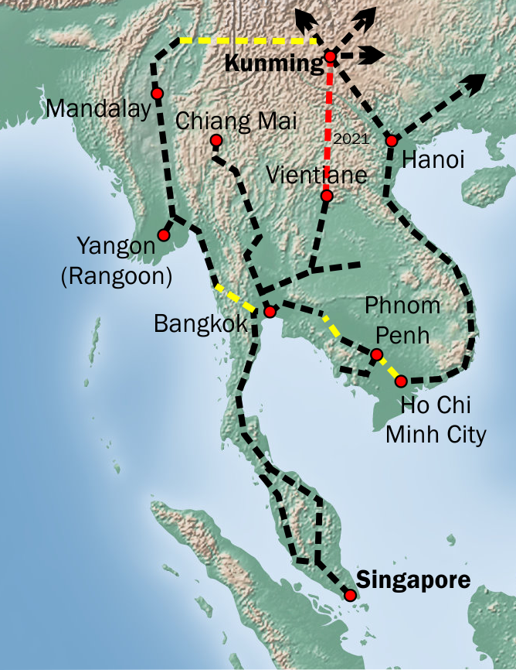

Slide 26
Southeast Asia
Main ambition in continental South East Asia: Kunming-Singapore railway network
- replacing old railways with high-speed ones

Slide 27
Southeast Asia
Main ambition in continental South East Asia: Kunming-Singapore railway network
- replacing old railways with high-speed ones
- connecting the rich coastal cities of Southeast Asia (Singapore, Bangkok etc.) with China‘s rail network -> new lines across inland Thailand and Laos

Slide 29
Southeast Asia
Laos
One of the poorest countries in the region, landlocked, ruled by a pro-Chinese Communist regime

Slide 30
Southeast Asia
Laos
One of the poorest countries in the region, landlocked, ruled by a pro-Chinese Communist regime
Vientiane-Boten High-Speed Railway

Slide 31
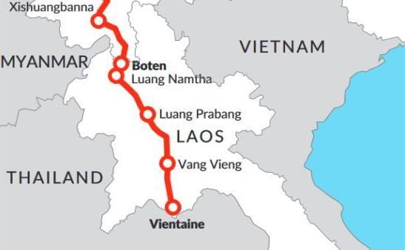

Slide 32
Southeast Asia
Laos
One of the poorest countries in the region, landlocked, ruled by a pro-Chinese Communist regime
Vientiane-Boten High-Speed Railway
- too expensive for most locals

Slide 33
Southeast Asia
Laos
One of the poorest countries in the region, landlocked, ruled by a pro-Chinese Communist regime
Vientiane-Boten High-Speed Railway
- too expensive for most locals
Also – hydropower stations on the Mekong

Slide 34
Southeast Asia
Thailand
Much richer and in a stronger position (US treaty ally!), a monarchy with frequent right-wing military coups

Slide 35
Southeast Asia
Thailand
Much richer and in a stronger position (US treaty ally!), a monarchy with frequent right-wing military coups
BRI is almost exclusively focused on high speed rails

Slide 36
Southeast Asia
Thailand
Much richer and in a stronger position (US treaty ally!), a monarchy with frequent right-wing military coups
BRI is almost exclusively focused on high speed rails
Main project – Bangkok-Nong Khai high speed rail

Slide 37
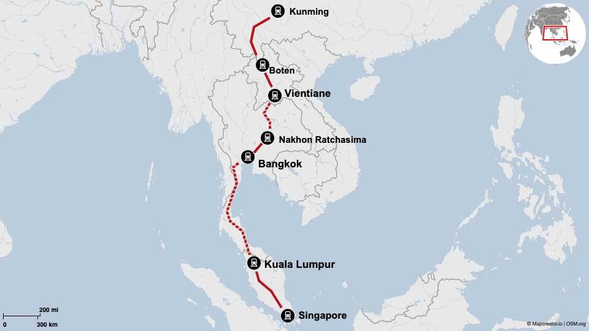

Slide 38
Southeast Asia
Thailand
Much richer and in a stronger position (US treaty ally!), a monarchy with frequent right-wing military coups
BRI is almost exclusively focused on high speed rails
Main project – Bangkok-Nong Khai high speed rail
Frequent delays due to changes of governments

Slide 39
Southeast Asia
Cambodia
Poor, pro-Chinese regime (former Khmer Rouge dictator!)

Slide 40
Southeast Asia
Cambodia
Poor, pro-Chinese regime (former Khmer Rouge dictator!)
Main project – Sihanoukville port and special economic zone
+ highway to capital Phnom Penh

Slide 41
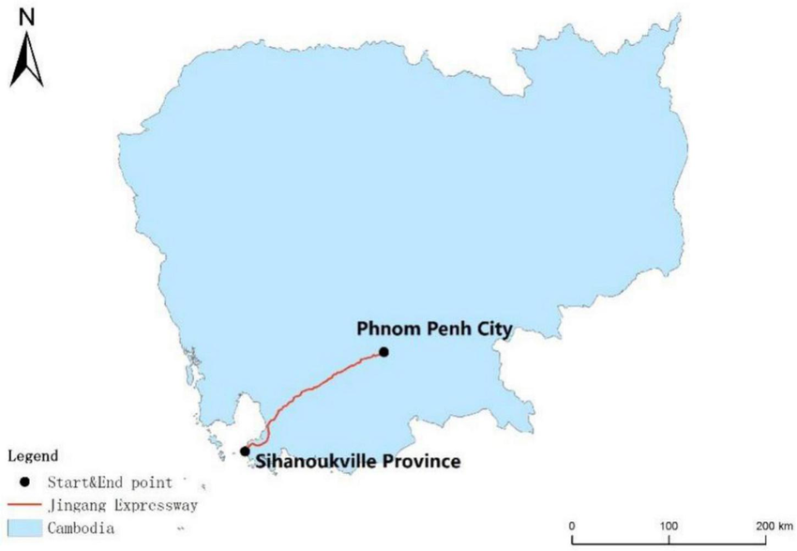
Southeast Asia

Slide 42
Southeast Asia
Cambodia
Poor, pro-Chinese regime (former Khmer Rouge dictator!)
Main project – Sihanoukville port and special economic zone
+ highway to capital Phnom Penh
Successful, main complications arise from illicit Chinese businesses and speculations – „Wild West vibe“

Slide 43
Southeast Asia
Vietnam
100 million inhabitants, history of conflict with China despite also being a Communist regime

Slide 44
Southeast Asia
Vietnam
100 million inhabitants, history of conflict with China despite also being a Communist regime
Sceptical towards the BRI, nevertheless, individual projects involving Chinese firms exist, primarily in the energy sector

Slide 45
Southeast Asia
Malaysia
Regional hub, including for Chinese firms (Huawei, Alibaba…); hugely important geographical location

Slide 46
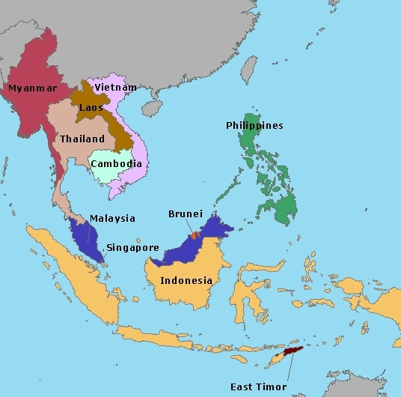

Slide 47
Southeast Asia
Malaysia
Regional hub, including for Chinese firms (Huawei, Alibaba…); hugely important geographical location
> strong bargaining position with China

Slide 48
Southeast Asia
Malaysia
Regional hub, including for Chinese firms (Huawei, Alibaba…); hugely important geographical location
> strong bargaining position with China
Many projects launched before 2010

Slide 49
Southeast Asia
Malaysia
Regional hub, including for Chinese firms (Huawei, Alibaba…); hugely important geographical location
> strong bargaining position with China
Many projects launched before 2010
Penang bridge, Kuantan industrial park, East Coast Rail Line, Malacca Gate Port

Slide 50
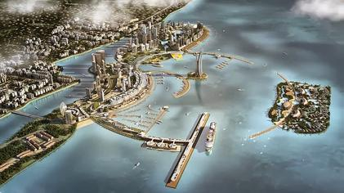
Southeast Asia

Slide 51
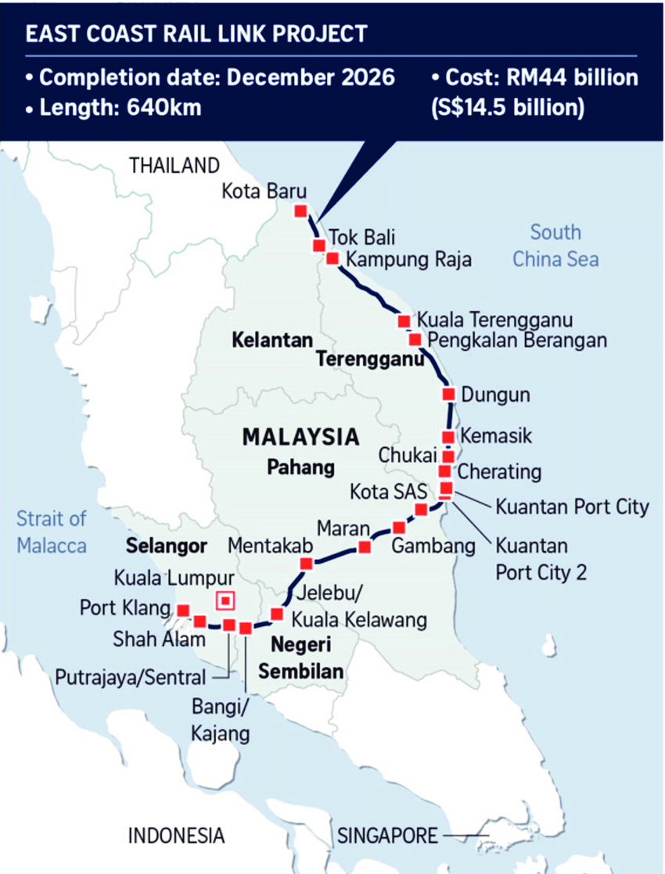
Southeast Asia

Slide 52
Southeast Asia
Malaysia
Anti-Chinese xenophobia – some 23 % of the population is of Chinese decent, came to the country centuries ago

Slide 53
Southeast Asia
Malaysia
Anti-Chinese xenophobia – some 23 % of the population is of Chinese decent, came to the country centuries ago
Discrimination, a history of violent pogroms

Slide 54
Southeast Asia
Malaysia
Anti-Chinese xenophobia – some 23 % of the population is of Chinese decent, came to the country centuries ago
Discrimination, a history of violent pogroms
> influx of Chinese investment can prove politically sensitive

Slide 55
Southeast Asia
Malaysia
Anti-Chinese xenophobia – some 23 % of the population is of Chinese decent, came to the country centuries ago
Discrimination, a history of violent pogroms
> influx of Chinese investment can prove politically sensitive
Other countries with large Chinese diasporas: Thailand, Indonesia, Singapore

Slide 56
Southeast Asia
Indonesia
270 million inhabitants, relatively democratic politics, anxiety over growing Chinese power > reluctance to take a large part in BRI

Slide 57
Southeast Asia
Indonesia
270 million inhabitants, relatively democratic politics, anxiety over growing Chinese power > reluctance to take a large part in BRI
Main project – Jakarta-Bandung railway

Slide 58
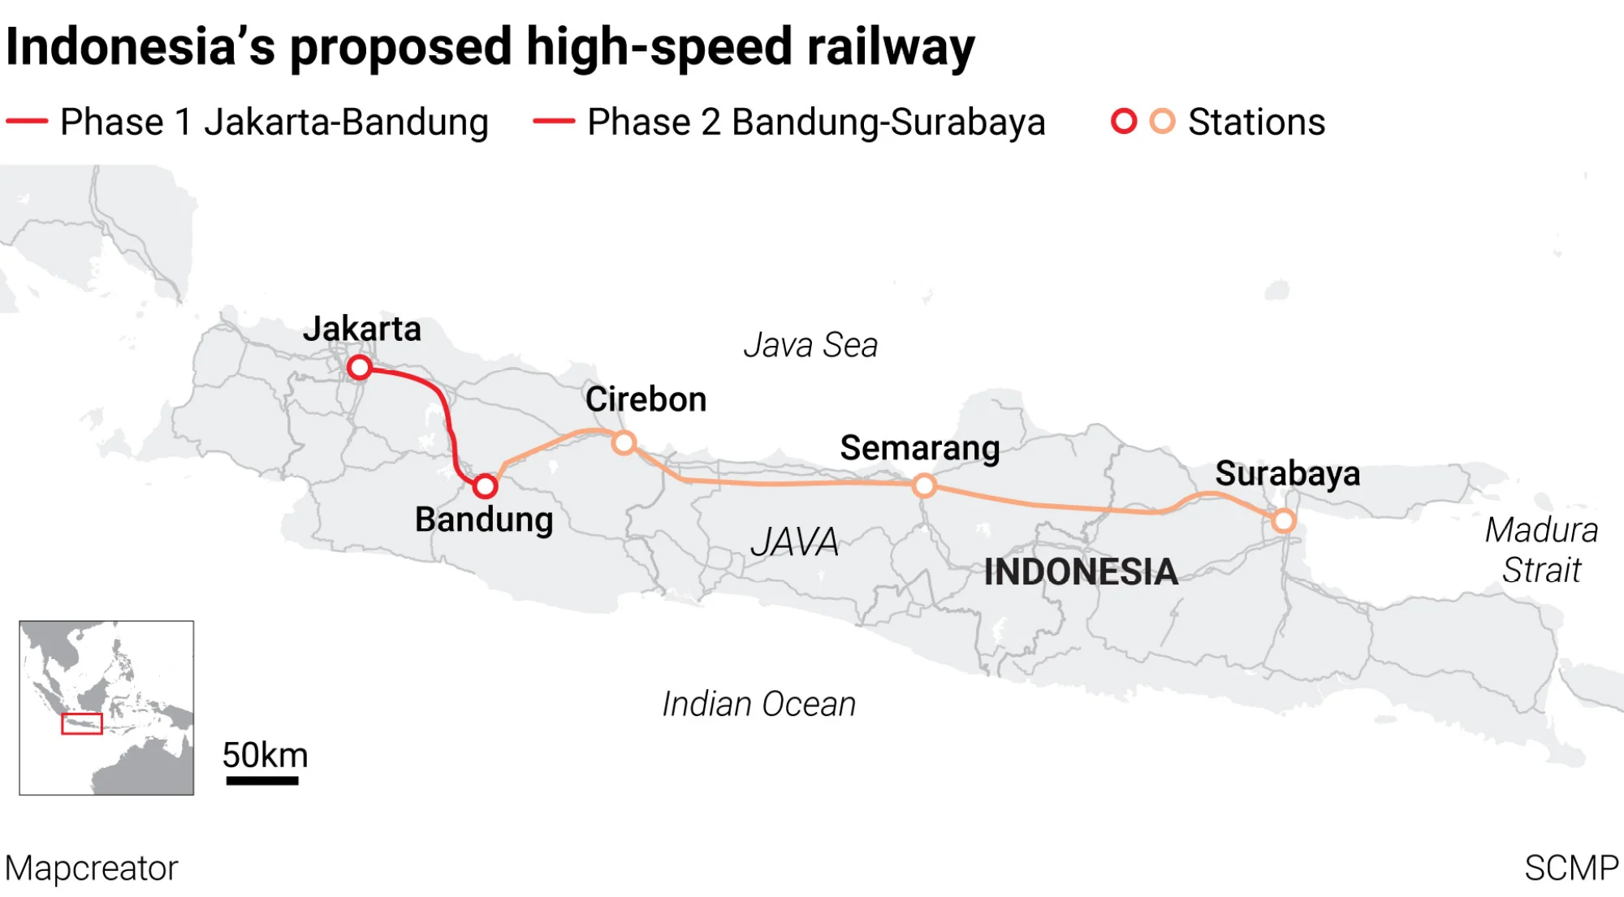
Southeast Asia

Slide 59
Southeast Asia
Indonesia
270 million inhabitants, relatively democratic politics, anxiety over growing Chinese power > reluctance to take a large part in BRI
Main project – Jakarta-Bandung railway
Some power stations
No Chinese-built ports!

Slide 60
Southeast Asia
Geopolitical tensions – maritime disputes with China over its claims in the South China Sea

Slide 61
Southeast Asia
Geopolitical tensions – maritime disputes with China over its claims in the South China Sea
Nine-dash line – at complete odds with the UNCLOS treaty

Slide 62
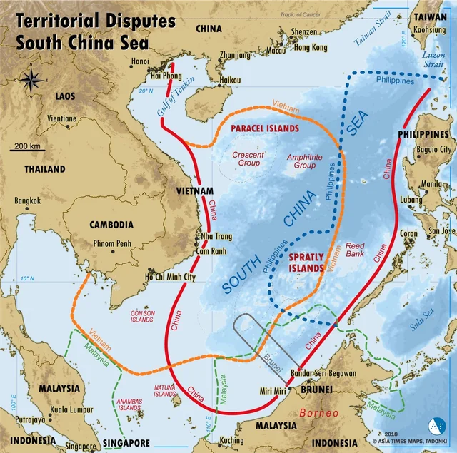

Slide 63
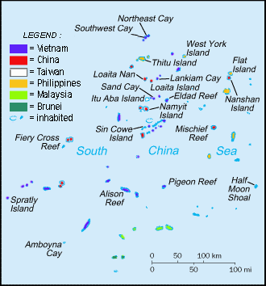

Slide 64
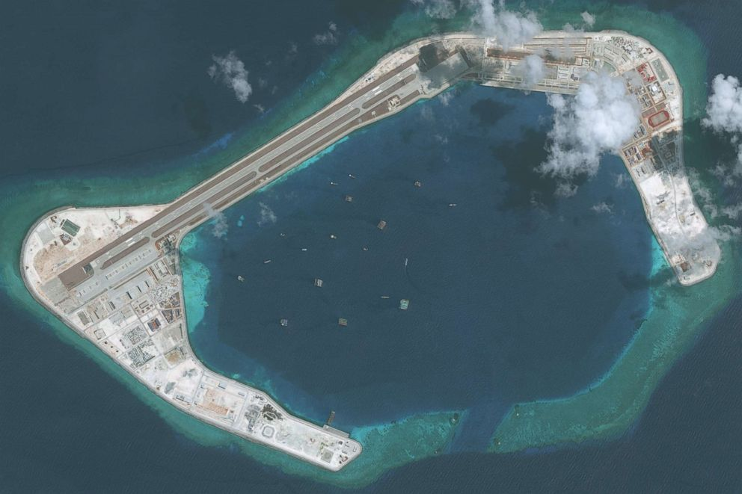

Slide 65
Southeast Asia
Myanmar
Pro-Chinese military dictatorship facing numerous ethnic insurgencies
China-Myanmar Economic Corridor - CMEC

Slide 66
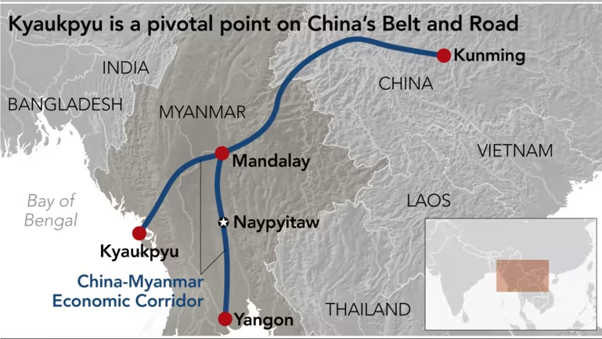
Southeast Asia

Slide 68
Southeast Asia
Myanmar
Pro-Chinese military dictatorship facing numerous ethnic insurgencies
China-Myanmar Economic Corridor – CMEC – mainly oil and gas pipelines, also project for a port and special economic zone on the shore
- possibility to import oil while avoiding the Strait of Malacca
- old project – predates BRI

Slide 69
Southeast Asia
Myanmar
Pro-Chinese military dictatorship facing numerous ethnic insurgencies
China-Myanmar Economic Corridor – CMEC – mainly oil and gas pipelines, also project for a port and special economic zone on the shore
- possibility to import oil while avoiding the Strait of Malacca
- old project – predates BRI
Long-history of smuggling, now joined by the smuggling of women into China

Slide 70
South Asia
Pakistan

Slide 71
South Asia
Pakistan – CPEC (China-Pakistan Economic Corridor)

Slide 73
South Asia
Pakistan – CPEC (China-Pakistan Economic Corridor)
Most important project, largest amount of investment!

Slide 74
South Asia
Pakistan – CPEC (China-Pakistan Economic Corridor)
Most important project, largest amount of investment!
Only truly new BRI project, flagship of the whole Initiative

Slide 75
South Asia
Pakistan – CPEC (China-Pakistan Economic Corridor)
Most important project, largest amount of investment!
Only truly new BRI project, flagship of the whole Initiative
Railway and road connection from Tibet through Kashmir to Karachi and Gwadar – a new port

Slide 76
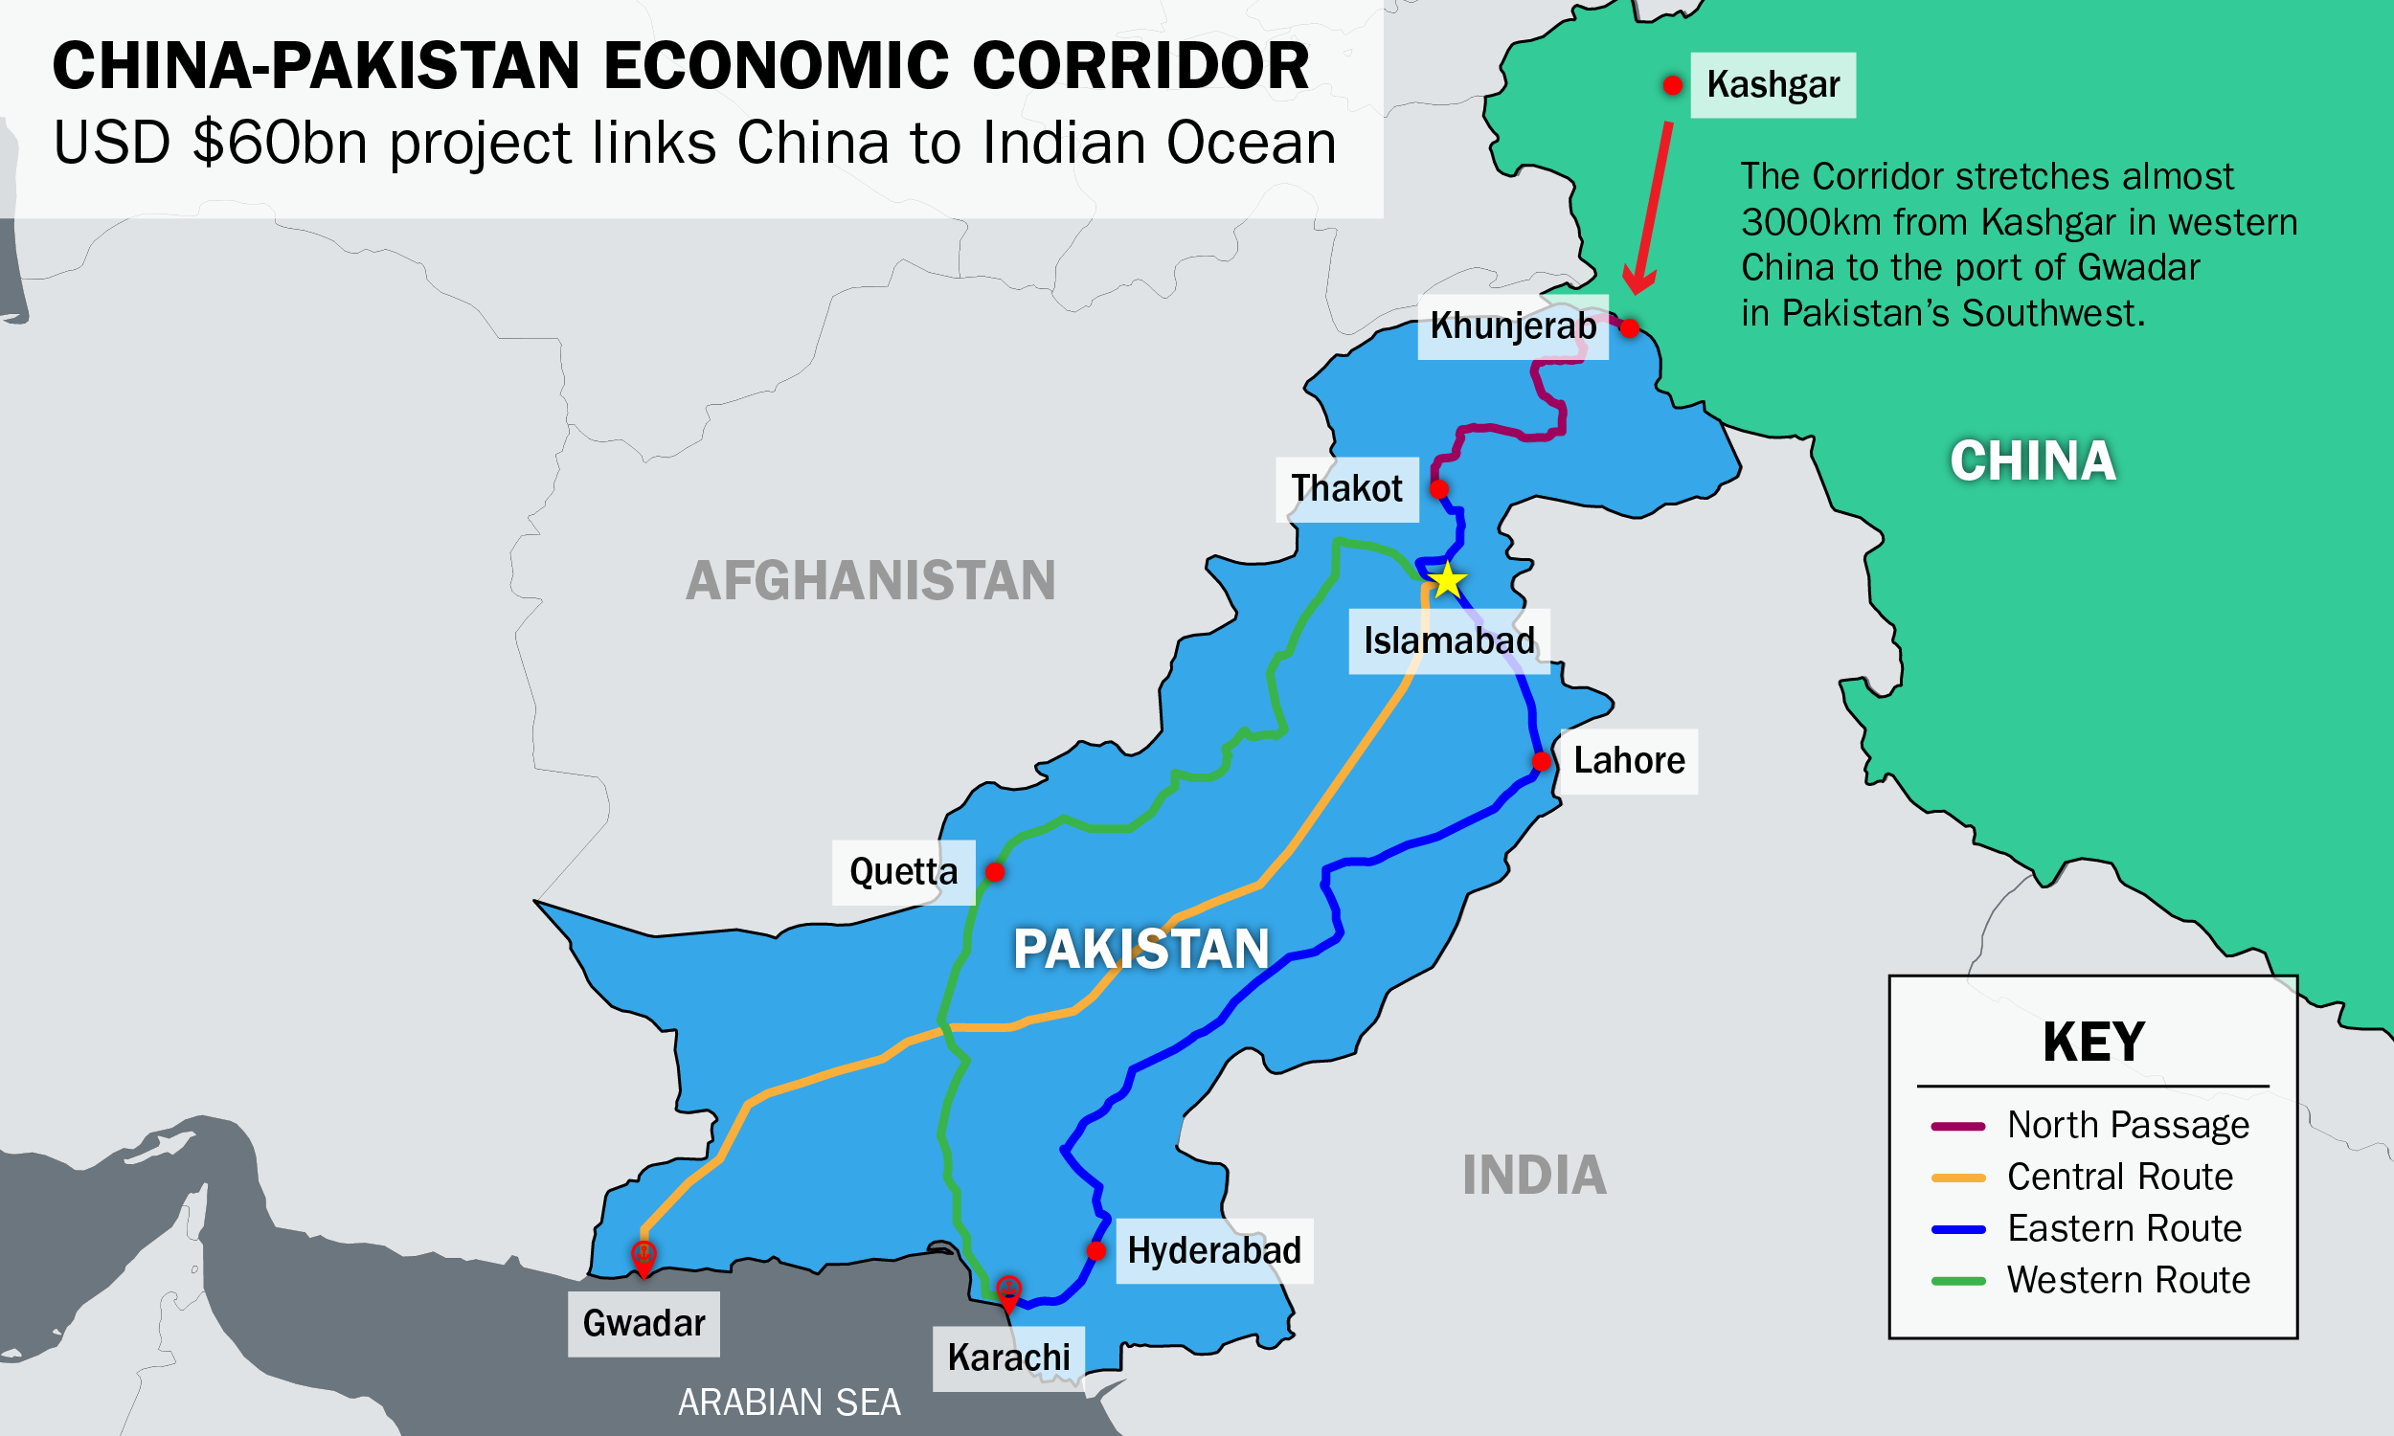

Slide 77
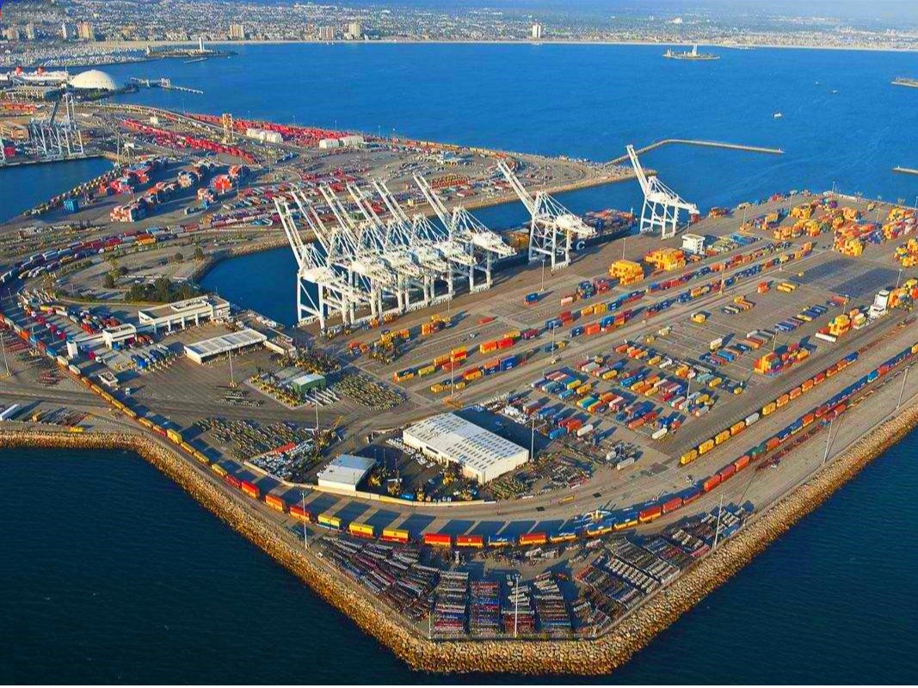

Slide 78
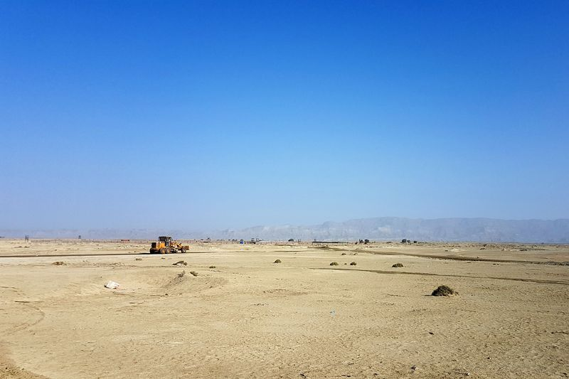

Slide 79
South Asia
Pakistan – CPEC (China-Pakistan Economic Corridor)
Most important project, largest amount of investment!
Only truly new BRI project, flagship of the whole Initiative
Railway and road connection from Tibet through Kashmir to Karachi and Gwadar – a new port
Connects the Belt and the Road – the western regions and the Indian ocean sea lanes

Slide 82
South Asia
Pakistan – CPEC (China-Pakistan Economic Corridor)
Large geopolitical significance – China and Pakistan are allies against India

Slide 83
South Asia
India
Does not take a part in BRI, tries to keep its regional influence by launching its own connectivity projects

Slide 84
South Asia
India
Does not take a part in BRI, tries to keep its regional influence by launching its own connectivity projects
> Bangladesh, Sri Lanka, Maledives

Slide 85
South Asia
Sri Lanka

Slide 86
South Asia
Sri Lanka
Debt crisis, forced to lease the newly-built port of Bambantota to a Chinese firm for 99 years

Slide 87
South Asia
Sri Lanka
Debt crisis, forced to lease the newly-built port of Hambantota to a Chinese firm for 99 years
BRI gone wrong?

Slide 88
Africa
Uniportant in terms of securing trade routes

Slide 89
Africa
Uniportant in terms of securing trade routes
Generally – probably secondary importance from China‘s point of view vs. very important for African countries

Slide 90
Africa
Uniportant in terms of securing trade routes
Generally – probably secondary importance from China‘s point of view vs. very important for African countries
Relevant as a provider of natural resources – oil, rare metals and minerals

Slide 91
Africa
Uniportant in terms of securing trade routes
Generally – probably secondary importance from China‘s point of view vs. very important for African countries
Relevant as a provider of natural resources – oil, rare metals and minerals
Resources-for-infrastructure deals – Chinese loans for infrastructure building and mining, the mining will pay back the loan

Slide 92
Africa
Uniportant in terms of securing trade routes
Generally – probably secondary importance from China‘s point of view vs. very important for African countries
Relevant as a provider of natural resources – oil, rare metals and minerals
Resources-for-infrastructure deals – Chinese loans for infrastructure building and mining, the mining will pay back the loan
Engagement usually predates BRI! – as in other regions

Slide 93
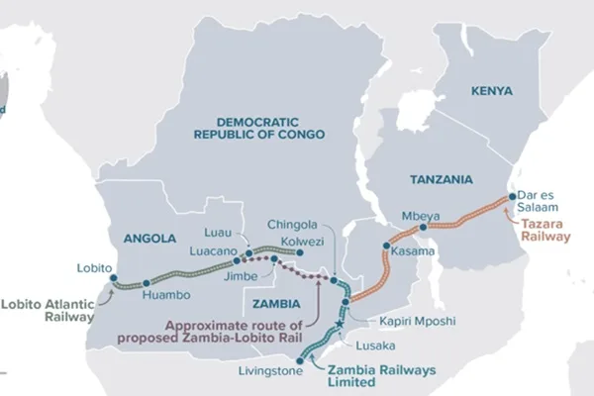
Africa

Slide 94
The overland corridor to Europe

Slide 96
The overland corridor to Europe
Through Central Asia, Russia, Poland and all the way to London

Slide 97
The overland corridor to Europe
Through Central Asia, Russia, Poland and all the way to London
Reality – mostly old Soviet railways

Slide 98
The overland corridor to Europe
Through Central Asia, Russia, Poland and all the way to London
Reality – mostly old Soviet railways
Necessity to change trains in terminals – because of different gauge

Slide 99
The overland corridor to Europe
Through Central Asia, Russia, Poland and all the way to London
Reality – mostly old Soviet railways
Necessity to change trains in terminals – because of different gauge
First change on China-Kazakhstan border, another at Belarus-Poland border

Slide 100
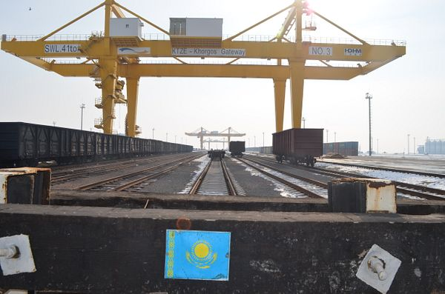

Slide 101
The overland corridor to Europe
Through Central Asia, Russia, Poland and all the way to London
Reality – mostly old Soviet railways
Necessity to change trains in terminals – because of different gauge
First change on China-Kazakhstan border, another at Belarus-Poland border
> increases cost
5 times more expansive than shipment!

Slide 102
The overland corridor to Europe
Through Central Asia, Russia, Poland and all the way to London
Reality – mostly old Soviet railways
Necessity to change trains in terminals – because of different gauge
First change on China-Kazakhstan border, another at Belarus-Poland border
> increases cost
5 times more expansive than shipment!
Faster, but is that useful?

Slide 103
The overland corridor to Europe
Only profitable when subsidized

Slide 104
The overland corridor to Europe
Only profitable when subsidized
What about the way back?
Europe does not export anything the other way around

Slide 105
The overland corridor to Europe
Only profitable when subsidized
What about the way back?
Europe does not export anything the other way around
> either China will subsidize the return of empty wagons, or containers will accumulate in Europe

Slide 106
BRI in European Union member states

Slide 107
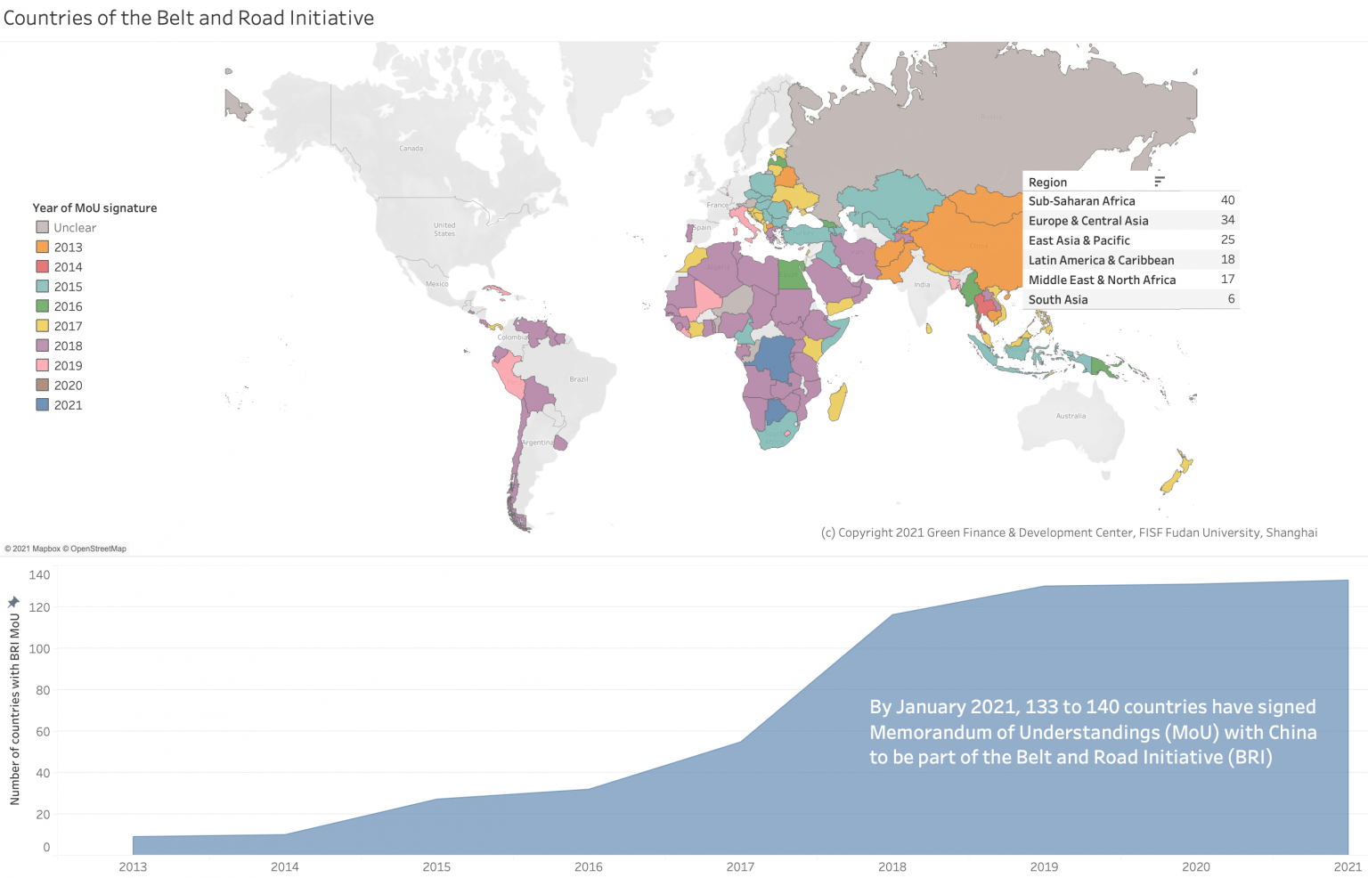

Slide 108
BRI in European Union member states
Mainly Hungary, Greece, Italy, Poland

Slide 109
BRI in European Union member states
Main problem: EU law
Regulates competition and rules for public procurement

Slide 110
BRI in European Union member states
Main problem: EU law
Regulates competition and rules for public procurement
> need for transparent tenders
> it is not possible to do a backroom deal with a Chinese bank

Slide 111
BRI in European Union member states
Main problem: EU law
Regulates competition and rules for public procurement
> need for transparent tenders
> it is not possible to do a backroom deal with a Chinese bank
Competition law – state guarantees would be seen as giving Chinese SOEs and banks and unfair advantage over competition > it cannot be done

Slide 112
BRI in European Union member states
Also – EU states are relatively rich + have access to EU funds

Slide 113
BRI in European Union member states
Also – EU states are relatively rich + have access to EU funds
> they have their own funding and don‘t need China‘s money
> they are higher on Maslow‘s pyramid and care about things like the environment or potential political interference

Slide 114
BRI in European Union member states
Also – better institutions and less corruption

Slide 115
BRI in European Union member states
China underestimated all of this
> their offers are often unacceptable
> overall, the Belt and Road project is a failure in Europe, without the EU even having to have some strategy against it

Slide 116
BRI in European Union member states
When Chinese companies do successfully win construction contracts, its under European rules:
1) Based on a public tender

Slide 117
BRI in European Union member states
When Chinese companies do successfully win construction contracts, its under European rules:
1) Based on a public tender
2) Financed by European resources
> do debts, no collateral, no ownership of the infrastructure for the Chinese

Slide 118
BRI in European Union member states
When Chinese companies do successfully win construction contracts, its under European rules:
1) Based on a public tender
2) Financed by European resources
> do debts, no collateral, no ownership of the infrastructure for the Chinese
3) No guarantees and obligatory renegotiation of prices
> China‘s companies must behave like any other company without any special regime

Slide 119
> it‘s not that hard to say „No“, if you have the will to do so

Slide 120
Non-EU countries in the Balkans
Montenegro, Serbia, Bosnia, Macedonia, Albania

Slide 121
Non-EU countries in the Balkans
Montenegro, Serbia, Bosnia, Macedonia, Albania
Alternative to EU financing

Slide 122
Non-EU countries in the Balkans
Montenegro, Serbia, Bosnia, Macedonia, Albania
Alternative to EU financing
Montenegro – an infamous case of huge debt acquired over the construction of a highway

Slide 123
Non-EU countries in the Balkans
Montenegro, Serbia, Bosnia, Macedonia, Albania
Alternative to EU financing
Montenegro – an infamous case of huge debt acquired over the construction of a highway
Complicates their route into the EU – the special régime for Chinese companies is at odds with EU competition law -> an obstacle for joining!

Slide 124
Problems
Most countries which began as enthusiastic supporters of the BRI are becoming more lukewarm, or outright sceptic

Slide 125
Problems
Most countries which began as enthusiastic supporters of the BRI are becoming more lukewarm, or outright sceptic
A large percentage of projects have been canceled, or scaled down, or delayed, etc.

Slide 126
Problems
Most countries which began as enthusiastic supporters of the BRI are becoming more lukewarm, or outright sceptic
A large percentage of projects have been canceled, or scaled down, or delayed, etc.
Large problem – local corruption!

Slide 127
Problems
Most countries which began as enthusiastic supporters of the BRI are becoming more lukewarm, or outright sceptic
A large percentage of projects have been canceled, or scaled down, or delayed, etc.
Large problem – local corruption!
(President of country X: „The proposed railway must go through my native region, where I need to reward my supporters, and a part of the contract must be given to my cousin‘s company!“)

Slide 128
Problems
The fact that a government accepts a deal does not necessarily mean it is good for the country!
Many countries – disrepancy between China‘s great relations with the national government and its much lower popularity in the street

Slide 129
Problems
Despite the problems, the hunger of the developing world for loans and infrastructure remains
Western/G7 alternatives to the BRI (Build Back Better World, Global Gateway) have so far failed to delivered and mostly exist on paper only
> Chinese-led projects continue to be sought after despite all the challenges

Slide 130
Problems
Despite the problems, the hunger of the developing world for loans and infrastructure remains

Slide 131
Problems
Despite the problems, the hunger of the developing world for loans and infrastructure remains
Western/G7 alternatives to the BRI (Build Back Better World, Global Gateway) have so far failed to delivered and mostly exist on paper only

Slide 132
Problems
Despite the problems, the hunger of the developing world for loans and infrastructure remains
Western/G7 alternatives to the BRI (Build Back Better World, Global Gateway) have so far failed to delivered and mostly exist on paper only
> Chinese-led projects continue to be sought after despite all the challenges

Slide 133
Problems
Thank you for your attention ☺
Next time: China‘s contemporary problems

