Slide 1

Yemen
Mgr. Lenka Martinkova
7 November 2023

Slide 2
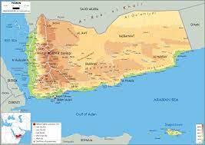
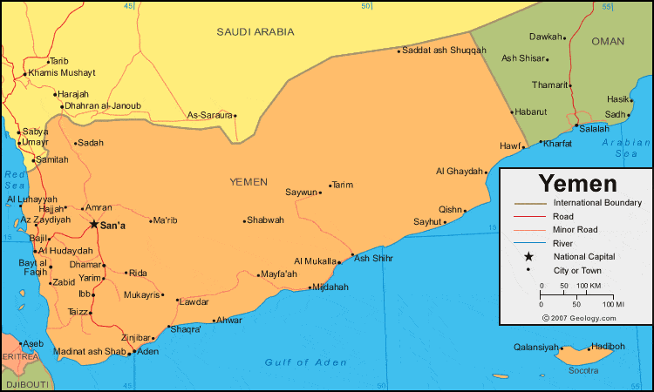
Yemeni geography
It is not a win

Slide 3
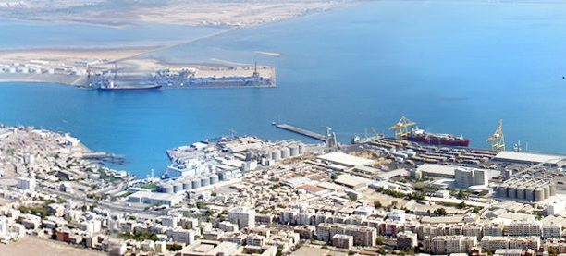
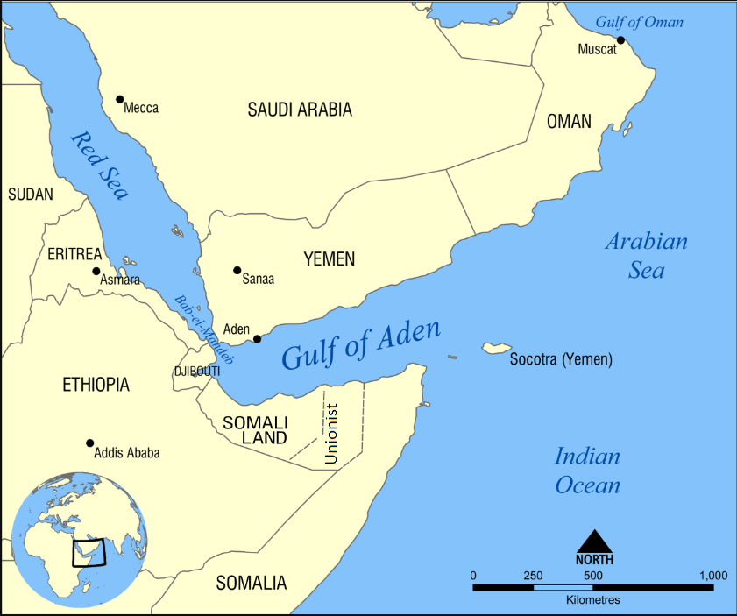
Data
Aden port
32 million people
527 970 km²
Yemeni Rial
123th GDP $21.045 billion
Reserves 3 billion barrels of oil
481 billion cubic meters of gas
Notes:
4 civil wars in north + today
4 civil wars in south + today
0.2% of the world's total oil reserves

Slide 4
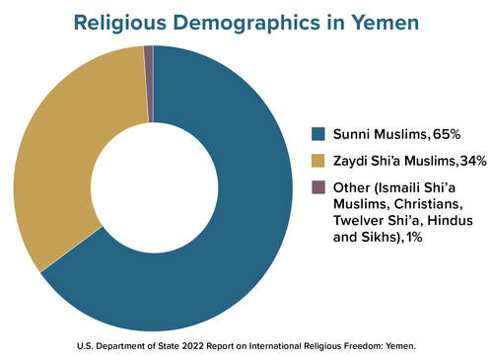
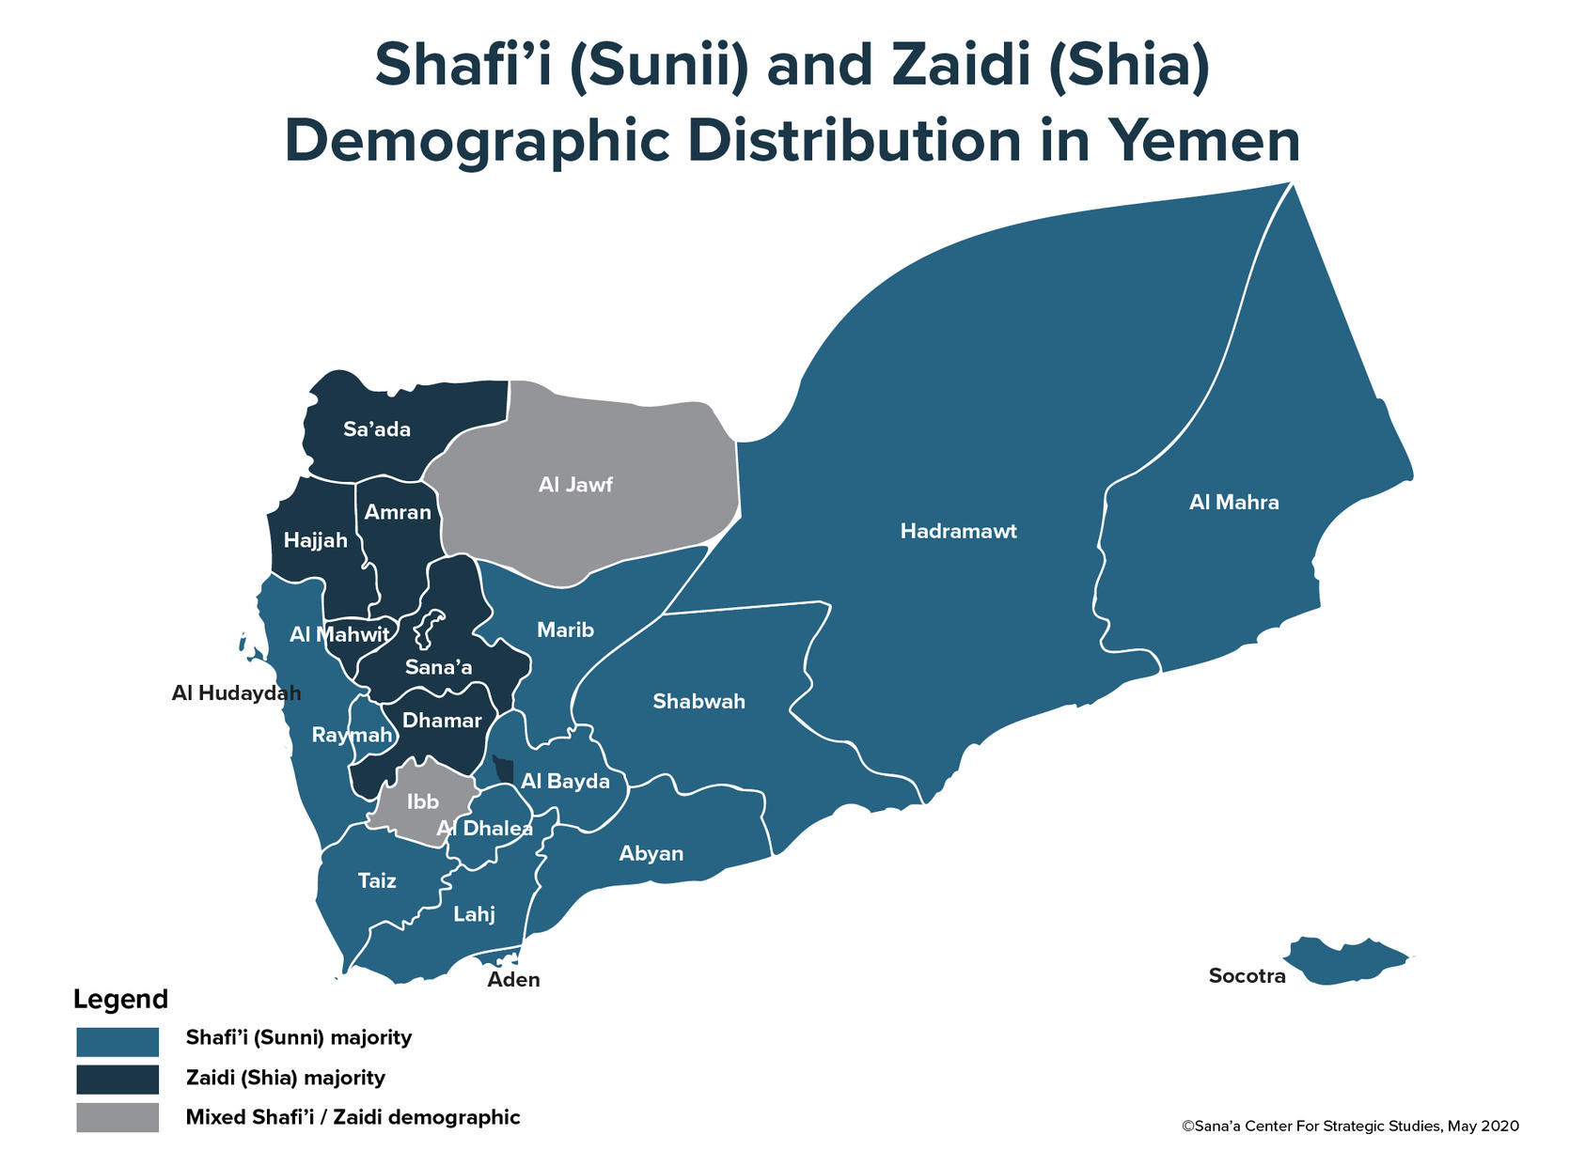
Demographics

Slide 5
Ancient History
Divided by the Conquerors
3,000 years, and its unique culture is still in evidence today in the architecture of its towns and villages
1000 BC this region of the Southern Arabian Peninsula was ruled by three successive civilisations - Minean, Sabaean and Himyarite
Until 1 century BC Arabia Felix in Latin, meaning "Happy Arabia
7th century Umayyad dynasty
8th century Abbasid dynasty
10th century Zaydi imamate
12th century Rasulids
16th century Portuguese, Mamelukes attempts
Ottoman Empire conquered Egypt in 1517, and in 1538 brought most of Yemen under their control
17th century Zaydi rule
division into two countries began with the British seizure of Aden in 1839 and the reoccupation of North Yemen by the Ottomans in 1849
early 20th century, the two powers drew a border between their territories, which came to be called North and South Yemen

Slide 6

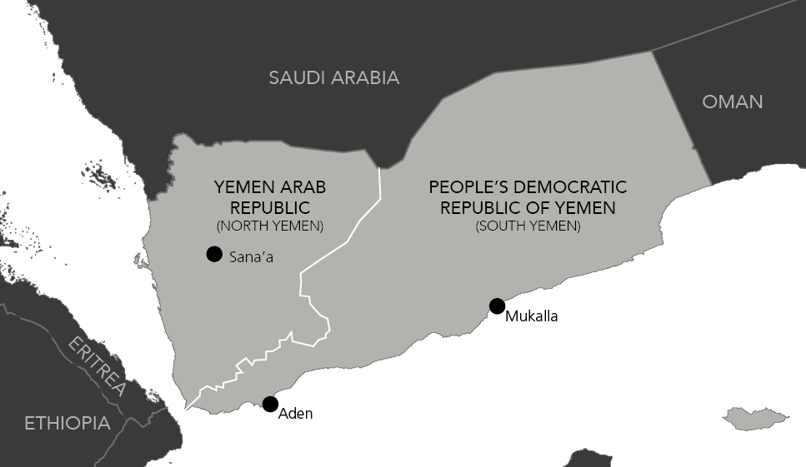
Modern History of Yemen
South
1937 the area was designated the Aden Protectorates
British occupation of Aden in 1839
British treaties with tribal leaders of the South
1965 the Federation of South Arabia
1967 British withdrawal from the area
National Liberation Front (NLF), forced the collapse of the federation and assumed political control
People's Republic of South Yemen in November 1967
1969 president al-Shaabi ousted, replaced by Salem Ali Rubayi; until 1978, Soviet Influence, atheist socialism
1869 Suez Canal opening (importance of Aden)
1970 the country was renamed the People's Democratic Republic of Yemen (PDRY), Yemeni Socialist Party
1986 a civil war erupted within the government of South Yemen (12 years)
Notes:
British signed treaties with tribal leaders in the interior, promising military protection and subsidies in exchange for loyalty;
British authority was extended to other mainland areas to the east of Aden.
1937 the area was designated the Aden Protectorates.
In 1958 six small states within the protectorates formed a British-sponsored federation. This federation was later expanded to include Aden and the remaining states of the region, and was renamed the Federation of South Arabia in 1965.
Great Britain finally withdrew from the area in 1967, when the dominant opposition group, the National Liberation Front (NLF), forced the collapse of the federation and assumed political control.
South Yemen became independent as the People's Republic of South Yemen in November of that year. The NLF became the only recognized political party and its leader, Qahtan Muhammad al-Shaabi, was installed as president.
In 1969 al-Shaabi was ousted and replaced by Salem Ali Rubayi; until 1978, South Yemen was governed under the co-leadership of Rubayi and his rival, Abdel Fattah Ismail, both of whom made efforts to organize the country according to their versions of Marxism.
In 1970 the country was renamed the People's Democratic Republic of Yemen (PDRY). Foreign-owned properties were nationalized, and close ties were established with the USSR. Rubayi was deposed and executed in 1978; under the prevailing authority of Ismail,
The Events of ‘86
result of ideological differences, and later tribal tensions, between two factions of the ruling Yemeni Socialist Party
Soviet influence intensified in South Yemen. Ismail was replaced by Ali Nasser Muhammad al-Hasani in 1980. In 1986 a civil war erupted within the government of South Yemen; the war ended after 12 days, and al-Hasani fled into exile. Former premier Haydar Bakr al-Attas was elected president in October.

Slide 7

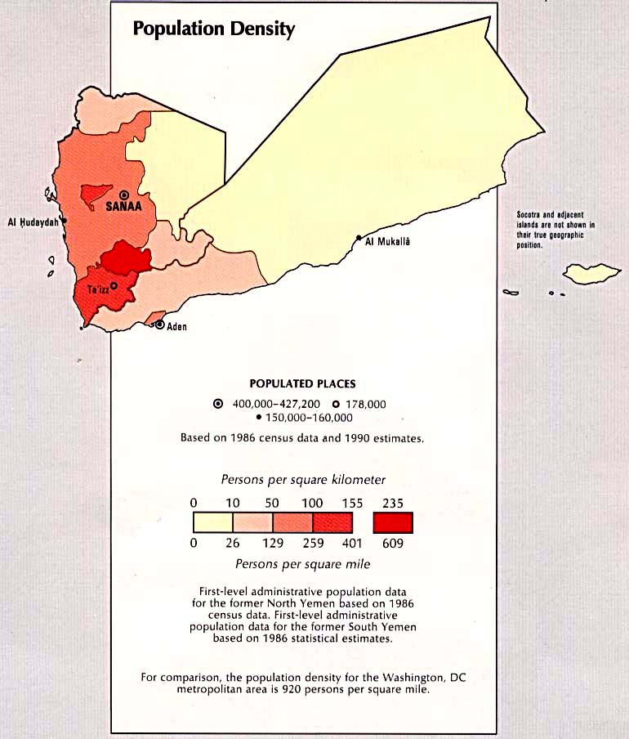
Modern History of Yemen
North
In North Yemen, Ottoman rule met with significant opposition during the early 1900s.
Under the leadership of the Zaydi imam, Yemenis staged many uprisings.
After years of rebellion, in 1911 the Ottomans finally granted the imam autonomy over much of North Yemen.
Defeat in World War I forced the Ottomans to evacuate Yemen in 1918.
Rule of two imams
nationalist Free Yemeni Movement in the mid-1940s, an aborted 1948 revolution in which Imam Yahya was killed, a failed 1955 coup against Imam Ahmad, and finally
North Yemen Civil War in 1962–1970, the 1962 revolution in which the imam was deposed by a group of nationalist officers and the Yemen Arab Republic (YAR) was proclaimed under the leadership of Abdullah al-Sallal
President Al-Sallal's rule, from 1962 to 1967, replaced Abdul Rahman al-Iryani
1967-1970 war between republicans and royalist
1970 adoption of democratic constitution
1974 military coup colonel Al-Hamdi
1977 Al-Hamci assassinated, his successor killed in 1978
1978-1990 President Ali Abdullah Saleh
Notes:
In 1965 Egyptian president Gamal Abdel Nasser met with King Faisal of Saudi Arabia to consider a possible settlement to the civil war.
The meeting resulted in an agreement whereby both countries pledged to end their involvement and allow the people of North Yemen to choose their own government. Subsequent peace conferences were ineffectual, however, and fighting flared up again in 1966.
1967 the war had reached a stalemate, and the republicans had split into opposing factions concerning relations with Egypt and Saudi Arabia.
In late 1967 Al-Sallal's government was overthrown and he was replaced as president by Abdul Rahman al-Iryani. Fighting continued until 1970, when Saudi Arabia halted its aid to royalists and established diplomatic ties with North Yemen. Al-Iryani effected the long-sought truce between republican and royalist forces, and presided over the adoption of a democratic constitution in 1970.
1974 military officers led by Colonel Ibrahim al-Hamdi staged a bloodless coup, claiming that the government of Al-Iryani had become ineffective. The constitution was suspended, and executive power was vested in a command council, dominated by the military. Al-Hamdi chaired the council and attempted to strengthen and restructure politics in North Yemen.
Al-Hamdi was assassinated in 1977, and his successor, former Chief of Staff Ahmed Hussein al-Ghashmi, was killed in June 1978.
President Ali Abdullah Saleh, who ruled North Yemen from 1978 until it merged with South Yemen in 1990, proved more stable. Saleh strengthened the political system, while an influx of foreign aid and the discovery of oil in North Yemen held out the prospect of economic expansion and development.

Slide 8
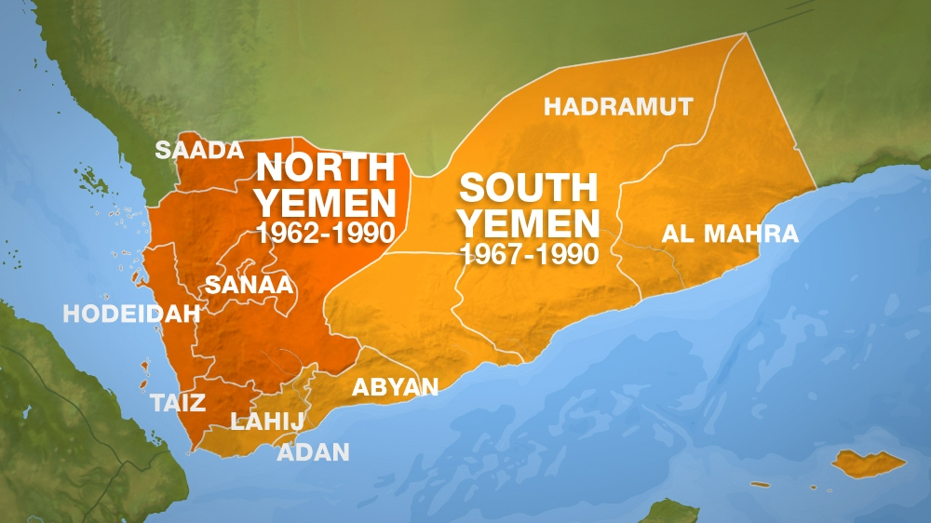
Unification Of Yemen
Two in One
Treaty of Cooperation was signed in 1981
Unification South Yemen and North Yemen on May 22, 1990
1994 Yemen Civil War (South lost), growing power of Northern government
Uneven distribution of sources
Exploitation of the south oil reserves
Corruption, clientelism of norther leadership
Neglect of south areas
Social and economic gap
Cultural and historical differences
South longing for independence
Northern tribalism and religious influences
May 2007 Aden protests (violently suppressed)
origins of the Southern Movement
secession of the south and the re-establishment of South Yemen as an independent state
Southern Transitional Council
Notes:
leaders independent southern state declared an end to the unity deal amidst an alleged power-grabbing usurp by their northern counterparts CIVIL WAR
swift defeat of the weakened southern forces and the expulsion of most of its leaders out of Yemen
new ruling party based in Sana'a, led by President Ali Abdullah Saleh, as well as a mishandling of the power-sharing arrangement agreed to by both parties in the 1990 unity deal.
SOUTH – oil, wealth…exploitation, corruption, neglect of the southern parts
Retired military personnel from South
new investments appeared to be focussed instead on northern Sana’a - new capital
North – tribalism, religious influence,
history was distinct from that of their northern neighbours
After 128 years of British rule, South Yemen was an independent state for 23 years.
Multiple protests by the Southern Movement took place between 2007–09, during which 100 were killed.
2015, the Southern Movement rose to prominence after entering into a loose alliance with the exiled President Hadi and proving to be a vital force in the pushback against Houthi forces from the southern city of Aden
Southern Transitional Council
Today, the Southern Movement through its political branch the Southern Transitional Council has a significant presence in all areas of the former southern territories

Slide 9
Unification reasons
fall of the USSR
rise of the pragmatic wing of the People's Republic Party to power
end of the Cold War
discovery of 15 rich resources of oil and gas on the common borderland
Notes:
The Iraqi invasion of Kuwait in 1990 happened during the Yemenis presidency in the Security Council of the United Nations.
Unfortunately, unified Yemen expressed support for Iraqi dictator Hussain.
This has caused anger among Arab countries and resulted in the huge expulsion of Yemenis workers from neighboring Gulf countries.
Yemen remained isolated
connection between Yemen and Iraq was strengthened after the Iraqi-Iranian war
the only country in the area has not been accepted to the GCC
non-demarcated borders with Saudi and Oman 90s
1995 Yemen and Oman demarcated borders
2000 Saudis and Yemen agreed on the disputed territory
Yemen and Eritrea, about the disputed territory in borderland consisting mainly of islands in the Red Sea. The conflict had to be resolved by arbitration of the International Criminal Court in Haag in 1998 mostly on behalf of Yemen. This arbitration is seen as one of the most significant at the end of the 20th century

Slide 10
Main differences between Yemenis
economy
religion
geographical differences
social status
culture
traditions
Notes:
terrain consists of parts of the country in mountains which are, and always will be, out of reach of the central government
strong tradition of blood vengeance
Yemen population includes many recruits of the Afghan-Soviet war - radical ideology and spreading the influence of Al Qaeda in Yemen
fall of the USSR

Slide 11
Political system
Pre-war
elected president for 7 years
Prime minister
The Council of Ministers
an elected 301-seat House of Representatives (Majlis al-Nuwaab) for 6 years
111-member (Shura Council) Consultative Council appointed by the president, no fixed time period, president removes them for political reasons

Slide 12
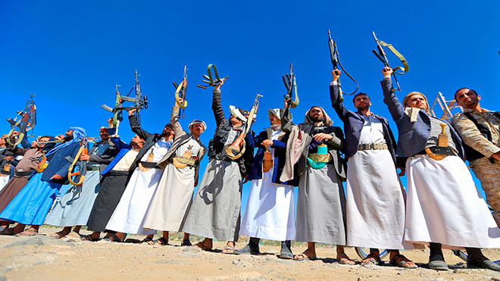
Tribes and separatism
Understanding the Yemeni social and cultural grievances
During the norther Yemeni kingdom fakhd (subgroup) of a tribe was obliged to send representatives to be held by the imam as a hostage to ensure the tribal loyalty to the imam
These complex networks of families or clans are intertwined together through common lineages, customs and alliances.
Cca 42 “tribes” in total
tribal confederation Hashid, the most powerful
2011 The Alliance of Yemeni Tribes, opposed to the government
collective security arrangement with the Yemeni protest movement

Slide 13
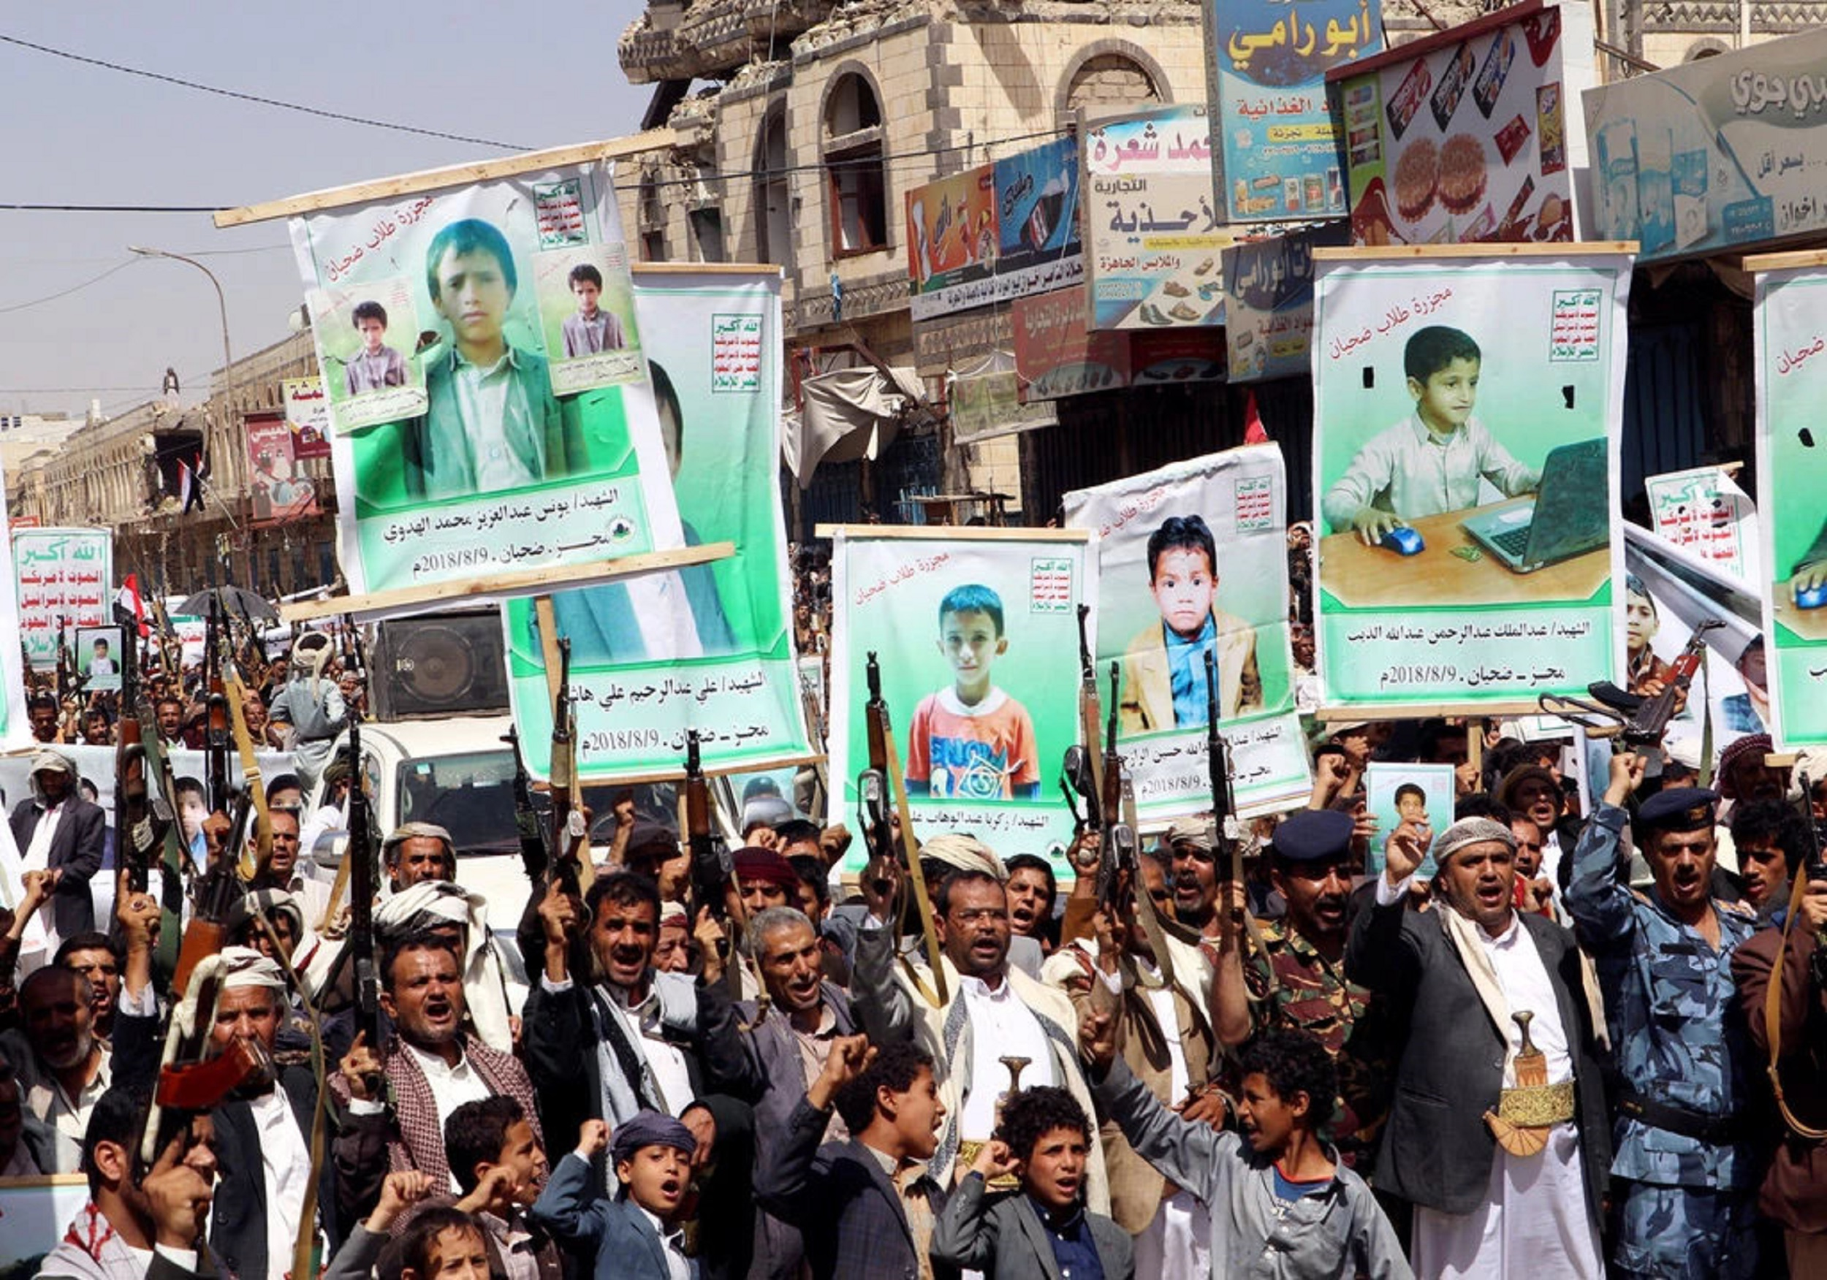
Zaydism
Branch of Shia Islam
Since the 8th century
Leader of the Umma can be only direct descendants of Fatima (Mohamed’s only daughter) – blood origins
Obedience to Imam is obligatory
Strong significant of Jihad
Exclusive for Northern Yemen and parts of Saudi Arabia
northern tribes are descendants of imam Zaidi, seen as Shia nobility
Notes:
Kingdom of Yemen or, retrospectively, as North Yemen, existed between 1918 and 1962 in the northern part of what is now Yemen. Its capital was Sana`a until 1948, then Ta'izz.
In the 21st century, the most prominent Zaidi movement is the Shabab Al Mu'mineen, commonly known as Houthis, who have been engaged in an uprising against the Yemeni Government in which the Army has lost 743 men and thousands of innocent civilians have been killed or displaced by government forces and Houthi, causing a grave humanitarian crisis in north Yemen.

Slide 14
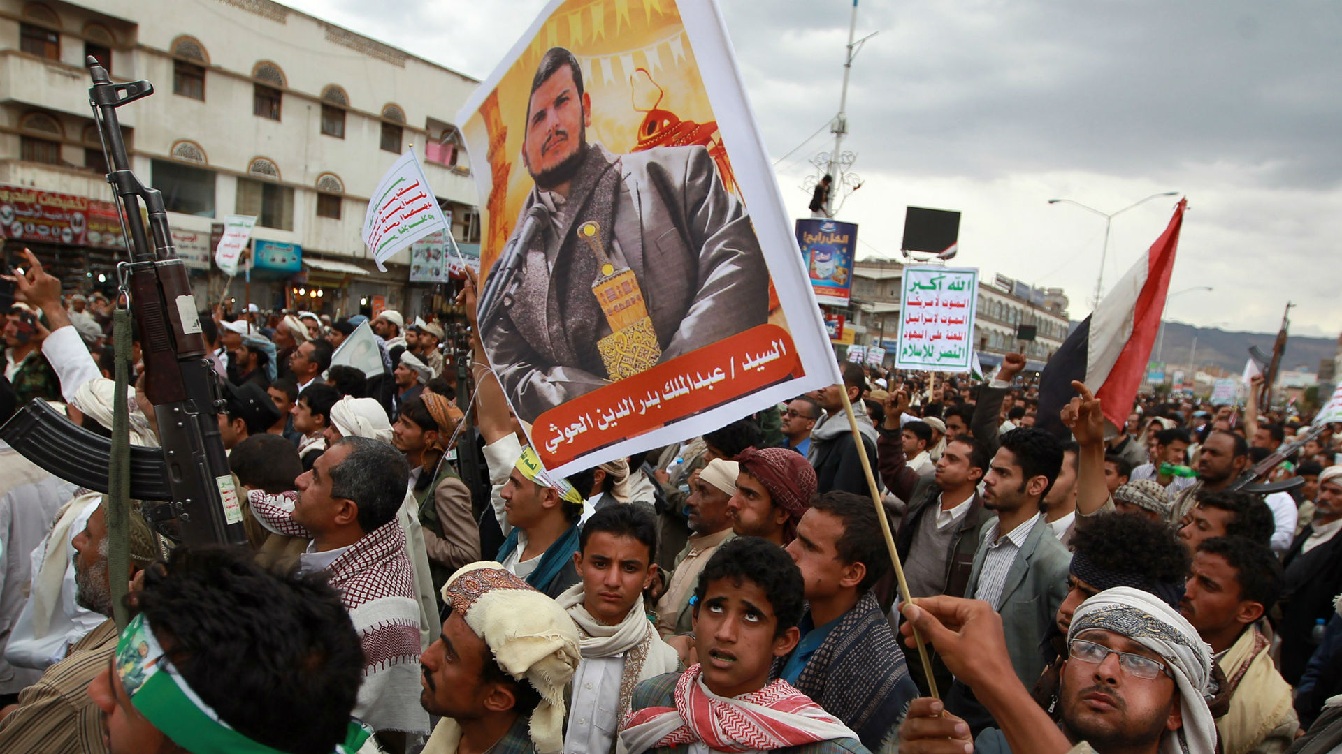
Houthis
Shabab Al Mu'mineen or Ansar Allah
Islamist political and armed organization
Houthi tribe, Zaydi shia religious group
2004 uprisings against Sunni majority (government)
Wish for religious law
2014 control of the government to Houthis (UN patronage)
Tribal militias
2015 declaring control over Yemen
Notes:
Since 2004 in Yemen, Zaidi fighters have been waging an uprising against factions belonging to the Sunni majority group in the country. The Houthis, as they are often called, have asserted that their actions are for the defense of their community from the government and discrimination, though the Yemeni government in turn accused them of wishing to bring it down and institute religious law.

Slide 15
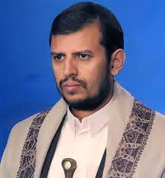
Houthis rise in the power
"God is great, death to the US, death to Israel, curse the Jews, and victory for Islam",
Hussein Badreddin al-Houthi
After 2001 cooperation with the US (perceived negatively)
“Cry” against USA since 2003
coordinating with other opposition groups during 2011 Arab Spring
Latest leader Abdul Malik al-Houthi
Notes:
attacks of 9/11/2001 have been an important milestone in the fight against terrorism and Yemen cooperated with the USA in the War on Terror
In 2003 was Yemen the most underdeveloped country in the region
In 2006 reelection of Saleh for president means that Yemen received foreign loans for the development of infrastructure, trade, manufacturing, and long-term investments
In 2009 a change of constitution was made to declare a lifetime presidency mandate for Saleh and later added a repeatable mandate for president. In 2009 the government was very unstable and decided to postpone the parliamentary elections for 2011.

Slide 16
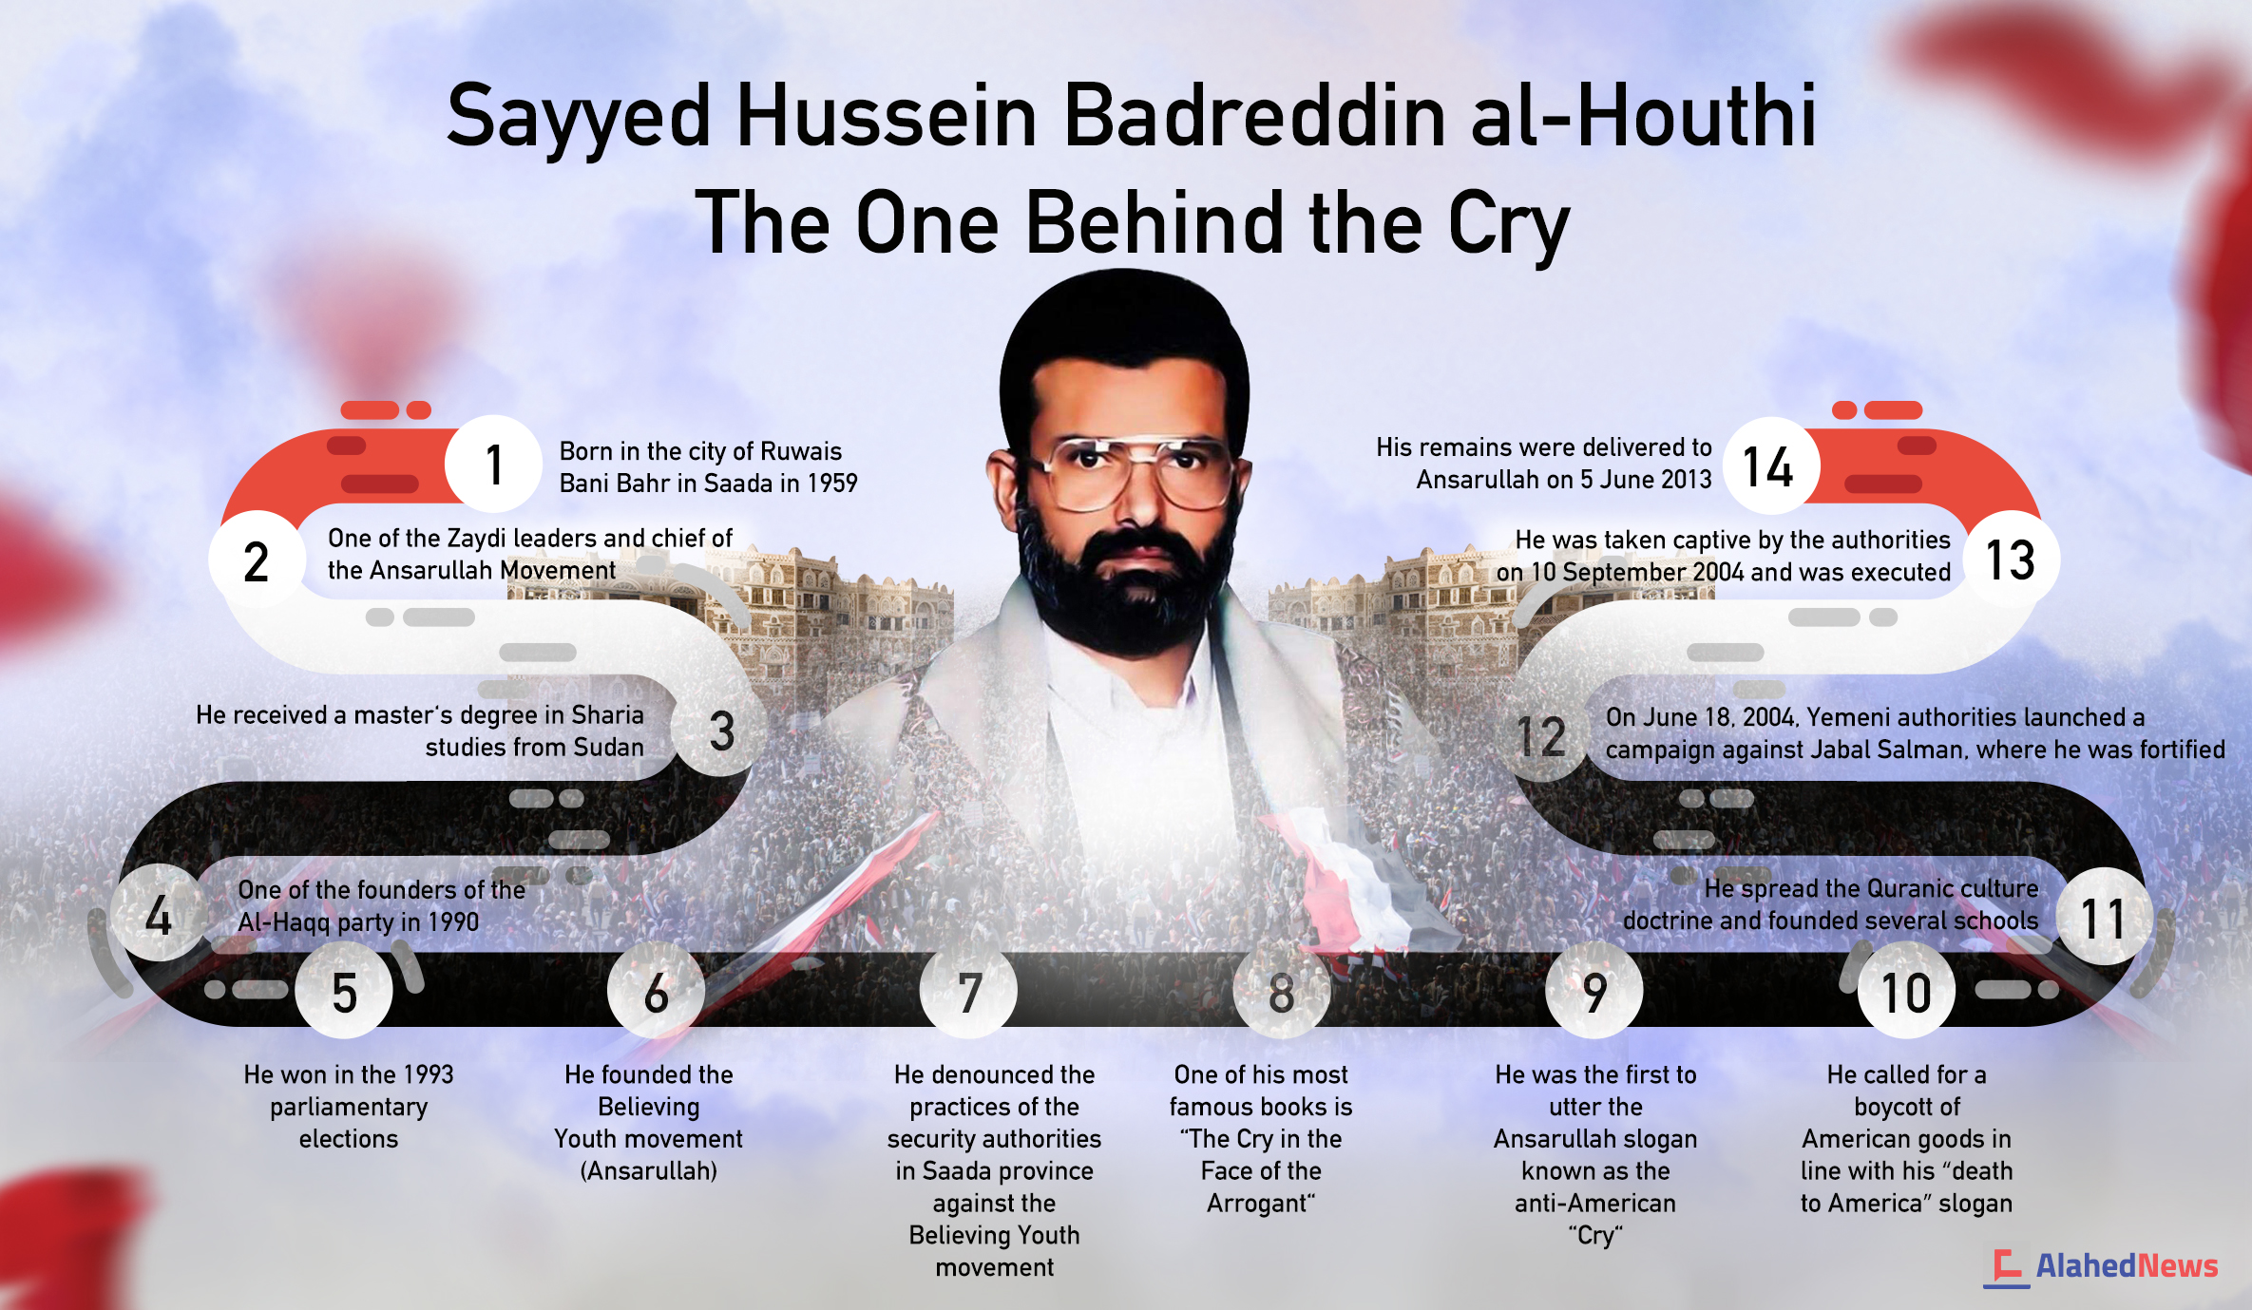

Slide 17
Arab Spring
2011
clientelism for the Hashid tribe, huge unemployment, worsening economic situation, lack of water, high illiteracy (over 50%), young population (15-25 years old form 50% of the population) and unreasonable use of oil production resources
government's proposals to modify Yemen's constitution
Mass defections from the military
16,000 protesters took place in Sanaʽa
"Friday of No Return" on 11 March
GCC countries negotiations
23 May, a day after Saleh refused to sign the transition agreement
Notes:
In the beginning, these were peaceful demands for change and civil liberties, but during the next 9 months the atmosphere changed and the demands of the protesters became more radical. President decided to order shooting as a means to disperse the crowd.
The solidarity among protesters was surprising, as Yemen is not culturally or socially unified.
Call for a new constitution
Saleh had to use loyal elite squads, militia and secret police, volunteers, and released convicts who were armed to fight for Saleh
dissolution of the government and the dismissal of high military and police officers because these went on to support the opposition

Slide 18
Arab Spring 2011
Earthquake in the ME societies
Saudi intervention in Bahrain protests
Saudi intervention in Yemeni protests
Saudi Arabia influence in the Yemen since 1970 (North Yemen Civil War)
2011 Yemeni Revolution
2012 protest of Arab Spring – removal of President Ali Abdullah Saleh
2013 National Dialogue Conference, United Nations Security Council Resolution 2051
Transitional government, 2 years period, presidency Abdrabbuh Mansour Hadi
Hadi was the only candidate in the election “show election” 2014
general distrust of Hadi
Notes:
National Dialogue is a key part of the agreement brokered by the UN and the Gulf Co-operation Council that saw long-time President Ali Abdullah Saleh hand over power to Abdrabbuh Mansour Hadi in November 2011 after an uprising.
Hadi was subsequently sworn in for a two-year term as president in February 2012 after an election in which he stood unopposed.
agreement that did not address the legitimate grievances of southern separatists or the Houthi coalition
general distrust of Hadi, who had profited from corruption as Saleh’s long time Vice President for nearly three decades
Southern separatist movement al-Hirak is a political movement and paramilitary organization active in the south of Yemen since 2007, demanding secession from the Republic of Yemen and a return to the former independent state of South Yemen
restructuring of parliament and the Shura Council, which will be composed of 50% northerners and 50% southerners

Slide 19
Youth movement protesters and radicals
“Reformists” and “Socialists”
Reformist stream is formed from northern tribesmen, moderate fundamentalists, businessmen from the cities, and young Salafists inspired by the Muslim Brotherhood (not moderate)
The socialist stream includes workers, craftsmen, socialist, and partisans from the Rafan mountains
Most visible Al Shabaab (the “youth”) and Houthis
Notes:
proposed deal for president Saleh was to leave the post in exchange for immunity for his crimes (corruption, clientelism, etc.).
Instead of him, Hadi should be appointed as the president
H.S. Sinwa would be the prime minister
Youth movement protesters and radicals
The variety of protesting bodies does not leave an option for a unified integrated opposition front and thus there were no prospects for democratic elections leading to any reasonable solution to the politically unstable situation in the country

Slide 20
Political system suggested by National Dialogue
After Aran spring
restructuring of parliament and the Shura Council, which will be composed of 50% northerners and 50% southerners
6-region federal system
Sana’a and Aden will have a special status
New constitution
(freedom of religion, makes stipulations on the nonsectarian nature of the government, outlaws illegal financial or arms support from foreign powers, calls for a return of stolen government weapons, prohibits the possession of medium to heavy arms, and calls for addressing the feuds that have contributed to the conflict)
Notes:
Azal, Saba, Janad and Tihama, Aden and Hadramawt
2012 presidential election was won by Hadi with 99,6% votes, the attendance was 60%. This election was boycotted by Houthi, Youth, and South Yemenis
rejected by southern leaders including Mohammad Ali Ahmed
Southern Issue Working Group did not get the fair system representing the south
NDC “has set an example in the region" for transitional phases”
Houthis “"because it divides Yemen into poor and wealthy regions”
Southerners “"what has been announced about the six regions is a coup against what had been agreed at the (NDC) dialogue”
Nasser al-Nawba Hirak separatist movement "We will continue our peaceful struggle until we achieve independence."

Slide 21
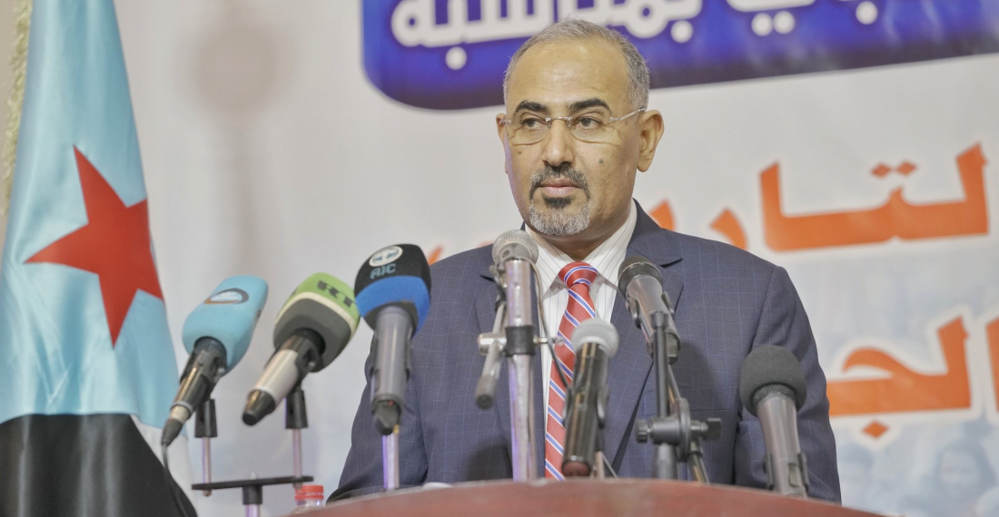
War in Yemen
Ruthless and supported
2014 Yemen officially in the Civil War
In 2015 Operation Decisive Storm
Actors: Opposition (Houthis, Islah Party - Muslim Brotherhood in Yemen, Southern Movement - Aidaroos Al-Zubaidi)
radical Islamist, Al-Qaeda in the Arabian Peninsula, ISIS
“pro-Government” Saudi led coalition
proxy war between Saudi and Iran, Shia and Sunni.
very complex conflict based on local dynamics and the regional struggle for hegemony.
Notes:
Since 2012 there has been a strong involvement of foreign actors (Saudi, US, Iran, UAE,...) and president Hadi escaped to exile to Saudi
Saudi enters the conflict on the side of the official government and provides the use of the army.
The majority of Sunny Arab states back the government, Shia states back the Houthis.
Since 2014 Yemen has been officially in the Civil War.

Slide 22
Progress of the conflict
How Saudis can not win...
2017 Saleh is killed by Houthis during bloody clashes in Sanaa
2018 governmental forces of president Hadi joined the Saudi-led Coalition
2019 there is severe growth of malnutrition, an outbreak of cholera, and a shortage of fuel
2019 violent clashes of Hadi and Secessionist in Aden were moderated by Saudis and a Riyadh agreement
war crimes and abuse of violence
Iranian military expenditure increased to 4,56% GDP in 2019
2020 Yemen still lacks the electoral framework and there is no actor exerting power over the whole territory
AQAP in the unreachable mountainous areas and a significant part of the Yemen population is inclined to support terrorist fighters due to common war experience from Afghanistan
2021 Joe Biden announced an end to U.S. support for Saudi-led offensive operations in Yemen
AQAP’s political violence surged in May and June, reaching the highest monthly level since November 2022
2023, AQAP launched an explosion that killed a military commander and three soldiers from the Security Belt Forces, an armed group loyal to the STC
Talks between Iran and Saudi Arabia in April 2023
Notes:
In 2015 Operation Decisive Storm took place without the Security Council UN but formally following the UN Charter Article 2.
President Hadi has officially authorized intervention in a call to ”willing countries that wish to help Yemen to provide immediate support for the legitimate authority by all means and measures to protect Yemen and deter the Houthi aggression"
It is an action of the Saudi army and airforce and NATO - USA, GB, FR logistics, and political support.
The conflict led to the formation of a coalition of Saudis, UAE, Kuwait, Sudan, etc.e
Stockholm talks NDC : 500 representatives of all concerned parties of Yemen conflict and external actors a common goal was set up for the drafting of a new constitution and plan for 6 region states (along the boundary lines of existing provinces and newly granting Saada
Riyadh agreement: cooperation of Hadi’s government and STC (Southern Transitional Counsil)

Slide 23
Social and Economic issues
70% of the population with the need for humanitarian aid
Over 79% of people in Yemen living under the poverty level and more than 60% within the extreme poverty level
Inequality with food supplies and a very limited source of water
Cholera outbreak - supply of clean water, trucking drinking water or to build latrines
chronic malnutrition
women's rights, health care (in accessibility of medical assistance), child soldiers, radicalization, PTSD, loss of social roles and stability – LOST GENERATIONS
Notes:
biggest one in the world, pointing out the level of famine
Houthis have been confiscating the food supplies and reselling it to get more financial means for the war
Saudi-led coalition has been attacking civilians including homes, farms, schools, and hospitals, but also food tracks
breach of international humanitarian law
sexual violence has raised about 60%
Houthis targetter education and schools
4 million Yemeni inhabitants have been displaced
famine and hunger became “weapons”,

Slide 24
Environment and Energy
Oil dependancy
oil 76%, natural gas 16%, biofuels and waste 3.7%, wind, and solar 1.9% and coal 2.4%
Environmental degradation, and scarcity of sources
90 % of groundwater is absorbed by the agricultural sector for irrigation (mostly exploited for the cultivation of qat)
95% of the Yemen population uses the drug
most of the arable land is situated on the west coast near big cities and port cities where irrigation systems are developed – war zones
coast are contaminated by landmines
Notes:
Yemen is highly dependent on oil with regards to its energy production
Before war 40% of rural areas had the access to public water
Lack of sustainable agricultural technics
most of the arable land is situated on the west coast near big cities and port cities where irrigation systems are developed – war zones

Slide 25
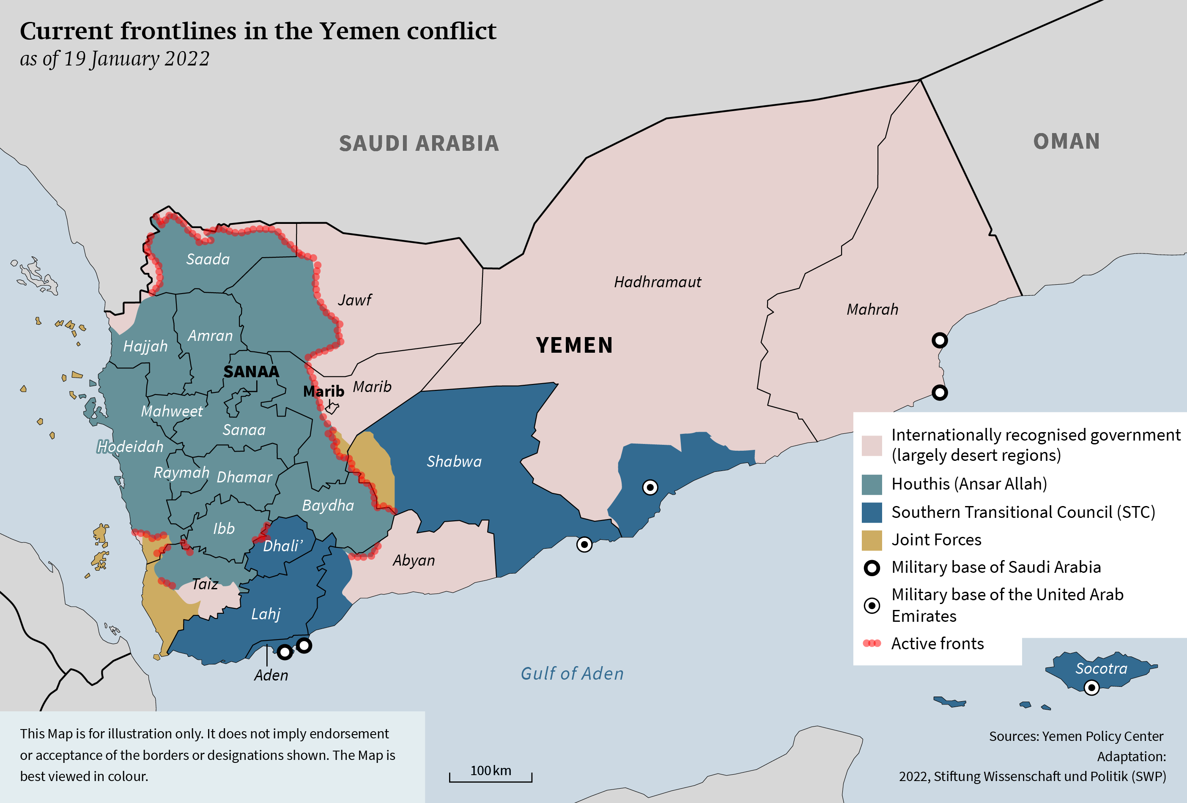
Current situation
Yemen is a fragmented state into several territories with competing authorities and interests

Slide 26
No such a thing as Yemen nation or Yemeni citizenship
at least two states as the powers are regionally divided in the prosperous “capitals” South Aden (STC) and North Sanaa (Houthis vs. pro-Hadi Coalition)
Saudi objective is for an agreement to unify two major anti-Houthi parties and provide fundamentals for a new one-state solution respecting the Saudi interests and diminishing the Iran influence
Notes:
There is no military solution to this war
2021 Joe Biden announced an end to U.S. support for Saudi-led offensive operations in Yemen

Slide 27
Questions?
Thank you for your attention!

