Slide 1
Age, Life cycle and Politics
Pmcb1013: Citizens, media and public opinion
11th November, 2024
Karolína Bieliková

Slide 2
How do you get your news everyday?
How do you your parents get their news?
How do your grandparents?
Does your political attitude differ?

Slide 3
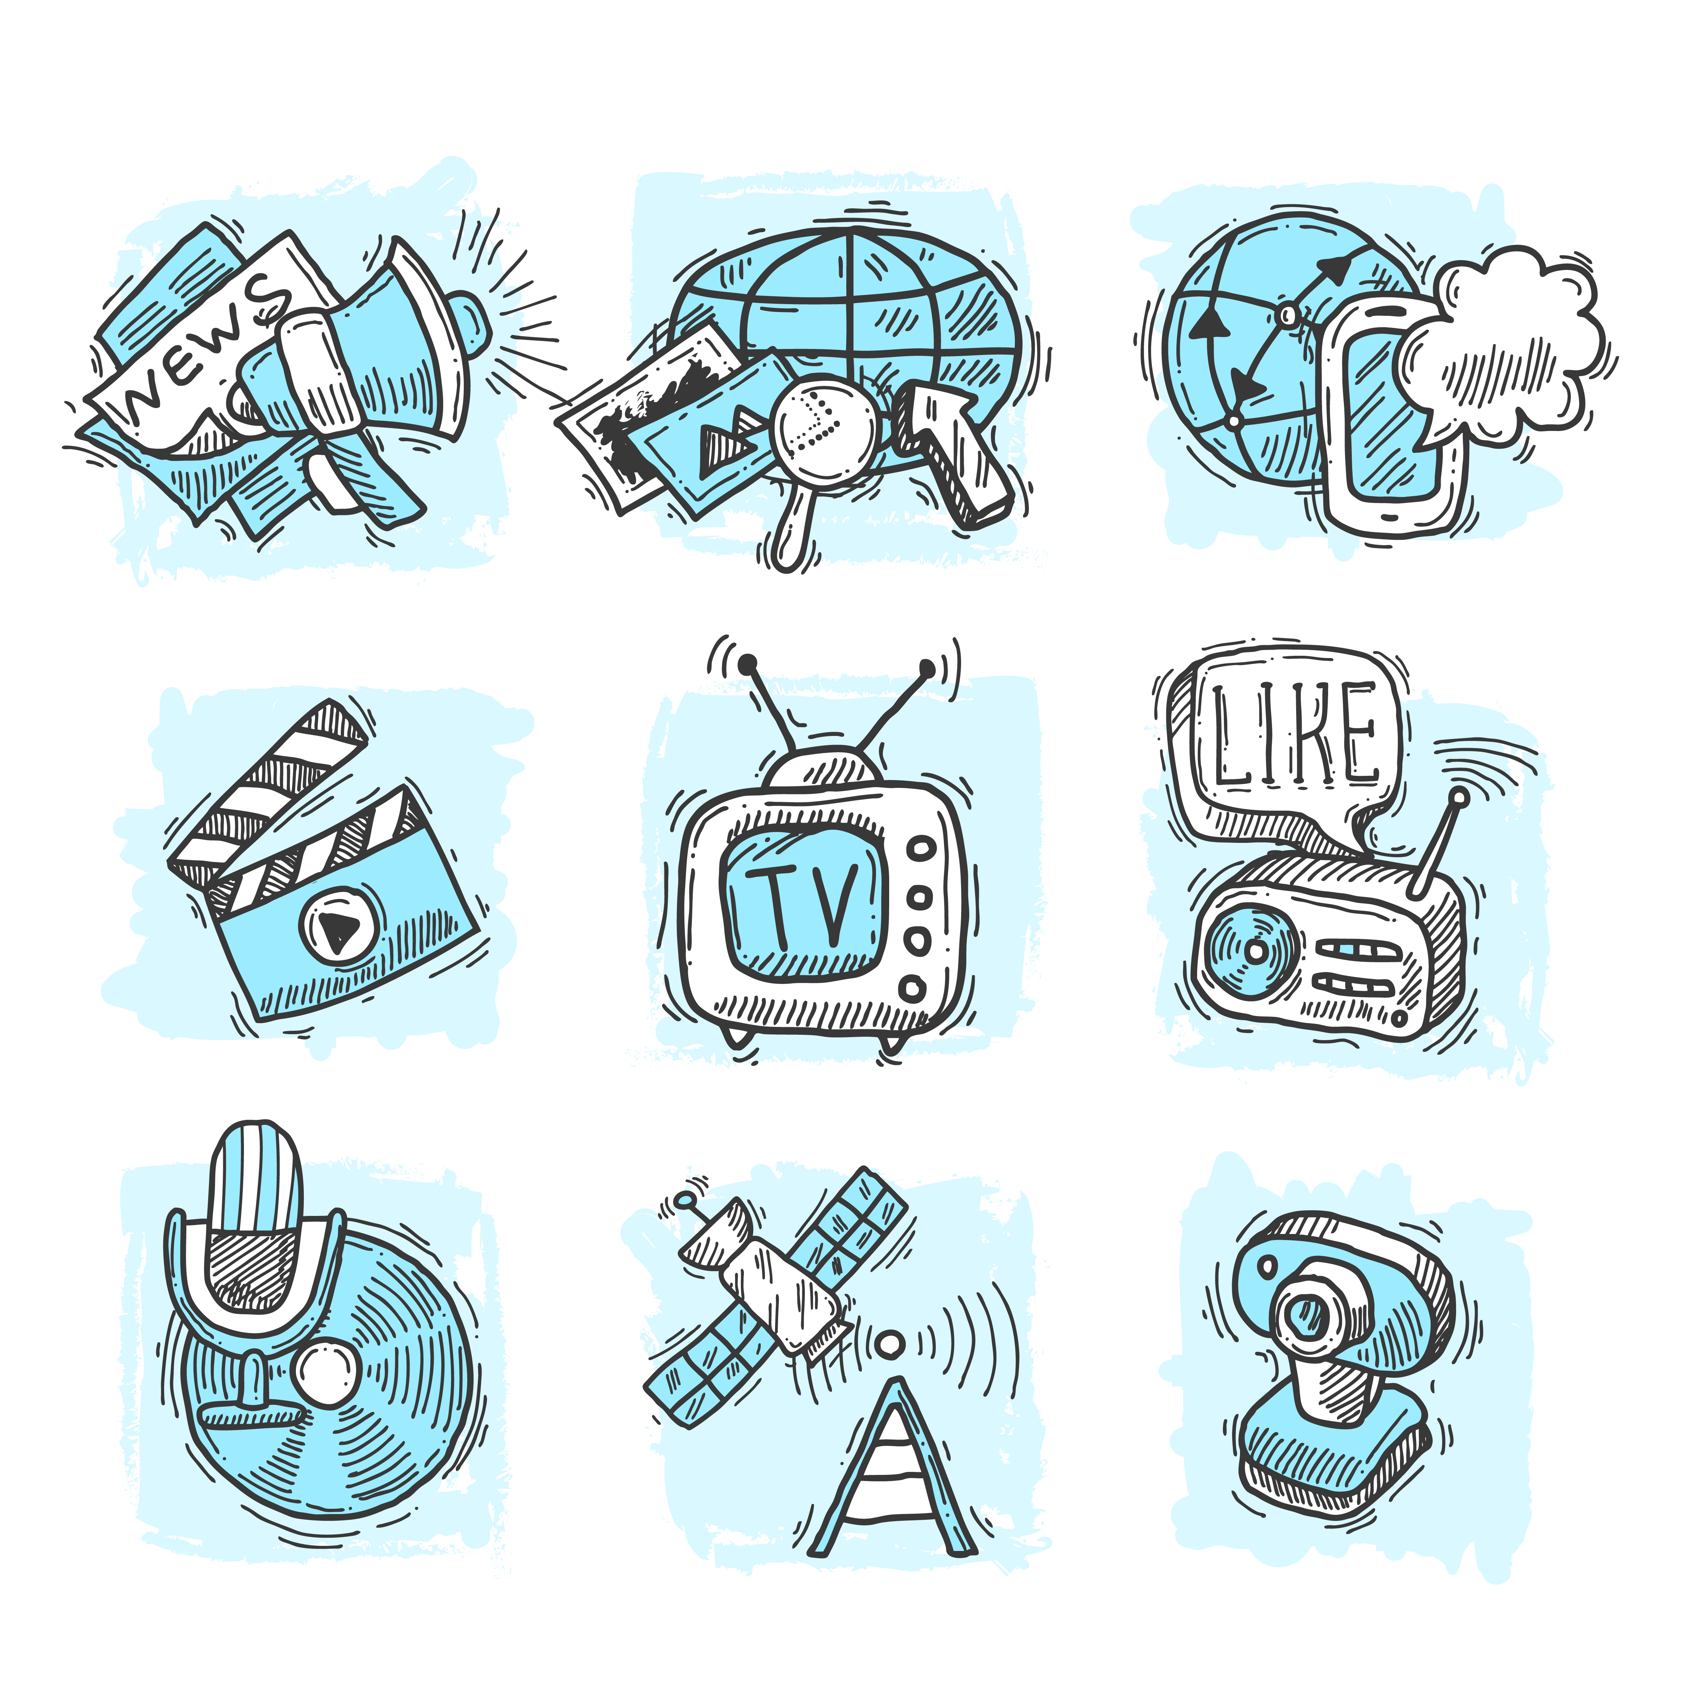
Today's agenda
News consumption
Political participation
Perception of citizenship
Election time

Slide 4
Different generations
Traditionalists (1922 – 1944)
Baby boomers (1945 – 1964)
Gen X (1965 – 1979)
Millenials (1980 – 1994)
Gen Z (1995 – 1997)

Slide 5
Why is news consumption important?
News use is a vital factor in influencing people's political opinions and engagement
Higher political information consumption leads to higher political participation (Boulliane, 2020)
New information environment first seen as an opportunity for better informed citizens and higher levels of participation
  BUT currently can be seen also as a challenge to this established conviction
    Influence of news consumption on social media (Knoll, Matthes, & Heiss, 2020)
    Dissemination of mis/disinformation (Vasoughi, Roy & Aral, 2018; Winnterlin et al., 2023)

Slide 6



Road to participation
Independent media
Informed citizen
Political participation

Slide 7
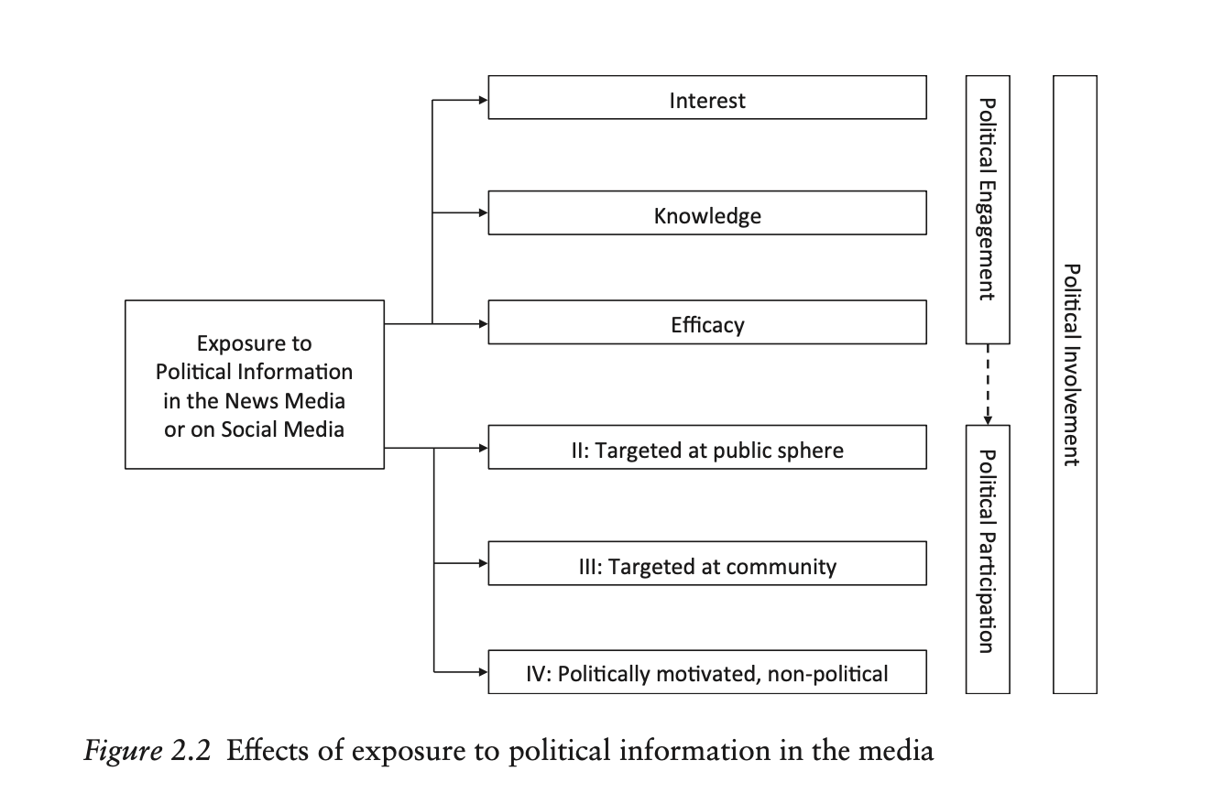
Road to Participation

Slide 8

News consumption
Differences between generations

Slide 9
Change in supply side
Growing number information sources
  Personalized media diets (different levels of political content)
New forms of information sources, that do not adhere to the same ethical and practical rules of traditional journalism – social media
Change in the news format
Combining hard news with entertainment
Using click-bait

Slide 10

Change in demand side
Continuing decrease in news subscription
New ways of consuming news:
  News-snacking
  News-find me
  Small group of political news junkies

Slide 11
Objective vs. Subjective knowledge
New forms of news structures is based in new forms of news consumption, e.g. mobile phones
Consuming news through headlines or social media can impact what we gain from the information we are consuming
  Objective vs. Subjective knowledge (Dreston & Neubaum, 2023)
This further impacts political attitudes and/or willingnes towards political participation (Ohme, 2020)

Slide 12

News consumption of our (grand)parents
Focus on traditional media - newspapers, tv, radio
  Based on tradition and habit – influences also trust
Some use of social media and accidental exposure to news
Specific sources actively targeting older people – chain emails

Slide 13
News consumption of younger generations
More focus on online sources (Boulliane & Shehata, 2021)
  Rejecting traditional news formats
  No source preference
Use of social media as a source of information and a platform for expression (Andersen et al., 2020)

Slide 14
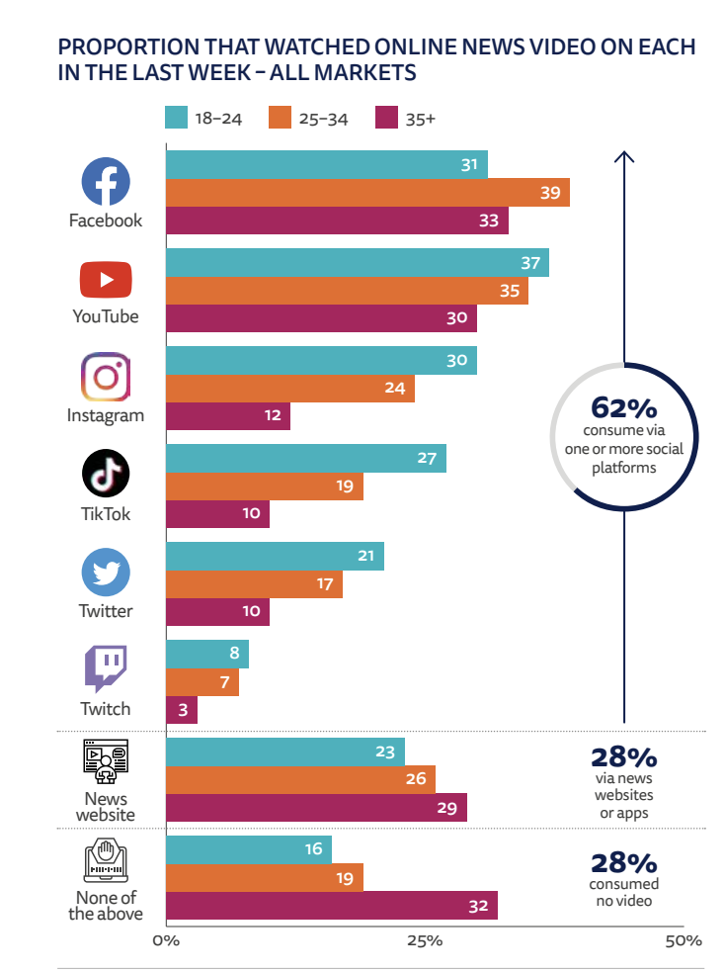
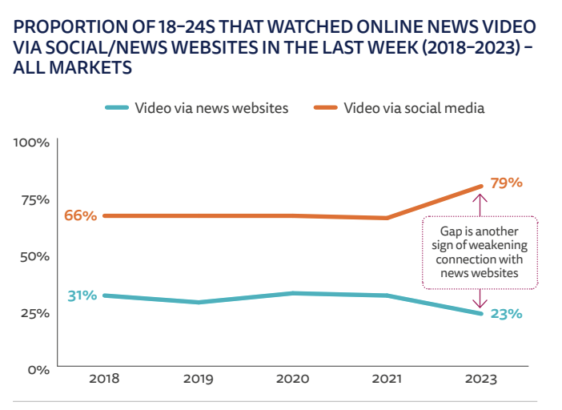
Who gets information where

Slide 15
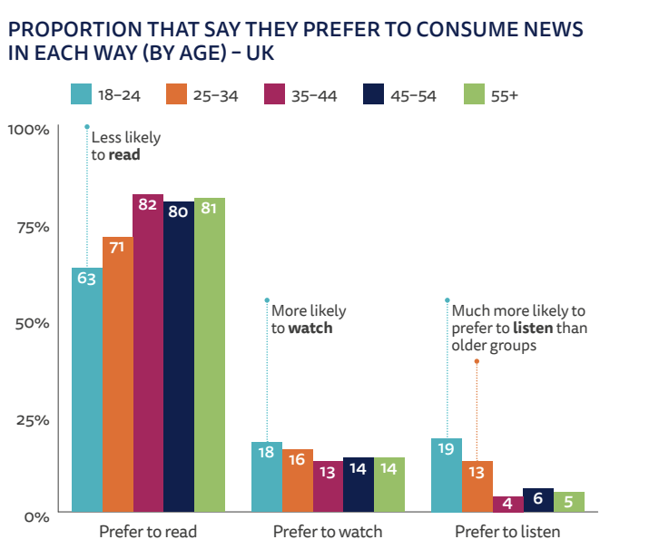
Who gets information where

Slide 16
"when a generation has grown old they have already developed strong media habits, which change slowly, whereas when individuals are young there is greater responsiveness to emergent news media that has to do with them being in a formative phase in life. During this period they are more open to trying new media and domesticating these into their lives."
(Westlund and Weibull (2013: 167)

Slide 17

Political participation and attitudes

Slide 18
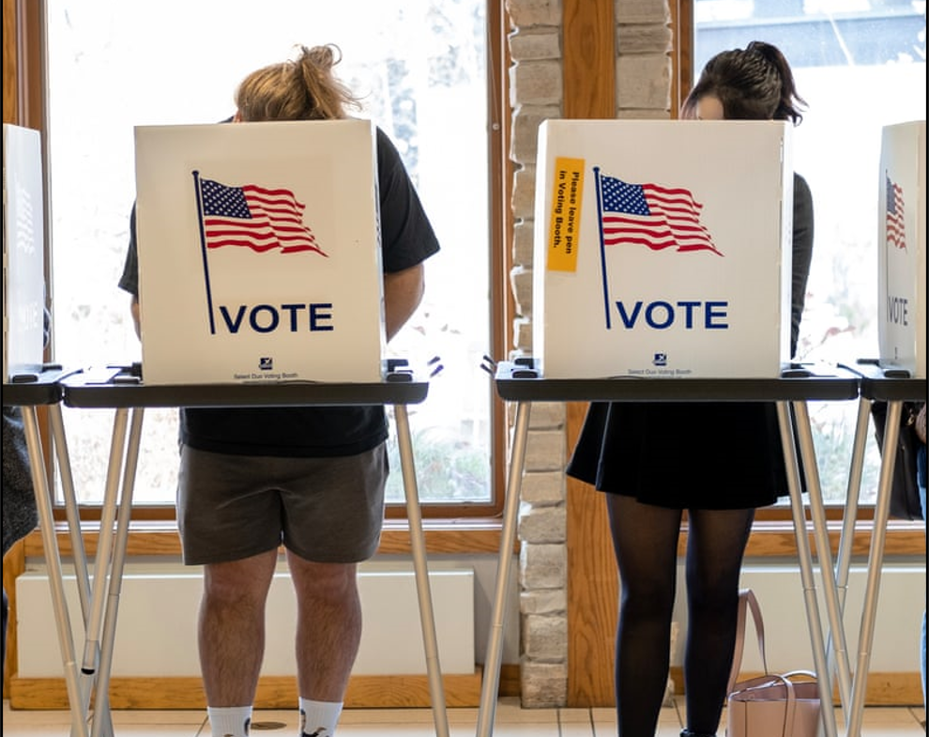
Political participation
‘those activities by private citizens that are more or less directly aimed at inﬂuencing the selection of governmental personnel and/or the actions they take’ (Verba & Nie, 1972)
Reflects activities not attitudes
Spectrum of what activities are political participation is getting wider with the use of internet and growing number of social media (Waeterloos, Walrave, & Ponnet, 2021; Lee & Kim, 2021)

Slide 19
Traditional forms of participation (Verba & Nie, 1972)
Verba and Nie’s seminal deﬁnition cited above, political participation has four minimal deﬁnitional features:
  (i) participation is an activity,
  (ii) it is voluntary and not ordered by a ruling class or obliged under some law,
  (iii) it refers to people in their role as non-professionals or amateurs,
  (iv) it concerns government, politics, or the state
Voting
Cooperative activity
Campaign activity
Citizen- initiated contact

Slide 20
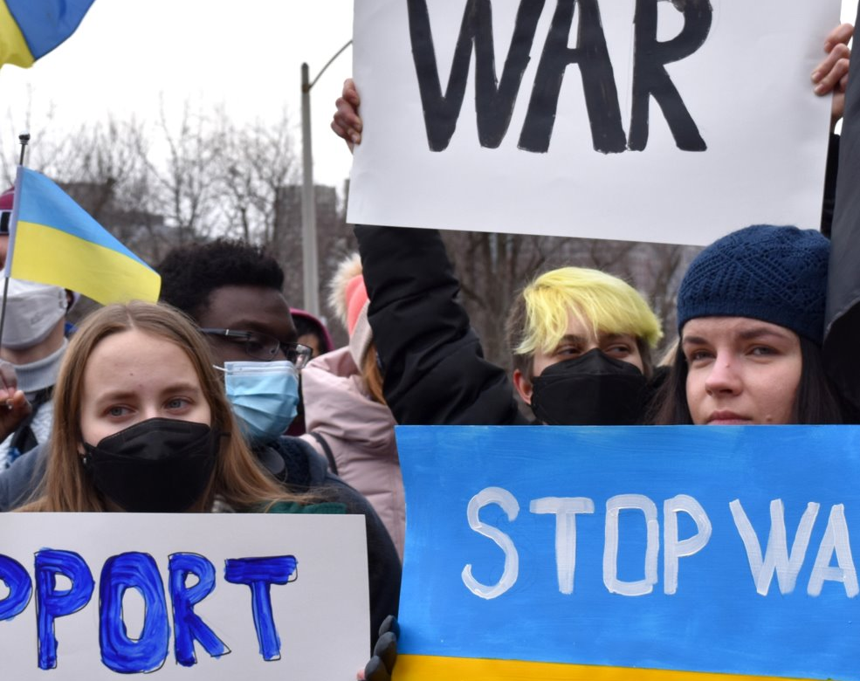
New forms of participation
Opening up the definition of participation: ‘any dimensions of social activity that are either designed directly to inﬂuence government agencies and the policy process, or indirectly to impact civil society, or which attempt to alter systematic patterns of social behavior’ (Norris, 2002: 16)
Blurring the boundaries between political and civic participation
Additional forms of participation such as joining boycotting or attending demonstrations

Slide 21
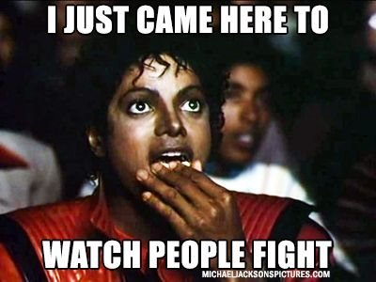
Role of social media
Both the place to get information and to participate
User can also become a source of information
  Influencers
  Comments
Place of political discussion:
  Shapes perception on what topics are important
  Forms a picture of how political attitudes look like in society

Slide 22
Life- cycle perspective
Political interest and participation related to which cycle of life you are in – what are you priorities?
the frequency of participation increases from early adulthood onwards and only drops in the very last stages of life
In younger years, immediate life challenges, such as education, career planning, dating, and identity building, make political involvement less of a priority
With responsibilities of adulthood, such as starting a family, work, and paying taxes, political decisions become more relevant in their lives

Slide 23

Cohort effect perspective
Challenges the life-cycle perspective
Each generations has different formative experiences
Motivation for participation and political attitudes is based in specific events/periods throughout life (e.g. Cold War, Communism, 9/11)

Slide 24
Cohort effect perspective
Socio-economic situation in the formative years
  Citizens’ levels of education, the norms and values of their time, and their political socialization create a ‘generational imprint’ that shapes their political participation throughout life
With time the way of expressing themselves becomes habitual and defines the way a generation engages in politics
Early experiences with the political system leaves a permanent mark on adolescents and young adults that afects their future political behaviour

Slide 25
Generations and their characteristics
Traditionalists (1922 – 1944)
  World War II and Great Depression
  Respect authorities through values like obedience, diligence, and duty
Baby boomers (1945 – 1964)
  Contrasting Traditionalist: optimistic, collectivistic, and embracing the free expression of opinion
  Grew up in politically stable and economically prosperous times
Gen X (1965 – 1979)
  grew up in a highly modern world with less stable social structures
  Questioning traditional norms (e.g. family)
  Less faith in political and economic promises and are known as the frst generation to regard political protest as an appropriate means of political expression

Slide 26
Generations and their characteristics
Millenials (1980 – 1994)
  Coming-of-age years are characterized by media coverage about permanent threats
  Do not take stability and economic well-being for granted but nonetheless decide to keep an optimistic pace in life
  Greater fexibility in life models
Gen Z (1995 – 1997)
  Born into the new information age (digital natives)
  Percpetion of the world as rather unsafe but at the same time sharpened their global awareness
  Believe in power of the network, when it comes to political participation and civic engagement

Slide 27
Road to Participation

Slide 28
Political interest
" citizen's willingness to pay attention to political phenomena at the possible expense of other topics” (Lupia and Philpot 2005)
one of the most important personal motivations explaining news media use and various forms of political engagement
Shaped by the current information environment with endless choices of information sources and forms of participation
  More important for younger generations (Boulliane & Shehata. 2021)

Slide 29
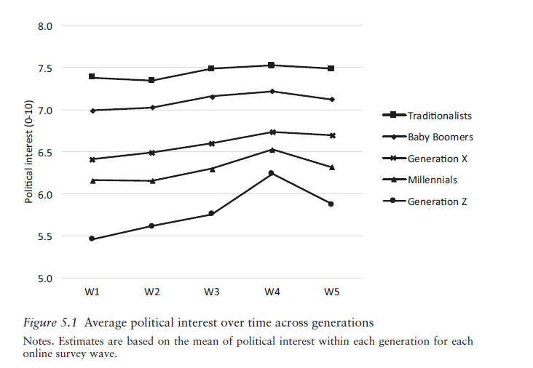
Political interest

Slide 30
Political knowledge
News media as a crucial source for whta we learn abotu politics
Older generation tend to know more about the ongoings in politics
Political knowledge rises in election time and generation gaps become smaller

Slide 31
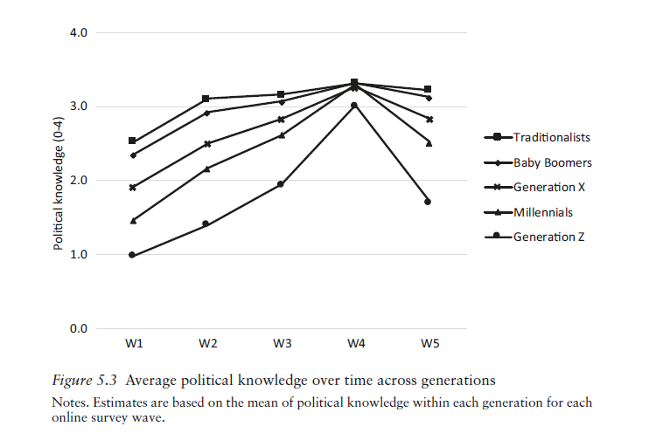
Political knowledge

Slide 32
Political efficacy
‘individuals’ self-perceptions that they are capable of understanding politics and competent enough to participate in political acts’ (Miller et al., 1979, p. 253)
Political efficacy may rise with more political experience, specifically voting
Exposure to political information in the news media is likely to have a positive effect on the feeling of being efficacious

Slide 33
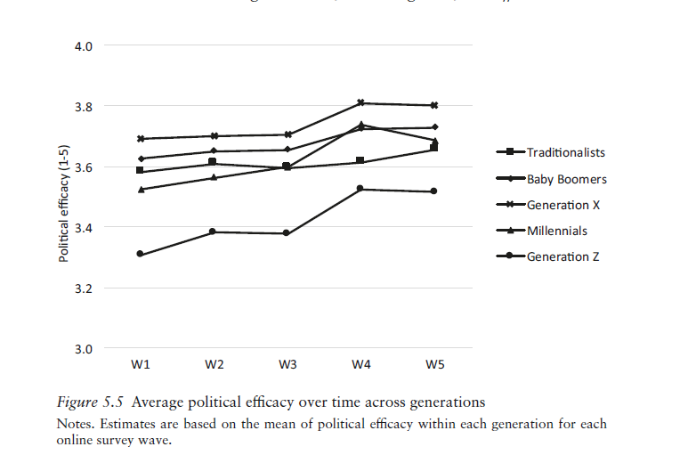
Political efficacy

Slide 34
Types of citizenship
Self-actualizing citizenship
Driven by a personal intrinsic motivation
Typical for younger generation
Cause-oriented
Motivated by self-actualizing goals
Formed by the digital information environment
Dutiful citizenship
Driven by an extrinsic sense of duty or importance
Typical for older generation
Socialized habits oriented toward institutional politics
Shaped by the use of traditional media

Slide 35
Election time!
Heightened exposure to political content
Media are especially relevant for younger voters since they have just entered the political system and are more uncertain than older generations about whom to vote for in their frst elections (Ohme, de Vreese, & Albæk, 2018)
Difference in political activities across generations before election

Slide 36
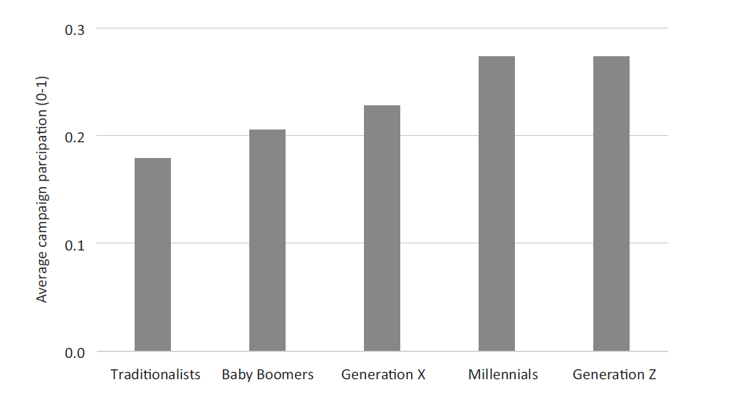
Election time!

Slide 37
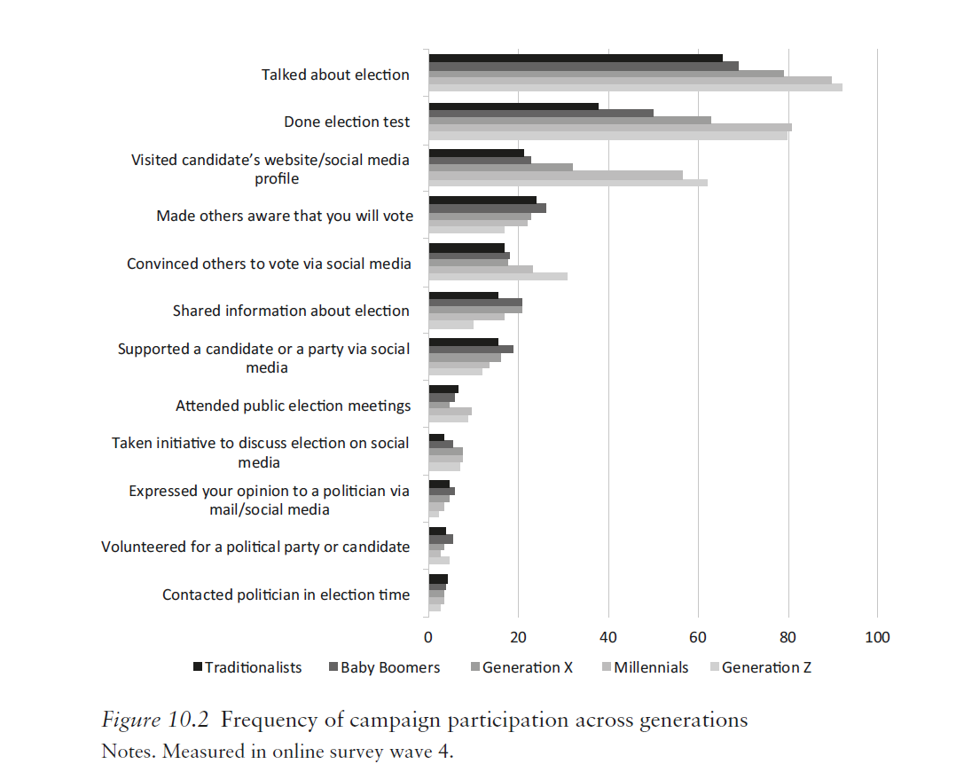
Election time!

Slide 38
Are the kids alright?
For young citizens, higher political engagement is a more important precondition for news exposure on both traditional media and social media
Generations who had more time throughout their lives to develop political interest and efcacy more easily consume news = life-cycle difference
Older generations are more politically active than the younger ones besides election
Younger generations are prone to using news types of political participation (social media)
Older generation using social media often targeted against the political system

Slide 39
