Slide 1

Attitude change and persuasion
POLb1013
14 October 2024

Slide 2

Have you ever changed your mind on politics?
What caused it?

Slide 3

Converse‘s Black and White Model
Either stable attitudes (no change)
Or non-attitudes
Gray are too small to be considered
But can people meaningfully change their minds?

Slide 4
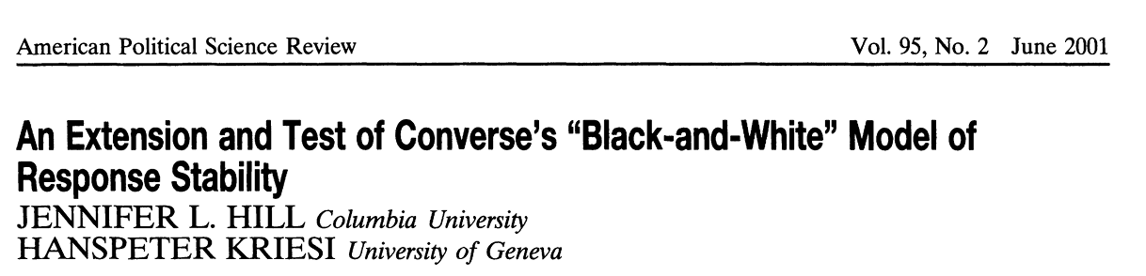
There actually is the grey area
Use of panel data
Example from Switzerland
Issue: air pollution
Opinion holders: 37-58%
Durable changers: 2-8%
Vacillating changers: 39-58%

Slide 5

Why do people change opinions?

Slide 6

Learning new facts
New information from environment
Update of existing opinions
Rational process
Bayes’ Rule

Slide 7
Is this how you update your preferences?
How accurate the model is when you encounter something which is not congruent with your attitudes?

Slide 8
What processes bias attitude change?
Cognitive dissonance: Leon Festinger (1957)
  How people process information contradictory to their beliefs?
  Events after the midnight of 21 December 1954
  Mental discomfort when two or more beliefs are contradictory
  Drive to hold attitudes (and behavior) in harmony
  Beliefs resistant to change
Motivated reasoning: Kunda (1991)
  Accuracy goals
  Directional goals

Slide 9
Hot cognition
Role of affect in political reasoning
Redlawsk 2002:
  People take longer time to process negative information about their preferred candidate
  They strengthen their support for the candidate despite the negative information

Slide 10
Motivated reasoning
Taber and Lodge 2006, 2013
Hot cognition
Affect primacy and Affect transfer
Motivated reasoning:
  Disconfirmation bias
  Confirmation bias
  Selective exposure
Polarization by incongruent information
Sophistication paradox

Slide 11
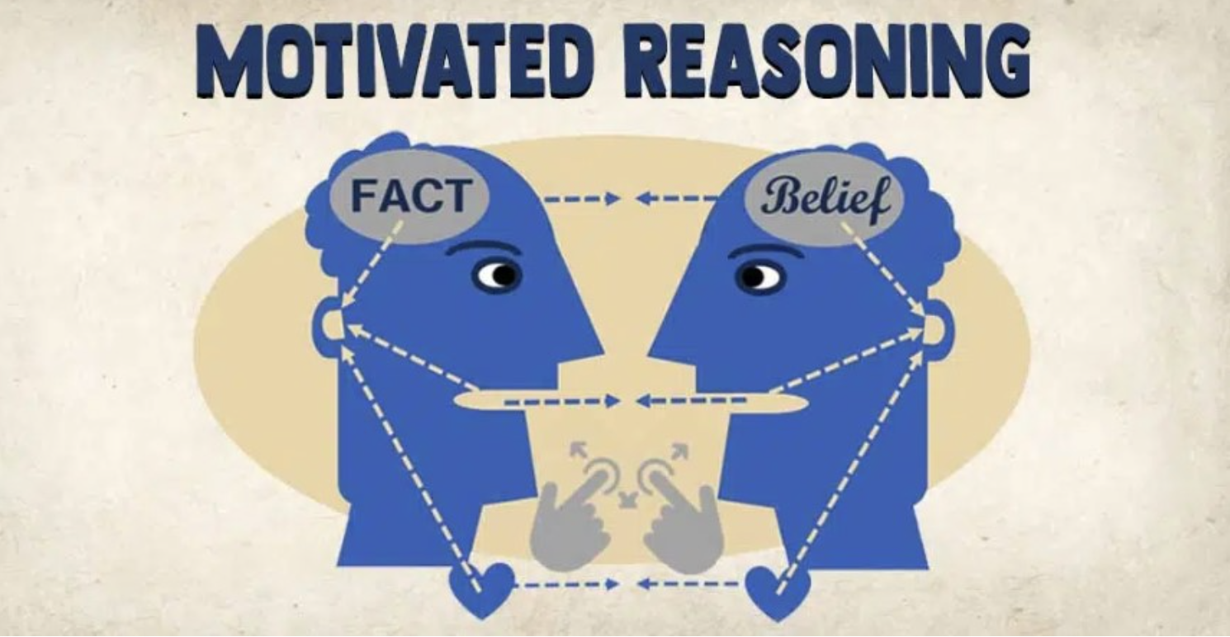
Examples of motivated reasoning?

Slide 12
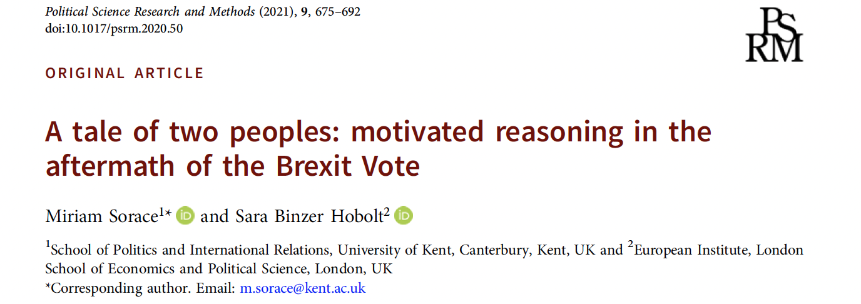
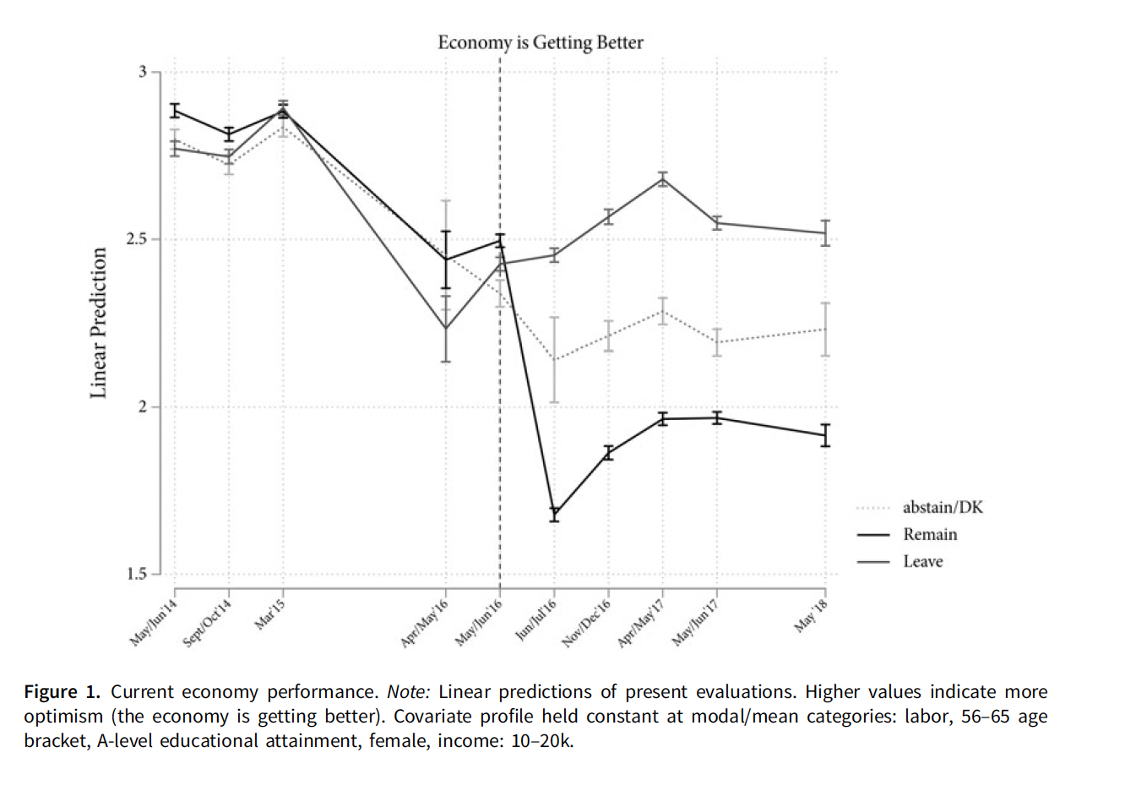
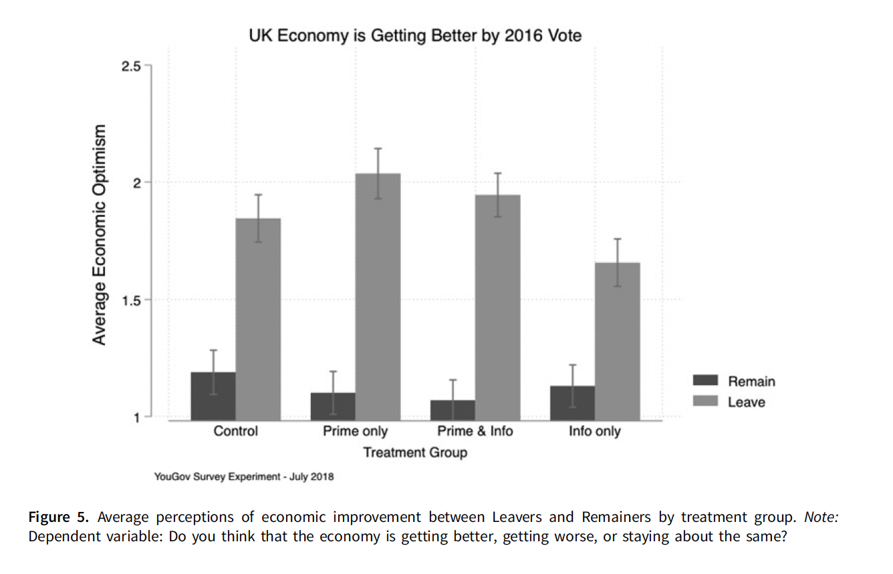
Perception of economy

Slide 13
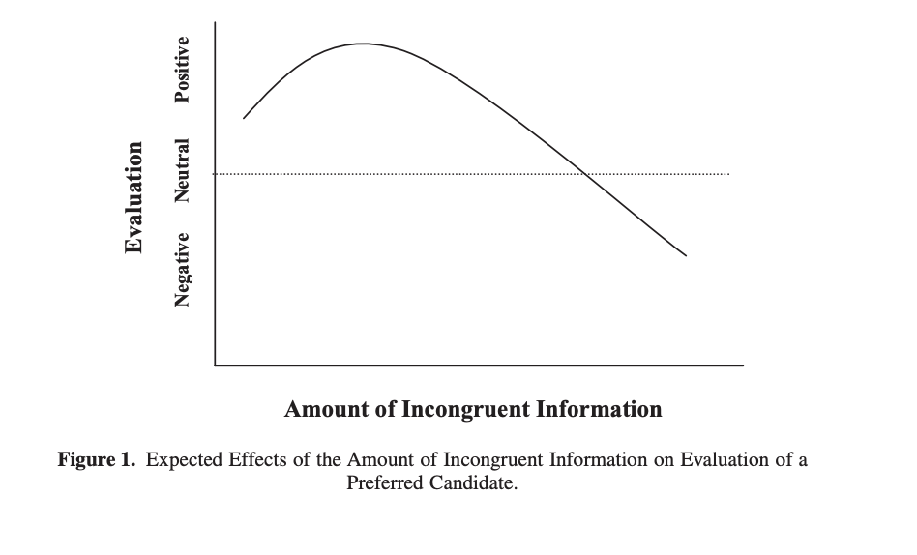
How is change possible?
Weak attitudes
Unsophisticated citizens (new issues, not contested issues, difficult issues)
Affective tipping point! (Redlawsk, Civettini, Emmerson 2010)
Accuracy motivation (Bolsen, Druckman, Cook 2014)
Emphasizing open-mindedness

Slide 14
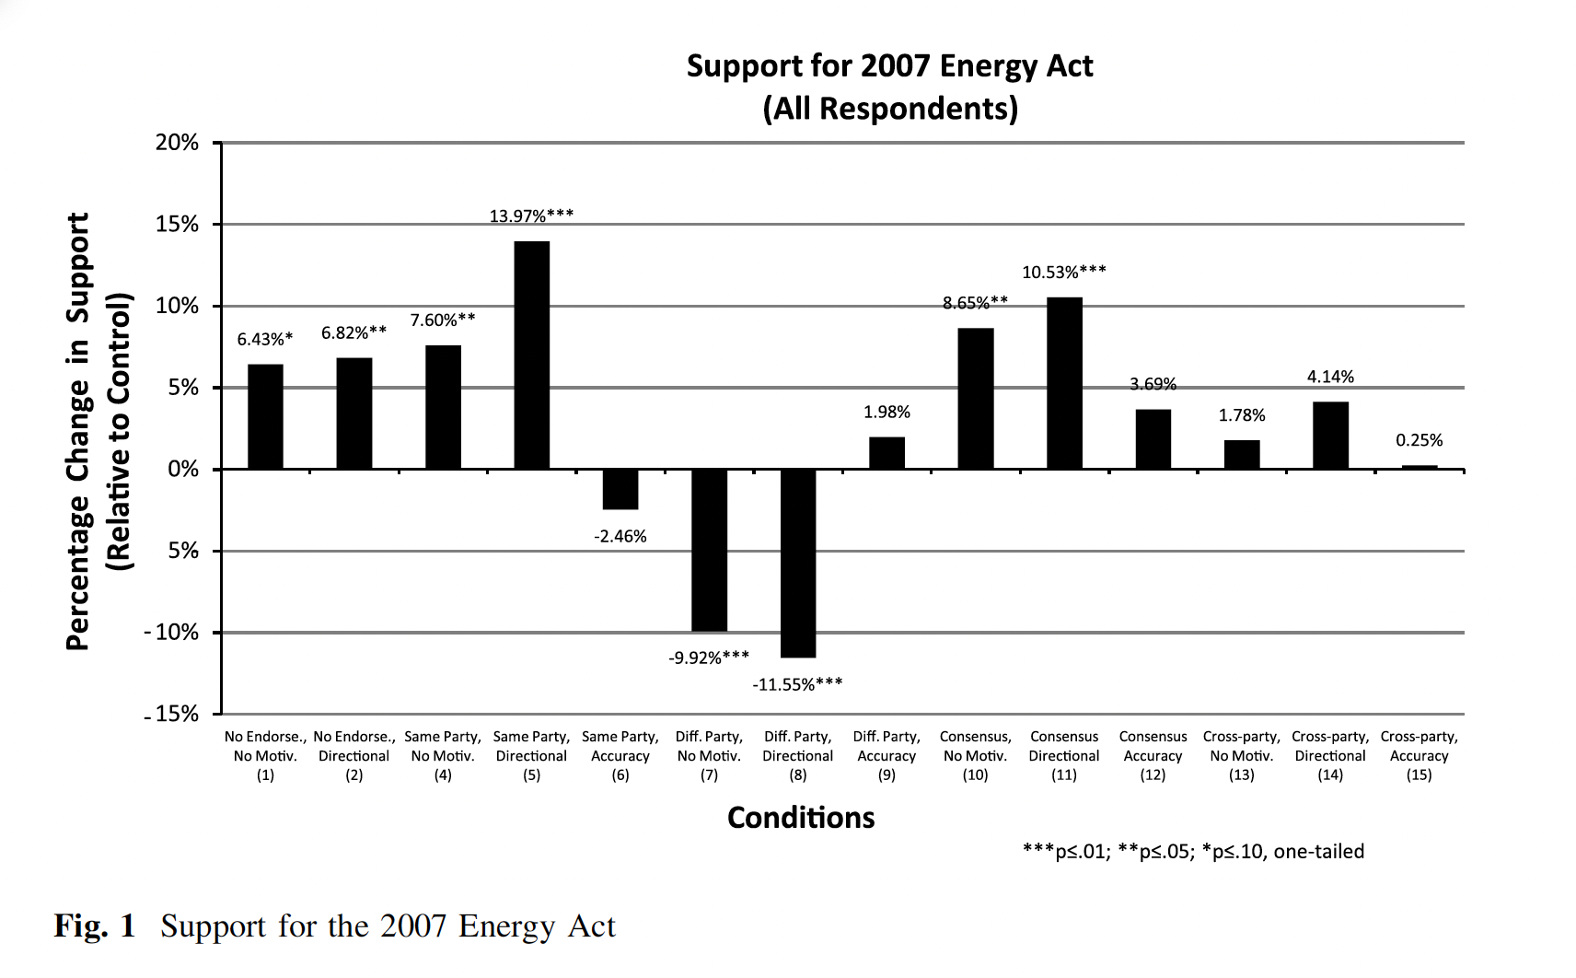
Accuracy motivation (Bolsen, Druckman, Cook 2014)

Slide 15
Persuasion in politics
Change of attitudes as a result of targeted messages
Political messages, campaigns, media, day to day conversations, science communication
“A successful intentional effort at influencing another’s mental state through communication in a circumstance in which the persuade has some measure of freedom” (O‘Keefe 2016)
Large body of research, little systematization

Slide 16
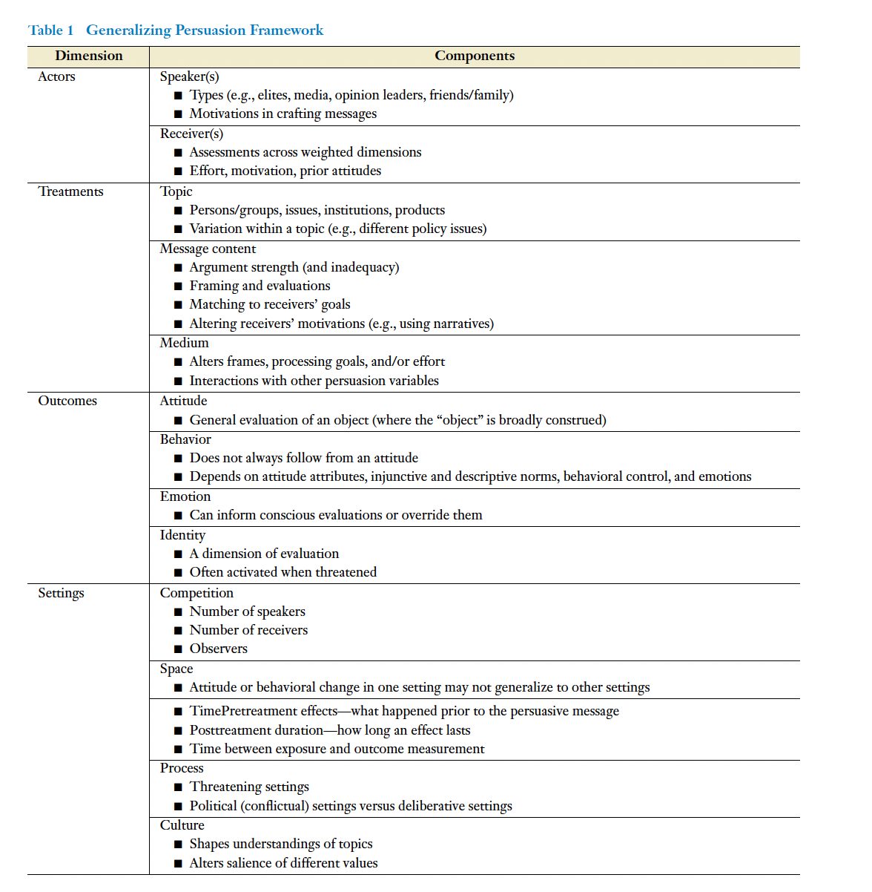
Druckman‘s Generalizing Persuasion Framework

