Slide 1
Attitudes, opinions, attitude stability
POLb1013
7.10. 2024

Slide 2
What is an attitude?
“.. a mental and neural state of readiness, organized through experience, exerting a directive and dynamic influence upon the individual's response to all objects and situations with which it is related" (Allport 1935, p. 810).
"An attitude can be defined as an enduring organization of motivational, emotional, perceptual, and cognitive processes with respect to some aspect of the individual's world" (Krech and Crutchfield 1948, p. 152).
Or the probability that a person will show a specified behavior in a specified situation.

Slide 3
Newer apporaches
More emphasis on evaluative dimension:
„Attitudes are likes and dislikes“ (Daryl Bem 1970, p. 14)
„psychological tendency that is expressed by evaluating a particular entity with some degree of favor or disfavor“ (Eagly and Chaiken 1993, p. 1)
Limits: how about political phenomena? Are all attitudes equal?

Slide 4
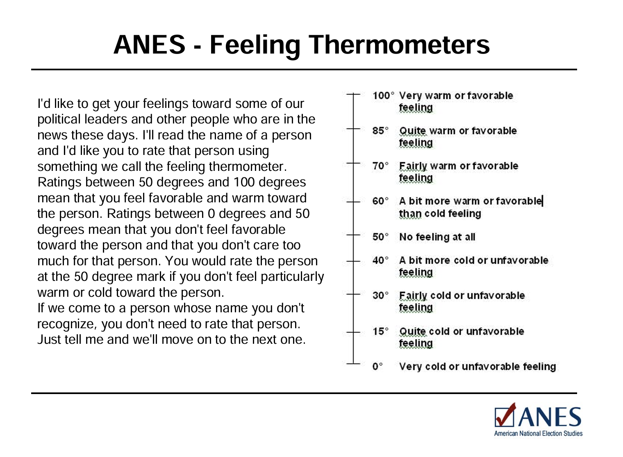
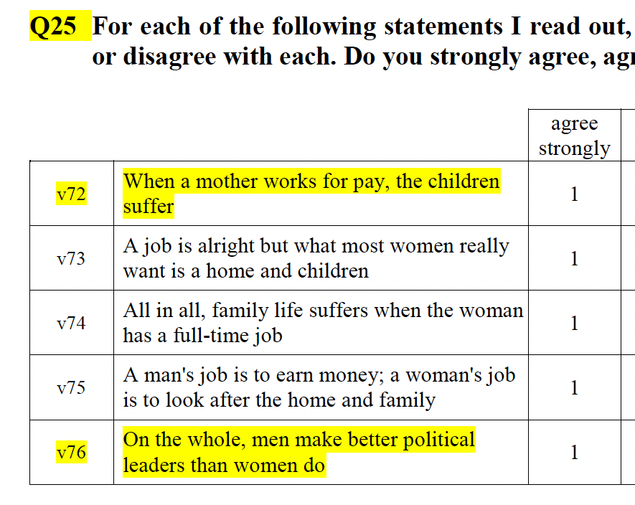

Slide 5
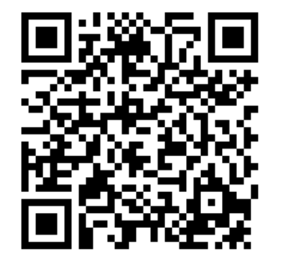
Please, answer some survey questions

Slide 6
Are all attitudes important to the same extent?

Slide 7
Are all attitudes important to the same extent?
Attitude strength
Krosnick and Petty 1995
Makes attitudes „durable and impactful“
Objective measurement
Subjective measurement
    Certainty
    Importance
    Accessibility
    Knowledge
    Extremity
    Intensity
    Elaboration
    Stability
    Moral basis
    Affective vs. Cognitive base
    Self-Relevance

Slide 8
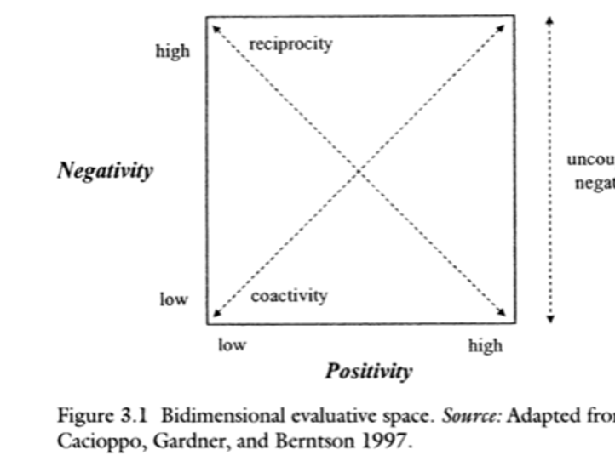
Attitude ambivalence
Can something be good and bad at the same time?
In Allport‘s definition: attitudes either positive or negative!
But things can be more complex not unidimensional
(do measures reflect this?)
People have ambivalent or contradicting attitudes!

Slide 9

Belief systems: Do people have them?
Belief system: how people organize their attitudes
Attitudes are bounded together (constraint)

Slide 10
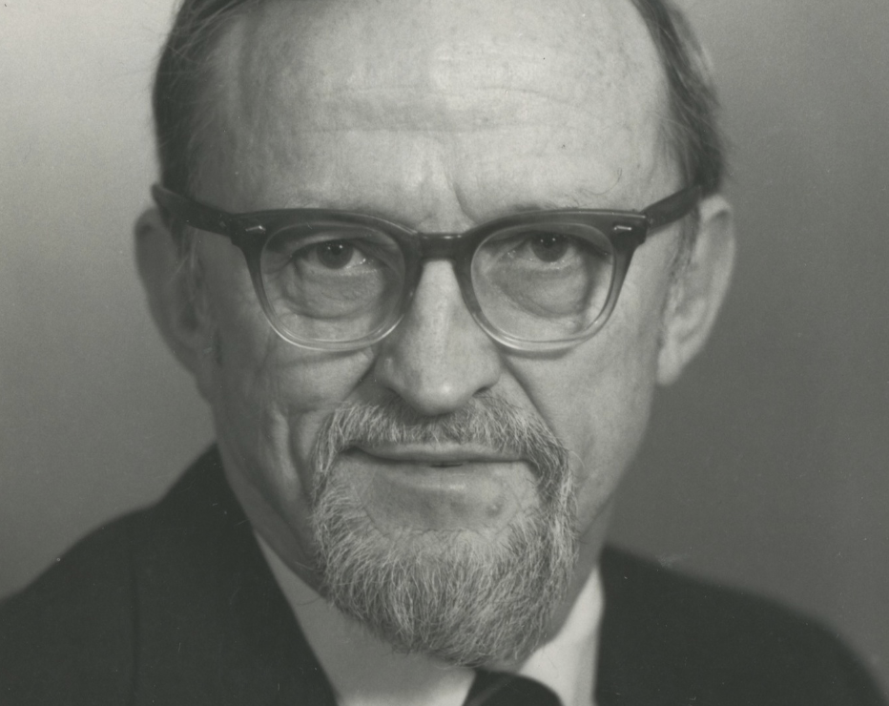
Converse: The Nature of Belief Systems (1964)
Main Idea: differences in belief systems between political elites and the mass public
focusing on how people organize their political attitudes
Key Concepts:
    Belief System (BS): A structured set of attitudes and ideas bound by constraints.
    Constraint: The degree to which knowing one attitude helps predict others within a belief system.
    Elites vs. Mass Public: Elites tend to have more consistent and structured belief systems, while the public often has less constrained, less coherent systems.
    Non-attitudes: people don‘t have structured attitudes

Slide 11

The Nature of Belief Systems
Static Constraint: one attitude (e.g., support for welfare) predicts others (e.g., opposition to tax cuts)
Dynamic Constraint: changing one belief = adjusting others
Centrality of Idea Elements
Elite more constrained than the public
Elite able to use abstract ideological constructs

Slide 12
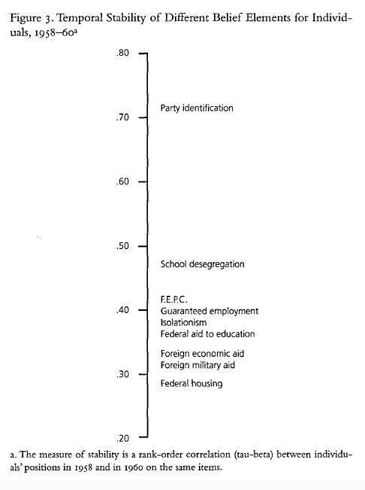
The Nature of Belief Systems
  Ideologues (10%)
  Near-Ideologues
  Group-specific interests
  Some attitudes but low constraint
  No belief system, no issue content (22%)
Shifts form liberal to conservative government not motivated by ideology!
Low levels of stability in time (13 out of 20 on the same side of dimension)
Black and white model of the public
Issue public

Slide 13
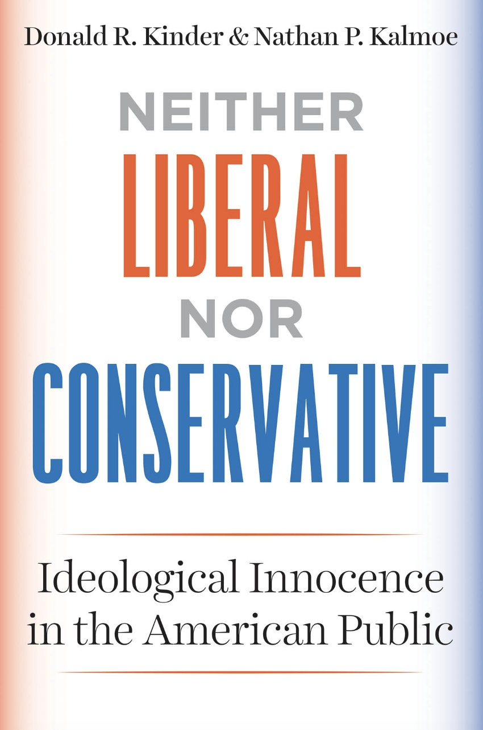
Converse’s work still alive today
Most people unconstrainted
What is the role of ideology in polarization?
Conservatives and liberals do not disagree
No increasing trend over time
US context

Slide 14
Response to Converse: Christopher Achen
„Voters are not fools!“
Not non-attitudes
Problem of methodology
Preferences as an interval
Responses not the same all the time
Vague questions = instability of responses
Even church attendance does not correlate perfectly
High interest in politics does not explain stability

Slide 15

John Zaller: R-A-S Model
Comprehensive theory
How PO works
Elite discourse
Caution when using surveys
Receive: People receive information from the political environment
Accept: They accept or reject this information
Sample: They sample from the considerations available in their mind

Slide 16
Online vs. memory-based information processing
People keep „running tally“ of object’s evaluation
Update it in real time
Forget information
Keep evaluation available
People encounter information
Store it in their memory
Retrieve from memory
Evaluate

Slide 17
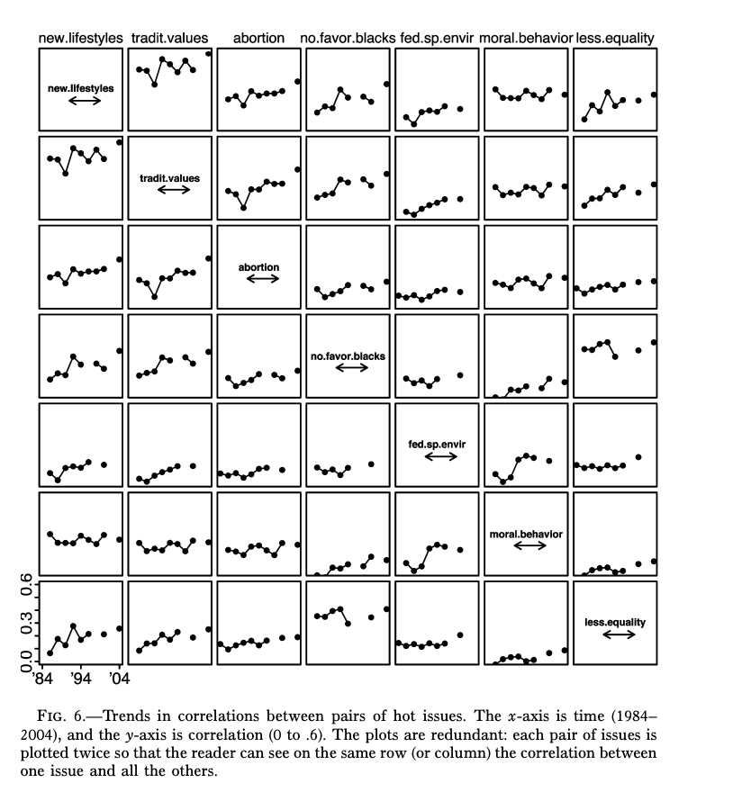
Is ideological constraint increasing?
What is polarization and how it matters for people‘s attitudes??
Baldassari and Gelman 2008, Partisans without Constraint: Political Polarization and Trends in American Public Opinion
Is US public more polarized over time (ANES 1972-2004)
Correlations between issues, issue-partisanship correlation
Partisan sorting
Issue-partisanship
Lack of constraint

Slide 18
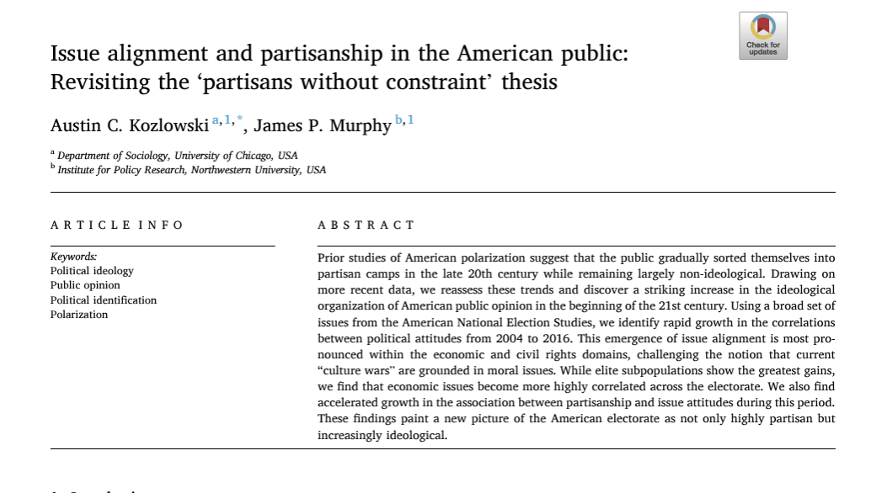
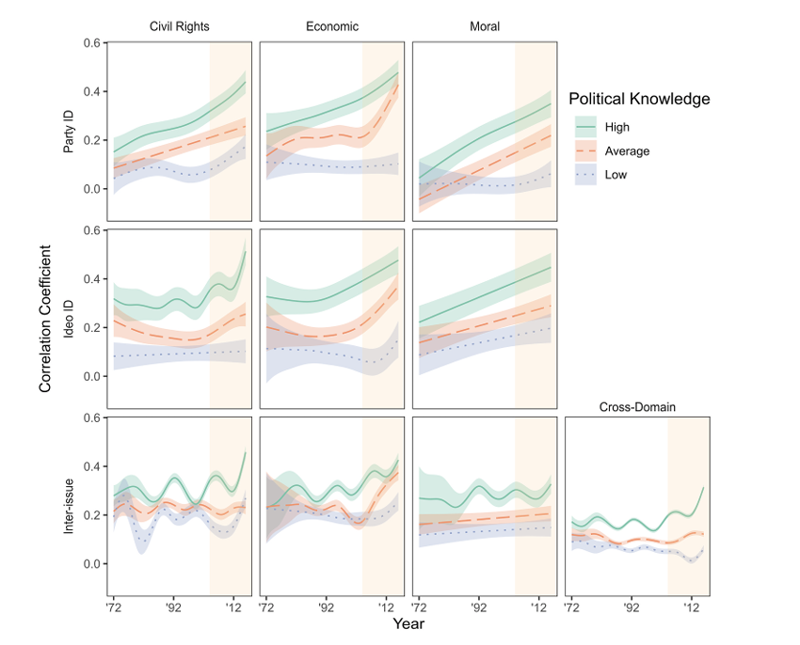
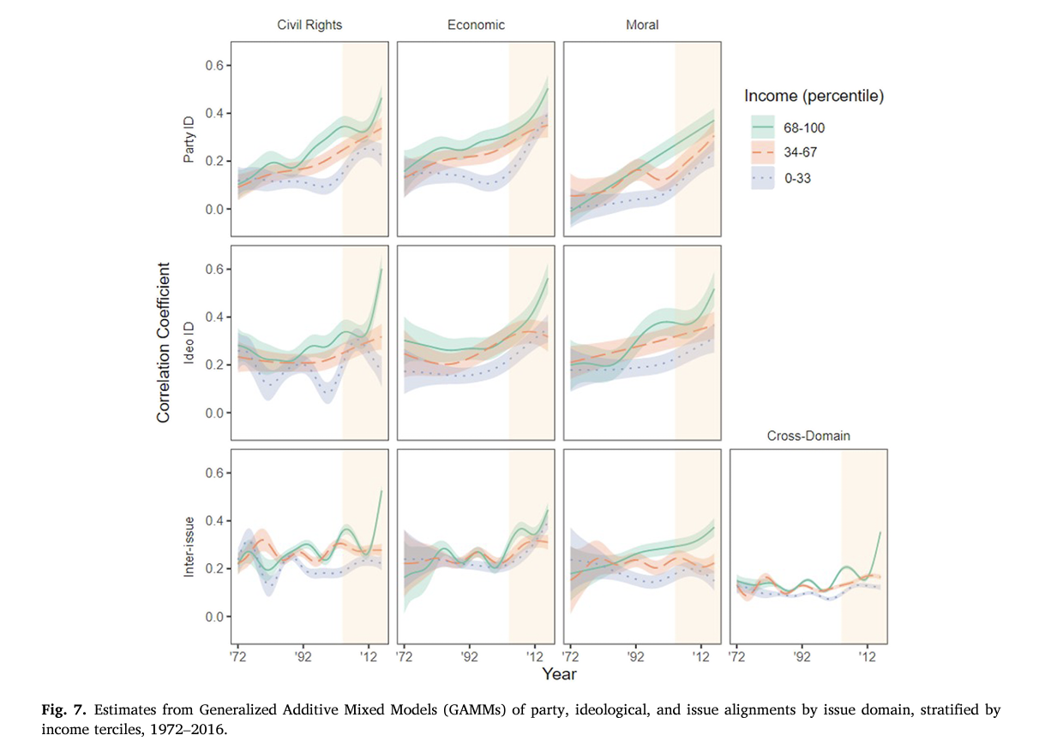
Extending the analysis to 2016
Increase of consistency after 2004

Slide 19
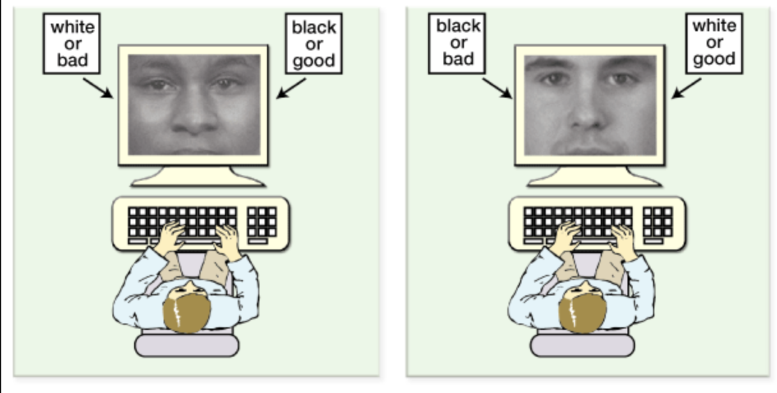
Implicit attitudes

Slide 20
Summary
Attitudes as evaluations of concepts
Different features of attitudes (strength and ambivalence)
Measurement in surveys
Converse: people without real attitudes
Differences between elites and non-elites
Others less strict (Achen, Zaller, Lodge)
Polarization = constraint might increase

