Slide 1
Ideologies
4. 11. 2024

Slide 2
Definition problem…
What is an ideology?

Slide 3
Ideologies
„Mental models that ensure interpretation of our environment and ideas about how this environment should be structured “ (Denzaou and North 1994)
„A set of ideas about the appropriate order of society and how this order should be achieved “ (Erikson and Tedin 2003)
Heywood (2019):
From a social-scientific viewpoint, an ideology is a more or less
coherent set of ideas that provides a basis for organized political action, whether this is intended to preserve, modify or overthrow
the existing system of power relationships.
All ideologies therefore
offer an account of the existing order, usually in the form of a ‘world-view’,
provide a model of a desired future, a vision of the Good Society, and
outline how political change can and should be brought about.

Slide 4
Ideologies
Descriptive and normative aspect How the world works How it should work How to achieve it
How do we perceive ideologies? Like some irrational distortion We call non-congruent opinions ideological (But not our own’s ☺ )

Slide 5
Grand ideologies
Liberalism Conservatism Socialism
What's next?

Slide 6
Ideologies in political science
Simplification of politics Effective Clear alternatives Structuring of the party system Neutral System of organization and structuring of attitudes Interpretative Frameworks

Slide 7
What does ideology often look like (in political science, in the media, in people's minds)?

Slide 8
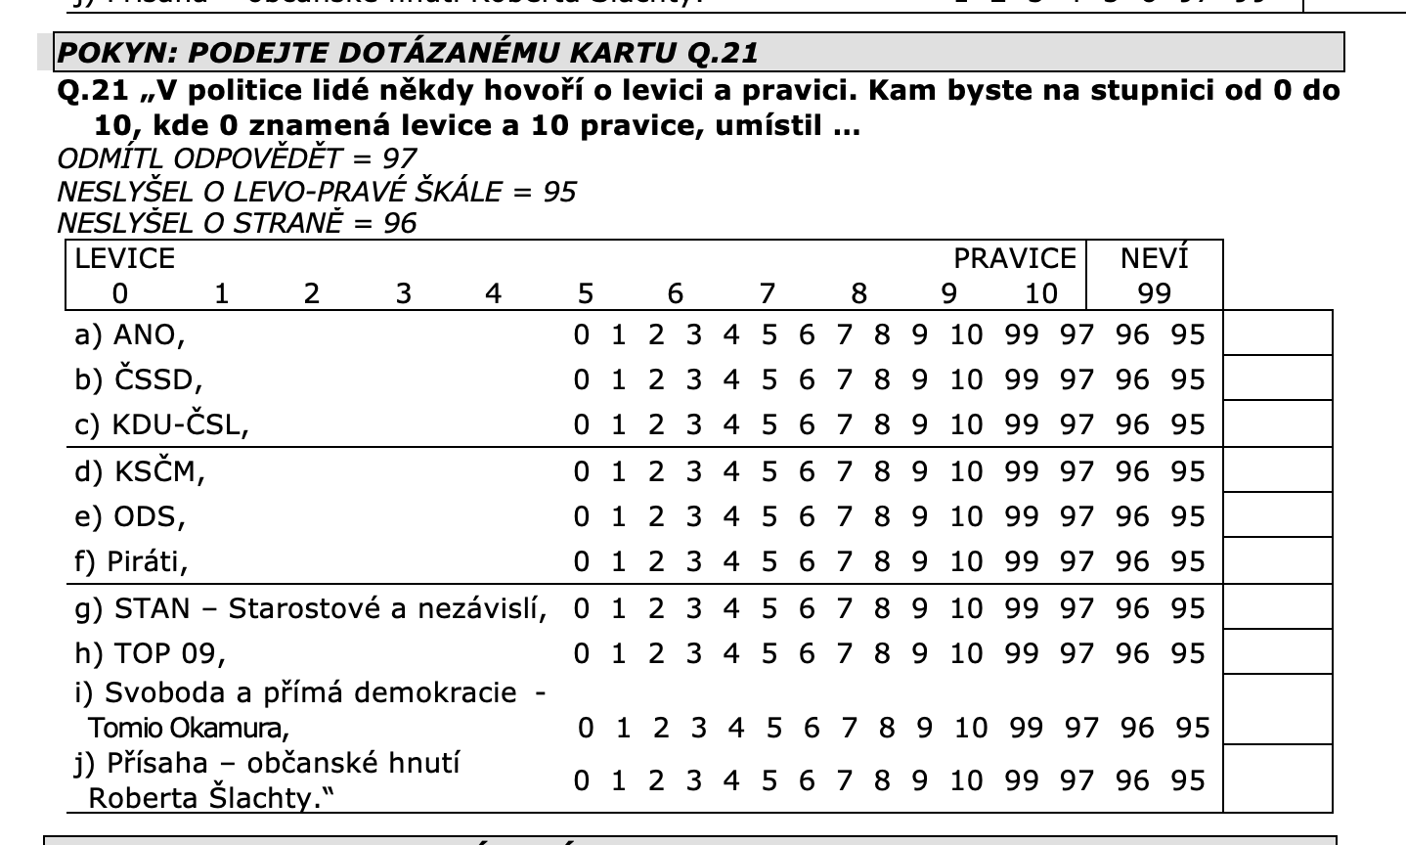
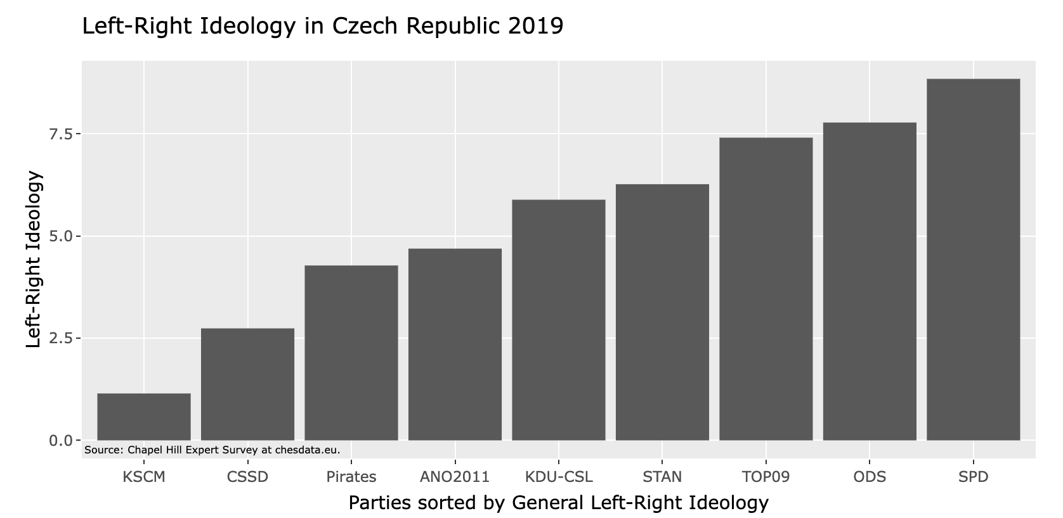
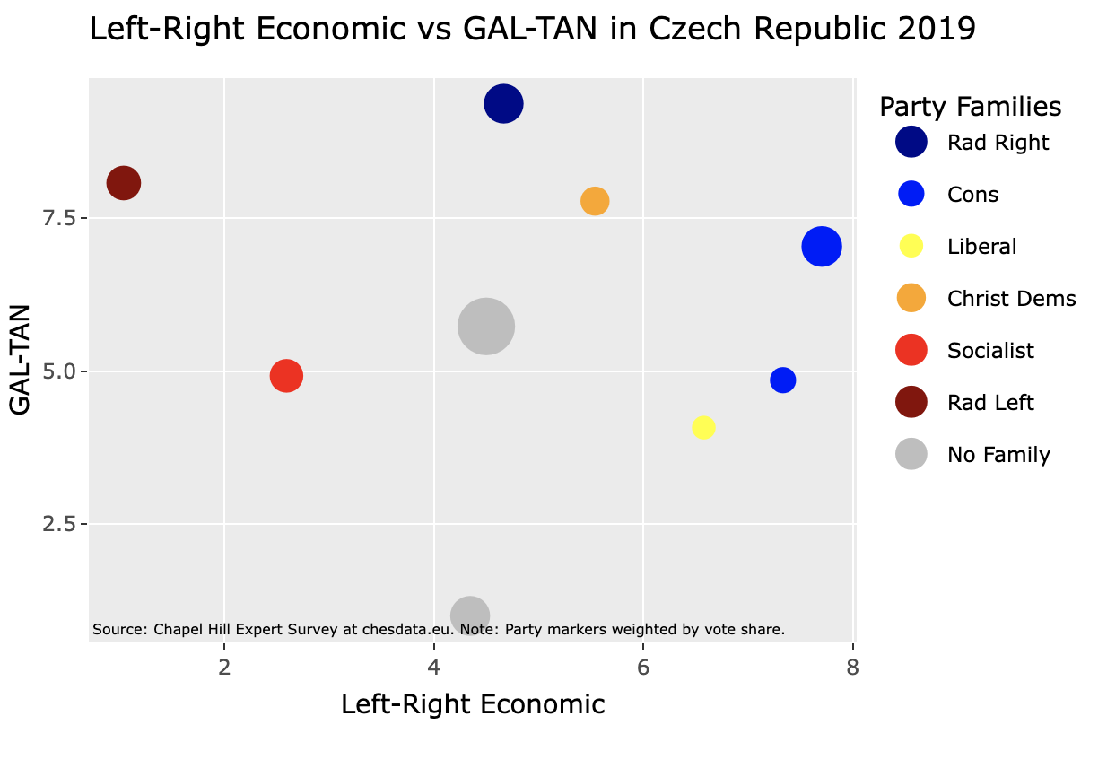

Slide 9
Left – Right (Europe) Liberal – Conservative (USA)

Slide 10
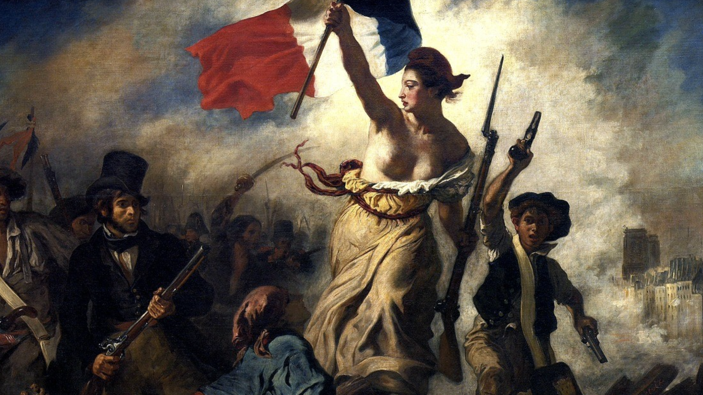
Basic political dimension
French Revolution John Jost: Left = promoting change and aversion to inequalities Right = resistance to change and acceptance and defense of hierarchy/inequality To make it easier to navigate the political space (Downs 1957) Integrates many topics into one dimension An important axis since the Industrial Revolution Communism and Fascism as Extreme Ends of the Axis Left/liberalism vs. right/conservatism (how does that make sense?) Party competition and the placement of voters in space

Slide 11
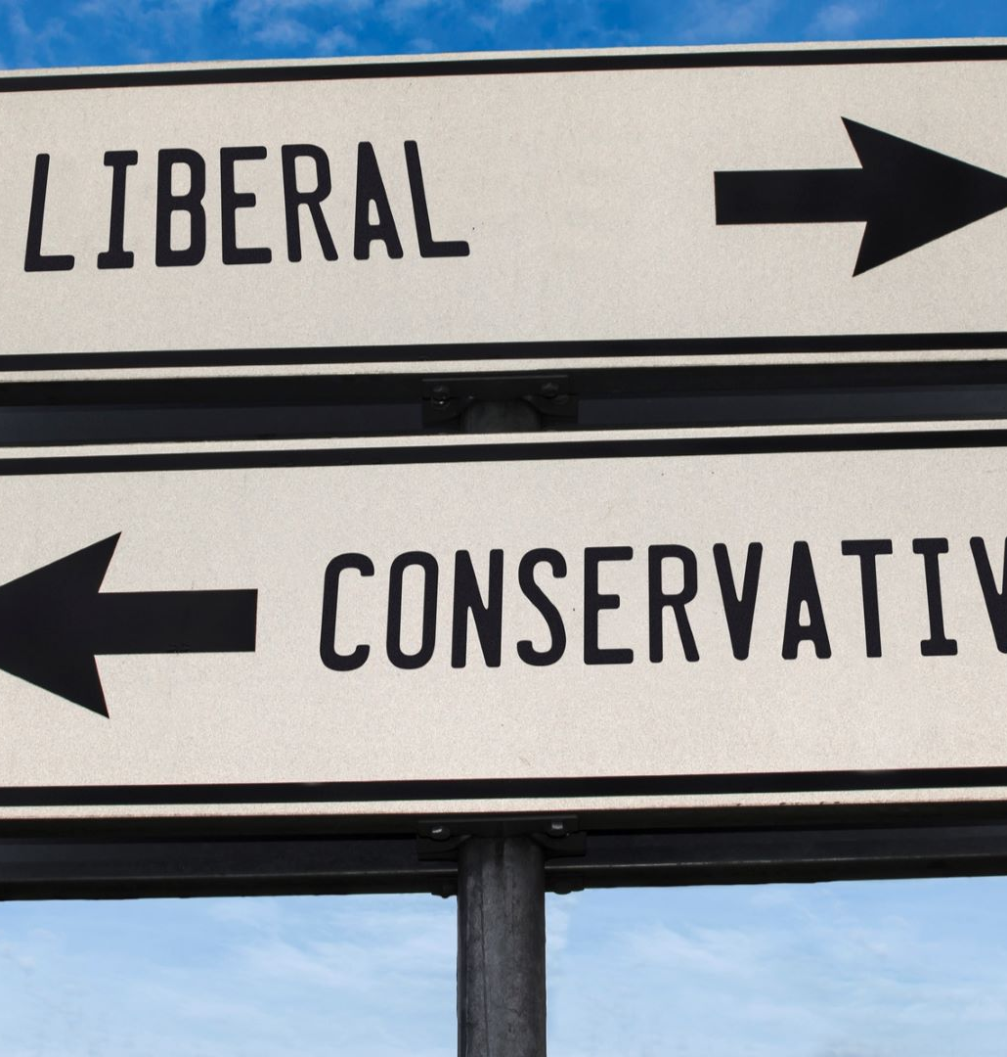
Spatial approach to politics
Politics as a space The actors move in space Hotelling 1929, traffic on the street "How much government intervention in the economy should there be?" (Downs 1957, 116) Ability to rank parties Universally applicable "plastic" dimension

Slide 12
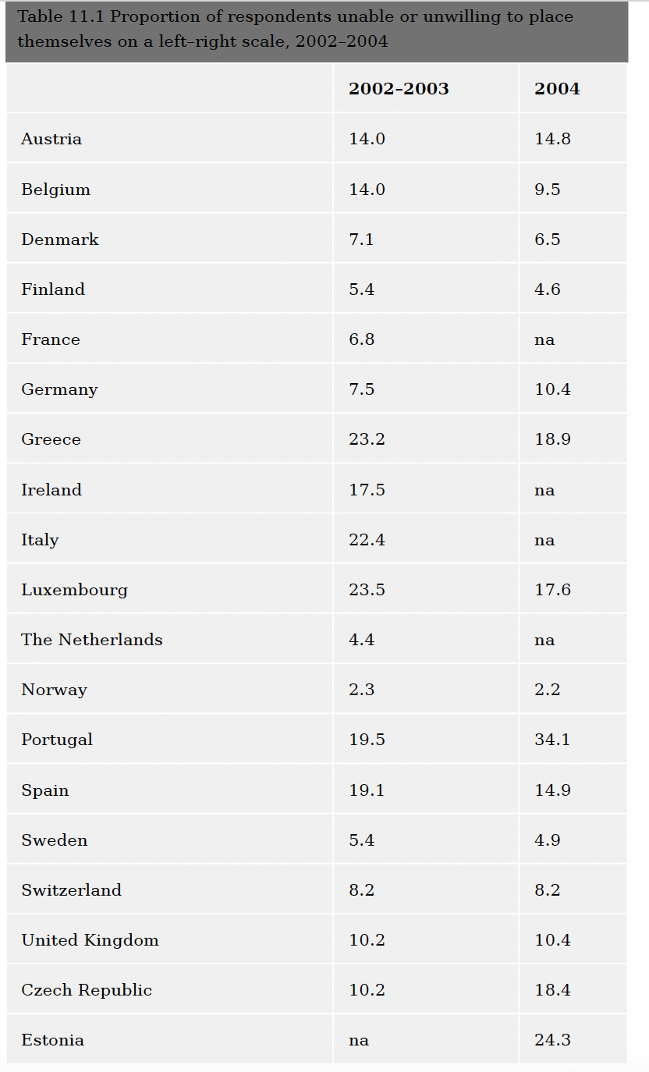

Slide 13
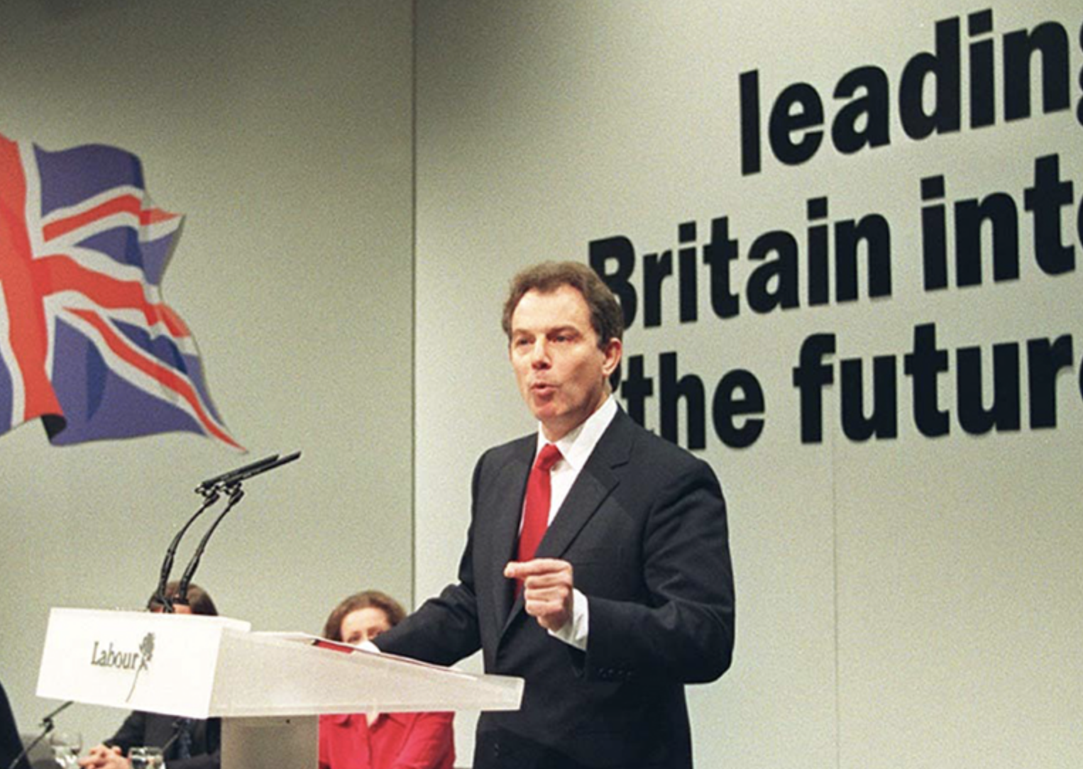
What could be problematic?
New actors in the 1960s It does not entirely correspond to the logic of the "old" left and right The space on the left is fragmenting (non-class left) Right = everything that is not left Weakening the differences between the right and the left, the problem of the left since the 1990s Globalization, Europeanization The Problem of Right and Left in CEE (Post-Communist Space) The Rise of Radical Right-Wing Populism – A Shift in Themes Dominance of a different political dimension????

Slide 14
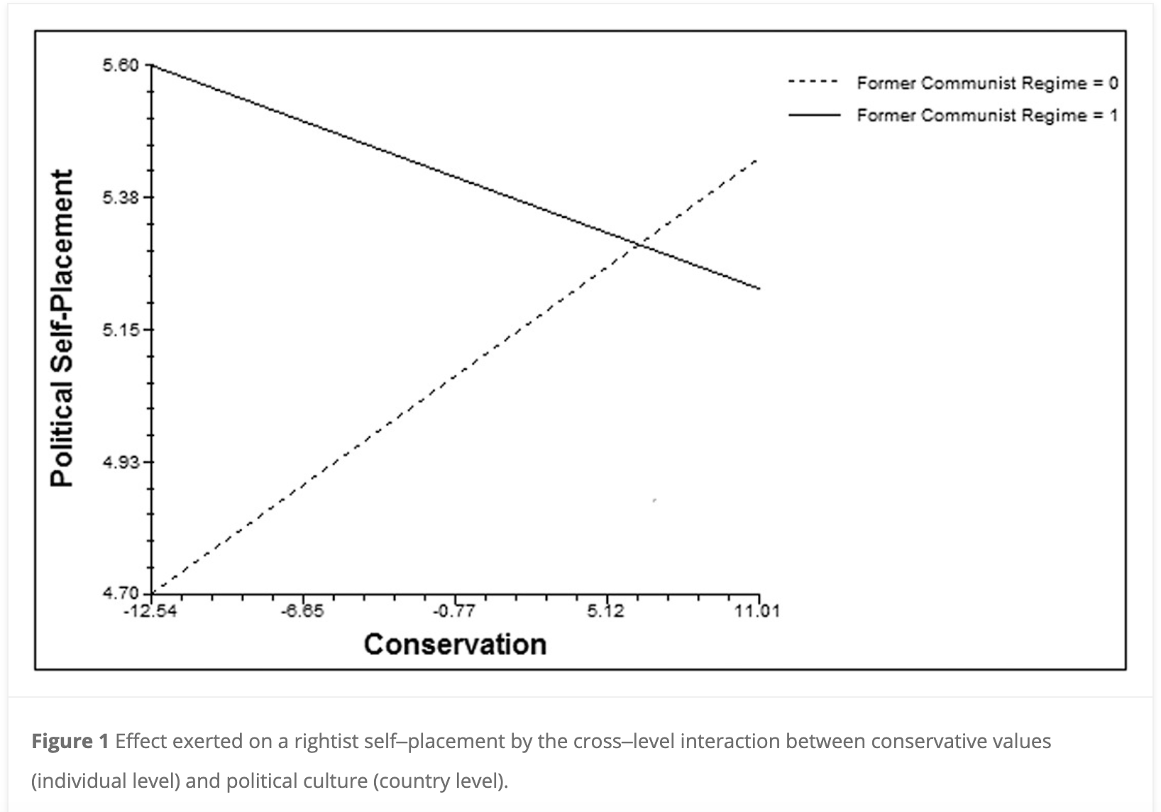
Post-communist context
The Left resists change The right advocates change Difference in values, different predictors of the right Acceptance of inequality (non-communist countries) vs. openness to change (post-communist) (Thorisdottir et al. 2007) "conservation" predicts right-wing inclusion in non-communist countries (Barni et al. 2016) Tradition is important for him/her. He/She tries to follow the customs handed down by his/her religion or his/her family

Slide 15
What does right and left mean?

Slide 16
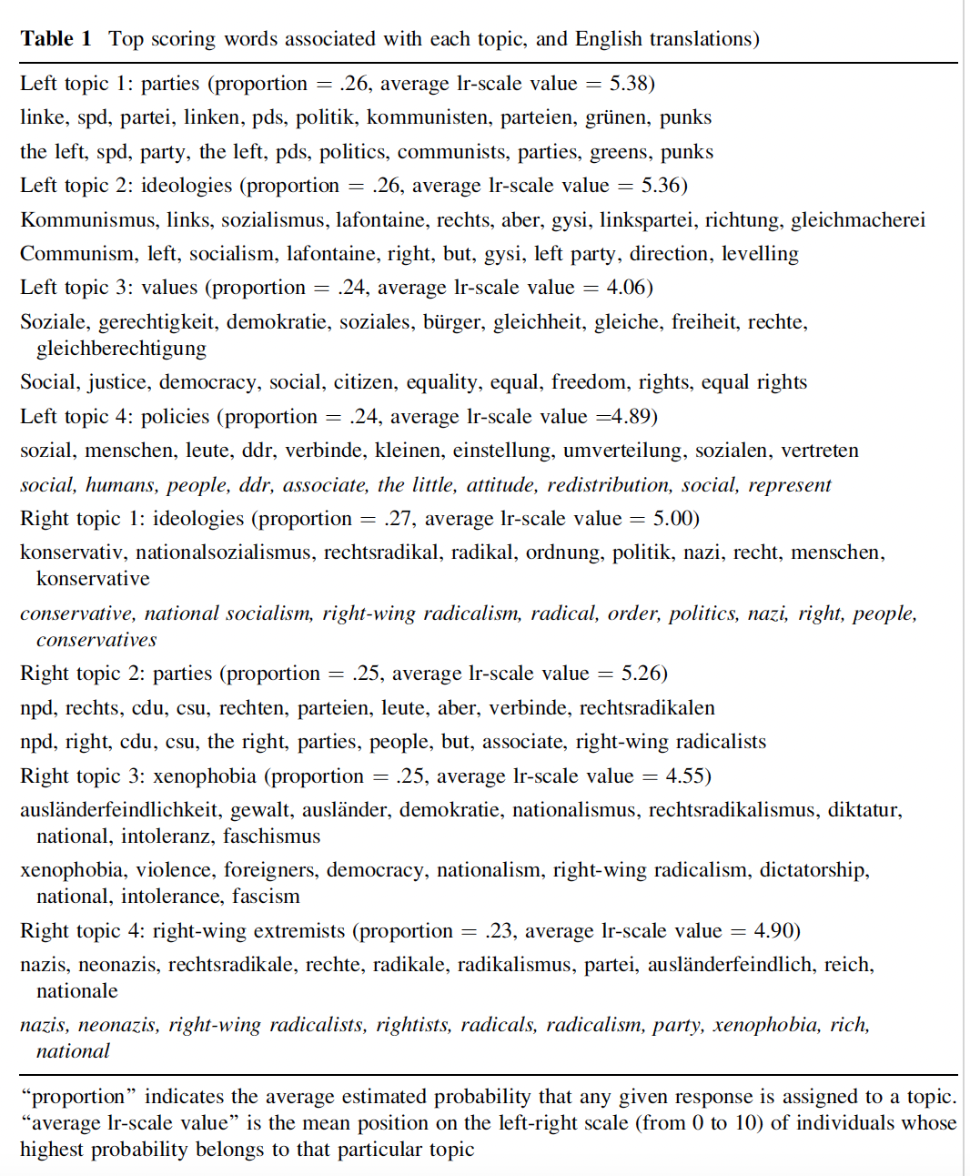
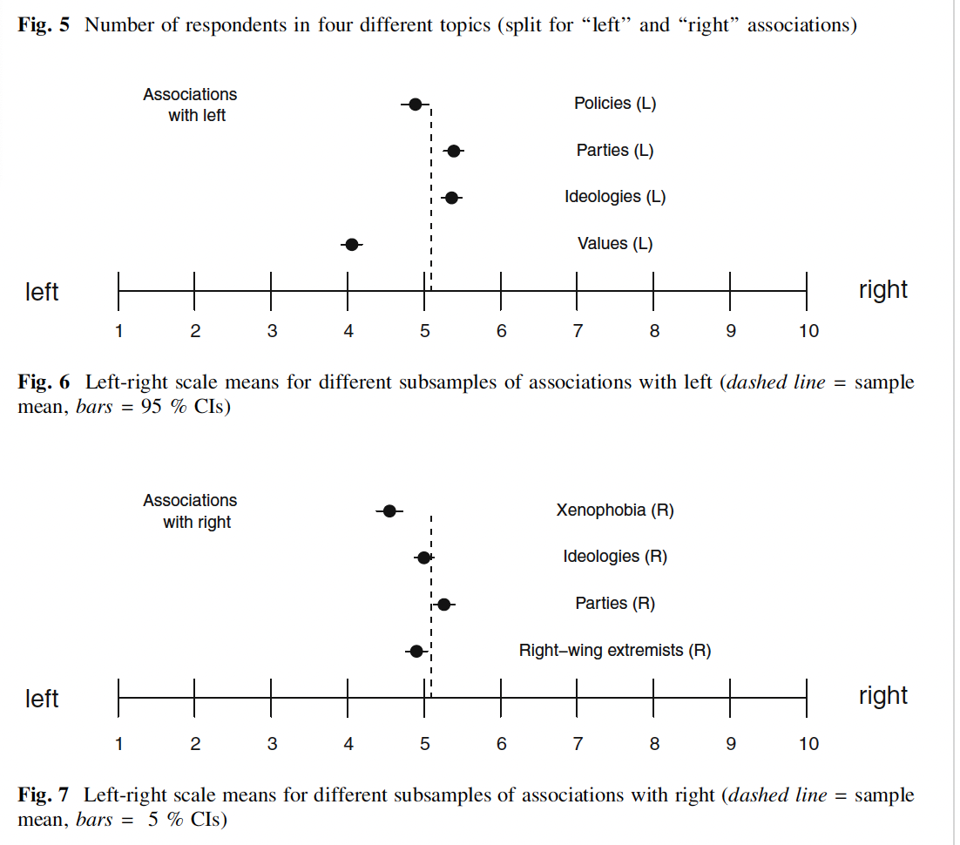

Slide 17
What does this mean?
Ideology as abstract concepts Different people treat them differently Caution in interpretations

Slide 18
How much do people know how to work with these concepts?
Phillipe Converse (1964): The Nature of Belief Systems in Mass Public Very few people in society know what abstract ideas mean A weak association of abstract ideology and issue positions 10 % (Converse 1964) 20-30 % (Kalmoe 2020)

Slide 19
Ideology as an identity or a set of attitudes?
Symbolic vs operational ideology Symbolic ideology: identity, self-classification on a scale Operational Ideology: Attitudes

Slide 20
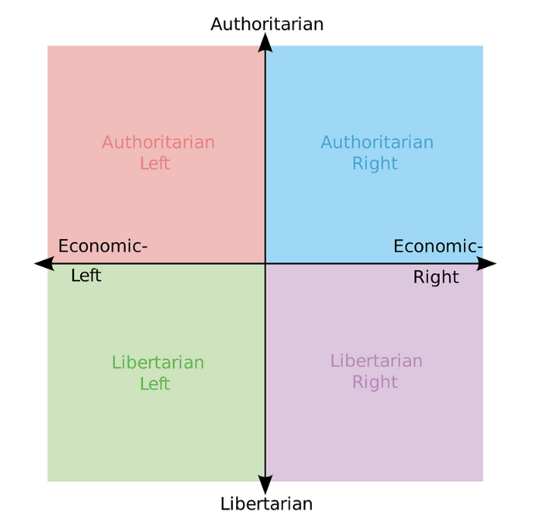
The actual content of attitude systems
Multidimensional political space Right-left is not enough (attitudes do not correlate) Different meanings across contexts New parties A new dimension useful Kitchelt: libertarian-authoritarian dimension

Slide 21
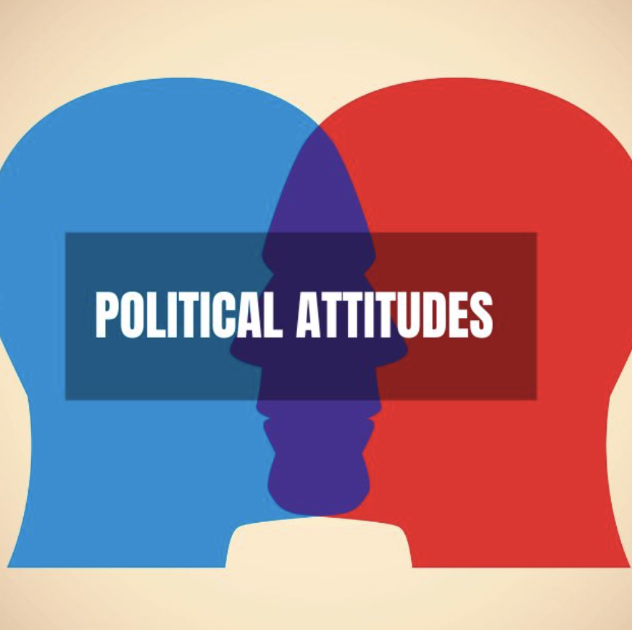
Organization of political attitudes
Studies show multiple dimensions (different levels of correlation) Political views in two dimensions (some say more)

Slide 22
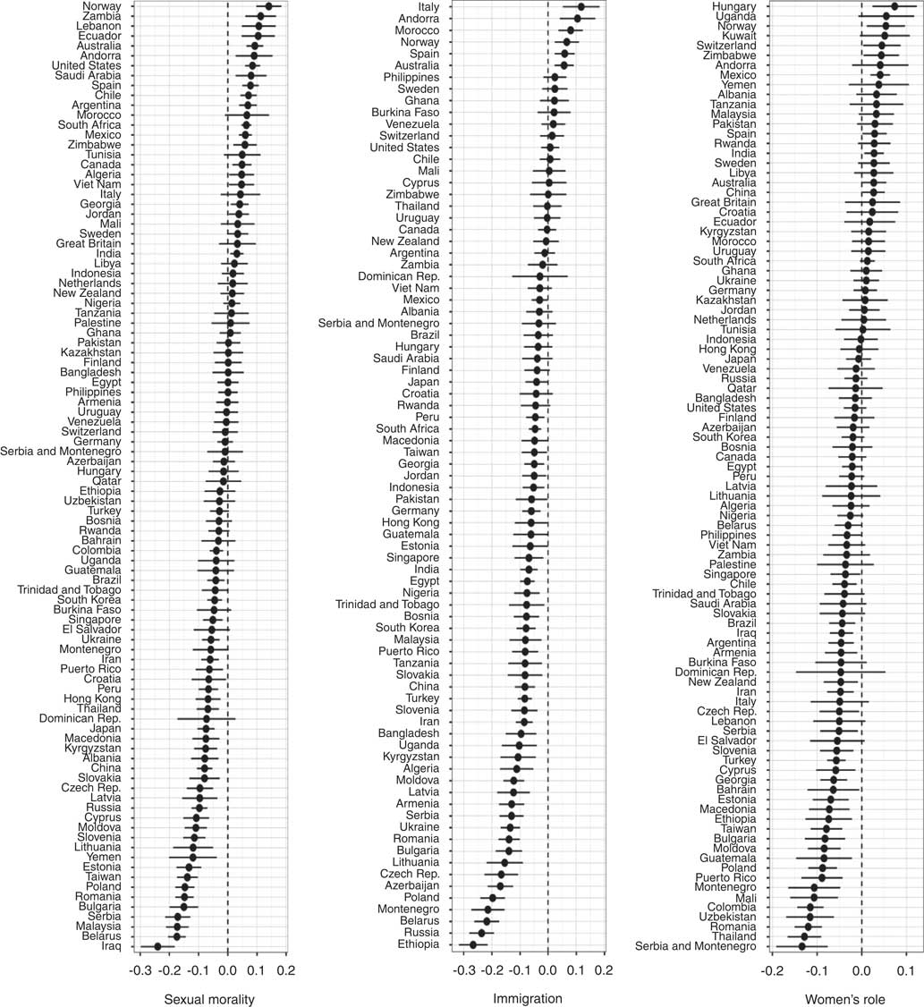
Social welfare
Business ownership

Slide 23
Correlations between social and economic conservatism are negative mainly in post-communist countries
This is true even for countries with a high degree of traditionalism
Individuals with low political involvement WVS Data 1984-2014

Slide 24
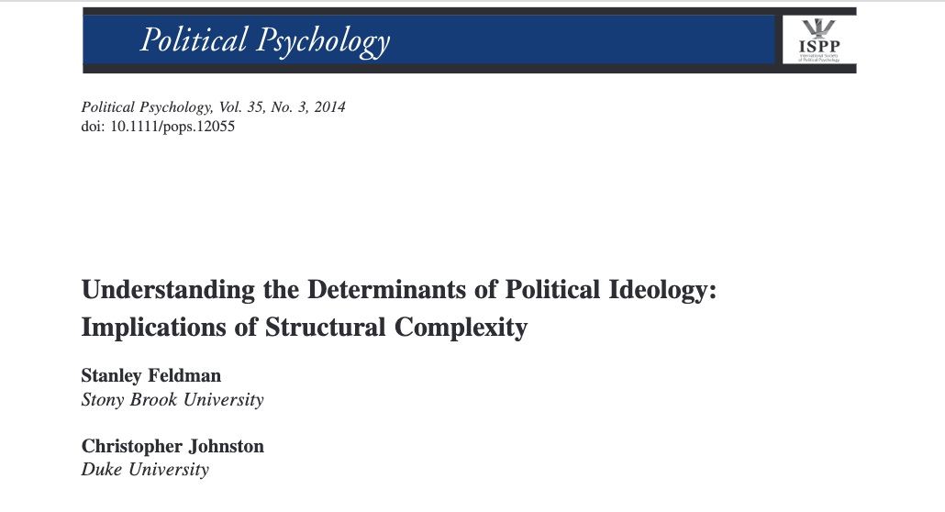

Slide 25
Study of Party Politics
Changes in the 60s-70s on the left (Green Party in Germany 1983..)
Changes in the 90s and 2000s on the right (National Front, FPÖ, Danish People's Party etc.)
Other new parties (technocratic, regional, radical left)
"New Left" vs. "New Right"
Cultural dimension

Slide 26
It manifests itself in a new so-called cleavage
Different names and conceptualizations
Libertarian-Authoritarian (Kitchelt 1994)
GAL-TAN (Green Alternative Libertarian vs. Traditional, Authoritatrian, Nationalis) (Hooghe,Marks, and Wilson 2002)
Integration-Demarcation (Kriesi et al. 2006, 2008)
Transnational cleavage (Hooghe and Marks 2018)

Slide 27
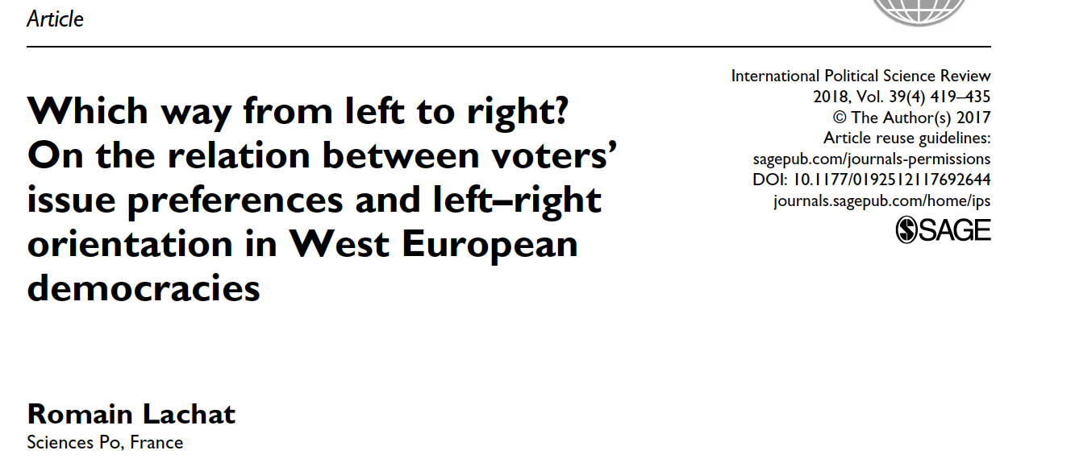
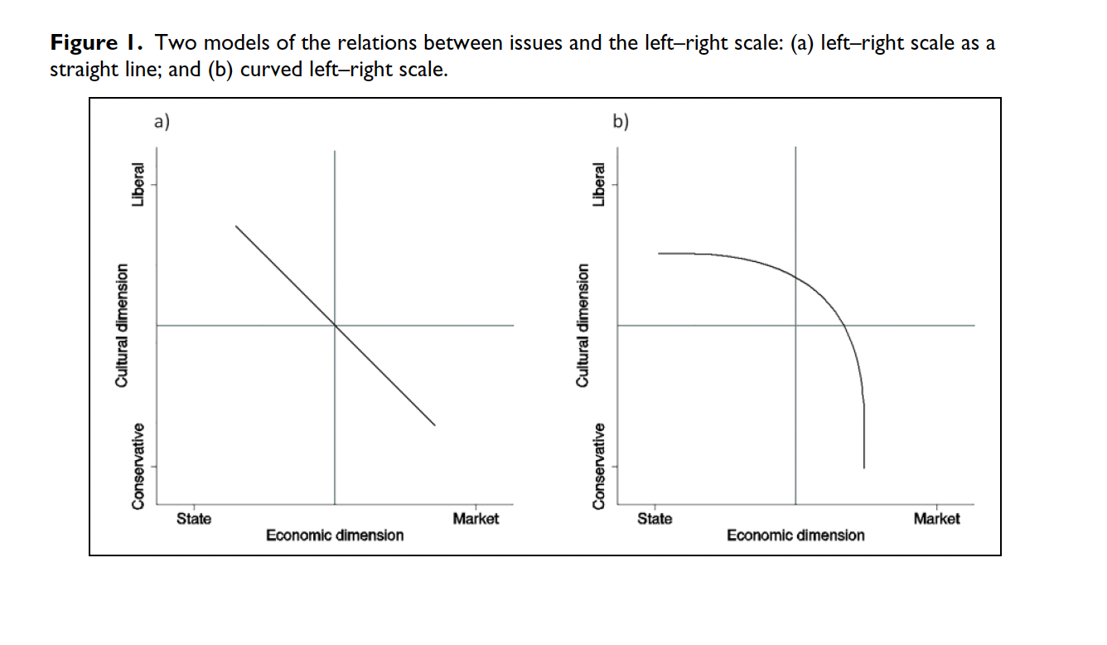
How do people deal with these dimensions?
The idea of political right and left dominates But in reality, there are more like two dimensions. What to do about it? The economic dimension is more important for left-wing voters The cultural dimension is more important for right-wing voters

Slide 28
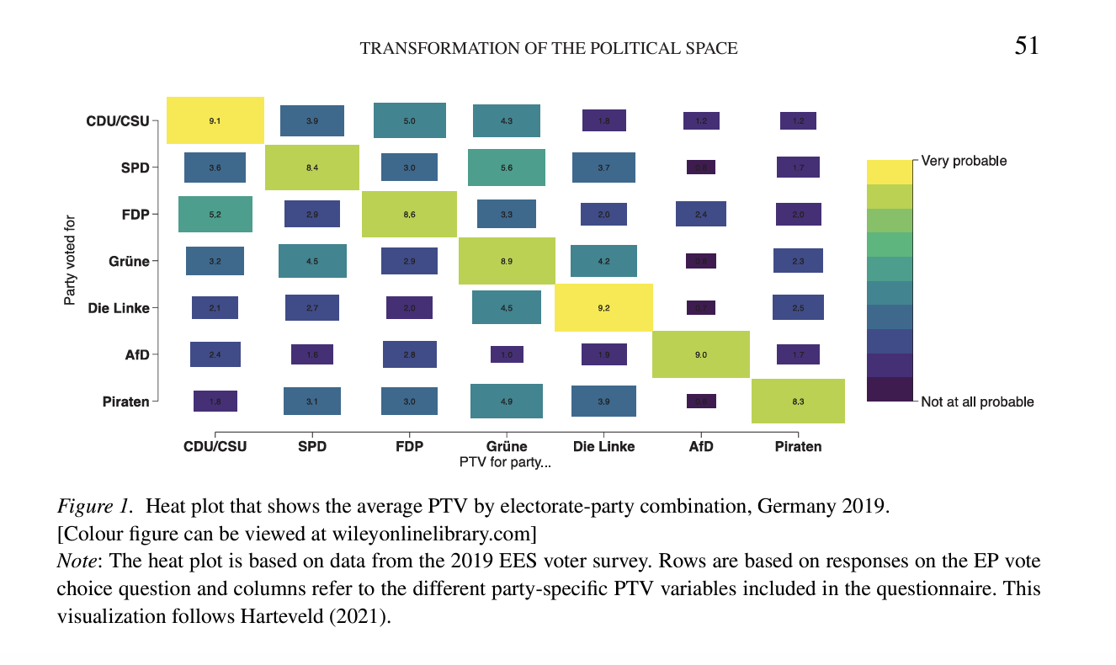
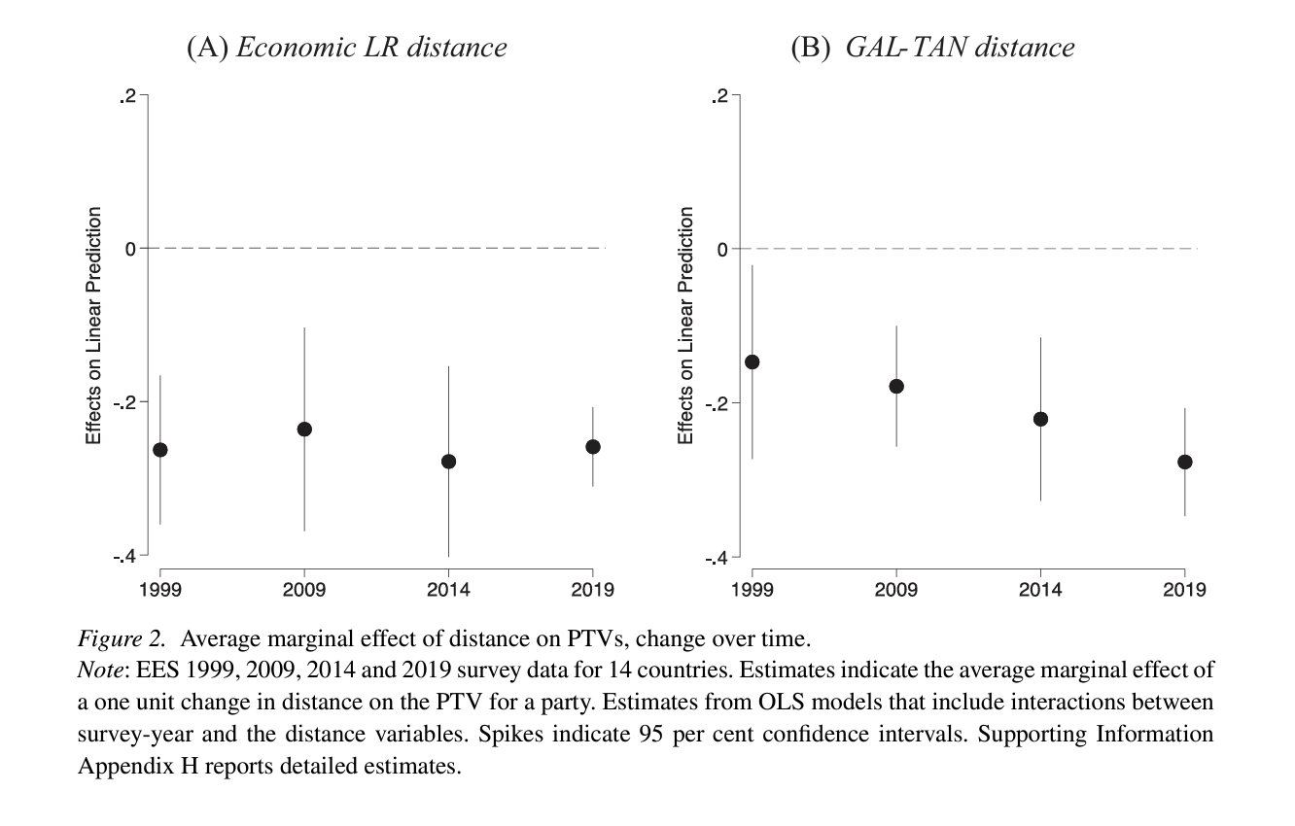
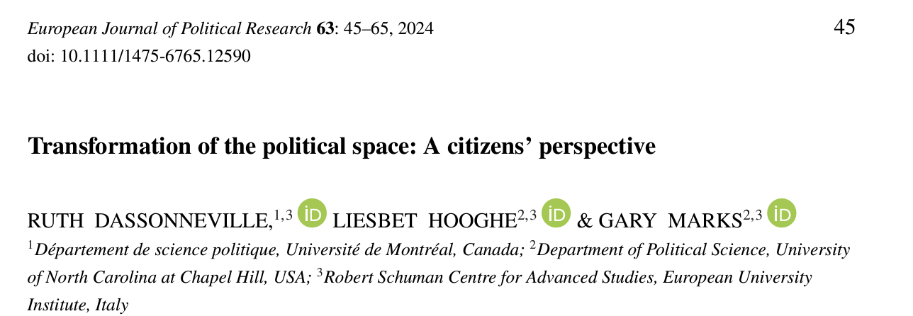
The "second dimension" is gaining importance (in Western Europe)
The importance of the GAL/TAN dimension has increased E.g. in electoral decision-making EES data (1999-2019) The distance on the GAL/TAN axis reduces the probability of choosing a political party
Economic dimension stable

Slide 29
Populism?
Political style? Rhetoric? Ideology? The idea that a nation is divided into a good people and a bad elite Moralism, people-orientation, anti-elitism It does not work on its own Programmatic limits Linked to a visiting ideology Populism of the Radical Right (RRP)

