Slide 1

Old and New Media
&
Political participation
Karolína Bieliková
PmCb1013: Citizens, Media and Public Opinion
2.12.2024

Slide 2
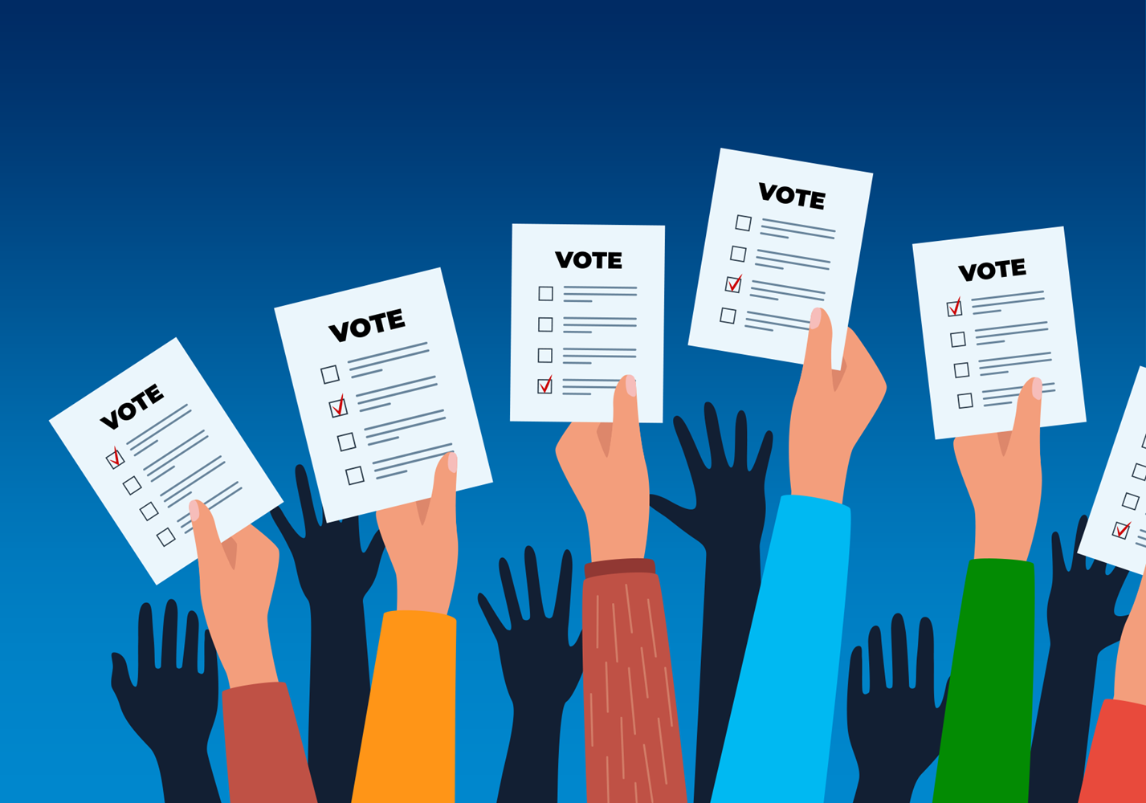
Today's agenda
Role of media in participation
Old and new forms of participation
Politization of everyday life
Dark participation

Slide 3



Road to participation
Independent media
Informed citizen
Political participation

Slide 4
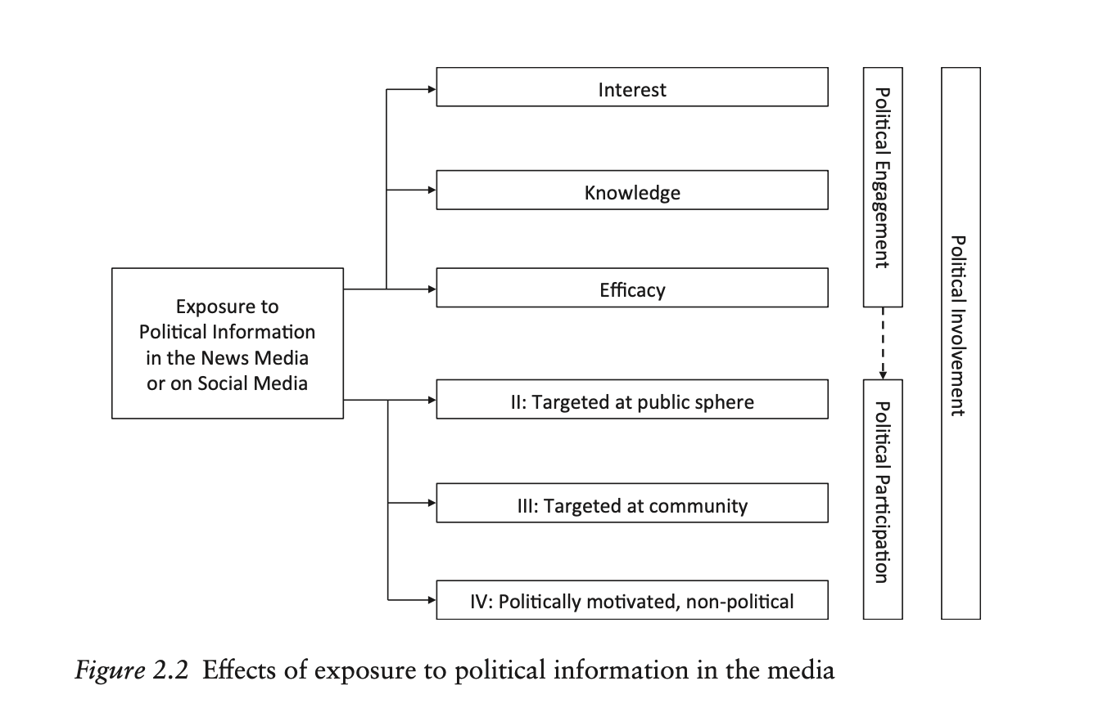
Road to Participation

Slide 5
Media and participation
Traditional (old) media
New media
Production: Expensive information selection and content generation by professional journalists according to news values
Distribution: Content selected by expert/ professional gatekeepers – based on established news values – distributed to a paying fixed audience of subscribers
Media usage: Location bound mass audience with limited selective exposure oriented towards passive consumption of information, based on professional selection.
Production: Inexpensive information selection and content generation by (lay) users according to their individual preferences and attention maximizing
Distribution: Users are like intermediaries, distributing popular content, sometimes like a chain letter, within networks of like-minded others
Media usage: Interest-bound and like-minded peer networks with highly selective exposure oriented towards interaction through practices of updating

Slide 6
New media and participation
New media provides not only different way of consumption but also new ways of participation
Environment where both are easily accesible
Optimistic idea:
Online environment and easily accesible information as a gateway to higher levels of political participation – spread beyond those who are already interested (Bimber et al., 2015)
Environment where citizens can organize an challenge authoritarian regimes

Slide 7
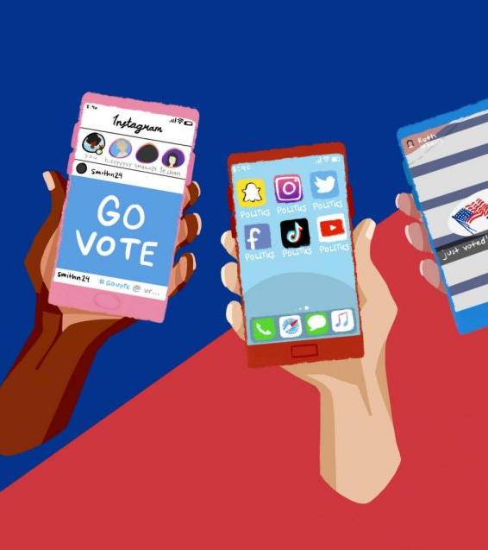
Old and new forms of participation

Slide 8
Political participation
‘those activities by private citizens that are more or less directly aimed at inﬂuencing the selection of governmental personnel and/or the actions they take’ (Verba & Nie, 1972)
Reflects activities not attitudes
Political participation has four minimal deﬁnitional features:
  (i) participation is an activity,
  (ii) it is voluntary and not ordered by a ruling class or obliged under some law,
  (iii) it refers to people in their role as non-professionals or amateurs,
  (iv) it concerns government, politics, or the state
Voting
Cooperative activity
Campaign activity
Citizen- initiated contact

Slide 9
What can change with internet?
Do you see any new possibilities?
What are new types of participation people can use now?

Slide 10
What does the internet change?
Direct communication
More voices/perspective
Open place for discussion
Bottom-up engagement

Slide 11
What does the internet change?
More voices/perspective
Blog, vlogs or social media account as a space for voicing own opinions or providing further individual reporting on current events
Also space for counter publics, composed of groups and interests that are not represented in the main-stream public discourses
More opportunities for marginalized voices than through traditional communication channels
BUT these voices do not necessarily have to support the current political democratic structure, e.g. radical initiatives

Slide 12
What does the internet change?
Direct communication
Citizens can more directly communicate with politcal actors
Political actors have more actors mointoring their behaviour
Communication also within communities – can lead to mobilization and organization
BUT Political actors can choose with whom and how they will communicate (they are not held responsible to respond and further act)

Slide 13
What does the internet change?
Open place for discussion
Opportunities to discuss current topics with more people – gain different perspective
Other people can becomae a source of information - provided the best argument wins
Public environemnet between the state and the private
BUT social media users can become closed off due to echo chambers and filter bubbles
Online discussion are often incivil and intolerant place demotivating engagement

Slide 14
What does the internet change?
Bottom-up engagement
Citizens can more easily mobilize in order to raise and issue – connection to other forms of (offline) participation
Raising issues overlooked by traditional media/political actors
BUT the mobilization can be anti-systematic, attacking democratic principles
There are divides and inequealities in the digital environment

Slide 15
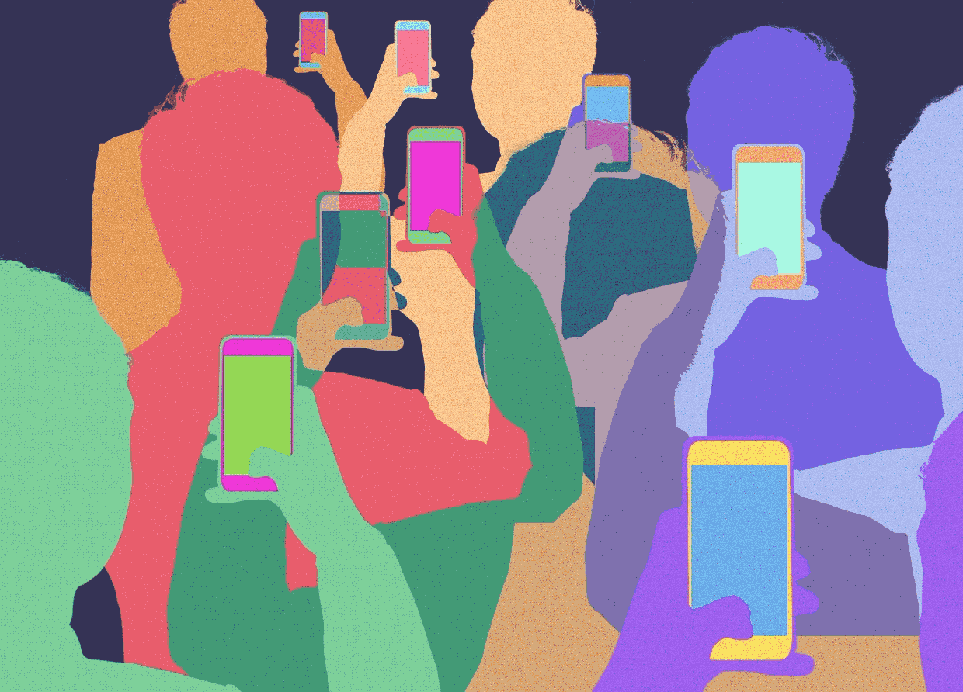
How does participation online look like in reality?
Expressing one‘s opinion online
BUT growing number of social media leads to grosing numbers of activities that can be considered political participation
What can we still consider as political participation?

Slide 16
Digitally networked participation
= a networked media–based personalized action that is carried out by individual citizens with the intent to display their own mobilization and activate their social networks in order to raise awareness about, or exert social and political pressures for the solution of, a social or political problem.
Information in online environment is dependent on its dissemination
User play a crucial role not only in creating but also connecting to, reacting and sharing content

Slide 17
Strategies for online participation
Expressive participation
Main attribute is that is more visible
Sharing, writing posts, posting images, creating events etc.
By some users considered more effective than passive participation
Takes more effort
Passive participation
Not as visible
Reading posts, comments, events, etc.
Often seen as less effective
Is like expressive or passive?

Slide 18
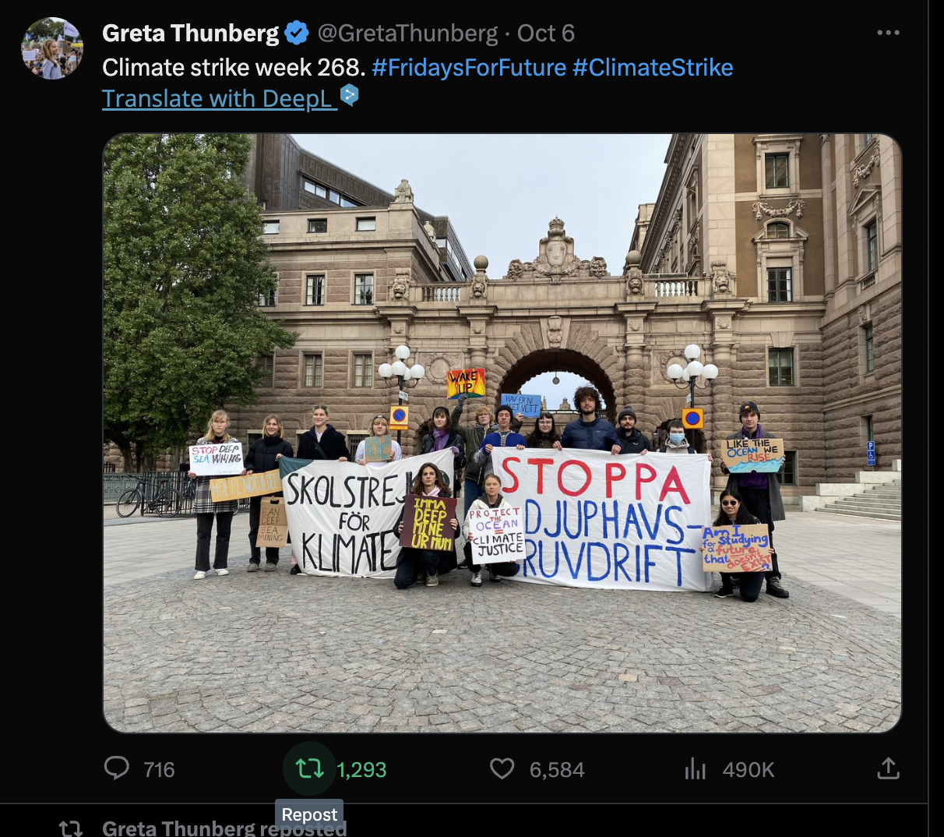
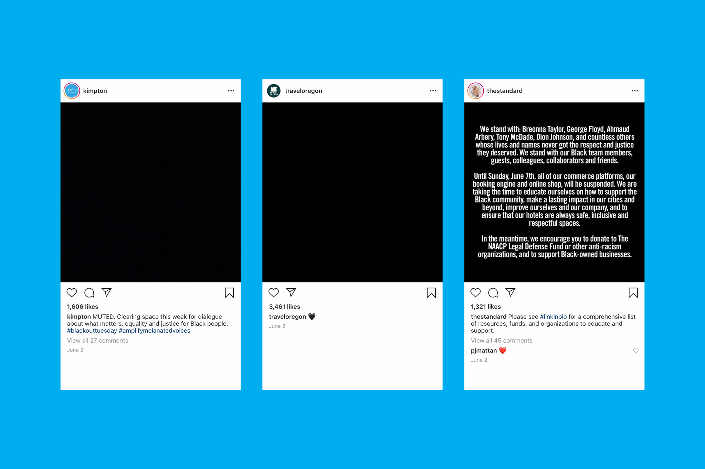
Expressive participation
Creating
Sharing
Participation that take the most effort
often perceived as the “most valuable”
Voicing opinions, providing information or preferences etc.
Expressing opinions or narrative without creating the content

Slide 19
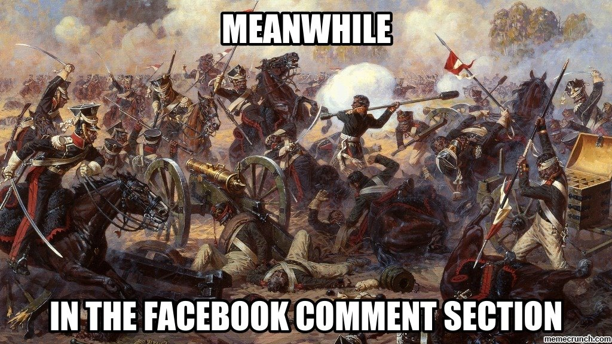
Passive participation – does it do anything?
Users often do not consider activities of passive participation as an act of political participation (f.e. reading posts, comment section)
This type of participation can be perceived as less important because it is not visible to the public
BUT passive participation can lead to expressive participation
Influence on attitudes and opinions

Slide 20
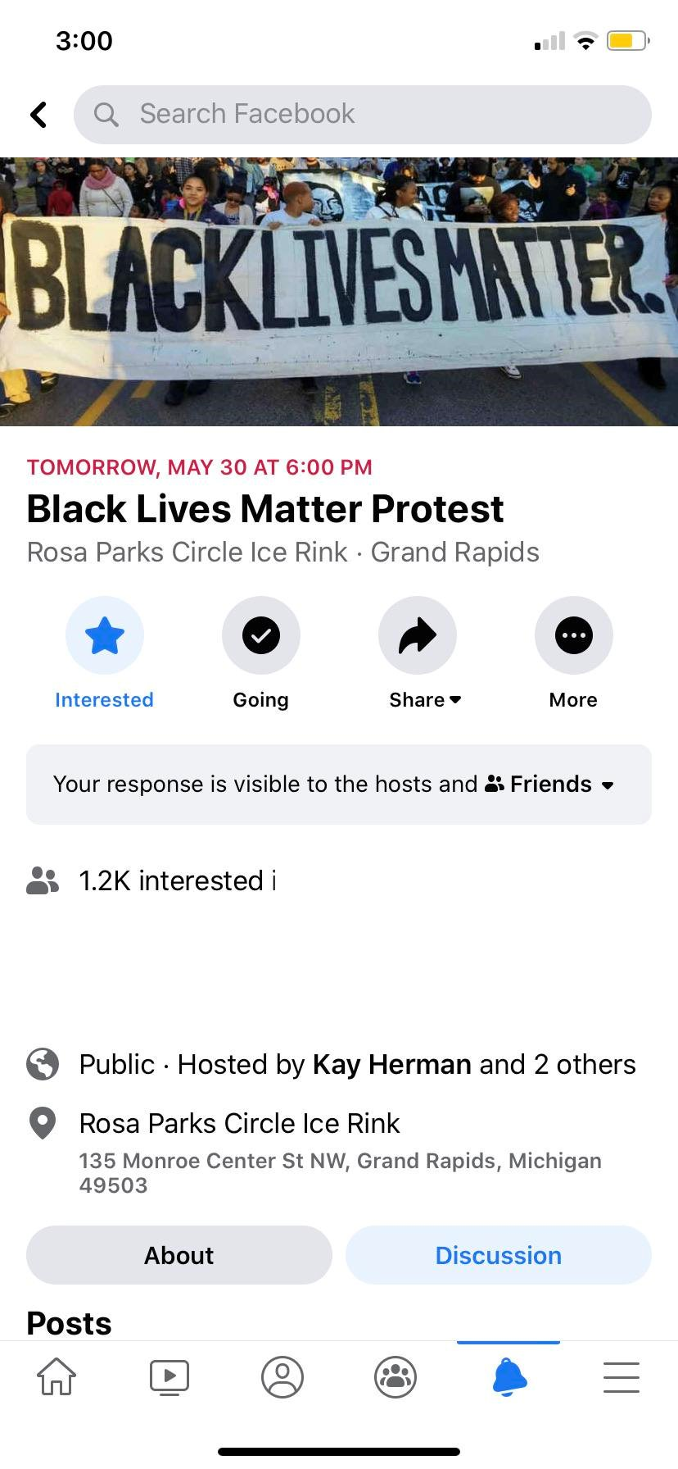
Question of slacktivism/clicktivism
(...) which refers to the trend of fulfilling only the desire for instant self-satisfaction and having little impact on actual political processes (Morozov, 2011).
Criticism that there is a disconnect between online activities and the real impact in everyday life (Štětka & Mazák, 2015)
Fear that opportunities in the online space may lead to less political activity offline (real participation in the demonstration)

Slide 21
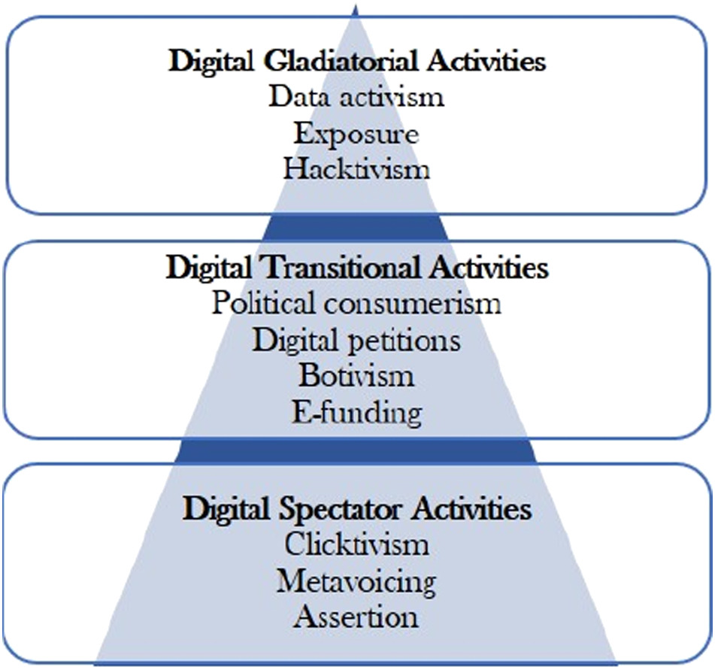
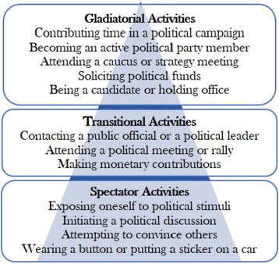
Ranking different forms of particpation
Activies can be considered different levels based on required energy or impact and visibility (George and Leidner, 2019)

Slide 22
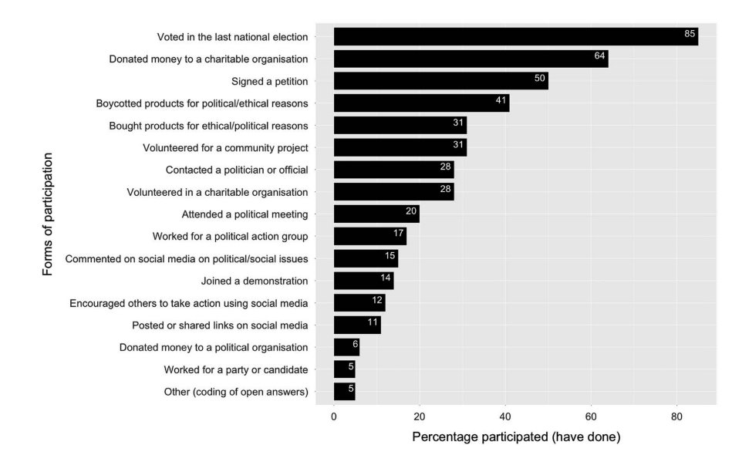
So what forms of participation people do?
Theocharis et al., 2018

Slide 23

The Personal and the Political

Slide 24
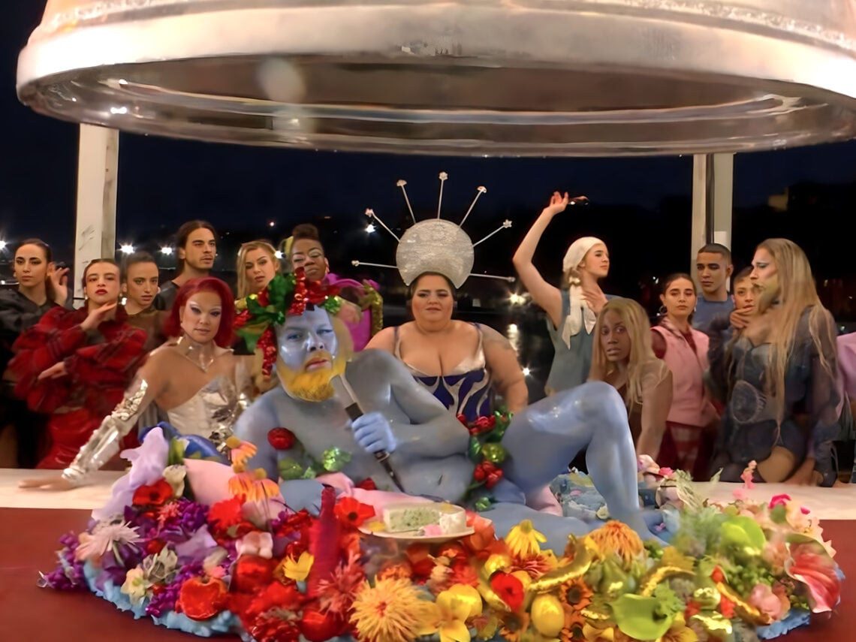


Slide 25
New forms of participation
Opening up the definition of participation: ‘any dimensions of social activity that are either designed directly to inﬂuence government agencies and the policy process, or indirectly to impact civil society, or which attempt to alter systematic patterns of social behavior’ (Norris, 2002: 16)
Blurring the boundaries between political and civic participation
Need to look for germs and projections of the political and public world in the private quarters and daily dealings of individual persons (Livingstone, 2005)

Slide 26
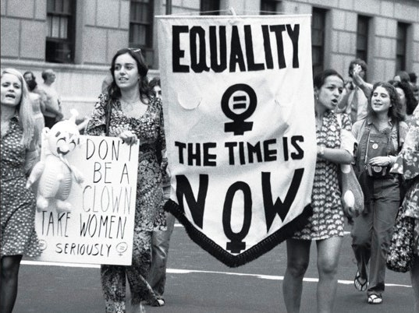
The personal is the political
Issues considered to be strictly personal in fact have their roots and projections in the political sphere - often used in feminist reflections
  e.g. Carol Hanisch’s essay “The Personal is Political” (1970) spelled out the dilemma that plagued women’s discussions at that time regarding how to distinguish “therapy” from “political action.”
Question of one’s identity in everyday life is on its own political, when we consider the inherent power struggle in society (Mouffe, 2005)

Slide 27
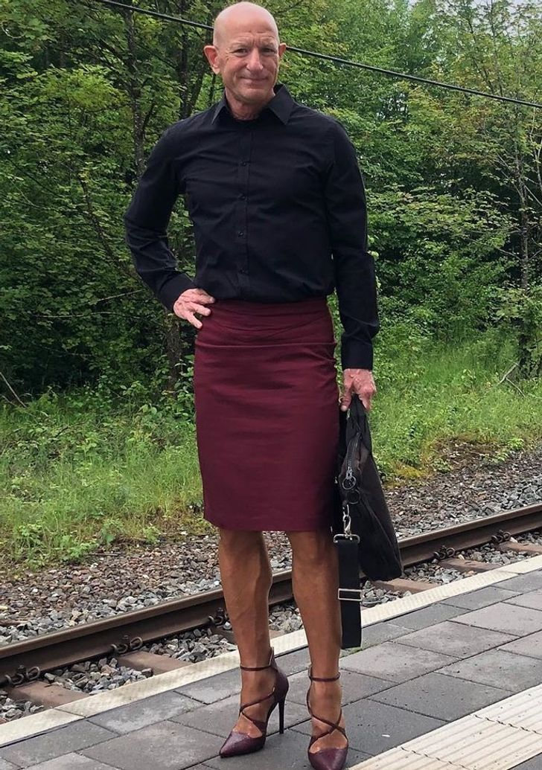
The personal is the political
Social media are primarily used for connection and communication with people
Personal is a building block of how social media are being used
BUT personal can often become political with/without the users intent
In social media political and personal are often interconnected and impossible to separate

Slide 28
Subactivism
= „small-scale, often individual decisions and actions that have either a political or ethical frame of reference (or both) and remain submerged in everyday life” (Bakardjieva, 2009)
Its locus is the private sphere or the small social world
Rooted in the subject but necessarily involves collective identities often in an imagined form
The decisions and actions that constitute it have no permanent place in a person’s agenda
They arise spontaneously, often as new dimensions of work, homemaking, parenting, entertainment

Slide 29
Subactivism
In online environment activities such as reposting, using hashtags or flagging and reporting can be highly political
Leads to creation of communities that are not bound geographically – bound by shared interests and beliefs
Representation of one’s own identity becomes political on social media especially if they are part of marginalized community

Slide 30
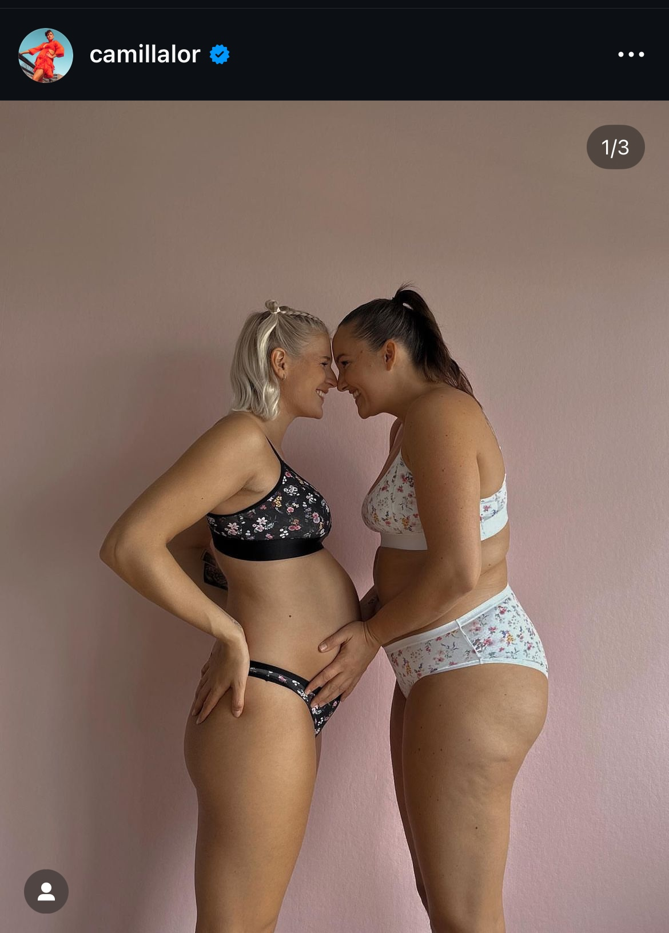
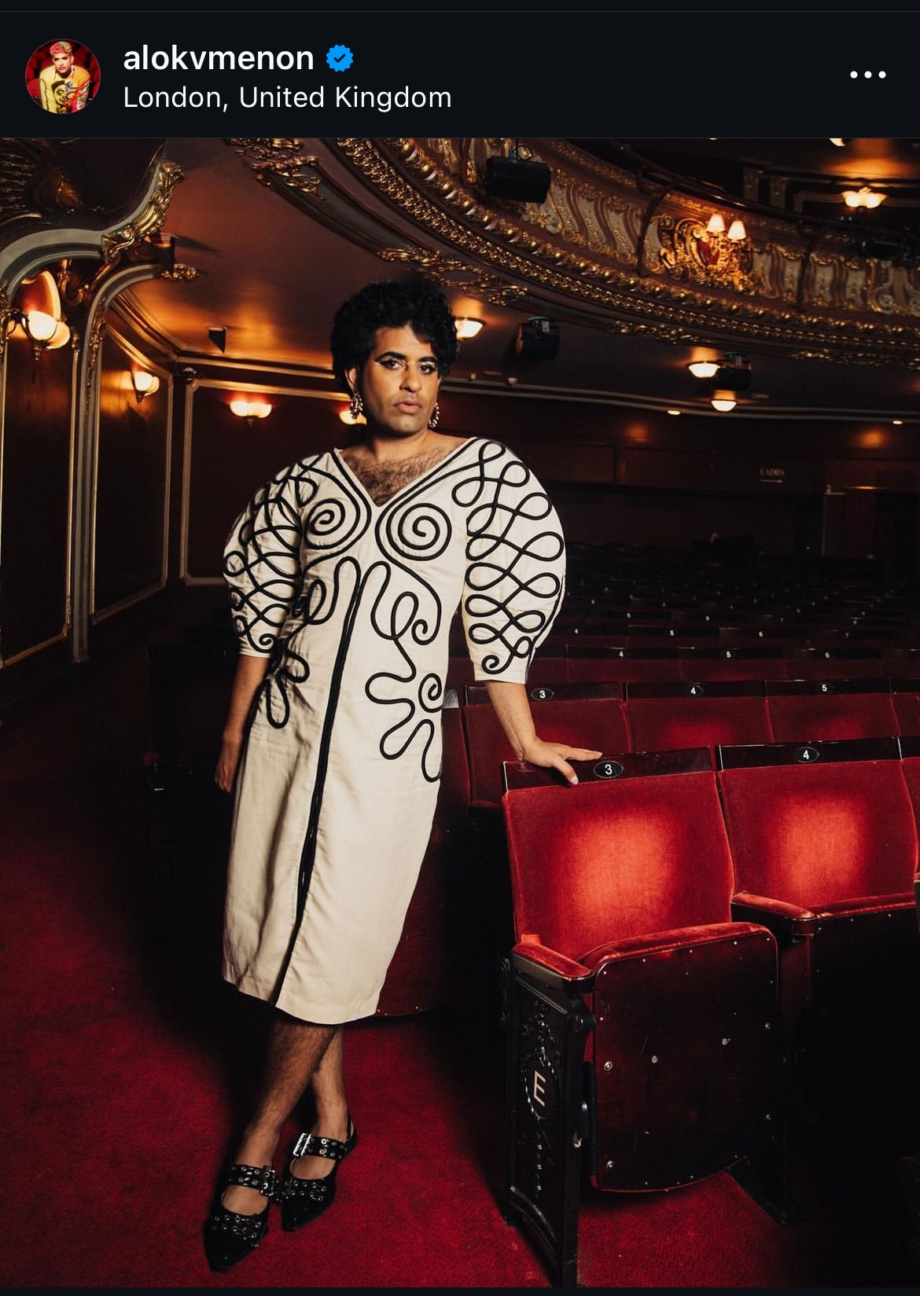
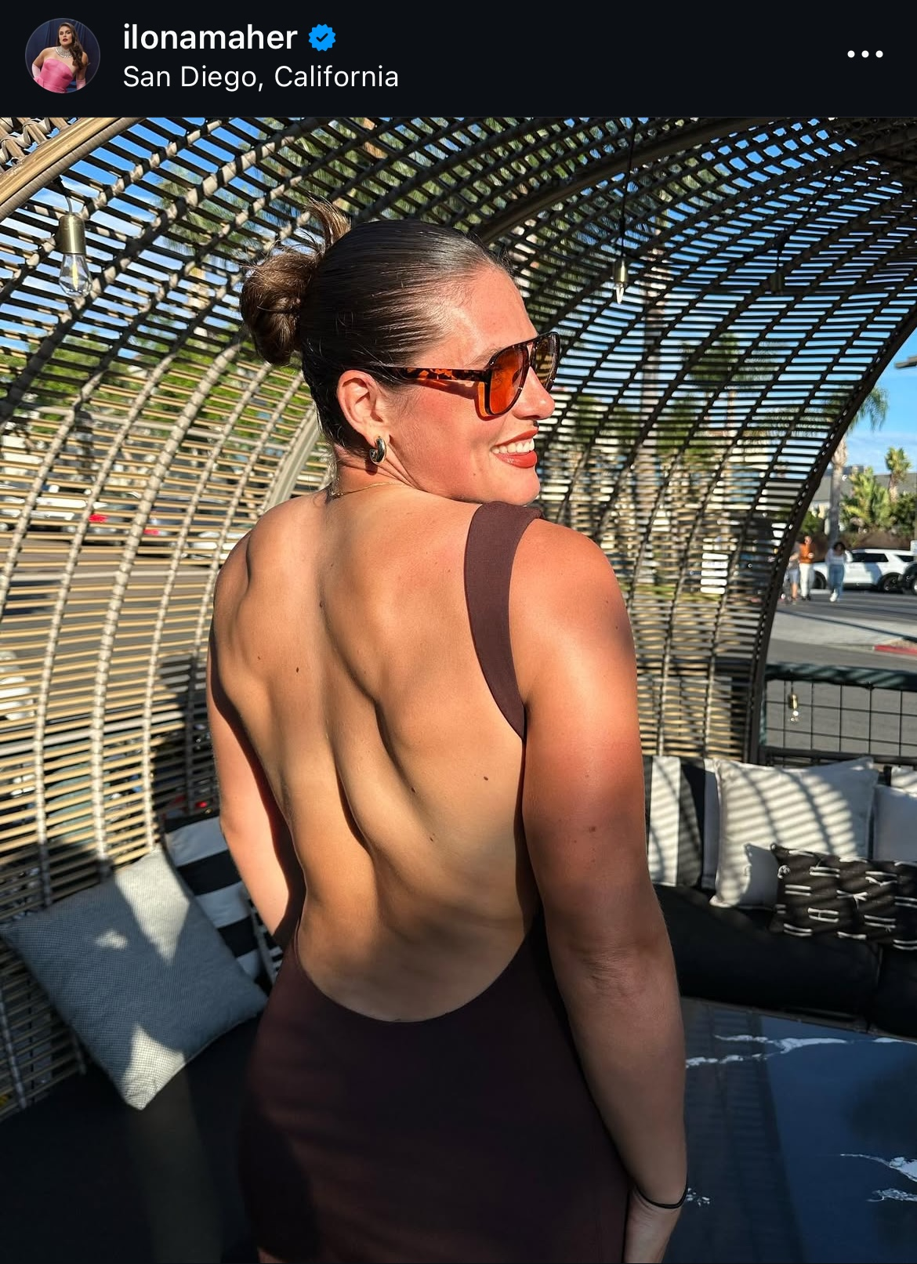
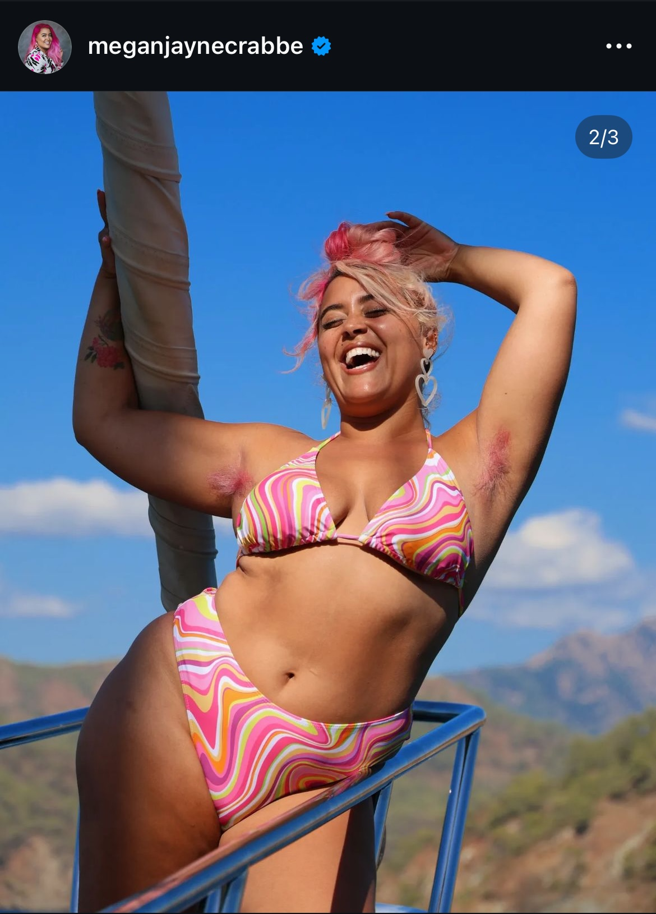
Subactivism on social media

Slide 31
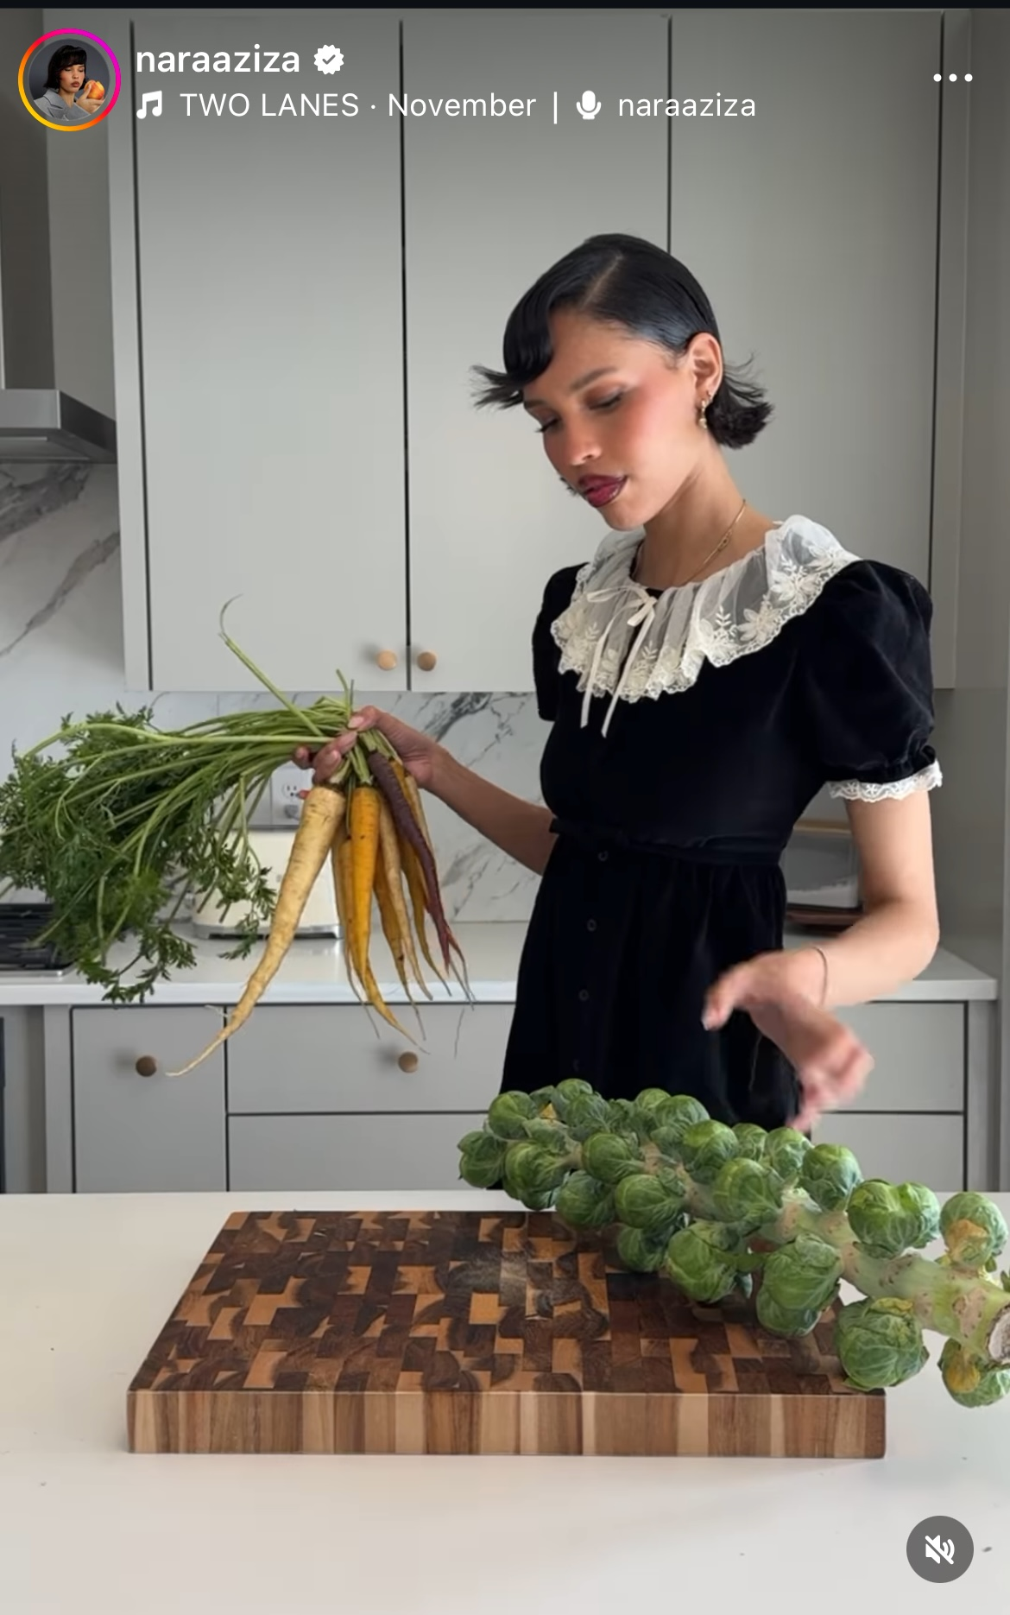
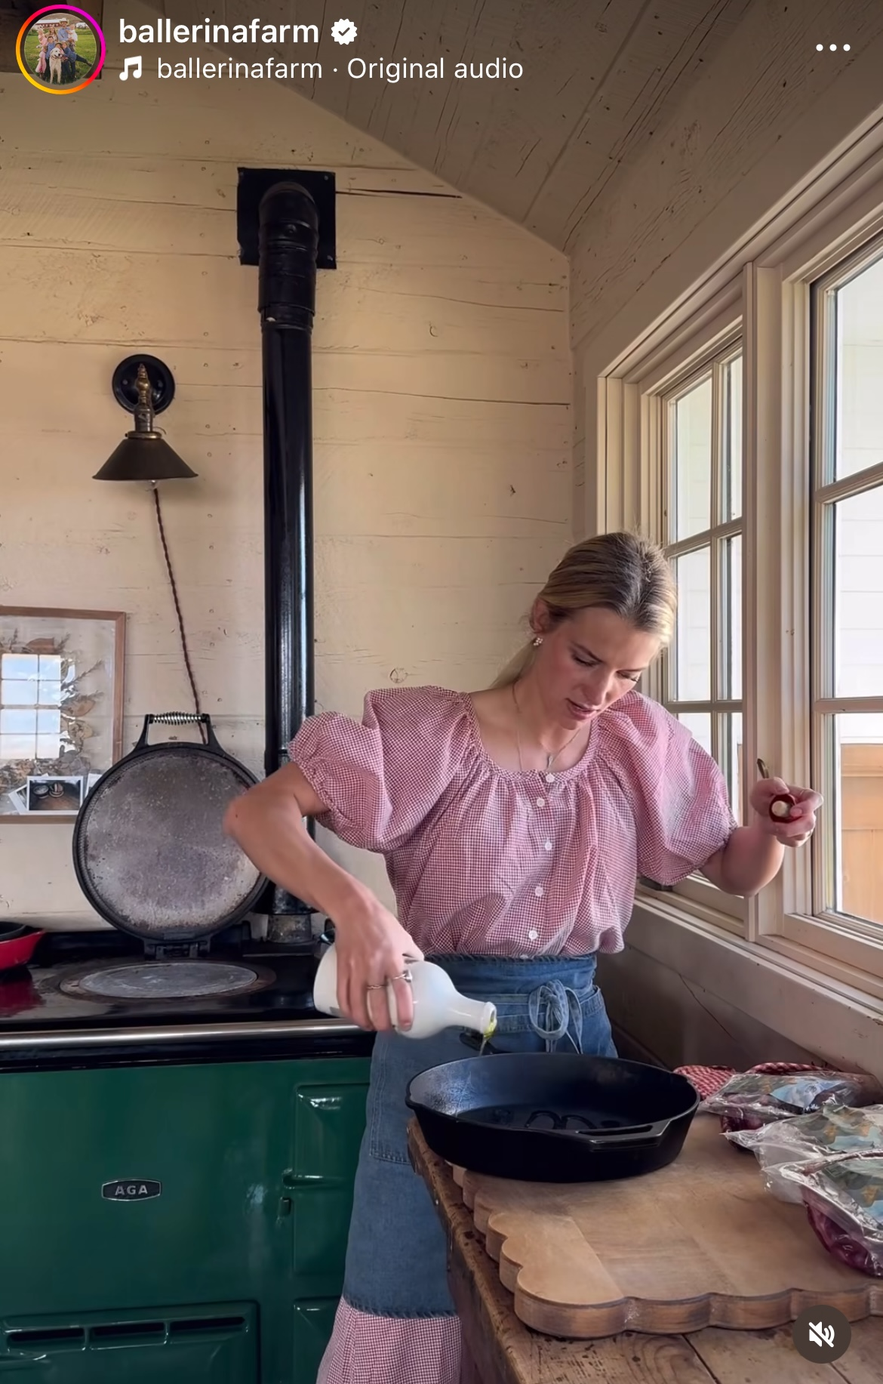
Subactivism on social media

Slide 32
Subactivism on on social media
Influencers who are not labeled as political can become political
Acting as a source of information, they can influence political attitudes either on purpose or involuntarily
Do not follow standard regulations and rules, e.g. in political campaign
Question of personal and political if you ourselves act as a source of information

Slide 33
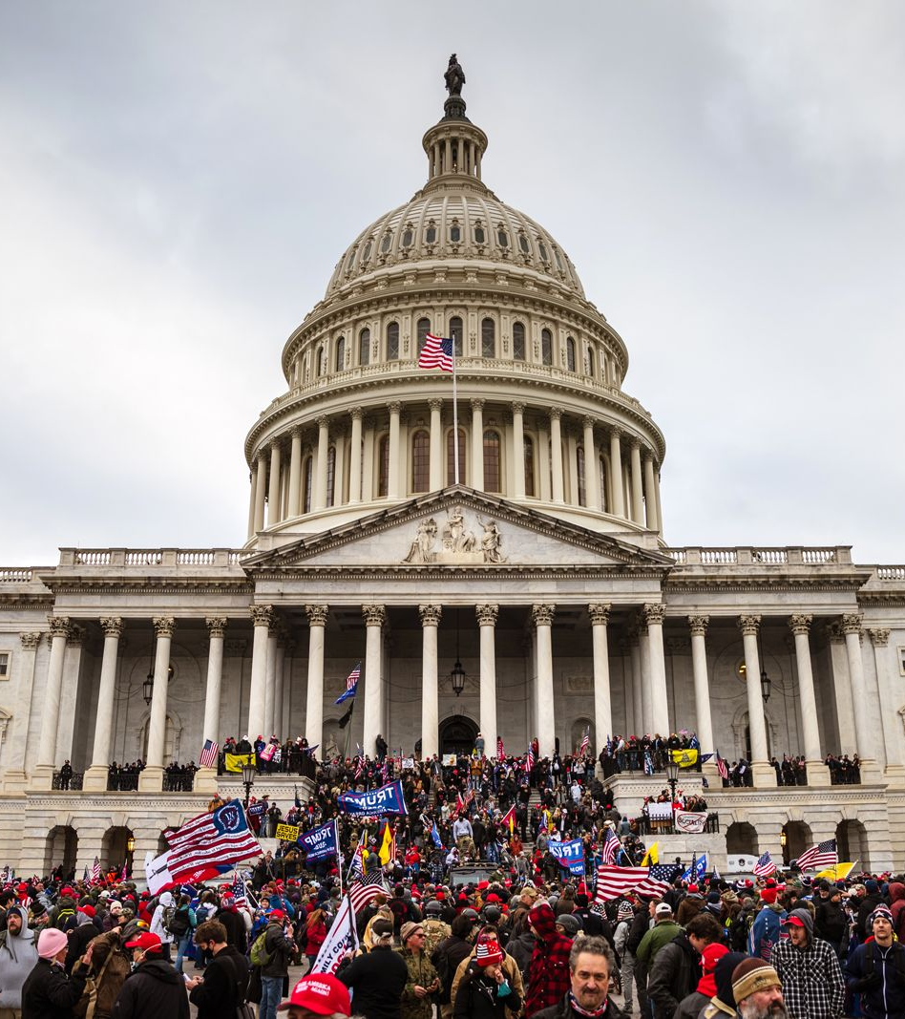
Dark participation

Slide 34
What is dark participation?
Quandt, 2018 : “(..) characterized by negative, selfish or even deeply sinister contributions (..)”
Participation that does not helps but threatens democracy
Includes: trolling, cyberbullying, dissemination of mis/disinformation, uncontrolled news environment, incivility, hateful comments, etc.
this type of participation seems to be growing parallel to the recent wave of populism in Western democracies

Slide 35
