Slide 1

Government responsiveness
PMCb1013
21 October 2024

Slide 2
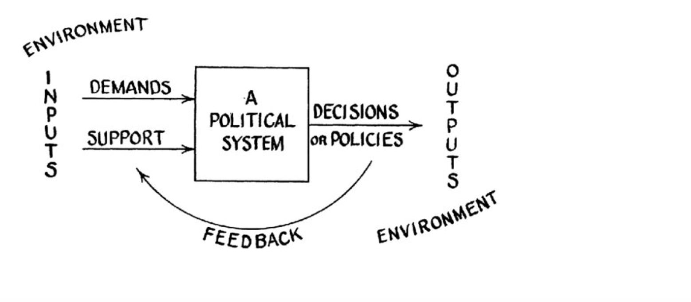
Public opinion and government
Legitimacy (consent of the governed)
Government constraint
Core of the political system (Easton)
Retrospective voting
    Informed decisions
    Policy based evaluation

Slide 3
Theories of democracy (Robert Dahl)
Democracy ideal type
Polyarchy = the rule of the many
  Free and fair elections
    Universal suffrage
  Freedom of expression
  Alternative sources of information
  Associational autonomy
    Inclusive citizenship
Continuing responsiveness of government essential outcome

Slide 4

The public as a thermostat (Wlezien)
Public responses to actual policy
Signals when policy needs adjustment
Stops signaling when adjusted adequately
E.g. preferences over government spending

Slide 5
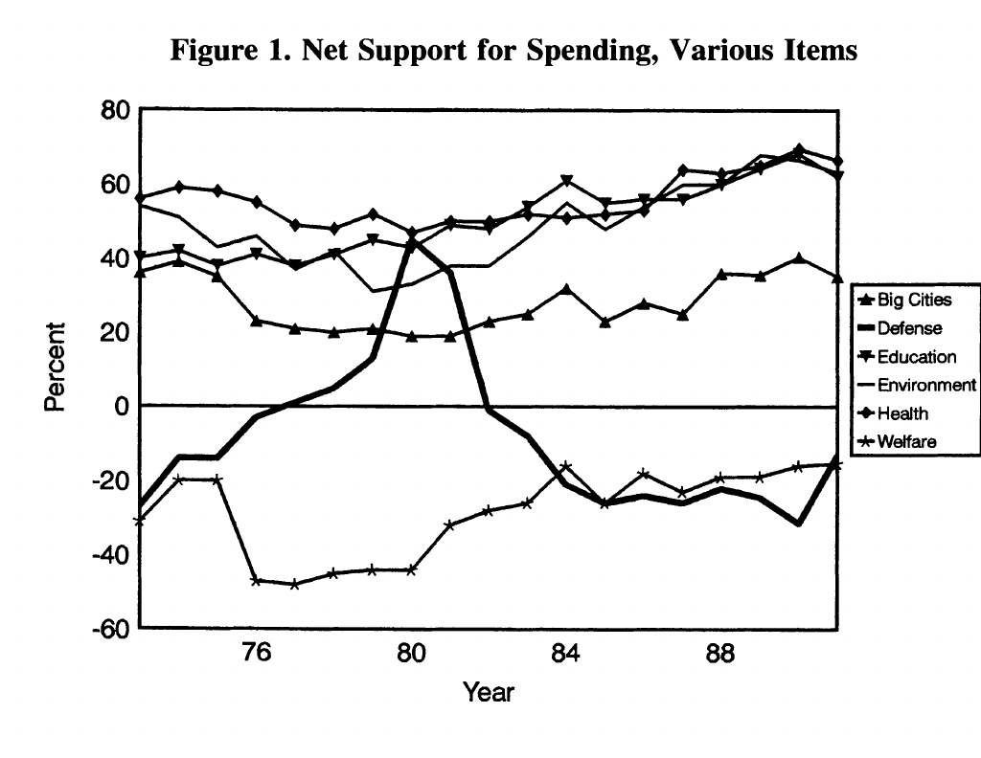
Government spending 1973-1991
Public preferences influenced by changes in policy
Spending decreases = public preferences for increase
Information gaps (eg. Defense)
Security = more long term considerations

Slide 6
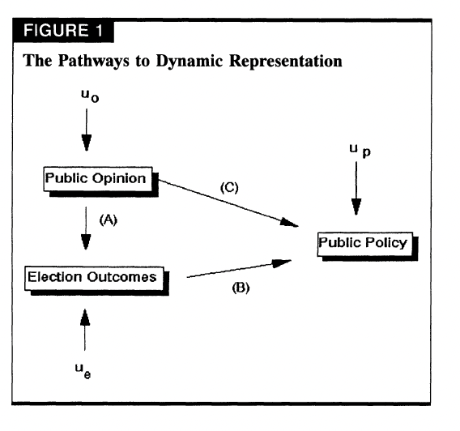
Dynamic model of representation
Stimson, McKuen, Erkison
Also from the 90s
Electoral change
Rational anticipation by institutions
Institutions differ in their responsiveness

Slide 7

How do politicians learn about public preferences?
Polls (public and private)
Media
Interest groups
Contact with citizens
Social media
??

Slide 8
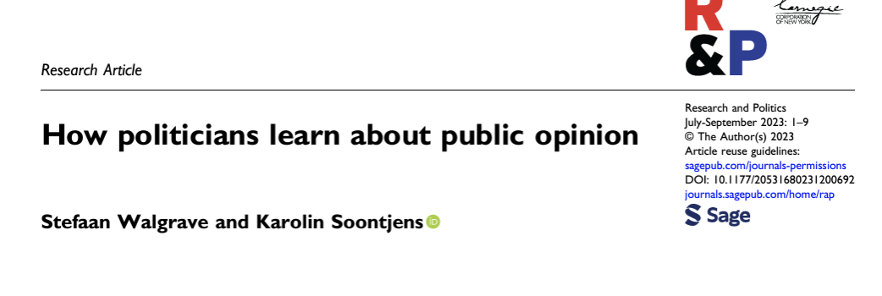
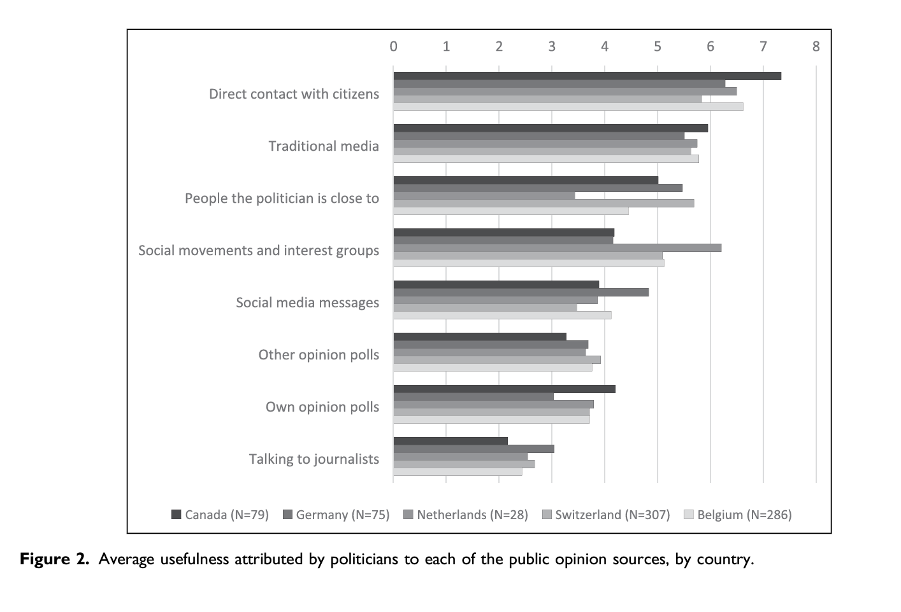

Slide 9

Factors influencing responsiveness
Electoral system
Concentration of power, federalism
Electoral competition
Populism?
Economic status of electorate
Interest group influence

Slide 10

Electoral systems
Proportional (Powel 2000)
vs
Majoritarian (Ferland 2000)

Slide 11
Centralization v. federalism
Soroka and Wlezien (2010)
US, UK, Canada
Testing the thermostat model
Federal structure enhances responsiveness

Slide 12
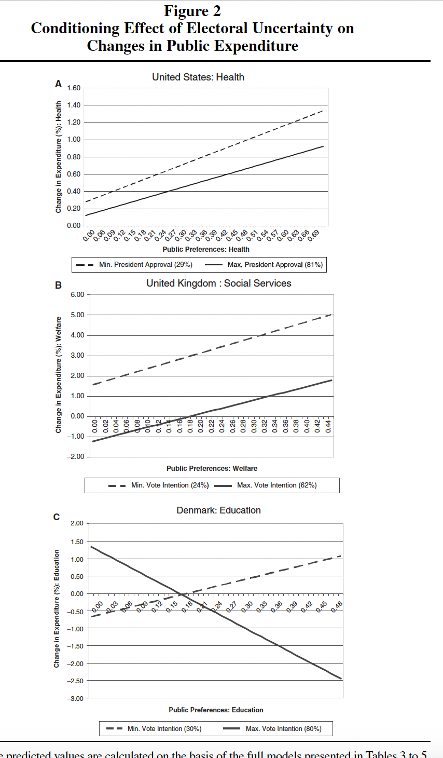
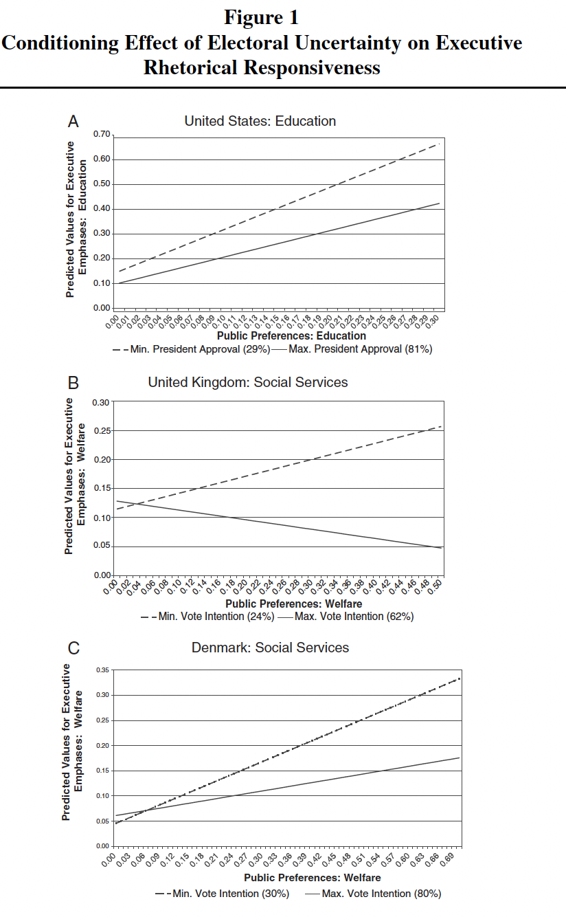
Electoral competition
Parties compete over voters
Parties in government want to deliver
More competition = more responsiveness
(Hobolt, Klemmensen 2008)

Slide 13
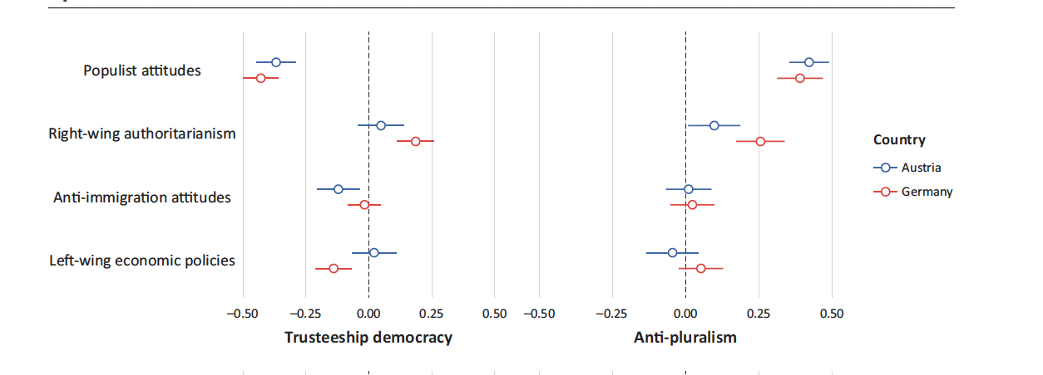
Do populists response more to public opinion?
Populism as a thin-centered ideology
Dividing corrupt elite vs. pure people
Representation of the pure people through direct democracy
Populist voters:
  low levels of satisfaction with democracy
  Low support for representative democracy (the trusteeship model) (Heinisch and Wegschleider 2020)

Slide 14
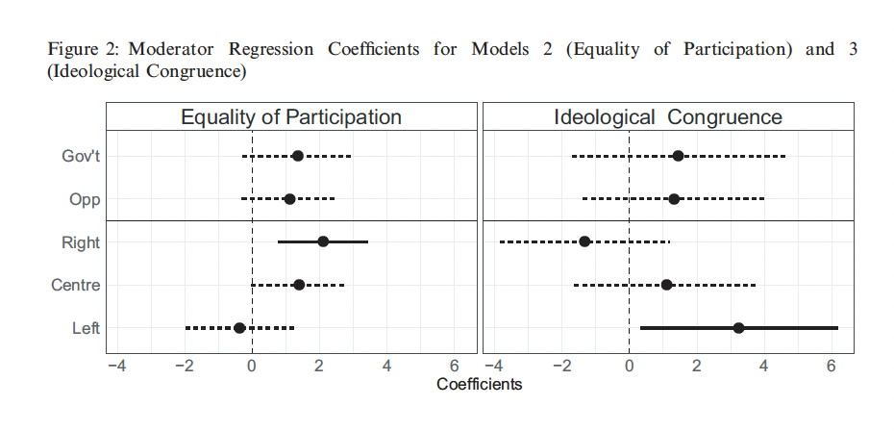
Evidence does not suggest populist responsiveness
Host ideology matters!
Left populist parties = ideological congruence
Voter-party congruence
Not the median voter responsiveness

Slide 15
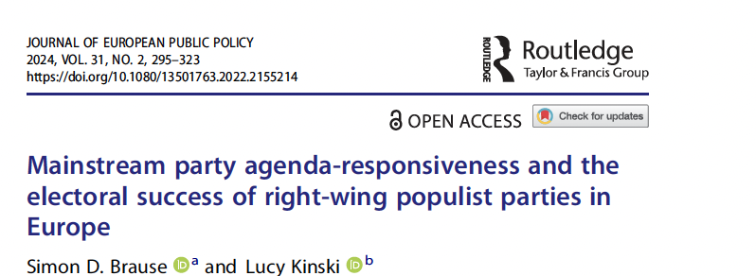
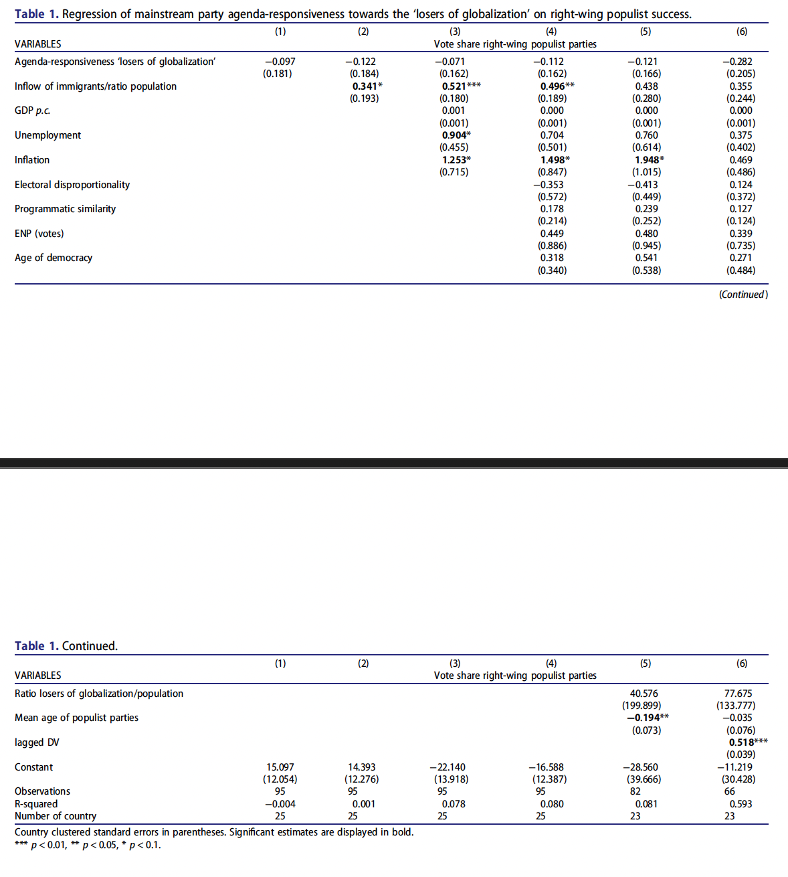
Mainstream parties underrepresent issues of „losers of globalizaiton“
Not effect on RRPP vote share

Slide 16
Individual-level predictors of responsiveness?
Do all attitudes matter to the same extent?
Is there equality in elite responsiveness?
Concern that political elites more responsive to high-income constituents.

Slide 17
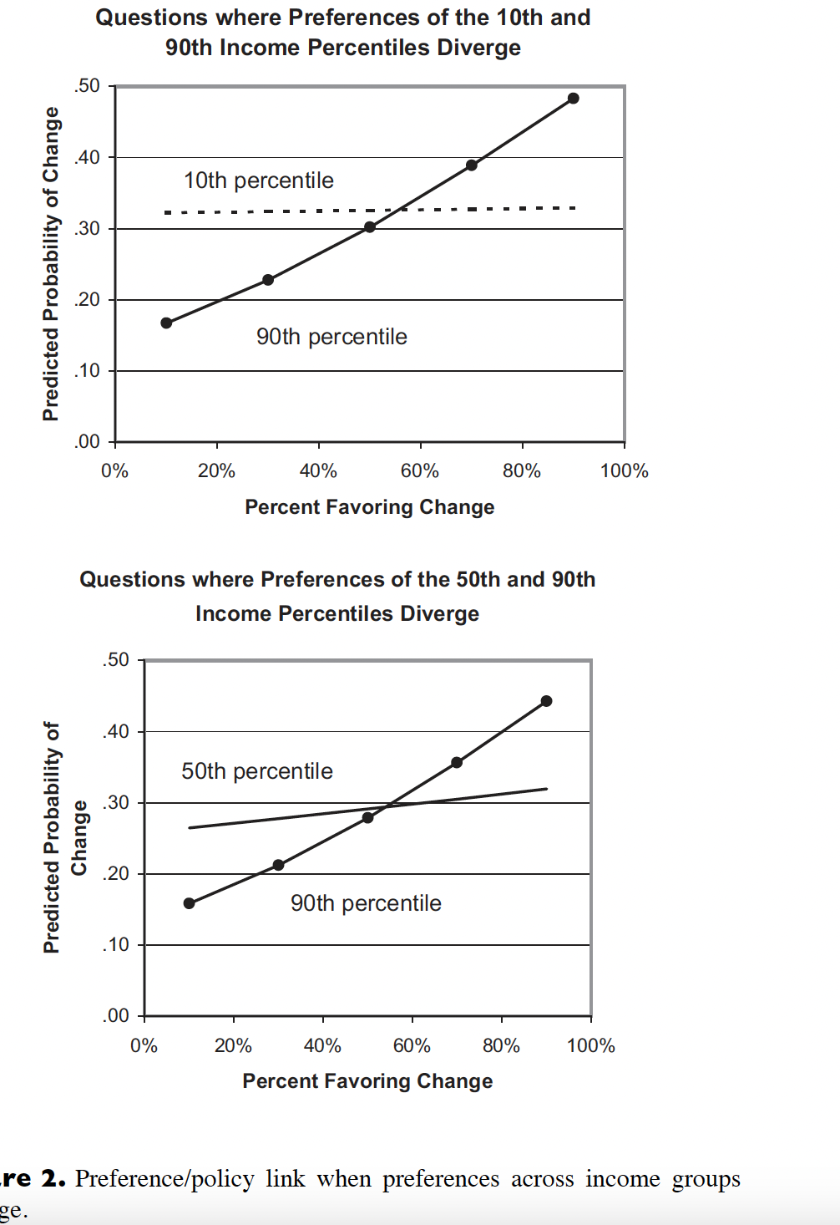

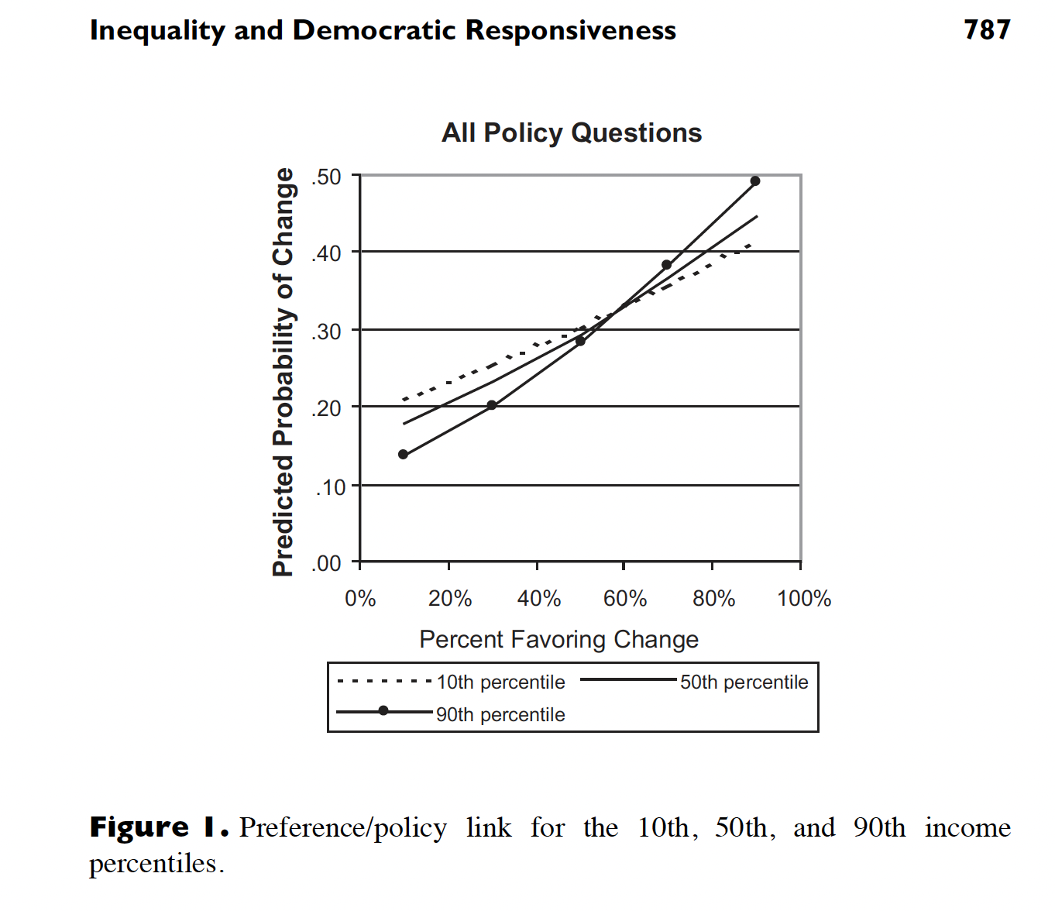

Slide 18
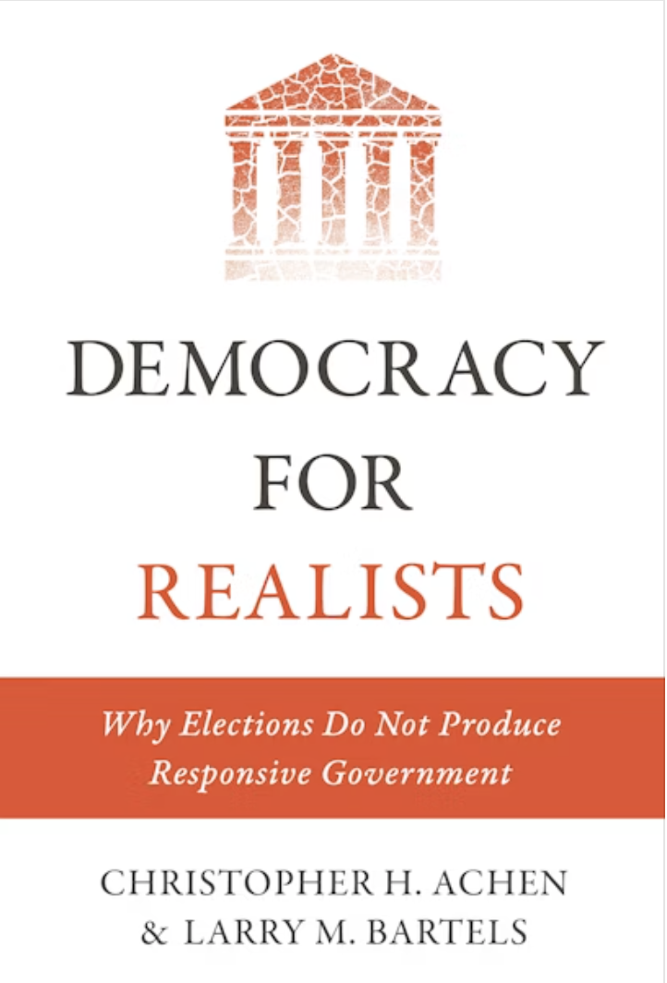
Do politicians care about public opinion at all?
Some are very skeptical
Bartels and Achen 2016
Folk Theory of Democracy
  Myth of rational voter
  Partisanship and role of parties
  Illusion of election mandates
  Limits to policy responsiveness
  Inequality
Democracy is not just translation of public preference into policy
What other functions?

Slide 19
How citizens react to nonresponsive governments?
External political efficacy
Satisfaction with democracy
Policy compliance

