Slide 1
What is public opinion??
PMCb1013
30.9.2024

Slide 2
What is it and why do we need it?
Who should be concerned about public opinion?
What is it anyway?
How do we learn about the state of public opinion?

Slide 3
Why is public opinion important?
Government stability and legitimacy
Consent of the governed
Public opinion as leader constraint
What politicians can and cannot do
Culture – norms and values
What is the zeitgeist?
Mobilization
Politicians utilize public opinion

Slide 4
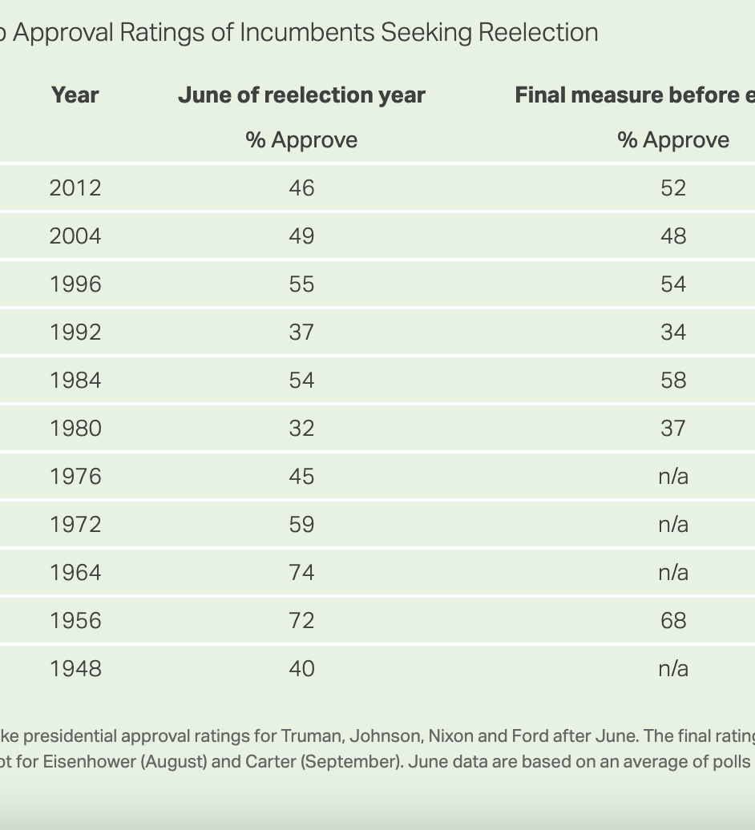
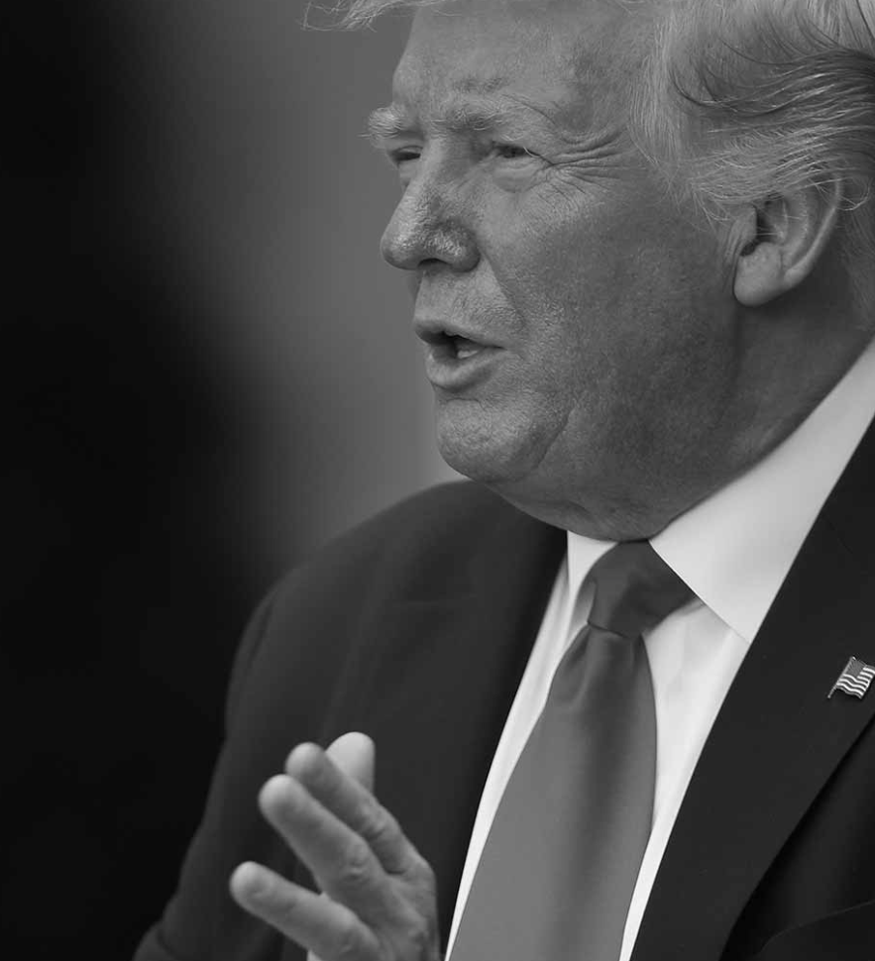
Government legitimacy and stability
Consent of the governed
Job approval
Trumps approval before 2020 election 34%

Slide 5
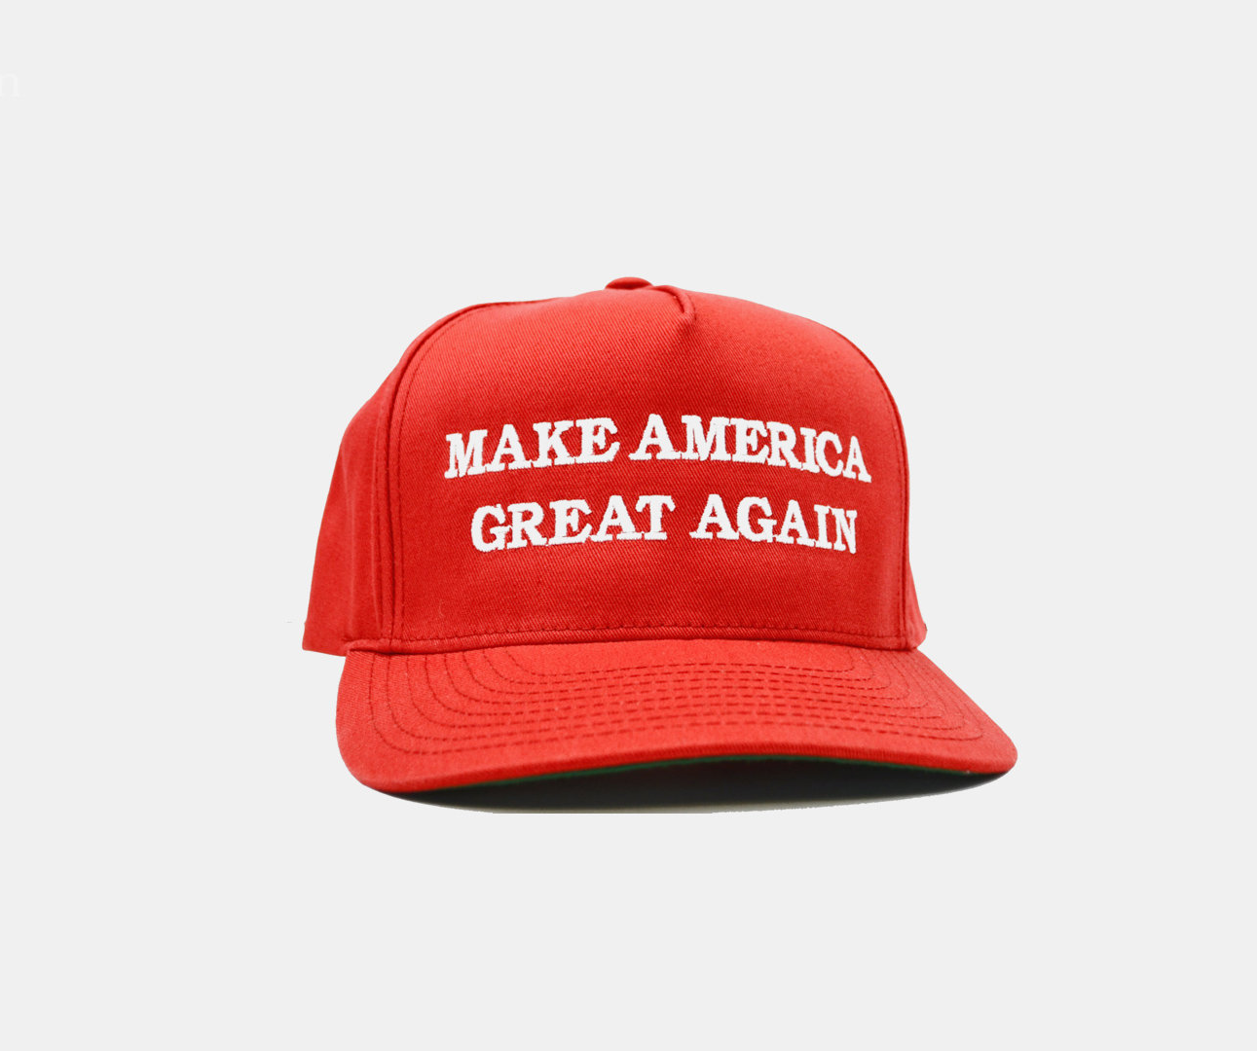
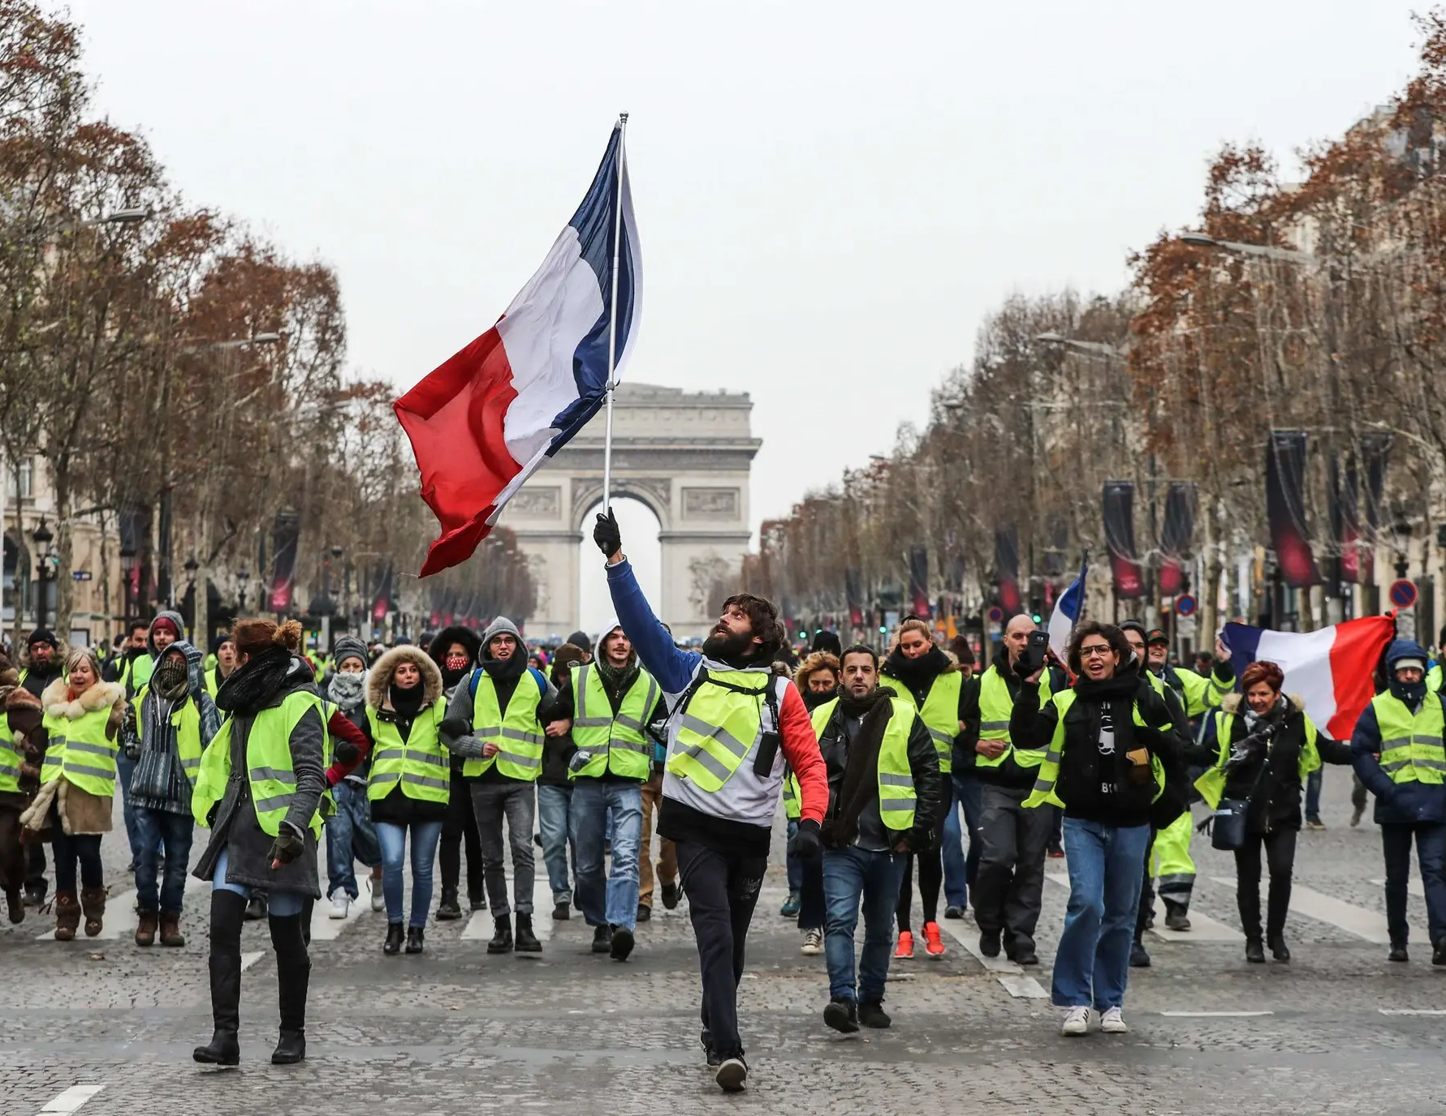
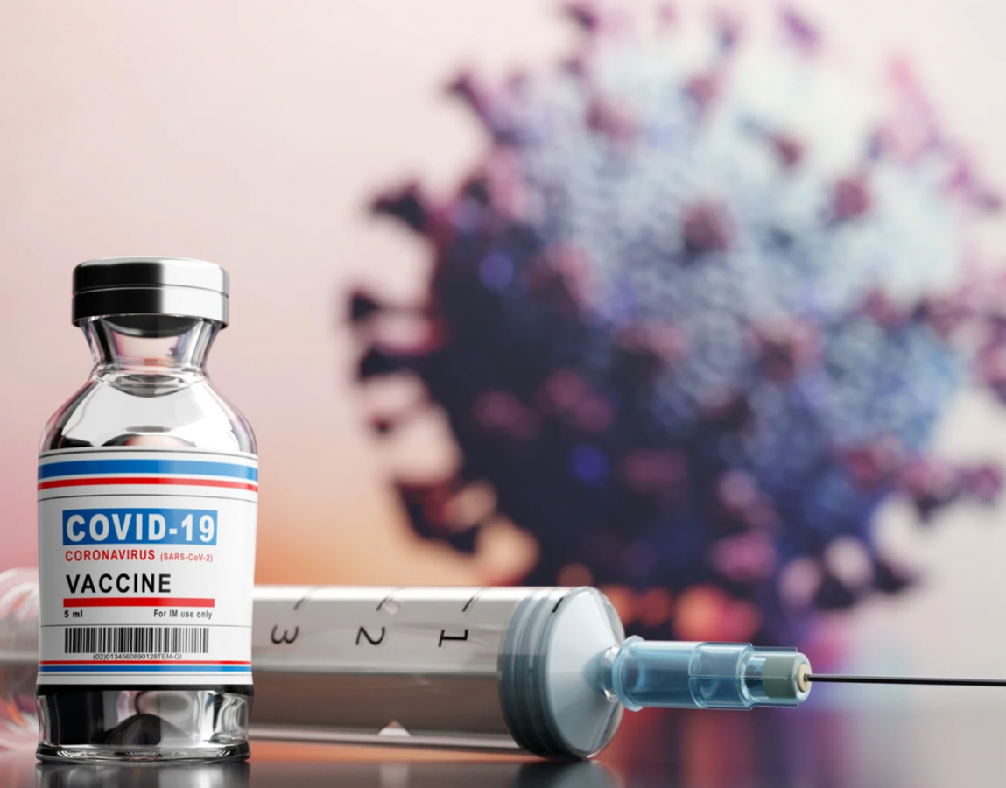
But also trust in government

Slide 6
Leader constraint
Should politicians listen to and obey public opinion?
Do politicians obey public opinion?

Slide 7
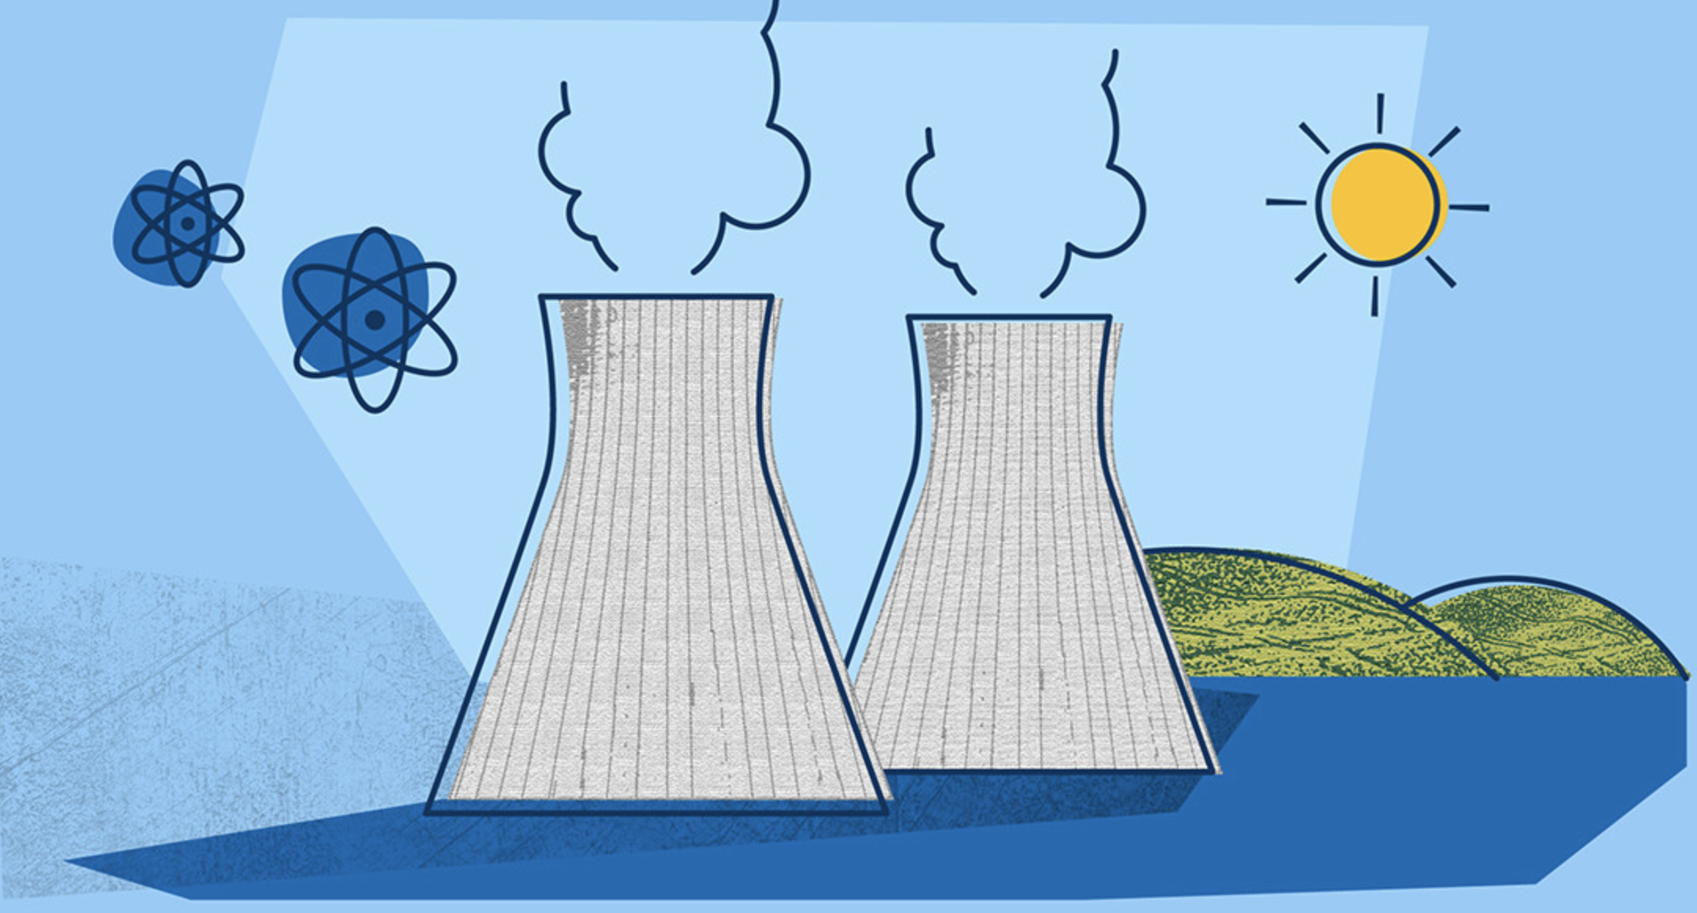
Nuclear phase-out in Germany
After Fukushima accident in March 2011
Change in public opinion in Germany

Slide 8
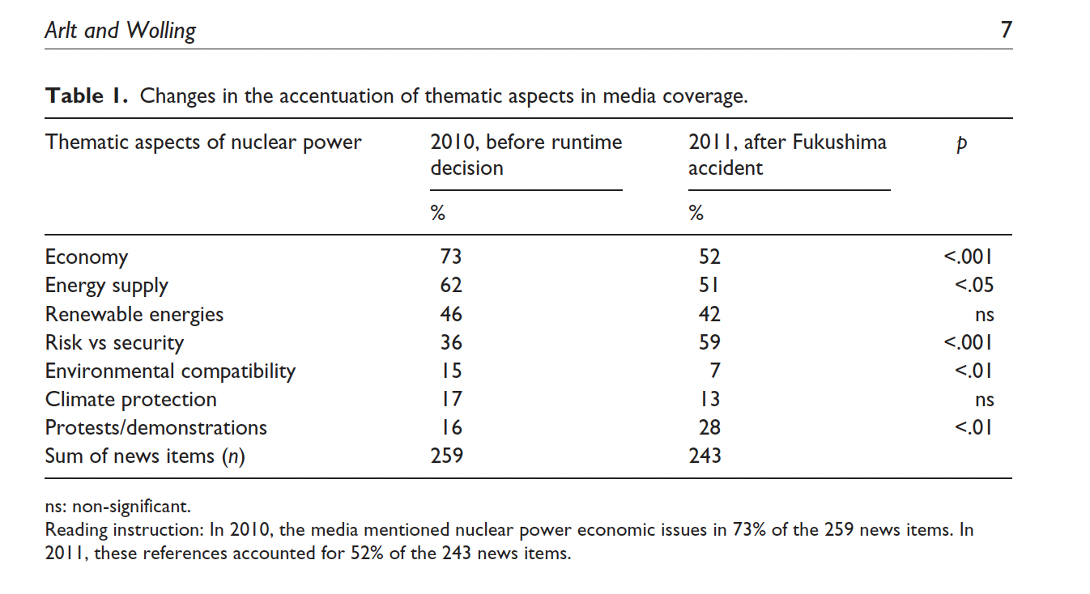
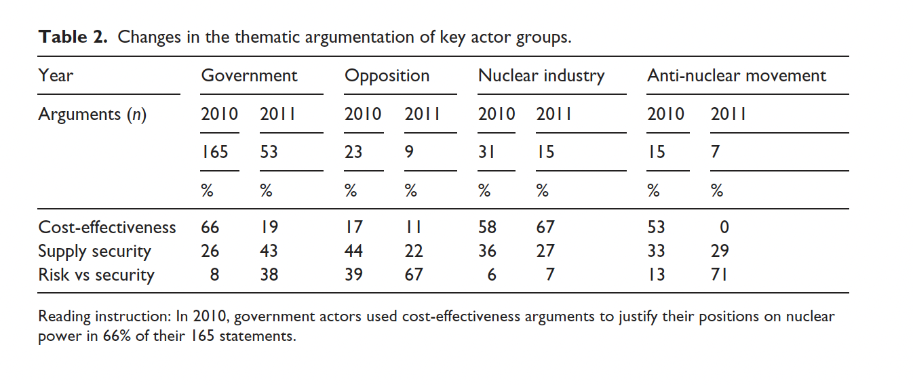
Arlt & Wolling 2015
Media content analysis
Panel data (survey)

Slide 9
Culture and norms
Attitudes on salient issues
Reveal basic values and orientations
Can shift!
E.g. Same-sex partnership

Slide 10
Cultural norms
Postmaterialist values
Generational shifts
Scarcity hypothesis
Shifts in work ethics, gender roles, sexual norms, and religious beliefs in more economically advanced societies

Slide 11
Public opinion mobilization
Politicians utilize public opinion

Slide 12
What is the public?
Evolved in 19th century
In contrast to crowds and masses
Crowds
Anonymous, spread of ideas and emotions, suggestive
Mass
Herbert Blumer: Interpersonal isolation, anonymous individuals, not communicating, heterogenous, own needs
Public
In context of issues, various positions, discussion and conscious reflection
HOW ACCURATE IS IT?

Slide 13
Public opinion definitions
Aggregation of individual options
Majority opinion
Clash of group interests
Media and elite influence
Fiction
https://www.youtube.com/watch?v=ahgjEjJkZks

Slide 14
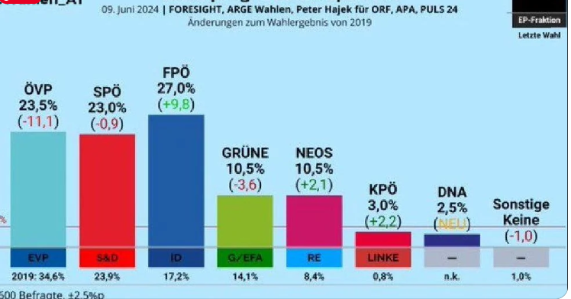
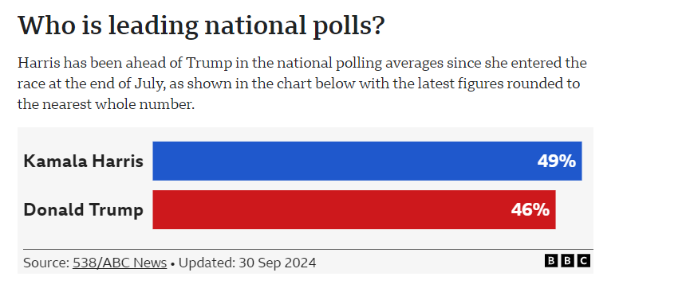
Aggregation of individual opinions

Slide 15
Majority opinion
Opinion climate
Spiral of Silence (Noelle-Neumann 1974)
Opinion climate can influence participation (online)

Slide 16
Conflict of interests
Organized groups
Whose opinions do policy-makers take more seriously??

Slide 17
Elite and media influence
Lippmann
What is important for opinion?
What do we actually perceive?
Who gives us ideas or “images” about the world we live in?
Construction of consent?

Slide 18
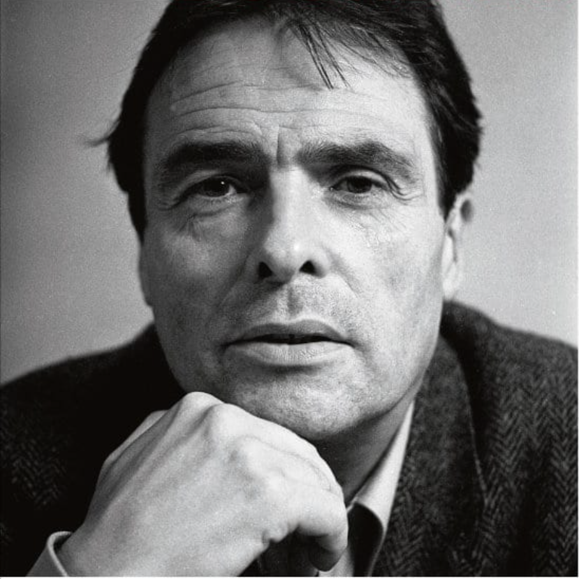
False assumptions:
Polls assume that people have opinions.
Each opinion has the same value.
There is consensus about what questions should be asked.

Slide 19
History and Meaning of Public Opinion

Slide 20
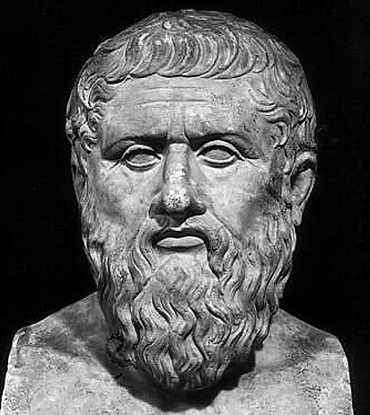
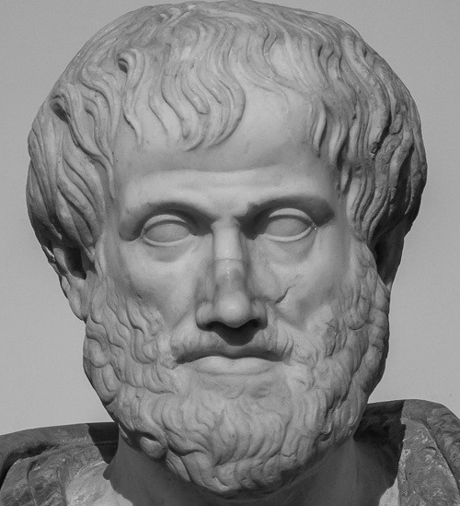
Did public opinion matter throughout the history?

Slide 21
History of public opinion
Plato vs. Aristotle
Uninformed public vs. Wisdom of the crowds
PO through discussions, rhetoric, theatre
Small scale democracy
But was it democracy?

Slide 22
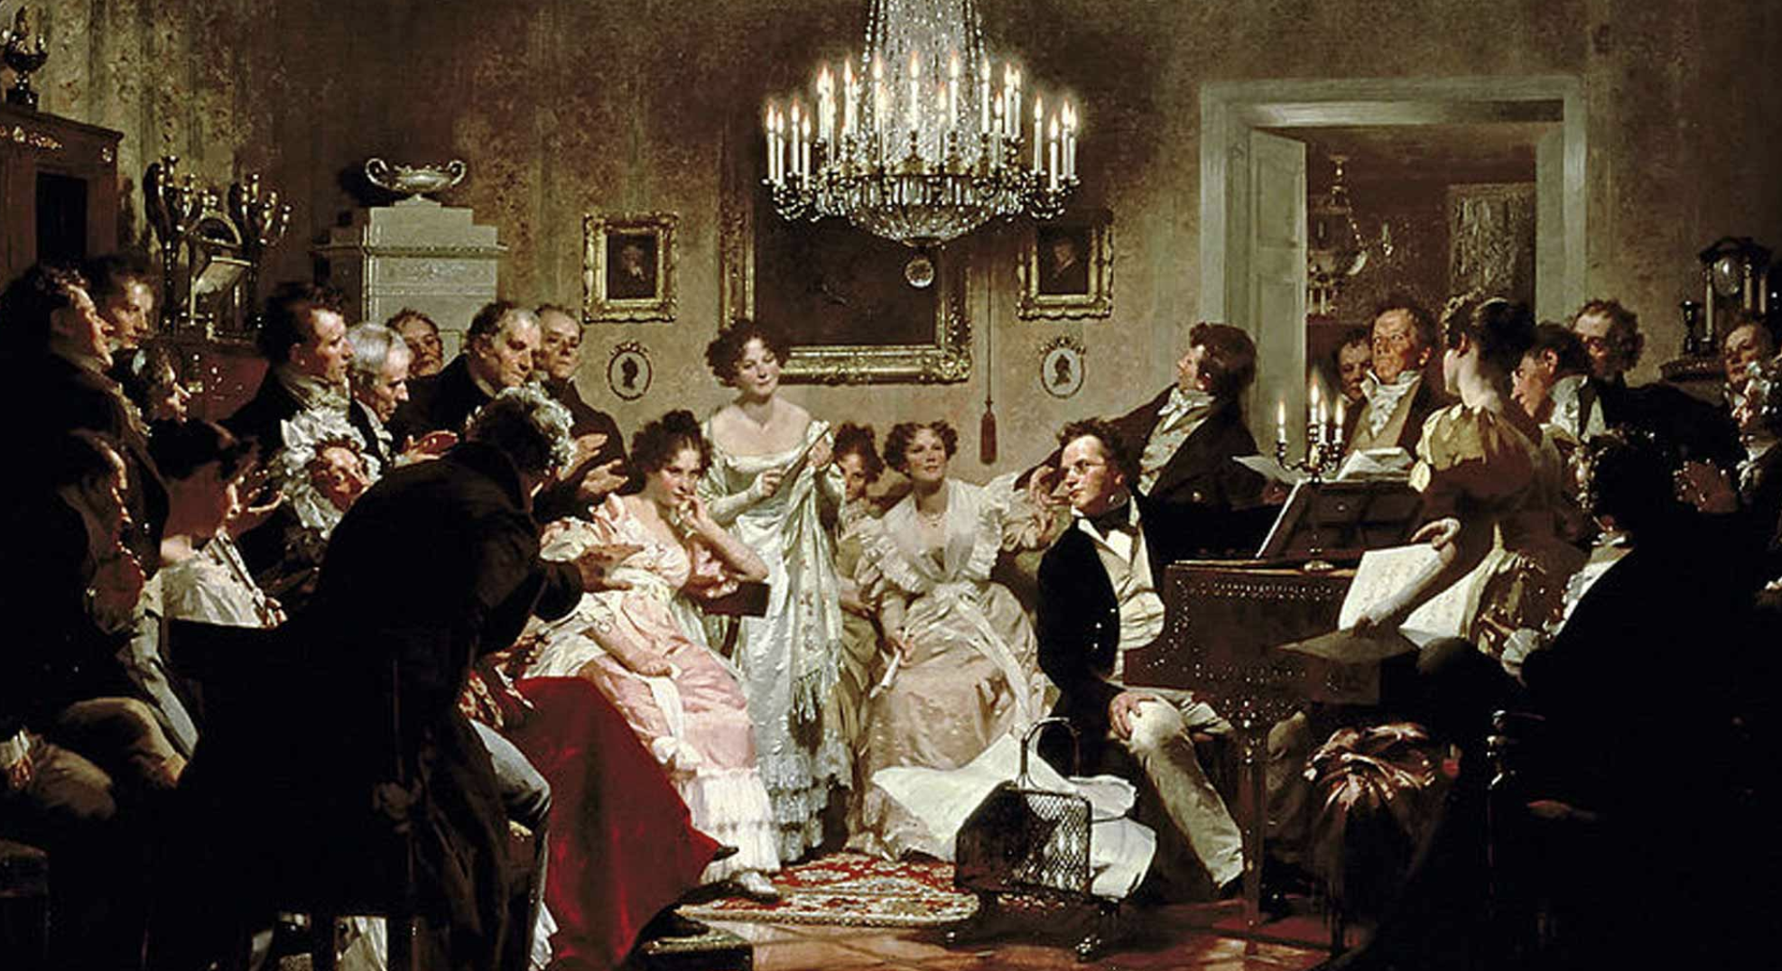
History of PO
Book print
Machiavelli, public opinion not a constitutive force
Social contract theories
Rousseau and „general will“
“public opinion“ invented by Jacques Necker in 18. century
Salons, coffeehouses, pubs (who is the public?)
England 17th, 18th century: petitions but lack of rational dialogue
Riots

Slide 23
Stronger role of public opinion
With democratization
Alexis de Tocqueville
Influence over political decision-making
Public opinion more important with spread of education
Warns against tyranny of the majority
Tendency to conformity (social pressure, tendency to align with majority)
PO volatile
Early 20th century: shift to empirical approaches
New modern society, migration, urbanisation, new social stratification
Public opinion matters more also in campaigns
1896 William McKinney vs. William Jennings Bryan

Slide 24
20th century and new approaches
Media (Pippmann)
George Gallup invented polling
How people feel about issues, policies
Attention to mass media
Propaganda
21st century
Internet, social network algorithms (Cambridge Analytica)

Slide 25
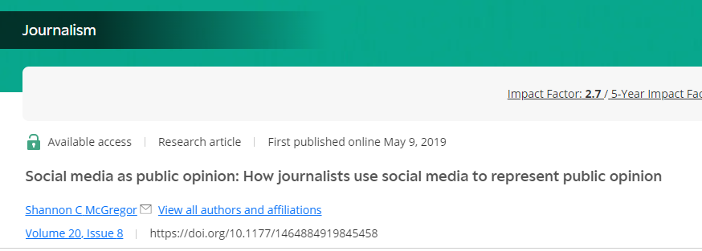
Social media and public opinion?
To measure public opinion
Textual data, visual data, user engagement metrics, network analysis.
Social media as public opinion
Example: 2016 US Elections

