Slide 1
Data processing

Slide 2
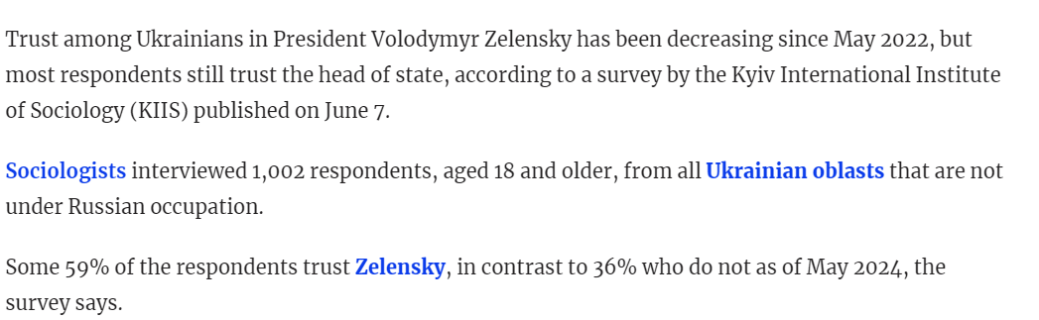
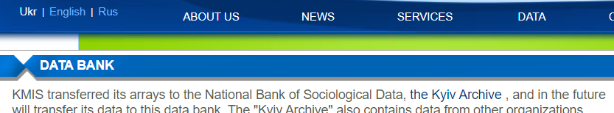
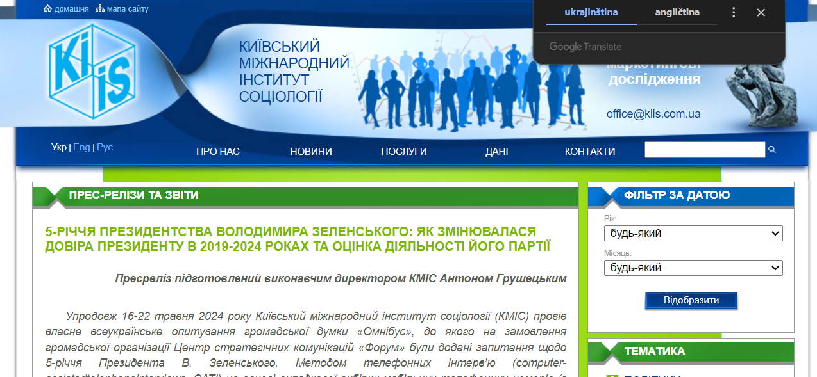


News articles
https://kyivindependent.com/ukrainians-trust-in-zelensky-decreasing-but-still-high-survey-shows/

Slide 3

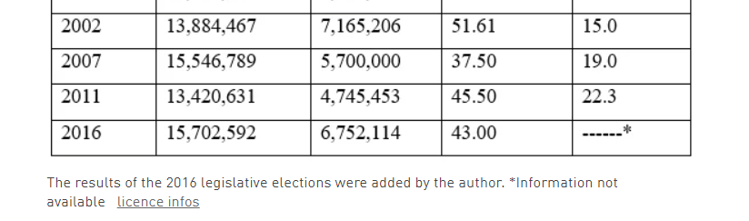

Slide 4


Slide 5
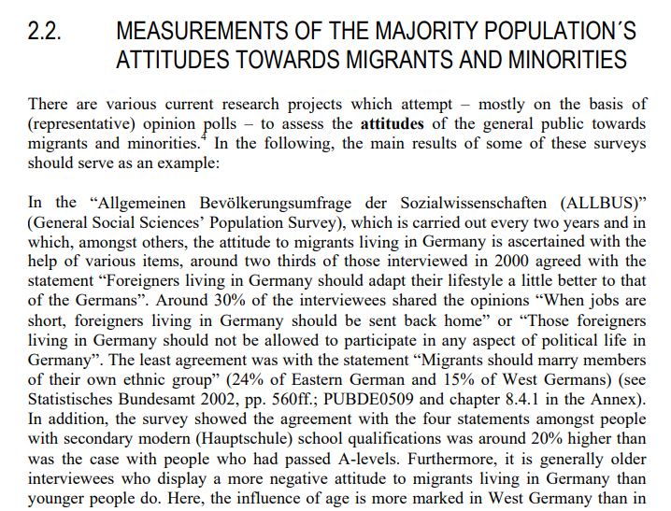
Data in acadamic articles and books

Slide 6

Real Data

Slide 7
Data linked to research articles
Processed data
Edited data
Original variables not used for article are deleted
Indication of source of data
data.mendeley.com
https://dataverse.harvard.edu/

Slide 8
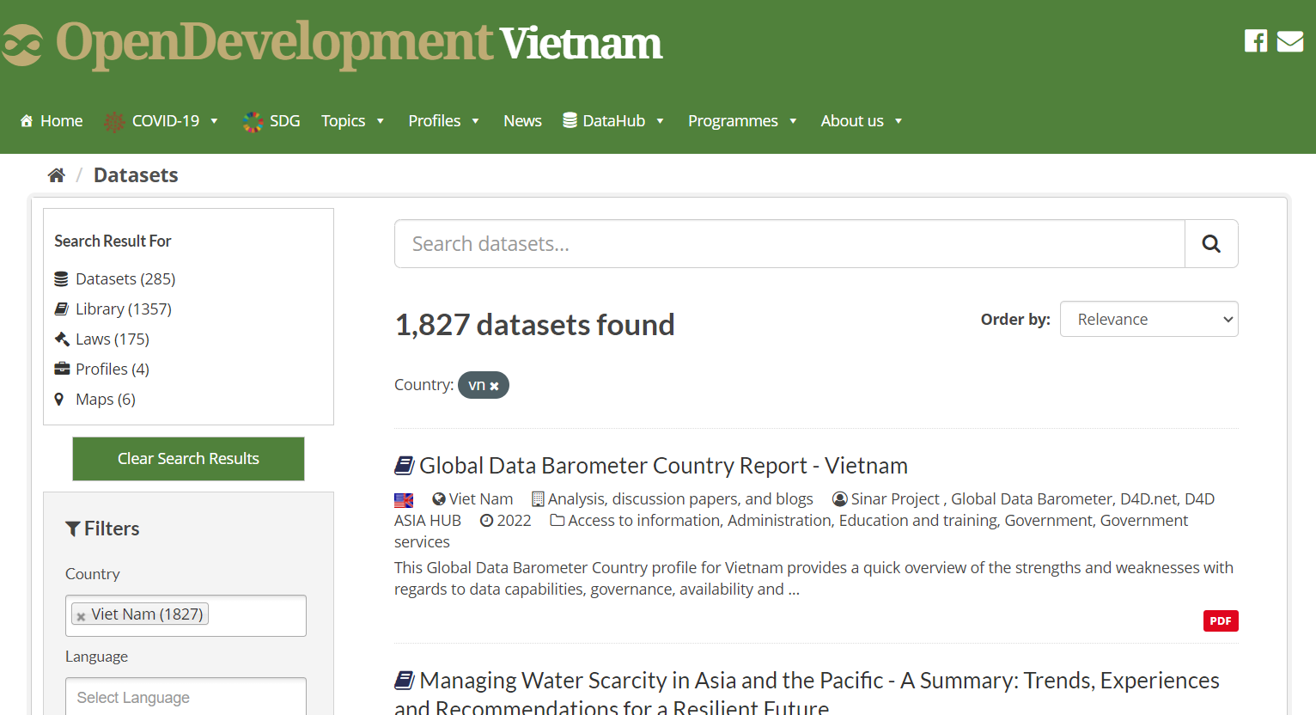
Vykopirovat vietnam

Slide 9
Typical scenarios
Excel (xls, xlsx)
SPSS (sav), Stata (dta), R (rdata)
CSV, TXT
XML
JSON

Slide 10
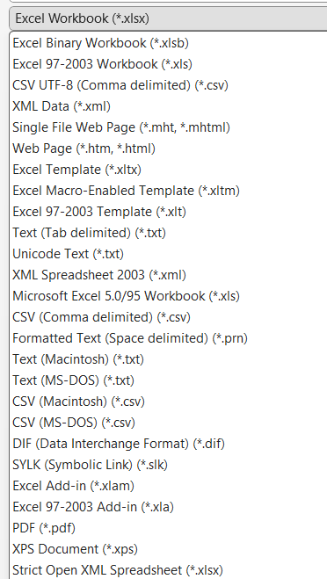
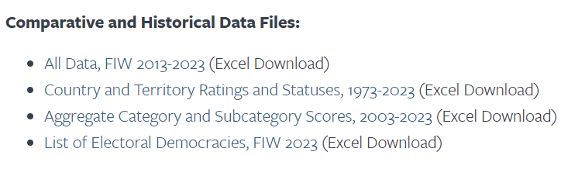
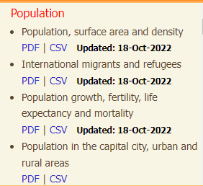
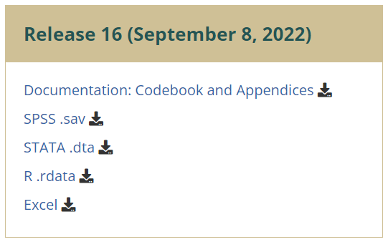
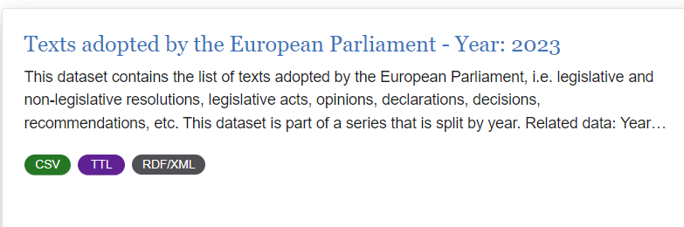
Examples

Slide 11
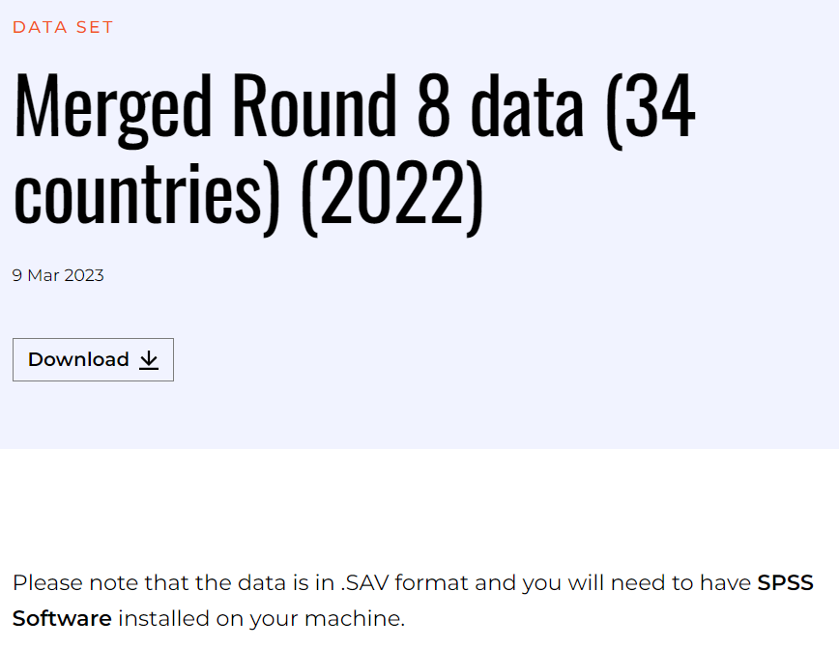
SPSS
https://www.afrobarometer.org/survey-resource/merged-round-8-data-34-countries-2022/
SPSS is available at the MU website (see next page)
SPSS to excel online conversion: https://secure.ncounter.de/spssconverter

Slide 12

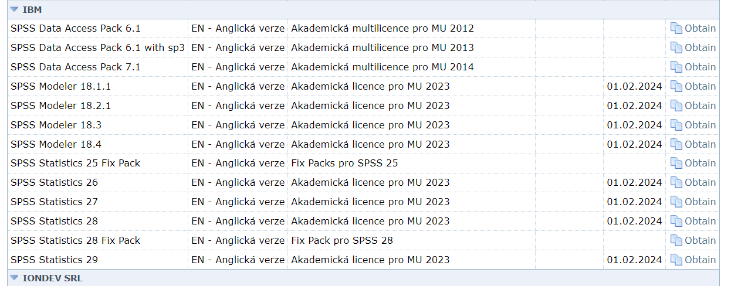
https://inet.muni.cz/?idr=ict.soft&pk=u&x=0&y=500

Slide 13
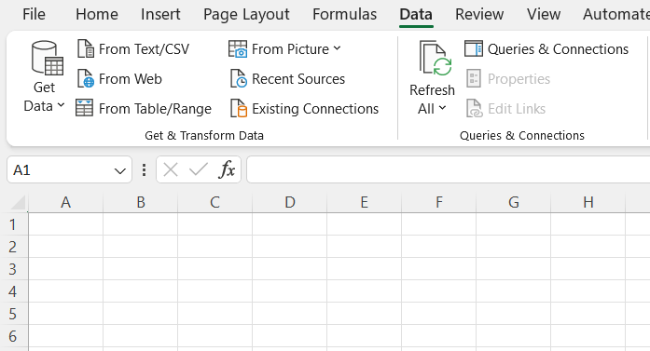
CSV
Our example of csv data: https://data.europarl.europa.eu/en/datasets/texts-adopted-by-the-european-parliament-year2023/26

Slide 14
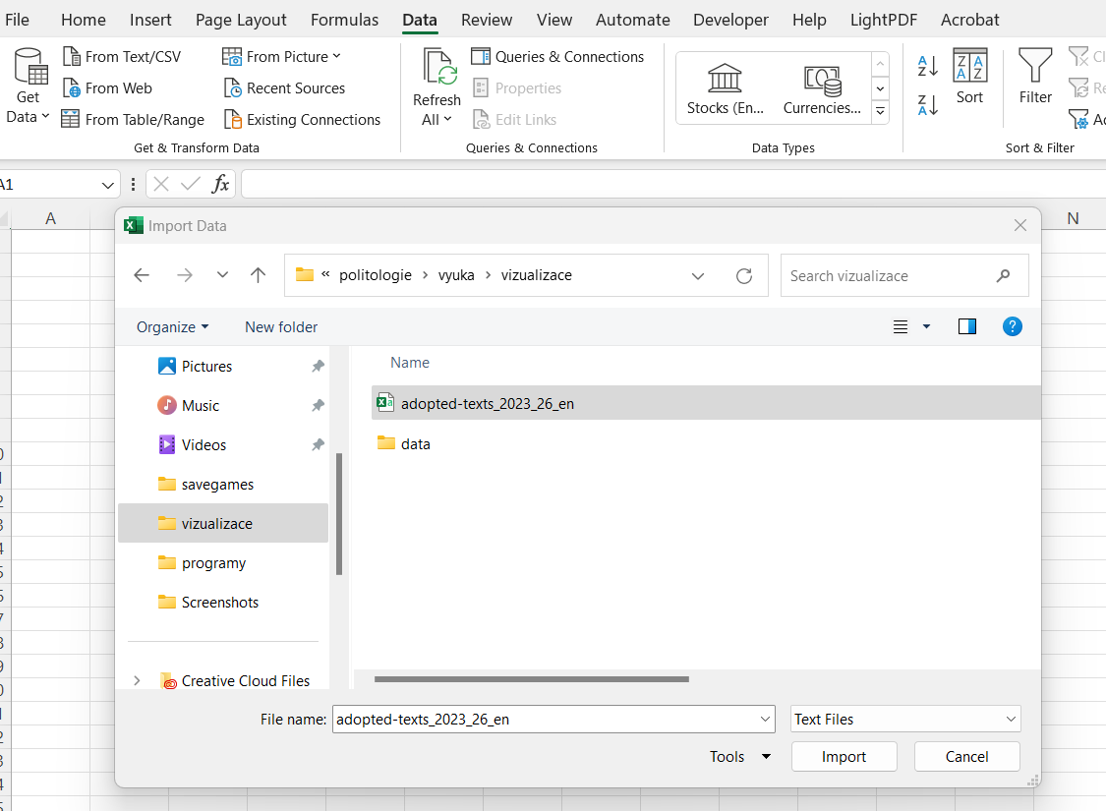

Slide 15
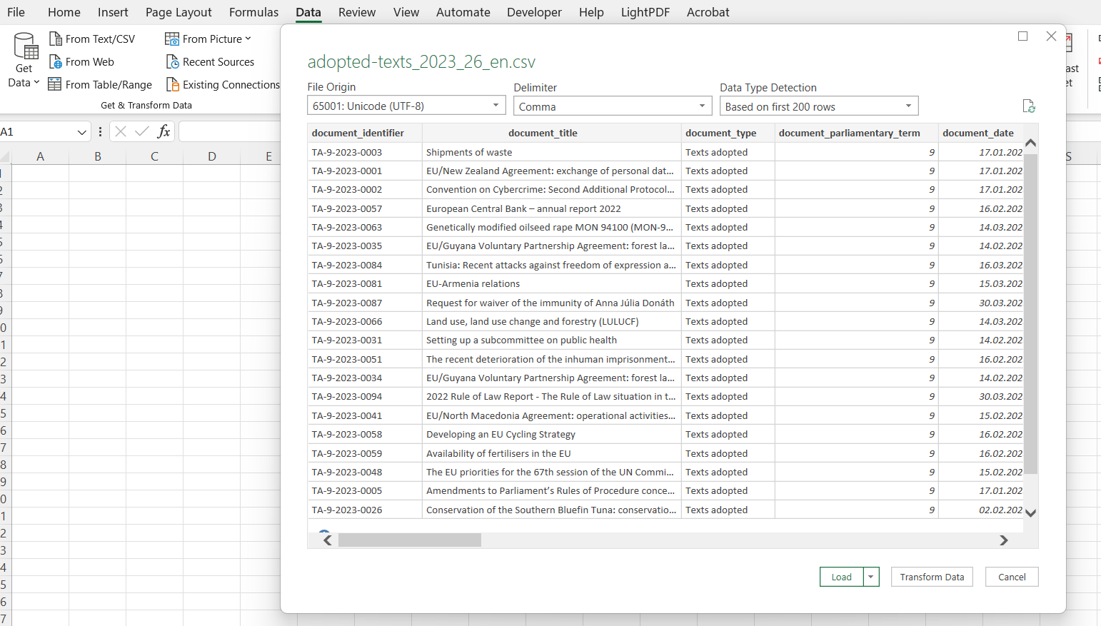
This is important for tables containing text in other language than English
TT

Slide 16
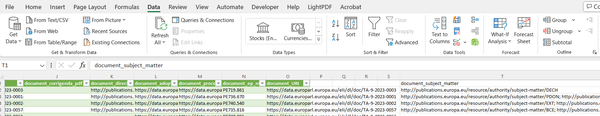
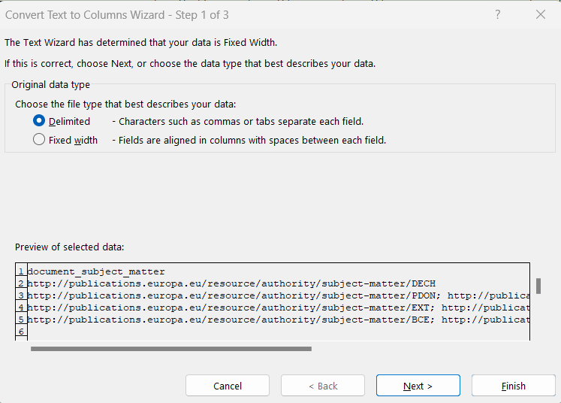
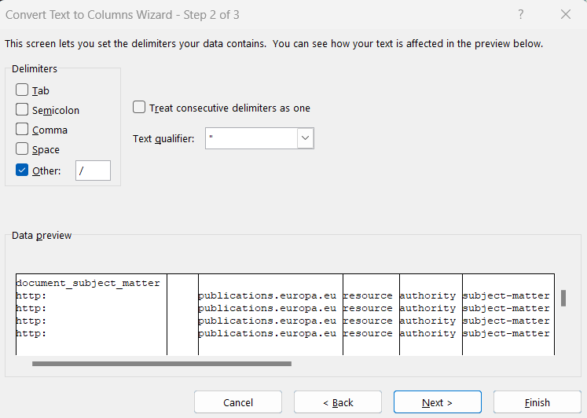
Split column into more columns

Slide 17
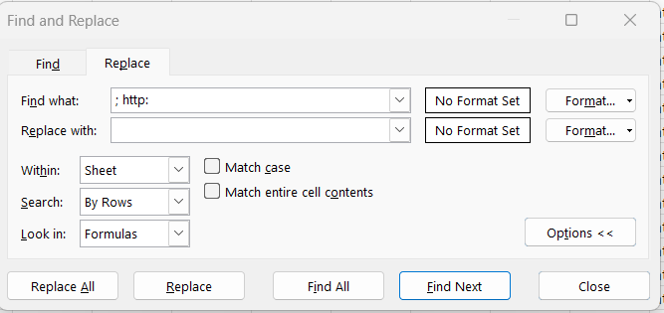
Cleaning (ctr+h)

Slide 18
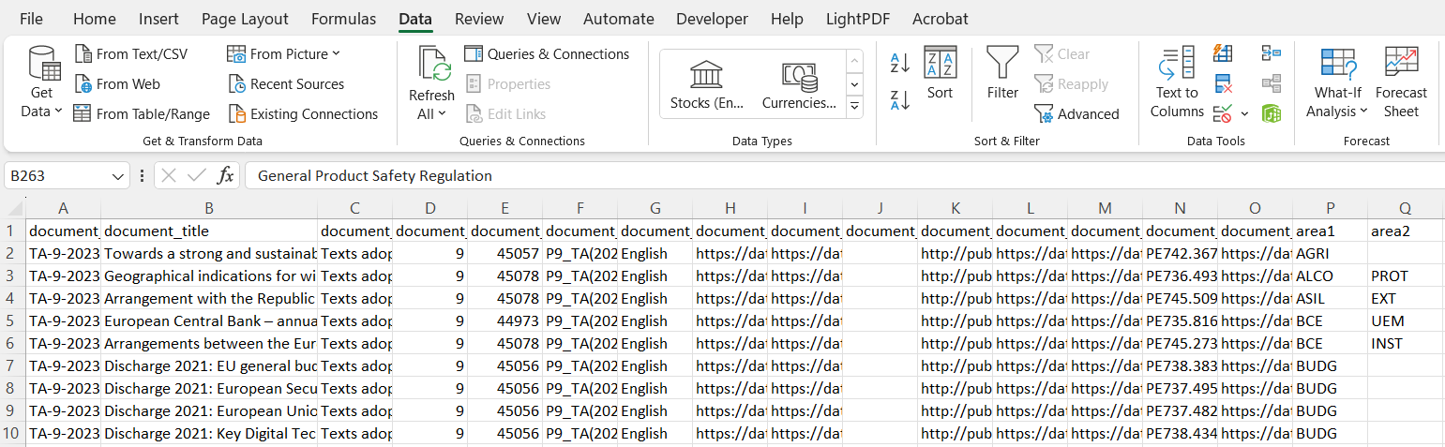
Sorting

Slide 19
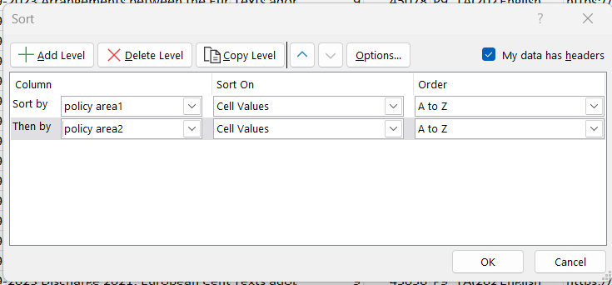
Here you can add one more box for choosing sorting variable
This box has to be marked to see variable names in „sort by“

Slide 20
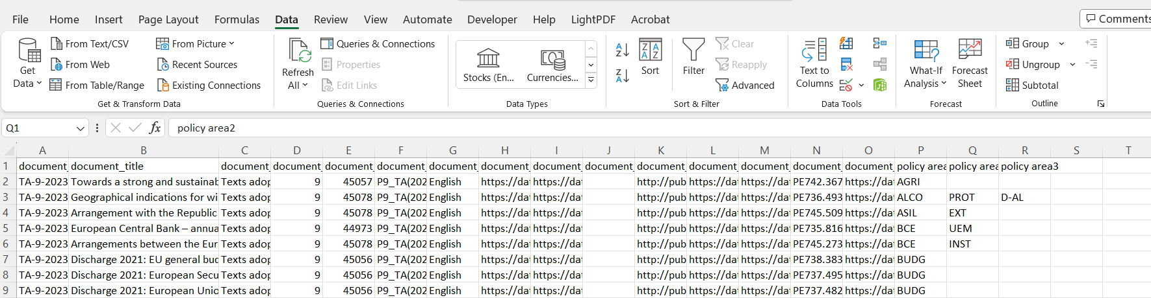
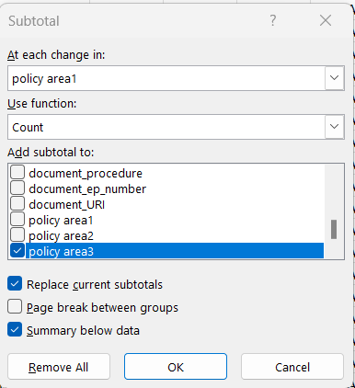
Computation
Grouping variable: for what categories we want to make the computation
Way of computation: what kind of number we want (sum, count, mean, min, max, SD)
Sum: the ammount which you have to pay in shop is sum of prices of pieces in your shopingcart
Count: number of pieces in your shopingcart
Mean: average price of pieces (e.g. 20, 30, 50, 100 mean is (20+30+50+100/4 = 50)
SD: mean deviation of values around the mean (50-20) + (50-30) + (50-50) +(100-50)/4 = 25
(real calculation works with squareroot of exposed numbers
What you want to count

Slide 21
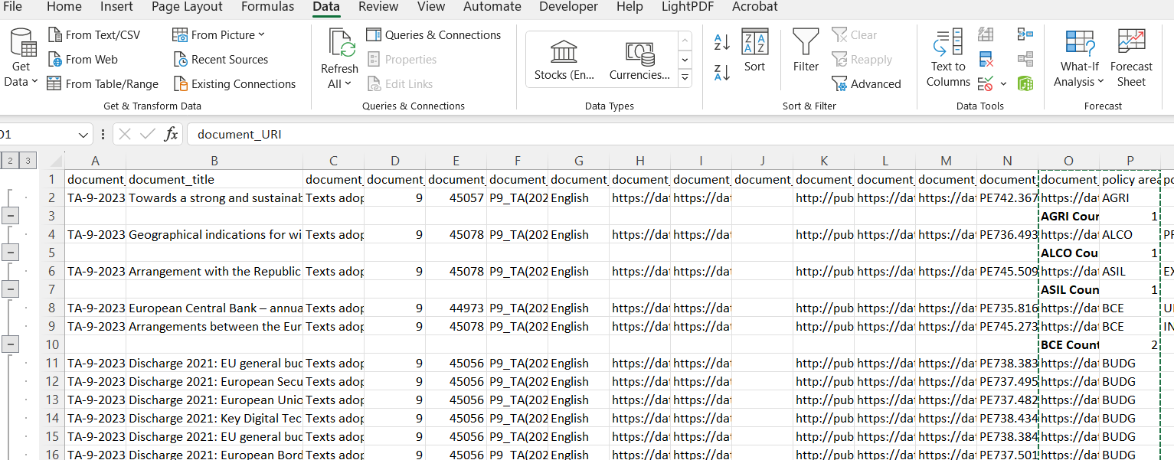
Result
It is not over yet

Slide 22
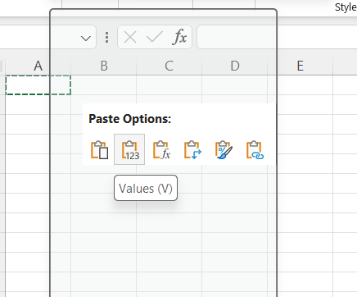
Copy the results to new sheet and insert them as values
  Click with right button of mouse
Select only rows wit result
  Add new empty column
  Use text to column wit „space“ as delimitor
  Sort data by new column
  Delete everything without word count (in new column)

Slide 23
Compute percentages
=C2/$C$70*100
$ allows to calculate values for whole column, but the value in denominator remains the sam

