Slide 1
Visualization of relationship between variables

Slide 2
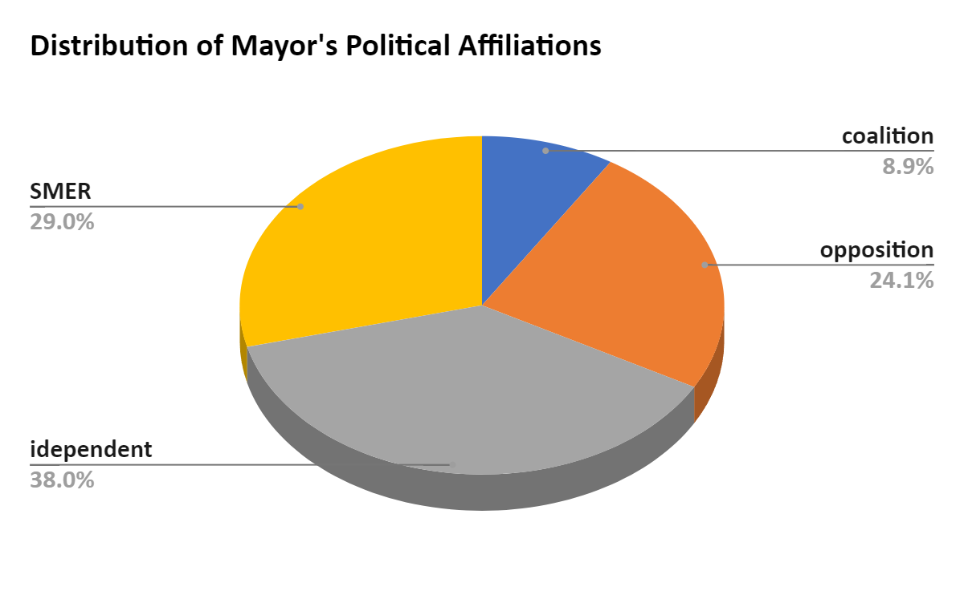
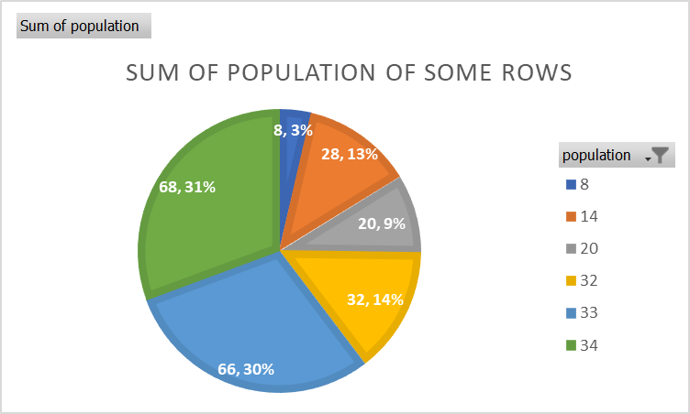
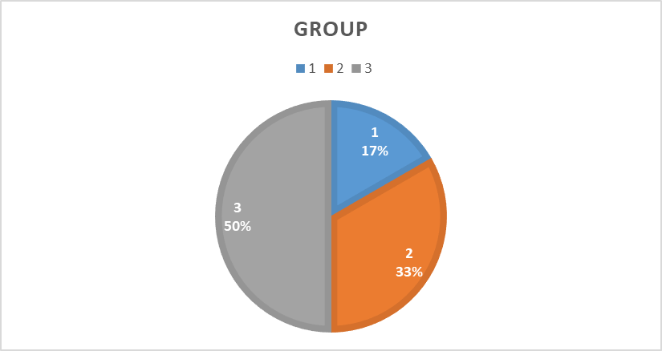

Slide 3
Count of Municipalities by Group

Slide 4
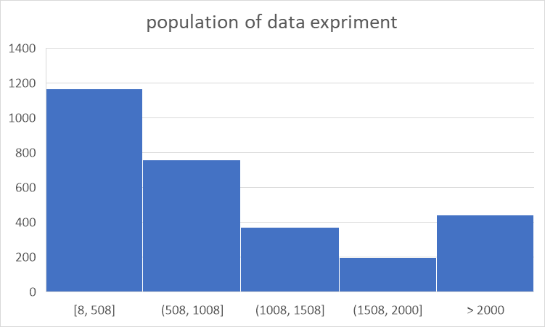
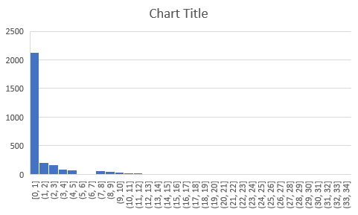

Slide 5
Two types of relationship
Correlation – two things are going together
Causation – one thing causes the second one
  Only advanced methods can reveal causation
Correlation ≠ Causation

Slide 6
Combinations of variables
Categorical x categorical – stacked bar chart, series of pie charts
Categorical x cardinal – set of boxplots
Cardinal x cardinal - scatterplot

Slide 7
How to recognize relationship
Categorical x categorical – charts are different for each category
Categorical x cardinal – charts are different for each category
Cardinal x cardinal – there is some pattern in scatterplot

Slide 8
=countif
=COUNTIFS(B:B; 1;C:C;1)
Same logic for sumif, averageif, etc
One condition ….IF
More condition …IFS
Column with variable survival
Only rows where survival = 1 are counted
Only rows where Pclass = 1 are counted
Column with variable Pclass

Slide 9
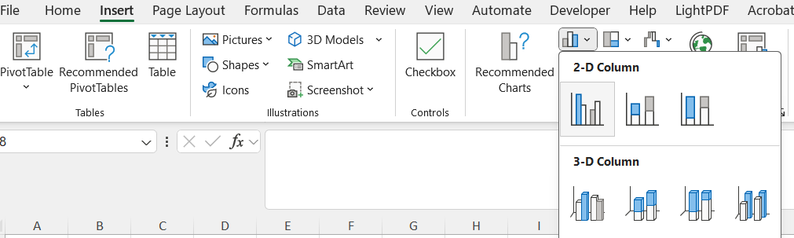
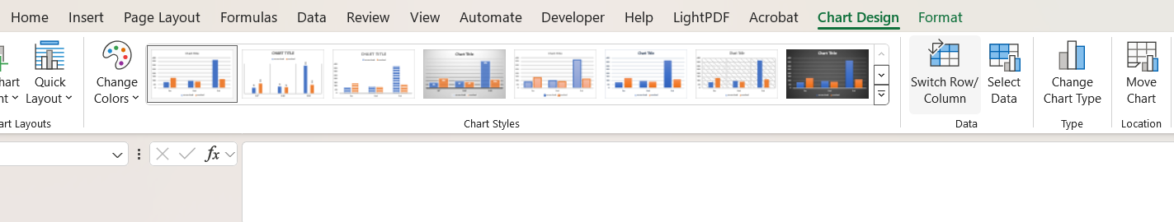

Slide 10
Bar chart

Slide 11
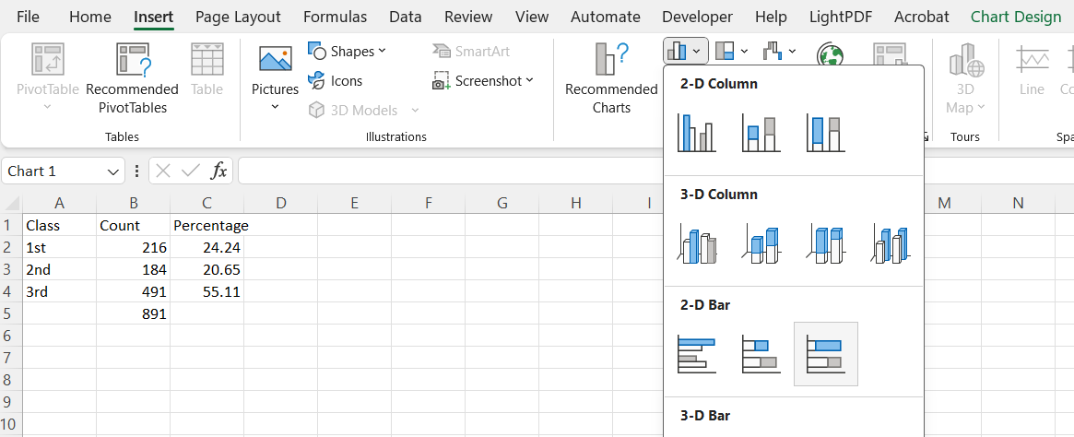
Stacked bar plot

Slide 12
Stacked bar chart

