Slide 1
Scatter plot

Slide 2
Final assignment
Deadline January 28th
Own issue
Usage of tools introduced in course

Slide 3
Relationship of two interval variables
Correlation
Weight x height
Unemployment rate x purchase power
Hours of reading x points in test

Slide 4
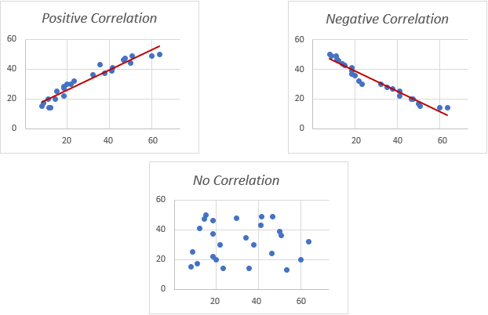
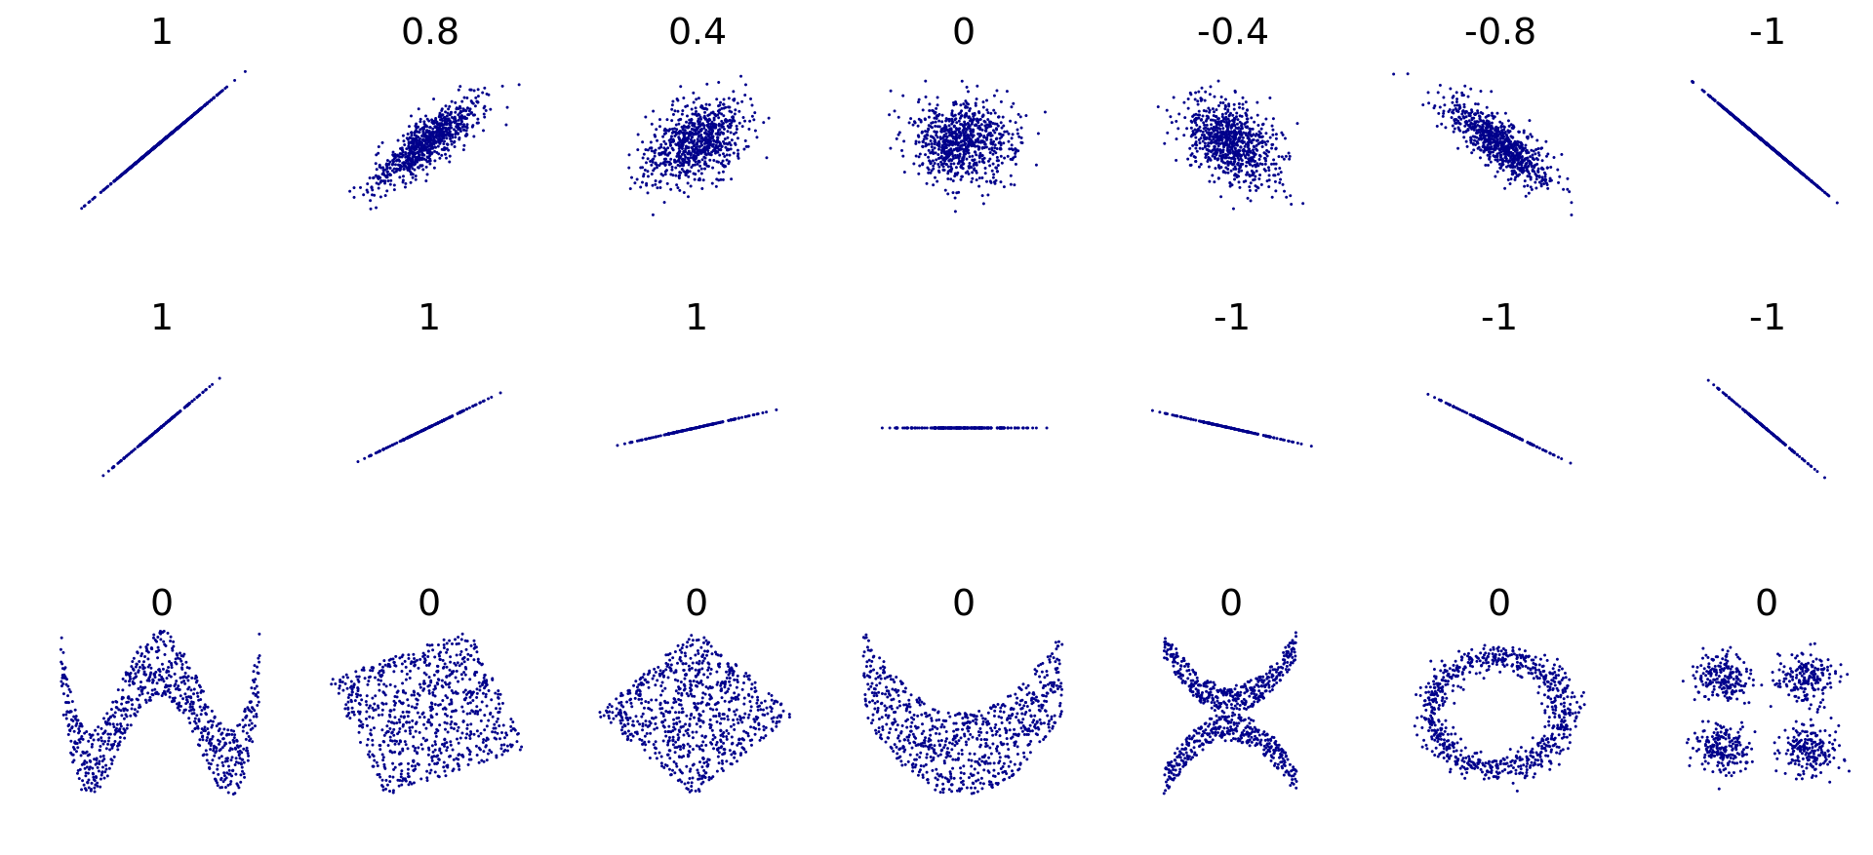

Slide 5
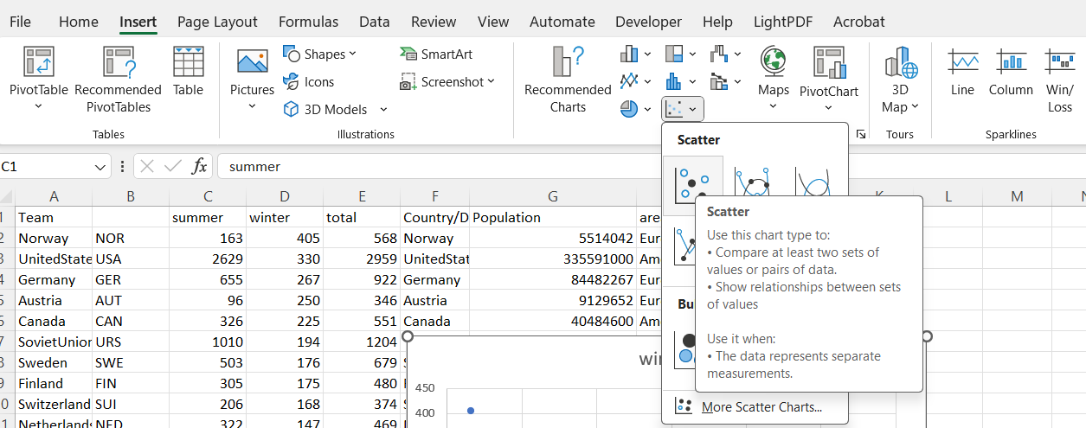
Scatterplot

Slide 6
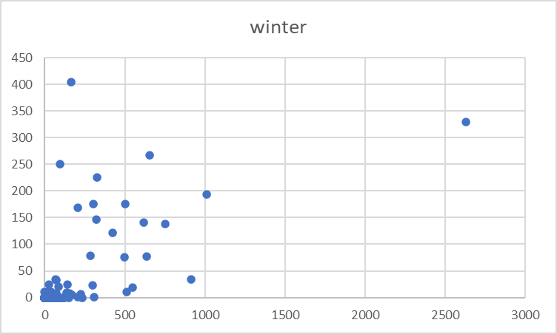
outliers
overplotting

Slide 7
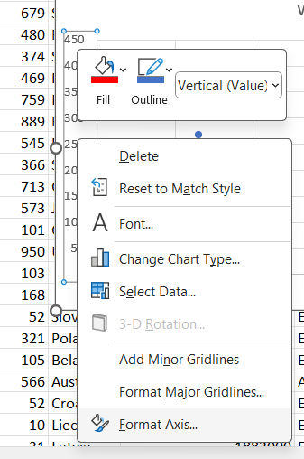
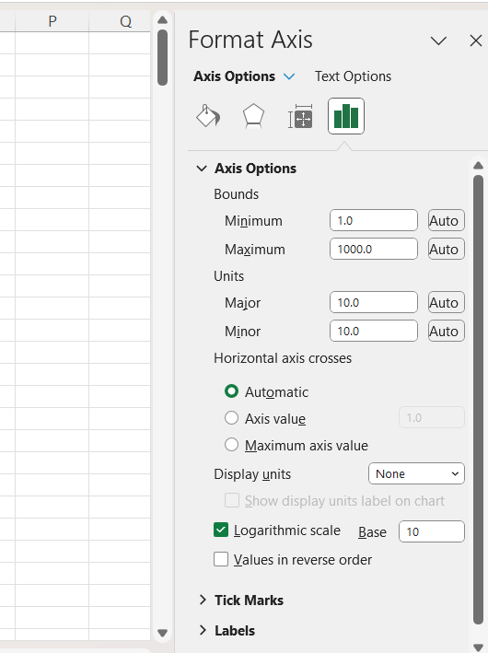
Log axis
Solution when there is a lot of small values and a few high values
  Typical situation: population
Problem: it does not work for 0 and negative numbers
Right click here
a quantity representing the power to which a fixed number (the base) must be raised to produce a given number (eg for 100 it is 2 because 10power2 is 100)
- does not work for zeros!!! (solution replace (ctrl+h) by number between 0 and 1 (e.g. 0.1)
Excel leaves the labels as not transformed, but it change look of axis

Slide 8
Both axes logged

Slide 9
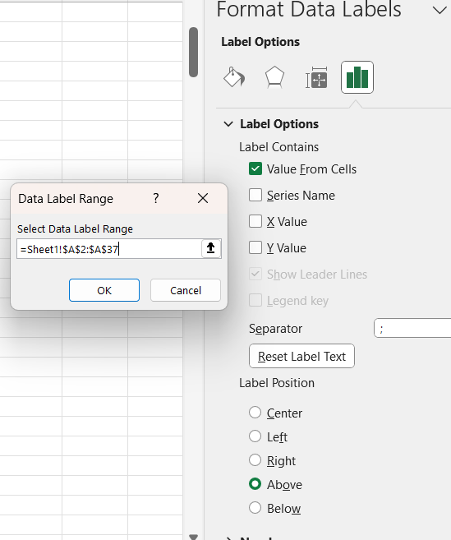
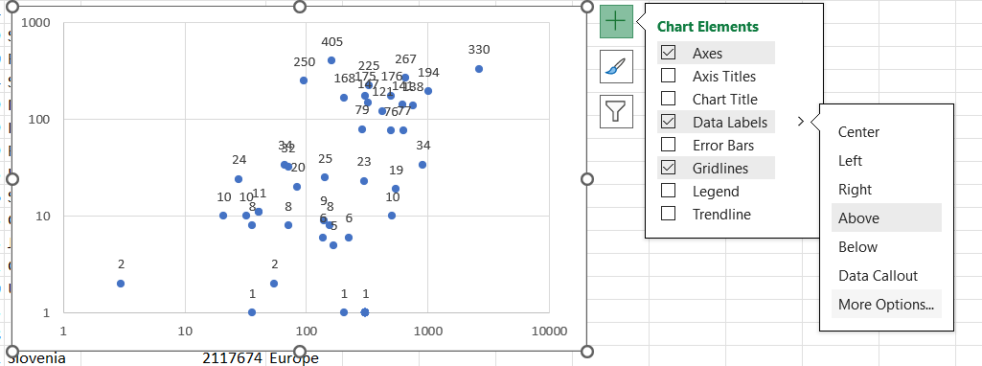
Add point labels

Slide 10
Overlays need to be managed manualy
Use short names or abbreviations

Slide 11
Add lines
Trend line
  Linear
  Exponential
Quartals

Slide 12
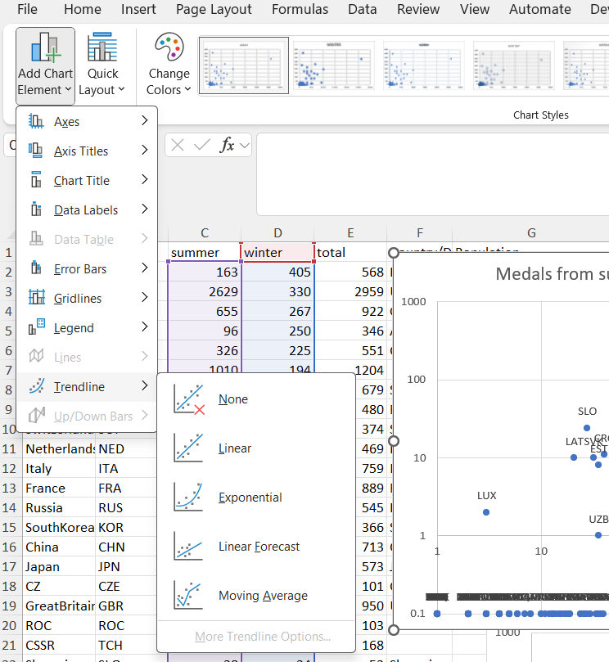

Slide 13
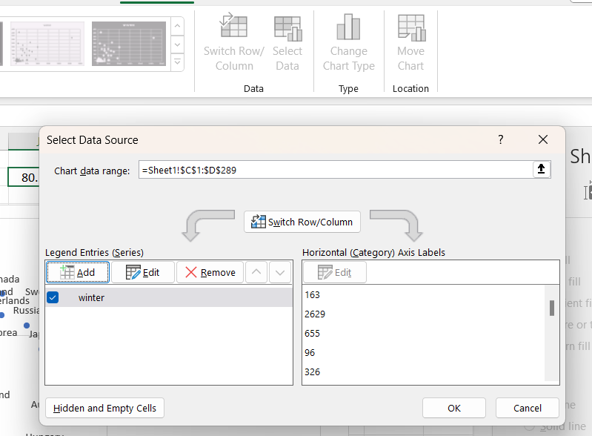
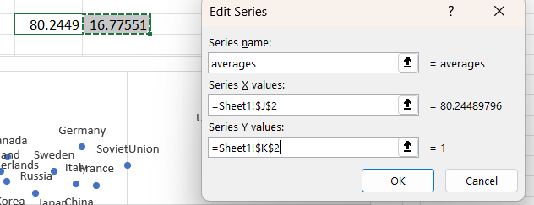
Add quartals

Slide 14
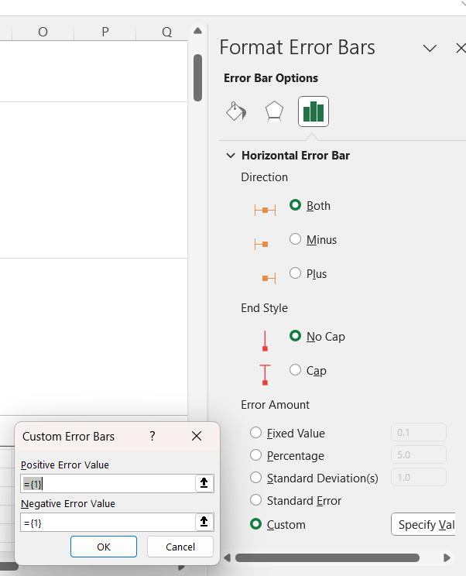
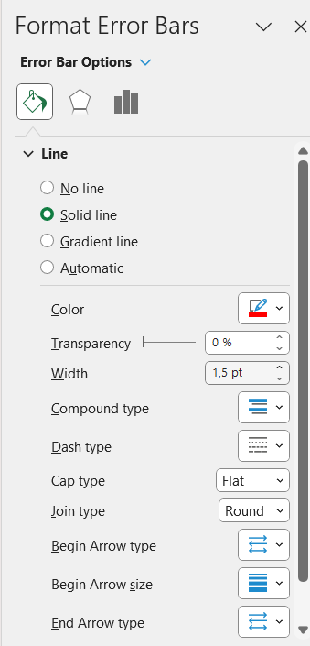
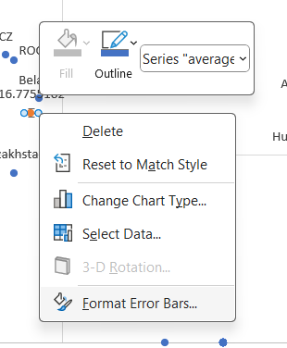
Right click here
From minimum to average
From average to maximum

Slide 16
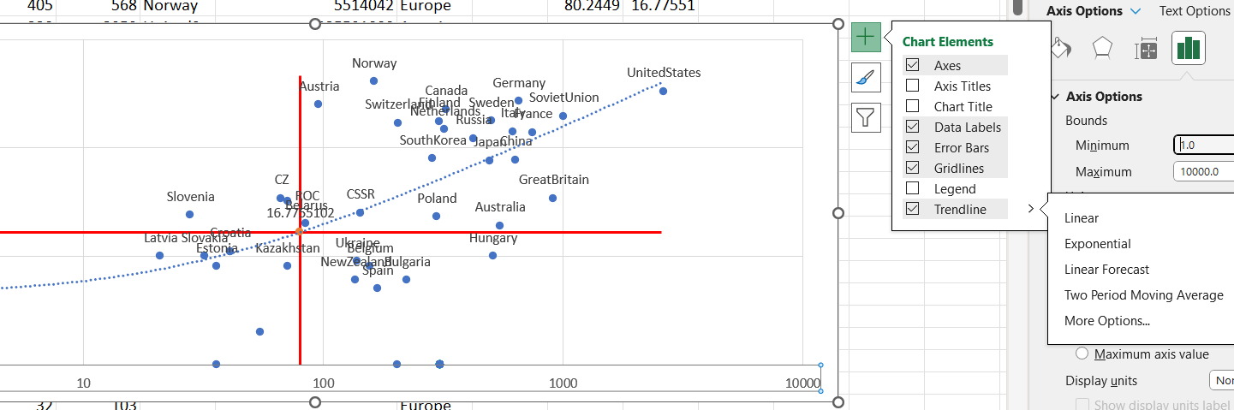
Trend line

Slide 17
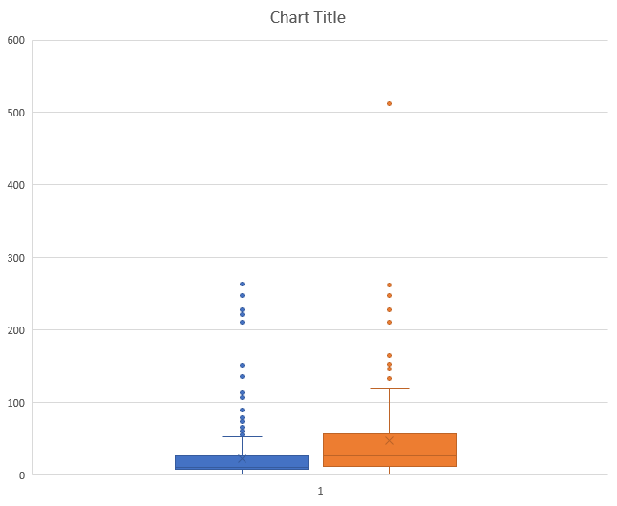
Set of boxplots

