Slide 2
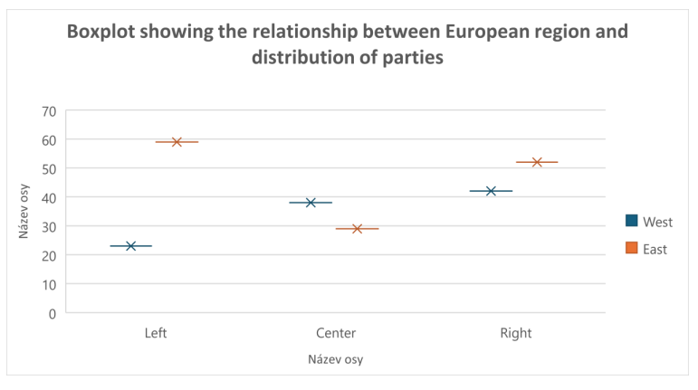
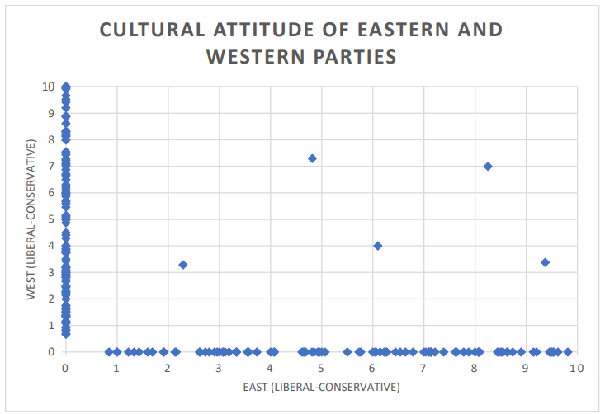
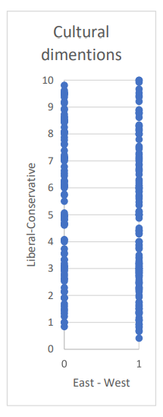
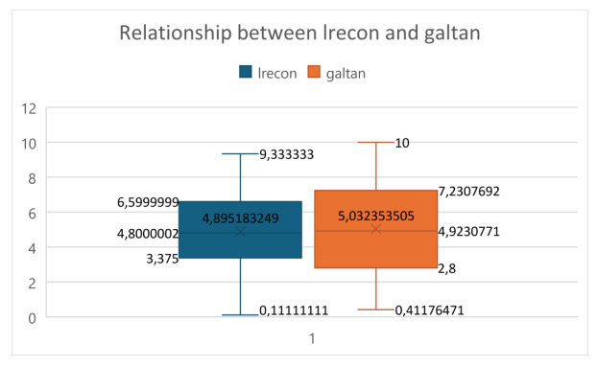
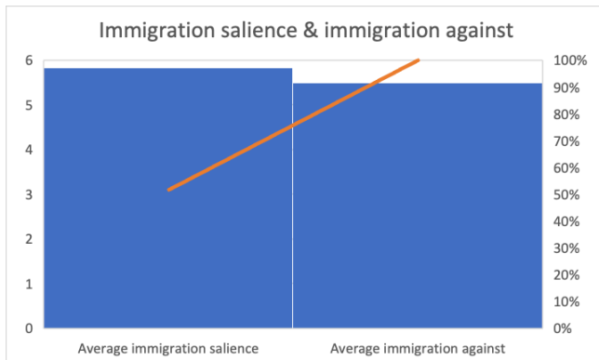

Slide 3
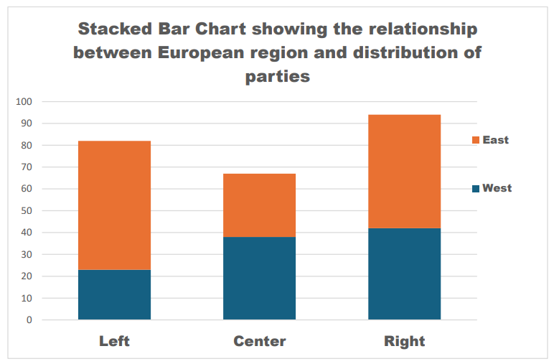
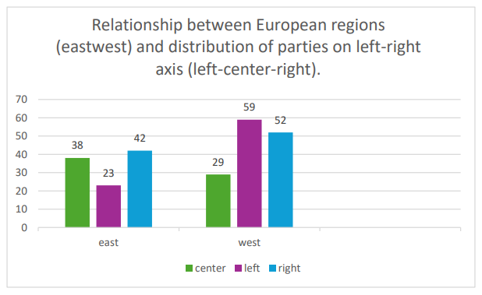
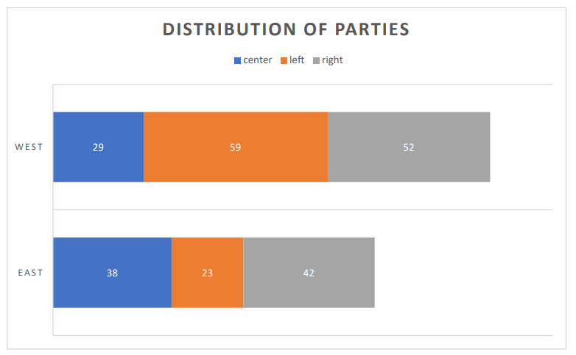
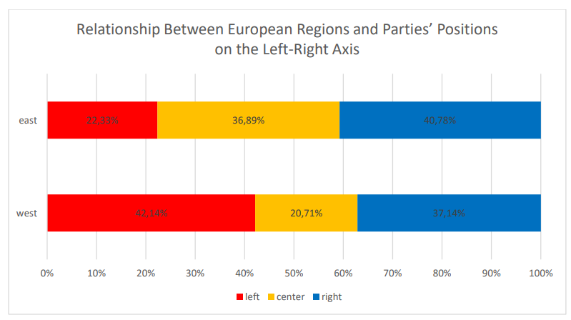

Slide 4
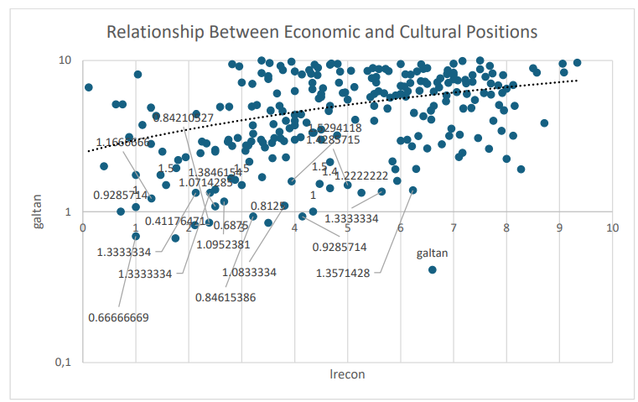
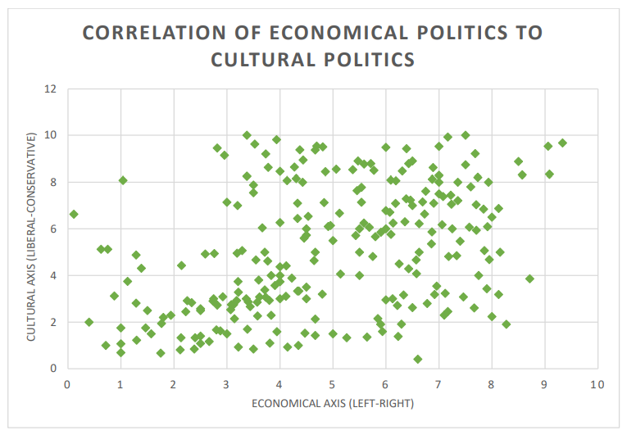
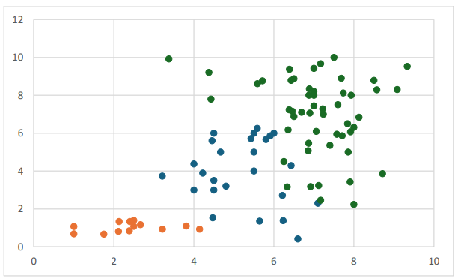

Slide 5
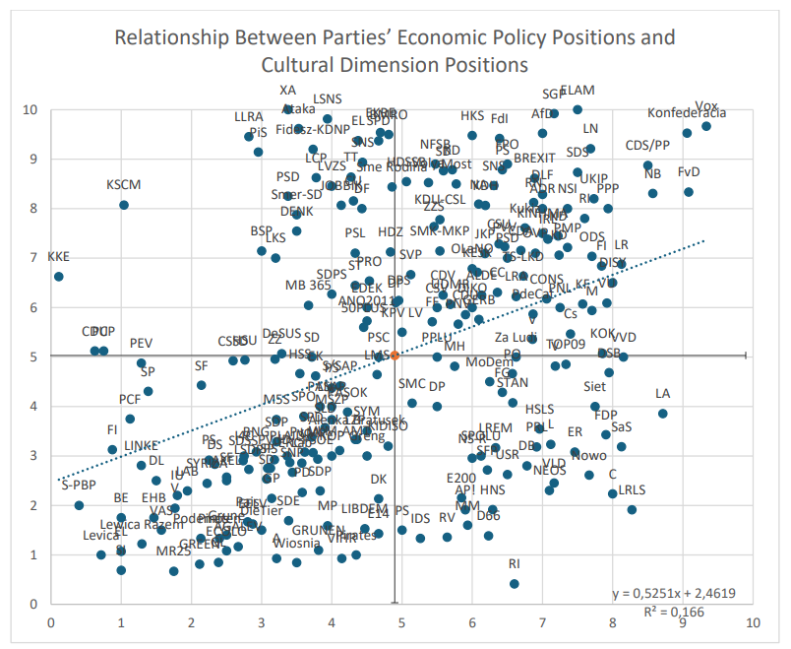

Slide 6
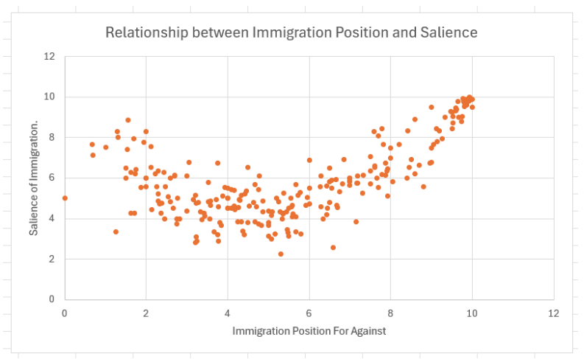
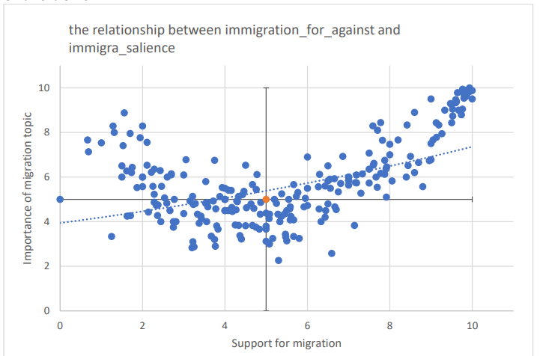
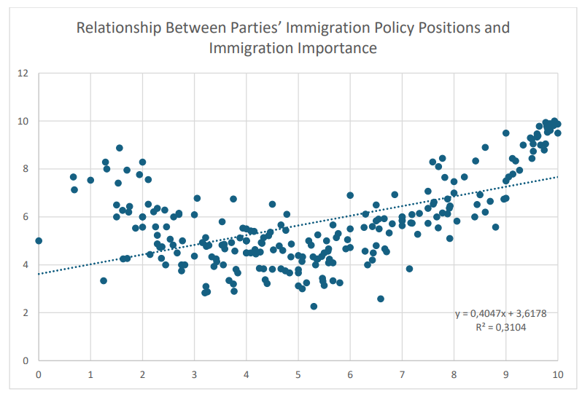
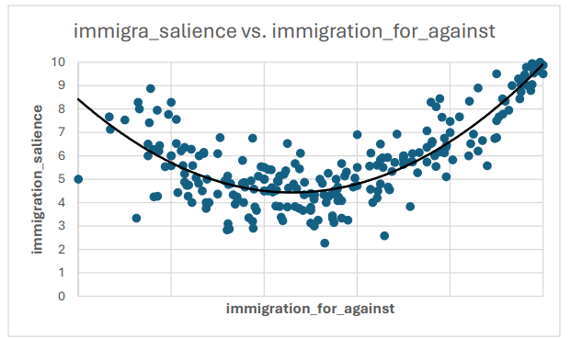

Slide 7
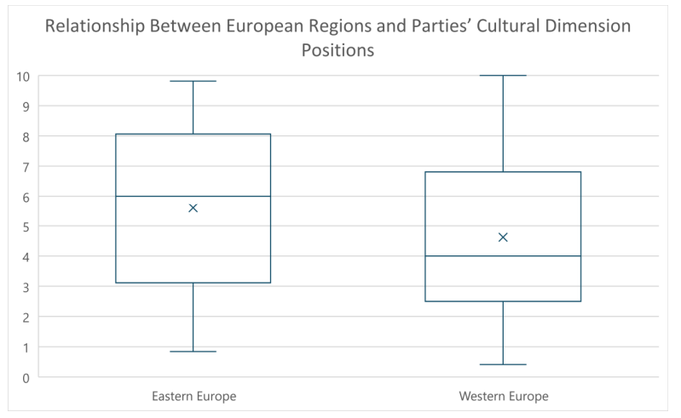

Slide 8
Time data
Continuity - temperature, party support
Discontuinity – elections
Data: Annualy, monthly, daily, (hours, minutes, seconds)
  Iregular: elections, exams, conflicts
Easy to find spurios correlation

Slide 9
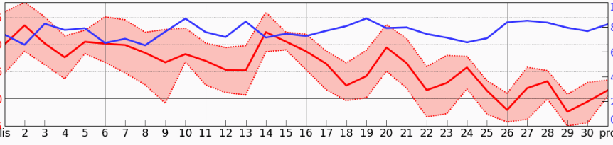
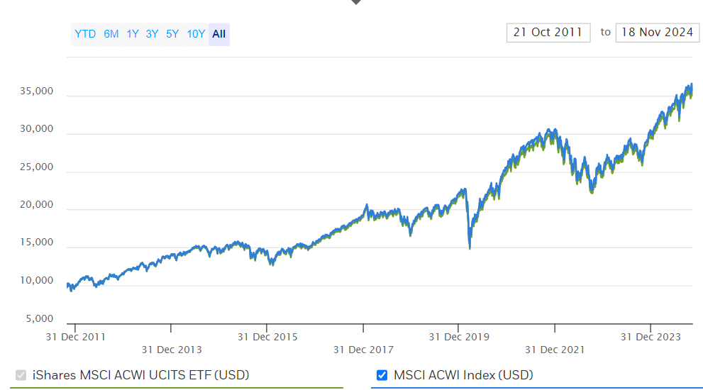
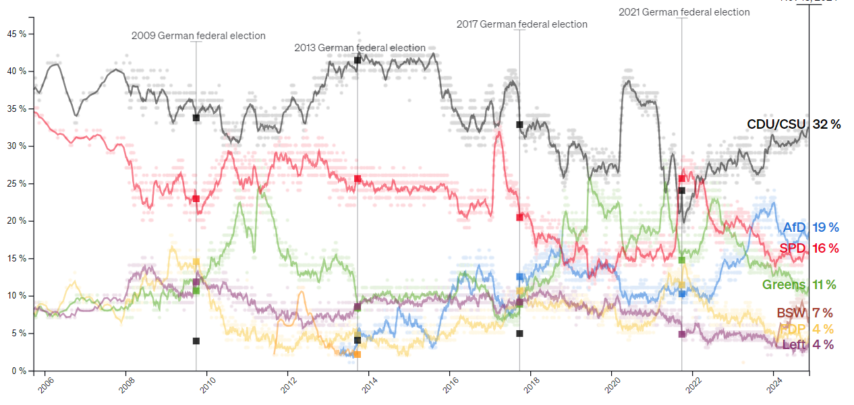

Slide 10
Three elements of Time Data
Trend – the overal direction of evolution
  E.g. Global warming, increasing prices
Seasonality – regular changes in data
  Wheather, unemployment, activity during day
White noise

Slide 11
Trend
Usually the most important things
Allows us to say what is happening
Forecast (be cautius with that)
The main source of spurious correlation

Slide 12
?

Slide 13
Seasonality
Usually the most anoying aspect of time data
The solution is to look on the whole season
  The detail is lost in such case

Slide 14
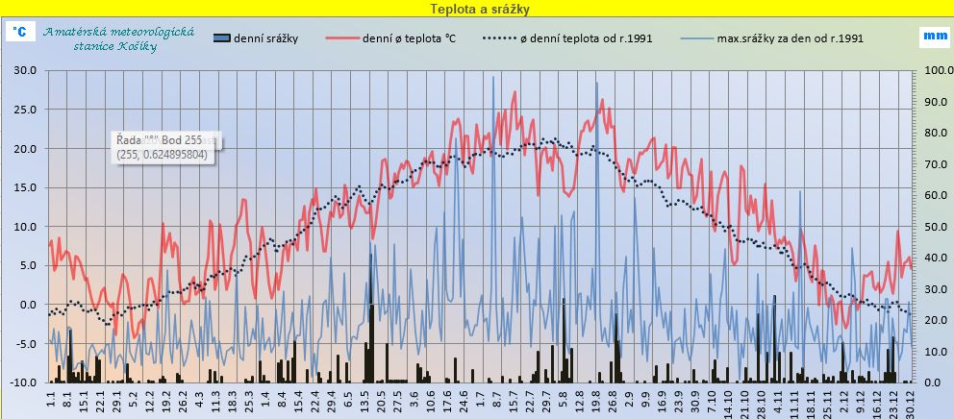

Slide 15
White noise
Short term irregular deviations
Important when we want to see impact of some event
Make the general information hard to see
Moving average – replace current value by average of neighbouring values
  Usualy 3, 5 or 7
  Depends on data (e.g. Monthly temperature)

Slide 16
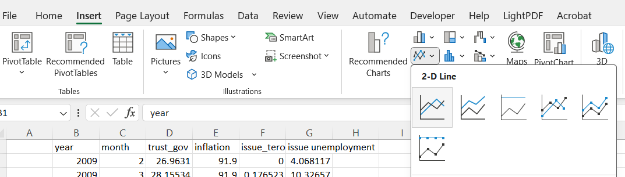
Plot of monthly temperature – line chart

Slide 17
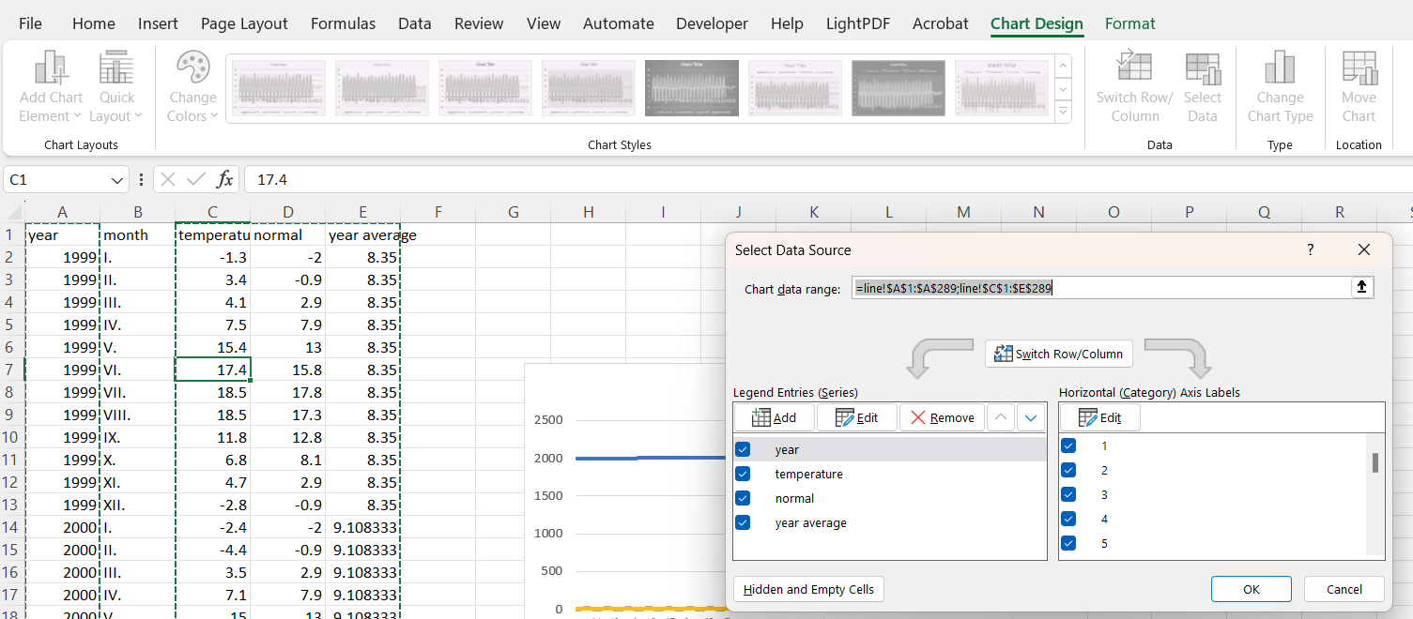
Change of labels and content

Slide 18
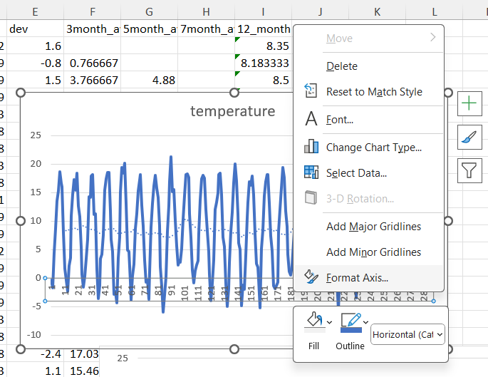
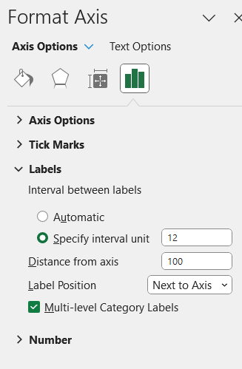
Right click somewhere here

Slide 19
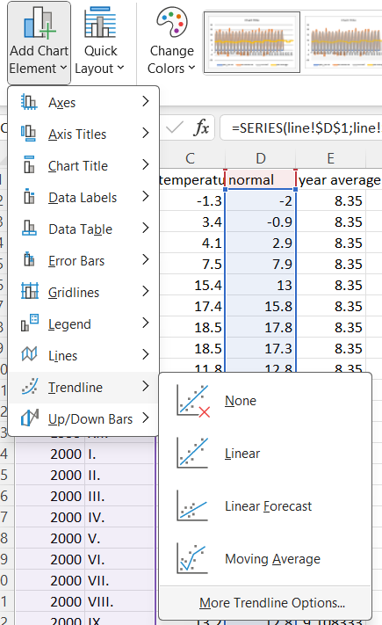
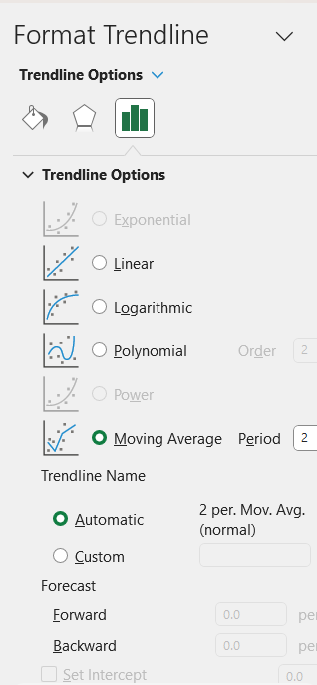

Slide 20
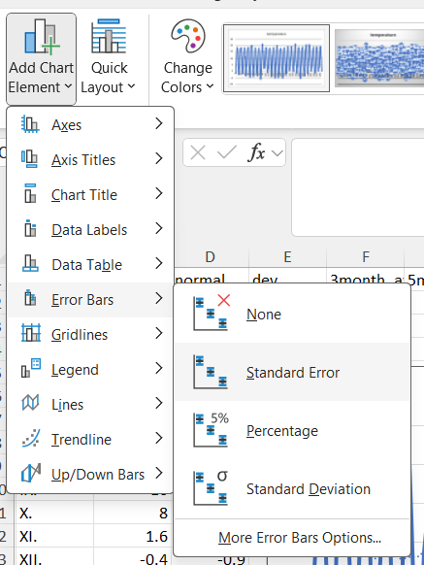
Just for the assignment
Error bars
  When the data are based on representative sample
  There is uncertainity around obtained number
  Standard error: interval where the true value is probably located

