Slide 1
Data Vizualization
Univariate vizualizations

Slide 2
Univariete = only one variable is visualized
Different ways of visualizations for different data types
Categorical – „names“ or short ordinal variables, numbers just labels for categories
  comparing categories (bar chart)
  Fraction – value relative to the whole (pie charts)
Cardinal – numbers have meaning as numbers
  distribution = „spread of data“ (histogram, box plot)

Slide 3
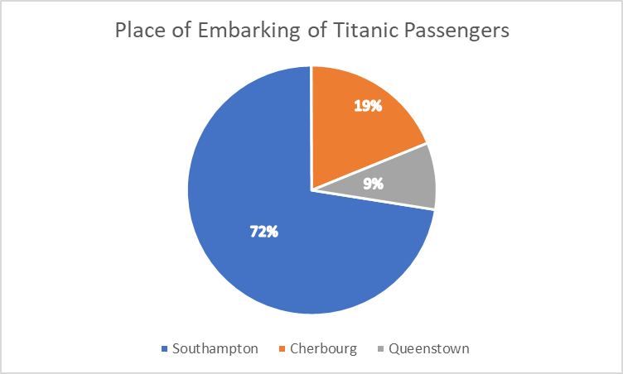
Pie chart
Only small number of categories (max about 7)
Not very informative when all slices are of similar size
Only when it is part of whole

Slide 4
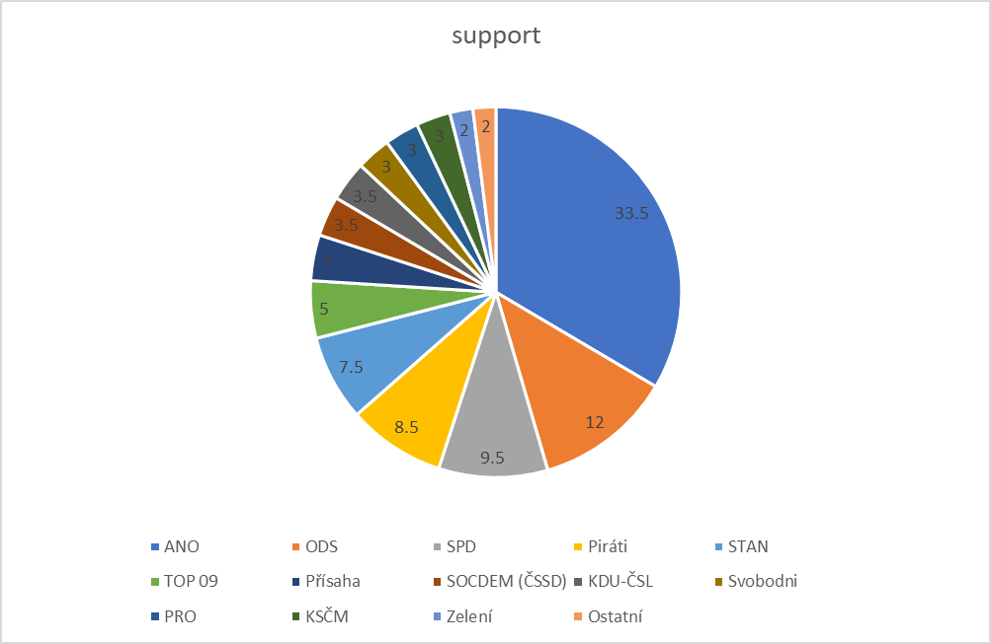
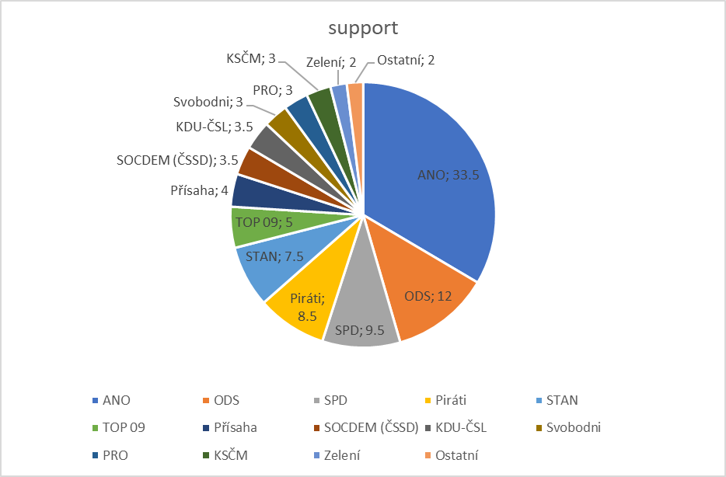

Slide 5
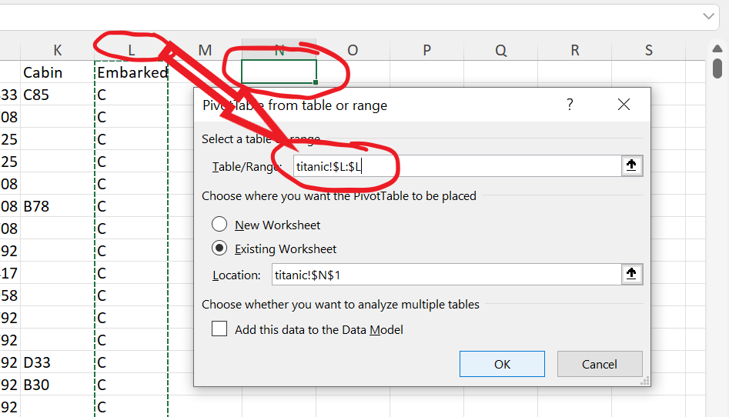
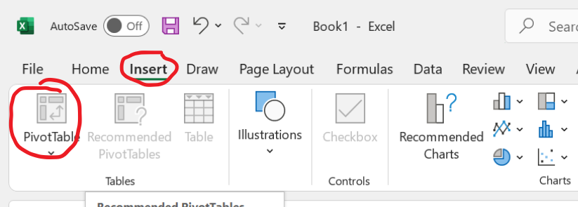
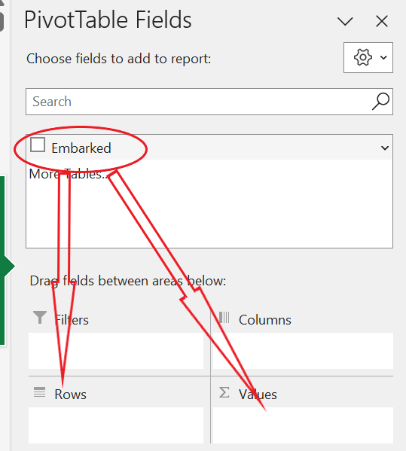
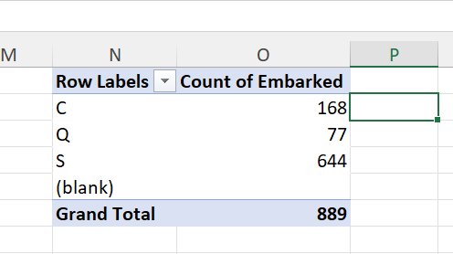
Pivot table
Click on the cell and than click into table/range and click on column L
Grab “embarked“ by left button of mouse and move it to rows and then again into values

Slide 6
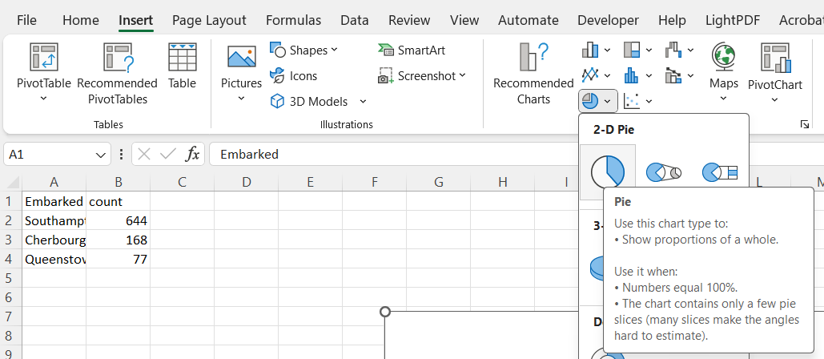
Making of pie chart
Counts for categories are needed

Slide 7
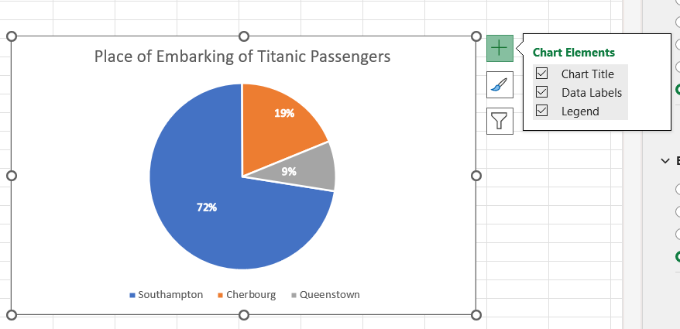

Slide 8
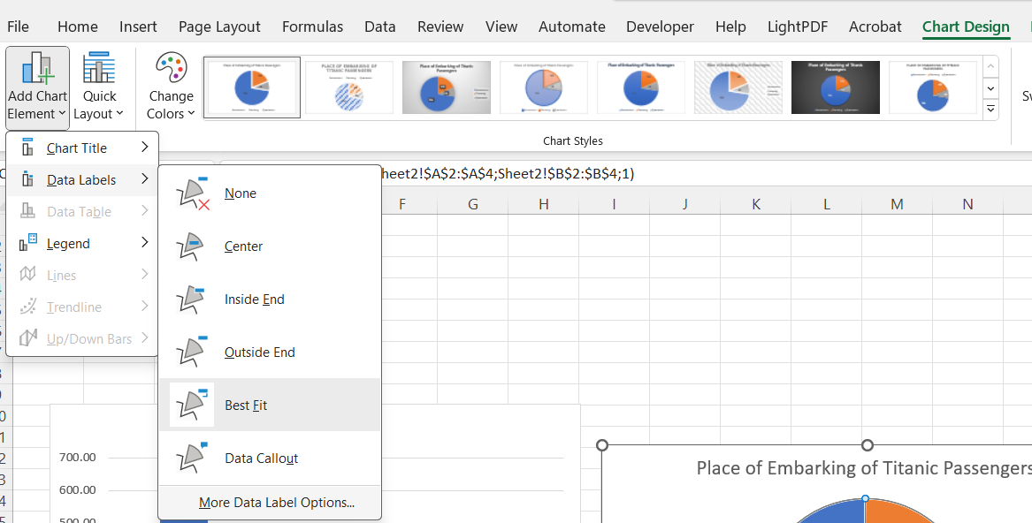
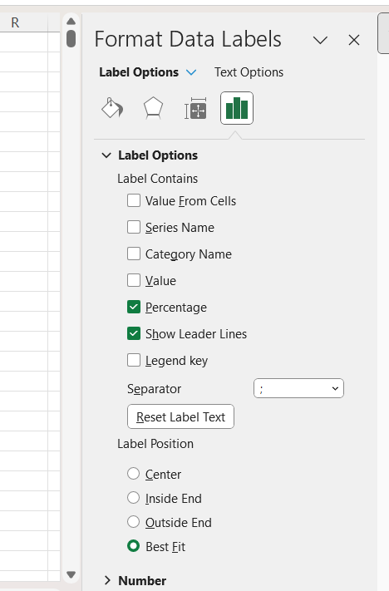

Slide 9
Bar chart
Useful for almost any situation
Base for numerous other charts
Very easy for interpretation
Unlimited number of categories
  (then it is turned into histogram)

Slide 10
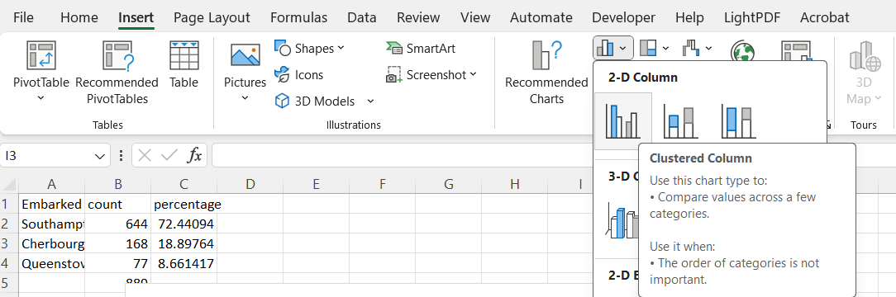

Slide 11
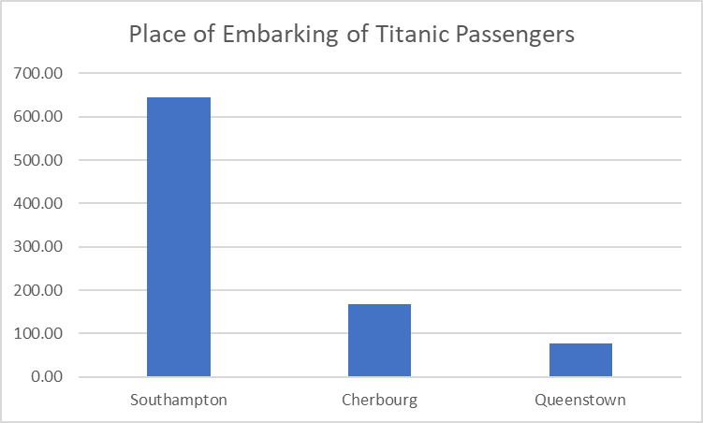
If we want percentages, we have to calculate them

Slide 12
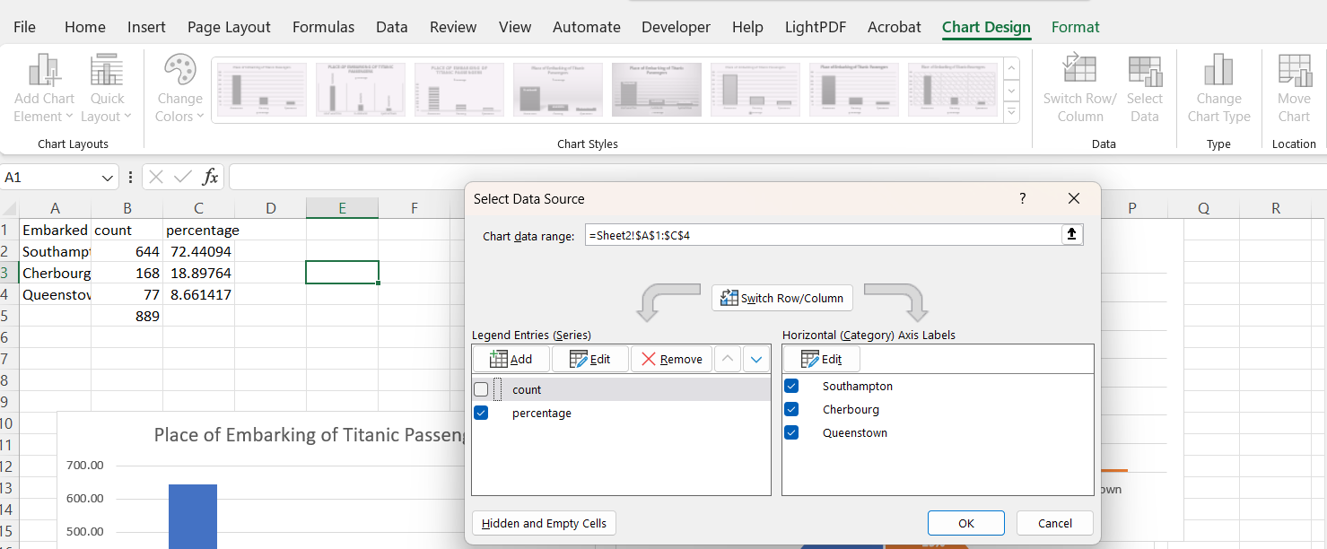

Slide 13
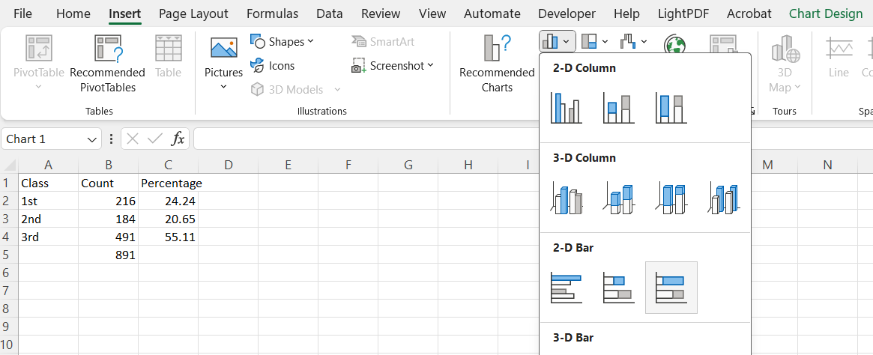
Stacked bar plot

Slide 14
Stacked bar plot

Slide 15
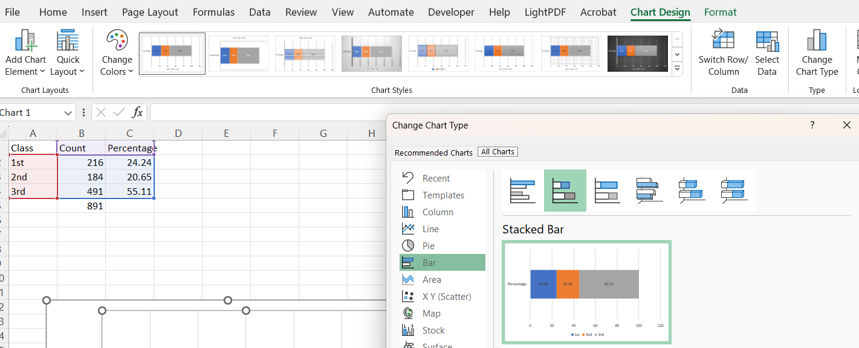

Slide 16
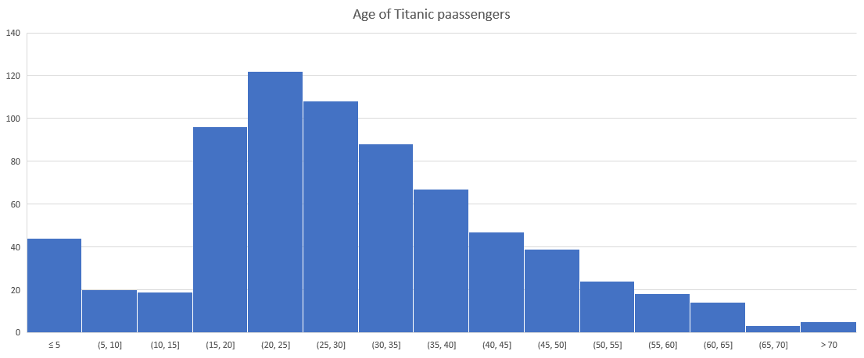
Histogram

Slide 17
Avoid the usage of 3D versions
  They can be very misleading
Always make titles, subtitles and labels as parsimonous as possible
  (parsimony means to be maximally simplistics and maximally informative simultaneously)

