Slide 1
Univariate visualization
- interval and ratio variables

Slide 2
A bit of statistics
Categorical variables
Counts (frequencies)
Relative (percentage)
Absolute (number as such)
Cardinal (interval and ratio) variables
Too many different values
Problems with showing just counts
What can be good quantity to show?
Central value : Average, Median
Variation: standard deviation
Other descriptive statistics: minimum, maximum
distribution

Slide 3
Average
The „geographical centre“ of data
sum of distances to lower values = sum of distances to higher values
movie rating 0-100 points
Red dots: users evaluation
Green dot: average value

Slide 4
Median
Value standing in the middle
Half of data are lower, half higher

Slide 5
Relation between mean and median
Can be the same
symetric distribution
Low variace
Can be different
Skewed distribution
E.g. income
Germany: household wage in 2022: 42,192 € 45,457 €
Why is it different?
Normal
U-shape

Slide 6
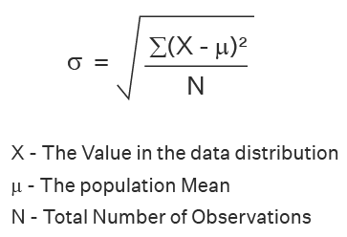
Standard deviation
How far are data from average
Average speed 50 KMpH (30 miles)
  Because the car went whole time exactly 50 (sd=0)
  Because car went half of journey 30 and other half 70 (sd=20)
  Because car spent one hour in traffic jam and half hour went 150 (sd=70)
higher deviation means higher variance

Slide 7
Other descriptive stats
Minimum, maximum (+ range)
World records, temperatures, ….
Quartiles
Way how to group values
Gini and variation coef.
Measures of concentration

Slide 8
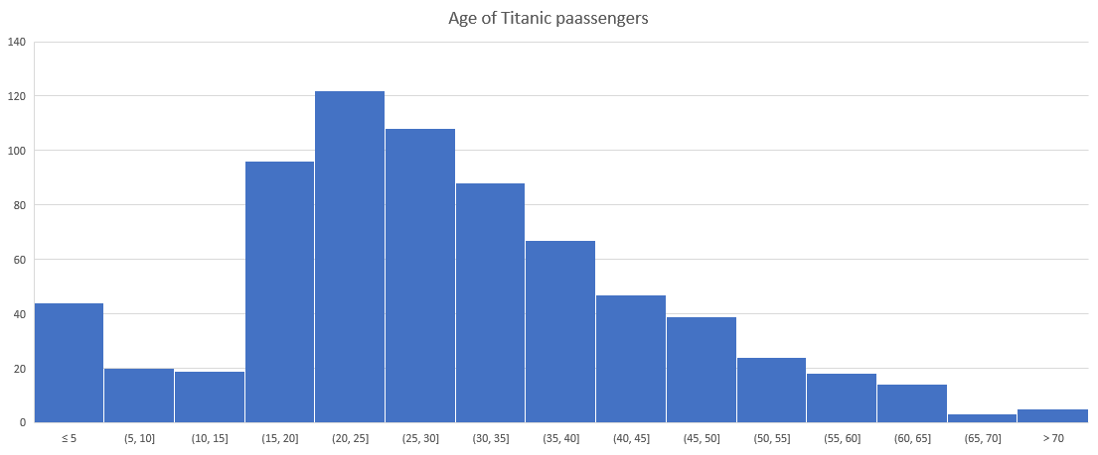
Histogram

Slide 9
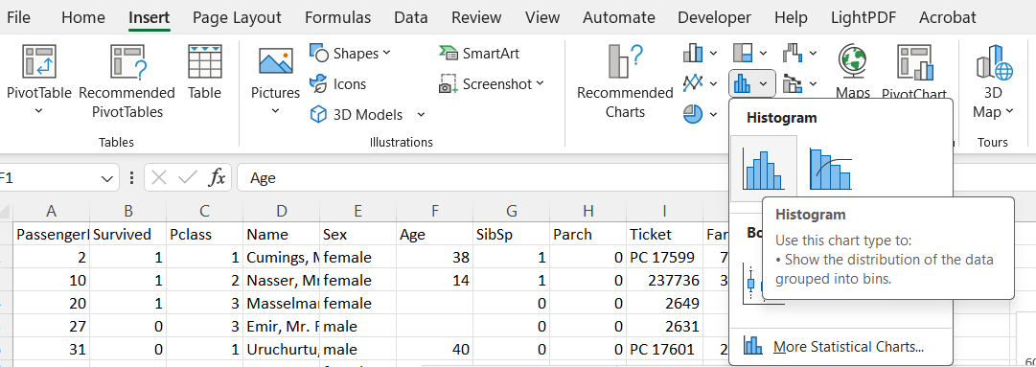
How to make histogram
No need for any computation!
Select column and click on histogram

Slide 10
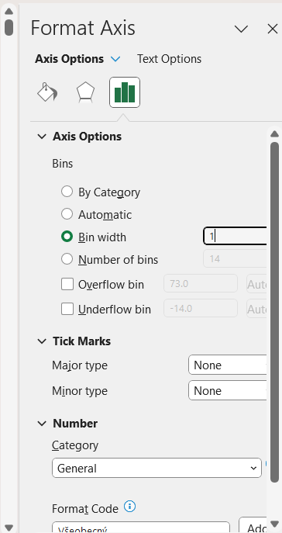
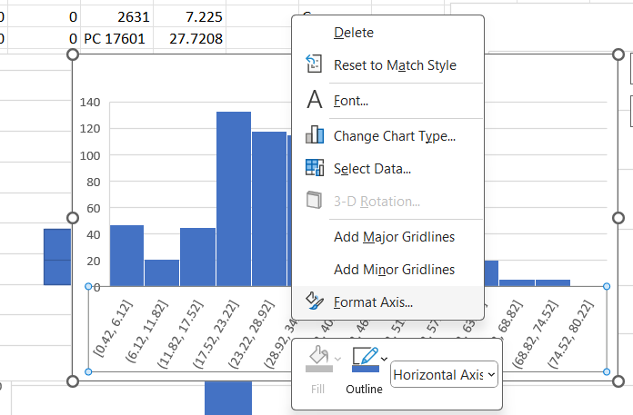

Keep it in line with width
Right click here

Slide 11
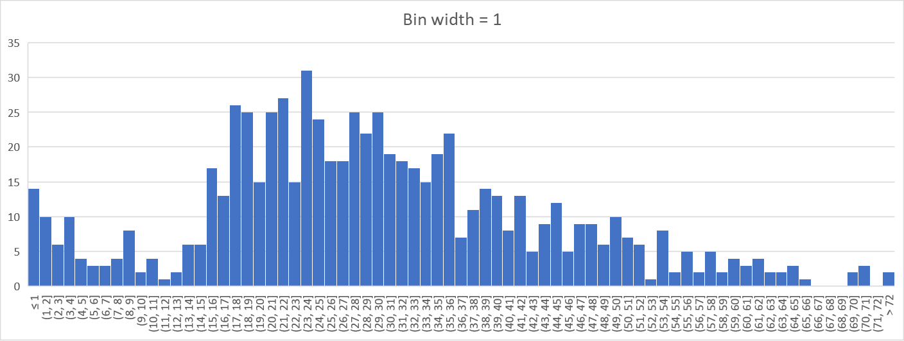
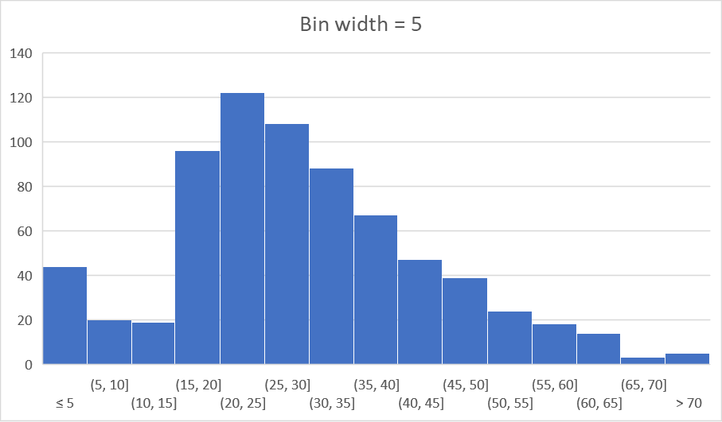
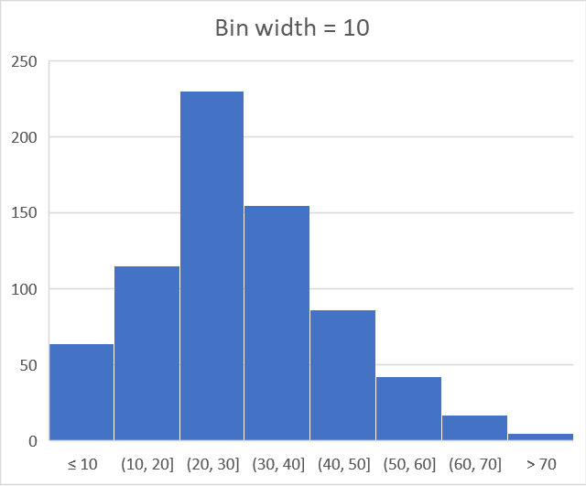
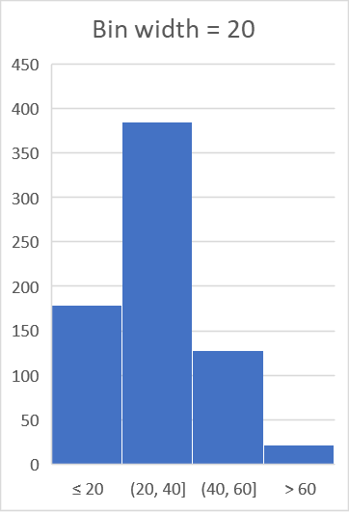

Slide 12
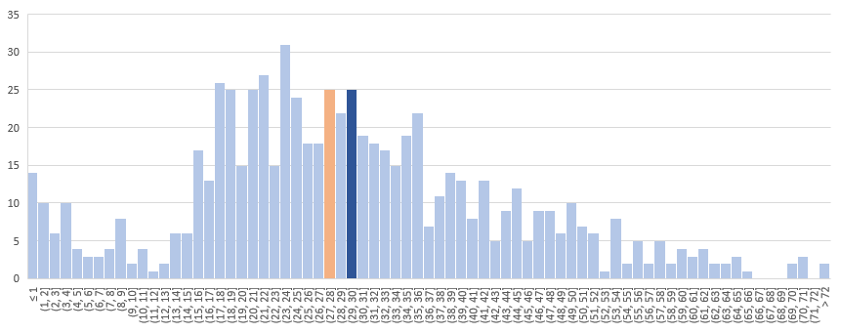
Highlighting mean
=AVERAGE(column)
= MEDIAN(column)
Change of color mave to be done manually
Square bracket – number belongs to interval
Round bracket – number does not belong to interval

Slide 13
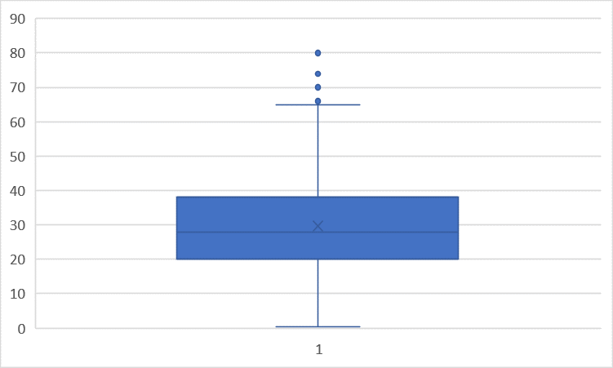
Box plot
outliers
75th percentile + 1.5*interquartile range
75th percentile
interquartile range
Mean
Median = 50th percentile
25th percentile = borderline between 1st and 2nd quartile
25th percentile - 1.5*interquartile range

Slide 14
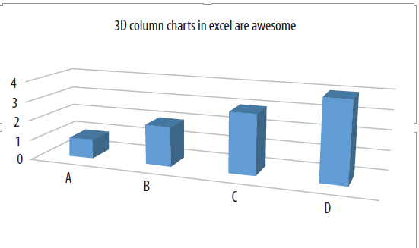
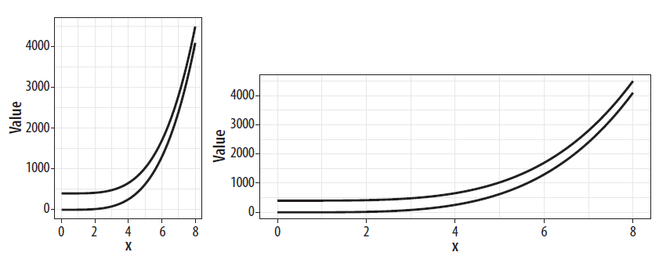
Avoid the usage of 3D versions
  They can be very misleading
Be carefull with ratio aspect
Always make titles, subtitles and labels as parsimonous as possible
  (parsimony means to be maximally simplistics and maximally informative simultaneously)

