Slide 1
Anti-populism as a communication style
Vlastimil Havlík

Slide 2
Outline
What is anti-populism
2. The empirical case of Czechia
3. Discussion - implications

Slide 3
What is anti-populism

Slide 4
Populist/anti-populist divide
“populism as an ideology that considers society to be ultimately separated into two homogeneous and antagonistic groups, ‘the pure people’ versus ‘the corrupt elite’, and which argues that politics should be an expression of the volonté générale (general will) of the people” (Mudde 2004)
Populism as „(democratic) illiberalism“ (Pappas 2014)
Antipopulism - strategic stances presented in opposition to populism (Moffit, 2018)
Creating its own and the enemy`s identities

Slide 5
Populist/anti-populist divide
the ideational (Stavrakakis et al. 2017) and performative dimensions (Ostiguy 2017) of (anti)-populism
IDEATIONAL: discursive construction of ideas and political identities
PERFORMATIVE: stylistic and behavioral characteristics
the context of discoursive opportunities (Koopmans, Olzak 2004)

Slide 6
Populist/anti-populist divide
Socio-cultural approach: going beyond but related to populism as an ideology and organization
high and low in politics: orthogonal to the left-right axis
Acting and being in politics – performative element (accent, language, body language, ways of dressing)
Important part of creating identities („being one of us“)
Linked to style, but also connected to the country`s history, group identities
Social-cultural and political-cultural elements

Slide 7
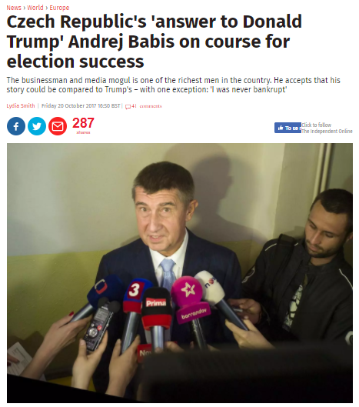
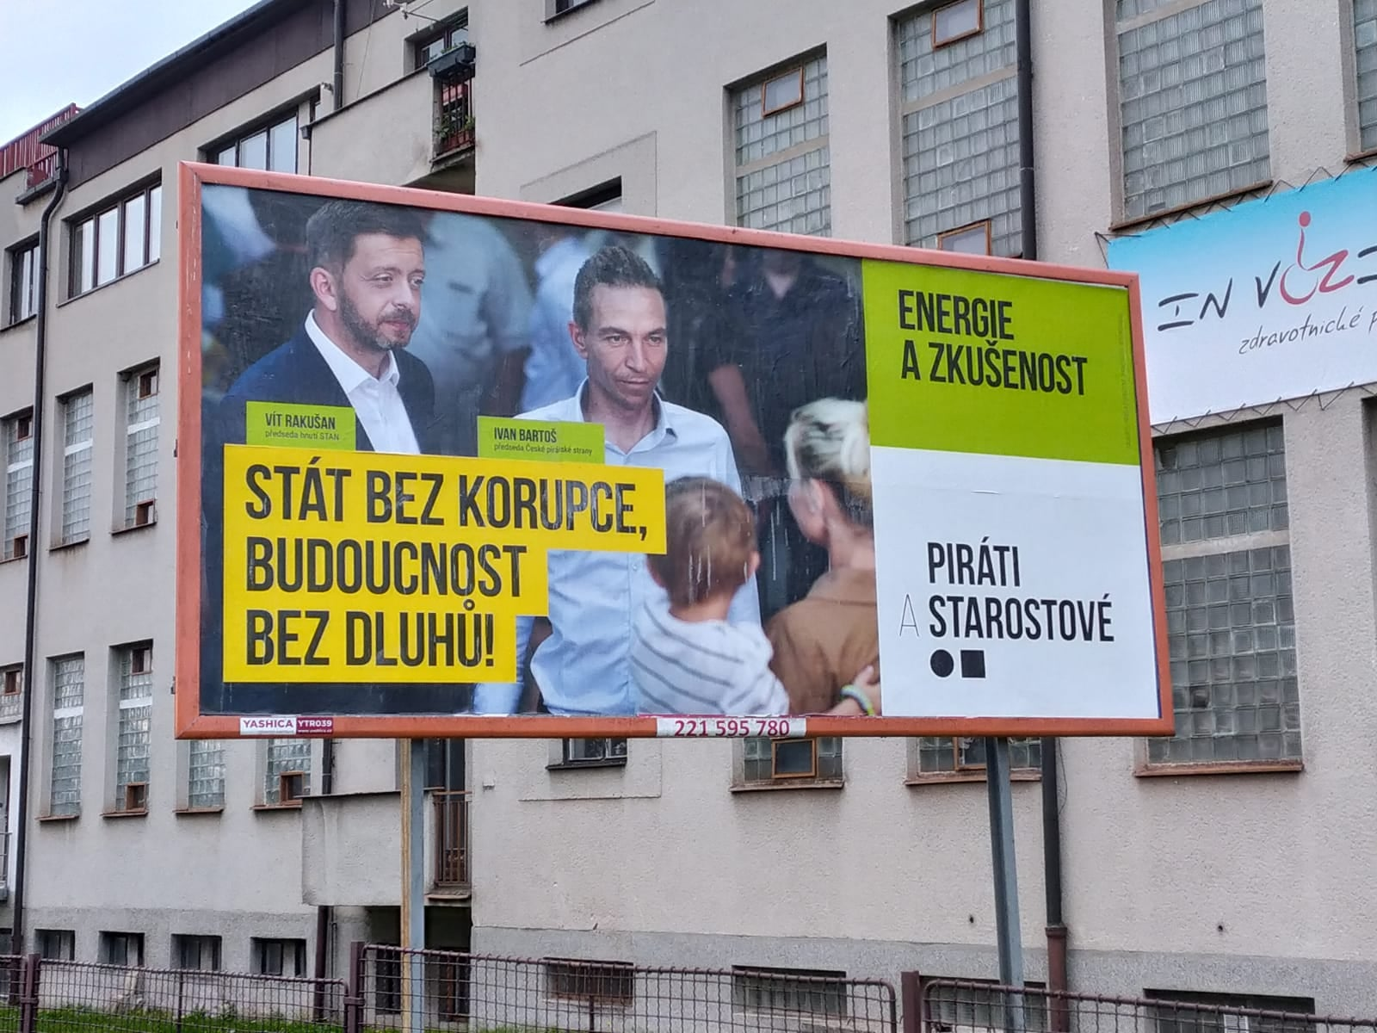


Populism, Czech politics and the 2021 election
Stabilization and unidimensionality of party competition in the Czech Republic since the mid-1990s
Political + economic crisis => the emergence and strengthening of populist political actors
2021 –victory of electoral coalitions campaigning on anti-populist platform
RQ: What was the content of the anti-populist communication before the 2021 election?
  What are the implications of the new populist/anti-populist divide for both Czech and European politics?
  Havlík, V., & Kluknavská, A. (2022). The Populist Vs Anti‐Populist Divide in the Time of Pandemic: The 2021 Czech National Election and its Consequences for European Politics. JCMS: Journal of Common Market Studies.

Slide 8
Data and method
Qualitative content analysis
Data: FB profiles of leaders of anti-populist parties (year before the election) + mainstream media presentation + official documents of the parties
The meaning of populism and populist political actors AND construction of anti-populist identities in ideational and performative dimensions

Slide 9
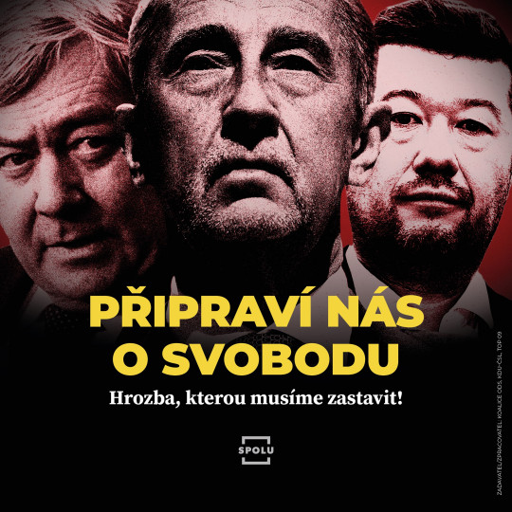
The ideatiational dimension of anti-populism
The constructed divide between populism vs democracy – populism (and extremism) as a fatal threat to Czech democracy
  „democratic politicians“ or „liberal force“ against „populism and extremism“
  Suppression of „primary“ ideological identities
Economically irresponsible populism vs responsible anti-populist forces – the anti-Covid distributive policy of the populist government
  the ‘irresponsible plundering of the public finances’ and ‘pernicious indebtedness of the country’
Pro-Eastern vs pro-Western foreign policy orientation
  Czechia as ‘an insignificant, isolated, poor, and endangered country in Eastern Europe’ vs ´democracy, prosperity, security, and stability’

Slide 10
The ideatiational dimension of anti-populism
Populist polarization vs anti-populist unification
  the populists ‘widen the abysses in our country´ and ‘pit people against each other´
Lying amoral populism vs truthful and moral anti-populism - populists' alleged absence of morality and democrats’ strong principles
  ‘lies and empty promises’ vs decency/‘top independent experts’

Slide 11
The performative dimension of anti-populism
Incivil populism vs civil anti-populism
low vs high politics
  ‘bringing normal decency back into politics’
Populist political theatre vs effective politics of anti-populists - empty, simple solutions aiming to arouse emotions, anti-populists supposedly crafted their policies through rational and reasonable decision-making

Slide 12
Implications
Discoursive emergence of populist/anti-populist divide replacing old (ideological) political identities
anti-populist reaction as a the highly polarising ‘confrontation by design’ – increased polarization (populist as „agents of Russia“, „Sins of populism“)
Highly moralizing discourse + suppresion of policy positions – unrealistic (?) expections and possible dissapointment (electoral mobilization)
Durability of the antipopulist „glue“ + the context of the lack of mainstream opposition
Reinforcing of pro-Western orientation + weakening of the Visegrad Four (HUN)

Slide 13
Conlusions
A major change in the logic of party system competition
Emergence of populist – anti/populist divide
Polarization of politics
The Czech Republic as a case of „full“ anti-populism going beyond a mere negative campaigning
Usefulness of distinguishing between ideational and performative dimensions of anti-populism

