Slide 1
Populism: the concept
Populist political communication

Slide 2
Aims of the lecture
Explain the core features of populism as a distinctive concept (= as a thin ideology)
Define different types of populism

Slide 3
Populist political communication
Form
Content

Slide 4

The main thesis is that…
…populism is like arancini.

Slide 5

Problems with populism
Canovan (1999): ‘contested concept’
Stanley (2008): vague term retaining an ‘awkward conceptual slipperiness’
Taggart (2000): ‘chameleonic nature’

Slide 6
Problems with populism
- Popular perception of populism (unrealistic promises, irresponsible policies, demagoguery, spending, socialist policies, xenophobia…)
- Negative political label
- Terminological mess: protest parties, challenger parties, anti-party parties, anti-mainstream parties, anti-political establishment parties, anti-establishment reform parties, discontent parties, neopopulism/ new populism, anti-corruption parties, national populist parties…

Slide 7

Popular perception of populism
Stretching of the term
All politicians are populists (from time to time)
Content – unrealistic promises, irresponsible policies, demagoguery, spending, socialist policies, xenophobia…
See Bale, Taggart, van Kessel. 2011: “Thrown around with abandon? Popular understandings of populism as conveyed by the print media: a UK case study.” Acta Politica 46 (2).
Populism as a label in political fight

Slide 8
Three waves of populism
Empirical diversity of populism (Pauwels 2014)
19th century populism – the People`s Party in the USA, „narodniky“ in Russia (Canovan 1981, Taggart 2000)
Latin American populism – Peron, Chávez, De la Torre…
New populism – radical right-wing or radical left parties in Europe
  (+ exclusively/centrist populist parties)
Case driven definitions (agrarian populism until the 1970s, RRP in Western Europe)

Slide 9
POPULISM AS AN IDEOLOGY
Ideology:
total, closed and cohesive view of human beings in society / a systematic body of concepts / a comprehensive normative vision / the integrated assertions, theories and aims that constitute a sociopolitical program
Is populism an ideology?
Populism is usually not regarded as a full-blown ideology (such as socialism, liberalism etc.)

Slide 10

POPULISM AS A THIN-CENTERED IDEOLOGY
Cas Mudde (2004, 2007):
“populism as an ideology that considers society to be ultimately separated into two homogeneous and antagonistic groups, ‘the pure people’ versus ‘the corrupt elite’, and which argues that politics should be an expression of the volonté générale (general will) of the people”
thin-centered ideology – does not cover all aspects of life, only specific political questions
can be combined with other thin-centered of full blown ideologies – ‘a receptive partner for full ideologies’ (Stanley 2008), ‘colourless’(Jagers, Walgrave, 2007) – East-Central European experience, M5S
Stanley, B. (2008). „The thin ideology of populism.“ Journal of Political Ideologies, 13(1), 95-110.

Slide 11
ANALYTICAL CORE OF POPULISM
Deconstruction of the definition (Rooduijn 2016, see also Deiwiks 2009, Stanley 2008, Muller 2016):
Muller (2016): moralistic imagination of politics
The people as a homogeneous group – the people and the elite
Denigration of the elites
The antagonistic relationship between the elites and the people
The idea of (restoration) of popular sovereignty

Slide 12
Political elites
People
Populists

Slide 13
THE ‘ PURE PEOPLE’ AS A HOMOGENEOUS GROUP
Crucial importance for populism
Refusal of division of society into different groups
How is the people defined – an empty signifier?
Purity as the most single important characteristic of the people
Taggart: heartland, idealized conception of the community

Slide 14
THE ‘ PURE PEOPLE’ AS A HOMOGENEOUS GROUP
Culturally/politically determined content of the “people”
As the sovereign – demos, against principles of liberal and representative democracy
As a nation – ethnos, populism = nationalism (?), vs. foreigners, immigrants etc.
As a class – ‘working people’, the ‘99 per cent’ vs. ‘the rich’, the ‘1 per cent’, exploitation the lower class
BUT related to the host ideology (see later)

Slide 15

Political elites
People
Populists

Slide 16
DENIGRATION OF THE ELITES
Establishment/elites as a collective, monolithic entity
Criticism targeting all the established actors
Political parties, businessmen, ‘the rich’, oligarchy, the ‘1 per cent’, ‘champaigne/drinkers’, “latte-drinking, sushi-eating, Volvo-driving, New York Times-reading, Hollywood-loving” liberal elites …“
Particular interests which are in opposition to the interests of the people
Sabotaging the interests and democratic rights of the people
Beyond the usual opposition

Slide 17
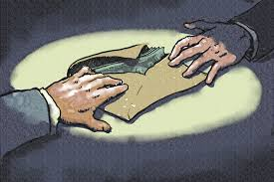
Political elites
People
Populists

Slide 18

Political elites
People
Populists

Slide 19
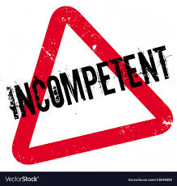
Political elites
People
Populists

Slide 20
The antagonistic relationship between the people and the elite
Manichaean view (moral dimension, normative outlook)
The good (‘pure’) people and the bad elite
People betrayed by the corrupt elite
Alienation of the elite, people exploited by the elite
P. speak in the name of the ‘oppressed people’
The chief social divide between the governing and the governed – denial of the old cleavages
Aggresive and/or mocking rhetoric (‘political class’, ‘dinosaurs’, ‘robber barons’, ‘thieves’, ‘oligarchy’, ‘godfathers’…)
Emphasis on the proclaimed crisis (elites blamed for it) - political, cultural, social, economic

Slide 21
Political elites
People
Populists

Slide 22
THE IDEA OF POPULAR SOVEREIGNTY
Sovereignty taken away from the people by the elite - against the representative democracy (next lecture)
Often proponents of direct democracy (not a defining characteristic of p.)
Renewal of the ‘distorted’ relationship between the elites and the people
People are fully formed and self-aware (no need for incompetent political elites)
‘common sense’ as the leading principle (‘votes for us are votes for common sense’ – R. John (VV))
All representatives have to do is to listen to the vox populi

Slide 23

Political elites
People
Populists

Slide 24
Types of populism

Slide 25
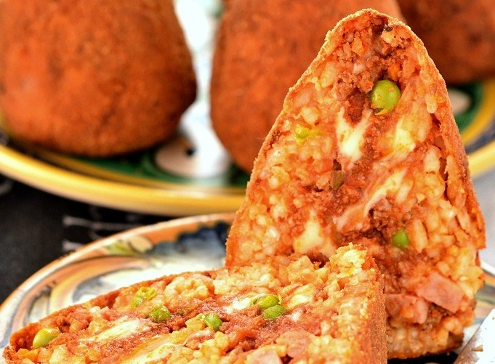
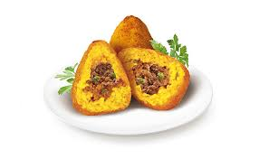

thin-centered ideology (Freeden 1996)
Goes together with other thin-centered or full blown ideologies:
Populist radical right (Lega, National Rally, Bolsonaro)
Populist radical left (Podemos, Syriza)
Centrist populist parties (ANO, M5S)

Slide 26
Typology of populism (based on Pauwels 2014; Havlík, Stanley 2015; modified)
 | Social populism | Radical right-wing populism | Neoliberal populism | Non-ideological/valence populism
Construction of the people | Working class, the opressed, 99%, the exploited | (Pure) nation, ethnos | Hard-working taxpayers, entrepreneurs | Ordinary people, citizens
Depiction of the elites/enemies | Capitalists, imperialists, bankers, exploiters | Immigrants, foreigners, multiculturalism, feminism | Bureaucratic elites/states, interventionist state | Corrupt incompetent politicians
Host ideology | Socialism | Nativism | Economic liberalism | Not clear
Examples | PDS, Syriza, SP | NF, VB, Ataka | LPF, ALP, ANO (SVK) | ANO (CZ), NDSV, M5S

Slide 27
Conclusion
populism as a contested concept X agreement on the analytical/definitional core: the people and the elite as homogeneous groups, antagonistic (and essentially moralistic) relationship between the two, popular sovereignty
Vague use of the term in the media/popular discourse X a precisely defined in political science
Populism usually combined with other ideologies that fill the “emptiness” of populism
The omnipresent moralistic antagonism between the people and the elites varies in its specific context
All these features determine HOW populism is communicated (next lectures)

Slide 28
Thank you for your attention.

