Slide 1
Populist political communication
Vlastimil Havlík
POLb1140 Populist political communication

Slide 2
Outline
Populism as a communication style – the approach
Features of populism as a communication style

Slide 3
How to communicate in a populist way?

Slide 4
Populism as a communication style
Follows populism as a thin centered ideology:
“populism as an ideology that considers society to be ultimately separated into two homogeneous and antagonistic groups, ‘the pure people’ versus ‘the corrupt elite’, and which argues that politics should be an expression of the volonté générale (general will) of the people” (Mudde 2004)
BUT
Anchored in the (political) communication studies: stress on the communication environment and communicatio per se -> populism as a matter of degree/part of communication of a political actor

Slide 5
Populism as a communication style
„Populism is reflected in the oral, written, and visual communication“ of various actors (Reinemann et al. 2016)
„it is a communication frame that appeals to and identify with the people and pretend to speak in their name“ (Jagers, Walgrave 2007)
Characteristics of a message rather than of an actor: populist messages as independent “phenomenon as such” and no longer on a particular party family or type of politician“ (De Vreese et al. 2018)
a discursive manifestation of a thin centered ideology that is not only focused on the underlying set of basic assumptions about the world but in particular on “the language that unwittingly expresses them” (De Vreese et al. 2018)
Stress on the communication tools and the style of communication

Slide 6
Populism in the changing media environment
(populist) political communication takes place in a media environment
Recent changes support the spread of populism
“populism is particularly suited to the contours of the ‘new media galaxy.’” (Kean 2013, in De Vreese 2018)
Social media as a by-pass of mainstream media (anti-populist bias – Mazzoleni 2003)
Three actors of populist political communication – political actors, the media, the public

Slide 7
Political actors
Close to the ideational approach BUT stress on the messages
Three elements of populism:
(1) reference to “the People,”
(2) a battle against the “corrupt” elite,
(3) the identification of an out-group
a specific sense of social identity is at the heart of populism.
Populist messages can define in-groups (the good people), and construct out-groups (problematic minorities, self-serving elites, scapegoats presented as threats)

Slide 8
Populist communication in Belgium
J. Jagers and S. Walgrave (2007): „Populism as political communication style: An empirical study of political parties` discourse in Belgium.“ European Journal of Political Research 46 (3), 319-345.
Context – striking electoral success of Vlaams Blok Study of supply side (strategy of the party) underdeveloped – one of the reasons for the research
Explanation of the success of the party
H: The Vlaams Blok’s external communication is characterised by an outspoken and all-pervading populism.
Need for a comparative research (in Belgium)
Lack of a measurable concept of populism – development of an operationalisable definition of populism

Slide 9
Populist communication in Belgium
Three key elements of populism: appeal to the people, anti-elitism, an exclusion strategy
Thick and thin populism
  Thin pop. – refers to the people, pretending to speak in their name, „precondition“ of thick populism (minimal definition of populism)
  Thick pop. – includes also the two other features of classical definitions of populism
Two dimensional typology (vertical and horizontal dimension)

Slide 10
Data and measurement
The aim is to examine communication style of Belgian political parties (related to the research question and the hypotheses)
Public TV broadcast– similarity and comparability of the data across political parties (each party 20 broadcast + 200 minutes per party, not electoral broadcast – to avoid affecting by political events)
Human coded content analysis
Developing of „the people index“ – proportion and intensity of thin populism in PPB, the anti-establishment index (degree of hostility towards the state, the media and politics) and the exclusivity index (proportion of positive and negative evaluations of specific groups of population)

Slide 11
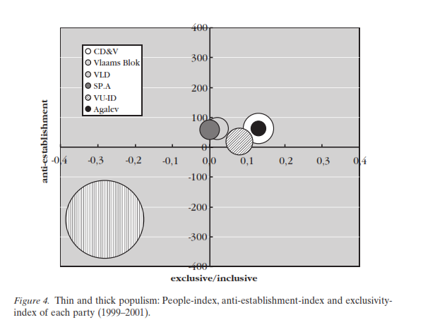
Results of the research
Vlaams Blok fundamentally differs from the other parties in terms of political communication (Jagers, Walgrave 2007)

Slide 12
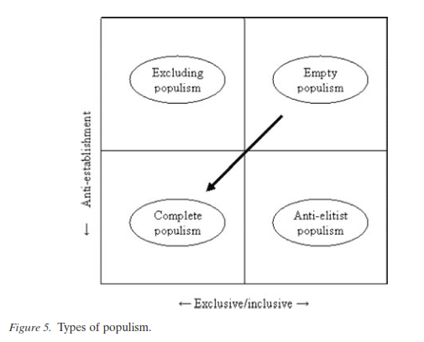
Results of the research – a typology o populism
Source: Jagers, Walgrave 2007

Slide 13
The media
Two approaches: media populism and media as a messenger (Mazzoleni)
1) media populism – media as activist actors communicating their own populist messages
2) media as messengers – carriers of someone else`s populist messages
Help populist mobilization
A tool for spreading populist messages (social media)
Media coverage of both actors and issues

Slide 14
Citizens
Communication content and its effects on political attitudes and electoral preferences (e.g. the research on framing)
as communicators expressing their beliefs and demands in reaction to the media or on the media (social media)
Some support of the relationship of populist voters and news consumption and preference of certain types of the media (mainstream/tabloid)
Messages induce/reinforce populist attitudes and support for populist parties

Slide 15
Elements of populist political communication
Ernst et al. (2017): Populists prefer social media to talkshows
systematic parallels in the use of populist key messages and the use of certain stylistic elements
Populist messages + communicative styles (not necessarily populist! See Part I of the lecture) linked to populism
a communication-centered approach, conceives of populist communication as an outcome of a strategy that uses both ideological key messages and certain stylistic elements – what is their relationship?
Detailed and clear operationalization of populism and populist communication style

Slide 18
Analysis
Set of hypotheses related to the type of the media and political actors (challengers/extreme)
Social media used more often for spreading populist content (both messages and style)
Challenger parties use populism more often
Extreme parties use populism more often
Linkage between different contents, media and actors
A good definition of the communication styles

Slide 19
Is pop.com. agressive and negative?
Nai (2019)
Comparing populist and non-populist parties/candidates
Partly based on the ideational approach
Negative campaigning vs positive self-presentation
Emotions inducing communication
Why should populists be negative and emotional?
Based on an original expert survey (negativity, target of attacks, fear and enthusiasm)
Populists more negative, more personal attacks and more often using fear

Slide 20
And what about post-truth?
Kluknavská, Eisele (2021)
Post-truth claim:
as part of anti-elitism – elites accused of communicating „purposefully false interpretations of reality“
  Truth evaluation
  Truth conflict
  Truth restoration
Style: emotional communication (vs fact-based) + negativity
Analysis of Trump`s Twitter account: truth evaluation linked to emotionality and negativity, media most targeted actors
Qualitative part – e.g. Blaming for being „fake (news)“

Slide 21
Conclusion
Populist political communication partly related to the ideational approach
Focus on communication rather than on actors
Populism as a matter of degree
Placed in a complex communication systems including political actors, the media, and citizens
Features of populist communication
Source: De Vreese et al. 2018

