Slide 1

Emotions and populist communication
Sára Cigánková
15.10.2024

Slide 2
Summary: populist communication style

Slide 3
Populist communication style main features:
It reflects populist main ideological elements: anti-elitism, people centrism, exclusion of an out-group, Manichean perception of world, etc.
moral appeal, expressive wording, emotionality
Emphasis on the crisis, blaming others
>> populist communication is “inherently emotional” <<

Slide 4
Are emotions important in political science?

Slide 5
Emotions and politics
Is the voter really rational? (Downs 1957 )
Emotions as key player in decision making-process (Zajonc 1985, Damasio 1994)
Cognition is a complex process in which the affective and cognitive components cannot be clearly separated.

Slide 6
Emotions and politics
Affective Intelligence Theory by George Marcus, Russell Neuman, and Michael MacKuen (2000): the disposition vs. surveillance system
Appraisal theory: each emotions have different “appraisal dimensions” that affect our behaviour (valence, certainty, responsibility and efficacy) (Lazarus 1991, Lerner, Keltner, 2000)

Slide 7
Emotions and political behaviour:
Different emotions have different effect on our political behaviour > emotions as influential tool in political campaigning
Brader (2006): political challengers use more fear appeals than incumbents, who tend rely more on enthusiasm. Why?

Slide 8
Emotions and political behaviour:
Different emotions have different effect on our political behaviour > emotions as influential tool in political campaigning
Brader (2006): political challengers use more fear appeals than incumbents, who tend rely more on enthusiasm.
1) enthusiasm motivates participation and activates existing loyalties
2) fear stimulates vigilance, ncreases interest in new information, and facilitates persuasion (Brader 2005)

Slide 9
Why are emotions important for populist parties?

Slide 10

What is behind the success of populism?

Slide 11
What is behind the success of populism?
Globalization and social-economic changes?
Immigration and cultural changes?
Unemployment?

Slide 12
What is behind the success of populism?
Globalization and social-economic changes?
Immigration and cultural changes?
Unemployment?
>> subjective „sense“ of perceptions of threat and vulnerability, identity loss

Slide 13
Emotions and affect as key motivators to support populist movements
How?

Slide 14
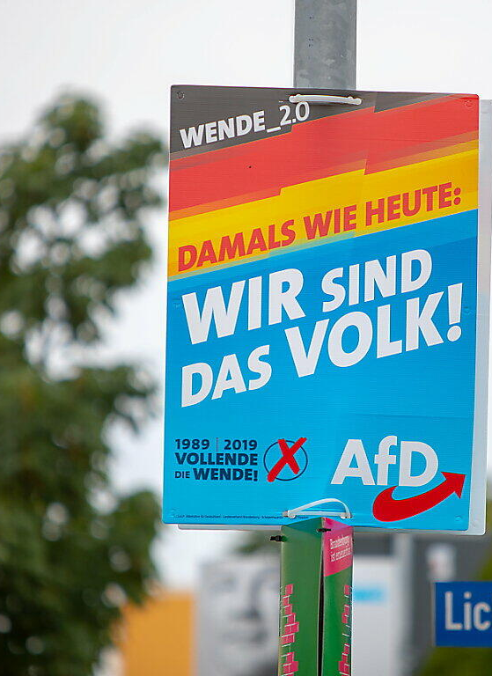
Populist political communication (in Wirz 2018)
Reference to the monolithic group of people
Stressing the people’s virtues and achievements
Demonstrating closeness to the people demanding sovereignty for the people
Excluding and discrediting others
Blaming the elite
Denying sovereignty to the elite
Emphasis on the crisis
Emotions as ”secret ingredient”

Slide 15
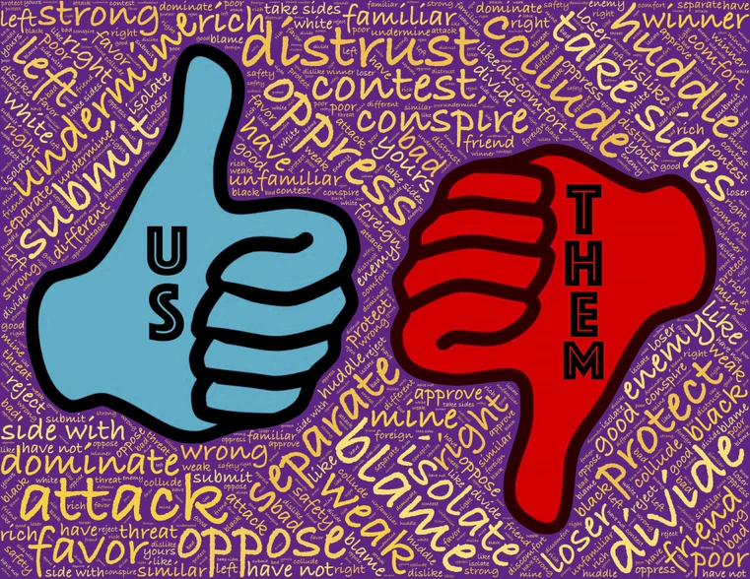
Emotionalized political communication
attachment to local identities still play important role in political life
Intuitive work with emotions rather than with rational facts:
Emotions play a central role in the rhetoric of (right-wing) populist parties.
P. appeal is far more urgent and attractive to voters precisely because of emotions such as anxiety, fear, desire, or hope (Solomon 2013)
Impression of identification with the candidate or political party.

Slide 16

Emotionalized blame attribution (Hameleers et al., 2017, 2018)
populist messages are often characterized by assigning blame to elites in an emotionalized way
emotionalized blame attributions can influence blame perceptions and populist attitudes.
Highly emotionalizet blame attribution: anger and fear toward threatening political elites

Slide 17
The populist communication, “emphasises agitation, spectacular acts, exaggeration, calculated provocations, and the intended breech of political and socio-cultural taboos” (Heinisch 2003,94) >> communication based on provocations, offensive language, aggressiveness, and negative emotionality
Examples??

Slide 18


SPD AI generated campaign

Slide 19
Emotionality of populist communication
the instrumentalization of emotions in society by populists as one of the key driving mechanisms behind the success of populist political parties
populist parties use significantly more negative emotional appeals: anger, fear, disgust, sadness)
less positive emotional appeals (joy, enthusiasm, pride, hope) than mainstream parties
populist campaigns are 15% more negative and contain 11% of more character attacks and 8% more fear messages than campaigns of non-populist candidates (Nai 2021)

Slide 20
What emotions? With what effect?

Slide 21
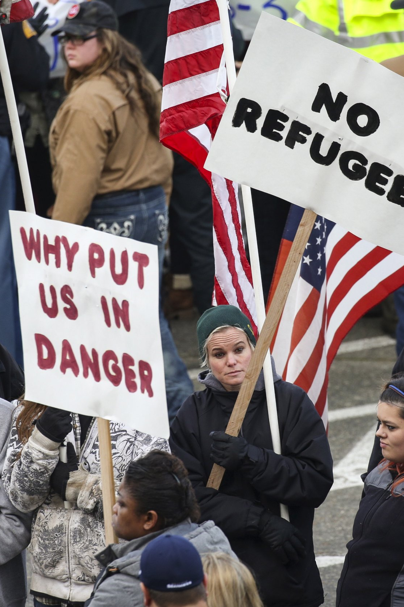
Negative emotions
populist parties use significantly more negative emotional appeals: anger and fear
Populists are often outside of the political establishment; they identity and image is rooted in “anti-attitude”:
ANGER and RESSENTMENT as emotion of protest moral disagreement and blame: anti-elitism and easy solutions
Ex. After Parisian terror attacks anger was associated with voting for the French far-right party Front National (Vasilopoulos, Marcus, Valentino, et al. 2018) .
FEAR and ANXIETY: from information seeking and less tolerance to acceptance of conservative ideology: repressive politics, patriotism, increased support for the head of state, resistance to an "unconventional" lifestyle, and support for protectionist policies
Ex: (The case of Parisien atacs) Fear significantly increase authoritarian policy preferences—yet, among left-wing individuals (Vasilopoulos, Marcus, & Foucault, 2018). + Anxiety has been found to cause conspiracy thinking about minorities and to make individuals more likely to search for, remember, and agree with threatening pieces of news about immigrant (Grzesiak-Feldman, 2013)

Slide 22
Positive emotions
Populist as part of the “People”, protectors and saviors
Enthusiasm, joy, pride: emotions of certainty.
Associated to qualities of the people, nationalism or achievements of the candidate
Hope: emotion oriented toward future. Connected to uncertainty > increasing interest in communicated issues

Slide 23
Further literature
Widmann, Tobias. 2021. „How Emotional Are Populists Really? Factors Explaining Emotional Appeals in the Communication of Political Parties". Political Psychology 42 (1): 163–81. https://onlinelibrary.wiley.com/doi/epdf/10.1111/pops.12693
Hameleers, Michael, Linda Bos, a Claes H. de Vreese. 2017. „“They Did It”: The Effects of Emotionalized Blame Attribution in Populist Communication". Communication Research 44 (6): 870–900. https://journals.sagepub.com/doi/10.1177/0093650216644026
Wodak, R. 2015. „The politics of fear: what right-wing populist discourses mean“. Los Angeles : SAGE Publication.
Weber, Christopher. 2013. „Emotions, Campaigns, and Political Participation". Political Research Quarterly 66 (2): 414–28. https://www.jstor.org/stable/23563153
Vasilopoulos, Pavlos. 2017. „Terrorist events, emotional reactions, and political participation: the 2015 Paris attacks". West European Politics 41 (červenec): 1–26. https://doi.org/10.1080/01402382.2017.1346901

