Slide 1

Ethnicity, State and Nationalism
Post-Communist Politics
Autumn 2024
Doc. Marek Rybář, PhD.

Slide 2
The centrality of ethnicity to the politics in ECE
The political principle of "the right to self-determination," which gained prominence during World War I, became the founding principle of the entire region for much of the 20th century.
During the period of Communism, ethnic minorities had their own newspapers and separate organizations, but these institutions had to align with the official party line to continue operating.
With the collapse of the Communist regimes in 1989, ethnic minorities quickly became politically mobilized, often forming their own parties.

Slide 3
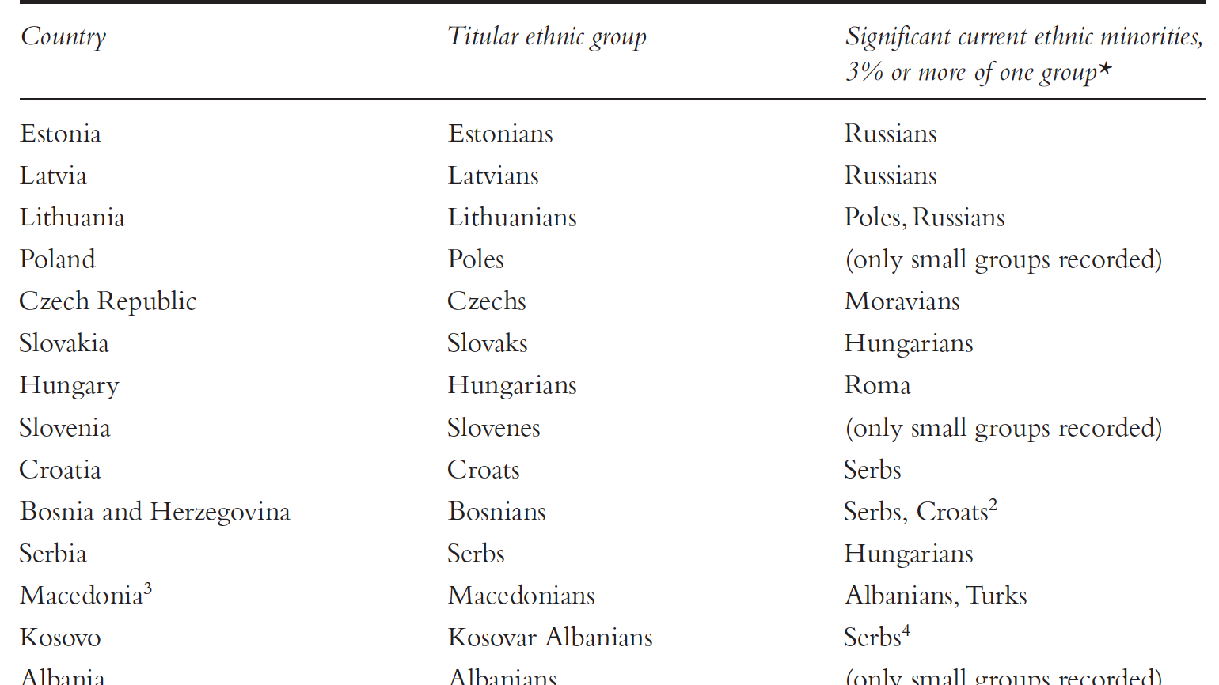

Slide 4
Ethnic relation in the early 1990s
The political upheavals of 1989 included mobilization by ethnic Hungarians in Timișoara (Romania), when the government attempted to arrest an ethnic Hungarian Protestant minister.
By the spring and summer of 1991, there were conflicts and then violence between Serbs and Croats related to the Croatian and Slovenian declarations of independence from Yugoslavia.
When Bosnia and Herzegovina declared independence in 1992, it became the site of a brutal civil war between mixed ethnic/religious groups.

Slide 5
Ethnic cleansing and civil war in Yugoslavia
The term "ethnic cleansing" was frequently used during this conflict.
It referred to the idea that group mixing should be reversed through violence, aiming to create ethnically homogeneous populations.
The conflict was brought to an end with the internationally brokered Dayton Peace Agreement in November 1995.
The Yugoslav conflicts are often described as ethnic, involving ethnic Serbs, Croats, and Bosnians. ​

Slide 6
Ethnic cleansing and civil war in Yugoslavia
The conflicts might be better understood as efforts by elites to establish political control over territories using national identity.
Slovenia and Croatia declared their independence in 1991. These declarations were followed by a Yugoslav National Army (JNA) response, which produced limited violence in homogeneous Slovenia.
However, the JNA response and Croatia's counter-response resulted in prolonged violence in Croatia, with initial Yugoslav attempts to prevent secession and later Croatian government efforts to pressure the Serbian population to leave.
When the heavily mixed Bosnia and Herzegovina declared independence in 1992, a three-way civil war between Serbs, Croats, and Bosniaks (or Muslims) broke out and lasted until 1995. ​

Slide 7
Explaining ethnic mobilization
1. Contact vs. conflict hypotheses
2. The commitment problem
3. Elite manipulation
4. The “triadic nexus”
5. The EU leverage vs domestic socialization

Slide 8
1. Contact vs. conflict
One perspective on ethnic relations explores whether increased contact between individuals from different groups promotes more tolerance or more conflict.
The "contact hypothesis" suggests that more interactions between individuals from different groups provide more information, which should foster tolerance.
The opposing "conflict hypothesis" argues that the more people learn about each other, the less they may like each other.
This was reflected in the work of Massey et al. (1999: 670) in Yugoslavia before the war, which showed that the highest levels of ethnic intolerance were found in ethnic enclaves, where there were concentrations of “similarly identified people.”

Slide 9
2. The commitment problem
A contrasting view is a focus on individual cost-benefit calculations
Fearon (1994) explained the unfolding of the Serb- Croat conflicts in 1991 with this approach, informed by international relations theories on security.
He outlined that a security dilemma existed between the groups in which it became rational to attack first.
this work on the inability of groups to make credible commitments to each other (the “commitment problem”) became part of the standard language applied to explain the conflict

Slide 10
3. Elite manipulation
Another approach to explaining ethnic conflict in the region is the elite manipulation hypothesis, put forward by Snyder (2000).
In this view, elites eager to gain support in new democracies will take an extreme ethnic or nationalist stance in order to win votes.
This theory became very popular in the policy community in their approach to the region, as it presented a set of achievable tasks:
If elites and a nationalist rhetoric were the source of the problem, various NGO-promoted projects could counter these elites and this rhetoric

Slide 11
4. The “triadic nexus”
Another line of focus in the literature examines transnational aspects of ethnic minority group mobilisation
Brubaker (1996) proposed the term “triadic nexus” to illustrate the political dynamics that take place between ethnic minorities and their state governments – as well as their “external national homelands,” or the states with which they do share a title.
As one example, the dynamics of politics between the Hungarian ethnic minority in Romania and the Romanian government also involve the external Hungarian “homeland” state.

Slide 12
The “triadic nexus”
Later work began to describe this external state as a “kin-state” with a strong interest in policies towards their ethnic kin living as minorities in other states
Another frequent kin- state example used is that of Russia and the ethnic Russians living in Estonia and Latvia, as ethnic politics in those countries are inevitably linked to Russia.
Turkey remains very interested in the fate of Turks in Bulgaria
Most kin-states in Eastern Europe have passed legislation that grants some legal status to their ethnic kin, and Hungary formally established dual citizenship in 2010.

Slide 13
5. The EU leverage vs socialization
another external focus point with regard to minority politics in the region has been the European Union
There has been a debate regarding the degree to which minority policies in the region have been affected by EU institutional conditionality or by Europeanisation, a process of socialisation to EU norms
With regard to policies on ethnic minorities, there is some debate on the degree to which the EU was in fact able to influence minority policy.
There is some evidence that political elites were most likely to align with EU policies when they suited their own domestic goals

Slide 14
Ethnic minorities in democratic politics
One of the early features of the post- 1989 democracies in Eastern Europe was the emergence of ethnic parties, or parties defined according to an ethnic principle
Two issues have gained importance in explaining the variation in their strength
1. Pre-existing organizations and formal rules
2. Decentralization and concentration

Slide 15
1. Organizations and Formal Rules
As many ethnic minorities had their own cultural organisations in the previous regimes, these institutions provided a base structure from which parties could arise.
In addition, most of the East European states adopted proportional electoral systems during the 1990s
In such systems, voters cast their votes for parties, and the parliamentary share reflects the proportion of the vote given to each.
One ethnic group that has been less successful in mobilising throughout the region are the Roma. While there are some successful Roma elites across different countries, Roma populations tend to be fragmented in most of the countries in a way that is not conducive to strong ethnic party positioning

Slide 16
2. Decentralization and concentration
ethnic minority political dynamics also relates to levels of decentralisation within states in the region
Ethnic minorities may have some concentrations in enclaves, where they are the local ethnic majority. Some countries feature large and politically mobilised enclaves, such as the Hungarians in Romania and in south Slovakia, as well as Albanians in north- western Macedonia.
Claims for increased governance powers in enclaves often emerge, because key actors in such regions would often prefer more self- government over their own affairs – particularly in relation to identity- related policies on language and education.
Ethnic majorities are often reluctant to agree to decentralisation or to grant autonomy, due to fears of loss of political control for the central state and the potential for autonomous units to become platforms for secession.

Slide 17
Identity
(Hale 2004) is the set of points of personal reference on which people rely to navigate the social world they inhabit
to make sense of social relationships that they encounter
to discern their place in these constellations
and to understand the opportunities for action in this context

Slide 18
The importance of ethnic identity
ethnicity is an important identity because:
(1) involves barriers to communication (language)
(2) (sometimes) involves physical differences
(3) 1. a 2. tend to be territorially concentrated
(4) symbols of ethnicity are shared by the whole community
(5) however, identity changes, and the meanings and identifications can be manipulated by elites and individual subjects

Slide 19
Ethnicity as a problematic analytical category
Much work carries the assumption that ethnic groups are stable and unified entities
however, individuals within the same ethnic group display vastly different political opinions and goals, including towards ethnic policies.
the political claims of ethnic minorities that are concentrated in enclaves may differ greatly from the interests of other members of the ethnic minority who live dispersed outside of the enclave
thus, claims for political autonomy for an ethnic enclave may be opposed by the titular majority, but also may not find favour from dispersed members of the same ethnic group who will fall outside of its proposed boundaries.

Slide 20
Ethnicity as a problematic analytical category
In addition, research shows that although individuals of the same group may have access to kin-state benefits, their individual characteristics produce varying degrees of engagement with those benefits (Brubaker et al. 2006, Knott 2015).
People may share the same ethnic name, but we may wrongly assume that it means they engage in the same type of politics.

