Slide 1

Governments and Bureaucracies
Post-Communist Politics PMCb1109,
Doc. Marek Rybář, PhD.

Slide 2
The executive branch of power
historically the oldest branch of power
following the breakdown of communism, the executive power was the most experimented with in the region
before 1989, only Czechoslovakia and Romania had a presidential office
POL – a collective head of state (the State Council)
after 1989: strong powers of the presidents especially in the post-Soviet space

Slide 3
Presidential regimes and democracy
presidential regimes less likely than parliamentarism to sustain democratic government (Linz, Stepan, Mainwaring) because
1. Presidential elections become “zero-sum games”, they exclude minorities
2. Produce competing claims of political legitimacy
3. Presidential democracies foster personalism of the executive
4. An outsider demagogue can capture the system and ignore the existing division of powers

Slide 4
Types of political systems
parliamentary (a system of dependency between the executive and legislative branches of powers)
presidential (a system of mutual independence of the executive and legislative branches)
semipresidential (directly elected president and a prime minister accountable to the parliament)

Slide 5
Duverger: semipresidential systems
President is directly elected by voters
Not accountable to parliament
Prime Minister is the head of government accountable to parliament
Prime Minister and President share some executive powers
president has “quite considerable powers”
system is open to “cohabitation”

Slide 6
Two types of semipresidentialism 1/3
A premier-presidential subtype
the prime minister and cabinet are formally accountable only to the assembly, not to the president
president appoints the prime minister who heads the governments
only the parliament can remove the PM/government from office

Slide 7
Two types of semipresidentialism 2/3
a president-parliamentary subtype
the prime minister and cabinet are dually accountable to the president and the assembly majority
president appoints and recalls the PM and government ministers
the PM and ministers are accountable to both the president and the parliament

Slide 8
Two types of semipresidentialism 3/3
president-parliamentary systems tend to be less democratic than premier-presidential ones
the key variable is a dependent and uncertain position of the PM and the cabinet between president and the parliament
if president does not have support of a parliamentary majority, conflicts abund

Slide 9
Executive systems in an early phase of post-communism
8 pure parliamentary systems (ALB, BOS, YUG, LAT, CZE, EST, HUN, SVK)
6 pure presidential systems (AZE, BLR, GEO, TAJ, TURK, UZB)
other countries were semipresidential
a few countries switched from one system to another
semipresidentialism is a prevailing form of government in the CEE region

Slide 10
Regional variation of executive systems in CEE
Central Europe and the Baltics
the Balkans
Caucasus and Central Asia
the rest of the former Soviet Union

Slide 11
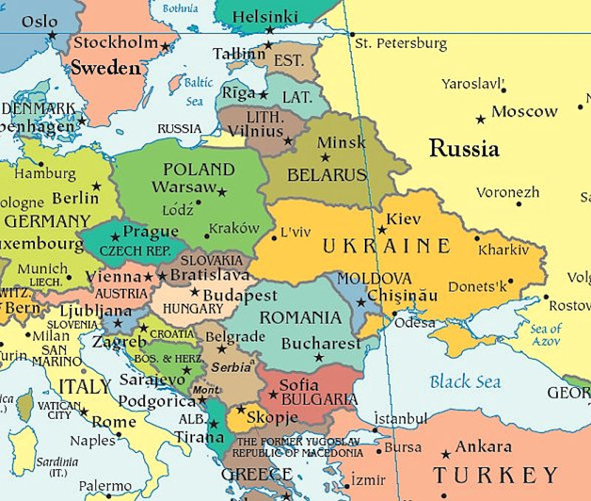
Central Europe and the Baltics
no pure presidentialism, no presidential-parliamentary systems
premier-presidential systems: BUL, LIT, POL, ROM, SVK 1999-, CZE 2012-
parliamentarism: LAT, pre-1999 SVK, pre-2012 CZE, EST, HUN

Slide 12
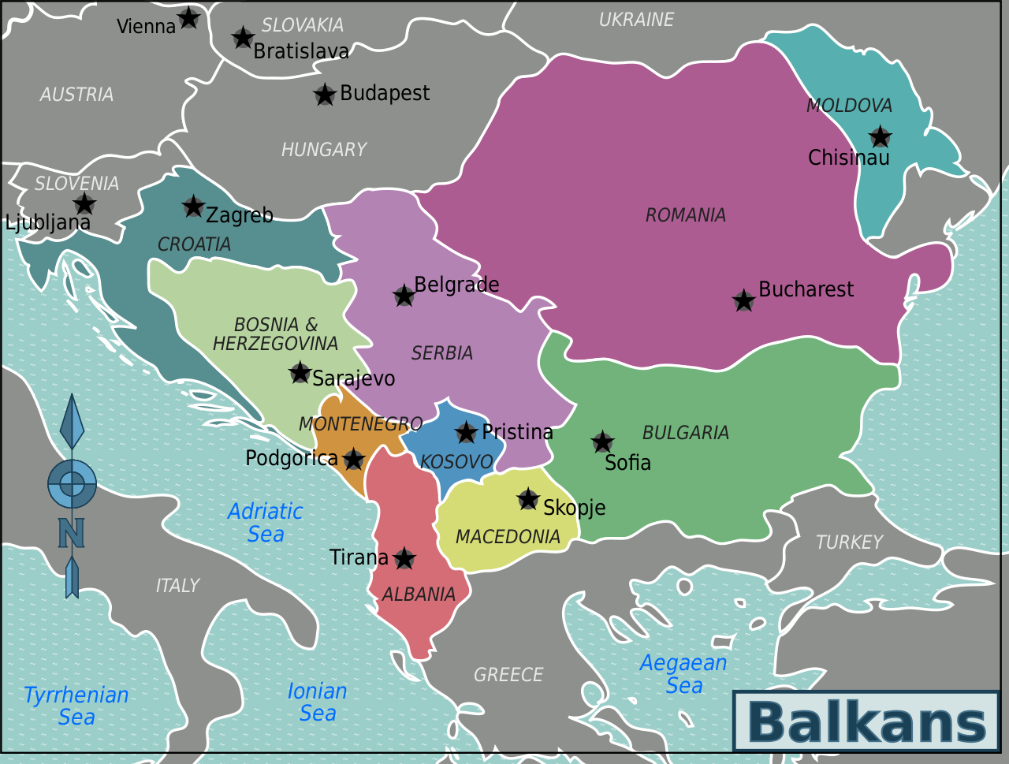
The Balkans
no pure presidentialism
pres-parl: CRO 1990-2000,
premier-presidential : CRO 2000-, MAC, SRB 2007-2008, YUG 2000-2003, SLO
parliamentarism: ALB, BOS 1995-, MONT 2007- YUG -2000, SRB-MONT (2003-2007)

Slide 13
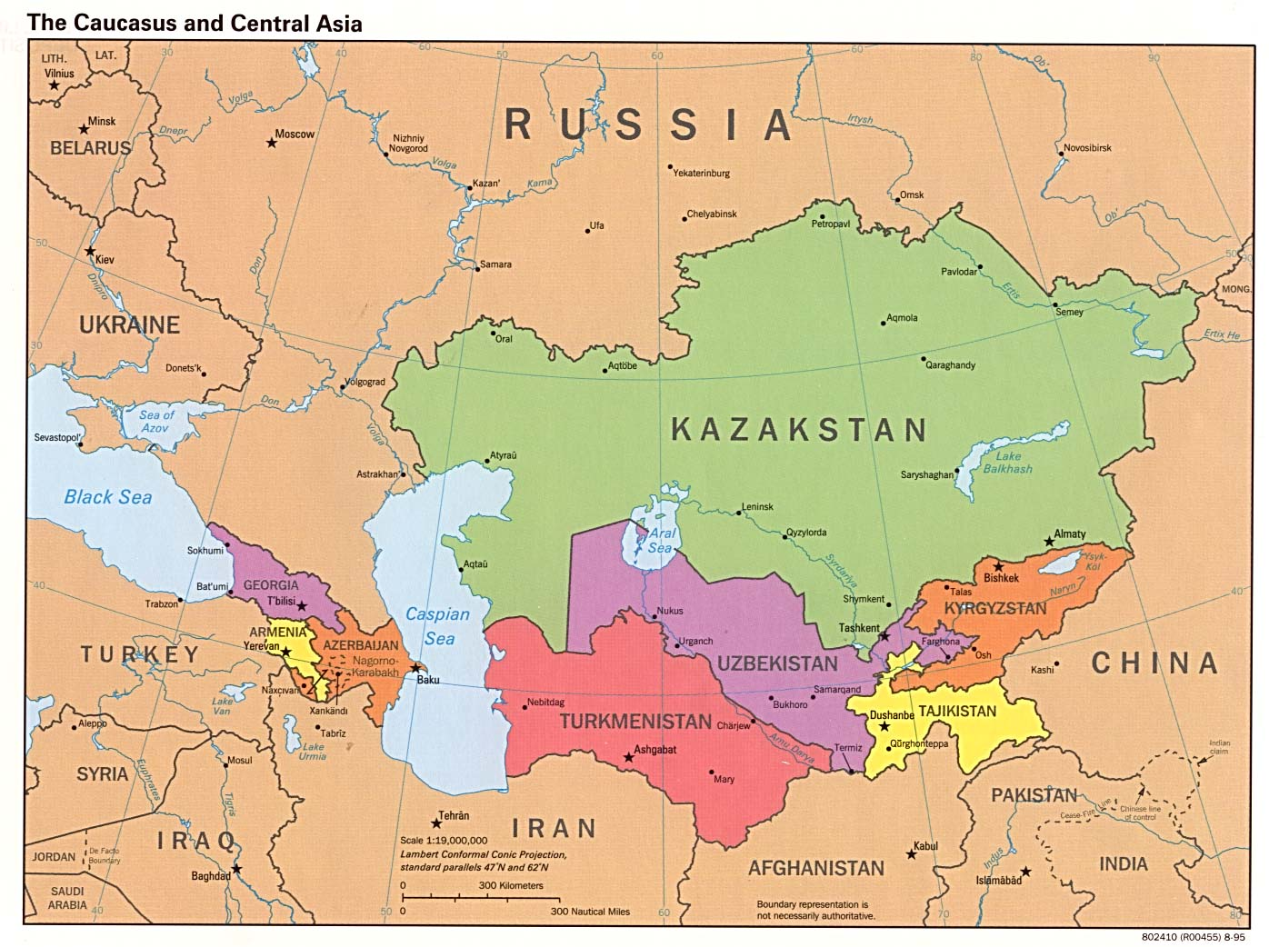
Caucasus and Central Asia
pure presidential: AZE, GEO 1995-2004, UZB, TUR, TAJ,
president-parliamentary: ARM 1991-2005, GEO 2004-, KAZ
premier-presidential: ARM 2005-2015, MONG 1992-
pure parliamentary: ARM 2015-,

Slide 14
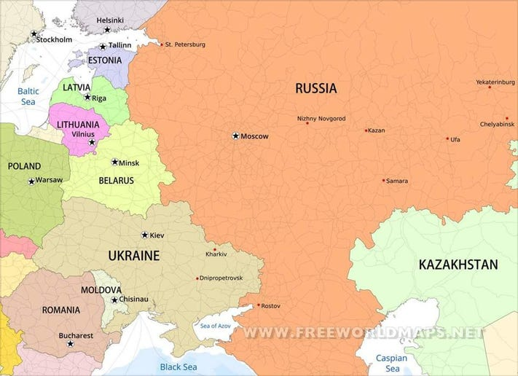
The rest of the frmr Soviet Union
pure presidentialism: BLR 1994-1996
presidential-parliamentary: BLR 1996, RUS 1993-, UKR 1996-2004, 2010-2014
Premier-Presidential ones: MOLD 1994-2000, 2016- UKR 2004-, 2014-
pure parliamentarism: MOLD 2000-2016

Slide 15
Semipresidencialism and democracy in CEE
premier-presidential systems no worse than pure parliamentarism in democratic performance
president-parliamentary systems far worse in democratic performance than parliamentarism AND premier-presidential systems
presidential systems linked to worst levels of democracy (they have often never been democratic in the first place)

Slide 16
How do president-parliamentary system undermine democracy?
1. Presidents often misuse decree powers in order to monopolize executive authority
2. Presidents consciously undermine the creation of stable parties and stable party systems
constitutionally strong presidents AND weak parties sustain/reproduce authoritarian government

Slide 17
Creating the Presidency: Poland
an outcome of the roundtable negotiations
elected for 6 years, the right to dissolve the parliament and veto the legislature
later (in 1990) reduced to 5-year term
the Little Constitution of 1992 – presidential prerogatives
the new constitution of 1997 – further reduction of presidential powers and the strengthening of the PM (a constructive vote of no confidence)

Slide 18
Creating the Presidency: Hungary
the roundtable negotiations failed to agree on presidency – a referendum in 11/1989
the Communists – a strong president elected before the parliamentary elections
the opposition – a weak president elected by a democratically newly elected parliament
weak presidency, the Constitutional Court further reduced its powers in a few landmark rulings

Slide 19
The presidency: other countries
Romania and Serbia/Yugoslavia: examples of how the political context and the personal factors may influence the functioning of intra-executive relations
Slovenia – weak & directly elected president
Lithuania – semipresidential system as a compromise, as both presidentialism and parliamentary governments existed in the pre-1940 history of the country
a formally strong role of the directly elected president but the system works as a de facto parliamentarism (the only impeached president in Europe)

Slide 20
Russia
extremely strong role of the president had pacified the PM and the government even without a parliamentary majority backing the president
some conflicts (Yeltsin vs. Primakov, Stepashin &Putin vs. Medvedev)
Putin in presidency = a consolidation of the parliamentary support of the president, his PMs as administrators (Zubkov, Mishustin)

Slide 21
Russia & Ukraine
RUS: tandem Putin-Medvedev, the level of conflicts depended on who held the presidency, constitutional changes in 2020
Ukraine: extreme intra-executive conflicts, manipulation of the constitutional norms
constitutional amendments tailored to put the office holders into an advantageous position
President Kuchma – preferred strong presidency while in office

Slide 22
Ukraine
2004 – constitutional amendments to weaken the presidency (in anticipation of Yushtchenko’s victory)
President Yushchenko – could not/did not prevent further weakening of presidency President Yanukovich (2010) – after taking control of the presidency, he objected the reduction of presidential powers that he himself had advocated before

Slide 23
Ukraine
the Constitutional Court ruled in 2010 that the 2004 weakening of the presidency was unconstitutional (i.e. the return to the 1996 Kuchma’s strong presidency)
2014: the parliament passed a constitutional amendment reinstalling the 2004 reforms (a weaker presidency)
Zelenskyy: strengthening the powers of presidency due to the state of war

Slide 24
Models of parliamentarism
parliamentary systems do not function in a uniform manner:
often a de facto fusion of parliament and government, because of:
the compatibility of the parliamentary and ministerial posts (ministers also hold parliamentary seats
PM is usually an MP
a strong and disciplined political parties

Slide 25
Prime Ministers in CEE
a comparatively weak position – given their short tenure
a link between party system instability and low durability of the PMs
major exceptions: Drnovšek (1992-2002), Orbán (1998-2002, 2010-), Klaus, Dzurinda (1998-2006), Fico (2006-2010, 2012-2018, 2023-), Tusk (2007-2014, 2023-)
However: PMs have a strong leader effect in elections – they shape voters’ electoral choices

