Slide 1
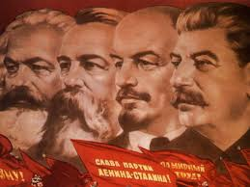
What was Communism?
Post-Communist Politics
Autumn 2024
Doc. Marek Rybář, MA, PhD.

Slide 2
Communism: Diversity in unity
countries of Eastern Europe and the Soviet Union differed from one another in many significant respects, for example:
in the intensity, span, and effectiveness of central control,
in the extent of popular support (pre-WW2 differences mattered)
in the degree and timing of efforts at reform
how to understand the communist regimes in their diversity?
a combination of ultimate ends and operational principles
the resemblances among communist countries were more important than their differences

Slide 3
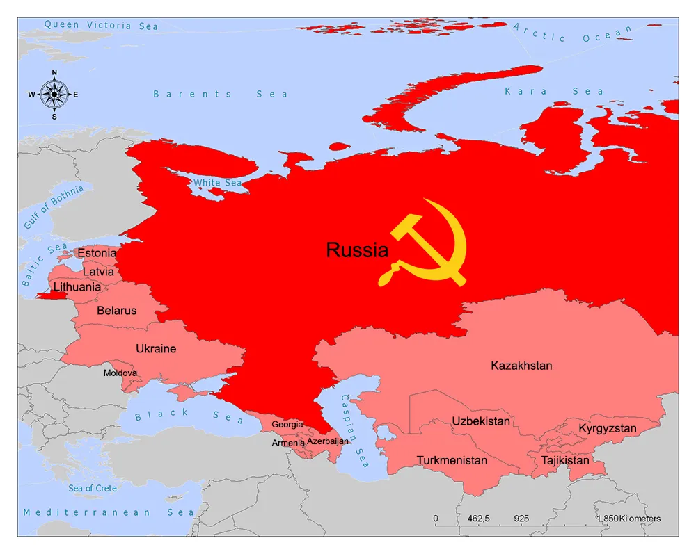
The Soviet Union
had undergone several phases of communist development:
the Leninist period
Stalinism
The Post-Stalin Period
Gorbachev - Exit from Communism (1985-1989)

Slide 4
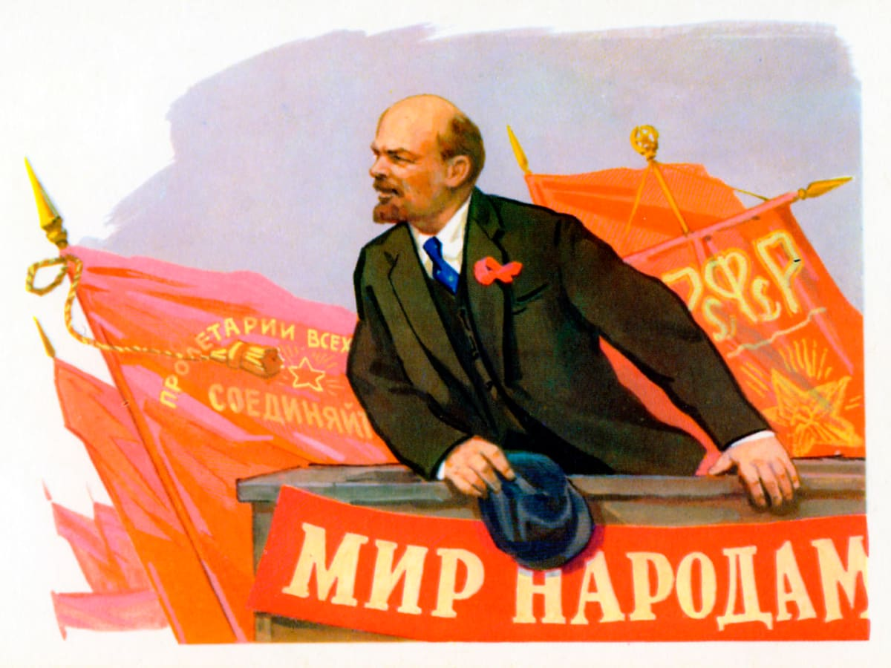
The Leninist State
for the first time in modern history a movement of the radical left claimed to have the key to absolute wisdom in overriding the principles of popular government
it was not a conventional authoritarianism or traditional autocracy known from history - this authoritarianism was that of a revolutionary state

Slide 5
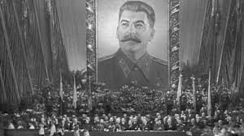
Stalinism (from Lenin to Stalin)
Secret Police - enormous power
Terror, torture supported by law
A network of informers
Internal and external espionage
Prison system including the Gulag
Trade Unions Destroyed
No alternative voices other than the Party were allowed
the state penetrated society, and eliminated all autonomous organizations

Slide 6
Stalinism
Stalin conducted a policy of purges
Millions were arrested, executed or sent to labour camps.
Stalin purged 90% of the army’s top officers, every admiral in the navy, 1 million Communist Party members, some 20 million ordinary Russians
in the 1930s and thereafter the victims would be counted in the millions
a cult of personality: Propaganda was used to make people aware of the part Stalin was playing in every aspect of life – work, home and leisure

Slide 7
The Post-Stalin Period (1953-1985)
participation in politics remained devoid of meaningful institutional forms
popular inputs into policy-making were filtered through the top echelons of a leadership whose members were selected by cooptation from above
the top priority of public policy was to supply the military with the necessary resources
a shift away from Europe as an immediate target and towards the Third World

Slide 8
Gorbachev - Exit from Communism
(1985-1989)
the Soviet and the East European economies continued to lag behind the West
Soviet military spending in this period is estimated to have been 20-25 per cent of Soviet GNP - unsustainable levels
attempted reforms: perestroika and glasnost
a goal of softer authoritarianism, to reassure the West while maintaining capability to accomplish the task of dismantling a militarized economic regime
permit a freer flow of information without full accountability in times of anticipated stress

Slide 9
Countries of Central and Eastern Europe
in the Stalin period their political formula and institutions closely followed the Soviet model
there were apparent differences in the extent to which this model was accepted, tolerated, or rejected by the populations of different states
after Stalin's death, the once uniformly obedient states could be grouped into three distinct categories (Janos 1996):
solidary states (Czechoslovakia, East Germany, Bulgaria)
states simulating Soviet-bloc solidarity (Hungary, Poland, Romania)
states following an independent course (Albania and Yugoslavia)

Slide 10
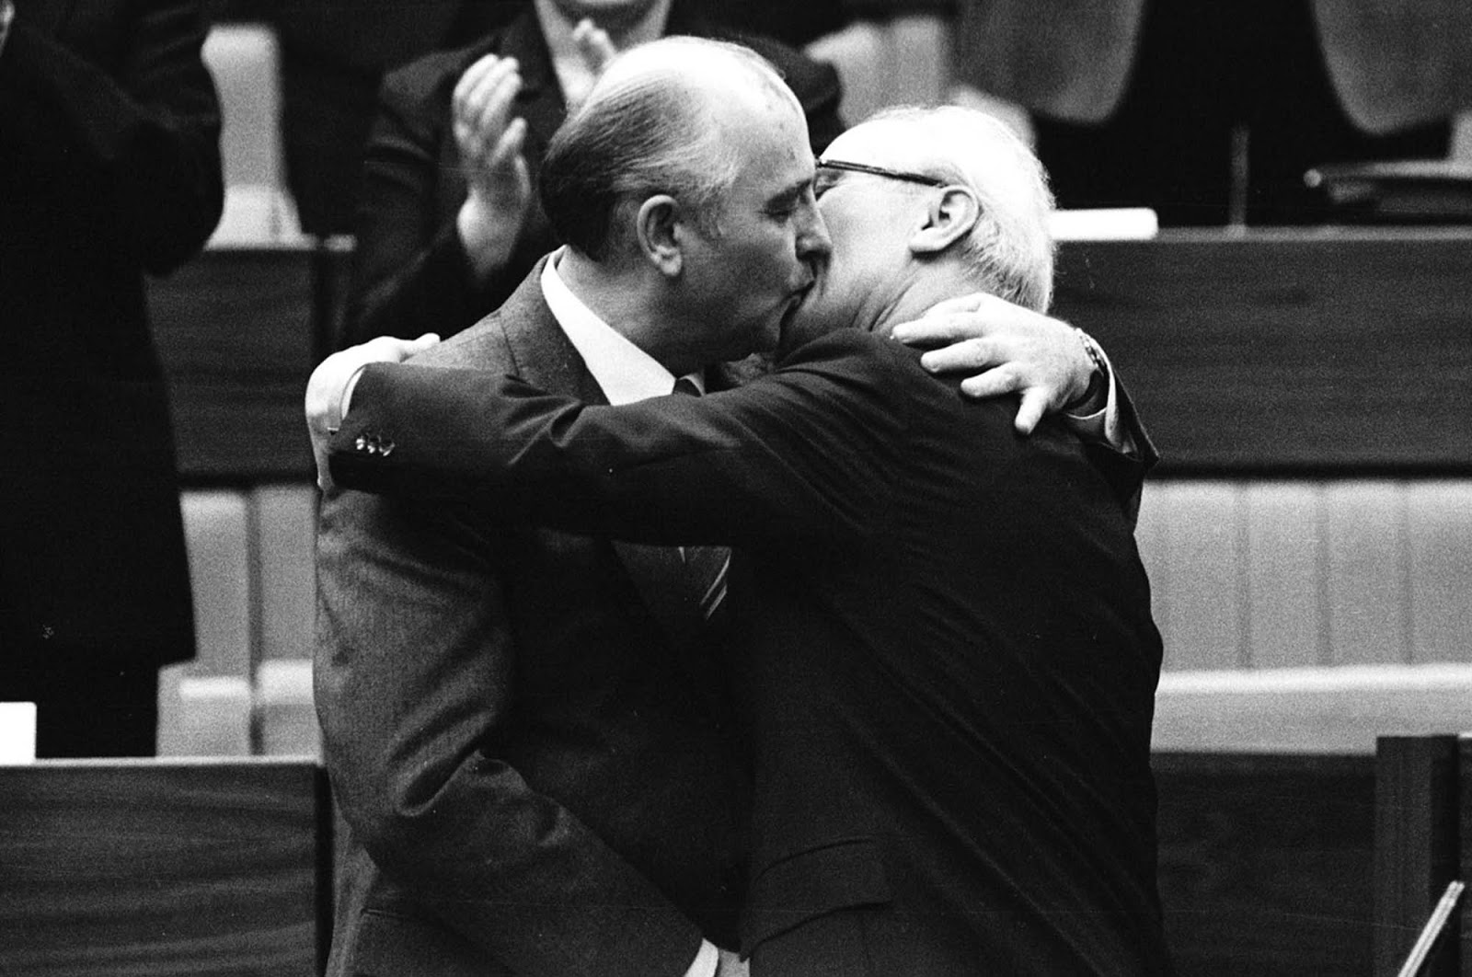
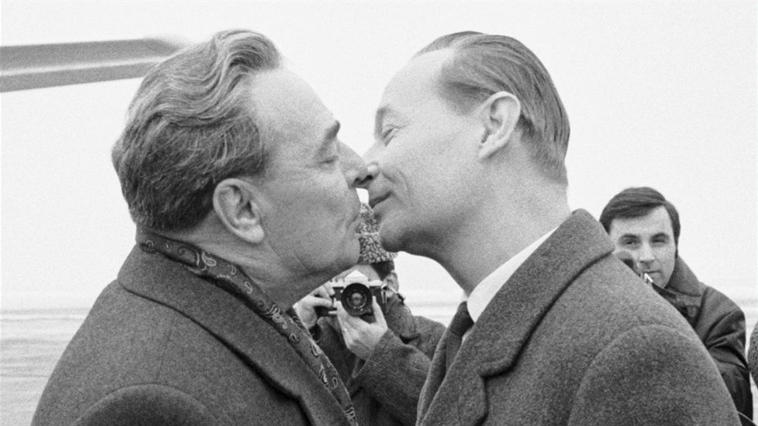
Solidary States
East Germany, Czechoslovakia (after 1968), Bulgaria
large military expenditures
weapon suppliers, extensive surveillance network organizations (Stasi, StB), foreign intelligence and subversive operations (assassinations)
extremely dependent on the Soviet support

Slide 11
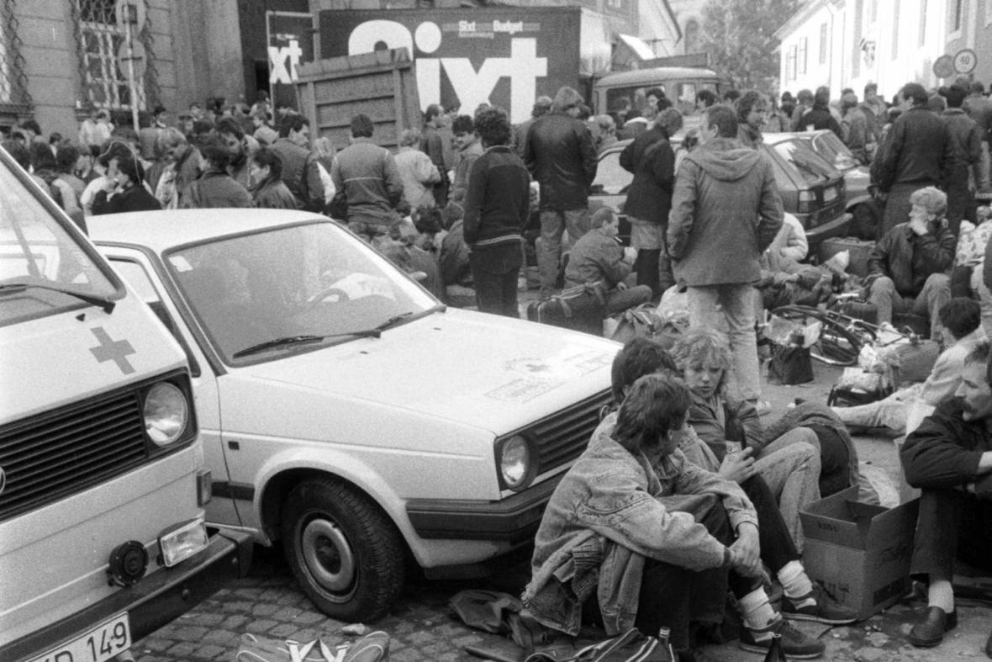
East Germany (GDR)
born with a defect: not an established nation-state but a regime occupying a randomly selected territory
hard-link Communism, any critique of the regime threatened the very existence of the state
an attractive exit option for its population (fewer pressures in the process of adaptation)

Slide 12
Czechoslovakia
the only CEE country where the Communist Party enjoyed a strong popular support before the Communist takeover in 1948
a brief period of Stalinism (1948-1955), meddling through (1955-63), regime liberalization (1963-1968), a frozen post-totalitarian system (Linz and Stepan, 1968-89)
after the Soviet military invasion (1968), exit strategy of many political activists
a rigid Communist Party – purges (1/3)– absence of a moderate wing, lack of economic reformers before 1989
imitation of perestroika, the Communist leadership perceived it as an existential threat

Slide 13
Bulgaria
in the post-WW2 setting, the Soviet leadership installed a communist government that quickly eliminated all non-communist political players
non-communist politicians were discredited by their collaboration with Nazi Germany
after a brief period of Stalinism, Todor Zhivkov took over the party leadership in 1956 and controlled it until 1989
agrarian country, industrialization and urbanization brought by the Communists
weak to non-existing opposition, independent initiatives emerged only in the late 1980s

Slide 14
States simulating Soviet-bloc solidarity
Poland, Hungary, Romania
simulating solidarity but following an independent political formula
internally different in the ways they combined political formula and strategies of modernization and economic growth
some pre-WW2 modernization in Poland and Hungary, very little in Romania
communist parties installed by the Soviet union in POL and HUN enjoyed little popular support; little meaningful political pluralism in ROM – Soviets helped an early installation of Communist-controlled government

Slide 15
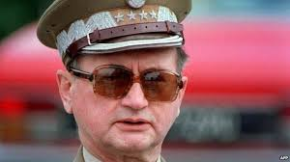
Poland
Linz and Stepan argue that communism in Poland never reached the fully totalitarian character, because in 1947-1989 there were
1. limited societal pluralism (Catholic church, a 10-million strong and united opposition unions)
2. strong agricultural sector that was never nationalized
3. frequent and highly significant changes to the party leadership
1980 – a de facto military coup led by General Jaruzelski (who simultaneously occupied the Communist Party leadership)
suppression of the opposition that remained strong underground, later attempts to negotiate a power-sharing arrangement

Slide 16
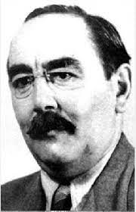
Hungary
Communist assumed power in 1947 after a series of electoral manipulations and interventions by the Soviet Army/leadership
after a brief period of Stalinism, reformist leadership of Imre Nagy attempted to establish a coalition government and to leave the Soviet Bloc – the 1956 Soviet military intervention
the Communist Party was reconstructed, a policy of limited economic interactions with the West was pursued , some economic reforms and legalization of private property (semi-market economy)
“Whoever Is Not Against Us Is for Us”

Slide 17
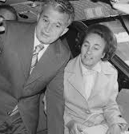
Romania
Romanian communism is linked with the person of N. Ceausescu, its leading representative between 1965 and 1989
originally selected as a representative of a collective (anti-Stalinist) leadership, Ceausescu quickly came to fully dominate the party and security apparatus
through combination of personalism and nationalism, Ceausescu built a “sultanistic regime”: cult of personality, fear, greed, key positions of members of his family
a degree of independence in foreign policy (the only core country not to take part in the 1968 invasion to Czechoslovakia)

Slide 18
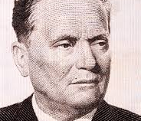
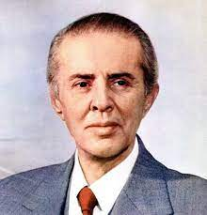
States rejecting the idea of a Soviet Bloc solidarity
Yugoslavia and Albania
built around the leaders who enjoyed the status of key personalities (Josip Tito and Enver Hoxha)
home-grown communisms, independence from Moscow
Albania: the persistence of fully fledged totalitarian institutions, adherence to permanent purges, links with China and subsequent international isolation; death of Hoxha in 1985, one-party state until 1991
Yugoslavia: a strategy of non-alignment, outside Soviet-controlled military and economic structures, an independent way to communism, a combination of central planning and private property/market

Slide 19
Conclusion
a number of important differences among the communist regimes of Central and Eastern Europe
sharing common political ends
pursuing them via divergent operational principles
all CEE countries and their communist regimes evolved against the backdrop of political changes in the Soviet Union
both the death of Stalin in 1953 and a decision not to intervene by Gorbachev in 1989 acted like catalysts of divergence

