Slide 1
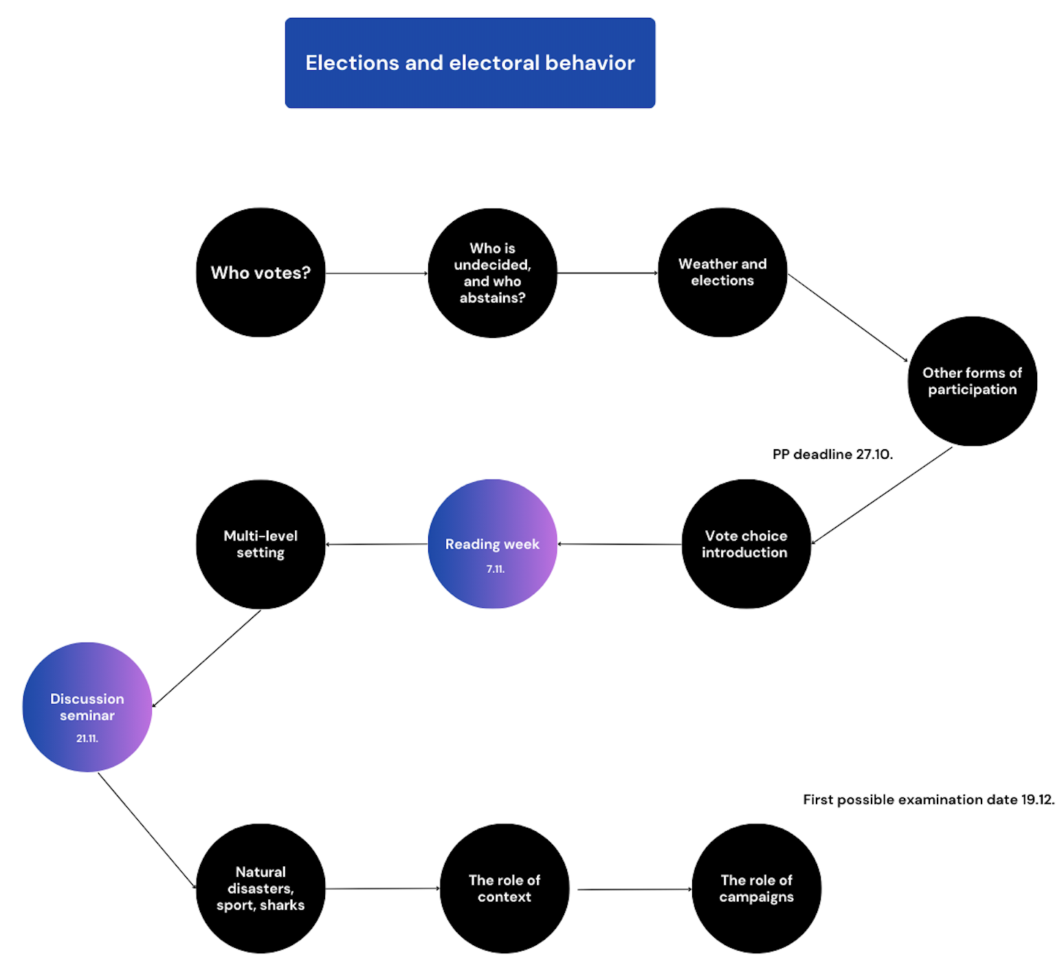

Slide 2
Who votes? Determinants of turnout
Part I
Jakub Jusko

Slide 3
Introduction and relevance
"Voting as the most common and important act of the citizen in a democracy" Aldrich 1993
"One of the most important indicators of democratic performance" Powell 1982
"An important factor in electoral performance"

Slide 4
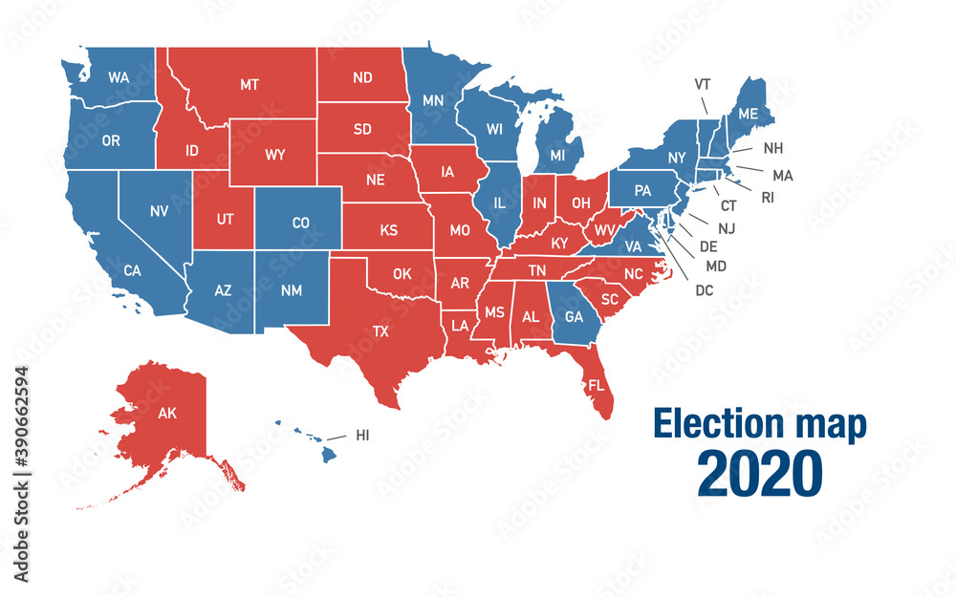
Volebná účasť

Slide 5
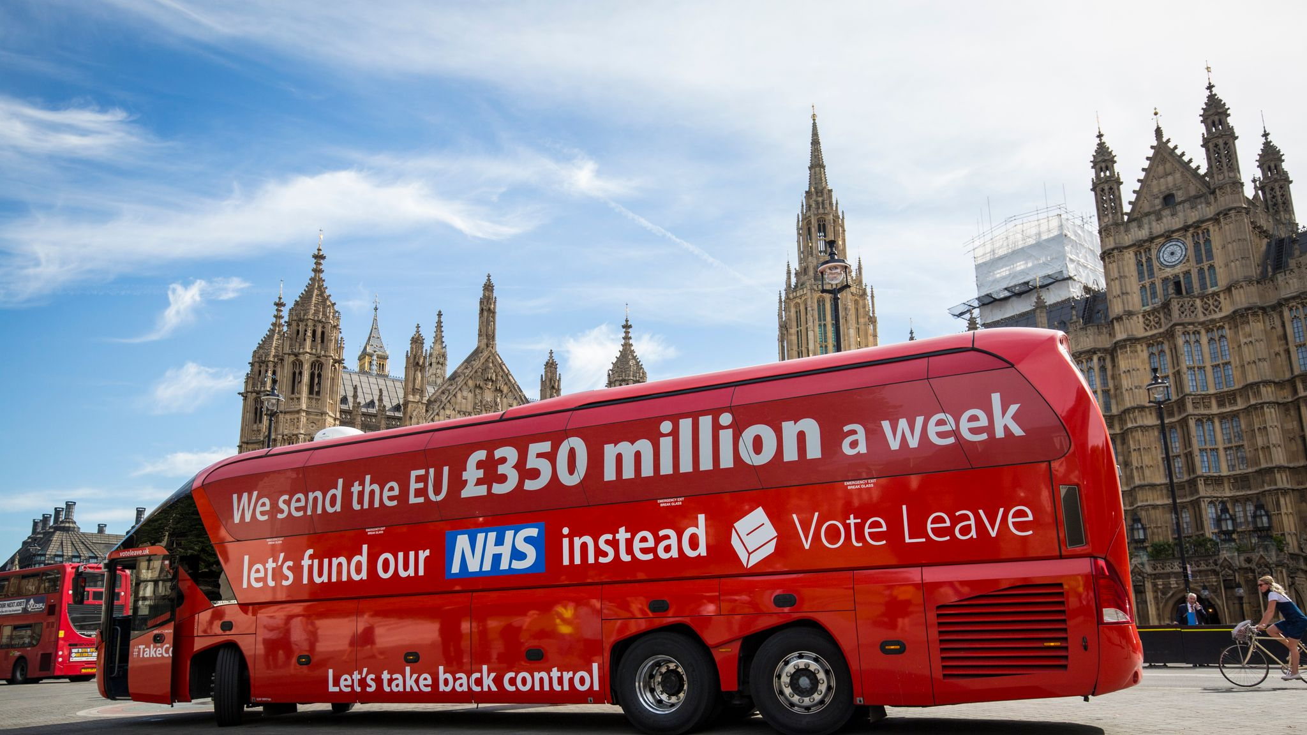
Volebná účasť

Slide 6
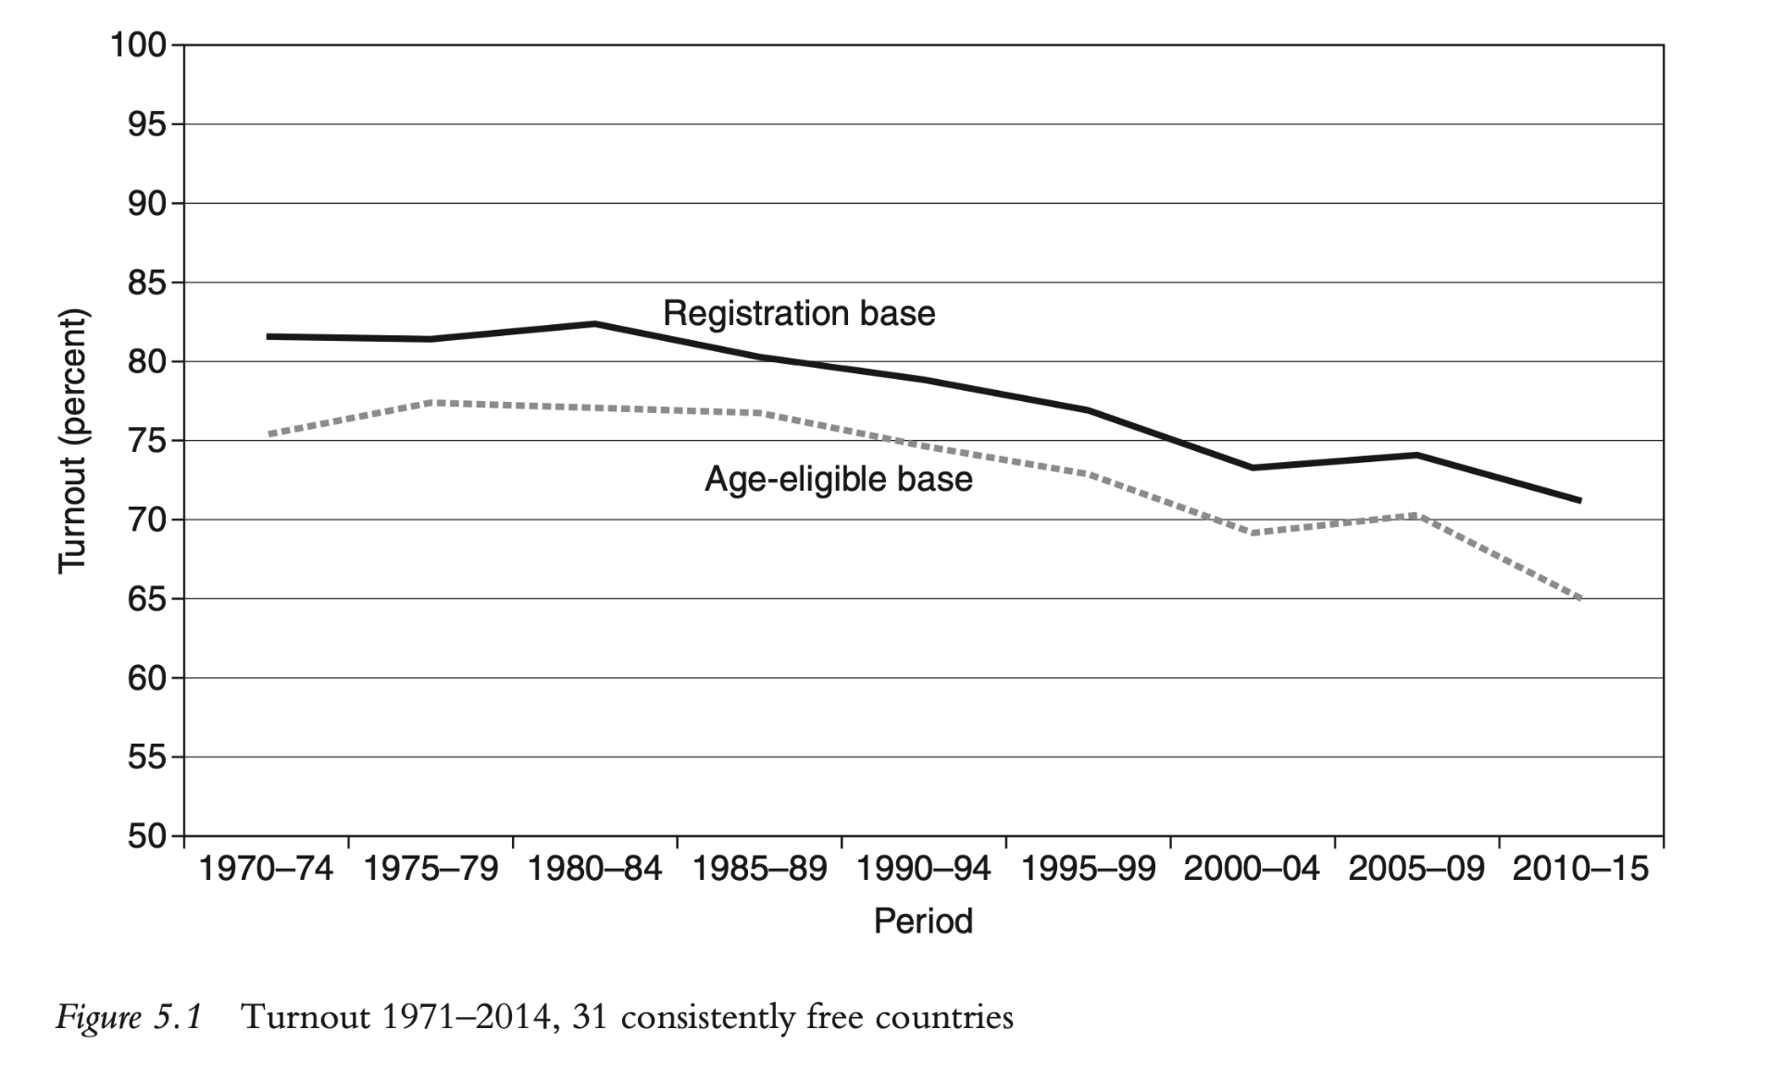
Source: Fisher et al. 2018
+ VARIATIONS across countries, continents, contexts
+ different “turnouts”
Notes:
• Definition: Voter turnout refers to the percentage of eligible voters who cast a ballot in an election. It is a crucial measure of political participation and democratic engagement.
+ variation in different countries ->
Global Variations:
• Australia: Implements compulsory voting, resulting in turnout rates around 90% in federal elections.
• United States: Voter turnout for presidential elections typically ranges between 55-65% of the voting-eligible population. For example, the 2020 election saw about 66.8% turnout.
• Switzerland: Known for frequent referendums, with turnout rates varying between 40-50%.
• Japan: Voter turnout has been declining, with recent elections seeing around 50-60% participation.
• National Examples:
• United Kingdom: The 2019 General Election had a turnout of approximately 67.3%.
• Germany: The 2021 federal election saw a turnout of about 76.6%.
• Brazil: Compulsory voting for literate citizens aged 18-70 results in turnout rates usually above 75%.

Slide 7
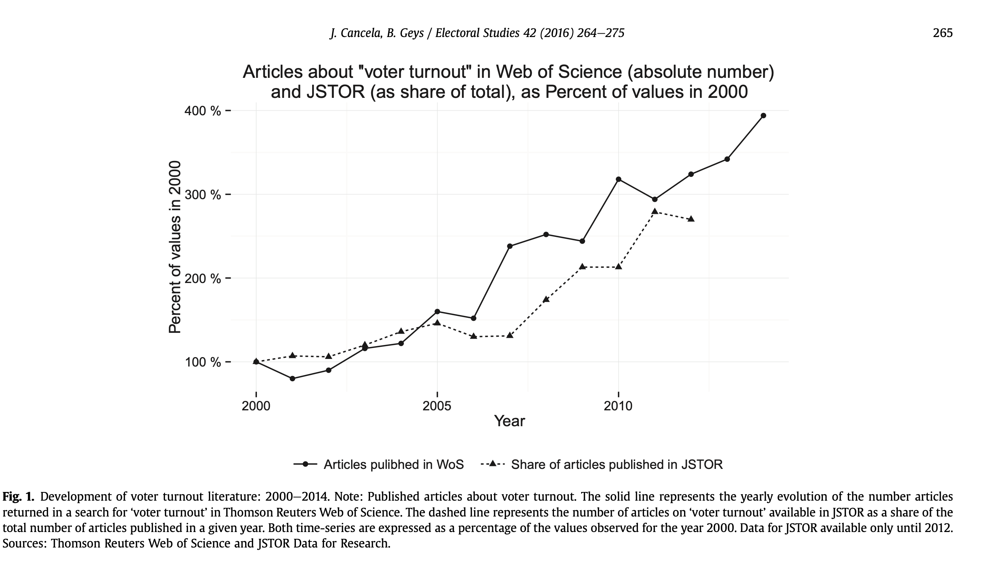
Source: Cancela a Geys 2016

Slide 8
Phenomenon in the academia
The argument about whether high turnout is important:
- IS (e.g. Lijphart 1997) vs. IS NOT (e.g. Rosema 2007)
Working with individual and marco-level, data-based from cross-sectional to longitudinal surveys, from big-data to experimental methods
Voter turnout and voting one of the most researched areas of political behaviour => in other words - lots of research

Slide 9
Phenomenon in the academia
Difference:
1) Whether they vote (how high the turnout is and why),
2) How people vote (determinants of choosing a particular party)
Lack of consensus within the scientific community on the "core model" of T -> Many factors and theories not always valid
T meta-analyses can help (e.g. Geys 2006, Smets and Van Ham 2013, Cancela and Geys 2016, Stockemer 2017)

Slide 10
Two streams of turnout studies
1) Individual level studies
Which personal characteristics among voters distinguish them from going out to vote?
2) Macro-level studies
How does the context in which the election takes place affect turnout?

Slide 11
What factors influence turnout?

Slide 12
1) Individual level studies how to measure?

Slide 13
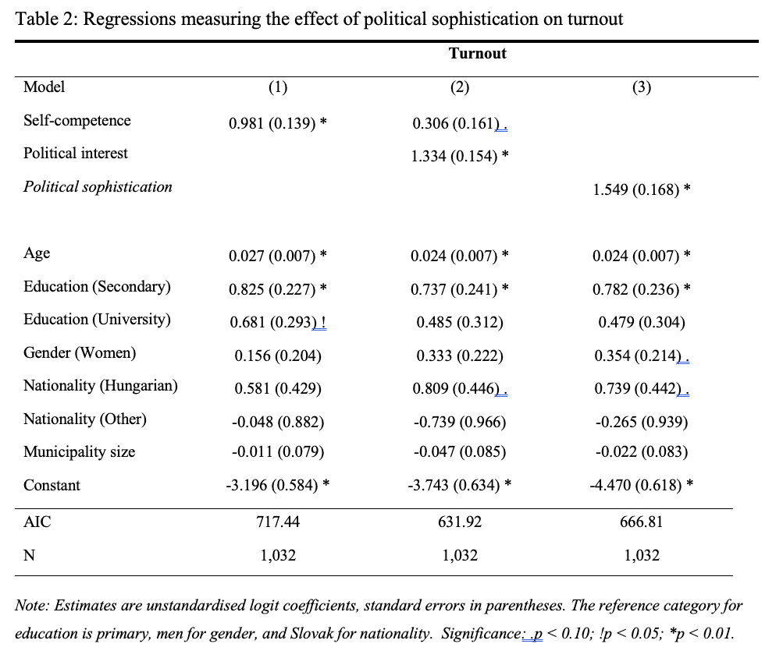
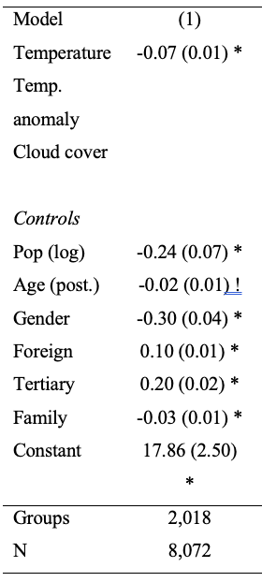

Slide 14
Individual level studies
A) The resource model
B) Rational choice model
C) Mobilisation model
D) Socialisation-psychological model

Slide 15


Slide 16
A) Socio-economic status model (SES, the resource model)
Participation is an act driven by individual resources (time, money, skills)
People who work, have higher income, and higher SES are more likely to have a wider range of resources
Persons with low SES are less likely to participate either because:
-they cannot bear the costs of voting (how to vote, registering)
-the need to concentrate on one's own material well-being does not increase civic interest and, thus, interest in politics

Slide 17
A) Socio-economic status model (SES, the resource model)
Age (+): young voters are not clear about their political interests, adults are more likely to accept social norms, changes in social networks (groups)
Education (+): contributes to resources -> proxy social class and skills
one of the strongest predictors,
the paradox of increasing education (and not increasing participation)
Income (+): small but significant effects

Slide 18
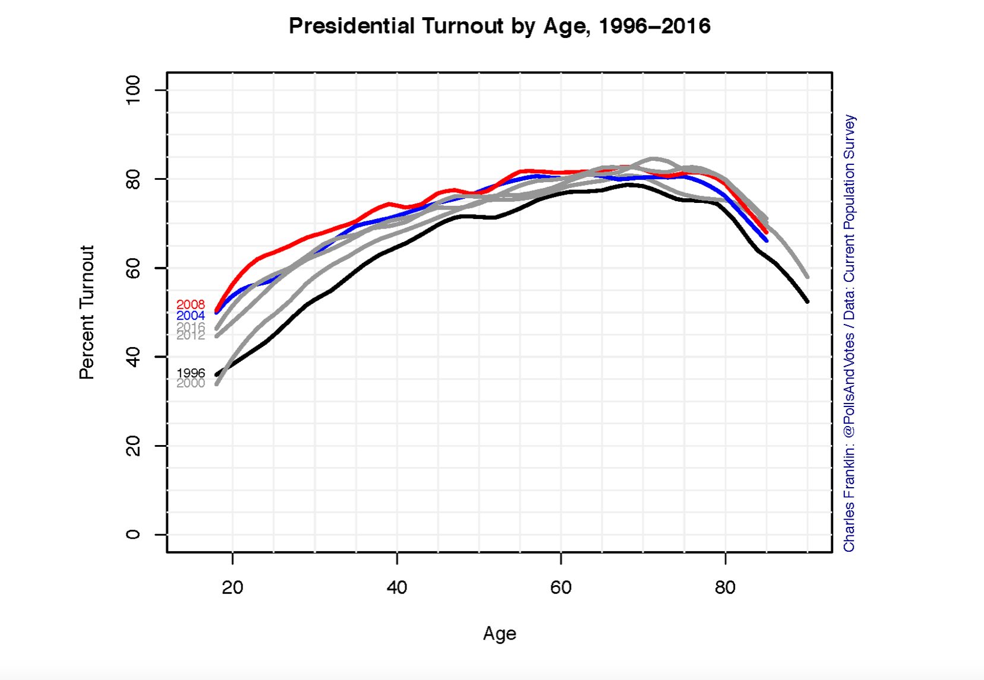

Slide 19
A) Socio-economic status model (SES, the resource model)
Residential stability (-): citizens more anchored in the community -> stronger community ties -> better knowledge of local (political) issues
Region (-): possible large differences within the landscape (as a control variable)

Slide 20
A) Socio-economic status model (SES, the resource model)
Less "successful" variables:
Gender
Race
Citizenship
Marital status: more committed partner, more pursuit of "good citizenship" vs. less free time

Slide 21
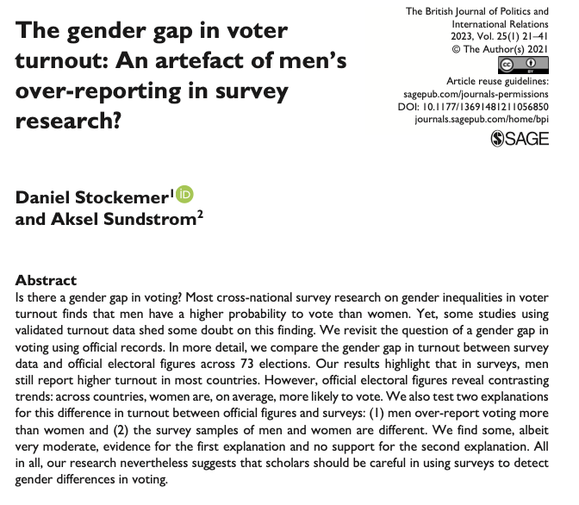

Slide 22
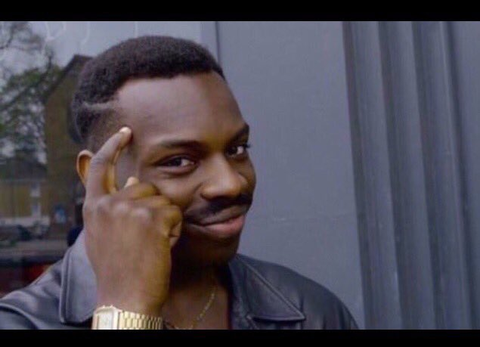

Slide 23
B) Rational choice model
It focuses on the "calculus of voting" of a voter who should vote when the benefits outweigh the costs of voting
R = PB - C
A voter should vote when PB > C
Modified version: R = PB - C + D

Slide 24
B) Rational choice model
Civic duty (D) (+): 'in a democracy it is the moral duty of every voter to vote', 'necessary to maintain democracy', 'failure to do so = guilt’ + reciprocity
Instrumental Benefits (B) (+): I care who won the election, personal benefit of winning
Costs (C) (-): time to vote, how "hard" it is to vote (less successful)

Slide 25

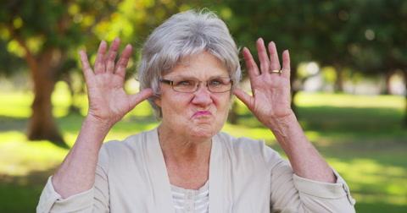

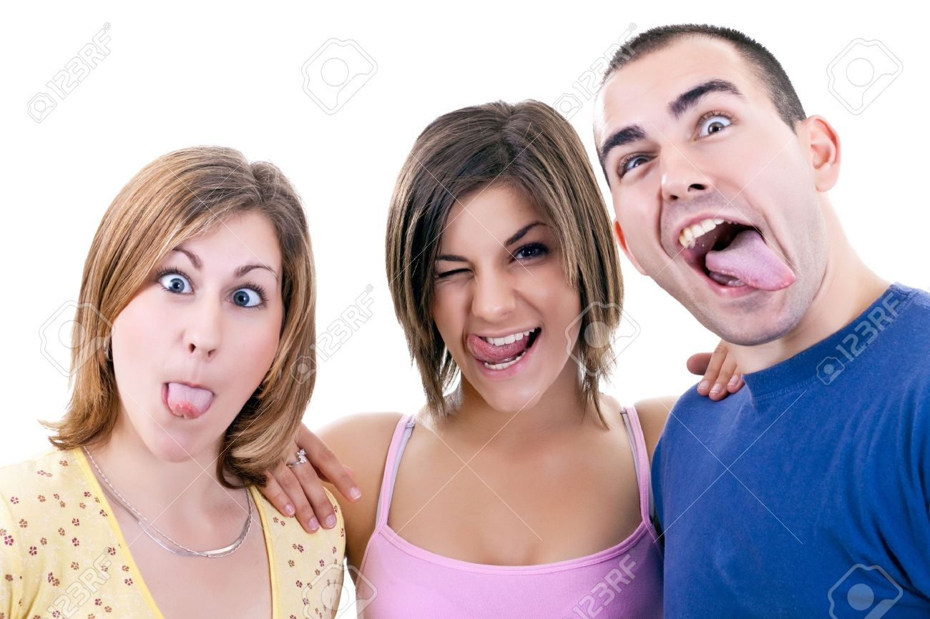

Slide 26
B) Rational choice model
Civic duty (D) (+): 'in a democracy it is the moral duty of every voter to vote', 'necessary to maintain democracy', 'failure to do so = guilt'
Instrumental Benefits (B) (+): I care who won the election, personal benefit of winning
Costs (C) (-): time to vote, how "hard" it is to vote (less successful)

Slide 27
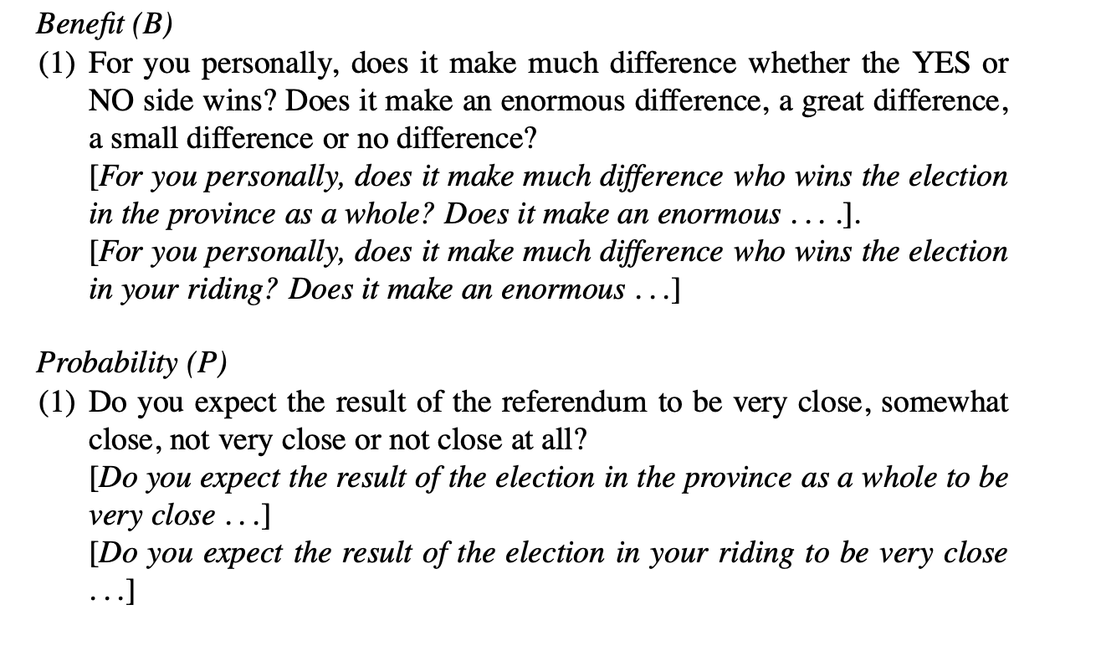
B) Rational choice model
Blais et al. (2000): The calculus of voting: An empirical test

Slide 28
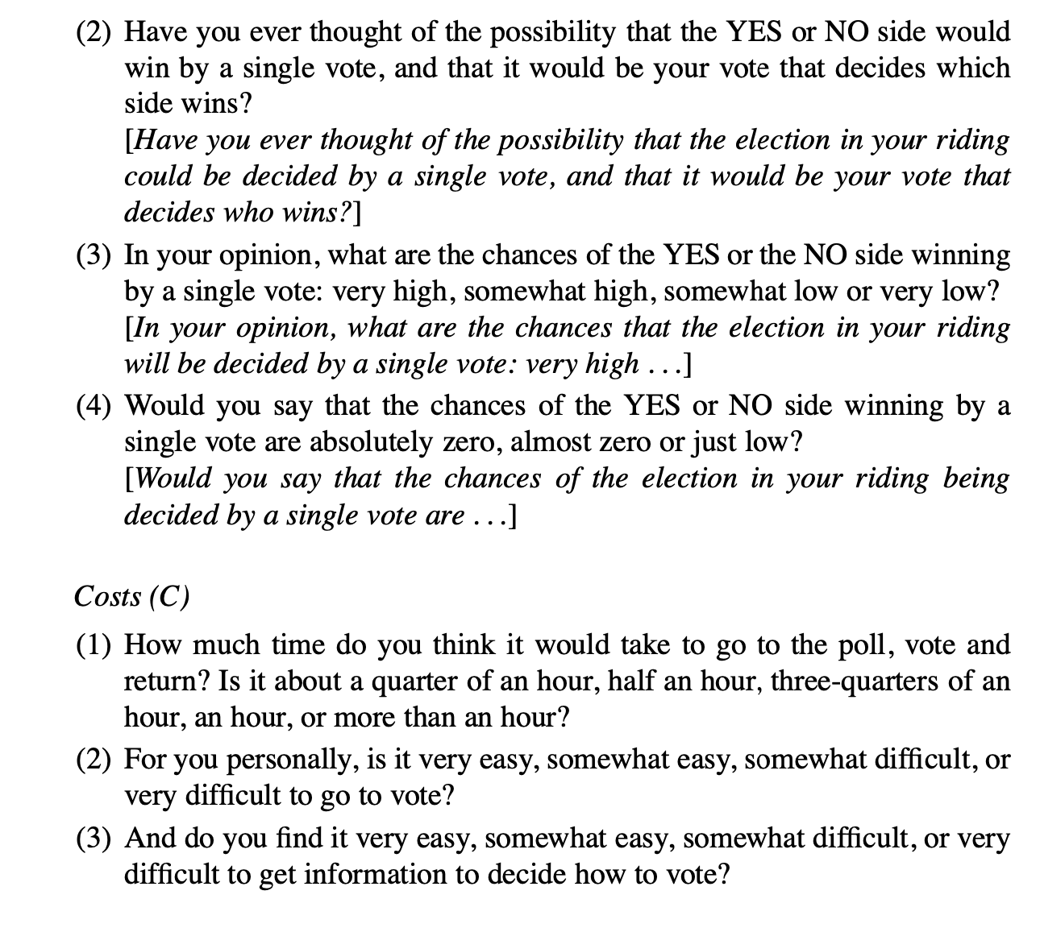
B) Rational choice model
Blais et al. (2000): The calculus of voting: An empirical test

Slide 29
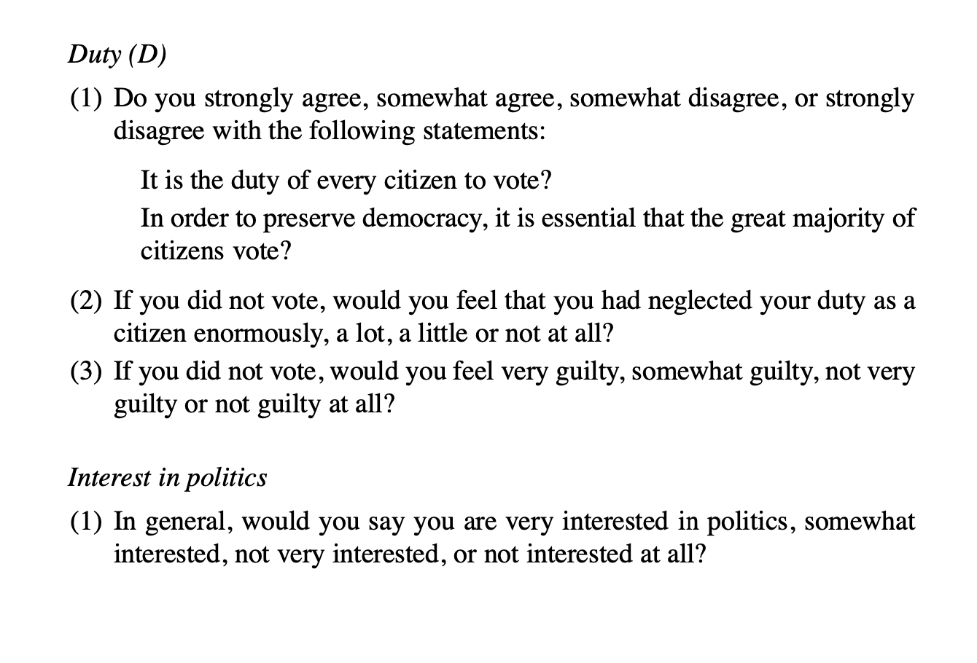
B) Rational choice model
Pr) Blais et al. (2000): The calculus of voting: An empirical test

Slide 30
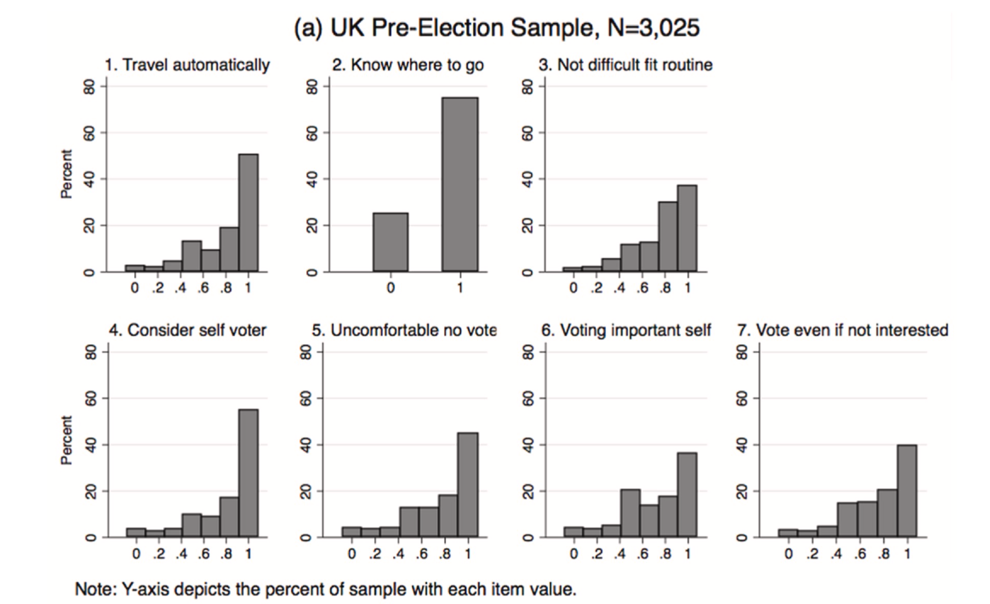
B) Rational choice model
Rozdíly spojené s věkem v rámci C -> dospělost -> výsledky -> sociální sítě -> kapacita pol.znalosti + skills -> náklady na zisk informací -> korelace s věkem
Rozšíření B) vysvětlení o behaviorální složku => volení je HABITUÁLNÍ = volení v prvých volbách usnadňuje volení v následujících volbách, čím je VÚ pravděpodobnější (více jak věk a vzdělání)
Důležité hlavně u mladých (prvovoliči) -> změna v chování je silnější -> snowball efekt na dlouhodobé politické chování (a opačně)
Source: Cravens 2020

Slide 31
B) Rational choice model
Age-related differences within C -> maturity -> outcomes -> social networks -> capacity for field knowledge + skills -> cost of information gain -> correlation with age
Extension of B) explanation to include behavioural component => voting is HABITUAL = voting in the first election makes it easier to vote in subsequent elections the more likely (more than age and education) to vote in subsequent elections (self-reinforcing effect)
Important especially for the young (first-time voters) -> behavioural change is stronger -> snowball effect on long-term political behaviour (and vice versa)

Slide 32


https://open.spotify.com/episode/2DSphgsZ7iXDXxycJRRwd4?si=034d4e2cf3d542f8
https://open.spotify.com/episode/1k7ofXS8KOle5Gj1Ov40Cj?si=9afe4de336ac4559

Slide 33


Slide 34
C) Mobilisation theories
Sometimes taken within the rational choice model
Political parties and organizations absorb part of the cost of participation (C) by providing information about parties, candidates, and political process so that C does not outweigh B
The burden of participation is on organizations that mobilize a rationally "deactivated" public

Slide 35
C) Mobilisation theories
Partisan + non-partisan mobilisation (GOTV) (+): usually stronger effect of partisan mobilisation
Media exposure (+):
-Political news leads to higher levels of political awareness
-Reading newspapers, TV, radio, a positive effect on GOTV (increase in the amount of content but per se does not increase GOTV)

Slide 36
C) Mobilisation theories
Green et al. 2013 - Field Experiments and the Study of Voter Turnout
Methods:
door to door => 2.54 p.p. increase.
phone calls => increase 0.16-1.94 p.p.
direct mail + leaflets left at the door => increase of 1 p.p.
non-personal techniques bring weaker effects
Arguments:
Social coercion, thank you notes, electoral closeness, civic duty...

Slide 37
D) Socialisation-psychological model
S
The formative period of life between childhood and adulthood is generally considered to be a crucial period for gaining a foundation of political attitudes and behaviour
The important role of parents, teachers, schools, media,...
Less successful: education of parents and SES; political debate

Slide 38
D) Socialisation-psychological model
P
Cognitive characteristics, usually successful
Interest in politics, political knowledge (+) => should act as resources, reduce C
Personal preferences associated with party identification, ideology (+) => intended to function as benefits (enjoyment of the act of voting)
Less successful: cognitive knowledge, trust in institutions, satisfaction with democracy, trust in others,...

Slide 39
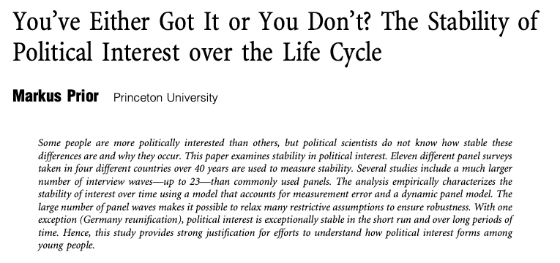
D) Socialisation-psychological model

Slide 40
2) Macro-level studies how to measure?

Slide 41
A) Institutional variables
Compulsory voting (+):
-Countries where citizens are legally obliged to vote have higher T
-”Only" half the effect in the case of non-application of a sanction or partial sanction (versus full sanctions)
Importance of elections (+):
-The more important the election (stronger the representative body), the stronger the incentive to participate

Slide 42
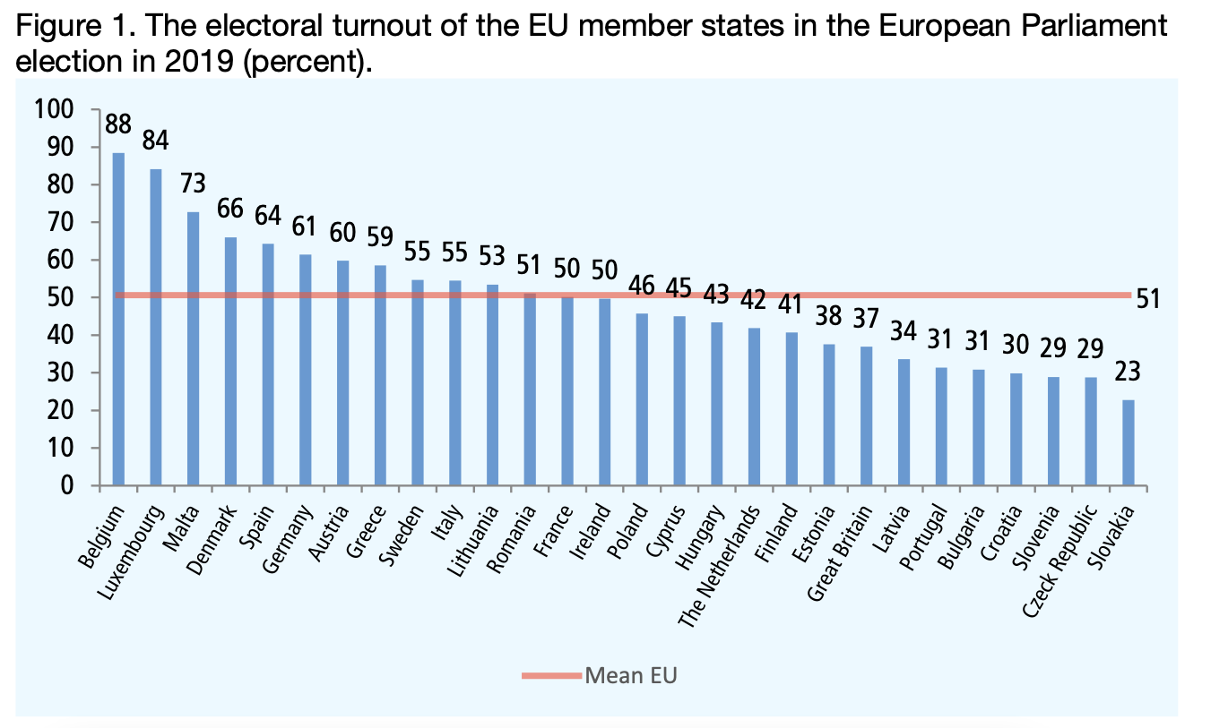

Slide 43
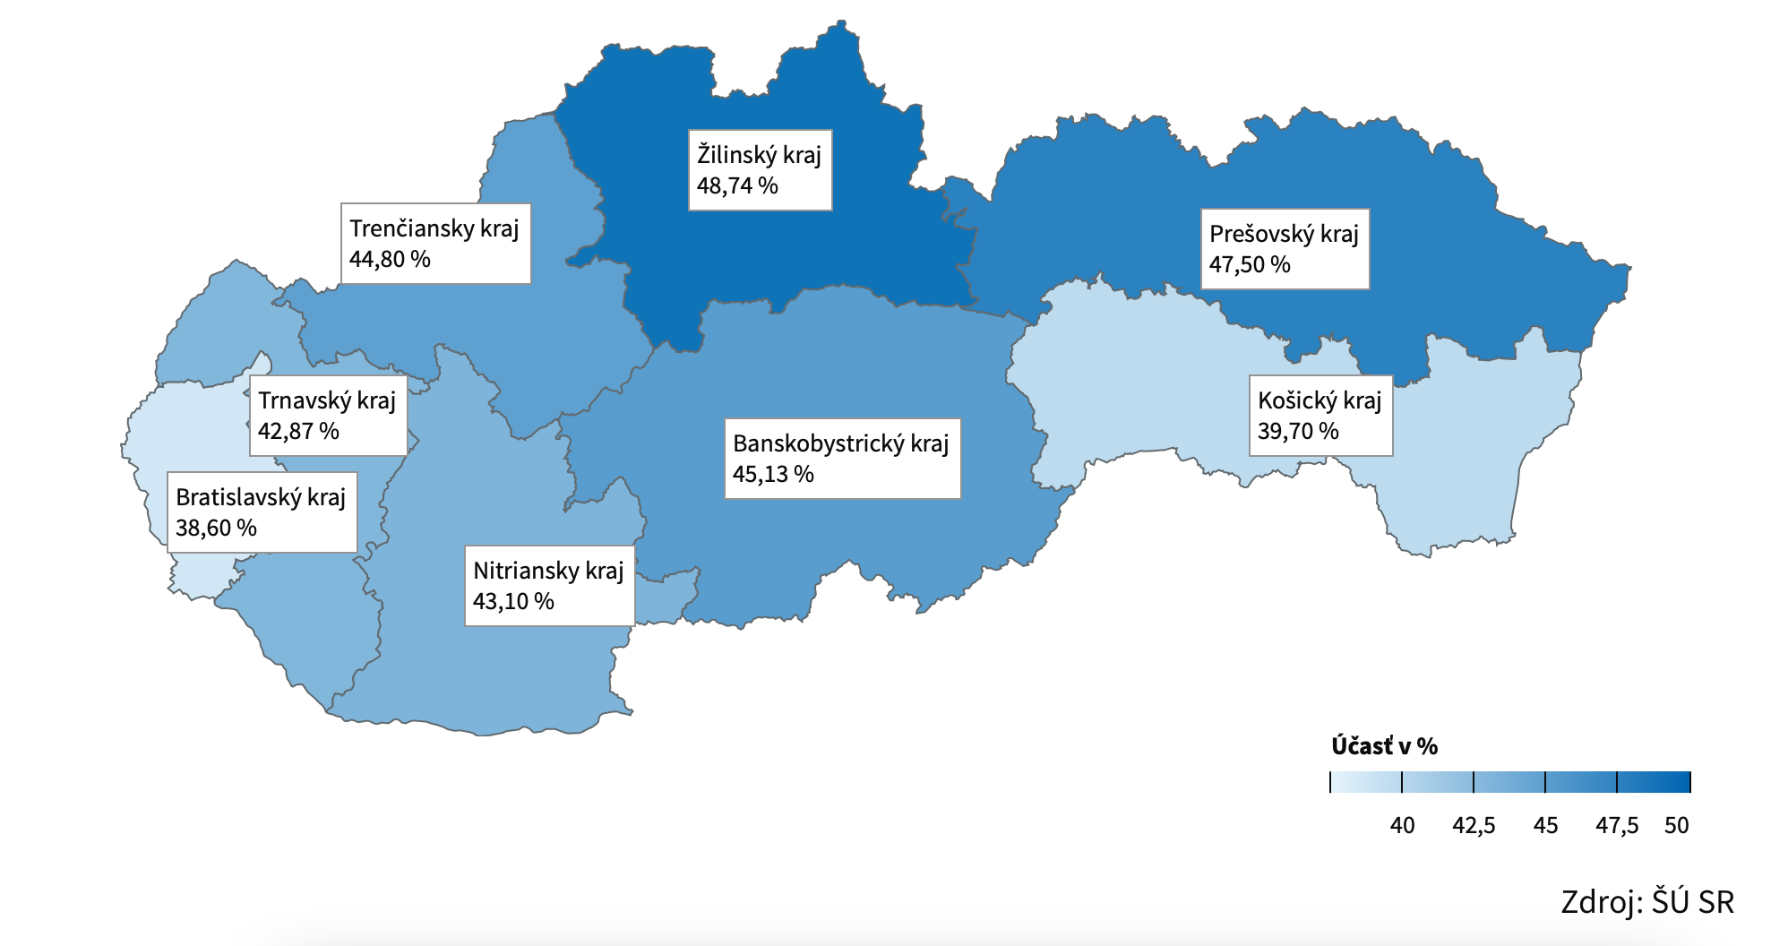
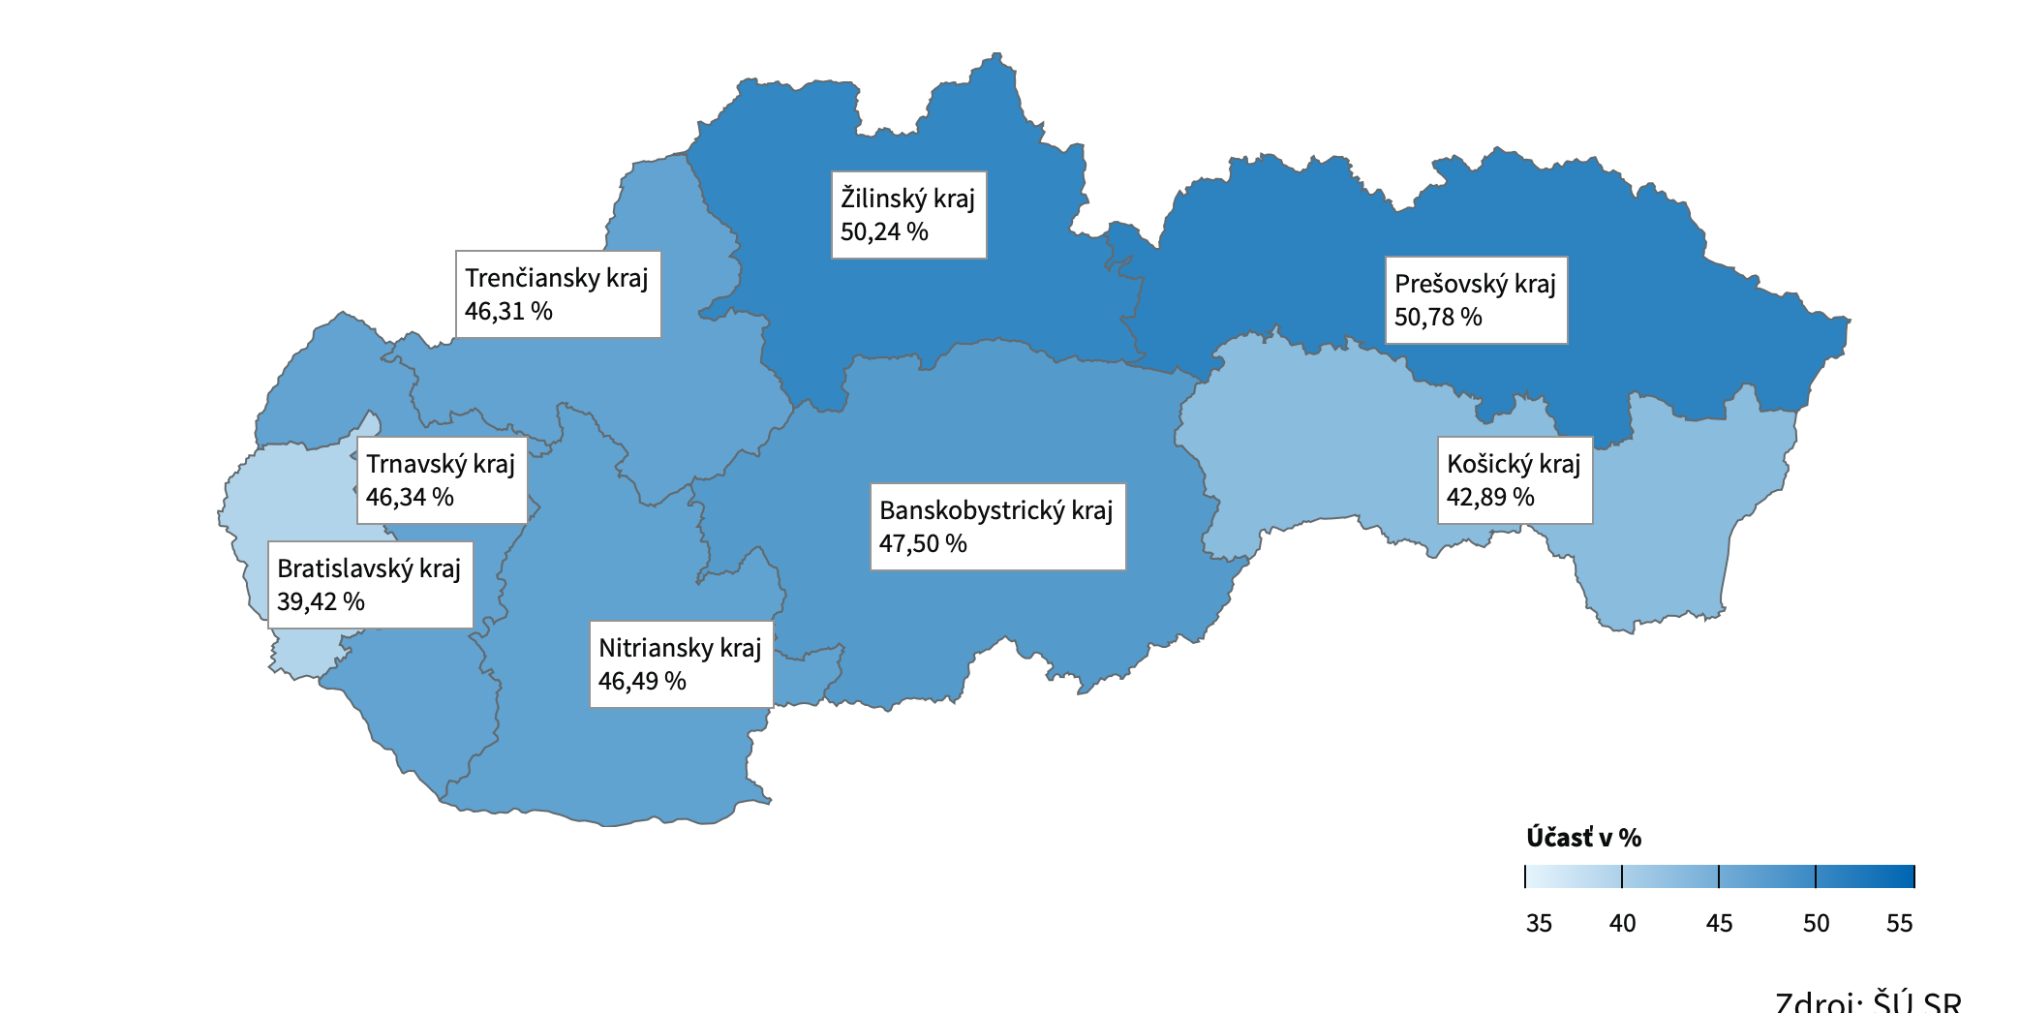

Slide 44
A) Institutional variables
Other:
Electoral system (PR+, FPTP-): argumentatively mastered BUT only a minority of cases (mainly by increasing the cases in non-Western EU countries)
Lowering the voting age (-): hard to measure (not many outside the 18 year mark)
Single chamber, voting on a free day, easier ways to vote: unclear conclusions
Notes:
Wasted votes vs. representation

Slide 45
B) Socio-economic variables
Population size (-): smaller countries have more homogeneous populations and closer relationships with each other and representatives (perhaps a sense of higher P?)
Other:
Economic development of country (+): long and short term, linked to age and education argument BUT unclear conclusions
Population density (-), corruption (-): few cases

Slide 46
C) Political and partisan variables
Closeness of elections (+):
- related to P in the rational model
- the smaller the gap between the two main candidates/parties, -> higher the chance that the citizen's vote will count => close elections attract media coverage and more party mobilization
Blais (2020) works vs. Stockemer (2017) doesn't

Slide 47
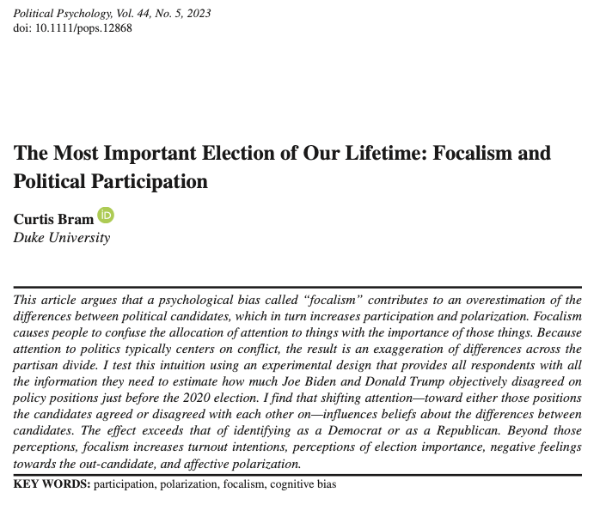
C) Political and partisan variables

Slide 48
C) Political and partisan variables
Less successful:
Number of parties (+): the more parties competing, the more choices voters have + better mobilization -> more likely to reflect their opinion vs. More parties means a more complicated system to understand (more info needed) + coalition governance

Slide 49
Conclusion
Motivation is key:
Do I like politics?
Do I have a duty to vote?
Do I care about the outcome?
Do I find it easy to vote?
(Blais and Daoust, 2020)
The research provided new predictors of VU (corruption, weather, ethnic fractionalization...) and better modelling techniques
Need to conduct research contextually (within regions, countries) and take contexts into account
Better comparisons are needed between different levels of analysis (local - regional - national) and between countries

Slide 50
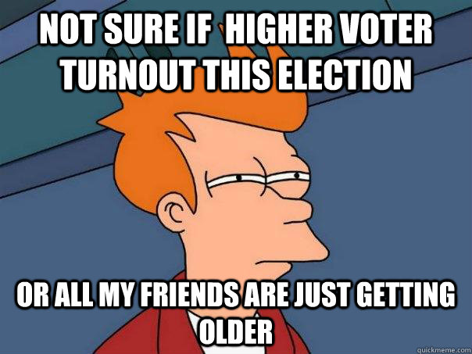

Slide 51
Literatute
Aldrich, J. H. (1993). Rational choice and turnout. American journal of political science, 246-278.
Blais, A. (2006). What affects voter turnout?. Annu. Rev. Polit. Sci., 9, 111-125.
Blais, A., Young, R., & Lapp, M. (2000). The calculus of voting: An empirical test. European Journal of Political Research, 37(2), 181-201.
Bram, C. (2023). The most important election of our lifetime: Focalism and political participation. Political Psychology, 44(5), 943-960.
Burns, N., Schlozman, K. L., & Verba, S. (2021). The private roots of public action. Harvard University Press.
Cancela, J., & Geys, B. (2016). Explaining voter turnout: A meta-analysis of national and subnational elections. Electoral Studies, 42, 264-275.
Cravens, M. D. (2020). Measuring the strength of voter turnout habits. Electoral Studies, 64, 102117.
Downs, A. (1957). An economic theory of democracy.
Fisher, J., Fieldhouse, E., Franklin, M. N., Gibson, R., Cantijoch, M., & Wlezien, C. (Eds.). (2018). The Routledge handbook of elections, voting behavior and public opinion (pp. 280-292). London: Routledge.
Geys, B. (2006). Explaining voter turnout: A review of aggregate-level research. Electoral studies, 25(4), 637-663.
Gomez, B. T., Hansford, T. G., & Krause, G. A. (2007). The Republicans should pray for rain: Weather, turnout, and voting in US presidential elections. The Journal of Politics, 69(3), 649-663.
Green, D. P., McGrath, M. C., & Aronow, P. M. (2013). Field experiments and the study of voter turnout. Journal of Elections, Public Opinion and Parties, 23(1), 27-48.
Lijphart, A. (1997). Unequal participation: Democracy's unresolved dilemma presidential address, American Political Science Association, 1996. American political science review, 91(1), 1-14.
Panagopoulos, C. (2008). The calculus of voting in compulsory voting systems. Political Behavior, 30, 455-467.
Powell, G. B. (1982). Contemporary democracies. Harvard University Press.
Riker, W. H., & Ordeshook, P. C. (1968). A Theory of the Calculus of Voting. American political science review, 62(1), 25-42.
Rosema, M. (2007). Low turnout: Threat to democracy or blessing in disguise? Consequences of citizens' varying tendencies to vote. Electoral Studies, 26(3), 612-623.
Smets, K., & Van Ham, C. (2013). The embarrassment of riches? A meta-analysis of individual-level research on voter turnout. Electoral studies, 32(2), 344-359.
Stockemer, D. (2017). What affects voter turnout? A review article/meta-analysis of aggregate research. Government and Opposition, 52(4), 698-722.
Stockemer, D., & Wigginton, M. (2018). Fair weather voters: do Canadians stay at home when the weather is bad?. International journal of biometeorology, 62(6), 1027-1037.

