Slide 2
Who is undecided, and who abstains? Determinants of turnout Part II
Jakub Jusko

Slide 3
Undecided voters

Slide 4
Undecideds (late-deciders, floating voters)
Increase in the proportion of voters who postpone their voting decision into the latter stages of a campaign (western democracies, last decades)
The role of the campaign
The need for identification of a target group
Possibility of surprise outcomes
-In foreign research, the share of voters who made last-minute decisions ranged from 10 to 25 %, depending on the type and location of the election (cf. Gopoian and Hadjiharalambous 1994; Hayes and McAllister 1996; Brox and Giammo 2009)
-Slovakia 15% the day of elections (2016)

Slide 5
Factors
Sociodemographic (age, gender)
Partisanship
Cross-pressures (ambivalence)
Political sophistication
Strategic considerations
(Political disaffection)
Contextual factors

Slide 6
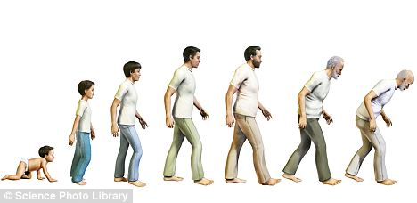
Sociodemographic
Possible consequence of the political socialization process

Slide 7
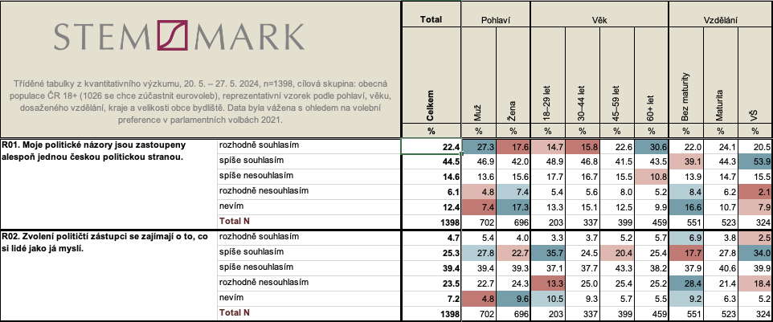
Sociodemographic

Slide 8
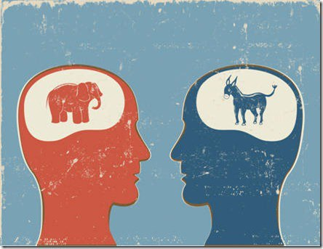
Partisanship

Slide 9
Cross-pressures
A conflict (inconsistencies) between opposite pressures in the voter’s environment => US context
Socioeconomic status (work, family, religion) + issue attitudes vs. valence
Internal ambivalence -> ‘individual’s endorsement of competing considerations relevant to evaluating an attitude object’ (Lavine, 2001).
External ambivalence -> either “cross-cutting social network” or “network ambivalence”
Notes:
Lazarsfeld et al. (1968)
Campbell et al. (1960)

Slide 10
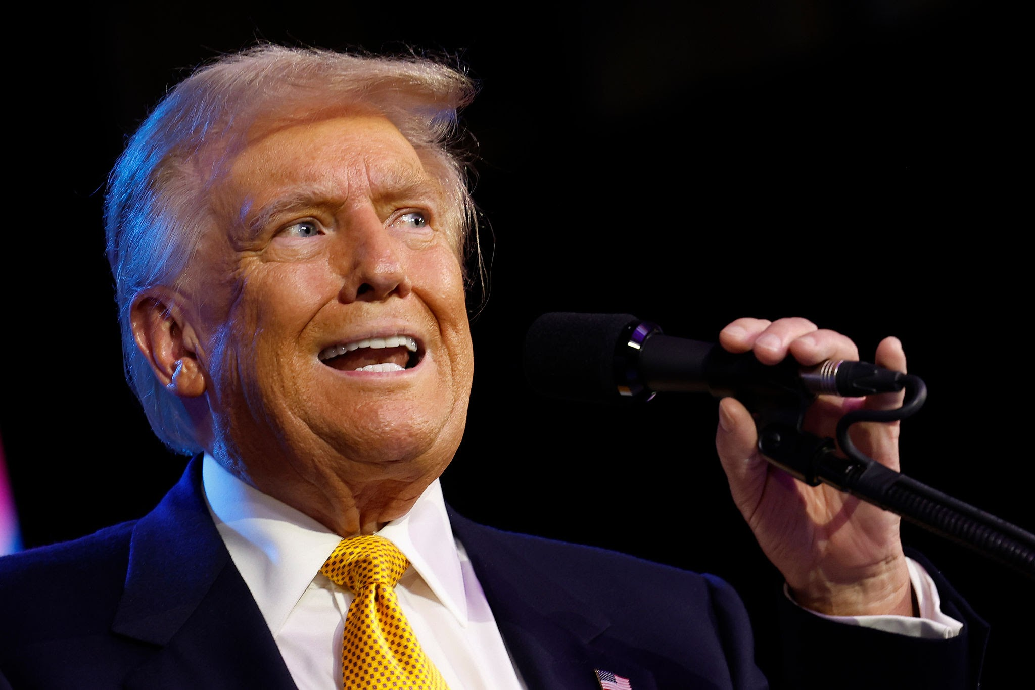
Cross-pressures
Notes:
Lazarsfeld et al. (1968)
Campbell et al. (1960)

Slide 11
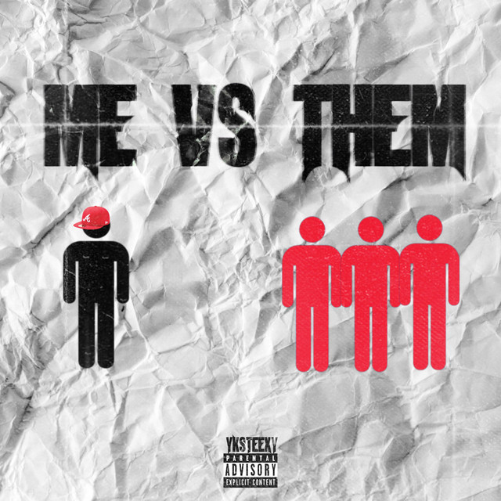
Cross-pressures
Notes:
Lazarsfeld et al. (1968)
Campbell et al. (1960)

Slide 12
Cross-pressures
A conflict (inconsistencies) between opposite pressures in the voter’s environment => US context
Socioeconomic status (work, family, religion) + issue attitudes vs. valence
Internal ambivalence -> ‘individual’s endorsement of competing considerations relevant to evaluating an attitude object’ (Lavine, 2001).
External ambivalence -> either “cross-cutting social network” or “network ambivalence”
Notes:
Lazarsfeld et al. (1968)
Campbell et al. (1960)

Slide 13
Political sophistication
Yarchi et al. (2021): Israel
Politically sophisticated undecideds
vs.
Less politically sophisticated undecideds
Difference:
more privileged social background (education, income)
greater trust in traditional media
consumes more news to follow the campaign
more likely to carry out online discussions
more likely to base his or her decision on policy issues
more likely to debate between parties within the same ideological camp (internal floater)
more likely to vote
Proportion around 4.5 vs. 16 %
Notes:
Optimistic view – Dalton (1984) -> cognitive mobilisation: abilities + mass media
Pessimistic view – Lazarsfeld et al. (1968)

Slide 14
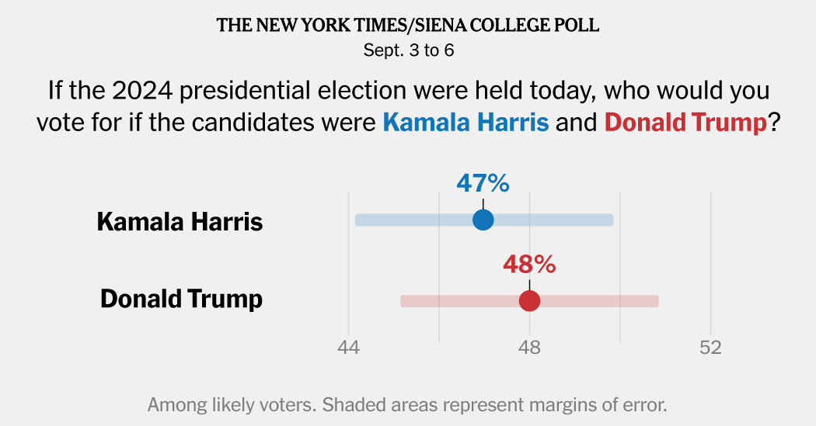
Strategic considerations

Slide 15
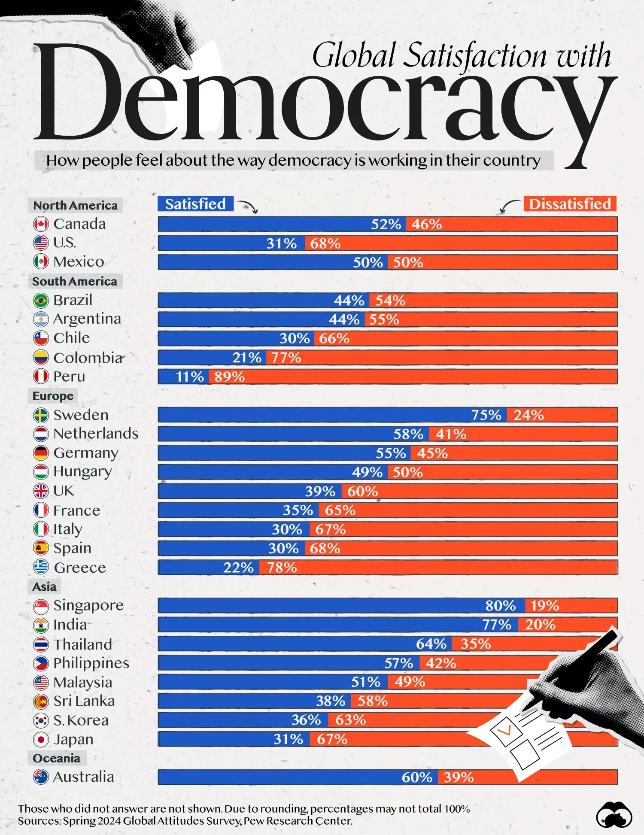
Political disaffection

Slide 16
Examples
Sociodemographic (age, gender): Germany 2017
Partisanship: United Kingdom 2019 (Conservatives)
Cross-pressures (ambivalence): Brazil 2018 (Jair Bolsonaro)
Political sophistication: India 2019
Strategic considerations: Canada 2019 (Liberal Party)
(Political disaffection): Spain 2015 (Podemos)
*party or candidate mentioned benefited from undecidedness

Slide 17
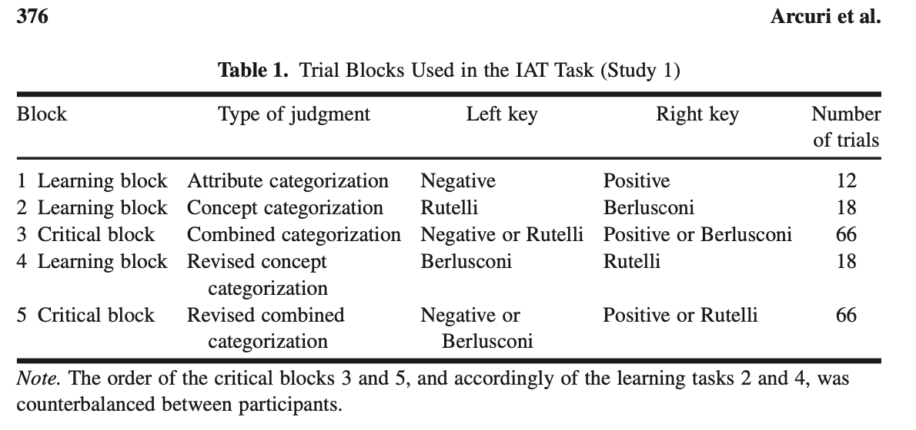
Contextual factors
Long-standing stability?
Type of office at stake, the number of candidates/parties
Importance (first-order vs. second-order?)
Competitiveness of the contest?
Implicit attitudes?

Slide 18
Also…
Less predictable in the last moments (Box-Steffensmeier et al. 2015)
Less likely to detect disinformation (Samuel-Azran 2022)
Less likely to consume media
Intense campaigning matters (Henderson and Hillygus, 2016)
Division into three groups…

Slide 19
Abstainers

Slide 20
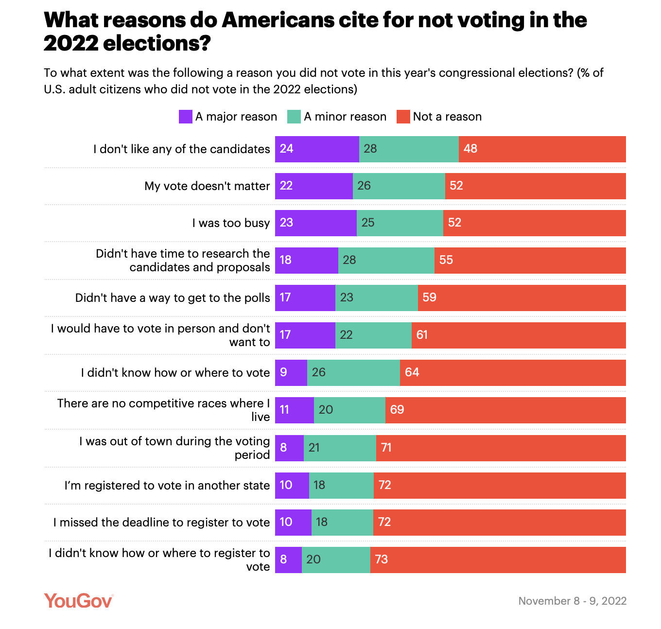
Source: YouGov

Slide 21
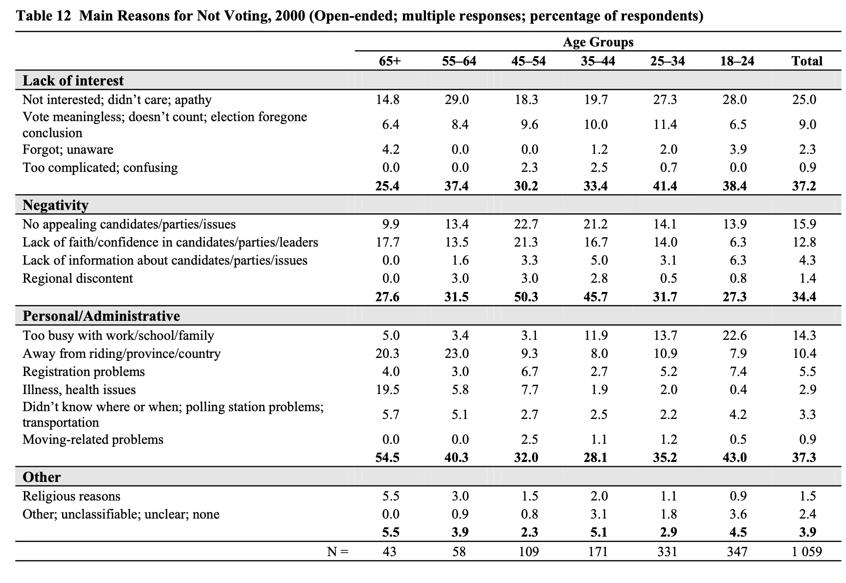
Abstainers

Slide 22
Relevance of abstention
Two assumptions about abstainers:
Abstention affects all alternatives in equal measure
The voter’s preferred alternative will be less likely to win if that voter abstains
Peripheral + core voters
No-Show Paradox (Fishburn and Brams, 1983)

Slide 23
Short-term reasons vs. global decline
Two arguments for why recent generations are less prone to vote:
Context school - the result of certain characteristics of elections that particularly affect new voters (less competition, lowering the voting age…) -> P+habit
Generation school – larger cultural value change in generations (less interest, priorities, voting not perceived as a duty)
Blais and Rubenson (2013) – support for generation school -> young generation less inclined to vote because they are less prone to construct voting as a moral duty and are more sceptical about politicians’
responsiveness to their concerns
“People like me don’t have any say about what the government does”
“I don’t think public officials care much what people like me think.”

Slide 24
Abstainers vs. other groups
1) Abstainers vs. party switchers
common: political dissatisfaction (general OR with a party they voted for)
2) Abstainers vs. populist voters (Germany – Koch et al. 2023)
common: (dis)satisfaction with democracy + rejection of mainstream politics
different: expectations about democracy (as best system + tool), political trust, quality of political information
3) Abstainers vs. right-wing voters
different: lower in measures of social integration (union membership, self-reported social activity and interpersonal trust)

Slide 25
Satisfaction with the decision

Slide 26
Conclusion
Key Points:
Importance of understanding the behaviour of undecided voters and abstainers in shaping election outcomes.
Undecided voters are influenced by multiple factors, from sociodemographic elements to implicit biases.
The need for distinguishing between more and less-sophisticated undecideds
Abstention weakens the democratic process, but there are solutions to address it.

Slide 27
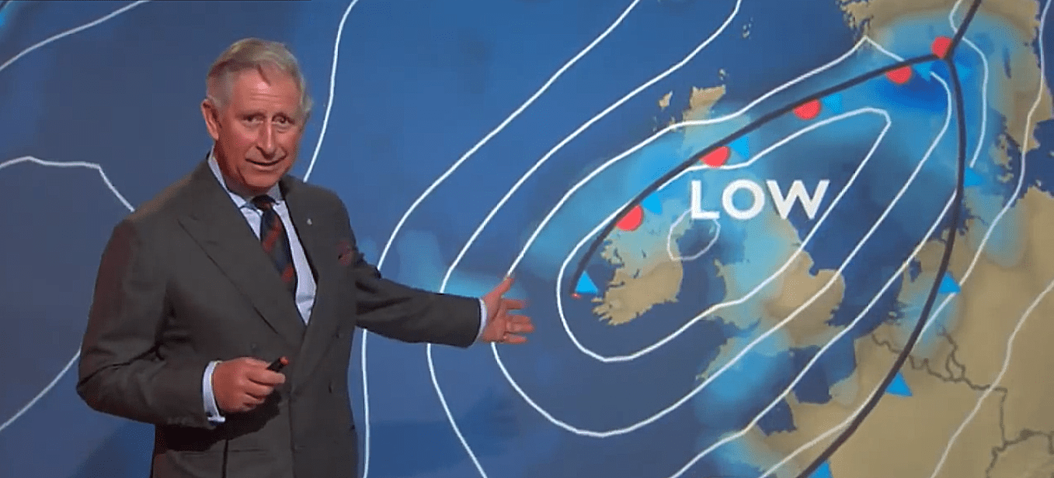
Next…

Slide 28
Literatute
Allen, T. J. (2017). Exit to the right? Comparing far right voters and abstainers in Western Europe. Electoral Studies, 50, 103-115.
Arcuri, L., Castelli, L., Galdi, S., Zogmaister, C., & Amadori, A. (2008). Predicting the vote: Implicit attitudes as predictors of the future behavior of decided and undecided voters. Political Psychology, 29(3), 369-387.
Blais, A., Feitosa, F., & Sevi, S. (2019). Was my decision to vote (or abstain) the right one?. Party Politics, 25(3), 382-389.
Blais, A., & Rubenson, D. (2013). The source of turnout decline: New values or new contexts?. Comparative Political Studies, 46(1), 95-117.
Box-Steffensmeier, J., Dillard, M., Kimball, D., & Massengill, W. (2015). The long and short of it: The unpredictability of late deciding voters. Electoral Studies, 39, 181-194.
Brox, B., & Giammo, J. (2009). Late deciders in US presidential elections. American Review of Politics, 30, 333-355.
Dassonneville, R., Blais, A., & Dejaeghere, Y. (2015). Staying with the party, switching or exiting? A comparative analysis of determinants of party switching and abstaining. Journal of Elections, Public Opinion and Parties, 25(3), 387-405.
https://www.elections.ca/content.aspx?section=res&dir=rec/eval/pes2021/rnv&document=index&lang=e
Gopoian, J. D., & Hadjiharalambous, S. (1994). Late-deciding voters in presidential elections. Political Behavior, 16, 55-78.
Henderson, M., & Hillygus, D. S. (2016). Changing the clock: the role of campaigns in the timing of vote decision. Public Opinion Quarterly, 80(3), 761-770.
Koch, C. M., Meléndez, C., & Rovira Kaltwasser, C. (2023). Mainstream voters, non-voters and populist voters: what sets them apart?. Political Studies, 71(3), 893-913.
Pammett, J. H., & LeDuc, L. (2003). Explaining the turnout decline in Canadian federal elections: A new survey of non-voters (p. 21). Ottawa: Elections Canada.
Samuel-Azran, T., Yarchi, M., & Hayat, T. (2022). Less critical and less informed: Undecided voters’ media (dis) engagement during Israel’s April 2019 elections. Information, Communication & Society, 25(12), 1752-1768.
Schill, D., & Kirk, R. (2017). Angry, passionate, and divided: Undecided voters and the 2016 presidential election. American Behavioral Scientist, 61(9), 1056-1076.
Stockemer, D., & Blais, A. (2019). Voters and abstainers in national and European elections. European Review, 27(2), 300-315.
Van Kessel, S., Sajuria, J., & Van Hauwaert, S. M. (2020). Informed, uninformed or misinformed? A cross-national analysis of populist party supporters across European democracies. West European Politics, 44(3), 585-610.
Willocq, S. (2019). Explaining time of vote decision: The socio-structural, attitudinal, and contextual determinants of late deciding. Political Studies Review, 17(1), 53-64.
Yarchi, M., Wolfsfeld, G., & Samuel-Azran, T. (2021). Not all undecided voters are alike: Evidence from an Israeli election. Government Information Quarterly, 38(4), 101598.

