Slide 1
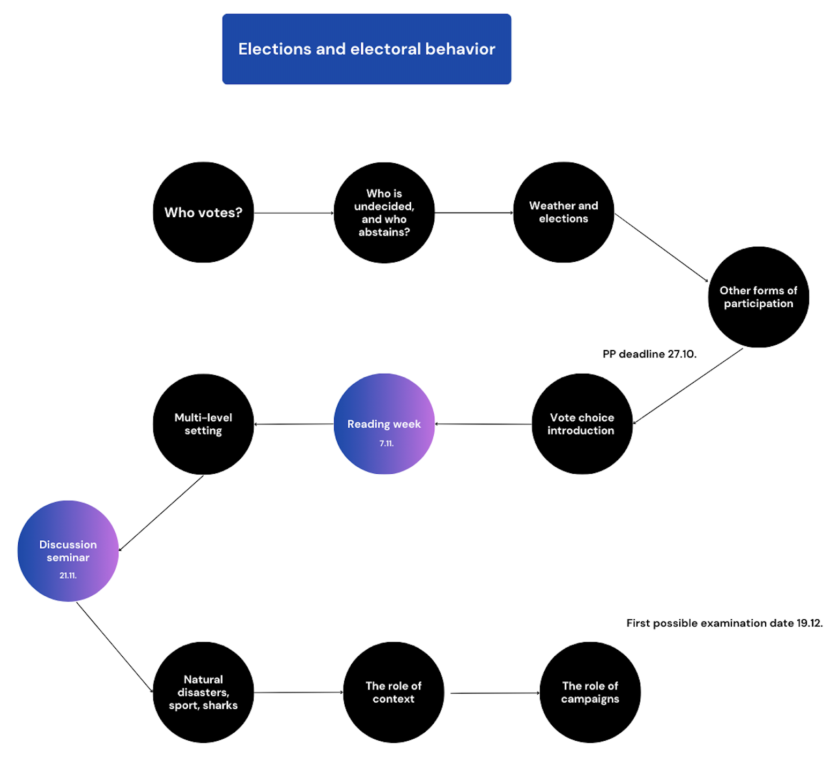

Slide 2
Weather and elections
Jakub Jusko

Slide 3
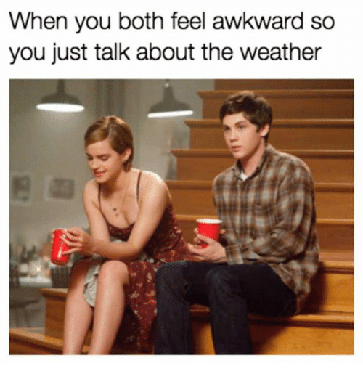

Slide 4
Weather and people
Reflections on the influence of the weather since Hippocrates, Montesquieu
The relation of climate and personality, intelligence, fertility, tone of voice,...
Weather and human behaviour:
Mood
Cognitive style of thinking
Aggression, criminality
Shopping (umbrellas, stock market)
Selfless help
Evaluation of the other sex

Slide 5
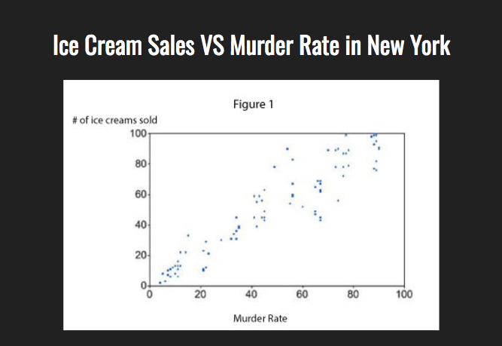
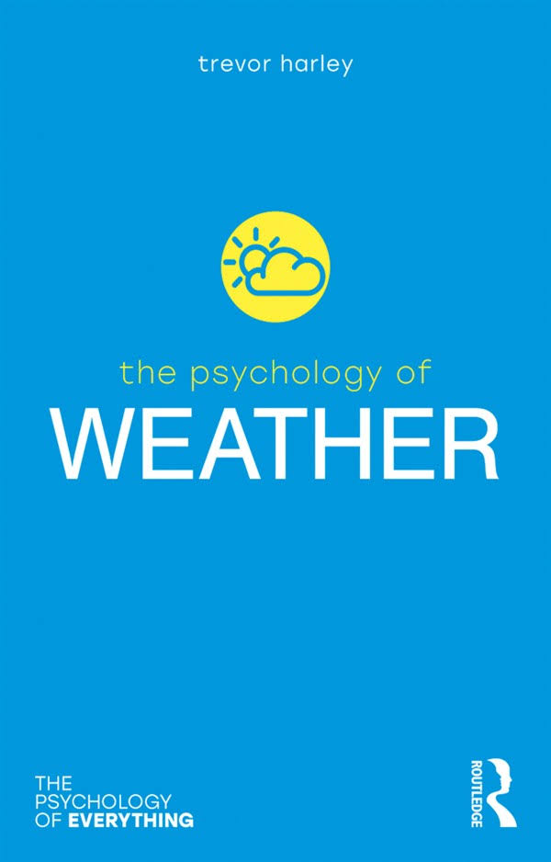

Slide 6
Weather and politics
Protests (demonstrations in Denmark, Tea Party movement in the USA)
Door-to-door campaigns
Abstention in the US Congress
Referenda (Switzerland, UK)
Participation in elections:
-One of the "hot issues" of political research
-High turnout as a sign of certain satisfaction with the democratic system
-Different influences: micro-level, macro-level

Slide 7
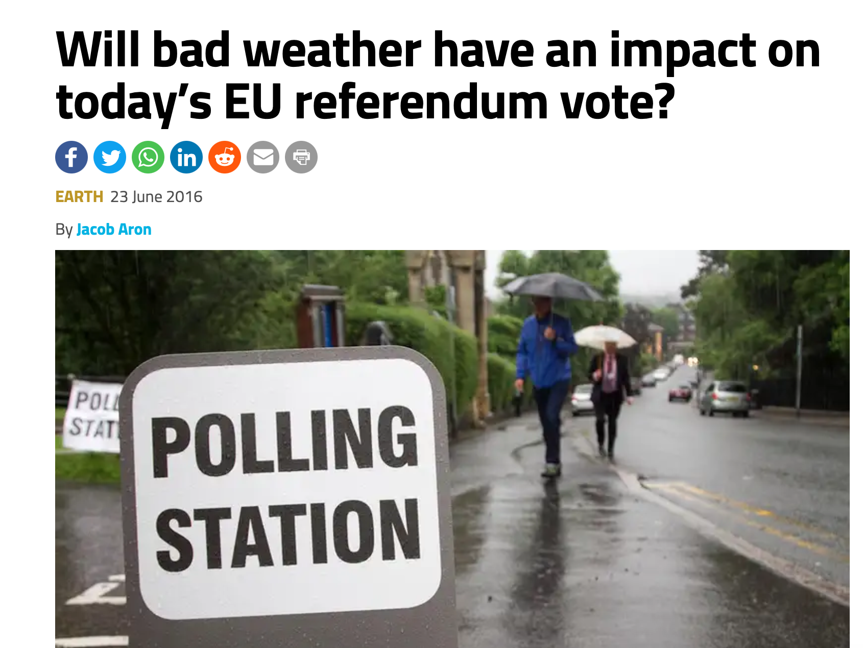
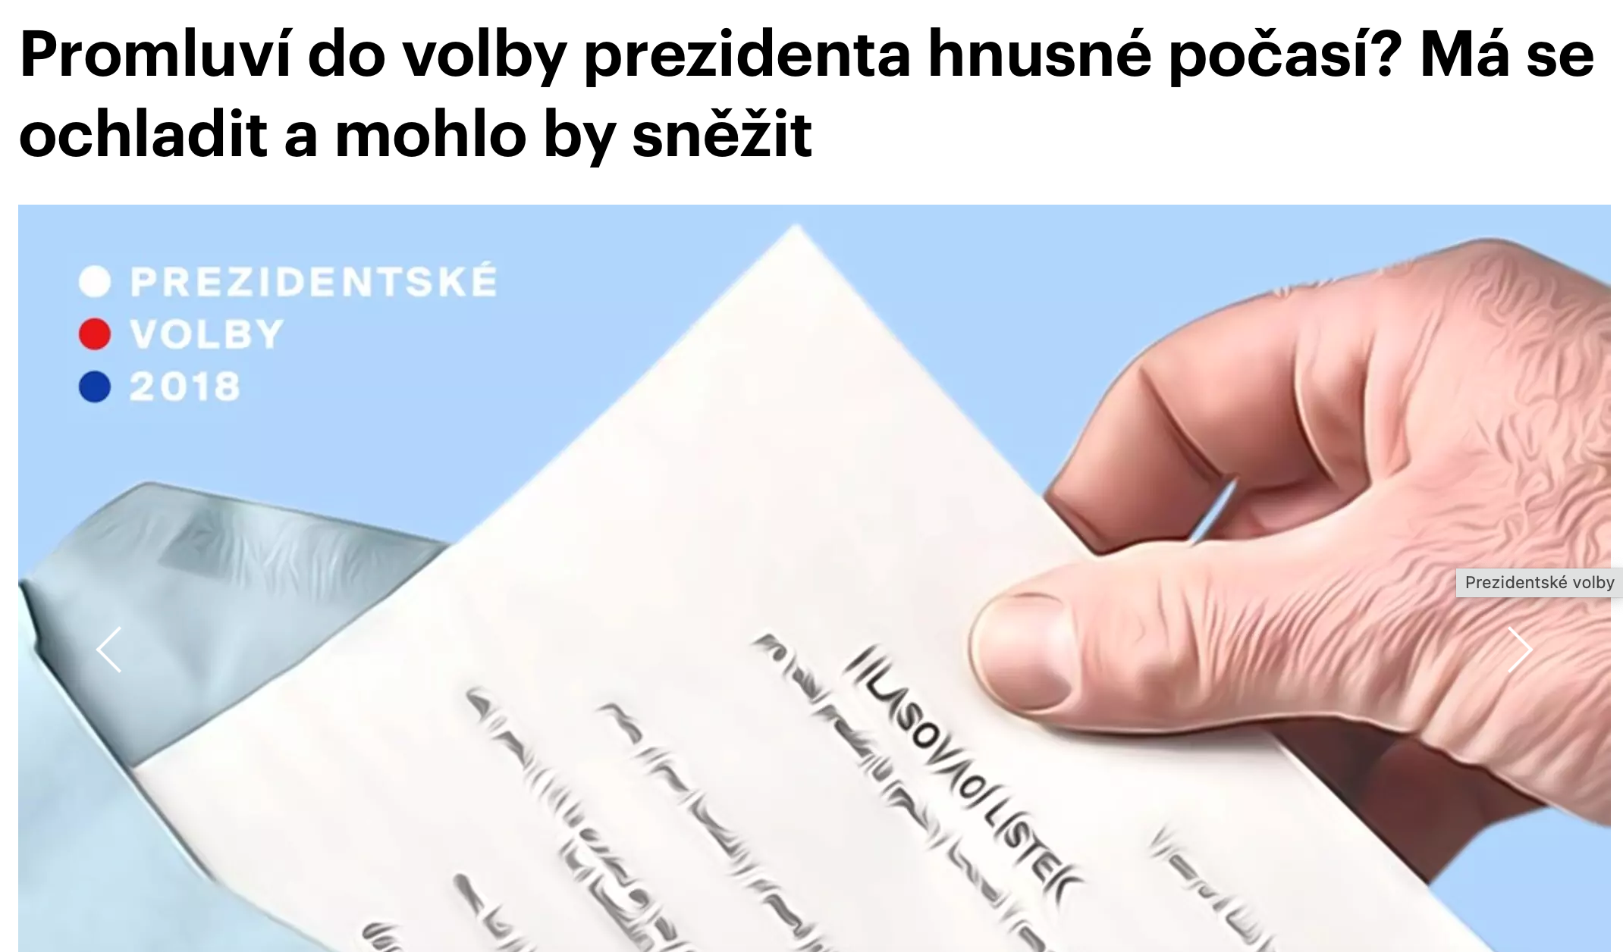
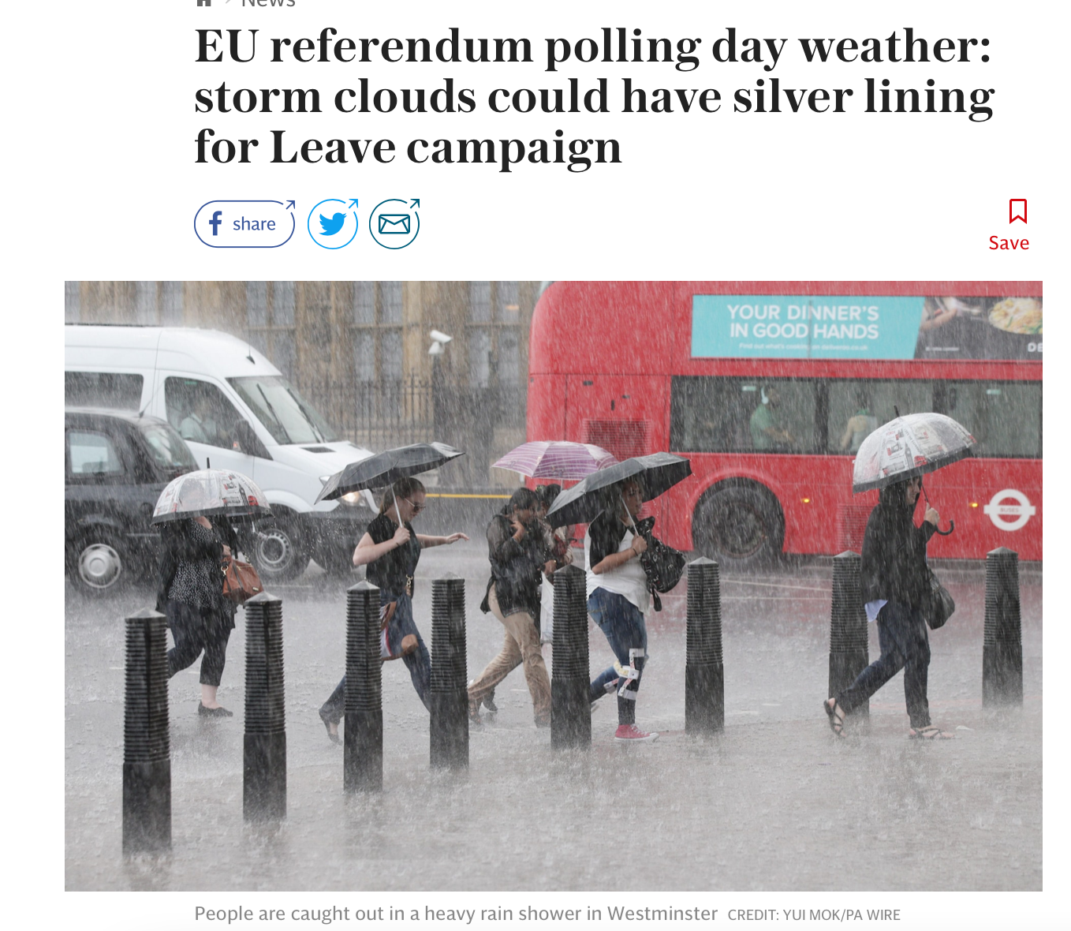
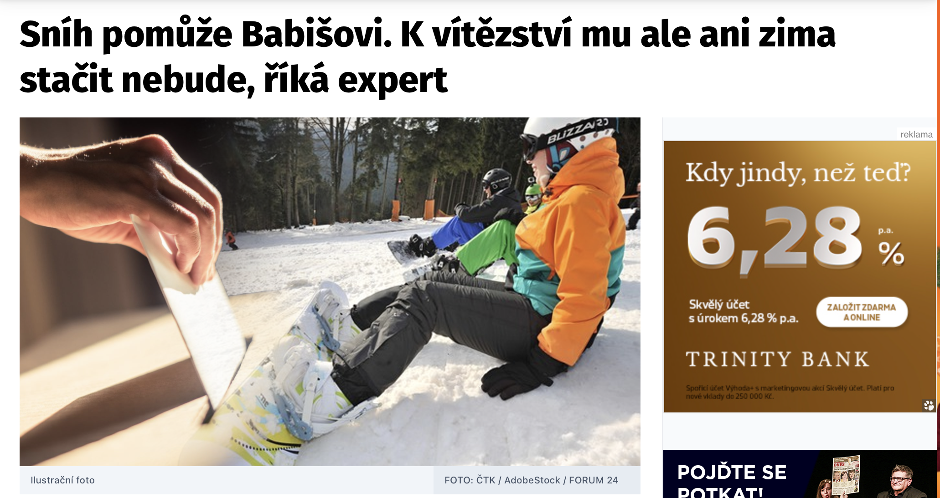

Slide 8
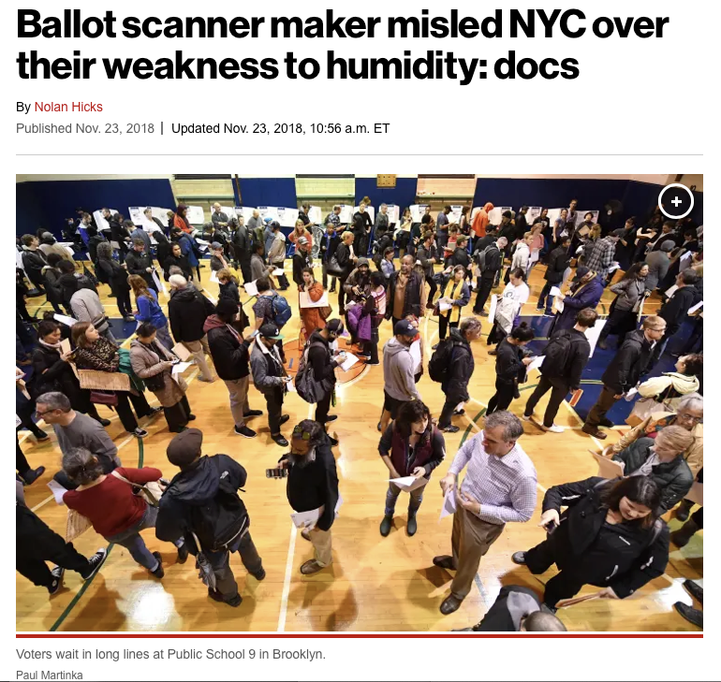

Slide 9
Rational choice theory
Downs (1957), Riker and Ordeshook (1968)
Individual action as a means to a goal
The citizen calculates the benefits and costs associated with the choice
R = PB - C
A voter should vote when PB > C
Modified version: R = PB - C + D

Slide 10
Rational choice theory
The cost of voting:
- Need to register before the election
- Travel from residence to polling place
- Time to make a decision
- Time spent travelling
- Weather (mood, getting dressed, unpleasant journey, risk of injury)
When benefits and costs are roughly equal, even a small change on election day (e.g. weather) can persuade voters

Slide 11
Rational choice theory
Weather "decomposed" into variables - mainly rain, snow, temperature, solar radiation
Prevailing evidence:
Rainfall -> Voter turnout
USA, Canada, Netherlands, Spain, Germany, (exception e.g. Sweden, Norway)
Turnout reduced from 0.033 to 0.12 pp. per 1 mm of precipitation
Different scenarios that are important

Slide 12
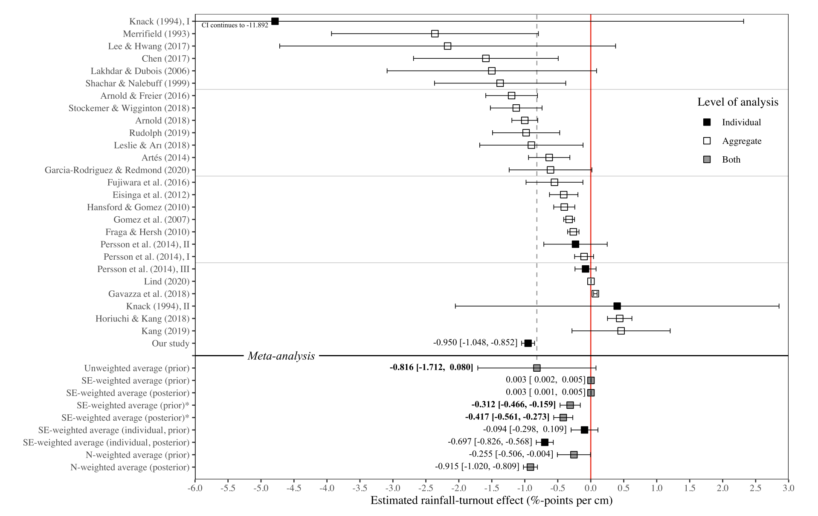
Damsbo-Svendsen and Hansen (2023)

Slide 13
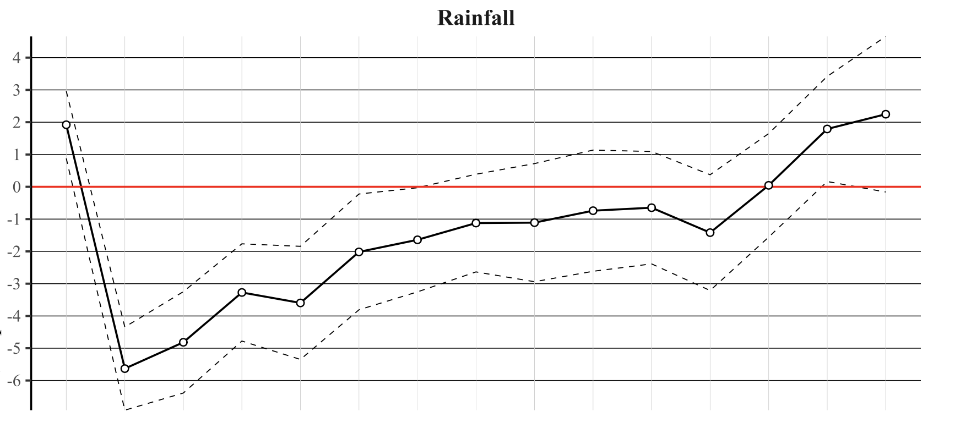
Damsbo-Svendsen and Hansen (2023)

Slide 14
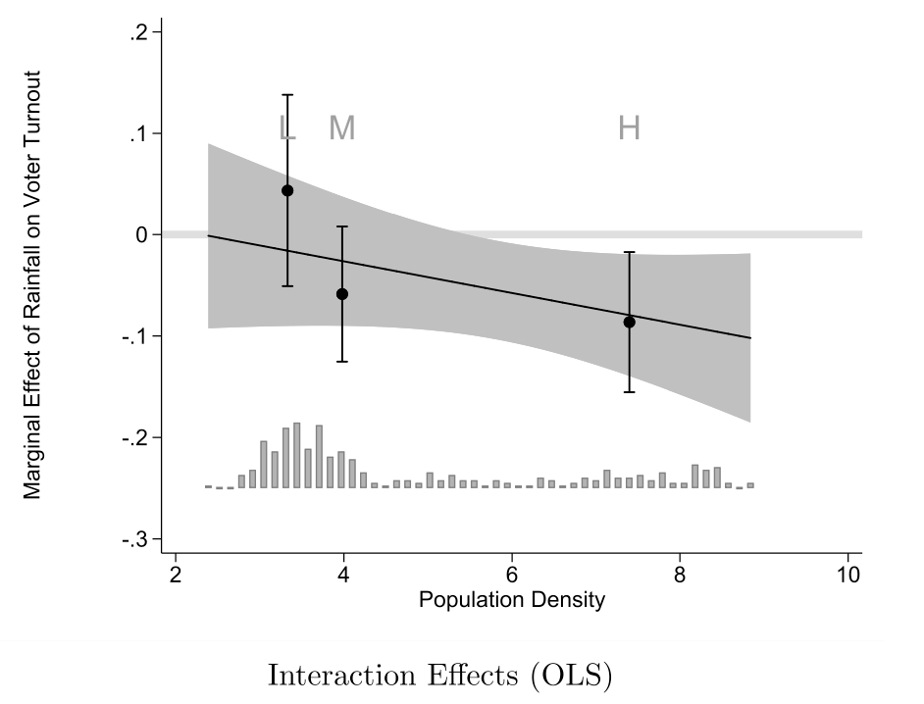
Abian Garcia-Rodriguez and Paul Redmond (2020)

Slide 15
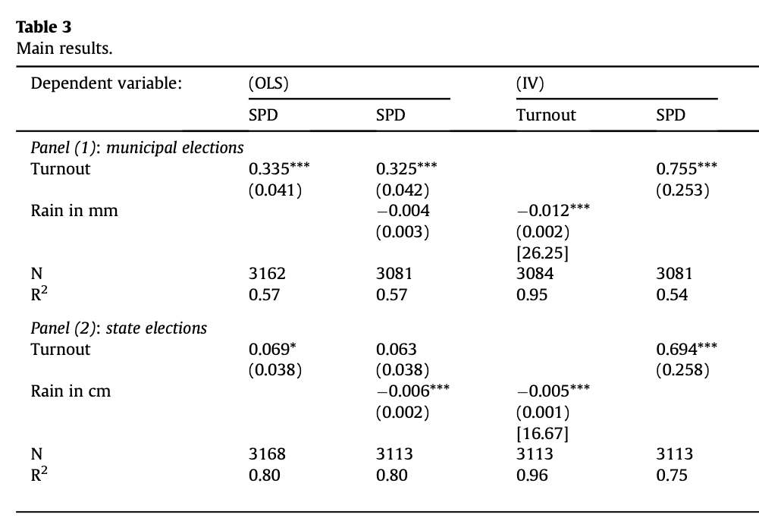
Arnold and Freier (2016)

Slide 16
Rational choice theory
Prevailing evidence:
Average temperature -> Voter turnout
Canada, Netherlands, France
Turnout increased from 0.05 to 0.44 pp. per 1 °C of temperature

Slide 17
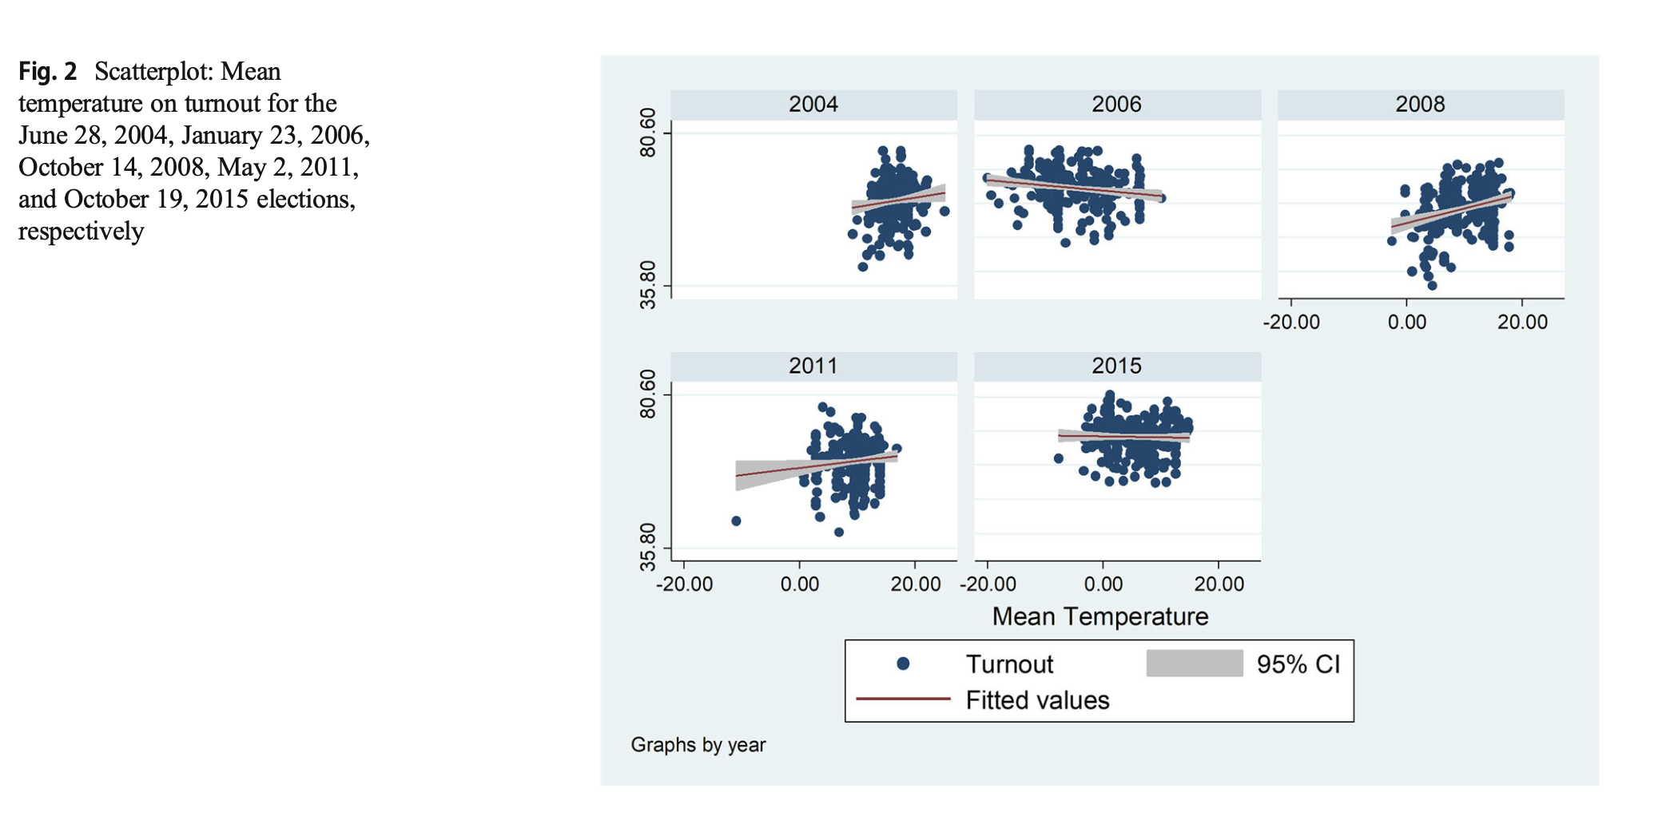
Stockemer and Wigginton (2018): Canada

Slide 18
Rational choice theory
Prevailing evidence:
Sunlight -> Voter turnout
Netherlands, Denmark
A change from the lowest to the highest recorded level of sunshine (6.2–42.8 W/m2) increases the probability of voting by 1.55 percentage points (Denmark)

Slide 19
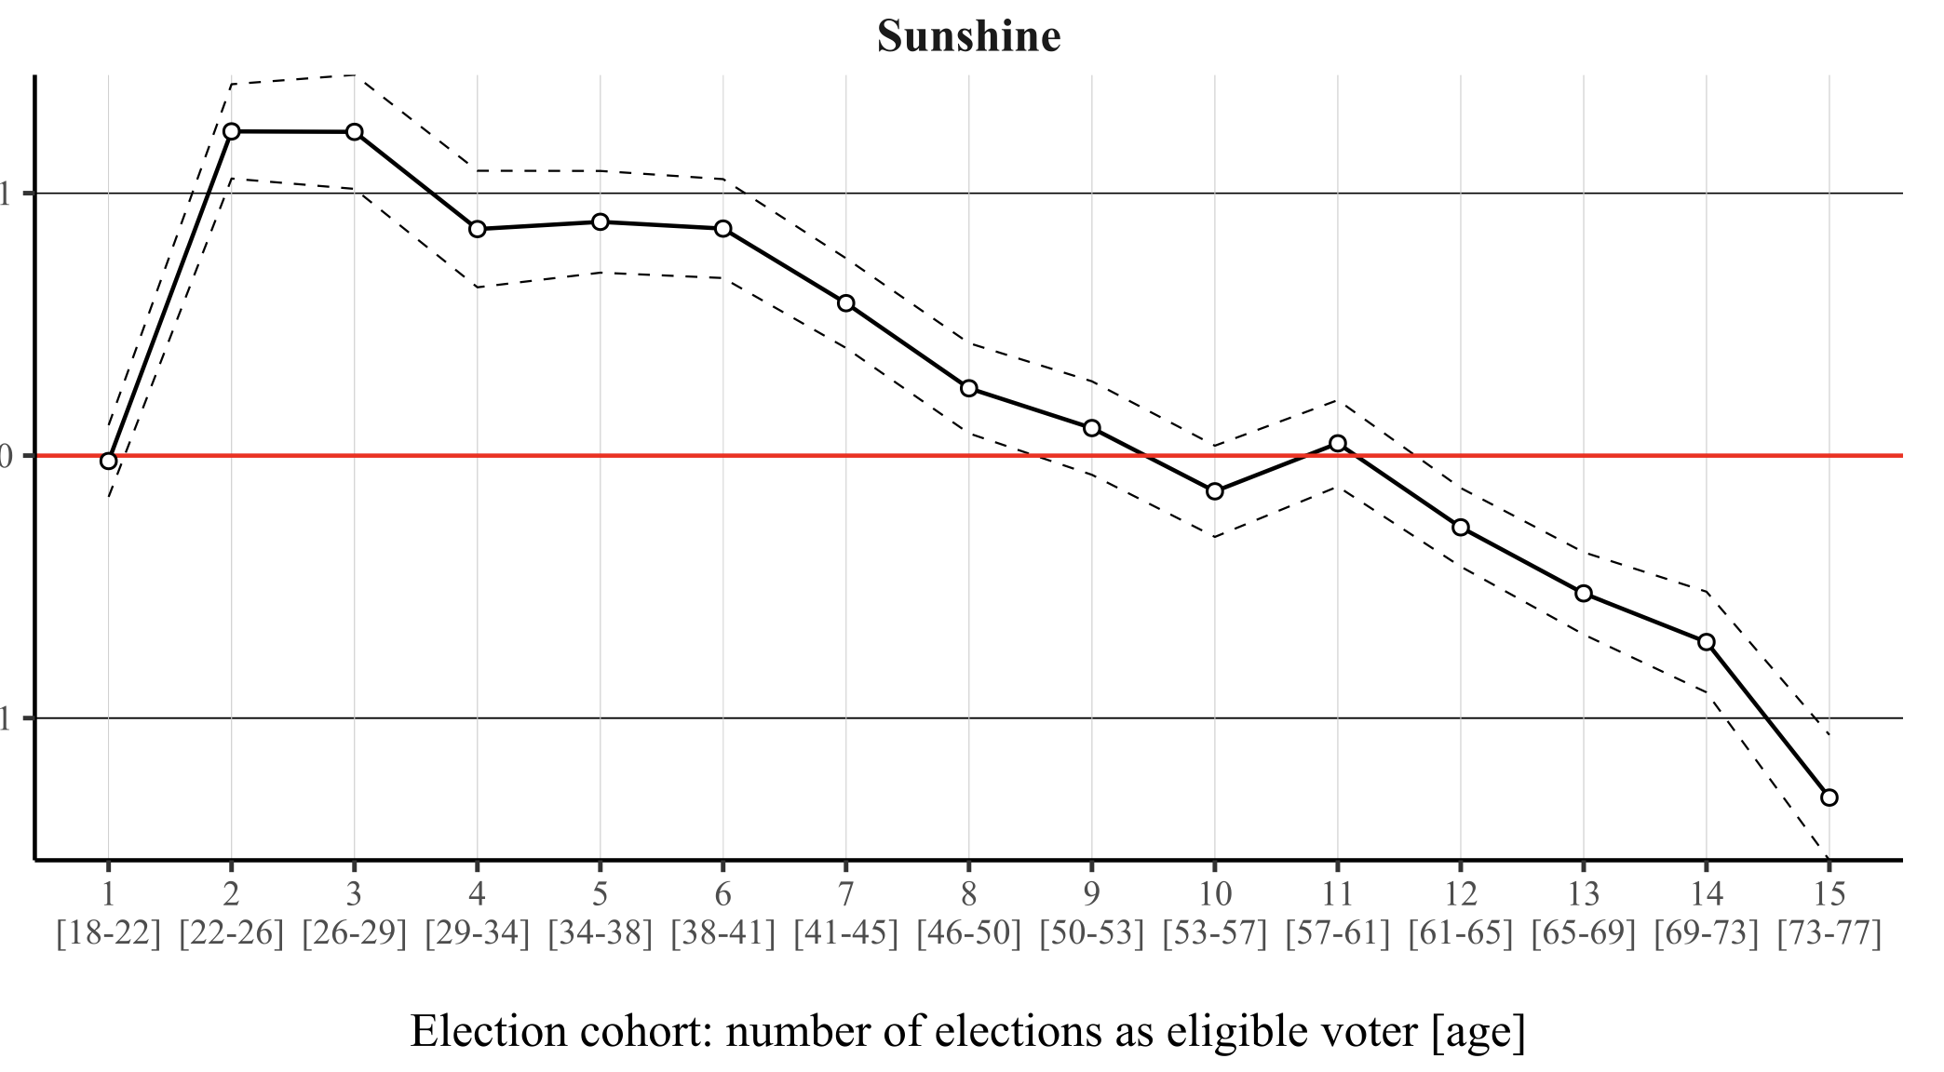
Damsbo-Svendsen and Hansen (2023)

Slide 20
Is it a problem?
NO:
It is “just” about turnout
Small effect (10 mm of rain -> 1 pp. lower turnout)
YES:
Elections themselves close (even a small change can decide): weather influence on party voters is not the same - indirect influence on the composition of the electorate
New findings: weather can influence voters' decision-making (Bassi 2019)

Slide 21
Who should ”pray” for rain?
Republicans (USA) – Gomez et al. 2007
“Conventional turnout effect model” by Tucker et al. 1986
Every inch of rain above election day normal -> +2.5 %
Every inch of snow above election day normal -> +0.6 %
Conservatives (Germany) – Arnold and Freier 2016
Turnout increase by 1 pp. -> SPD gained +0.76 pp.
Turnout decrease by 1 pp. -> CDU lost -0.85 pp. (…and rain decreases turnout)
Christian democrats (Netherlands) – Eisinga et al. 2012
Smaller parties (Spain) – Artes 2014

Slide 22
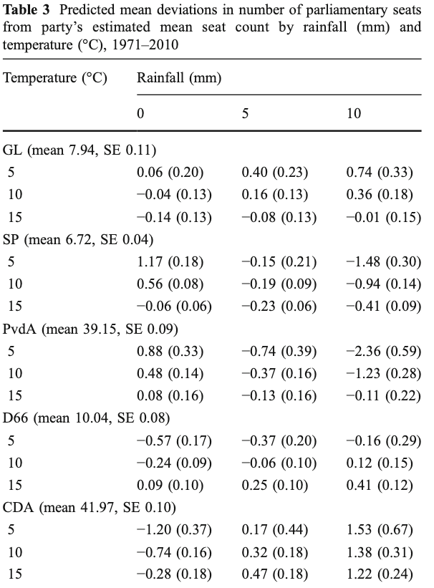
Who should ”pray” for rain?

Slide 23
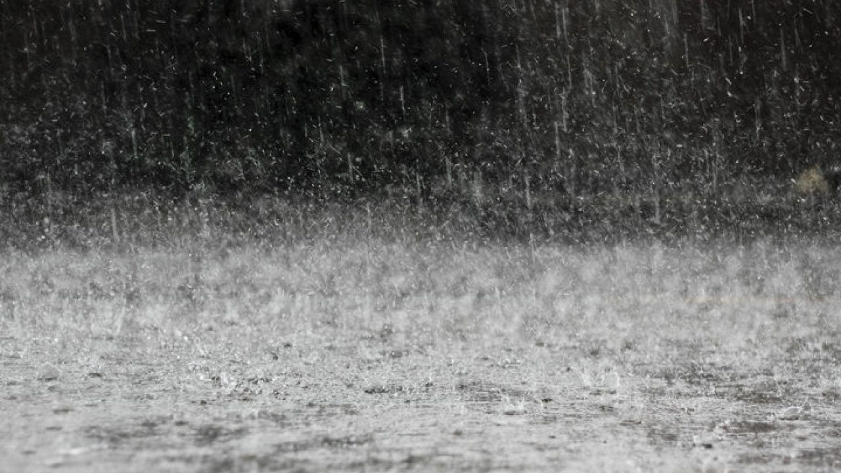
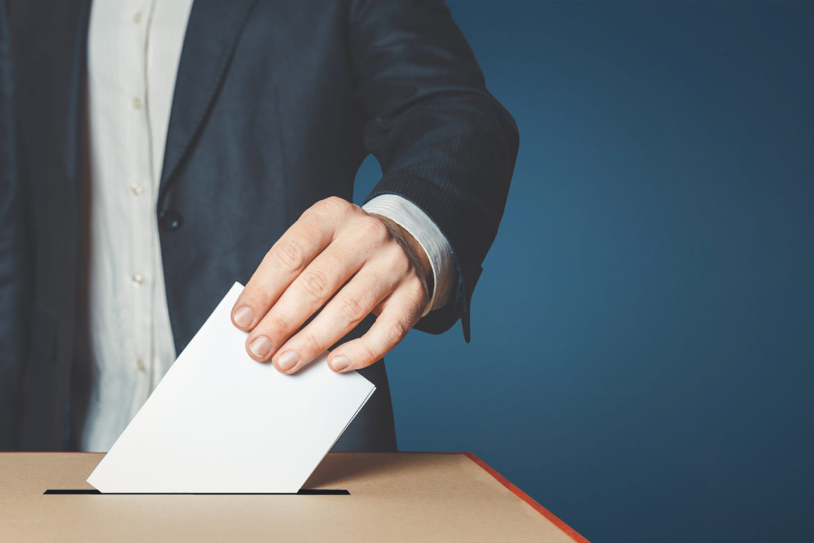
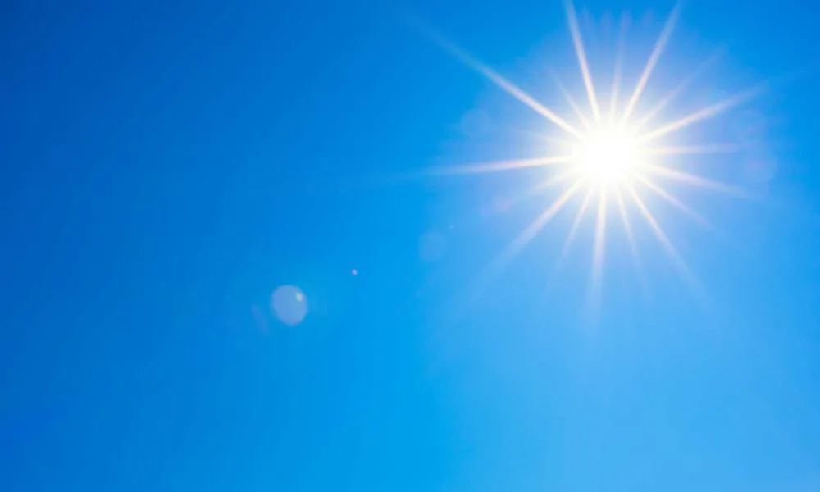
How to measure?

Slide 24
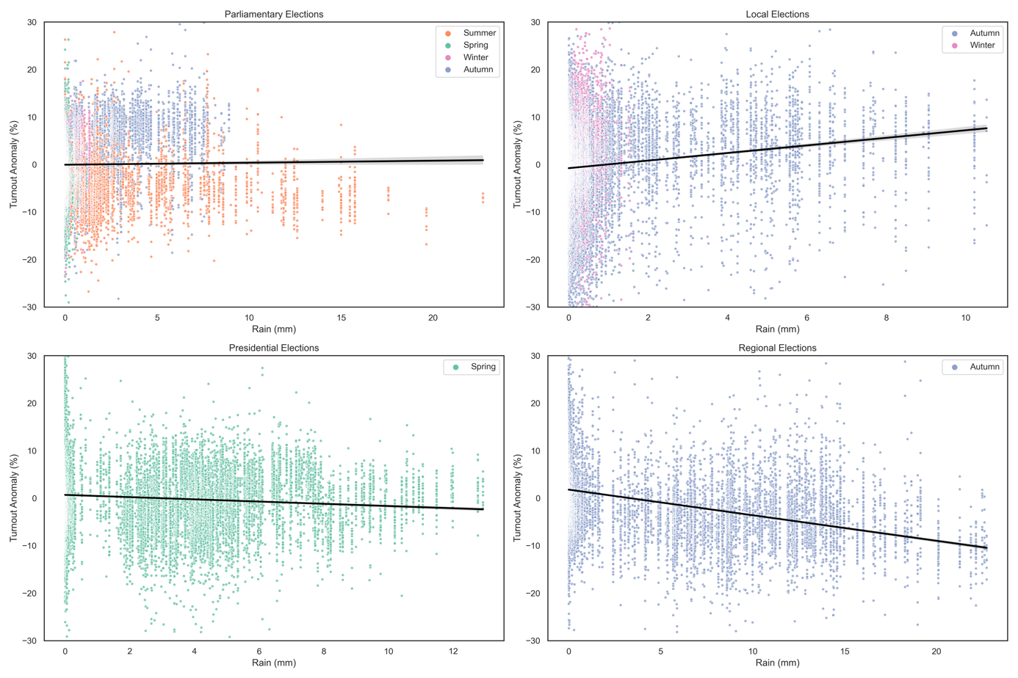
1. Increase in turnout in case of PARL+LOCAL
2. Decrease in turnout in case of PRESID+REG
Fig. 1: The effect of a rainfall on turnout anomaly in different types of elections

Slide 25
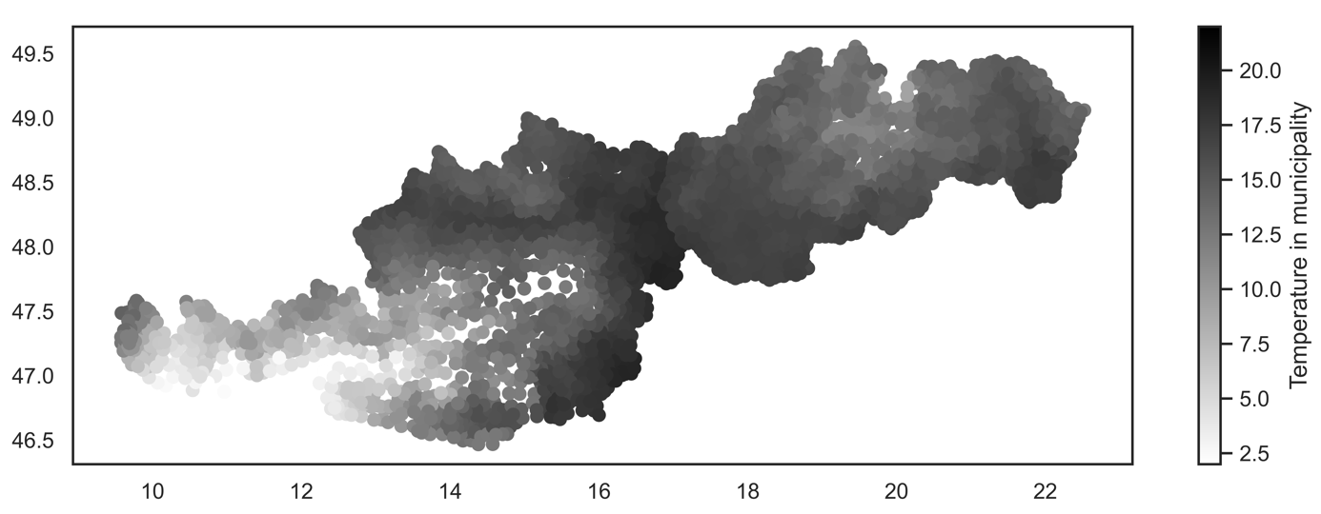

Slide 26
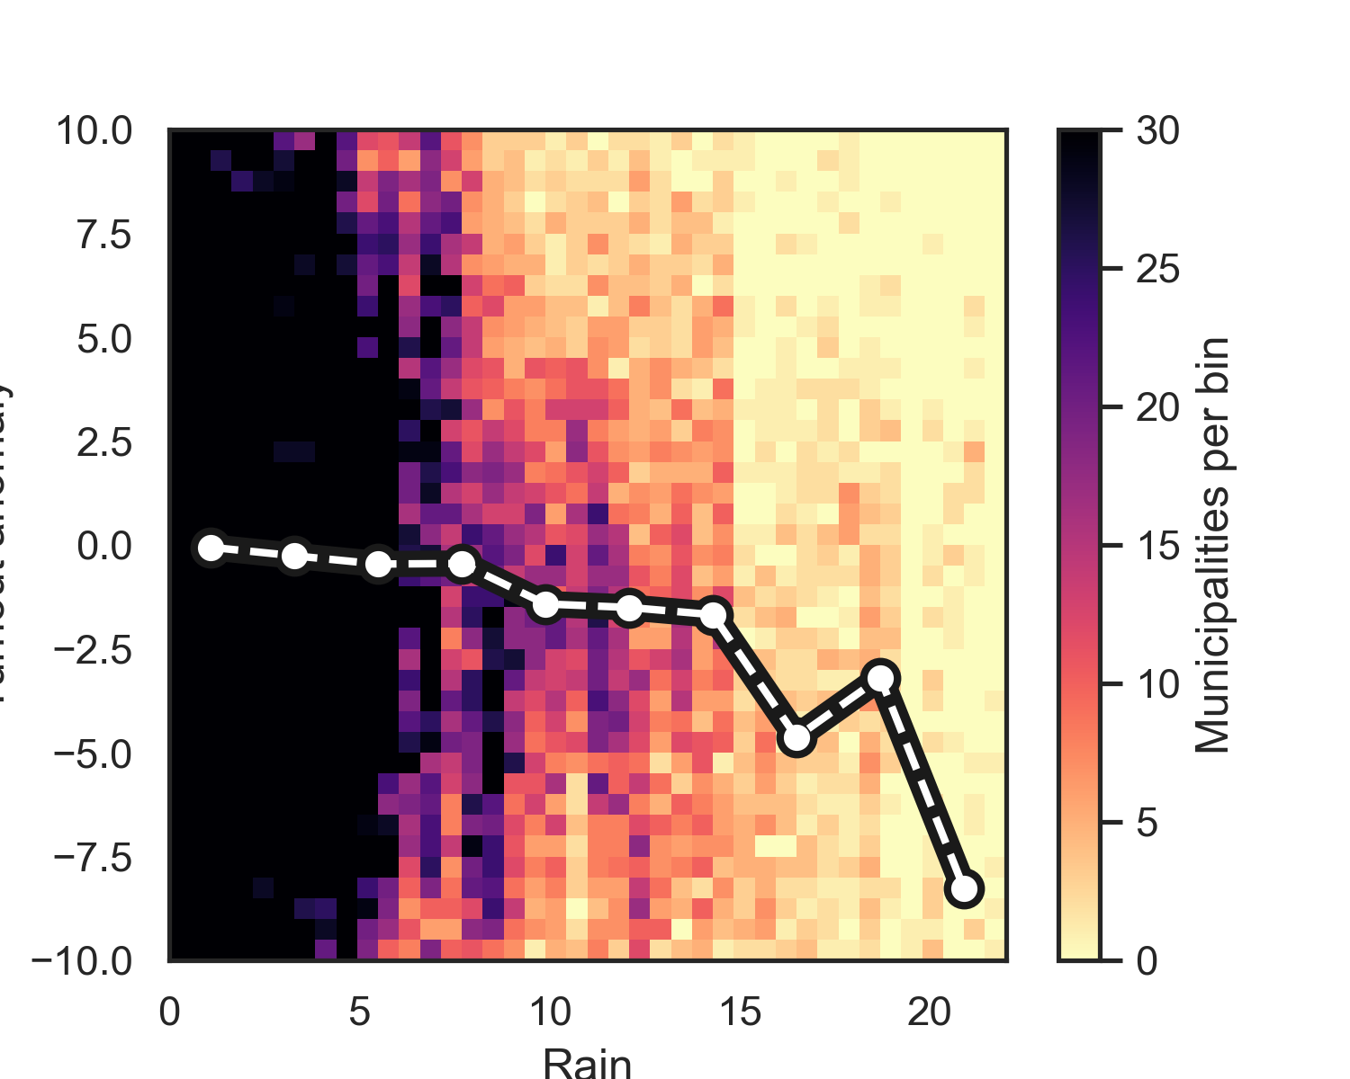
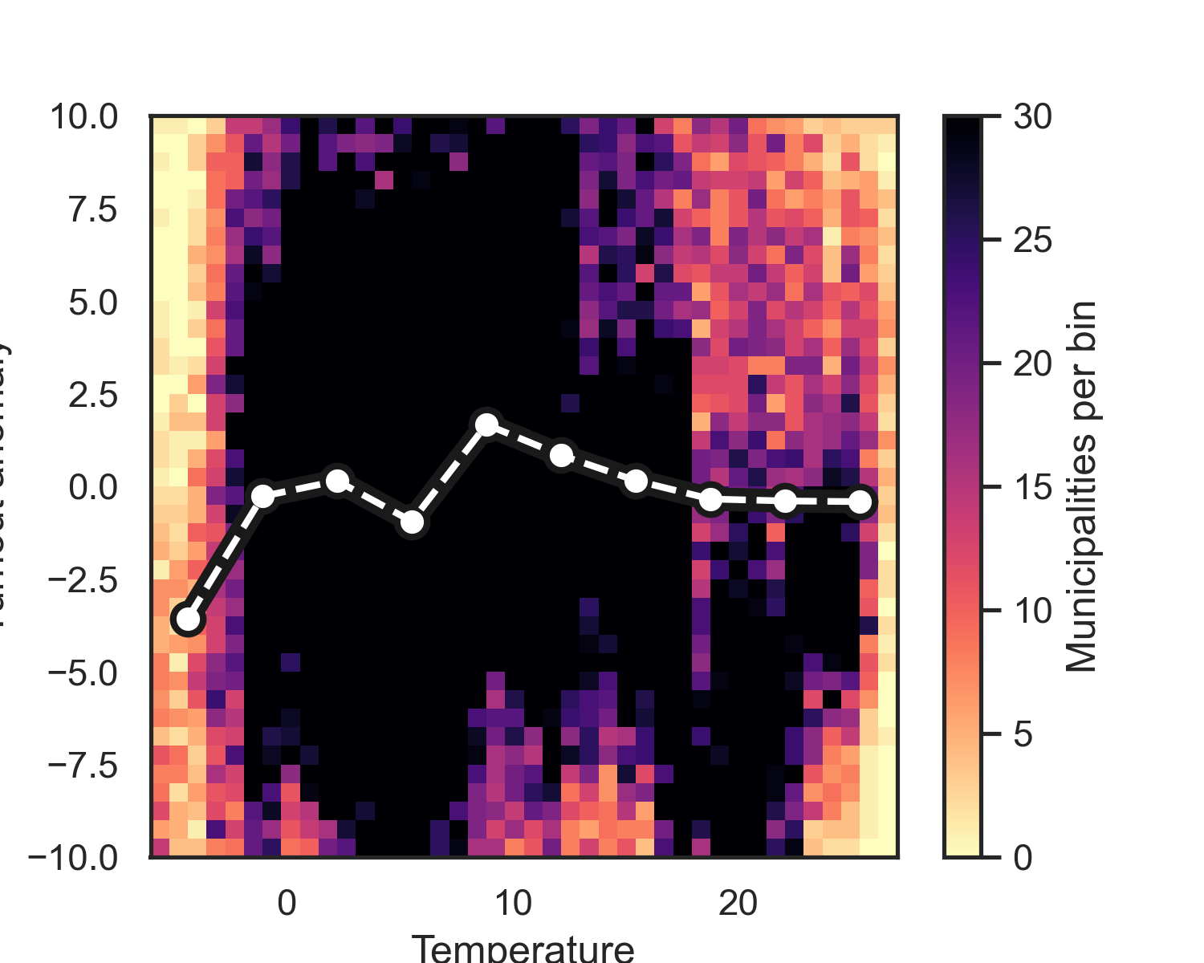
Non-linear results for all elections

Slide 27
Solution?

Slide 28
Abstainers (note from previous lecture)

Slide 29
Relevance of abstention
Two assumptions about abstainers:
Abstention affects all alternatives in equal measure
The voter’s preferred alternative will be less likely to win if that voter abstains
Peripheral + core voters
No-Show Paradox (Fishburn and Brams, 1983)
Notes:
A
B
C

Slide 30
Short-term reasons vs. global decline
Two arguments for why recent generations are less prone to vote:
Context school - the result of certain characteristics of elections that particularly affect new voters (less competition, lowering the voting age…) -> P+habit
Generation school – larger cultural value change in generations (less interest, priorities, voting not perceived as a duty)
Blais and Rubenson (2013) – support for generation school -> young generation less inclined to vote because they are less prone to construct voting as a moral duty and are more sceptical about politicians’
responsiveness to their concerns
“People like me don’t have any say about what the government does”
“I don’t think public officials care much what people like me think.”

Slide 31
How do we increase turnout?
New research on electoral participation

Slide 32
1) personal state effects

Slide 33
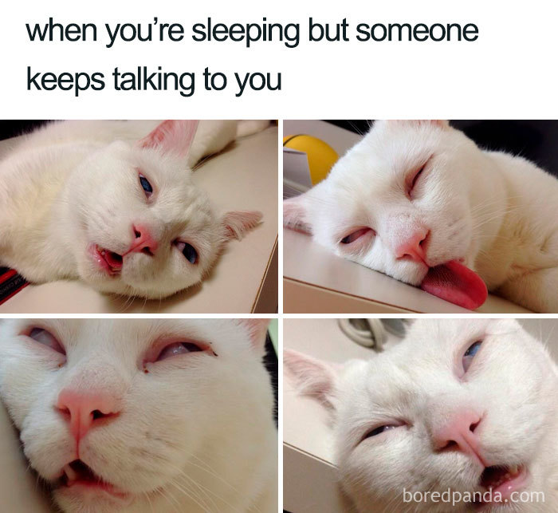

Slide 34
Personal state
Ksiazkiewicz and Erol 2022 - Too tired to vote: A multi-national comparison of election turnout with sleep preferences and behaviors
Analysis of 9 countries (Finland, Greece, Ireland, Mexico, the Netherlands, New Zealand, the Philippines, Russia, and South Korea), questionnaires
Is there an association between sleep, chronotype and turnout?
"those who sleep too little or too much are less likely to vote” -> non-linear relationship, sleep as a resource
Morning chronotype - higher T (but not always)

Slide 35
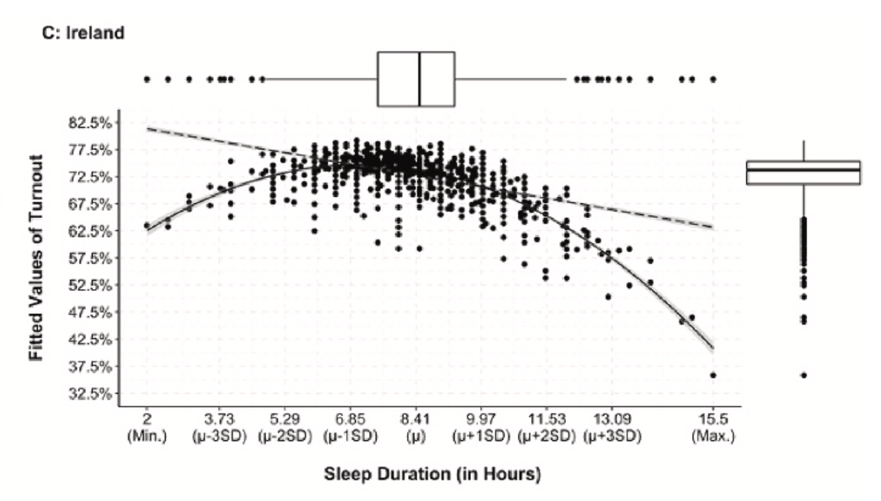
Personal state
SLEEP
Conservation of limited energy
Mental and physical health impacts
Memory and abilities

Slide 36
Personal state
General health:
20 EU countries -> decreases turnout (0.48 pp.)
Sweden -> decreases turnout BUT increases in other forms (contact, protest)
Hampered by daily activities:
20 EU countries -> decreases turnout BUT increases in other forms (boycott, petition, contact a politician)
USA – disabled 5.7 pp. turnout gap
Depression:
USA (mediated by education and partisanship)
Why important?

Slide 37
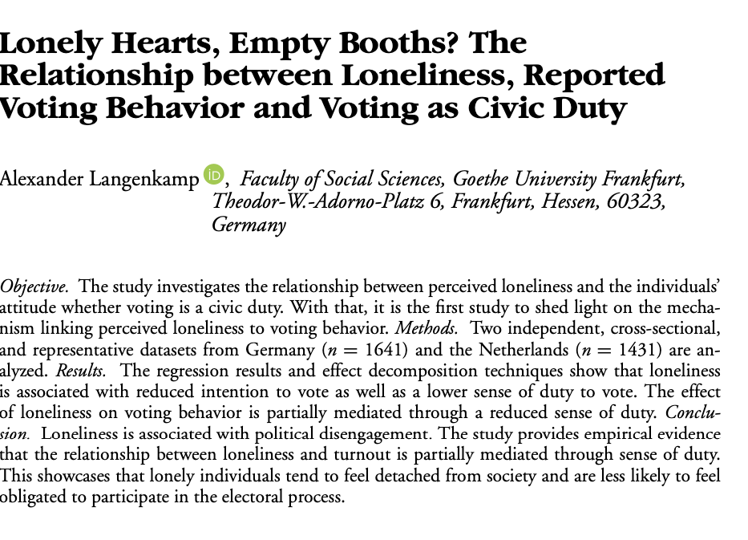
Personal state

Slide 38
2) facilitation procedures

Slide 39
Activity: Barriers to Voting
• Objective: Explore the challenges that prevent people from voting and think about solutions.
• Instructions:
1. Small groups -> assigning each group a different barrier to voter turnout (e.g., voter ID laws, registration requirements, lack of political interest, accessibility for people with disabilities).
2. Brainstorming for 5 minutes on how these barriers impact turnout and potential solutions to overcome them.
3. Presenting ideas to the class.

Slide 40


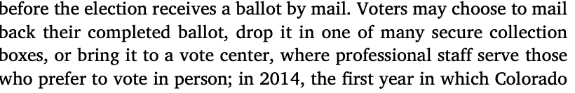
Research: how to increase turnout
Vote by mail tend to be preferred by disabled voters (Kincart, 2023)
Long lines
Opening new polling stations (abroad): Latvia
Changing the location of polling stations: Los Angeles County during California's 2003 gubernatorial recall election -> -1.8 pp.
Automatically registering voters -> + 2.1 pp.
All-mail-voting: Colorado -> +8 pp. (young, less-educated, voters of colour)

Slide 41
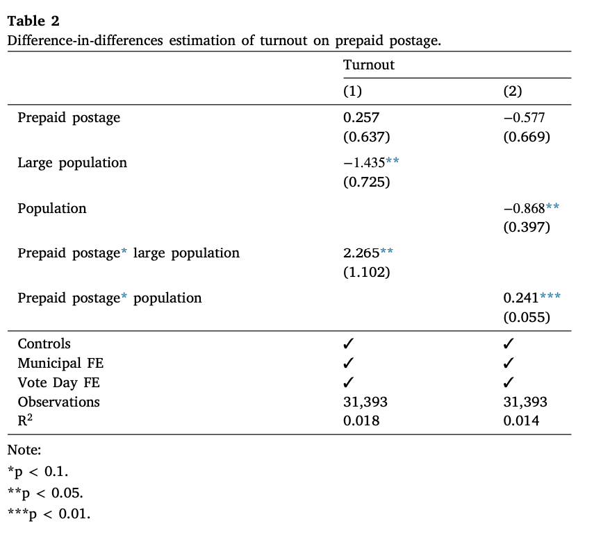
Prepaid postage
Yin et al. 2021 – all Swiss cantons
You could send it by mail or bring it to the town government’s mailbox
Positive effect about +1.1-1.3 pp.
Effect stronger in larger municipalities

Slide 42
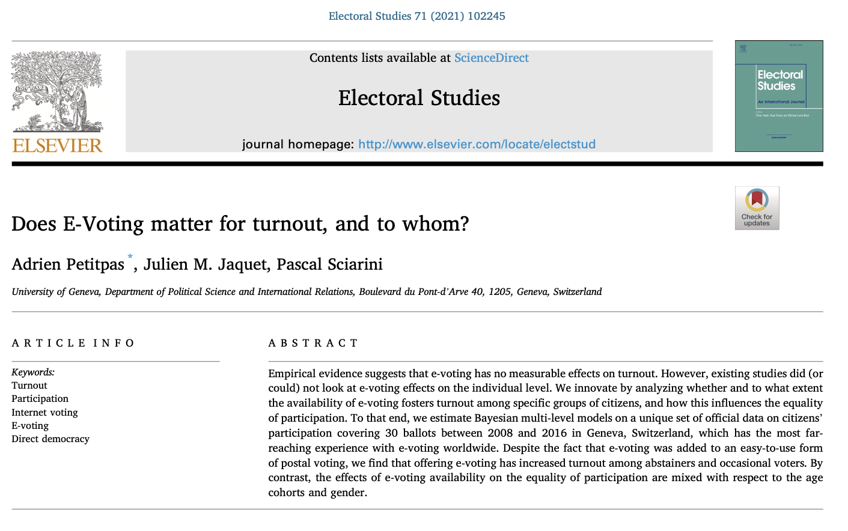
E-voting?

Slide 43
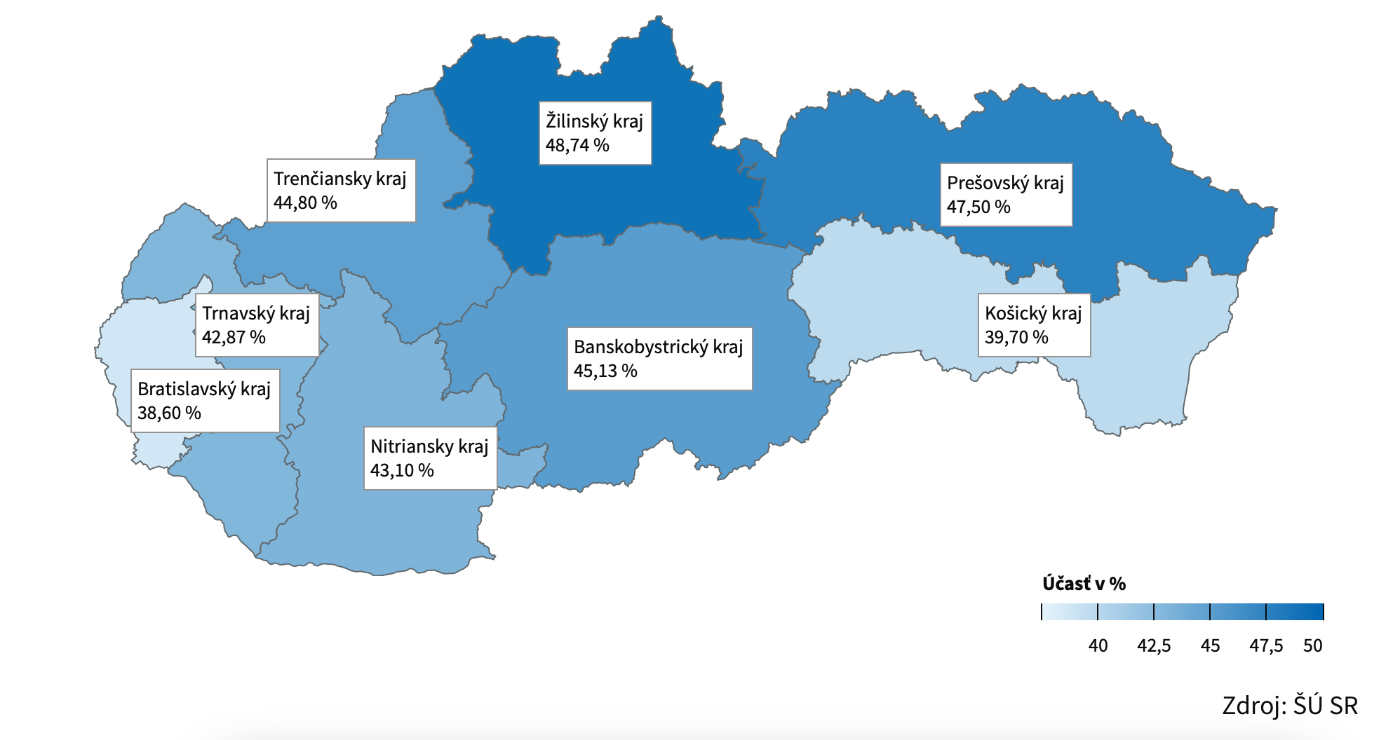
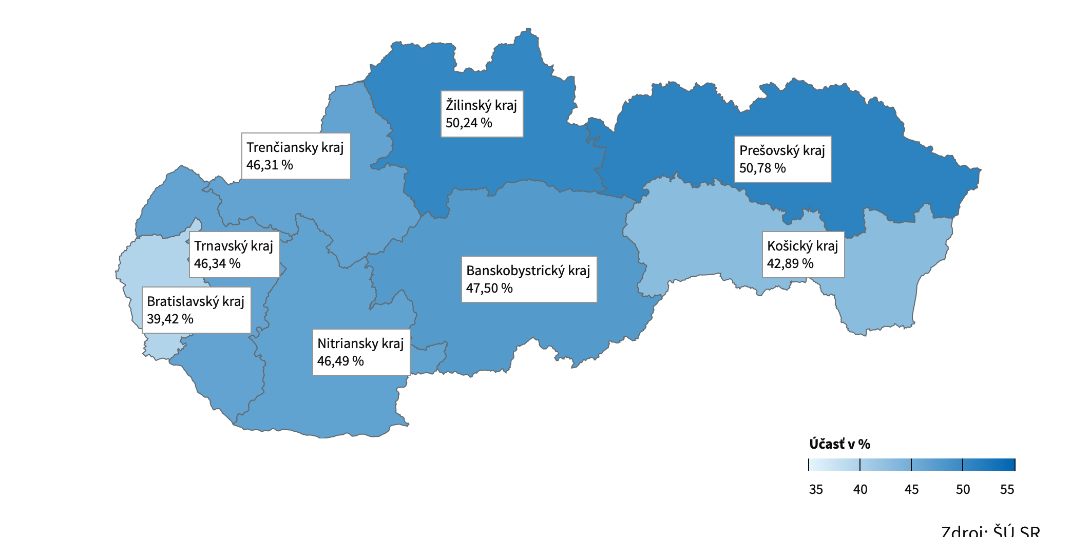
Concurrent elections?

Slide 44
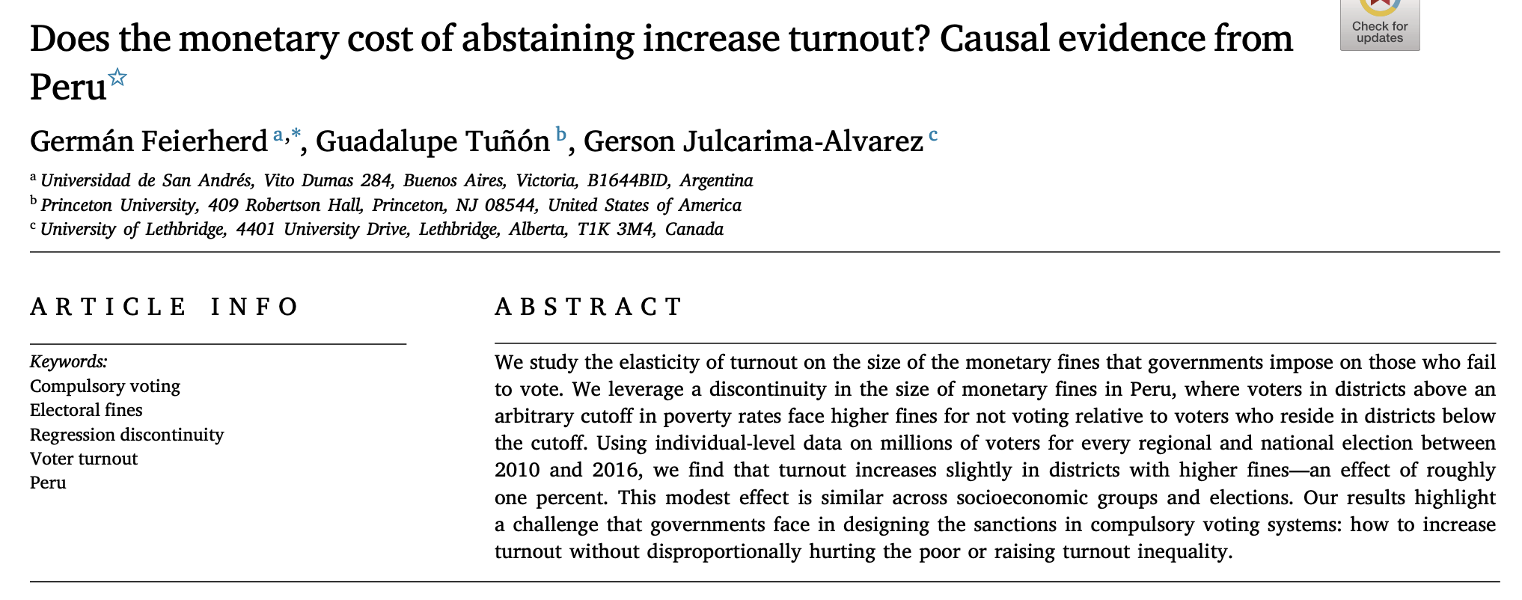
Incentives to ”persuade” abstainers?

Slide 45
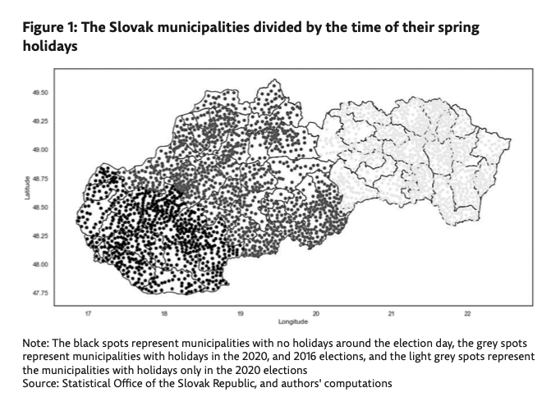
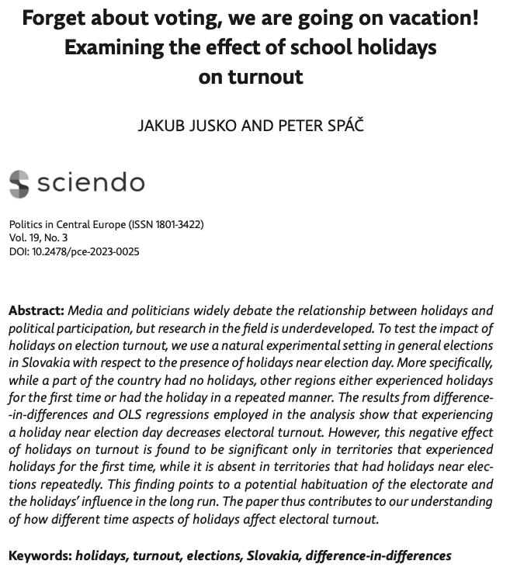
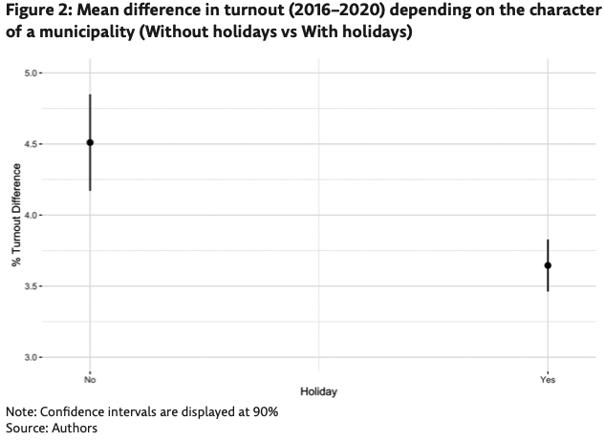
Holidays?

Slide 46
How do we increase turnout?
1) decreasing costs for voting – monetary (postage), polling-stations related, registration, shorter ballot list
2) increasing availability of voting – all-mail-voting, e-voting, concurrent elections, multiple day voting and no holiday voting (probably)

Slide 47
Conclusion
The weather impacts humans, therefore, it also impacts human activities (one such is elections)
Rain (usually) decreases turnout (depends on age, density, electoral contest)
Temperature (usually) increases turnout
Rain helps certain types of political parties
Different tools to increase turnout

Slide 48
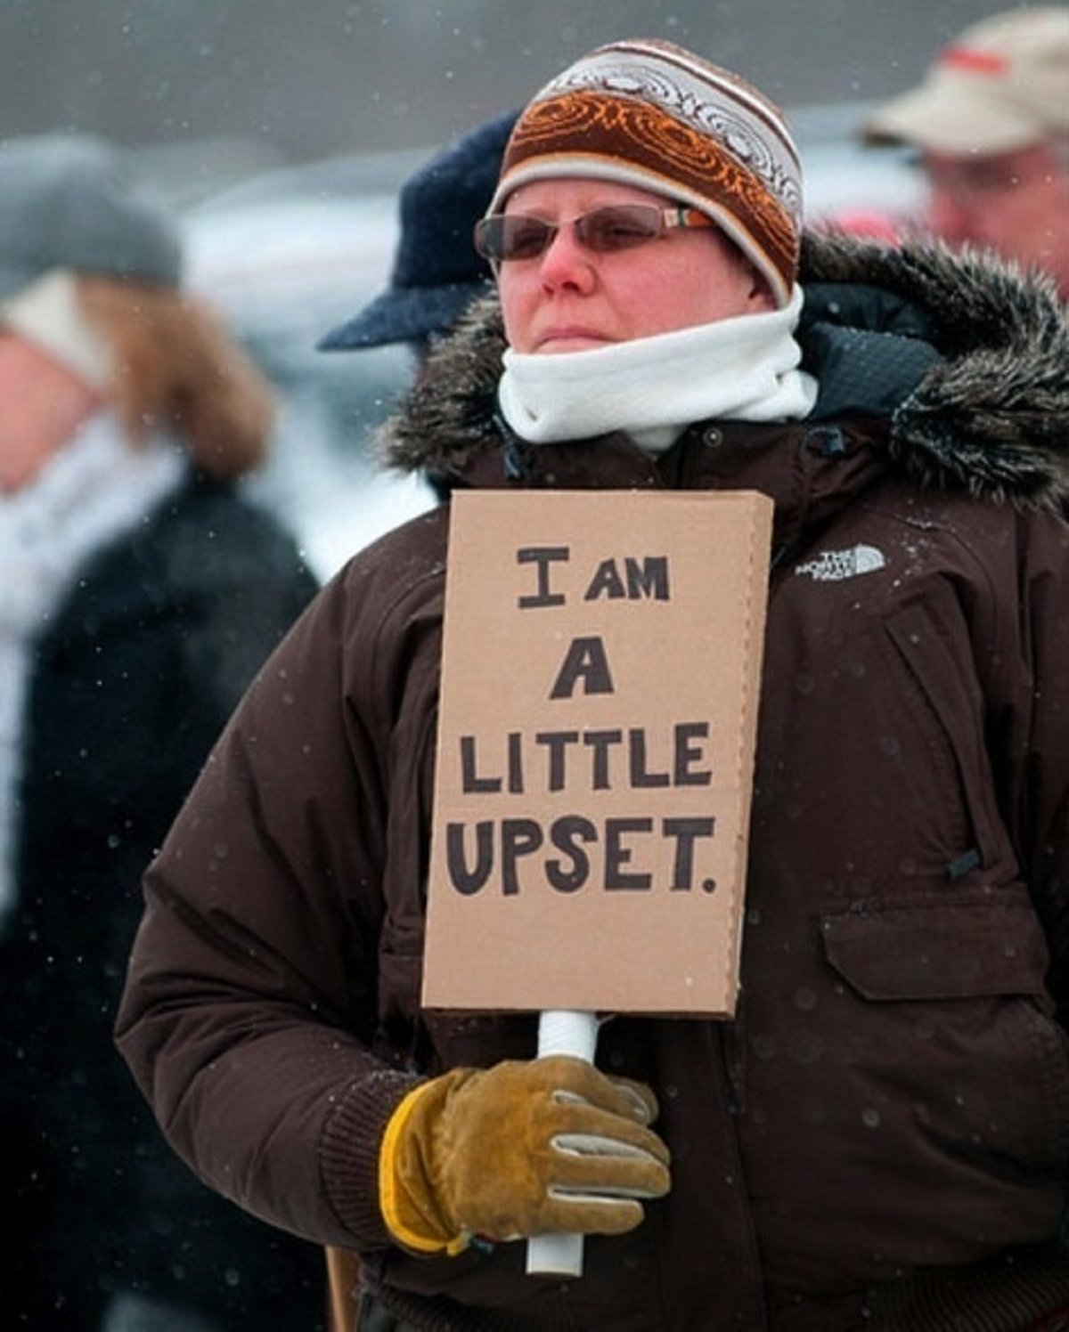
Next…

Slide 49
Literatute
Adman, P. (2020). Does poor health cause political passivity even in a Scandinavian welfare state? Investigating the impact of self-rated health using Swedish panel data. Electoral Studies, 65, 102110.
Arnold, F., & Freier, R. (2016). Only conservatives are voting in the rain: Evidence from German local and state elections. Electoral Studies, 41, 216-221.
Artés, J. (2014). The rain in Spain: Turnout and partisan voting in Spanish elections. European Journal of Political Economy, 34, 126-141.
Cantoni, E., Gazzè, L., & Schafer, J. (2021). Turnout in concurrent elections: Evidence from two quasi-experiments in Italy. European Journal of Political Economy, 70, 102035.
Bonica, A., Grumbach, J. M., Hill, C., & Jefferson, H. (2021). All-mail voting in Colorado increases turnout and reduces turnout inequality. Electoral studies, 72, 102363.
Cunow, S., Desposato, S., Janusz, A., & Sells, C. (2021). Less is more: The paradox of choice in voting behavior. Electoral Studies, 69, 102230.
Damsbo-Svendsen, S., & Hansen, K. M. (2023). When the election rains out and how bad weather excludes marginal voters from turning out. Electoral Studies, 81, 102573.
Downs, A. (1957). An economic theory of democracy.
Eisinga, R., Te Grotenhuis, M., & Pelzer, B. (2012). Weather conditions and voter turnout in Dutch national parliament elections, 1971–2010. International journal of biometeorology, 56, 783-786.
Eisinga, R., Te Grotenhuis, M., & Pelzer, B. (2012). Weather conditions and political party vote share in Dutch national parliament elections, 1971–2010. International journal of biometeorology, 56, 1161-1165.
Garcia-Rodriguez, A., & Redmond, P. (2020). Rainfall, population density and voter turnout. Electoral Studies, 64, 102128.
Gomez, B. T., Hansford, T. G., & Krause, G. A. (2007). The Republicans should pray for rain: Weather, turnout, and voting in US presidential elections. The Journal of Politics, 69(3), 649-663.
Harley, T. (2018). The psychology of weather. Routledge.
Kang, W. C. (2019). Liberals should pray for rain: weather, opportunity costs of voting and electoral outcomes in South Korea. Political Science, 71(1), 61-78.
Kincart, S. (2023). Addressing the Voter Turnout Gap Between Disabled and Non-Disabled Voters. Hinckley Journal of Politics, 24.
Ksiazkiewicz, A., & Erol, F. (2022). Too tired to vote: A multi-national comparison of election turnout with sleep preferences and behaviors. Electoral Studies, 78, 102491.
Langenkamp, A. (2021). Lonely hearts, empty booths? The relationship between loneliness, reported voting behavior and voting as civic duty. Social science quarterly, 102(4), 1239-1254.
Ojeda, C. (2015). Depression and political participation. Social Science Quarterly, 96(5), 1226-1243.
Petitpas, A., Jaquet, J. M., & Sciarini, P. (2021). Does E-Voting matter for turnout, and to whom?. Electoral studies, 71, 102245.
Pettigrew, S. (2021). The downstream consequences of long waits: How lines at the precinct depress future turnout. Electoral studies, 71, 102188.
Reire, G. (2021). Opening of new election polling stations: the effect on turnout and diaspora voting patterns. Economic Science for Rural Development (Latvia), (55).
Riker, W. H., & Ordeshook, P. C. (1968). A Theory of the Calculus of Voting. American political science review, 62(1), 25-42.
Stockemer, D., & Rapp, C. (2019). The influence of various measures of health on different types of political participation. Politics, 39(4), 480-513.
Stockemer, D., & Wigginton, M. (2018). Fair weather voters: do Canadians stay at home when the weather is bad?. International journal of biometeorology, 62(6), 1027-1037.
Yin, J., Willi, T., & Leemann, L. (2021). Prepaid postage using pre-stamped envelopes to affect turnout costs. Electoral Studies, 74, 102405.

