Slide 1
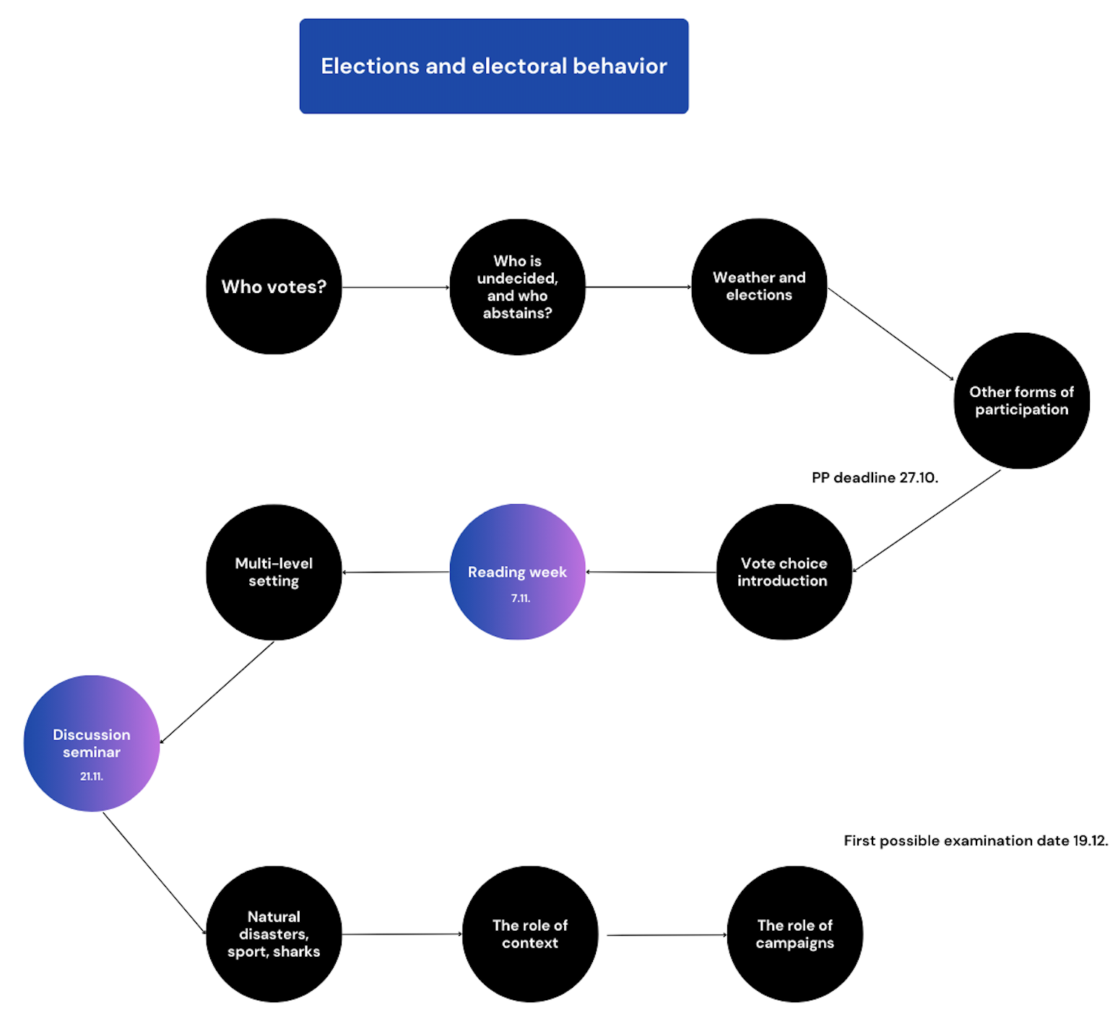

Slide 2
Position paper deadline
27.10.2024 23:59
3 topics -> you choose one
5-6 pages -> 1800 signs=1 page
Your argumentation as a core skill for the paper
Secondary sources also needed
10 points
…also document for case study
https://docs.google.com/spreadsheets/d/120jDtv1CNVuucEm1CLkToAEbQoWfiOKQDTKrcn57J44/edit?usp=sharing

Slide 3
Other forms of political participation – referenda, protests, petitions
Jakub Jusko

Slide 4
Political participation
“Activity that has the intent or effect of influencing government action – either directly by affecting the making or implementation of public policy or indirectly by influencing the selection of people who make those policies” (Verba et al. 1995, 38).
“Action by ordinary citizens directed
toward influencing some political outcomes” (Brady 1999, 737)
Electoral participation
Consumer participation
Protest activity
Party activity
Contact activity (Teorell et al. 2007)

Slide 5
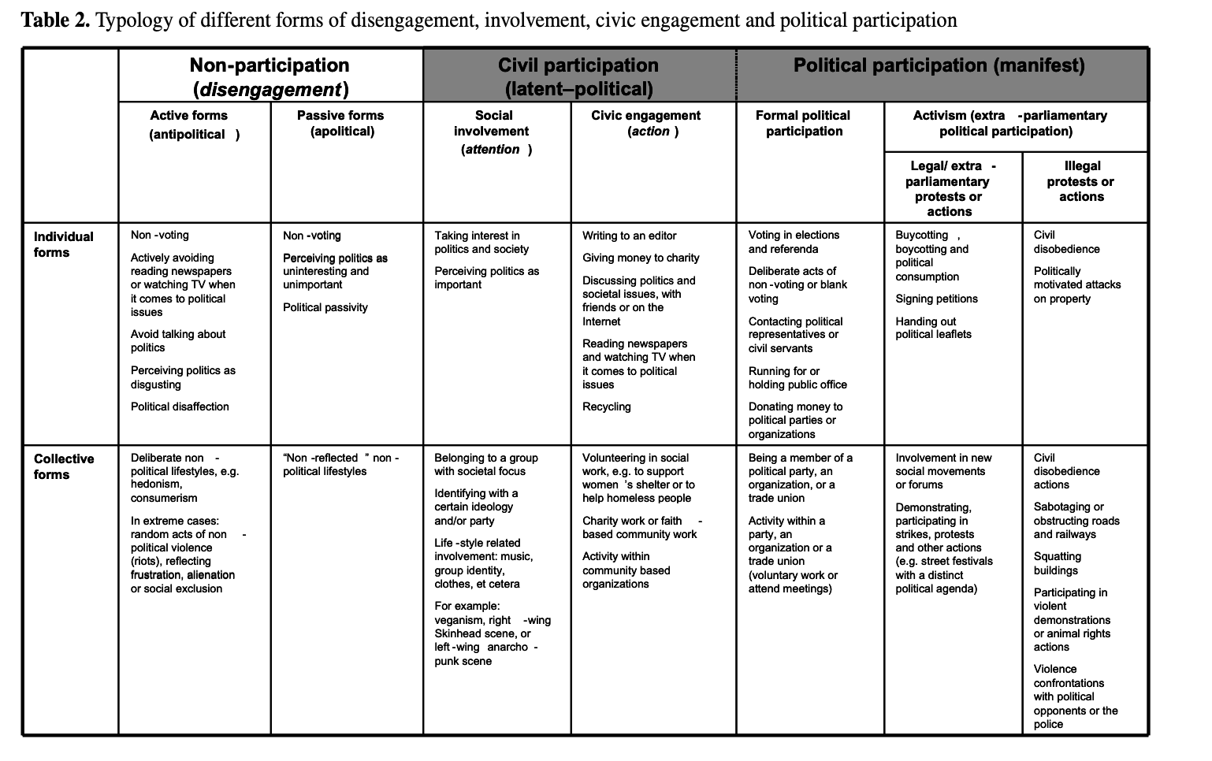
Ekman and Amna, 2012

Slide 6
Referendums as Direct Democratic Expressions of Electoral Behaviour
Demonstrations as Expressions of Political Dissatisfaction and Mobilization
Petitions as Low-Cost Political Engagement Complementing Elections

Slide 7
Political participation
Referendums
Factors (X) Demonstrations Outcomes (Y)
Petitions

Slide 8
Referendums

Slide 9
Referendum
The main tool of direct democracy in presence (increase in recent decades)
Origin in Switzerland in 13th century
Mechanism which allows citizens to express their attitude on a specific question mostly by either a „yes“ or a „no“ vote
Similar attributes as elections – universal suffrage, secret vote, equal weight of votes etc.
Different characteristics to elections – quorum rules, turnout fluctuation, contextuality
Different motivations of the actors involved

Slide 10
Example - Slovak referendums
 | Year | Topic | Turnout | Result
1 | 1994 | Privatization | 19,96 | Not valid
2 | 1997 | NATO / President | 9,53 | Not valid / marred
3 | 1998 | Strategic companies | 44,25 | Not valid
4 | 2000 | Early elections | 20,03 | Not valid
5 | 2003 | EU | 52,15 | Valid – yes
6 | 2004 | Early elections | 35,86 | Not valid
7 | 2010 | Various | 22,84 | Not valid
8 | 2015 | Family | 21,41 | Not valid
9 | 2023 | Early elections | 27,25 | Not valid

Slide 11
Who participates in referendums?
Switzerland (Geneva canton): (Goldberg and Sciarini, 2023)
Individual-level (age + past participation)
Contextual factors: importance of the issue, complexity
Netherlands: (van Egmond et al. 1998)
Individual characteristics (education, interest) are dependent upon contextual factors (importance of the issue)
Similar turnout behaviour than in regular elections
BUT
Crucial role of referendum importance and political (government) parties in determining the referendum behaviour

Slide 12
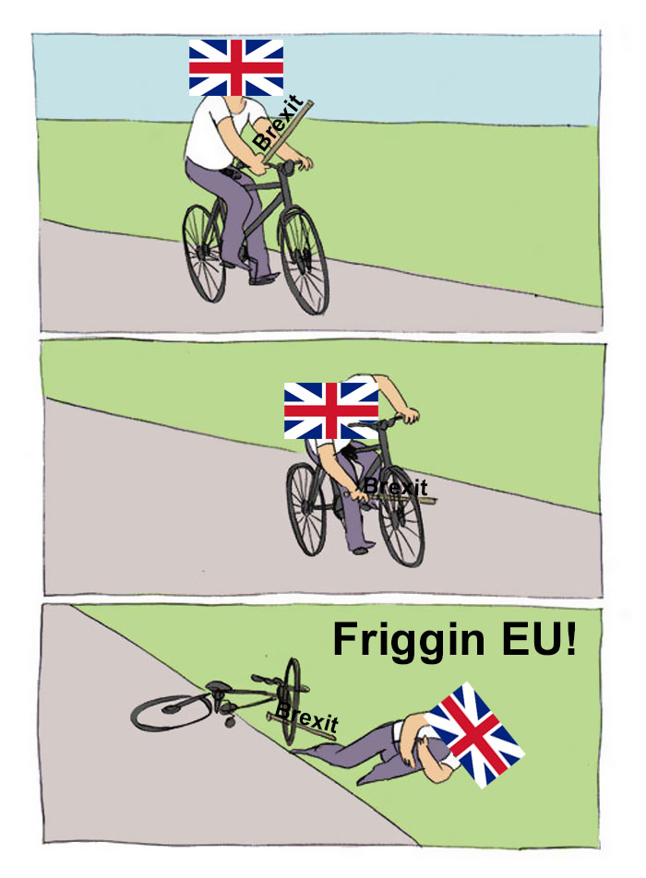
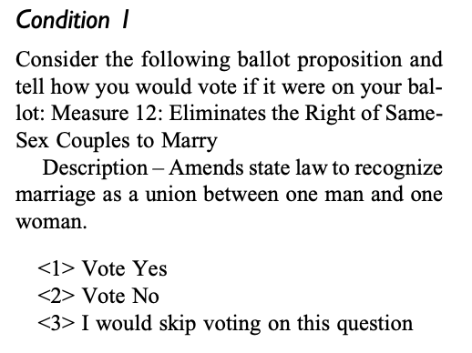
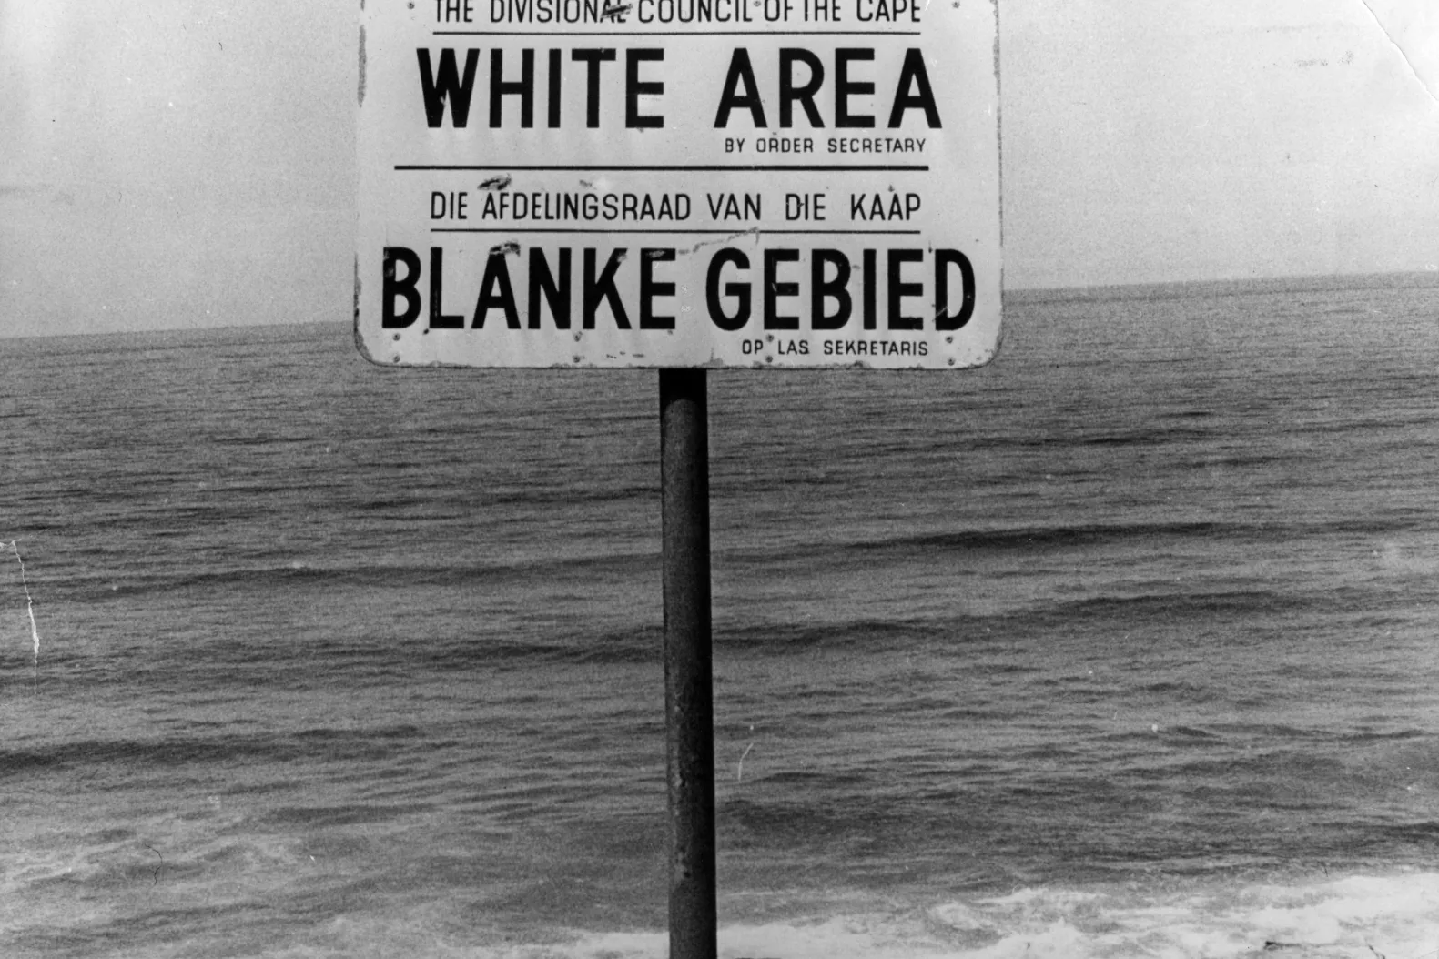
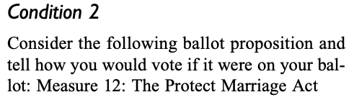
Vote choice in referendums:
1) personal attitudes
2) role of political parties and mobilisation
3) role of question framing

Slide 13
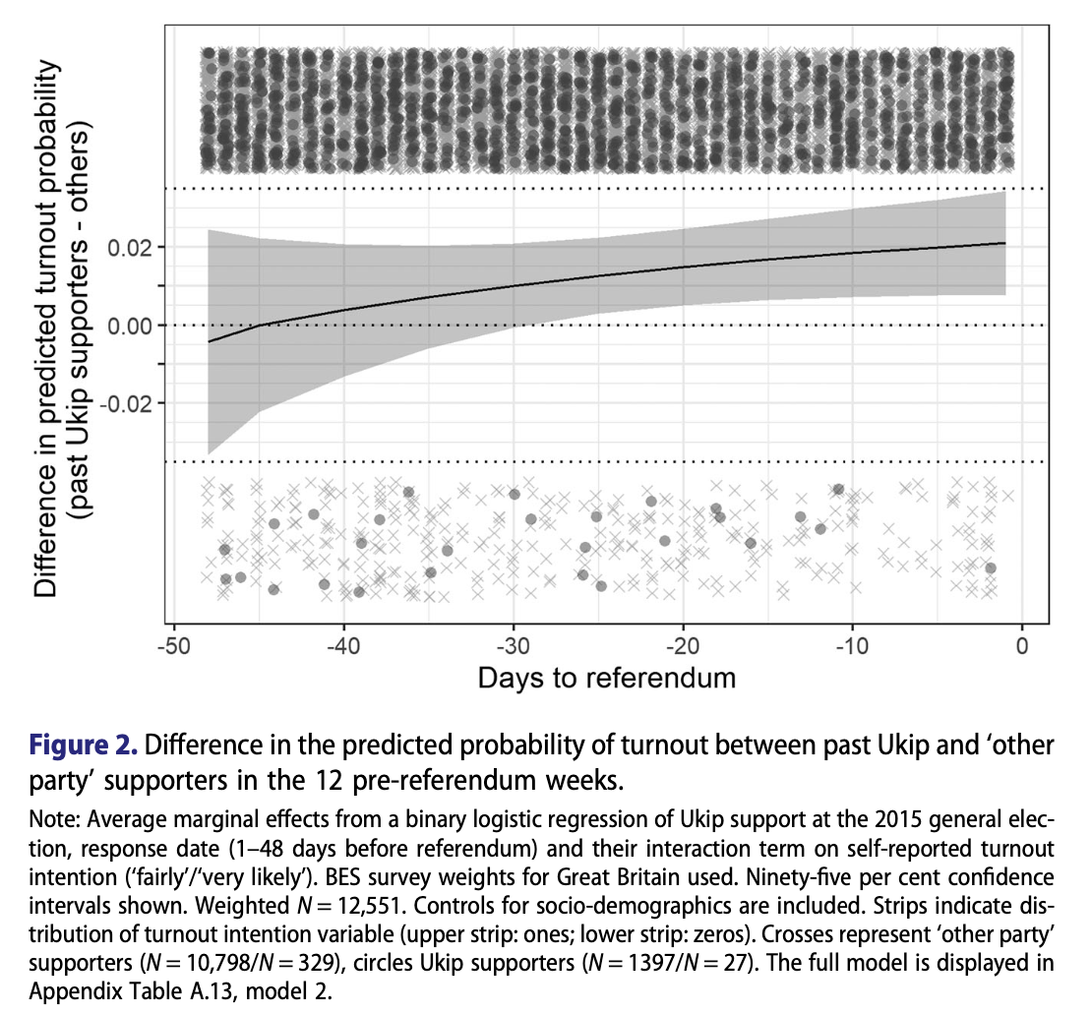
Rudolph 2020 and occasional voters in Brexit

Slide 14
Positives and negatives of referendum?

Slide 15
Positives and negatives of referendum?
Anderson and Goodyear-Grant (2010)
Why are highly informed citizens sceptical of referenda? (Canada)
- the incompetent public explanation
the confidence in government explanation (ethics, competence, responsiveness)
the concern for minority rights explanation

Slide 16
Demonstrations

Slide 17
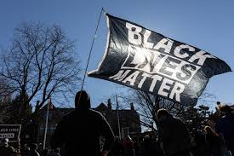
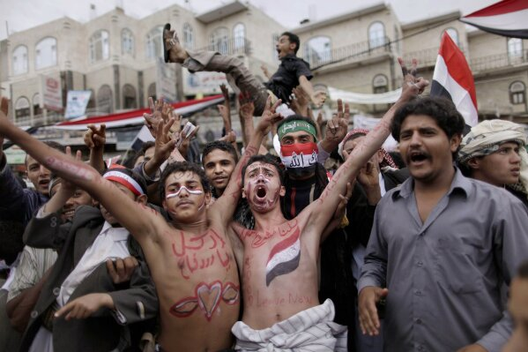
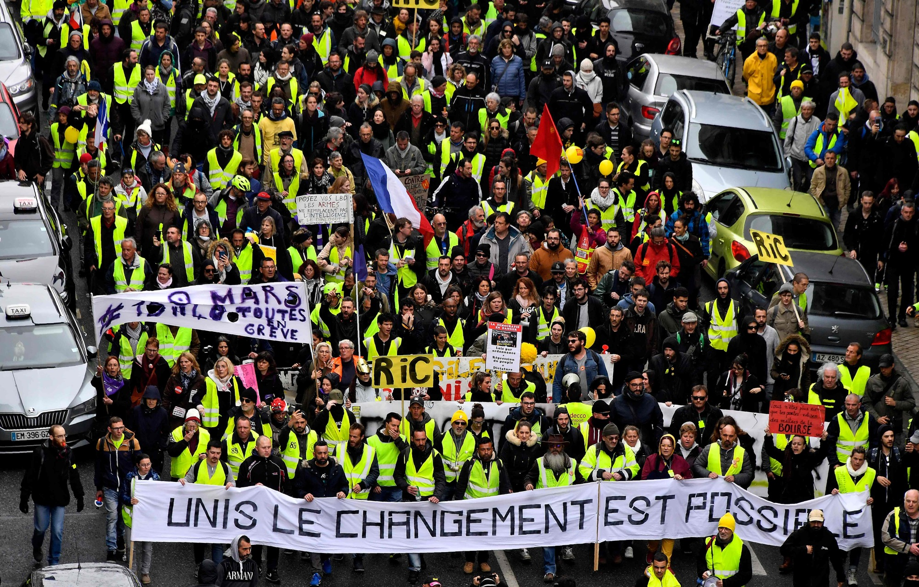
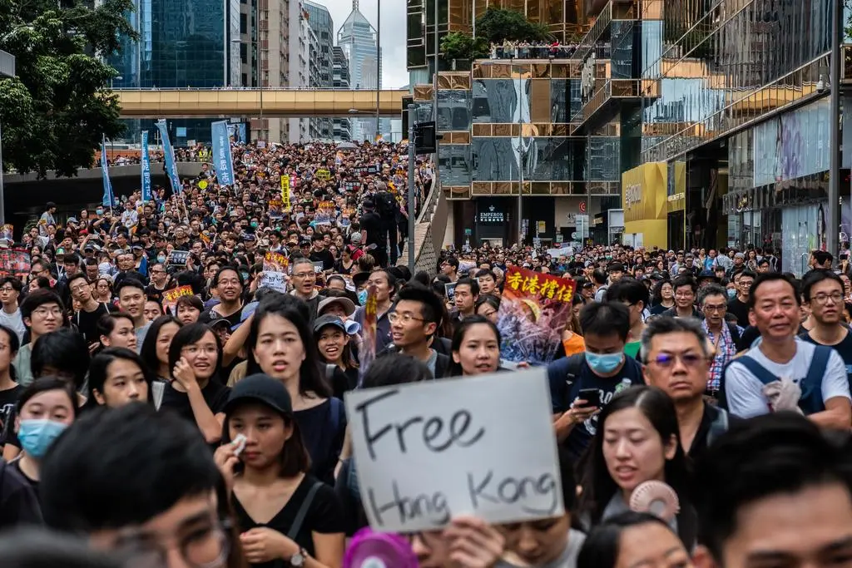

Slide 18
Demonstrations
Unconventional political participation -> aiming to influence politics through non-institutionalised means (not electoral arena)
More open act of political engagement that involves a relatively high amount of time commitment (compared to petitions)
More of political reasons (boycotts more ethical)
More impactful for protesters when protesting locally (vs. large-scale) (Wallace et al. 2014) – immigration rights in the US
More impactful for overall support when done non-violently (Shuman et al. 2024)

Slide 19
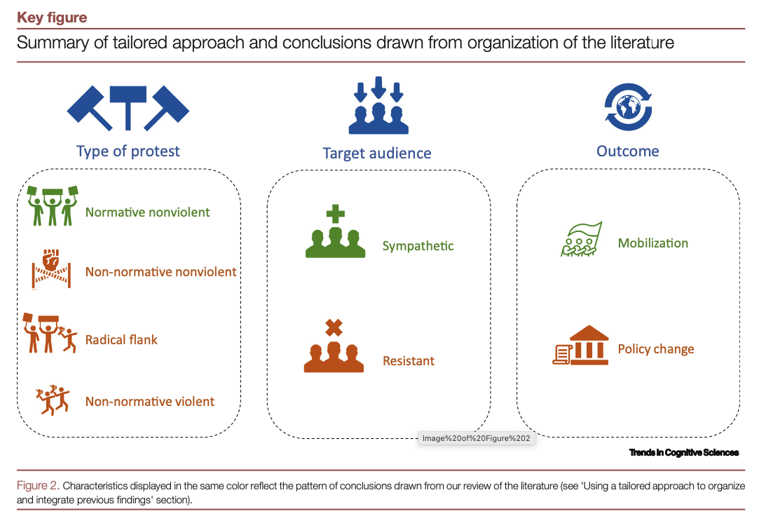
Demonstrations effects

Slide 20
Who participates in demonstrations?
Stockemer (2014) -> World Values Survey (2009) – 39 countries
- Education
- Membership in civil society organisations
Voting
Dissatisfaction with the government
Age!
Men (also boycotts)
Income
Democratic experience (of a country)
Economic development (of a country)
Chang et al. (2021)
- higher levels of agreeableness, emotional stability are significantly associated with a decreased likelihood of protest participation (+ low extroversion in democracies)

Slide 21
Petitions

Slide 22
Petitions
Unconventional political participation -> aiming to influence politics through non-institutionalised means (not electoral arena)
Low-risk form of political engagement that involves a relatively low amount of time commitment (Low-cost activity)
Signalling of issues to parties -> campaigning (before elections), policy outcomes
Highlight limitations of electoral participation (but scepticism of MPs -> UK)
Educative effect -> increase turnout in irregular US (compared to habitual) voters (Parry et al. 2012, Harper and Parry, 2023)

Slide 23
Who participates in petitions?
Stockemer (2014) -> World Values Survey (2009) – 39 countries
- Education
- Membership in civil society organisations
Voting
Dissatisfaction with the government
Age!
Women (opposite to demonstrations)
Income
Democratic experience (of a country) (also boycott)
Economic development (of a country)
Couture and Breux (2017)
- Poor mental health associated with higher online petitions signing

Slide 24
Who participates in petitions?
Merita Ulo et al. (2019) (E-petitions)
- High altruism, positive attitude towards e-petitions, credible e-petition initiators increase probability of signing e-petition
Freyemayer and Johnson (2010) – environmental actions
- Respondents living in wealthier countries, no matter the environ-
mental quality, more frequently join environmental groups, sign petitions concerning the environment, and give money for environmental causes

Slide 25
Petition Simulation: Craft Your Cause
Objective: Illustrate the process and impact of petitions.
Instructions: 3-5 minutes to think of a political or social issue you are passionate about. Create a short petition statement (1-2 sentences) that they would use to gather support for their cause -> try to make it effective
Wrap-up: How petitions—especially online petitions—mobilize people and keep issues on the political agenda?

Slide 26
How to write an effective petition?
Setyoko et al. (2022)
1) the way of communication in which there is a linguistic approach is an important factor that influences how information from the petition is conveyed to the public and leads to the publicity of the petition.
2) the way of delivery is the basis for how the voice of the community is conveyed to policymakers, which is influenced by the political will of a region.
3) media attention is a factor between the two scopes, which have dual roles as a “toa” to the public, and a messenger of policy.
Trending petitions are gaining support more rapidly (UK)
More positive emotions (Change.org petitions study)
Credible e-petition initiators (Merita Ulo et al. 2019)

Slide 27
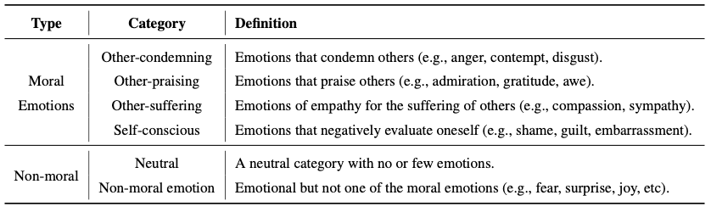
How to write an effective petition?
Kim et al. 2024

Slide 28
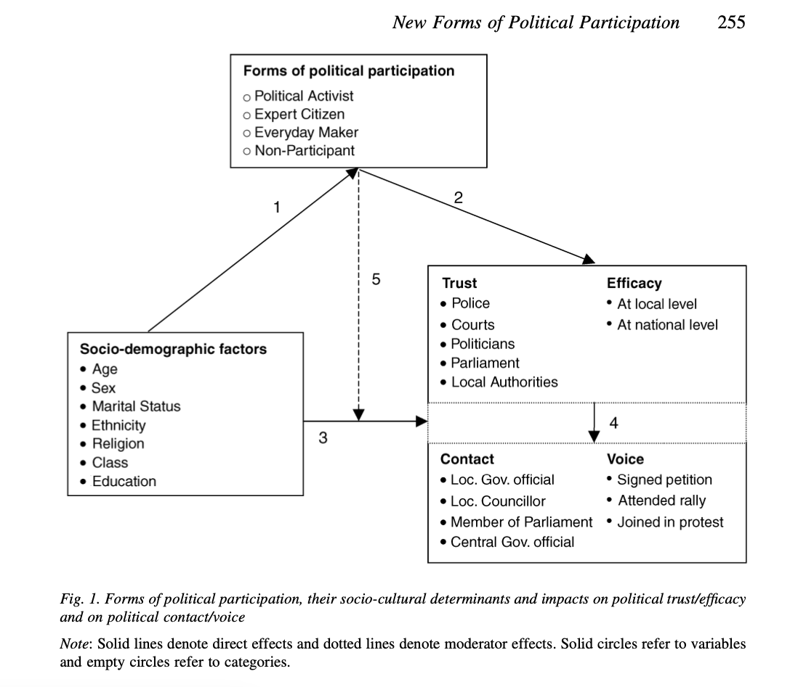

Slide 29
Activity
Your activity in other forms of participation

Slide 30
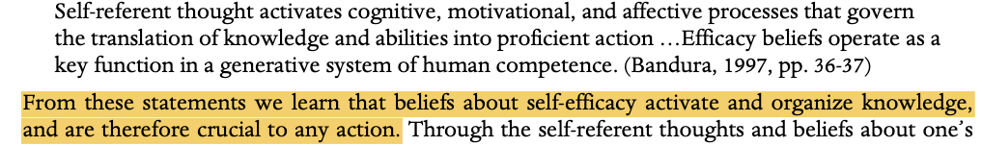
How to increase participation?
We cannot dictate the person to be involved in the politics
We (often) cannot change peoples SES and personality traits
Education programmes for increasing political sophistication:
-The Political Engagement Project (USA) – boost of many dimensions of democratic participation and identity (mostly with lower interest) + increase in political knowledge and skills (mostly with higher interest) (Beaumont et al. 2006)
-Civic education (Norway) – importance of enhancing self-efficacy in the political field (compared to civic competence)
Political knowledge as a good predictor of civic competence (less on motivation)
Self-efficacy as a predictor for motivation which increases participation ------→

Slide 31
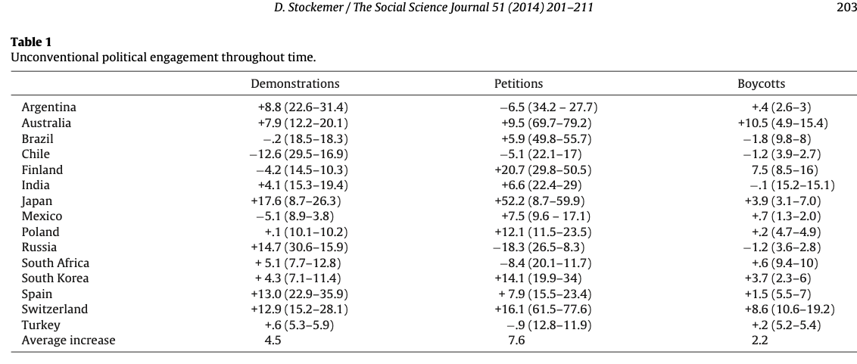
Summary of the first lecture block
Increase in the number of other participation activities in recent decades
Different techniques for different occasions
Different types of socio-economic groups participating in offline-online activities
The role of (not)sophisticated undecideds and non-voters in political outcomes
Seemingly unrelated factors and mechanisms hidden behind them (rain, sleep, long-lines,…)

Slide 32
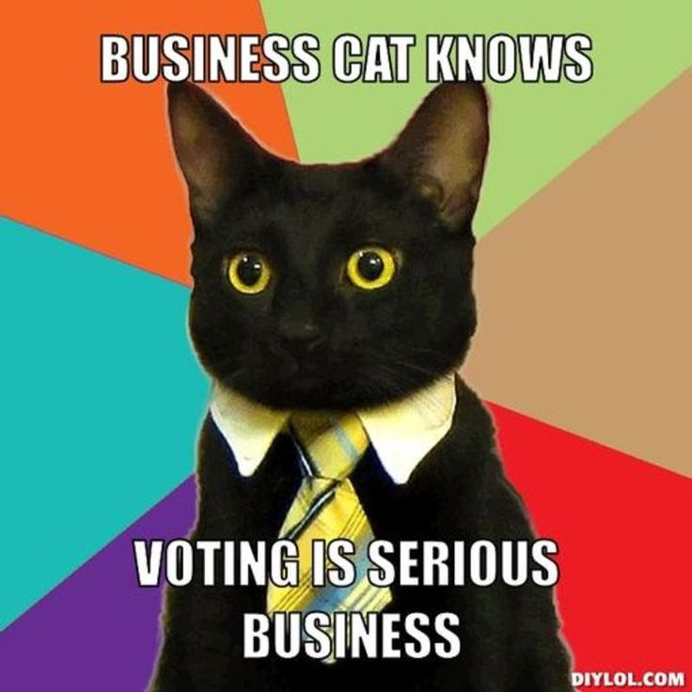
Next…

Slide 33
Literatute
Anderson, C., & Goodyear-Grant, E. (2010). Why are highly informed citizens sceptical of referenda?. Electoral Studies, 29(2), 227-238.
Brady, H. E. (1999). Political participation. Measures of political attitudes, 2, 737-801.
Chang, Y. B., Weng, D. L. C., & Wang, C. H. (2021). Personality traits and the propensity to protest: a cross-national analysis. Asian Journal of Political Science, 29(1), 22-41.
Clarke, H. D., Goodwin, M., & Whiteley, P. (2017). Why Britain voted for Brexit: An individual-level analysis of the 2016 referendum vote. Parliamentary Affairs, 70(3), 439-464.
Couture, J., & Breux, S. (2017). The differentiated effects of health on political participation. The European Journal of Public Health, 27(4), 599-604.
Ekman, J., & Amnå, E. (2012). Political participation and civic engagement: Towards a new typology. Human affairs, 22, 283-300.
Freymeyer, R. H., & Johnson, B. E. (2010). A cross-cultural investigation of factors influencing environmental actions. Sociological Spectrum, 30(2), 184-195.
Goldberg, A. C., & Sciarini, P. (2023). Voter turnout in direct democracy: A joint analysis of individual, referendum and community factors. European Journal of Political Research, 62(1), 25-46.
Harper, S. F., & Parry, J. A. (2023). The effect of signing ballot petitions on turnout. Journal of Elections, Public Opinion and Parties, 1-13.
Hastings, J., & Cann, D. (2014). Ballot titles and voter decision making on ballot questions. State and Local Government Review, 46(2), 118-127.
Hobolt, S. B. (2005). When Europe matters: The impact of political information on voting behaviour in EU referendums. Journal of elections, public opinion & parties, 15(1), 85-109.
Liu, J., Modrek, S., & Sieverding, M. (2019). The effects of political protests on youth human capital and well-being in Egypt. Social Science & Medicine, 243, 112602.
Matthews, F. (2021). The value of ‘between-election’political participation: Do parliamentary e-petitions matter to political elites?. The British Journal of Politics and International Relations, 23(3), 410-429.
Parry, J. A., Smith, D. A., & Henry, S. (2012). The impact of petition signing on voter turnout. Political Behavior, 34, 117-136.
Rudolph, L. (2020). Turning out to turn down the EU: The mobilisation of occasional voters and Brexit. Journal of European Public Policy, 27(12), 1858-1878.
Setyoko, P. I., Wahyuningrat, W., & Kurniasih, D. (2023). Factors of Successful E-Petitions in Policy Making Process: A Scoping Review. Policy & Governance Review, 7(1), 72-85.
Shuman, E., Goldenberg, A., Saguy, T., Halperin, E., & van Zomeren, M. (2024). When are social protests effective?. Trends in Cognitive Sciences, 28(3), 252-263.
Stockemer, D. (2014). What drives unconventional political participation? A two level study. The Social Science Journal, 51(2), 201-211.
Teorell, J., & Torcal, M. (2007). Political participation: Mapping the terrain. In Citizenship and involvement in European democracies (pp. 358-381). Routledge.
Ulo, K. L. M., Hidayanto, A. N., Sandhyaduhita, P. I., Fitriani, W. R., & Abidin, Z. (2019). Factors influencing internet users’ intention to sign e-petitions. Transforming Government: People, Process and Policy, 13(3/4), 257-275.
Van Egmond, M., De Graaf, N. D., & Van Der Eijk, C. (1998). Electoral participation in the Netherlands: Individual and contextual influences. European Journal of Political Research, 34(2), 281-300.
Verba, S. (1995). Voice and equality: Civic voluntarism in American politics. Harvard UP.
Wallace, S. J., Zepeda‐Millán, C., & Jones‐Correa, M. (2014). Spatial and temporal proximity: Examining the effects of protests on political attitudes. American Journal of Political Science, 58(2), 433-448.

