Slide 1
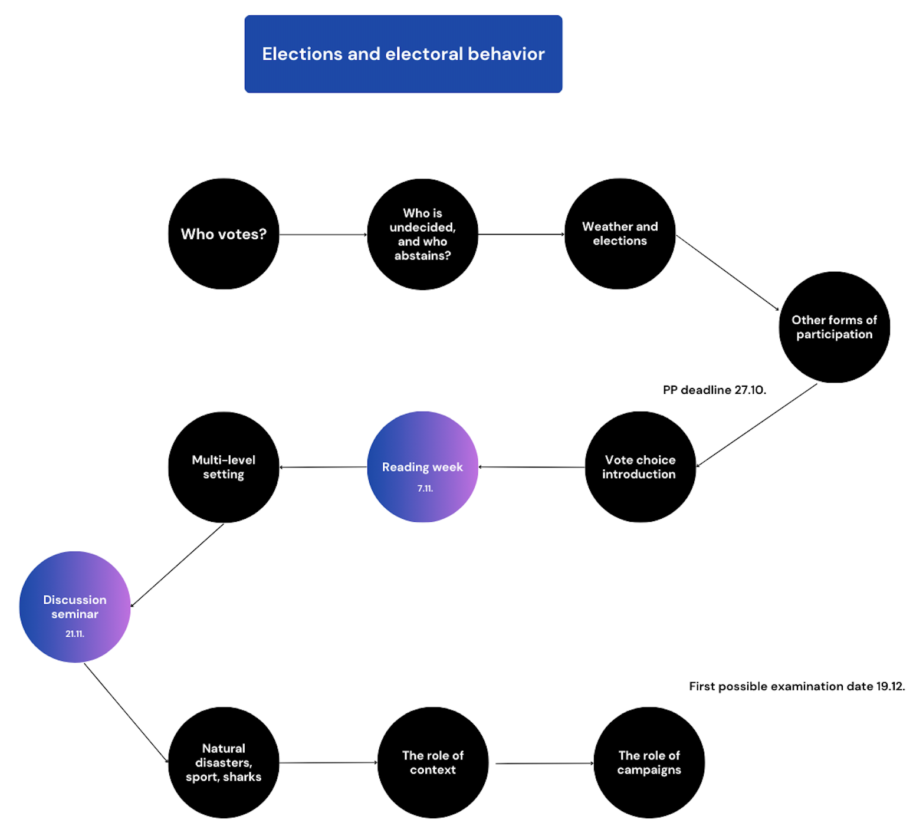

Slide 2
Introduction to the vote choice
Long-term factors determining voting behaviour
Jakub Jusko

Slide 3
Introduction
Definition: Vote choice as the decision-making process in which voters select candidates or options.
Why it matters: Helps predict election outcomes, understand political dynamics, and gauge democratic engagement.
Voting behaviour as the product of complex, overlapping influences—identity, social group, and rational interest—that shape, but don’t fully define, how we vote. No single factor or theory can fully capture this complexity.

Slide 4
Why study vote choice?
Relevance to democratic functioning.
Insights into political preferences.
Implications for party strategies and voter outreach.
Long term factors:
Ideology
Party identification
SES and class
Religion and ethnicity
Geography
+
Contemporary political systems factors

Slide 5
Theoretical foundations
Michigan Model: Emphasis on party identification.
Columbia Model: Sociological perspective - class, religion, and family.
Rational Choice Theory: Voters as rational actors making cost-benefit decisions.

Slide 6
Theoretical foundations
Columbia Model – Lazarsfeld, Berelson – The People’s choice
Representative sample surveys – Ohio 1940
Emphasis on social characteristics of voters
Campaign → reinforcement of early deciders, motivation of latent predispositions of others
1) class; 2) race/religion; 3) region (urban/rural)
Cross-pressures
BUT…

Slide 7

Theoretical foundations
Michigan Model – Campbell et al. – The American Voter
Emphasis on individual attitudes + identification with political parties
Psychological identification with parties as with other identities
This identification is a long-term component, and it persists through swings in voting
Identification is important not only directly (vote choice) but also indirectly (influence on attitudes)
Identification prior voting
Stable over time (but can change)
BUT…
P.S.: The American Voter Revisited (Lewis-Beck et al.)
- Members associating with the group vote in accordance with the group

Slide 8
Theoretical foundations
Rational Choice Theory
Derived from political economy – several political-economic theories:
Kenneth Arrow, Anthony Downs (spatial model)
The party that will do best is the party that voters' the ideological space closest to where most voters are also located – assuming, that is, that voters vote for the party closest to them in the ideological space. (in the USA, UK in the ideological middle – median voter) => The role of the voters’ utility
Parties that are located elsewhere would always do worse.
BUT…often not working -> more a reference point
+ valence of the candidates/parties
+ information about parties and voters' ideology

Slide 9
Factors associated with the vote choice

Slide 10
Ideology
“Politics is a complex and confusing arena of modern life” (Lipman)
Complicated world => ideologies as a tool for orientation
“a set of beliefs or principles, especially one on which a political system, party, or organization is based” (Cambridge)
Operational vs. symbolic ideology (Ellis and Stimson 2009)
O: coherent set of attitudes and beliefs
S: self-identification with ideological labels, such as left or right, or with groups denoted by such labels, such as liberals or conservatives
Top-down vs. bottom-up perspective
Unidimensional vs. multidimensional

Slide 11
Ideology
Unidimensional
French Revolution -> conflict between stability and progress
Right (Conservative, keeping the system, order, individualism, capitalism, nationalism, fascism)
Left (Progress, system change, equality, solidarity, protest, opposition, radical, socialism, communism)
Multidimensional
Economic
Social, post-materialist, GAL-TAN,…

Slide 12
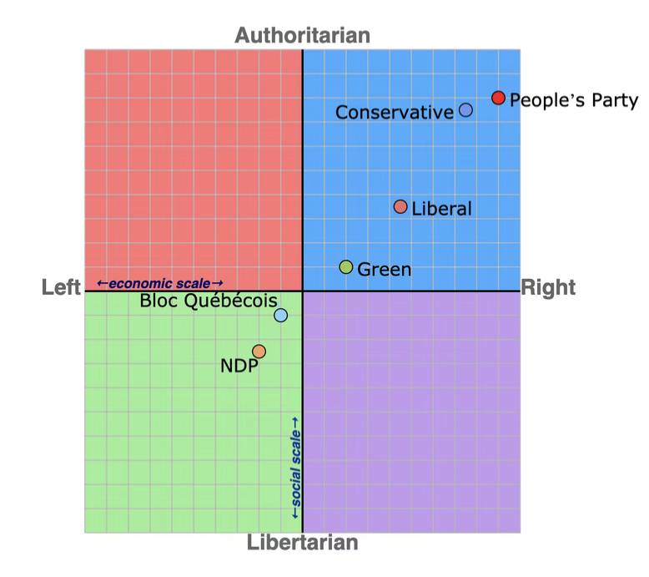
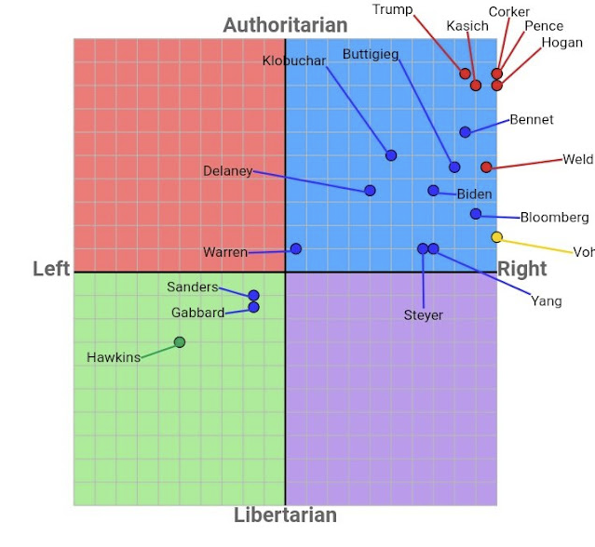
Ideology

Slide 13
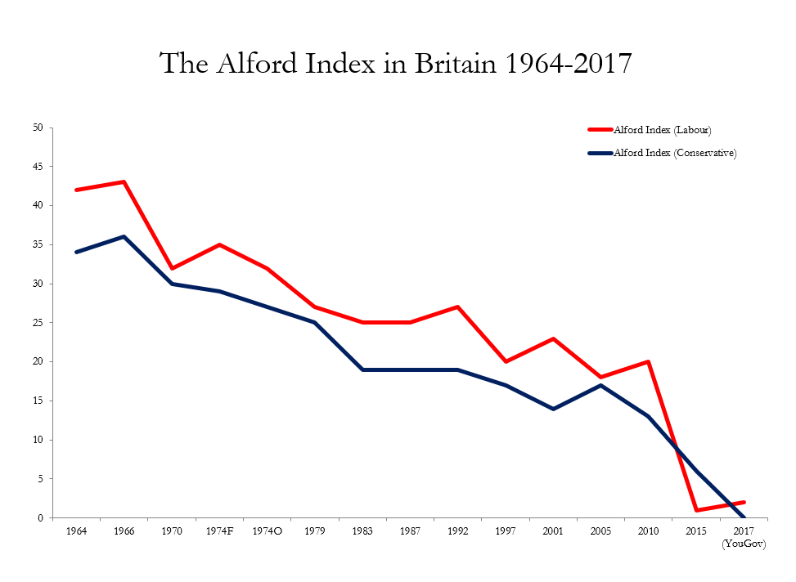
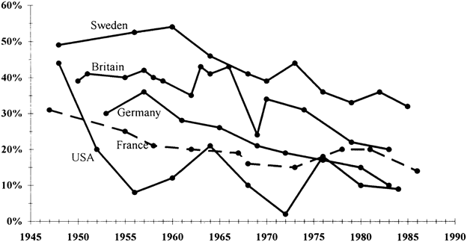
Class and socioeconomic status (SES)
Class – can mean different things (occupational classifications, employment status (e.g., owner versus employee), income, education,…
Class voting -> classical studies and the competition between working class (left-wing) and middle-class (right-wing)
The Alford Index - the percentage of manual workers that voted for left-­wing parties minus the percentage of nonmanual workers that voted for these parties

Slide 14
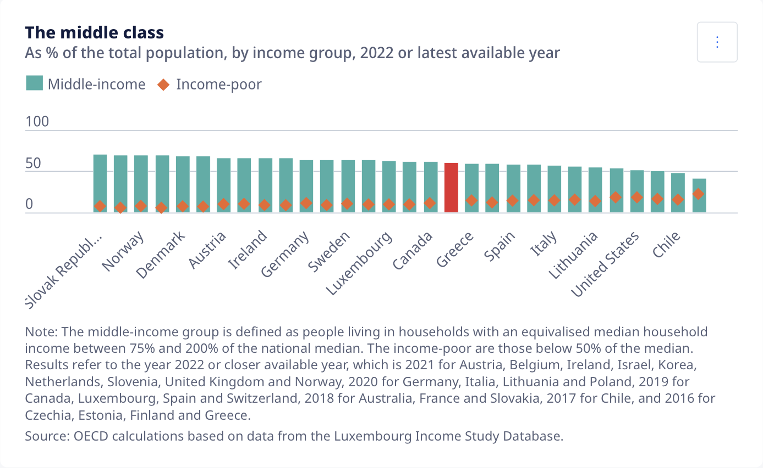
Class

Slide 15
Religion
Religion similar line of argumentation than class
Bottom-up approach – urbanisation, education, economic development changes, blurring of religious divisions
Top-down approach – political elites determine the relevance of religion to political choice through their strategic considerations
Religion in a general decline (80’) vs. the rise of religious issues
                However still important compared to class (Netherlands, USA, France), also newer democracies (Poland, Spain,…)
Shift from long-term party loyalties to more fluid issue-based voting -> class (and religion) important for issue positions (not party voting per se)
Research – from describing the decline to understanding the reasons for voting

Slide 16
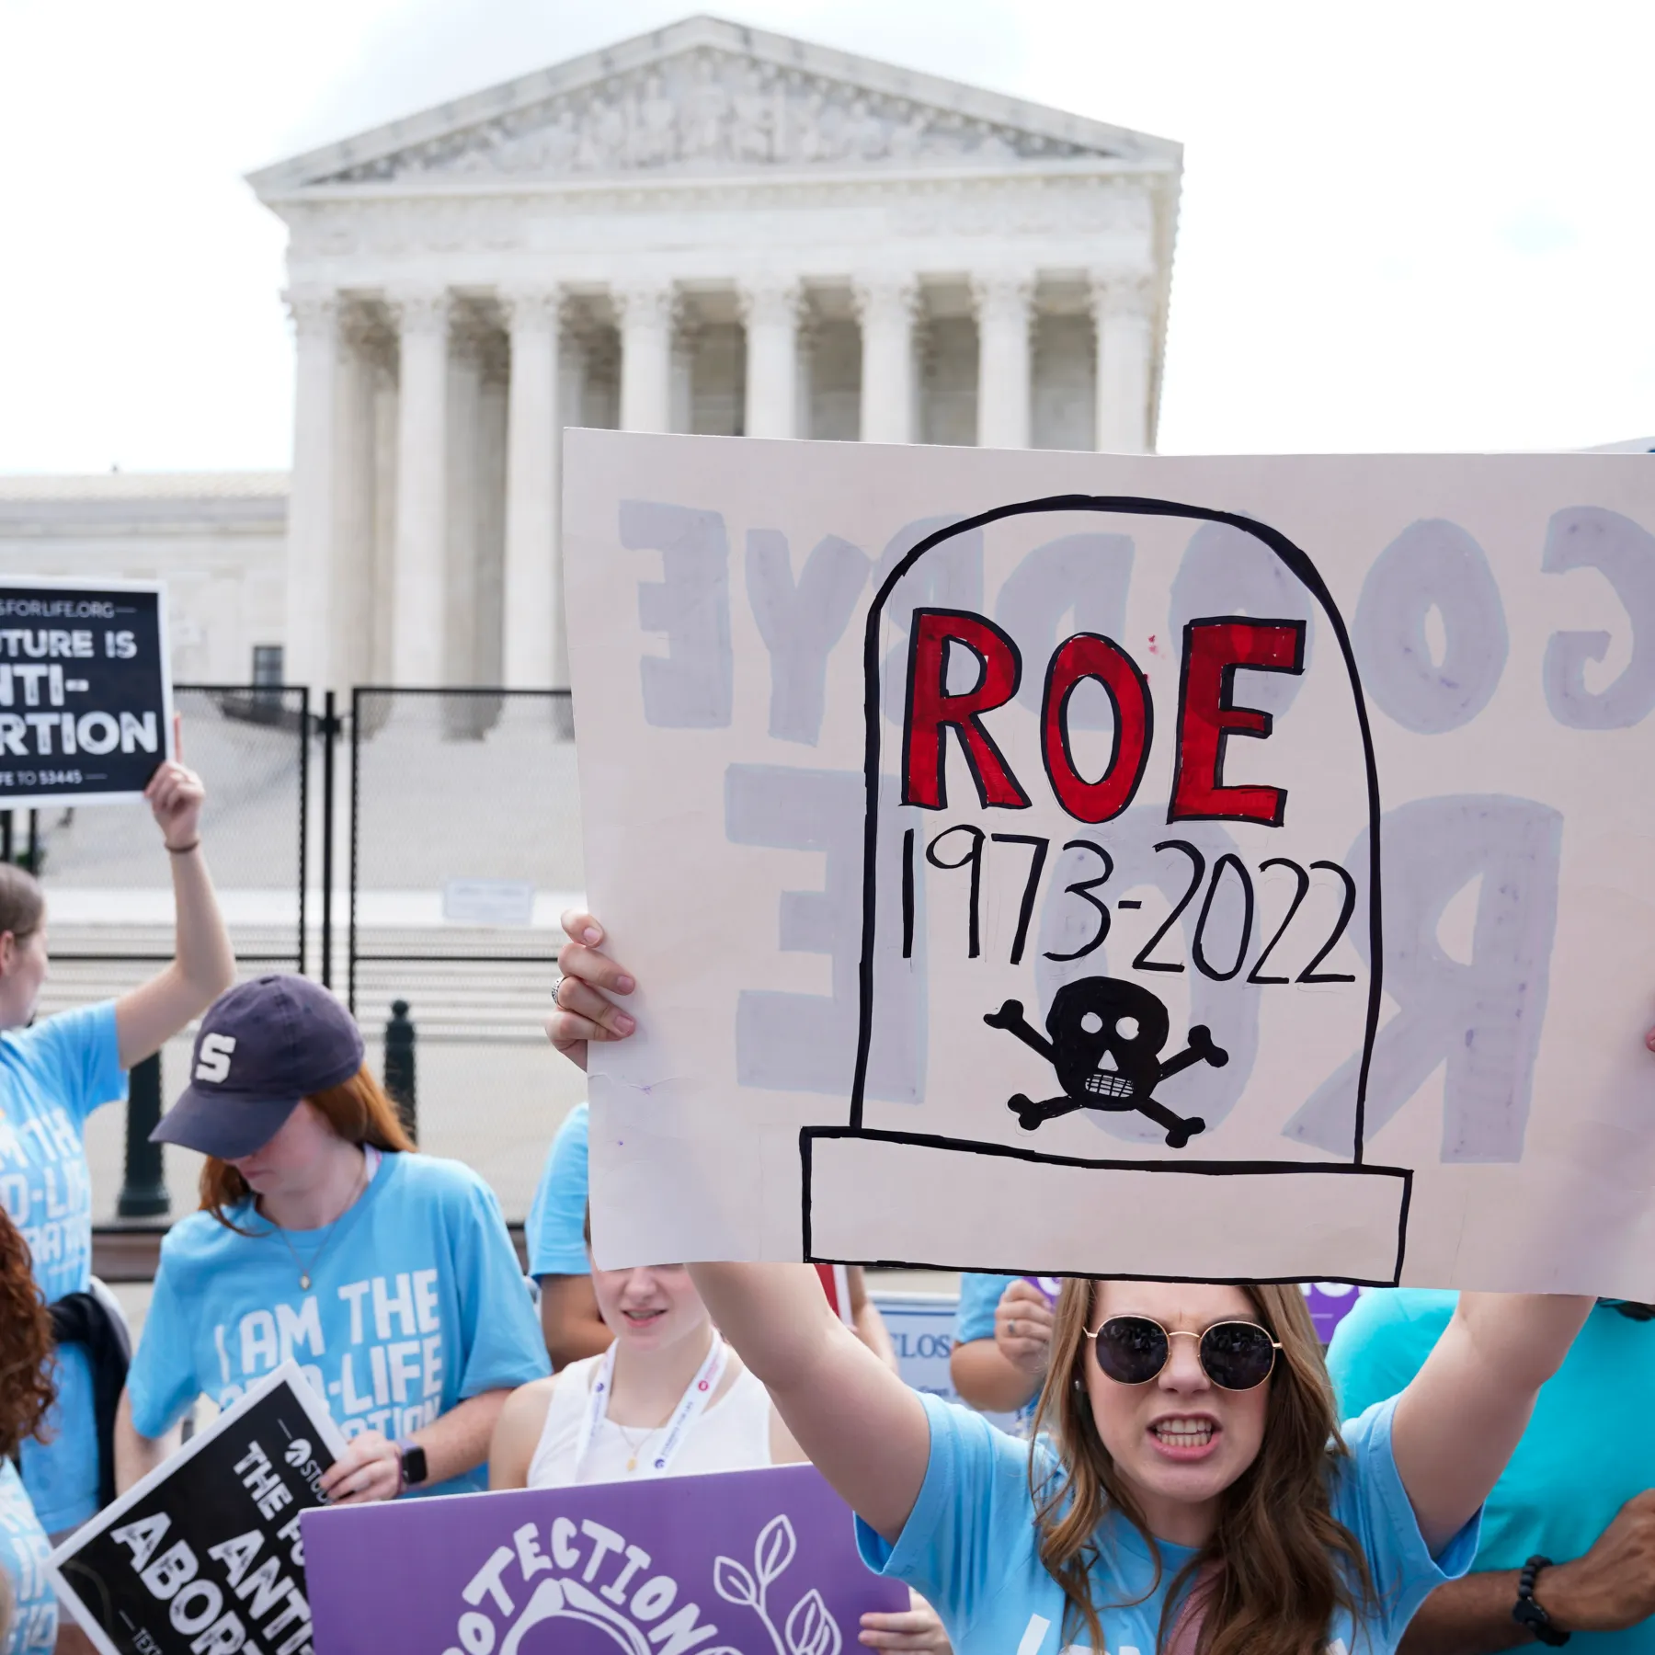
Religion and Ethnicity

Slide 17


Religion and Ethnicity

Slide 18
Party identification
…as a sense of personal attachment which an individual feels towards a party (of their choice)
Party identification helps to shape choices directly as well as indirectly - it helps to make sense of the information we receive
Example: how party identification may help to filter economic news
Behavioural changes: campaign activity, consistency voting, early decision
Also: a way of locating for people in the system, associated with interest in politics and elections (and turn out)
How it arises? Socialisation vs. habituation
Role of geography of voter

Slide 19
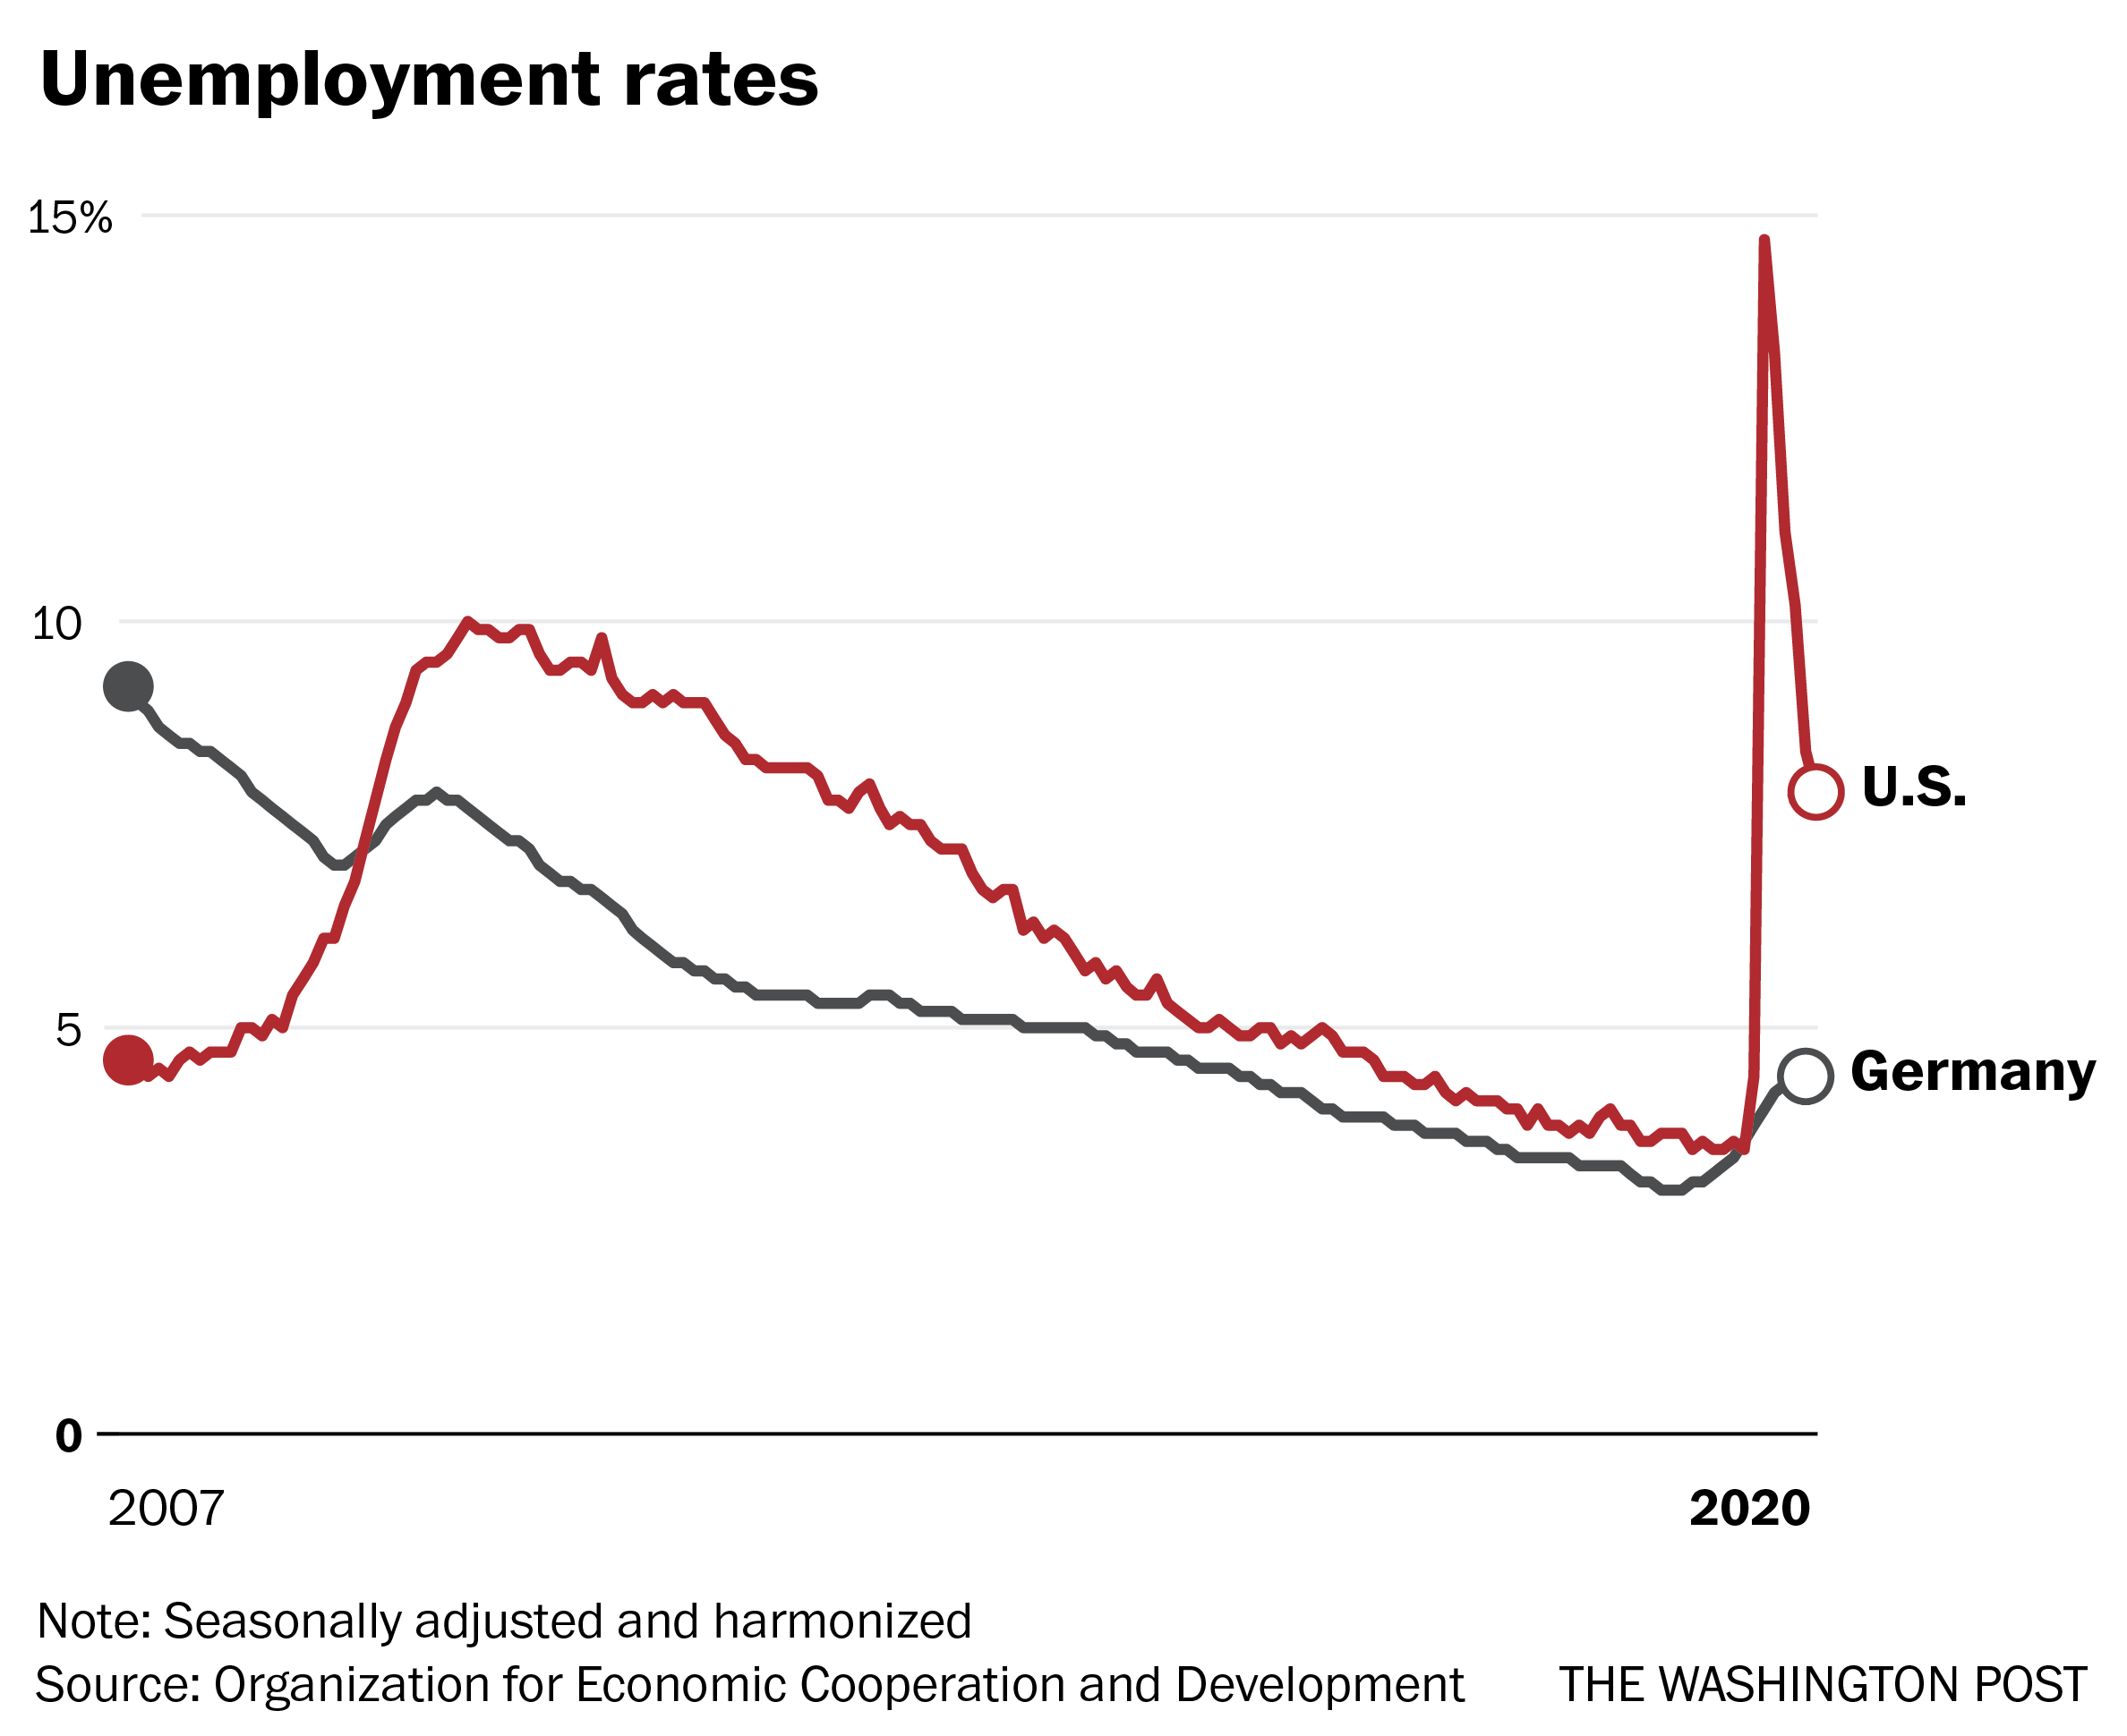
Religion and Ethnicity

Slide 20
Party identification
…as a sense of personal attachment which an individual feels towards a party (of their choice)
Party identification helps to shape choices directly as well as indirectly - it helps to make sense of the information we receive
Example: how party identification may help to filter economic news
Behavioural changes: campaign activity, consistency voting, early decision
Also: a way of locating for people in the system, associated with interest in politics and elections (and turn out)
How it arises? Socialisation vs. habituation
Role of geography of voter

Slide 21
Contemporary political systems and new reality

Slide 22
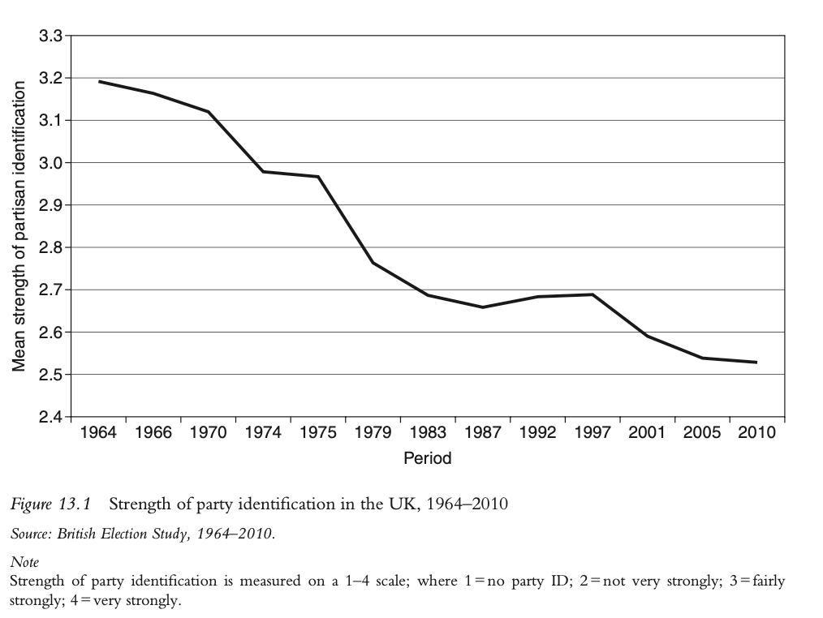
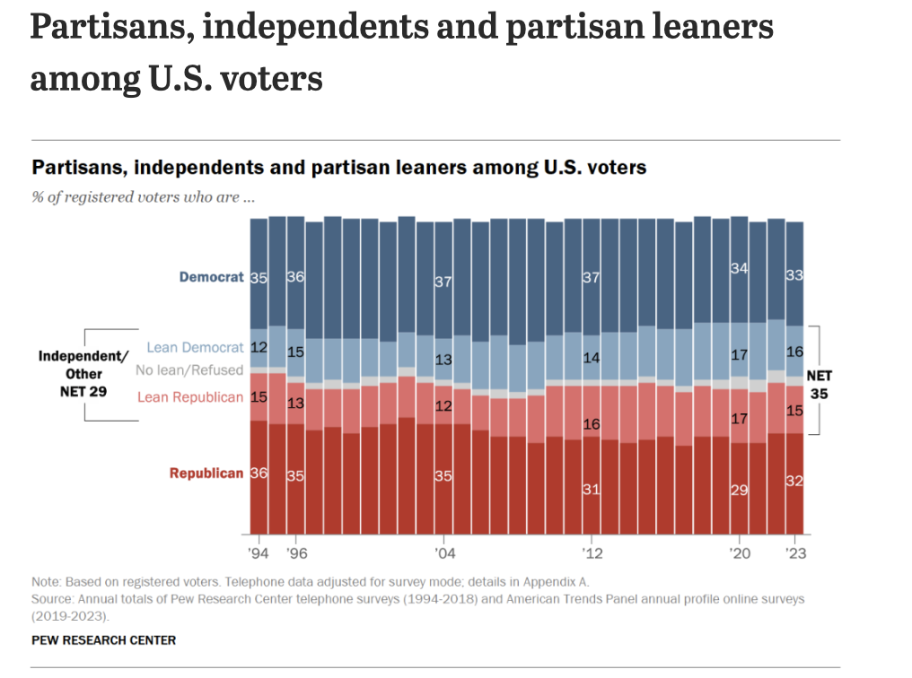
The decline of party loyalty
Role of social changes and political changes in the society

Slide 23
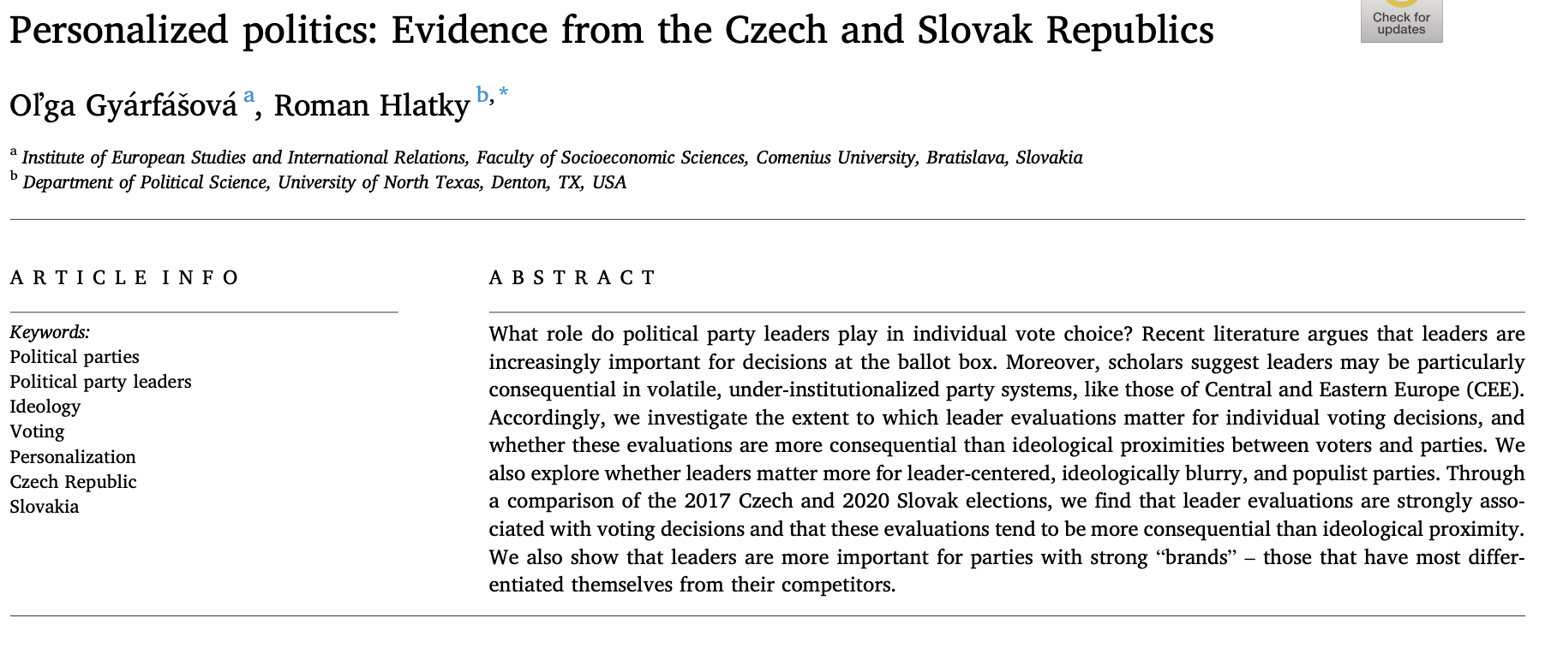
The decline of party loyalty
Examples:
Shift toward personality-based voting in France (e.g., Macron).
Volatile voting behaviour in post-communist countries.

Slide 24
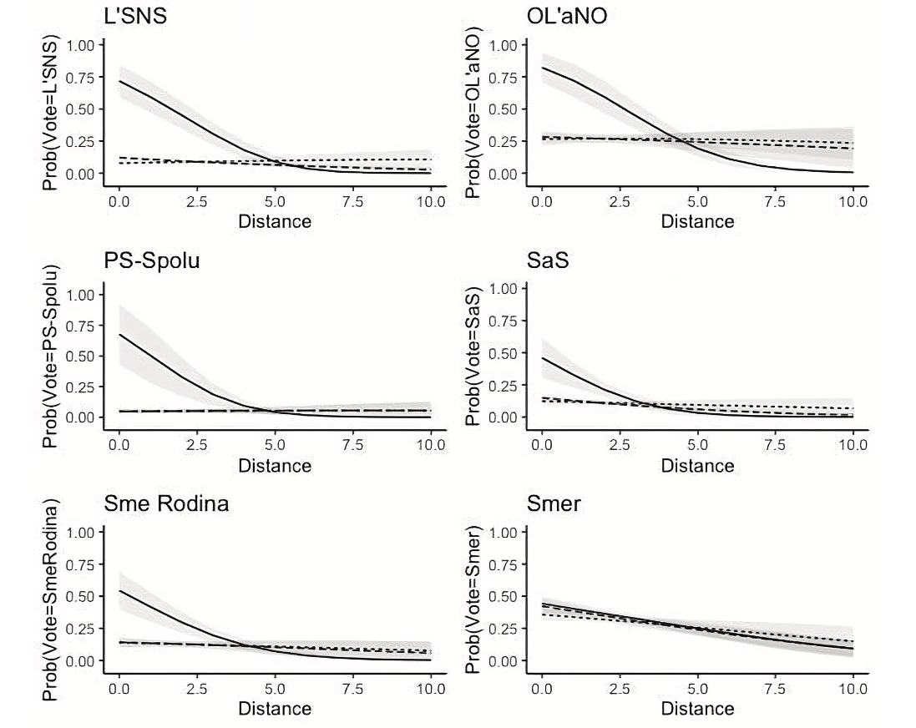
The decline of party loyalty
Examples:
Shift toward personality-based voting in France (e.g., Macron).
Volatile voting behaviour in post-communist countries.

Slide 25
New socioeconomic realities
Impact of globalization: How global economic shifts affect voting behaviour
Examples:
Economic restructuring in post-industrial regions
Increased support for populism in economically declining regions
Economic shocks significantly influence political attitudes and voting behaviour, with negative shocks generally increasing support for left-leaning policies and redistribution (Margalit 2019). BUT decrease trust in political institutions, potentially driving voters towards populist parties or disengagement
Regional economic factors, such as long-term structural changes, impact of the Great Recession, and current economic conditions (regions with low, but rising immigrant shares, old industrial regions, smaller regions) -> shaping populist vote shares (Essletzbichler et al. 2018).
Globalization as strengthening link between economic performance and voting behaviour by providing citizens with more comparative information (Park 2023).

Slide 26
Rise of identity politics
The role of personal identity (e.g., race, gender, sexual orientation) in vote choice.
Examples:
Growing importance of national identity in European elections.
Gender and identity issues in South American elections.
Cognitive models -> policy positions and social identities compete, rather than simply combine, to determine voter preferences (Jenke and Huettel 2016). Aka internal ambivalence
Endorsements from marginalized community organizations can influence voter evaluations as much as candidate demographics (particularly for LGBT-endorsed candidates) -> process associational affect (Bell and Borelli 2023).
Xenophobia, racial resentment and sexism, white identity influenced primary voting and potential 2020 voting intentions -> Trump (Buyuker et al., 2021)

Slide 27
Summary
Long-term factors historically shape voting behaviour but are evolving
Lasting role of personal ideology, class, religion, ethnicity, political identification on voting behaviour, although in different ways than it used to
More focus on valence and issues
Contemporary influences like identity politics and SES are reshaping voter loyalty and choices.

Slide 28
Activity
Do you know the voter based on their characteristics?

Slide 29

Turkey
Profile: Mohammed, 40, a Sunni Muslim shop owner in Istanbul, Turkey
Long-Term Influences: Strong religious beliefs, commitment to Islamic values, and concerns about secularization.

Slide 30

Spain
Profile: Elena, 43, a farmer in rural Castilla-La Mancha, Spain
Long-Term Influences: Agricultural background, reliance on EU subsidies, preference for rural development policies.

Slide 31

Italy
Profile: Giovanni, 61, an entrepreneur in Milan, Italy
Long-Term Influences: High-income, business-focused, interested in tax reduction and economic liberalization.

Slide 32

Ukraine
Profile: Andriy, 42, an Orthodox Christian in Lviv, Ukraine
Long-Term Influences: Strong national identity, traditional values, concerns about cultural autonomy, and a pro-European outlook.

Slide 33

Sweden
Profile: Sven, 34, an unemployed worker, in Stockholm, Sweden

Slide 34

Germany
Profile: Lukas, 22, a university student in Munich, Germany
Long-Term Influences: Climate-conscious, progressive social values, tech-savvy, concerns about environmental issues.

Slide 35
Germany
Profile: Lukas, 22, a university student in Munich, Germany
Long-Term Influences: Climate-conscious, progressive social values, tech-savvy, concerns about environmental issues.
Lukas is enthusiastic about the Green Party’s environmental policies, but he’s worried about job opportunities post-graduation in a potentially slower economy due to the Greens’ ambitious environmental goals. With pressure from his parents to consider job security, he’s contemplating voting for the …, which offers a more moderate approach to both job growth and climate initiatives.

Slide 36

USA
Profile: Emma, 56, a schoolteacher in Ohio, USA
Long-Term Influences: Comes from a family of lifelong Democrats, values social programs, education funding, and workers’ rights.

Slide 37
USA
Profile: Emma, 56, a schoolteacher in Ohio, USA
Long-Term Influences: Comes from a family of lifelong Democrats, values social programs, education funding, and workers’ rights.
Emma’s neighbourhood has experienced an uptick in crime, and she feels the Democratic Party’s approach to policing doesn’t address her concerns fully. Although she typically votes Democratic due to her background and social beliefs, she’s now considering the …, which takes a stronger stance on crime control and law enforcement.

Slide 38
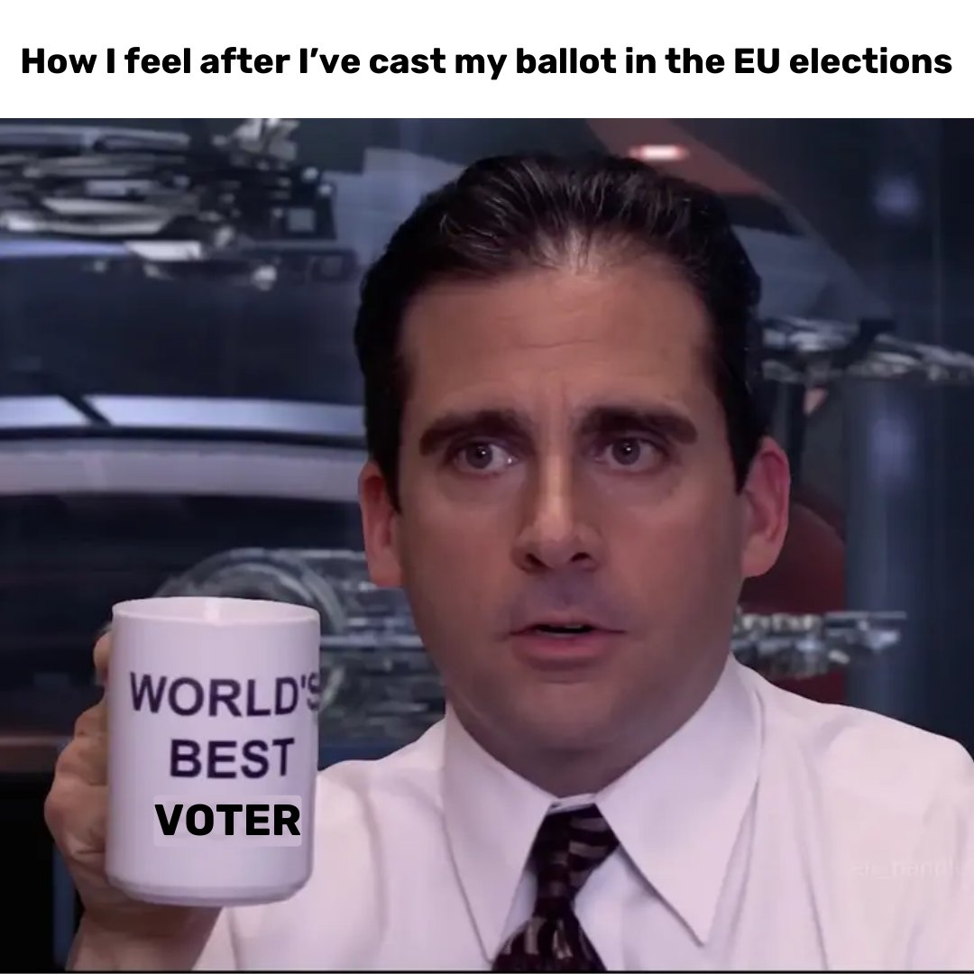
Next…

Slide 39
Literatute
Bell, R., & Borelli, G. (2024). Marginalization by Proxy: Voter Evaluations at the Intersection of Candidate Identity and Community Ties. Politics & Gender, 20(2), 422-448.
Buyuker, B., D'Urso, A. J., Filindra, A., & Kaplan, N. J. (2021). Race politics research and the American presidency: thinking about white attitudes, identities and vote choice in the Trump era and beyond. Journal of Race, Ethnicity, and Politics, 6(3), 600-641.
https://dictionary.cambridge.org/dictionary/english/shout-out#google_vignette
Campbell, A., Converse, P. E., Miller, W. and Stokes, D. (1960) The American Voter, New York: Wiley.
Downs, A. (1957) An Economic Theory of Democracy, New York: Harper and Row.
Ellis, C. and Stimson, J. A. (2009) “Symbolic Ideology in the American Electorate,” Electoral Studies, vol. 28, no. 3, September, 388–402.
Essletzbichler, J., Disslbacher, F., & Moser, M. (2018). The victims of neoliberal globalisation and the rise of the populist vote: a comparative analysis of three recent electoral decisions. Cambridge Journal of Regions, Economy and Society, 11(1), 73-94.
Feldman, S. and Johnston, C. (2014) “Understanding the Determinants of Political Ideology: Implications
of Structural Complexity,” Political Psychology, vol. 35, no. 3, June, 337–358.
Gyárfášová, O., & Hlatky, R. (2023). Personalized politics: Evidence from the Czech and Slovak Republics. Electoral Studies, 81, 102567.
Lazarsfeld, P., Berelson, B., and Gaudet, H. (1944) The People’s Choice, New York: Duell, Sloane, and Pearce.
Lewis-­ Beck, M., Jacoby, W. G., Norpoth, H., and Weisberg, H. F. (2008) The American Voter Revisited, Ann Arbor: University of Michigan Press.
Margalit, Y. (2019). Political responses to economic shocks. Annual Review of Political Science, 22(1), 277-295.
Park, B. B. (2023). How does economic openness affect the relative economic voting?. European Political Science Review, 15(4), 562-581.
Powell, E. N., & Tucker, J. A. (2014). Revisiting electoral volatility in post-communist countries: New data, new results and new approaches. British Journal of Political Science, 44(1), 123-147.
https://www.politicalcompass.org

