Slide 1
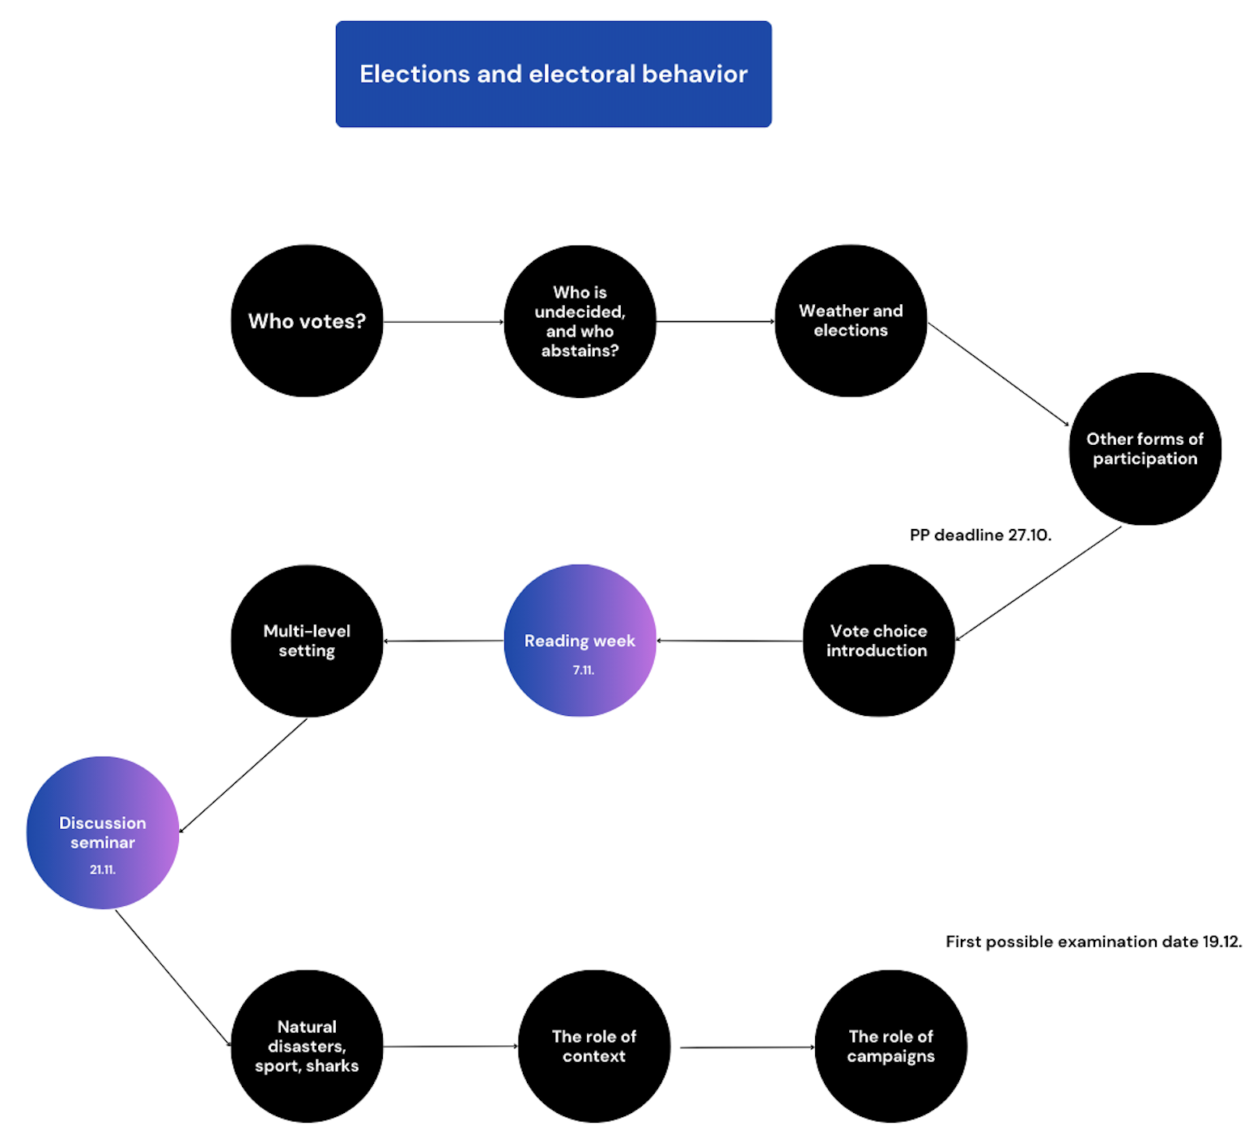

Slide 2
Voting in a multi-level electoral setting
Jakub Jusko

Slide 3
Multilevel dynamics of electoral politics
The need for understanding differential behaviour between different levels of governance
Especially relevant in federal states (e.g. Belgium, Canada, Germany, the US or Spain) -> the US as the starting point for the other research
+ shift of authority from the national to the subnational or supranational level (EU)
Turnout -> similar discussion to the first lecture BUT how do factors work in different settings?
Vote choice -> several theories of how voters behave and why they defect (fluctuate) in party voting in different settings

Slide 4
Turnout

Slide 5
Turnout
Why is turnout (usually) higher in one election type and lower in the other?
Conventional wisdom -> participation is lower at the subnational (regional, local) or supranational (European) level
There is less at stake in non-national elections -> “second-order election” theory
Evidence:
- 9 federations (2003-2006) -> less than 10 points difference between regional and national elections (but sometimes regional elections showed higher turnout)
- 21 European countries (1990-2014) -> around 10 points difference between local and national elections (except France)

Slide 6
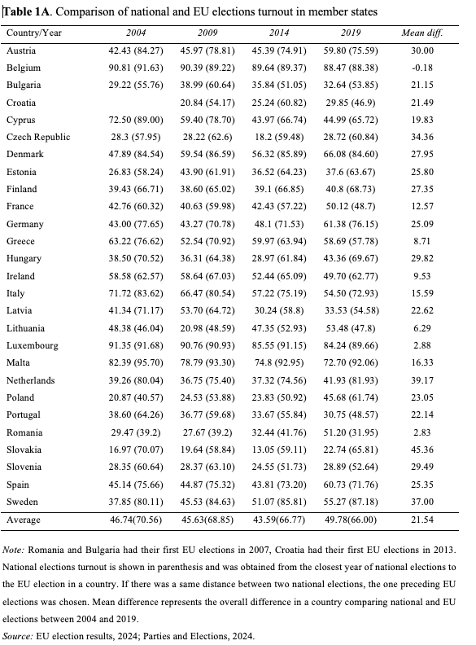
Next…

Slide 7
Aggregate level
Some aggregate level factors are affecting differently voter turnout:
Population size better explaining T at subnational level
Political factors (campaign expenditures) better explaining T at national level
Turnout gap smaller when there is more at stake (local autonomy index) -> not as significant as…
Synchronisation of electoral cycles
Compulsory voting and closeness (through interest) -> moderation effect is stronger in European elections compared to national
Decentralisation (in Spain and Canada) -> turnout in regional elections
Some others are not:
- Degree of (regional) authority
- Revenues and spending of reg. entities (both turnout in national elections)

Slide 8
Individual level
Henderson and McEwen (2015) – 29 regions (Canada, UK, Spain)
Regional identity
Perceived importance of the election => reg. elections turnout
Blais and Daoust (2020) – 2011-2015 - regional, national, subnational
- Little variance in the means of predispositions for voting -> political interest, D, B, C (rational choice theory)
Exception -> D and B in European elections is smaller!

Slide 9
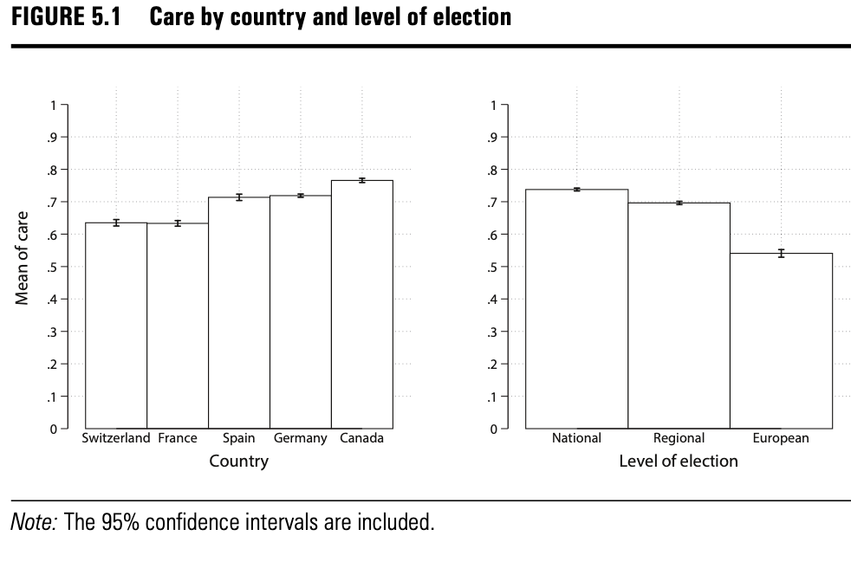
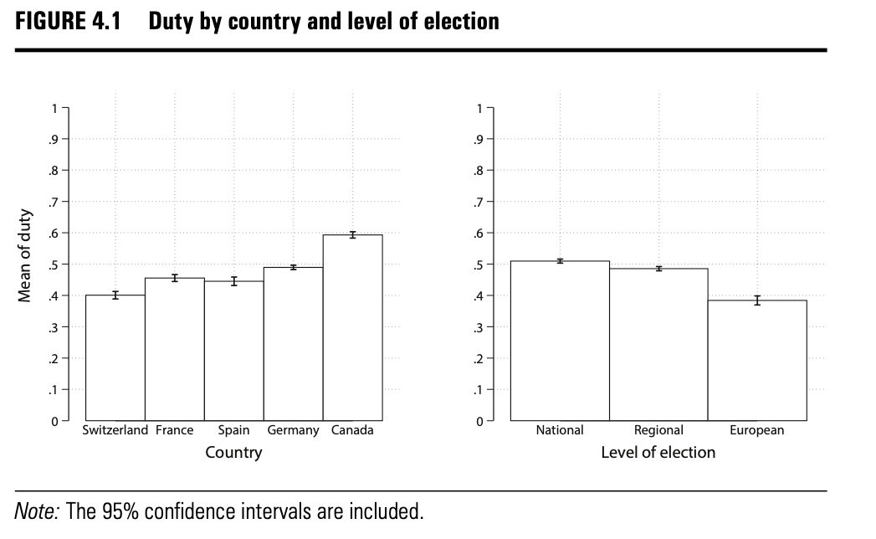

Slide 10
Individual level
Franklin and Hobolt (2011): elections as habitual activity
Those, who vote in EU elections have acquired a habit of voting at a previous occasion (national election mostly)
Potential problem when first elections of a voter are EU elections
Kostelka et al. (2019): gender gap?
No gender gap in national elections
Women systematically vote less in supranational (EU)
Overall, supranational (EU) elections turnout more sensitive to changes in individual characteristics (regional less -> D or C almost the same)

Slide 11
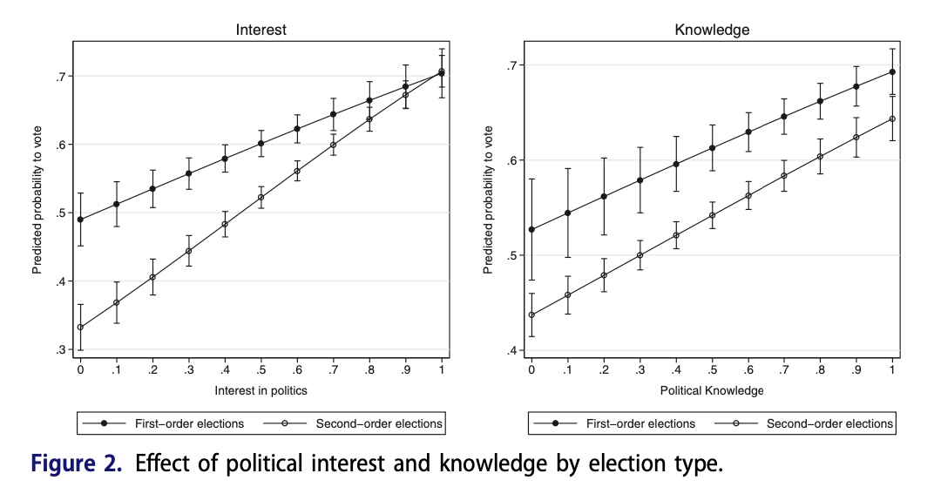
Individual level
Kostelka et al. (2019): gender gap?

Slide 12
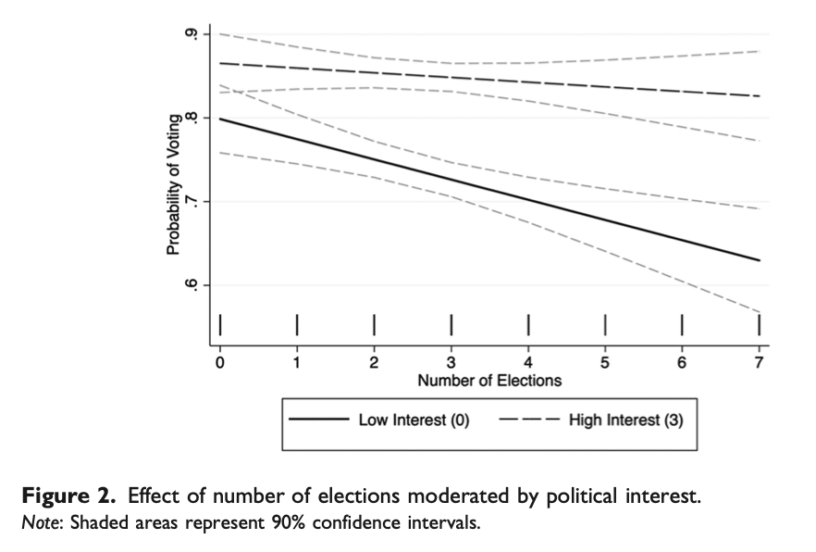
Individual level
Nonnemacher (2021): voter fatigue

Slide 13
Vote choice

Slide 14
Vote choice
Start of the theory in the US –> comparison of general and mid-term elections
Surge and decline theory
Referendum theory
Balancing theory
Difference in the US and European elections –> the role of the electoral cycle + multiparty system
The second-order theory by Reif and Schmitt (1980)

Slide 15
Surge and decline
A. Campbell (1960)
Reasons for mid-term loss of presidential party:
- level of political stimulation
political interest
party identification
Presidential elections important and “high stimulus” -> who is running the country
Normal vote vs. short-term deviation

Slide 16
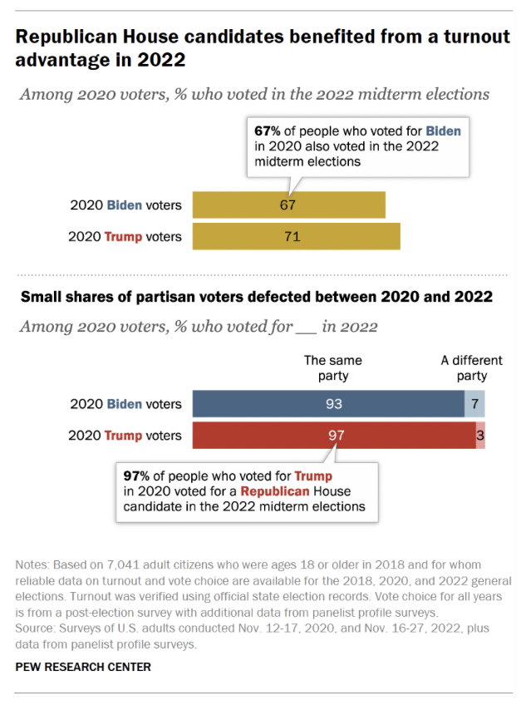
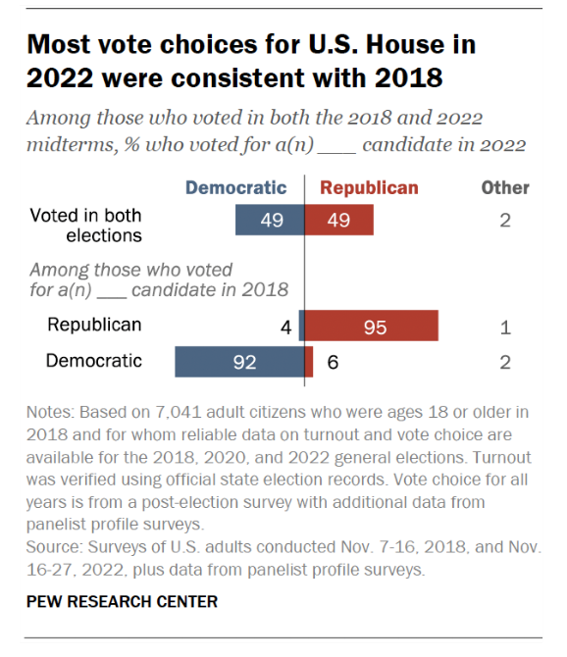

Slide 17
Referendum and accountability
Tufte (1975)
Mid-term elections serving as a referendum:
Evaluation of the president’s performance
Evaluation of the performance of the economy
Accountability at the heart of a healthy democracy -> voters are aware which level is responsible for which domain -> reward/punish mechanisms
Evidence from Canada, France, Germany, Spain (González-Sirois and Bélanger, 2019; Golder et al., 2017)
Related to economic voting and pledges

Slide 18
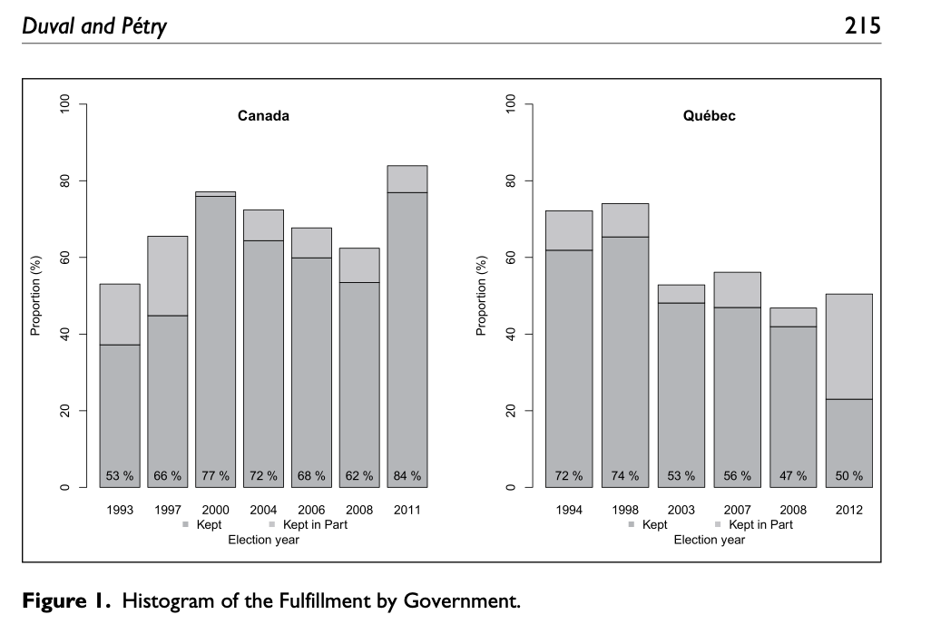
Referendum and accountability

Slide 19
Balancing
Alesina and Rosenthal 1989, 1995
Voters split their ticket between elections by supporting one party for the presidency and another one for the Congress -> aim for divided government
Promoting policy moderation, seeking ”balance”
Difficult to show the motivation but…
-Kern and Hainmueller (2006) – midterm losses (in state elections) by national party more prevalent when they control lower and upper chambers
-Canada (1935-1953) – five wins at national level but not always in provincial governments

Slide 20
Second-order election theory
Low stimulus elections arguments developed in the US context generalised by Reif and Schmitt (1980) -> first EP elections in 1979
Central idea: there is “less at stake” in SOE than in FOE (typically national parliamentary) -> for voters, media, parties
Exposure to campaigns in SOE should be lower, mostly caused by inactivity of media and parties
The vote in SOE is shaped by how people feel about national politics (the incumbent party at the national level) -> national level considerations prominent in other levels as well
Less important => room for all kinds of considerations not related with the policies representatives are responsible for (weather, ballot order,…)

Slide 21
Second-order election theory
Main point of reference for the study of less important elections – local, regional, EU, by-elections, mid-term elections
However, not all are equally unimportant -> the concept of local elections as “one and three-quarters order” (Heath et al., 1999)
Other properties:
- The role of electoral cycle
- Multiparty setting – party size important -> government parties
-> big parties
-> smaller parties
Mechanisms: protest voting (voting with the boot), voting with the heart

Slide 22
Second-order election theory
Main point of reference for the study of less important elections – local, regional, EU, by-elections, mid-term elections
However, not all are equally unimportant -> the concept of local elections as “one and three-quarters order” (Heath et al., 1999)
Other properties:
- The role of electoral cycle
- Multiparty setting – party size important -> government parties
-> big parties
-> smaller parties
Mechanisms: protest voting (voting with the boot), voting with the heart

Slide 23
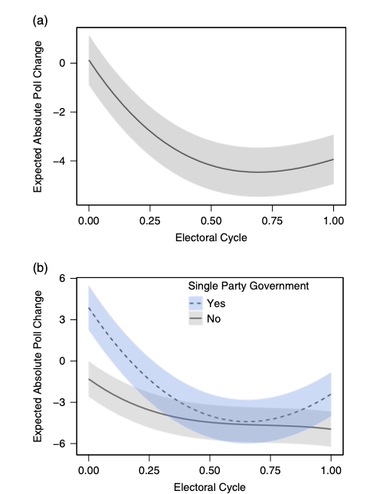
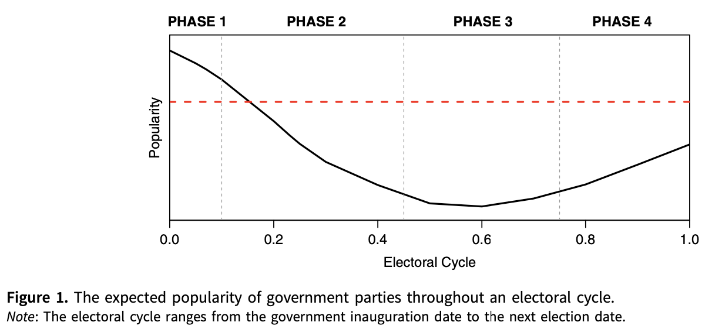
Mueller and Louwerse (2020)
171 cycles in 22 countries -> government parties lose support during the first half of the electoral cycle, but at most partially recover from their initial losses.
Stronger effects with single-party governments
Harder to recover since the 2000s

Slide 24
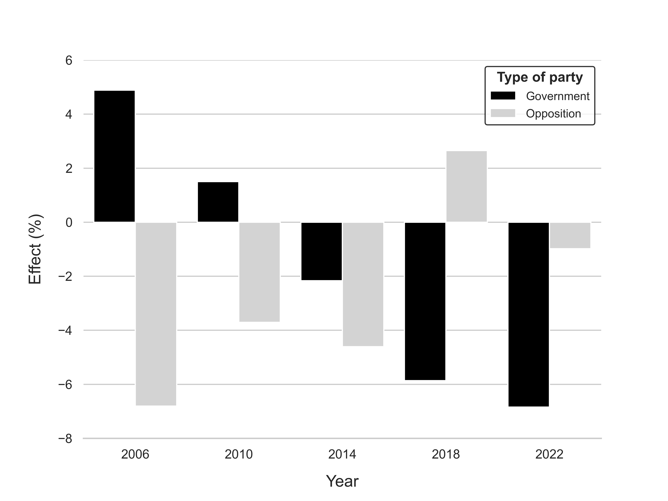

Slide 25
Second-order election theory
A lots of evidence, but also exceptions -> 2004 EU elections,
regional elections in some states,…
Consequences of SOE for FOE:
SOE and impact on national party systems -> “midwife assisting in the birth of new parties” (FN, UKIP, green parties,…)
SOE and further depressing of turnout in FOE
Better chances for getting into the national parliament?
Hájek (2017) Multiple office holding
Positive effects -> plenary sessions, bills
Negative effects -> committee meetings, addressed speeches

Slide 26
Summary
Multiple levels, different behaviours
The role of SOE in the perceived importance by the voters and the need for participation
Different theoretical foundations for explaining defection in SOE -> surge and decline, referendum, balance or general SOE theory
Often important a particular context – media attention, time in electoral cycle, which type of SOE, which country,…

Slide 27
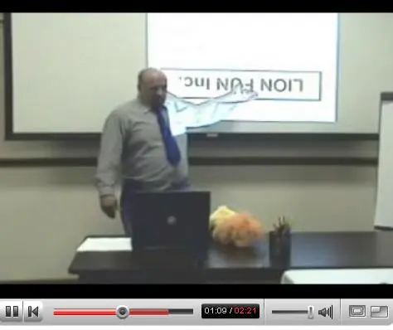

Next…

Slide 28
Literatute
Alesina, A., & Rosenthal, H. (1995). Partisan politics, divided government, and the economy. Cambridge University Press.
Anderson, C. D. (2008). Economic voting, multilevel governance and information in Canada. Canadian Journal of Political Science/Revue canadienne de science politique, 41(2), 329-354.
Blais, A., & Daoust, J. F. (2020). The motivation to vote: Explaining electoral participation. UBC Press.
Blais, A., Anduiza, E., & Gallego, A. (2011). Decentralization and voter turnout. Environment and Planning C: Government and Policy, 29(2), 297-320.
Campbell, A. (1960). Surge and decline: A study of electoral change. Public opinion quarterly, 24(3), 397-418.
Cancela, J., & Geys, B. (2016). Explaining voter turnout: A meta-analysis of national and subnational elections. Electoral studies, 42, 264-275.
Daoust, J. F., & Blais, A. (2021). Electoral behaviour in multilevel systems. In Handbook on decentralization, devolution and the state (pp. 255-268). Edward Elgar Publishing.
Franklin, M. N., & Hobolt, S. B. (2011). The legacy of lethargy: How elections to the European Parliament depress turnout. Electoral Studies, 30(1), 67-76.
Gendzwill, A. (2021). Local autonomy and national–local turnout gap: Higher stakes, higher turnout?. Regional & Federal Studies, 31(4), 519-539.
Golder, S. N., Lago, I., Blais, A., Gidengil, E., & Gschwend, T. (2017). Multi-level electoral politics: Beyond the second-order election model. Oxford University Press.
González-Sirois, G., & Bélanger, É. (2019). Economic voting in provincial elections: Revisiting electoral accountability in the Canadian provinces. Regional & Federal Studies, 29(3), 307-327.
Hájek, L. (2017). The effect of multiple-office holding on the parliamentary activity of MPs in the Czech Republic. The Journal of Legislative Studies, 23(4), 484-507.
Heath, A., McLean, I., Taylor, B., & Curtice, J. (1999). Between first and second order: A comparison of voting behaviour in European and local elections in Britain. European Journal of Political Research, 35(3), 389-414.
Henderson, A., & McEwen, N. (2010). A comparative analysis of voter turnout in regional elections. Electoral Studies, 29(3), 405-416.
Lefevere, J., & Van Aelst, P. (2014). First-order, second-order or third-rate? A comparison of turnout in European, local and national elections in the Netherlands. Electoral Studies, 35, 159-170.
Lutz Kern, H., & Hainmueller, J. (2006). Electoral balancing, divided government and ‘midterm’loss in German elections. The Journal of Legislative Studies, 12(2), 127-149.
Kostelka, F., Blais, A., & Gidengil, E. (2019). Has the gender gap in voter turnout really disappeared?. West European Politics, 42(3), 437-463.
Reif, K., & Schmitt, H. (1980). Nine second‐order national elections–a conceptual framework for the analysis of European Election results. European journal of political research, 8(1), 3-44.
Schmitt, H. (2005). The European Parliament elections of June 2004: still second-order?. West European Politics, 28(3), 650-679.
Söderlund, P., Wass, H., & Blais, A. (2011). The impact of motivational and contextual factors on turnout in first-and second-order elections. Electoral studies, 30(4), 689-699.
Tufte, E. R. (1975). Determinants of the outcomes of midterm congressional elections. American Political Science Review, 69(3), 812-826.
Van der Eijk, C., Franklin, M., & Marsh, M. (1996). What voters teach us about Europe-wide elections: What Europe-wide elections teach us about voters. Electoral Studies, 15(2), 149-166.
Wrong, D. H. (1957). The pattern of party voting in Canada. Public Opinion Quarterly, 21(2), 252-264.

