Slide 1
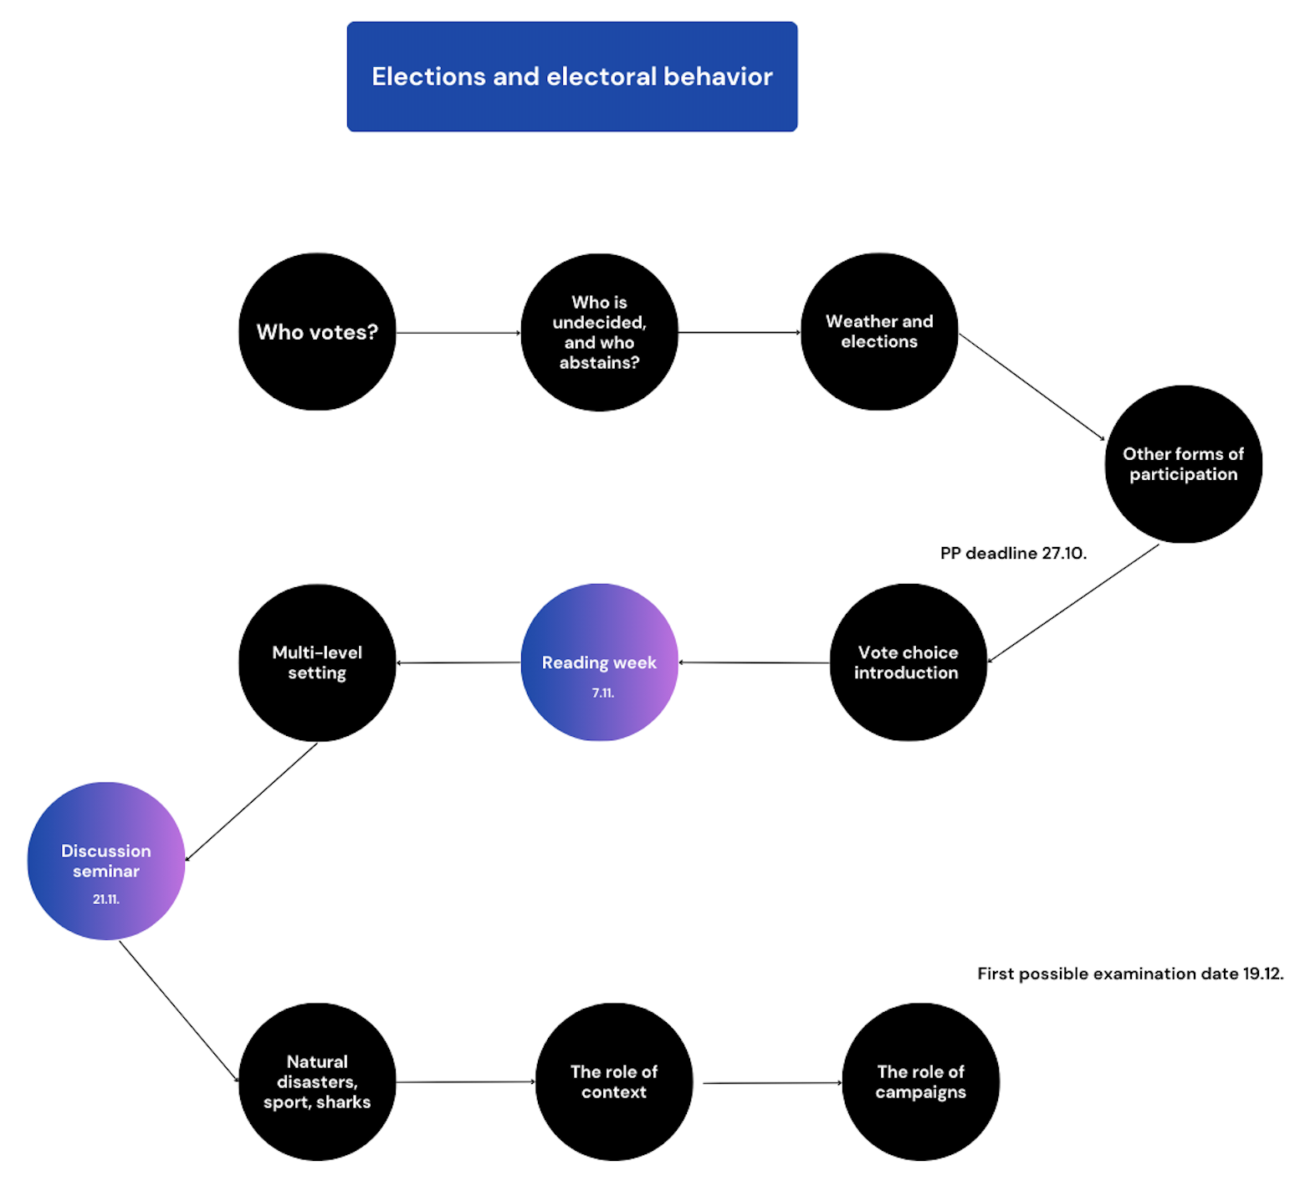

Slide 2
Seemingly unrelated events
Jakub Jusko

Slide 3
Seemingly unrelated events
The classic notion that voters should use all relevant information to make a rational decision-making
However, voters are emotional beings; many things happen between the pre-election campaign campaign to the moment of casting a ballot
Health problems, life - changing events, and normal events seemingly unrelated to the electoral process
Associated with a decision to turnout and/or support a certain type of candidate/party

Slide 4
Voter rationality
The classic notion of how voters decide who to vote for – rational vs irrational voter
The question of retrospective vs. prospective voters
The question of responsive vs. attentive voters
The question of voting-> economic voting
-Socio-tropic or ego-tropic
The question of voting -> natural disasters voting
The question of voting -> sports matches

Slide 5
Voter rationality
Political scientists have long been interested in evaluating voters’ competence to fulfil their electoral responsibility -> are they sufficiently informed? Are they sufficiently rational?
Why rationality important -> central to normative debates about electoral democracy; theory often assumes rationality
Rationality embedded in the theory of retrospective voting:
- Voters base their decisions on an evaluation of the past
- For example, the performance of incumbents or governing parties
- Vs. assessments of candidates’ or parties’ likely future (economic) success -> prospective voting

Slide 6
Voter rationality
Two perspectives on voters' understanding of politicians' accountability:
1)The voter is irrational/ignorant - sharks, sports matches...
retrospective judgments as a direct response to the absolute state of the world
- citizens punish or reward an incumbent party based on the state of the world without regard to the responsibility of the incumbent in shaping it
2)The voter is rational – retrospectively evaluates a politician's performance
- citizens reward a good performance with electoral support for the incumbent government and punish a bad performance by voting for the opposition.

Slide 7
Responsive electorate
1)The voter is irrational/ignorant - sharks, sports matches...
studied by Achen and Bartels (2002, 2016) = “blind retrospection”
-random events may determine the fate of the incumbent – outcomes, not policies themselves, are important
-The United Kingdom’s Conservative party losing an election because of a bad harvest
-The pharaoh’s reign being shortened because of drought
-President Wilson losing votes in New Jersey because of shark attacks
-American presidents losing about a percent of the vote in states that were too dry or too wet
“…you need two things to be successful.. . . You need rain in the north and a strong economy. And there is nothing you can do about either one.”

Slide 8
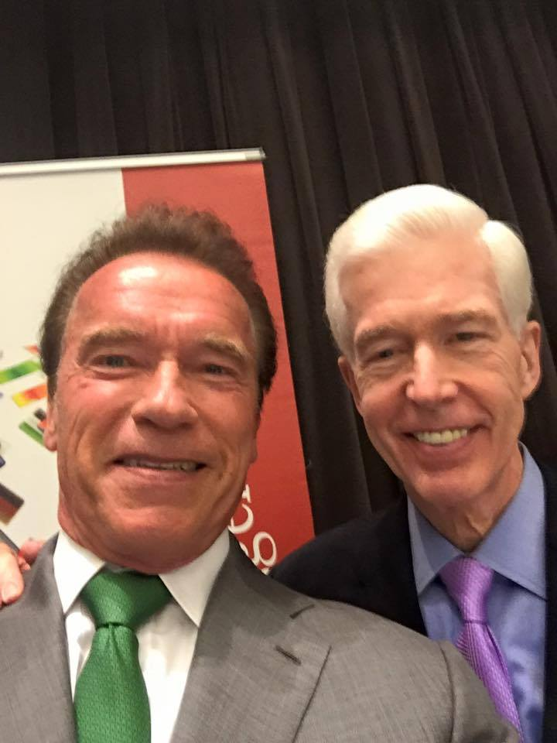
Responsive electorate

Slide 9
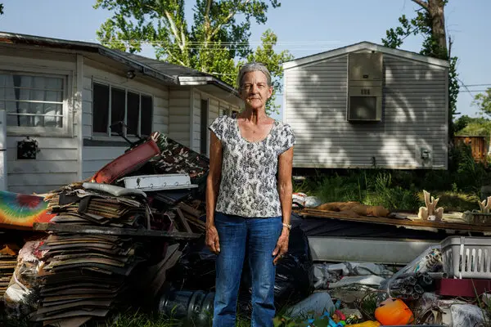
Responsive electorate

Slide 10
Attentive electorate
2)The voter is rational – retrospectively evaluates a politician's performance
- A politician is held accountable only for his or her efforts to shape the
state of the world.
However, the problem of attribution – who is actually responsible for dealing with the crisis, situation, or event?
Powell and Whitten (1993) – weak relationship between economic performance and the vote in countries in which responsibility for economic policy is blurred between government and opposition, but a strong relationship in countries where responsibility is clear.

Slide 11
Responsive electorate

Slide 12
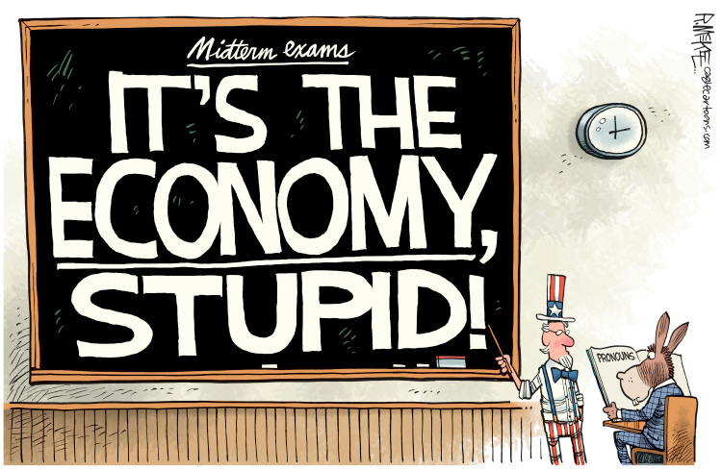

Slide 13
Economic voting
How the economy affects incumbents' support
For many, a basis for evaluation of government performance
When an economy is doing well (poorly) , citizens are more (less) likely to re-elect incumbents
Evidence from all the levels, for different offices (Lewis-Beck and Stegmaier, 2008) BUT size and strength differs
Shared vs exclusive authority
Credit attribution vs. hiding behind institutional opacity (Lago-Peñas and Lago-Peñas, 2010)

Slide 14
Economic voting
Determined by how voters take the economy into account:
1)Own pocketbooks – “egotropic” voting
- Own finances (Fiorina 1978), loss of employment (Grafstein 2005)
2)Well-being of the country as a whole – “sociotropic” voting
- Rates of inflation (Norpoth 1996), consumer prices (Lepper 1974), leading economic indicators (Wlezien and Erikson 1996)
- Possible bias introduced by local conditions, personal finances, political attitudes, demographics, and the media

Slide 15
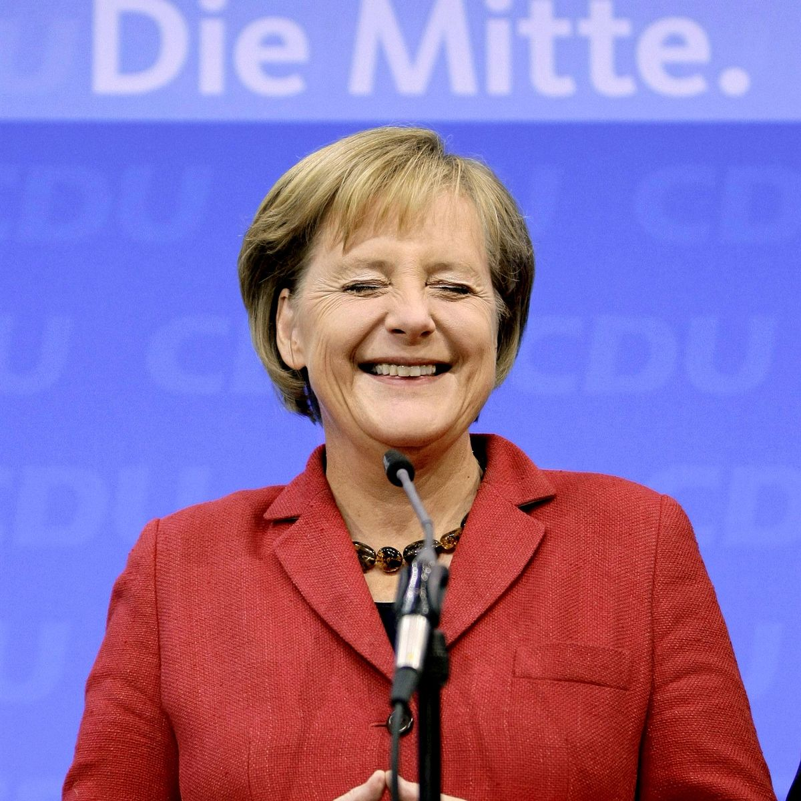
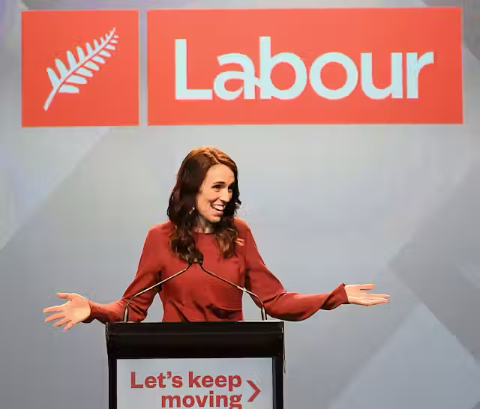
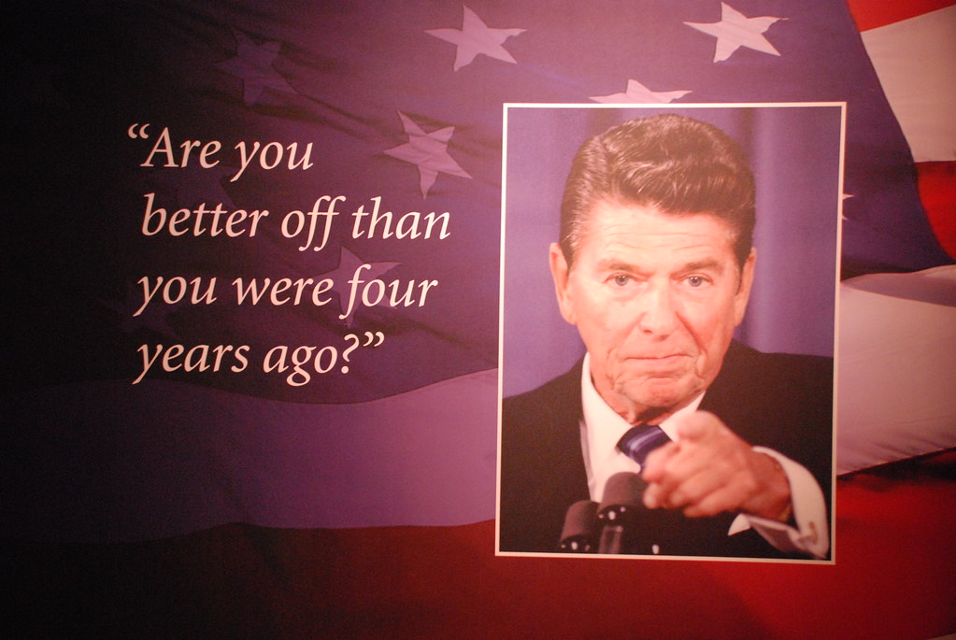

Slide 16
Natural disasters

Slide 17
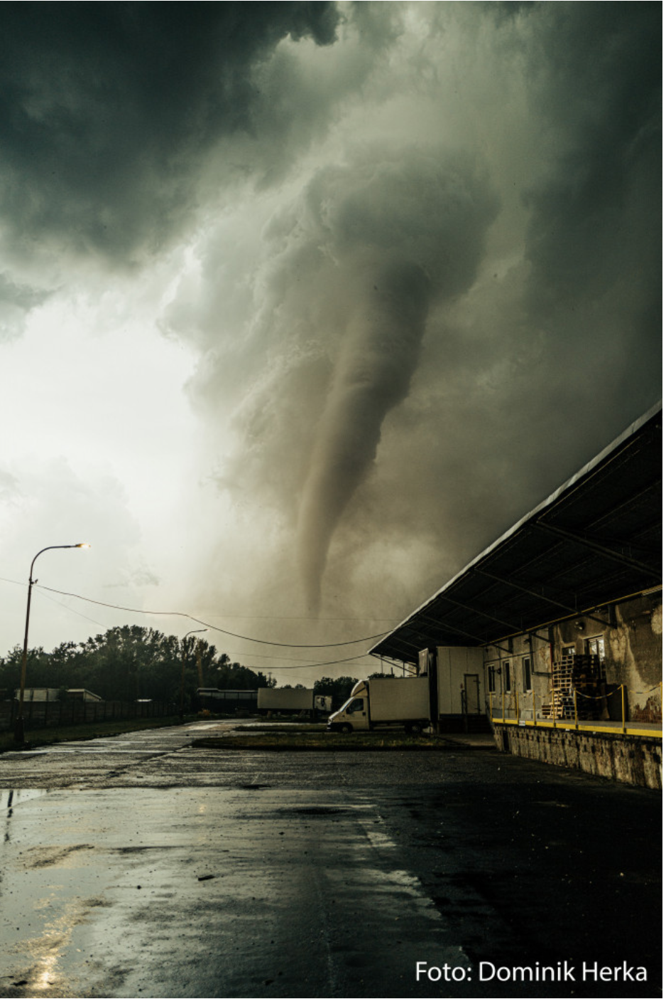
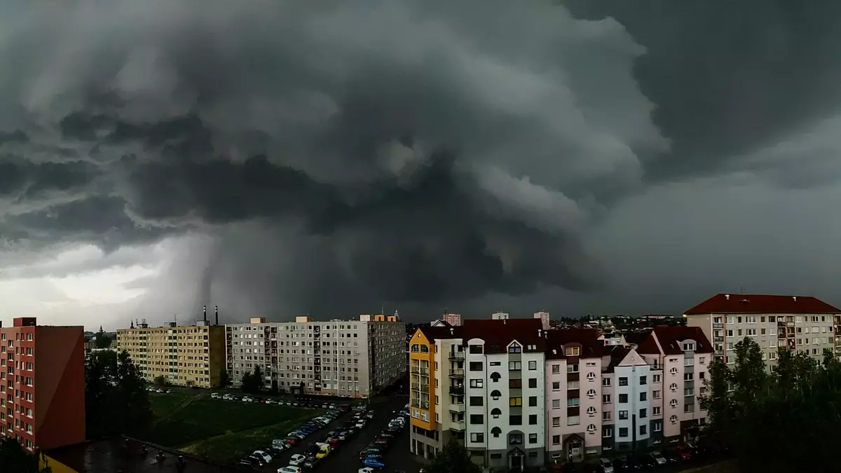

Slide 18
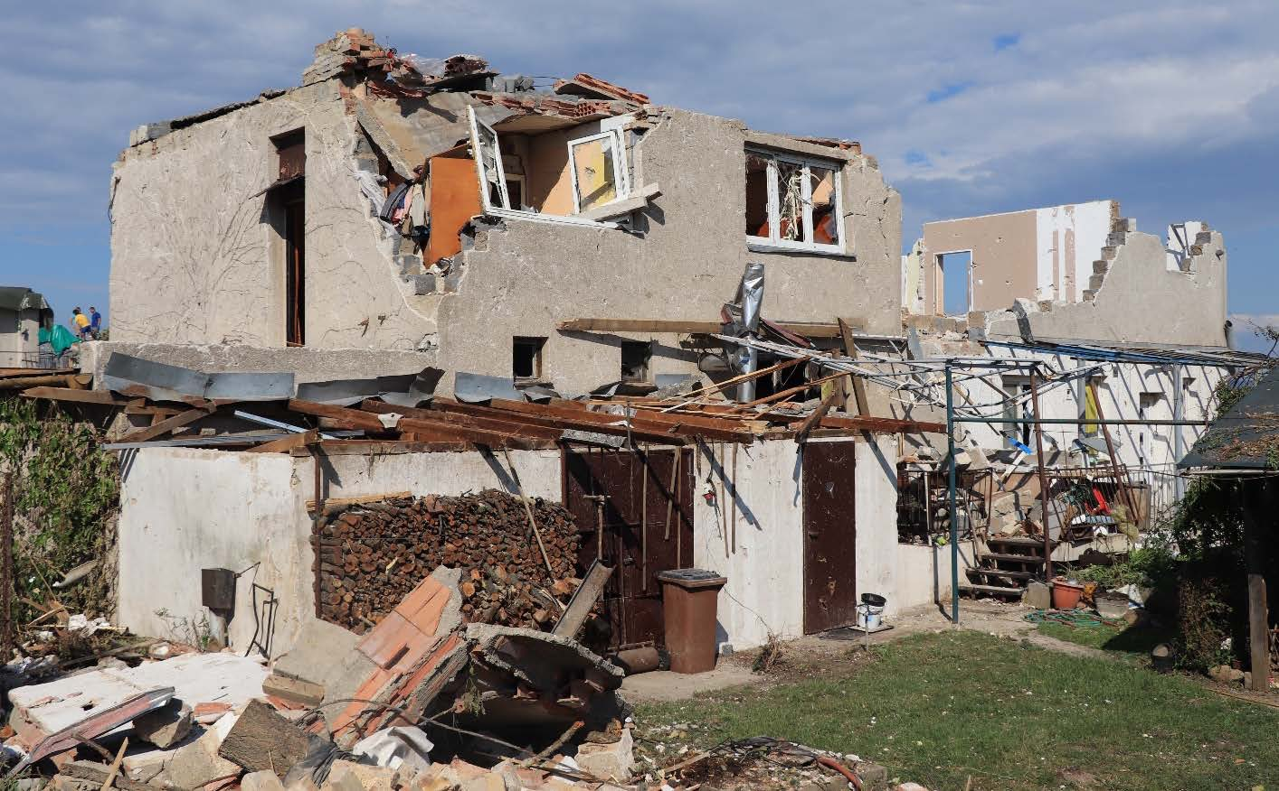
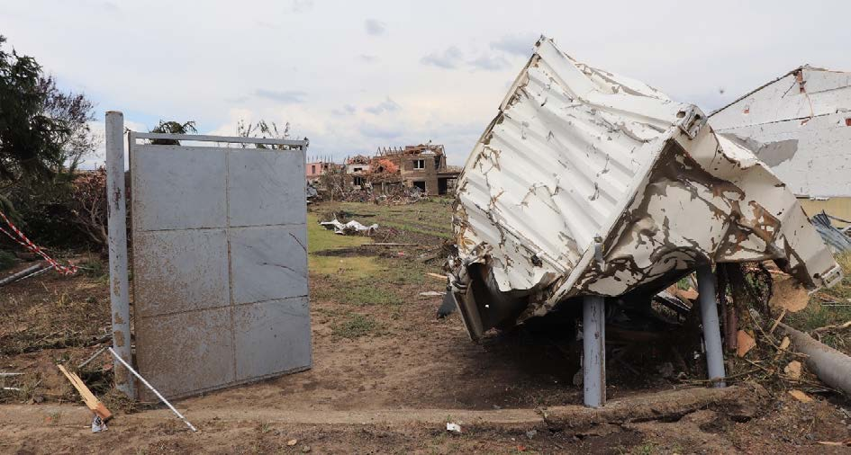

Slide 19
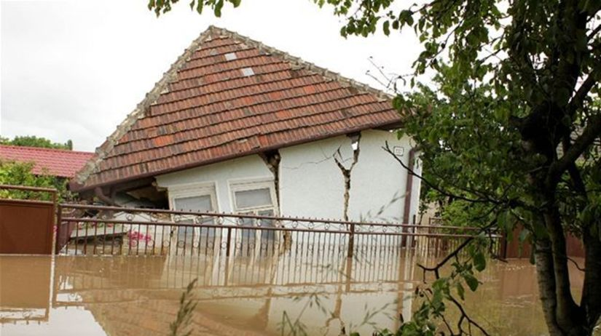

Slide 20
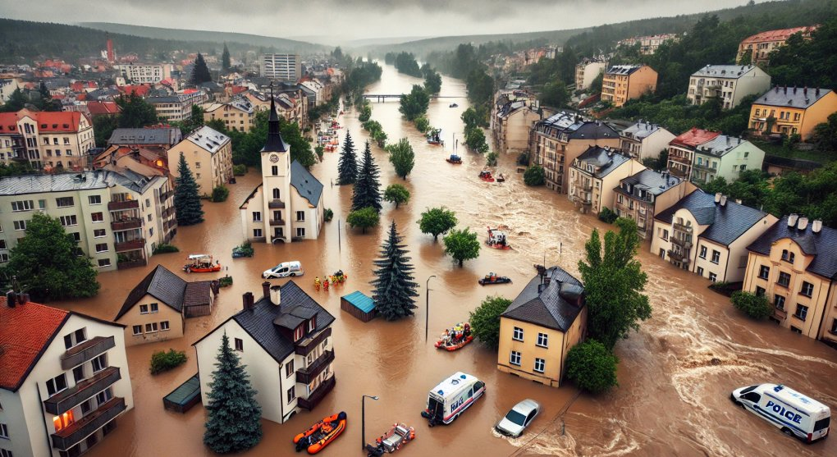

Slide 21
Electoral turnout
Rational choice argument - increased costs (more like rain) -> not elected
BUT
Motivational aspect? - I want to express an opinion on the solution to the crisis -> voting
Different outcomes:
No effect - Bodet, Thomas and Tessier 2016, Lasala-Blanco et al. 2017
Negative effect - Sinclair et al. 2011 (BUT more affected areas higher participation),
Positive effect - Fair et al. 2017, Jusko and Spáč 2024
Difference in addressing turnout in "normal" weather and natural disaster

Slide 22
Note: important mechanisms
“Peak and end” heuristic (Frederickson and Kahneman 1993)
Individuals may use heuristics to minimize the costs of becoming informed about political issues
Related to political budget cycle and pork barrel politics issues
Habituation (Rogers and Frey, 2015)
- People repeatedly affected by floods over several years tend to foster resilience to the damaging effects of floods (Garde-Hansen et al., 2017)

Slide 23
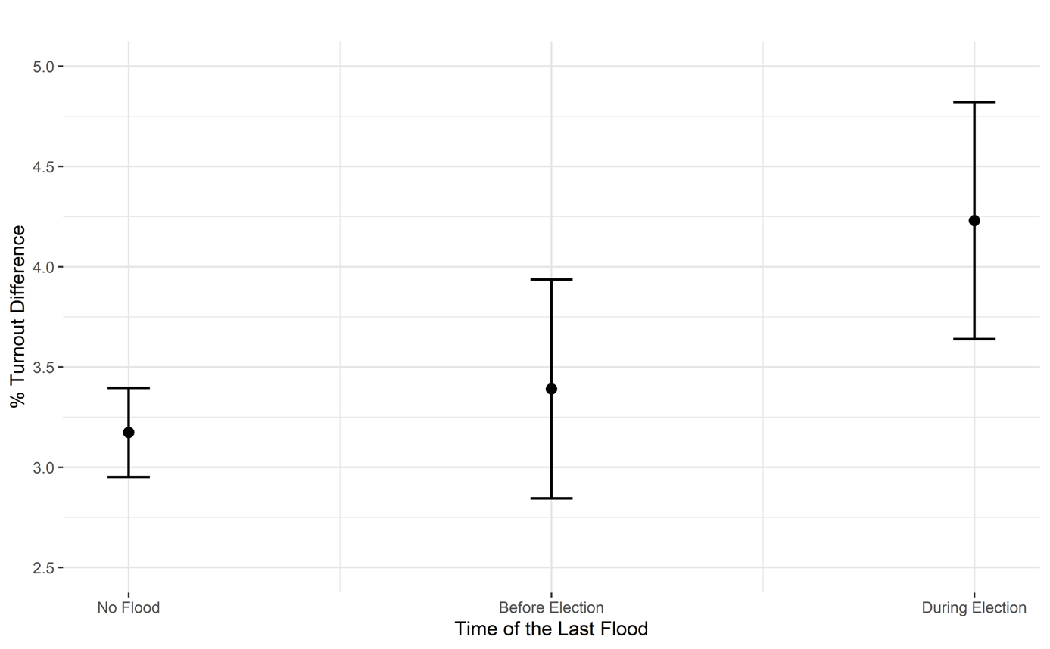
Jusko and Spáč (2024)

Slide 24
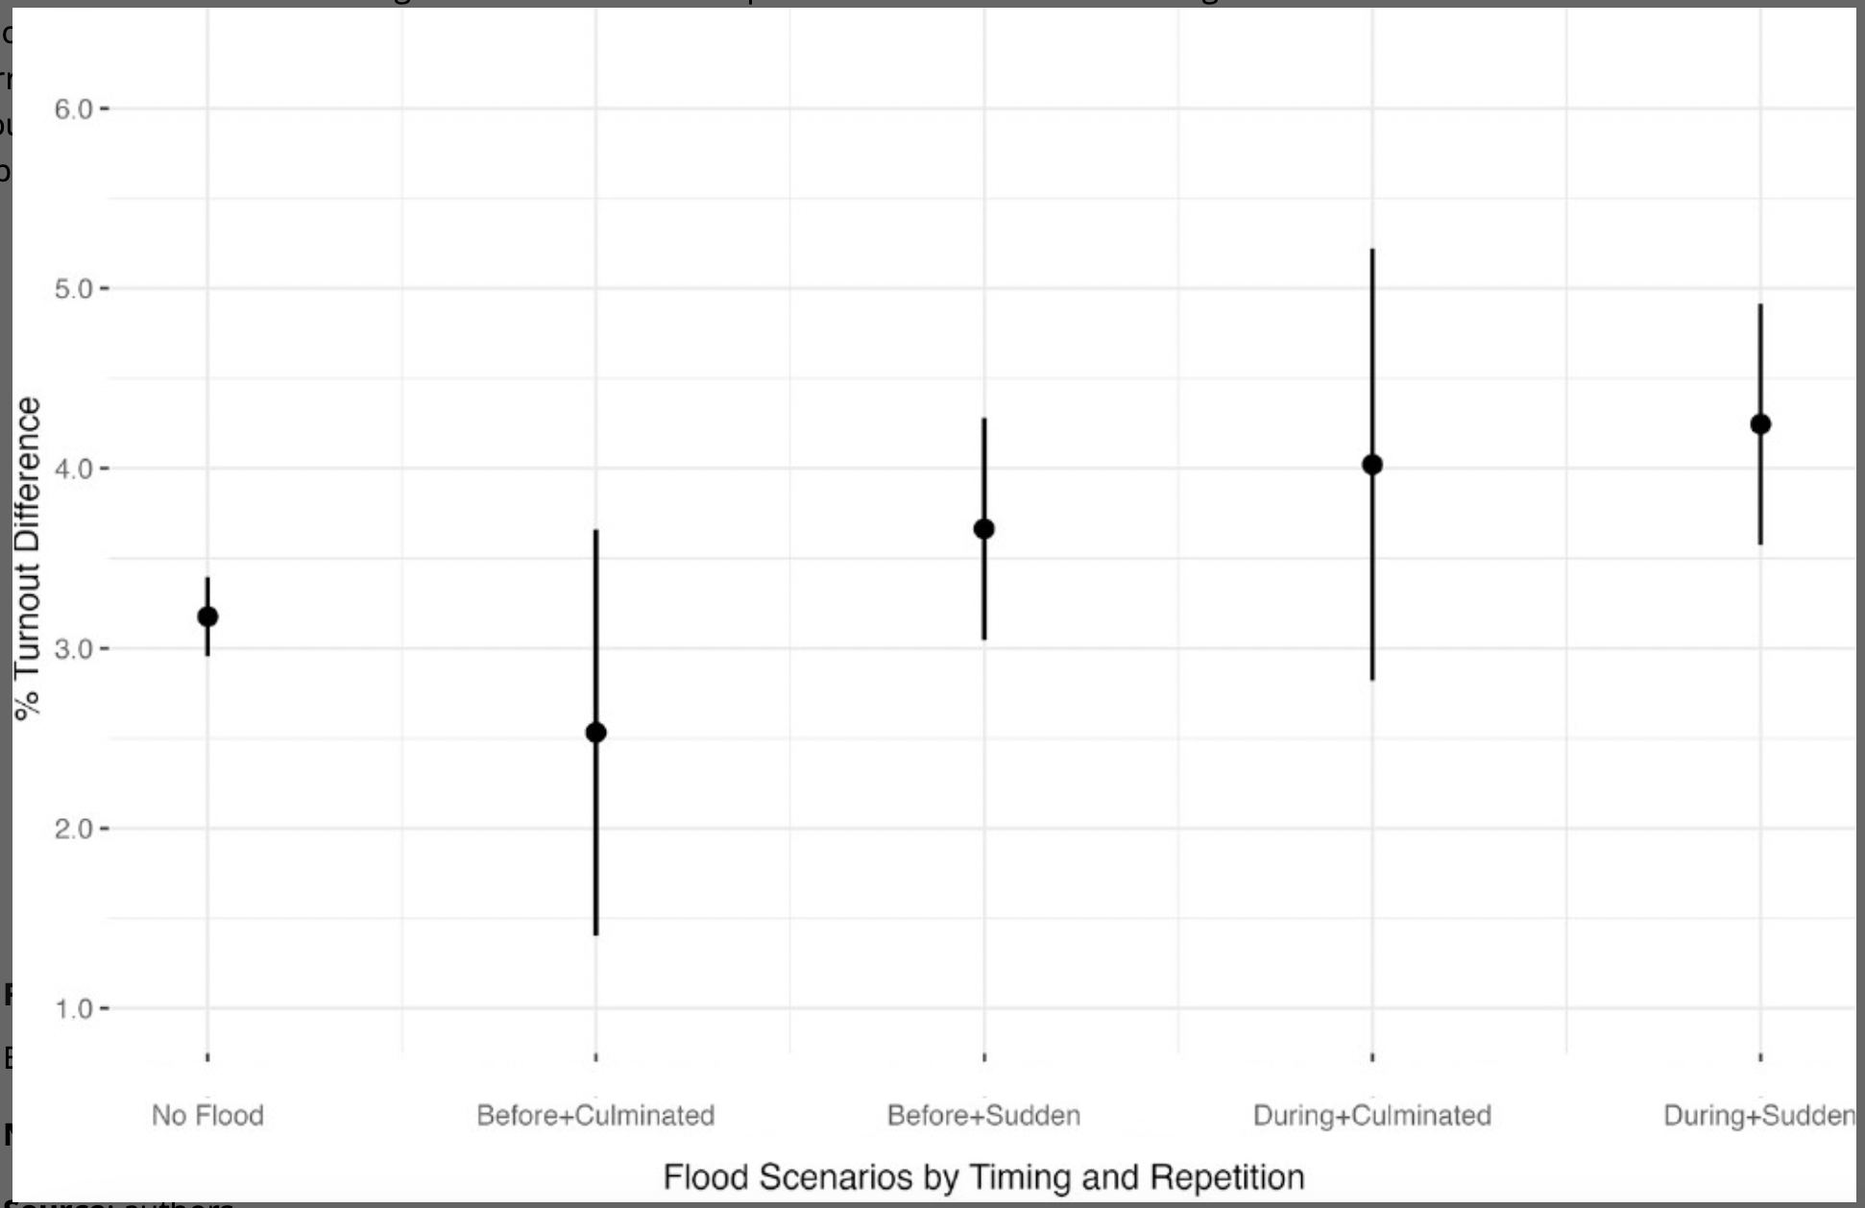
Jusko and Spáč (2024)

Slide 25
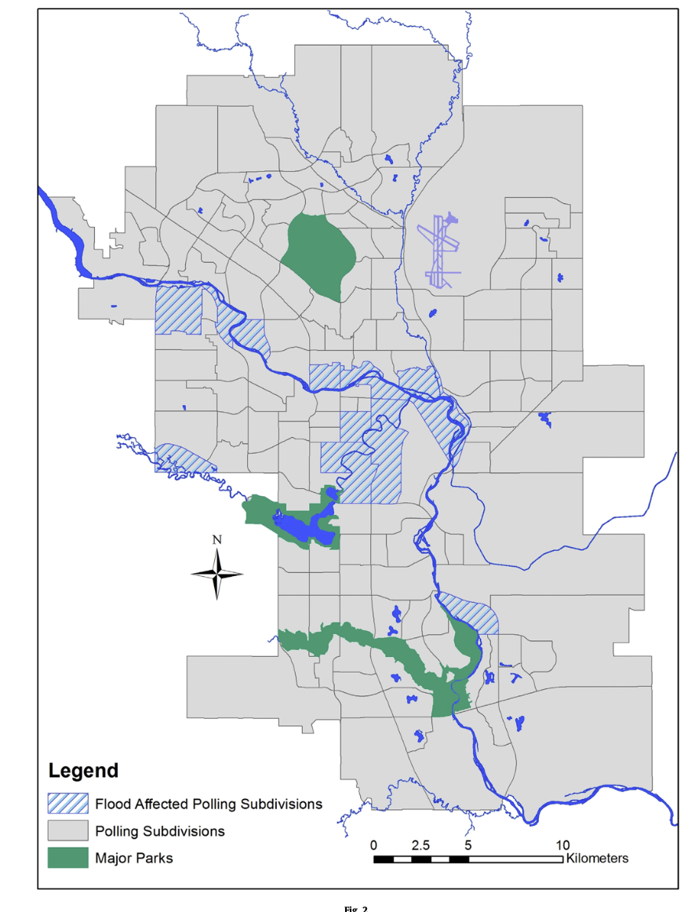

Slide 26
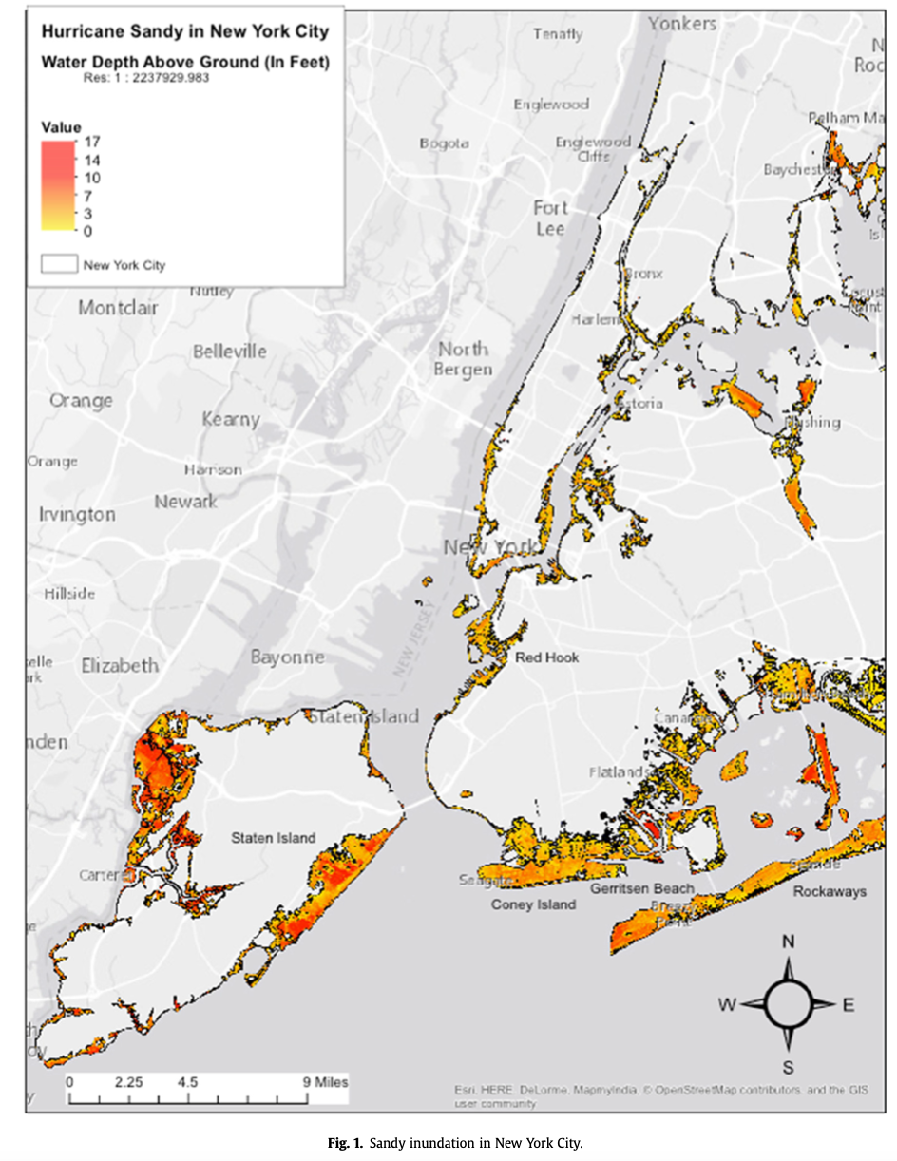
Volebná účasť

Slide 27
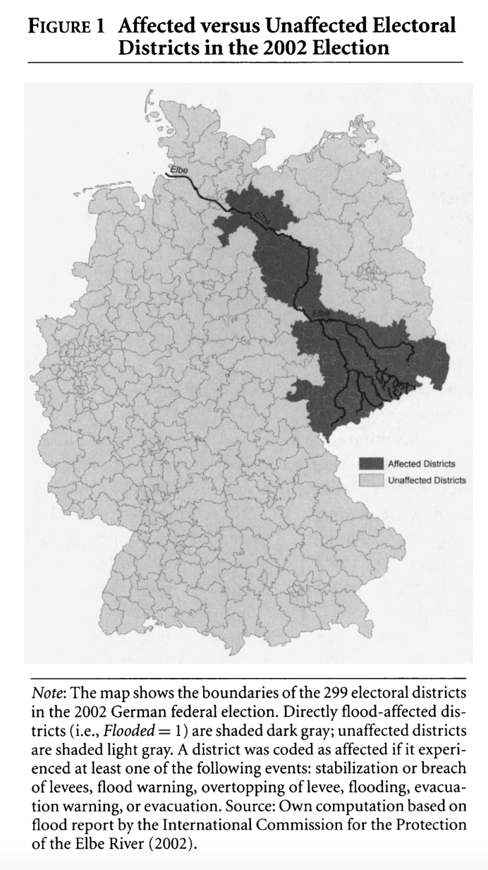
Volebná účasť

Slide 28
Effect on incumbents and parties
Two perspectives on voters' understanding of politicians' accountability:
1) The voter is irrational/ignorant - sharks, sports matches...
2) The voter is rational - retrospectively evaluates a politician's performance
natural disasters can actually provide information about government preparedness and their capabilities, the performance of the entity responsible for dealing with the crisis
it is not about irrationality but about reflecting political (in)competence -> credit claiming + media attention important
+ gratitude?
+ clientelism?
Methodologically - better at examining the effect of government spending (incumbent) on electoral outcomes (like general economic reform)

Slide 29
Can a natural disaster help a politician get re-elected?
NO
Abney and Hill (1966), Hurricane Betsy and the Mayors of Louisiana
- Voters did not factor the hurricane into their vote choice – did not know who to blame
Bodet et al. (2016), Calgary flooding and mayors
Bovan et al. (2018), Croatia floods
YES
Masiero and Santarrosa (2021), earthquake in Italy and mayors (5 p.p.)
Bechtel and Hainmueller (2011), flooding in Germany and SPD
Gallego (2018), flooding in Colombia and local elections
+ others -> YES prevails

Slide 30
Can a natural disaster help a politician get re-elected?
Major government incumbents (Blankenship et al. 2021) – India
In an election year more generous (Cole et al. 2012) - India
Closer at election time -> abuse (Wang 2020) - Taiwan
Leftist and nationalist parties allocate more $ (Klomp 2020)
Disaster-aids are better than prevention (Gallego 2018) - Colombia
Reward lasts longer (25% of original reward in next election) (Bechtel and Hainmueller 2011) - Germany
Stronger effect in less democratically established countries (Neugart and Rode 2021) - Germany

Slide 31
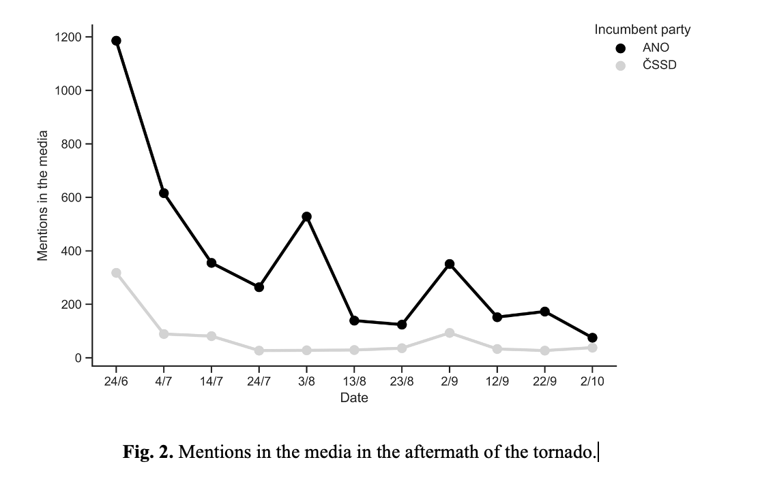

Slide 32
Note: attentive or responsive electorate?
Healy and Malhotra (2010) and Gasper and Reeves (2011)
-while voters do punish incumbent presidents for severe weather damage, they also reward them for disaster declarations
Heersink et al. (2022)
-Hurricane Sandy 2012 - voters’ reactions to disaster damage were strongly conditioned by pre-existing partisanship, with counties that previously supported Obama reacting far more positively to disaster damage than those that had earlier opposed him. => partisan retrospection

Slide 33
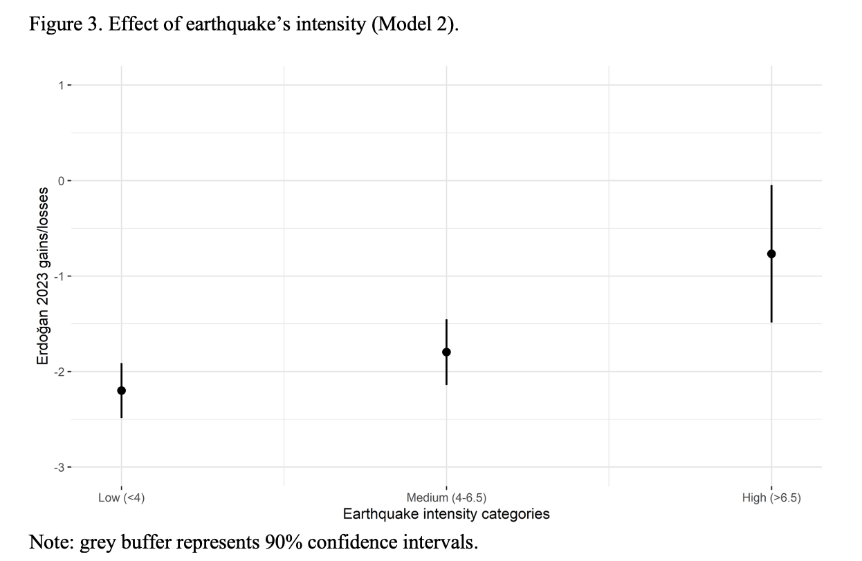
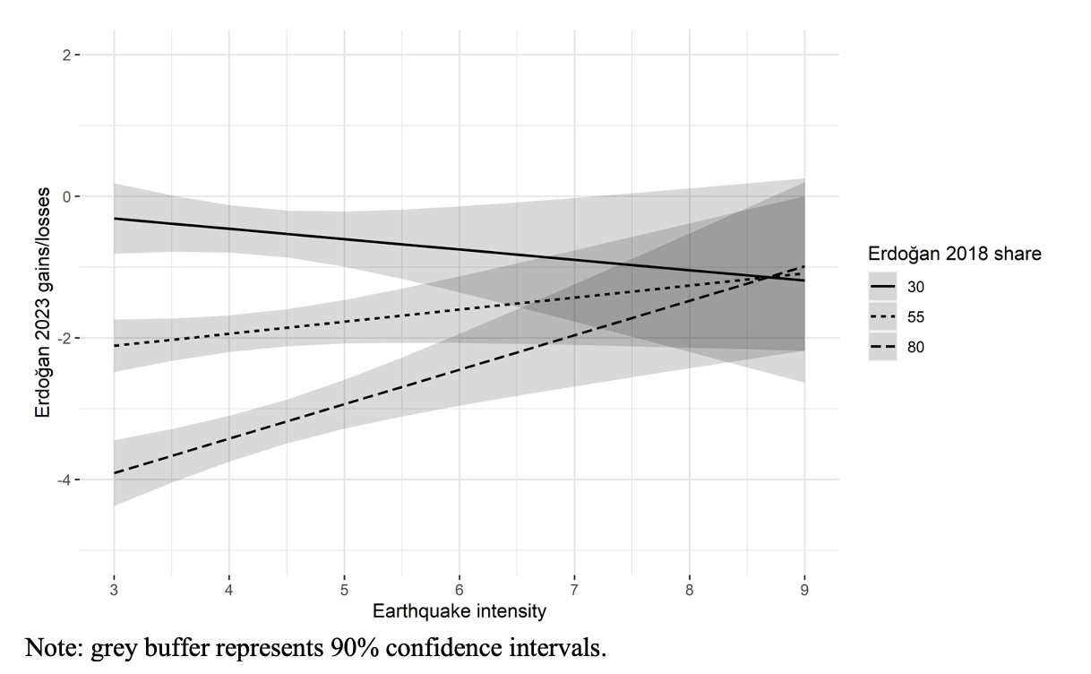

Slide 34
Sports matches

Slide 35
Sport
An important event in a day of a fan – win improves mood (Goetze et al. 2020)
Improves coexistence, solidarity, local and national patriotism (Misener and Mason 2006)
The question of durability - Busby et al. 2016
YES – Healy et al. 2010 (USA), Busby et al. 2016 – (college football game)
NO – Fowler and Montagnes (NFL USA), Rapeli and Soderlund 2022 (Finland), Muller and Kneafsey 2021 (Ireland)

Slide 36
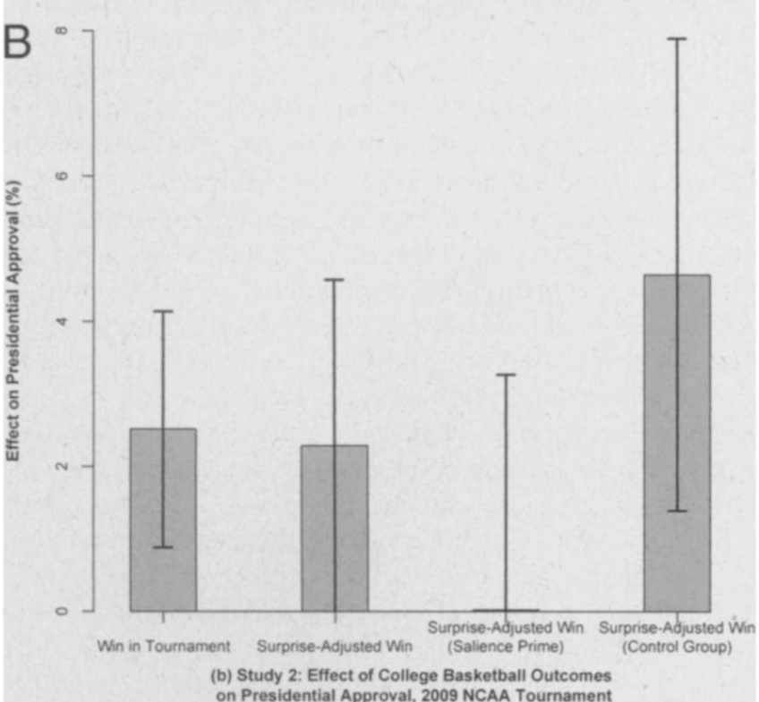
Sport
Healy et al. 2010
The success of the local football team before the elections increase the success of the incumbent in presidential, senatorial, gubernatorial elections in the home county of the team
Win 2009 NCAA tournament -> President Obama's positive image increased by 2.3% and 5% - among fans who followed the tournament closely => fans reward and punish incumbents for changes in their sentiments.

Slide 37
Sport
Potoski and Urbatsch 2017
-Monday Night Football (the day before the US elections) as a civic distraction to elections
-“Time as the principal cost of voting” – Downs 1957
-leisure more valuable -> opportunity costs higher -> decrease in turnout
-preelection football game quality increase -> 2-8 p.p. decrease in turnout
-effect weaker in those with a higher interest in politics + partisans

Slide 38
Life changing moments and turnout
The role of habit vs. costs associated with other circumstances
How strong is the voting habit in the face of different types of life circumstances?
Experiencing LCHM may:
Alter political interest
Decrease continuity in the social and personal contexts
Introduce new social influences
May cause a person to rethink the importance of politics (updating)
Important factors (Rapeli et al. 2023):
Divorce
Relocating (occasional + habitual voters)
Retiring (increase among habitual voters) => social connections important

Slide 39
Conclusion
Seemingly unrelated events can have outsized impacts on voter decisions, underscoring the complexity of electoral behaviour.
Two stories important:
1) Voters often rely on heuristics, emotions, and short-term events when evaluating incumbents.
-Psychological Factors:
•Emotional reasoning (e.g., anger, optimism).
•Recency bias: Voters weigh recent events more heavily.
•Attribution errors: Misplaced blame or credit.
-Contextual Factors:
• Visibility of events in media.
• Timing of events relative to elections.
2) Voters can take some of the events to better analyse the performance of the incumbent
Understanding these influences helps us better predict and interpret electoral outcomes.

Slide 40
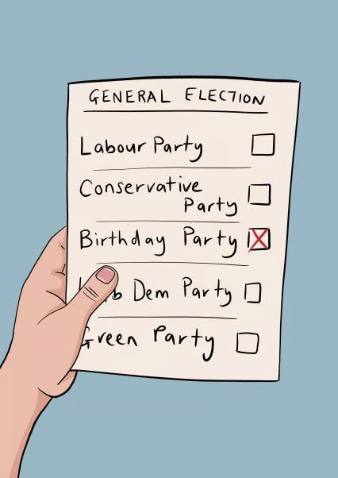
Next…

Slide 41
Literatute
Allcott, H., & Rogers, T. (2014). The short-run and long-run effects of behavioral interventions: Experimental evidence from energy conservation. American Economic Review, 104(10), 3003-3037.
Bechtel, M. M., & Hainmueller, J. (2011). How lasting is voter gratitude? An analysis of the short‐and long‐term electoral returns to beneficial policy. American Journal of Political Science, 55(4), 852-868.
Berry, C. R., & Howell, W. G. (2007). Accountability and local elections: Rethinking retrospective voting. The Journal of Politics, 69(3), 844-858.
Blankenship, B., Kennedy, R., Urpelainen, J., & Yang, J. (2021). Barking up the wrong tree: How political alignment shapes electoral backlash from natural disasters. Comparative Political Studies, 54(7), 1163-1196.
Bodet, M. A., Thomas, M., & Tessier, C. (2016). Come hell or high water: An investigation of the effects of a natural disaster on a local election. Electoral Studies, 43, 85-94.
Busby, E. C., Druckman, J. N., & Fredendall, A. (2017). The political relevance of irrelevant events. The Journal of Politics, 79(1), 346-350.
Cole, S., Healy, A., & Werker, E. (2012). Do voters demand responsive governments? Evidence from Indian disaster relief. Journal of Development Economics, 97(2), 167-181.
Dassonneville, R., Claes, E., & Lewis-Beck, M. S. (2016). Punishing local incumbents for the local economy: economic voting in the 2012 Belgian municipal elections. Italian Political Science Review/Rivista Italiana di Scienza Politica, 46(1), 3-22.
Fair, C. C., Kuhn, P., Malhotra, N. A., & Shapiro, J. (2017). Natural disasters and political engagement: evidence from the 2010–11 Pakistani floods.
Fowler, A., & Montagnes, B. P. (2015). College football, elections, and false-positive results in observational research. Proceedings of the National Academy of Sciences, 112(45), 13800-13804.
Fukumoto, K., Horiuchi, Y., & Tanaka, S. (2020). Treated politicians, treated voters: A natural experiment on political budget cycles. Electoral Studies, 67, 102206.
Gallego, J. (2018). Natural disasters and clientelism: The case of floods and landslides in Colombia. Electoral Studies, 55, 73-88.
Gasper, J. T., & Reeves, A. (2011). Make it rain? Retrospection and the attentive electorate in the context of natural disasters. American journal of political science, 55(2), 340-355.
Healy, A. J., Malhotra, N., & Mo, C. H. (2010). Irrelevant events affect voters' evaluations of government performance. Proceedings of the National Academy of Sciences, 107(29), 12804-12809.
Heersink, B., Jenkins, J. A., Olson, M. P., & Peterson, B. D. (2020). Natural disasters,‘partisan retrospection,’and US presidential elections. Political Behavior, 1-22.
Jusko, J., & Spáč, P. (2023). Motivated to vote? The effect of flooding on political participation. Disasters.
Klomp, J. (2020). Election or disaster support?. The Journal of Development Studies, 56(1), 205-220. ISO 690
Lasala-Blanco, N., Shapiro, R. Y., & Rivera-Burgos, V. (2017). Turnout and weather disruptions: Survey evidence from the 2012 presidential elections in the aftermath of Hurricane Sandy. Electoral Studies, 45, 141-152.
Masiero, G., & Santarossa, M. (2021). Natural disasters and electoral outcomes. European Journal of Political Economy, 67, 101983.
Müller, S., & Kneafsey, L. (2023). Evidence for the irrelevance of irrelevant events. Political Science Research and Methods, 11(2), 311-327.
Neugart, M., & Rode, J. (2021). Voting after a major flood: Is there a link between democratic experience and retrospective voting?. European Economic Review, 133, 103665.
Potoski, M., & Urbatsch, R. (2017). Entertainment and the opportunity cost of civic participation: Monday Night Football game quality suppresses turnout in US elections. The Journal of Politics, 79(2), 424-438.
Rapeli, L., & Söderlund, P. (2022). Does sports success increase government support? Voter (ir) rationality in a multiparty context. Research & Politics, 9(3), 20531680221122369.
Rapeli, L., Papageorgiou, A., & Mattila, M. (2023). When life happens: the impact of life events on turnout. Political Studies, 71(4), 1243-1260.
Sinclair, B., Hall, T. E., & Alvarez, R. M. (2011). Flooding the vote: Hurricane Katrina and voter participation in New Orleans. American politics research, 39(5), 921-957.
Wang, A. H. E. (2020). Efficiency over generosity? Evidence of electoral accountability from typhoon dayoff in Taiwan. Asian Journal of Political Science, 28(1), 32-46.

