Slide 1
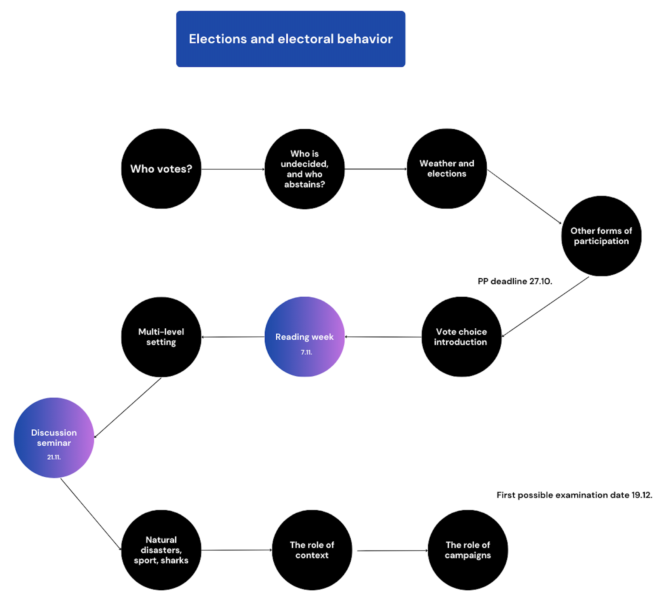

Slide 2
The role of election day context – ballot, heuristics, cues
Jakub Jusko

Slide 3
Seemingly unrelated events
The classic notion that voters should use all relevant information to make a rational decision-making
However, voters are emotional beings; many things happen between the pre-election campaign campaign to the moment of casting a ballot
Health problems, life - changing events, and normal events seemingly unrelated to the electoral process -> also things happening during election day
Undecided voters or voters with not enough information – susceptible to be influenced

Slide 4
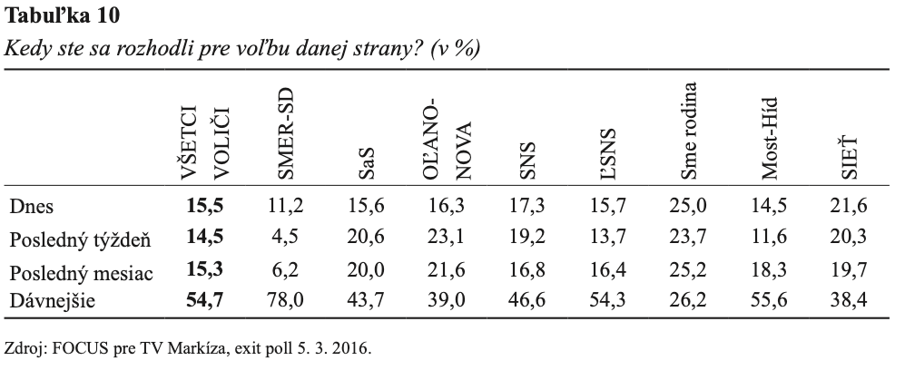
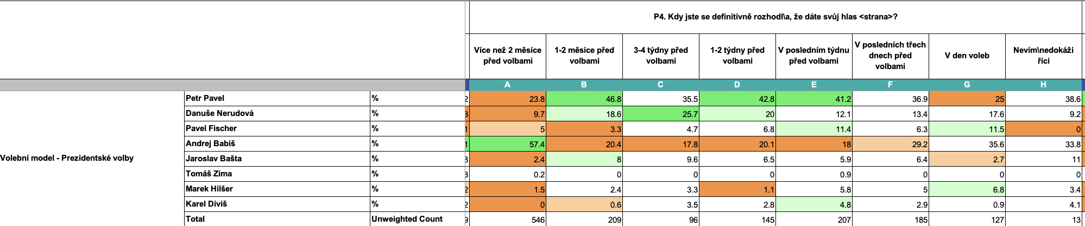

Slide 5

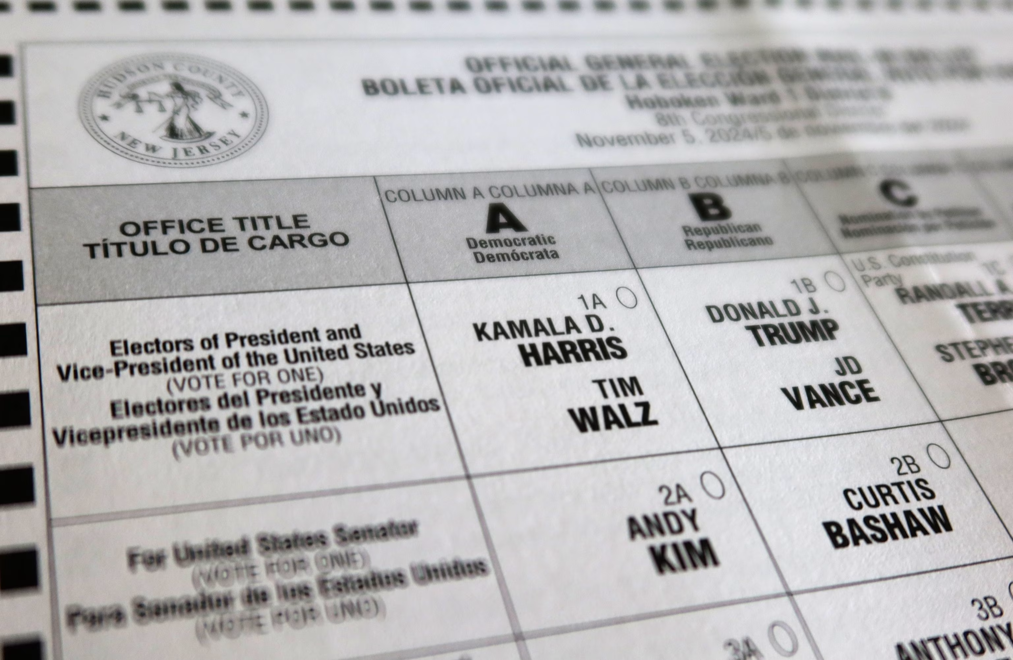
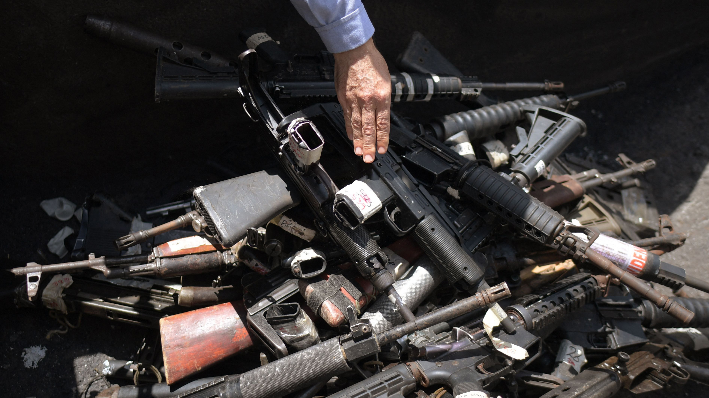

Slide 6
Election day environment context – polling station
When people make choices, they do so in particular environmental contexts:
People may enrol in a health plan while at work or home, select a potential mate while at a bar or park, and cast their ballot while at a church or school.
Stimuli in the environment have been shown to prime or activate content in memory, making related constructs more accessible (unconsciously)
Berger et al. (2008) – voting in schools -> activation of school-relevant norms (support for education), support for children -> support for increased school spending

Slide 7
Election day environment context – intimidation and clientelism
In contexts where the use of violence is also an option on the ‘menu of manipulation’ of elections (Schedler 2002), parties use intimidation to prevent non-supporters from participating in elections.
Clientelism – vote buying -> unaligned and core voters targeted
-intention: getting votes
Violence – opposition voters targeted
-intention: abstention
Overall aim: increase support for me, decrease support for rivals
Sub-saharan Africa
Nigeria 2003, 2007 elections
Sri Lanka – 2005 presidential elections
Notes:
If a voter were threatened into voting for a party against her pre- erence, she would face a dilemma. She could either give in to the threat or vote according to her preferences. The most common reaction will be that she chooses the mid- dle ground and abstains.

Slide 8
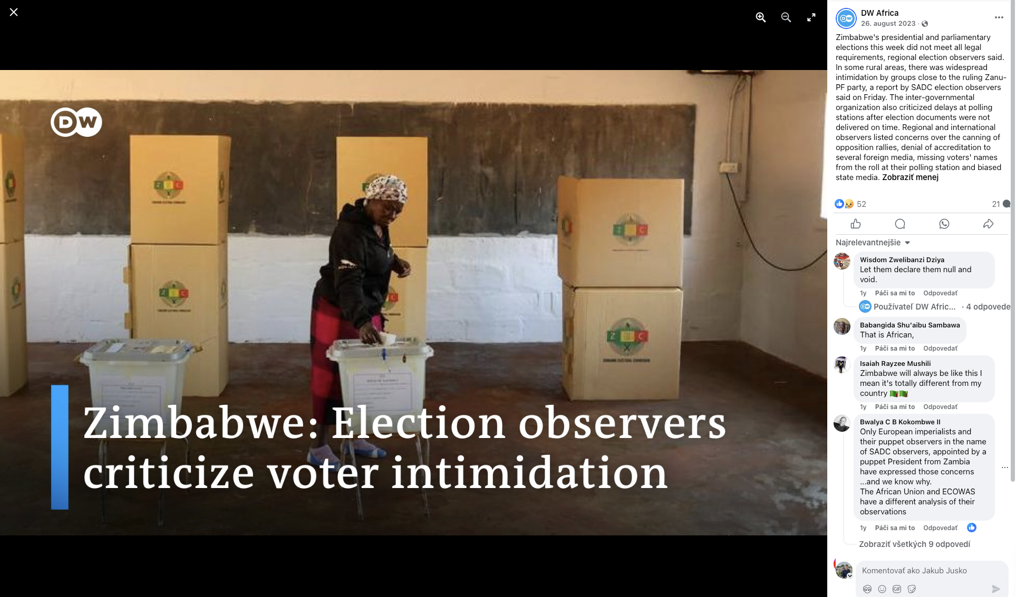

Slide 9
Ballot
A tool for a voter to express their choice in elections
Contains information about the candidate's name, party affiliations, sometimes age, education, occupation, residence
A line of research focusing on how the ballot structure can influence voters
The role of heuristics and ballot order

Slide 10
Heuristics

Slide 11
Heuristics
“how a public that is notoriously uninterested and largely "innocent" of political matters can provide any control over public policy”
Most individuals fall short of fully informed, fully rational voting behaviour
Our behaviour reveals that we are cognitive misers attempting to maximize the utility of the limited information we do have while avoiding the time-consuming search needed to enact a fully informed vote (e.g., Conover and Feldman 1984, 1989; Redlawsk 2004; Lau et al. 2018)
How can democracy survive?

Slide 12
Heuristics
People solve their lack of knowledge with cognitive shortcuts
Original research by Kahneman and Tversky
People use heuristics to simplify decision situations, may lead to errors in judgment
Political science adopts the concept of heuristics as a tool to help people navigate an overly complex political environment
Major optimism boom in the 1990s -> “low information rationality” (Popkin 1991) vs. backlash of not “correct voting”
The concept helps overcome the problem of not being informed fully
Applies also to other situations

Slide 13
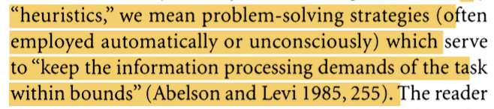
Heuristics (Lau and Redlawsk 2001)

Slide 14
Heuristics
Law and Redlawsk (2001):
-party affiliation and ideology
-endorsement
-polls
-candidate appearance
-Sophisticates can use heuristics to make the right choice (paradoxically)
-They are useless to unsophisticated voters
-Sophisticated = ideology and endorsement, unsophisticated voters = partisanship and appearance
Bernhard and Freeder (2020)
Endorsements, experience, and specific programmatic stances -> SOPH
Personal requests -> UNSOPH
Knowledgeable voters report looking for good representatives, while less knowledgeable voters report looking for good people.

Slide 15
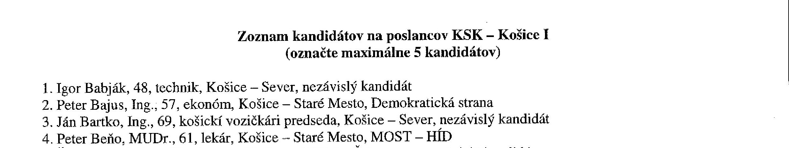
Heuristics -> can be found on a ballot list
Assumption – voter not fully informed

Slide 16
Occupation
Jobs as roles through which we learn skills and talents that help us to move up the occupational ladder
Since voters are choosing candidates to fill or retain a position in government -> past experience is important
The relevance of previous experience to future performance may make voters likely to rely on this inferred information -> communication of competence

Slide 17
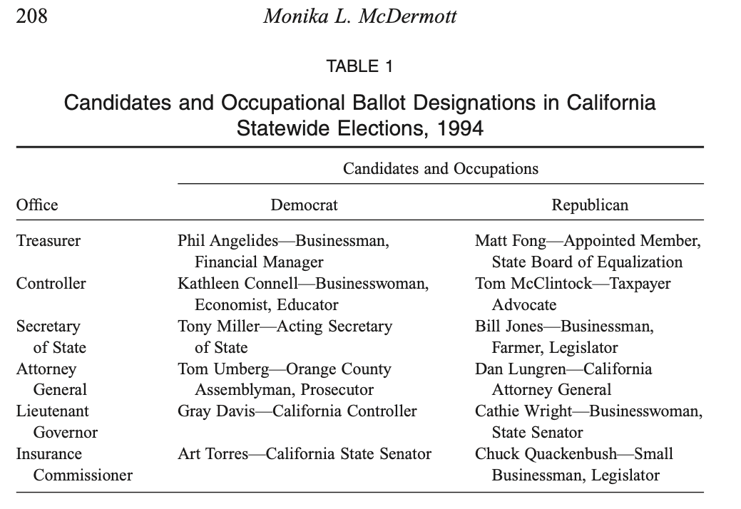
Occupation

Slide 18
Occupation

Slide 19
Title
Boas (2014)
Brazilian city council elections – low information contests (2012 - median 52 candidates – 9 seats)
Paulo Rodrigues de Souza vs. Carlos Fernandes da Silva
Pastor Paulo vs. Dr. Carlos
Pastor decreases vote intention (except Evangelical voters), doctor increases vote intention
Group associations and stereotypes – positive features of doctors (intelligent, competent, experienced) vs. many religious groups in Brazil

Slide 20
Photos
A wide range of traits are inferred from facial appearance, and several of these – particularly compassion, likeability, authority and honesty – significantly boost the willingness to vote for candidates displaying such traits => attractiveness
+ stereotypes about candidates -> gender and age
UK (Johns and Shepard 2011) – more attractive (when comparing woman vs. man) are more likely to get votes (when a photo is on a ballot), strongest impact on a least interested and least likely to vote, a tendency to reward younger candidates
Ireland (Buckley et al. 2007) – voters know the faces of candidates -> 80% accuracy of voting with only photos compared to real elections

Slide 21
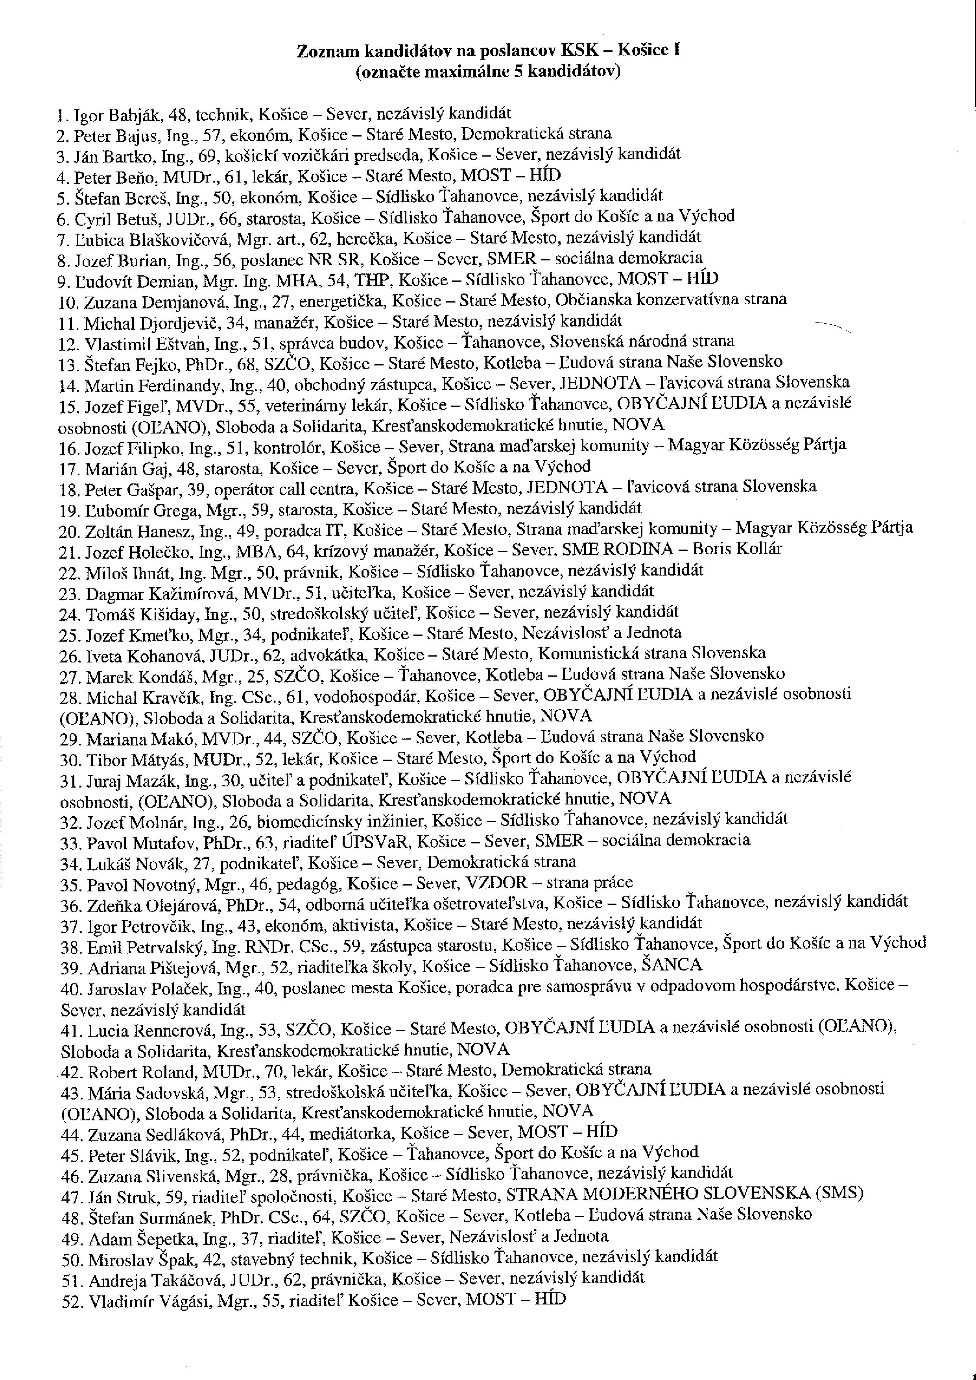

Slide 22
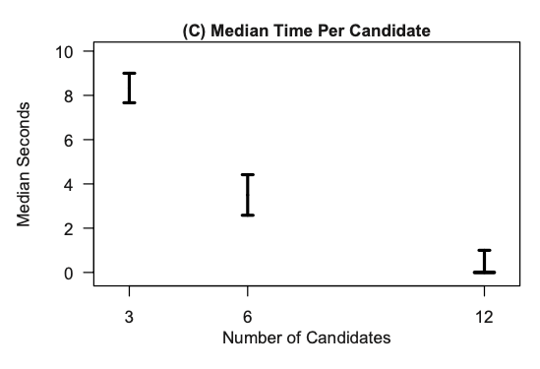
Caution: ballot length
Cunow et al. (2021)
Less is more (3 vs 6 vs 12 candidates) - subjects presented with many options:
learn less about candidates
are more likely to vote based on meaningless heuristics (ballot position)
are more likely to commit voting errors
Ballot completion lower when having less information on a ballot (Lamb and Perry 2020)

Slide 23
Ballot order

Slide 24
Ideal vs reality of elections
Free and just elections
Fair electoral system
Equal strength of a vote
Equal chance to get a seat
VS
Chance to get a seat is not the same for candidates ->>>>>>

Slide 25
Ballot order effect
The structure of the ballot affects candidates' chances of winning a seat
Key attributes:
-Length (number of candidates on the list)
-Importance of the election and voter’s information bank

Slide 26
Ballot order effect
The ranking of candidates on the list is not only a technical and formal aspect
Ranking as a key predictor of vote gain (or loss)
In other words, being at the top of the list is not the same as being in the middle of the list
More names on the list reduce the attention span of voters who use cognitive shortcuts to make their choice
This is especially true for lower-profile elections.

Slide 28
Satisficing theory
Miller and Krosnick 1998
Voters are willing to accept suboptimal decisions if they are acceptable enough
With each additional name on the list, voter interest declines
Resultant effect:
Support for front-runner candidates (primacy effect)
Support for candidates in lower positions (recency effect)

Slide 29
Other explanations
Voters' efforts to pose as "good citizens":
Important for them to vote no matter who
The vote will go to the "first in line"
Complicated voting mechanism:
Australia
Awarding points to candidates
Donkey voting - votes awarded in descending or ascending order

Slide 30
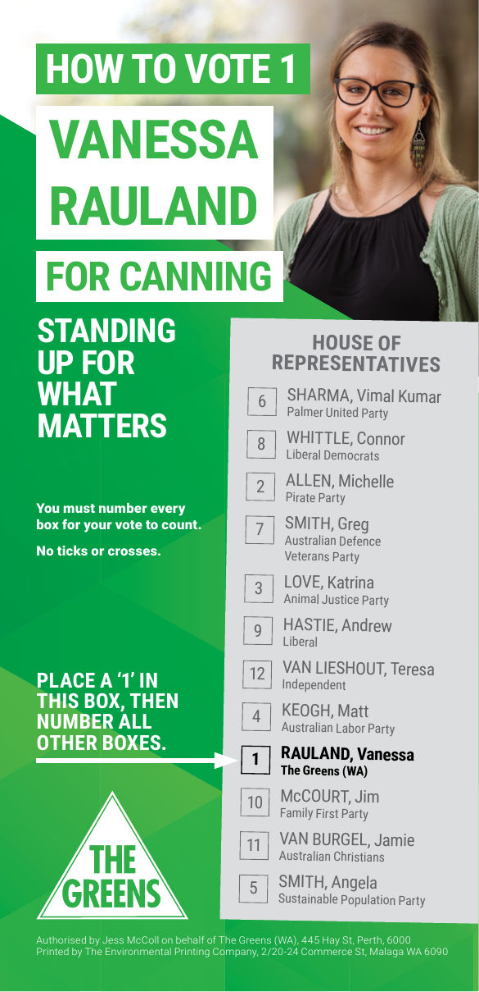
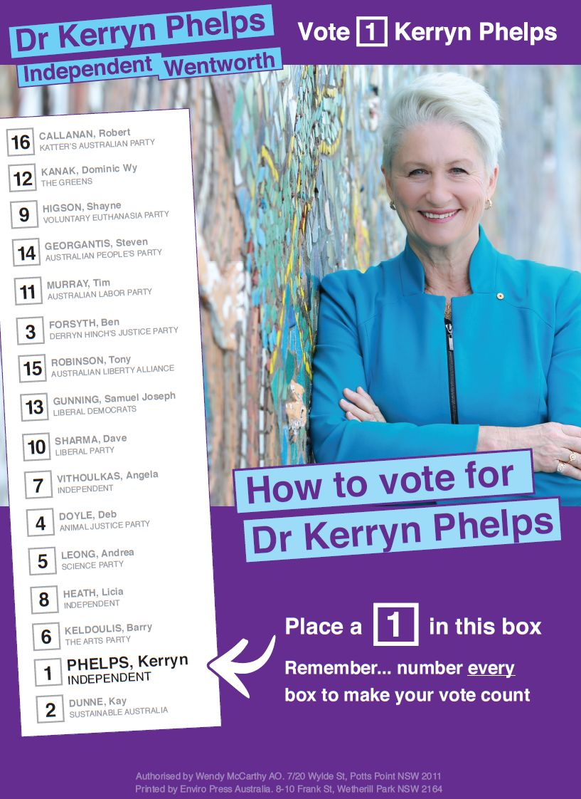

Slide 31
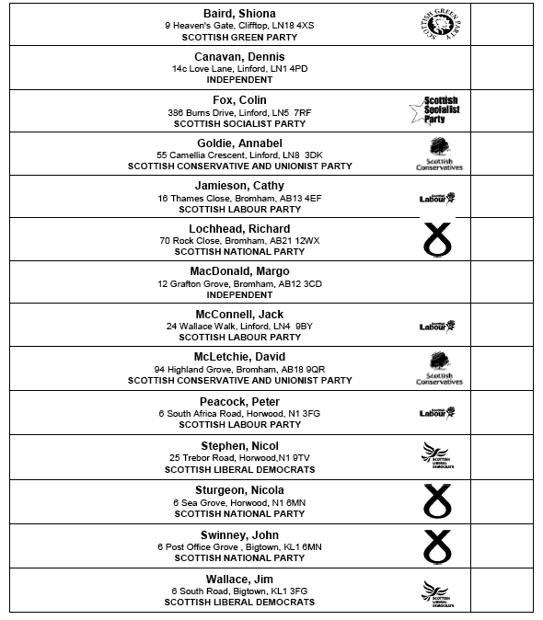




Slide 32
Ballot order effect
A lot of evidence from many countries
California (Ho and Imai 2008), New York (Koppel and Steen 2004), Spain (Bagues and Esteve-Volart 2011), Australia (King and Leigh 2009), Ireland (Regan 2012)
BOE stronger in polling stations compared to postal voting (Jankowski and Frank 2022)
The measured effect is often stronger than the difference between the winner of the election and the runner-up
Better-placed candidates not only get more votes but also have better access to seats

Slide 33
Is it a problem?
NO:
If the political parties themselves decide on the order of candidates on their lists
The ranking of candidates is a matter for their political entity and is the result of some consideration (ideological, pragmatic, power)
YES:
If the ranking of the candidates is decided by a chosen criterion which does not say anything about the quality of the candidates

Slide 34
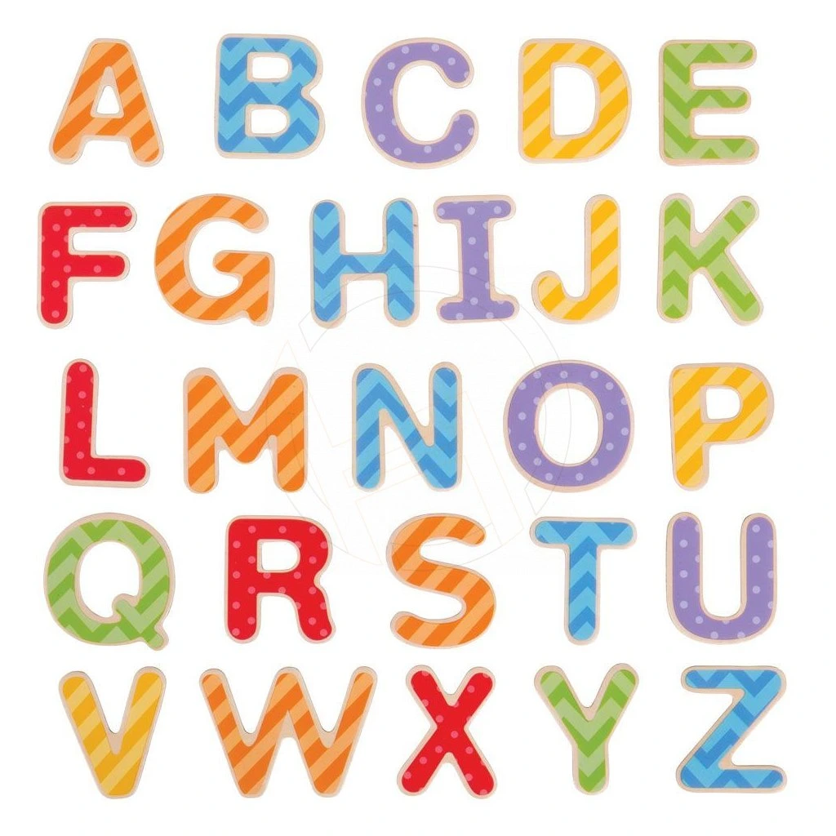

Slide 35
Alphabet
A seemingly neutral element:
Student names in the examiner's notebook
Telephone directories
Statistical lists of municipalities in districts
If the assumption that the order itself is meaningful holds, the neutrality of the alphabet is eliminated
Even more so if neutrality (= equality) is part of the constitutionally enshrined right to vote

Slide 36
Alphabet
Why is this a problem?
1) the order of the candidates is determined based on a completely random element (why not hair colour or height?)
2) the alphabetical criterion says nothing about the quality of the candidates
3) statistically, candidates with surnames starting with a letter from the edges of the alphabet have a higher chance of getting to the top/end of the list

Slide 37
Regional elections SK
Spáč, Voda, Zagrapan 2016
Results (always against candidates in positions 3 to 3 from the end):
Number of votes:
First position (+2.18 p.p.), second (+1.14), second to last (+1.43), last (+1.19)
Chances of being elected
First position (+ 75%), last position (+ 49%)
The distribution of elected representatives' names shifted towards the beginning of the alphabet

Slide 39
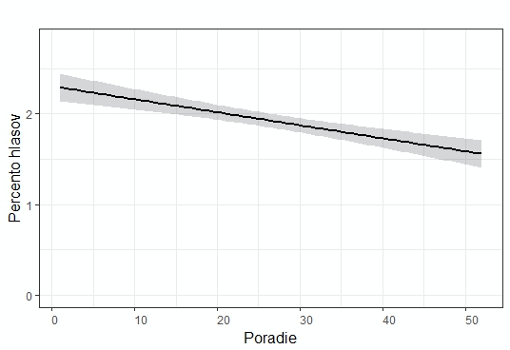
Experiment
(Jusko, Spáč, Voda 2019)
Reality
Ideal

Slide 40
Conclusion
Seemingly unrelated events can have outsized impacts on voter decisions and electoral outcomes, underscoring the complexity of electoral behaviour.
Two stories important:
Election day circumstances may change (sometimes) the behaviour of voters - weather, polling station, people with guns outside it
Ballot structure and information – heuristics helping undecided voters, alphabet

Slide 41
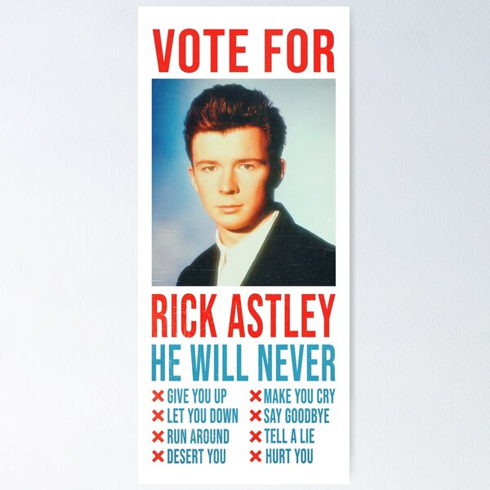
Next…

Slide 42
Literatute
Berger, J., Meredith, M., & Wheeler, S. C. (2008). Contextual priming: Where people vote affects how they vote. Proceedings of the National Academy of Sciences, 105(26), 8846-8849.
Bernhard, R., & Freeder, S. (2020). The more you know: Voter heuristics and the information search. Political Behavior, 42(2), 603-623.
Boas, T. C. (2014). Pastor Paulo vs. Doctor Carlos: Professional titles as voting heuristics in Brazil. Journal of Politics in Latin America, 6(2), 39-72.
Buckley, F., Collins, N., & Reidy, T. (2007). Ballot paper photographs and low-information elections in Ireland. Politics, 27(3), 174-181.
Cunow, S., Desposato, S., Janusz, A., & Sells, C. (2021). Less is more: The paradox of choice in voting behavior. Electoral Studies, 69, 102230.
Hickman, J. (2009). Is electoral violence effective? Evidence from Sri Lanka's 2005 presidential election. Contemporary South Asia, 17(4), 429-435.
Ho, D. E., & Imai, K. (2008). Estimating causal effects of ballot order from a randomized natural experiment: The California alphabet lottery, 1978–2002. Public opinion quarterly, 72(2), 216-240.
Jankowski, M., & Frank, T. (2022). Ballot position effects in open-list PR systems: the moderating impact of postal voting. Acta politica, 57(2), 320-340.
Johns, R., & Shephard, M. (2011). Facing the voters: The potential impact of ballot paper photographs in British elections. Political Studies, 59(3), 636-658.
Jusko, J., Spac, P., & Voda, P. (2019). Name as a Benefit? Experimental Study on Ballot Order Effect. SOCIOLOGIA, 51(4), 339-366.
Lamb, M., & Perry, S. (2020). Knowing What You Don't Know: The Role of Information and Sophistication in Ballot Completion. Social Science Quarterly, 101(3), 1132-1149.
Lau, R. R., & Redlawsk, D. P. (2001). Advantages and disadvantages of cognitive heuristics in political decision making. American journal of political science, 951-971.
McDermott, M. L. (2005). Candidate occupations and voter information shortcuts. The Journal of Politics, 67(1), 201-219.
Miller, J. M., & Krosnick, J. A. (1998). The impact of candidate name order on election outcomes. Public Opinion Quarterly, 291-330.
Rauschenbach, M., & Paula, K. (2019). Intimidating voters with violence and mobilizing them with clientelism. Journal of Peace Research, 56(5), 682-696.
Spáč, P., Voda, P., & Zagrapan, J. (2016). Abeceda ako nástroj úspechu. Prípad regionálnych volieb na Slovensku. Sociológia, 48(1).

