Slide 1
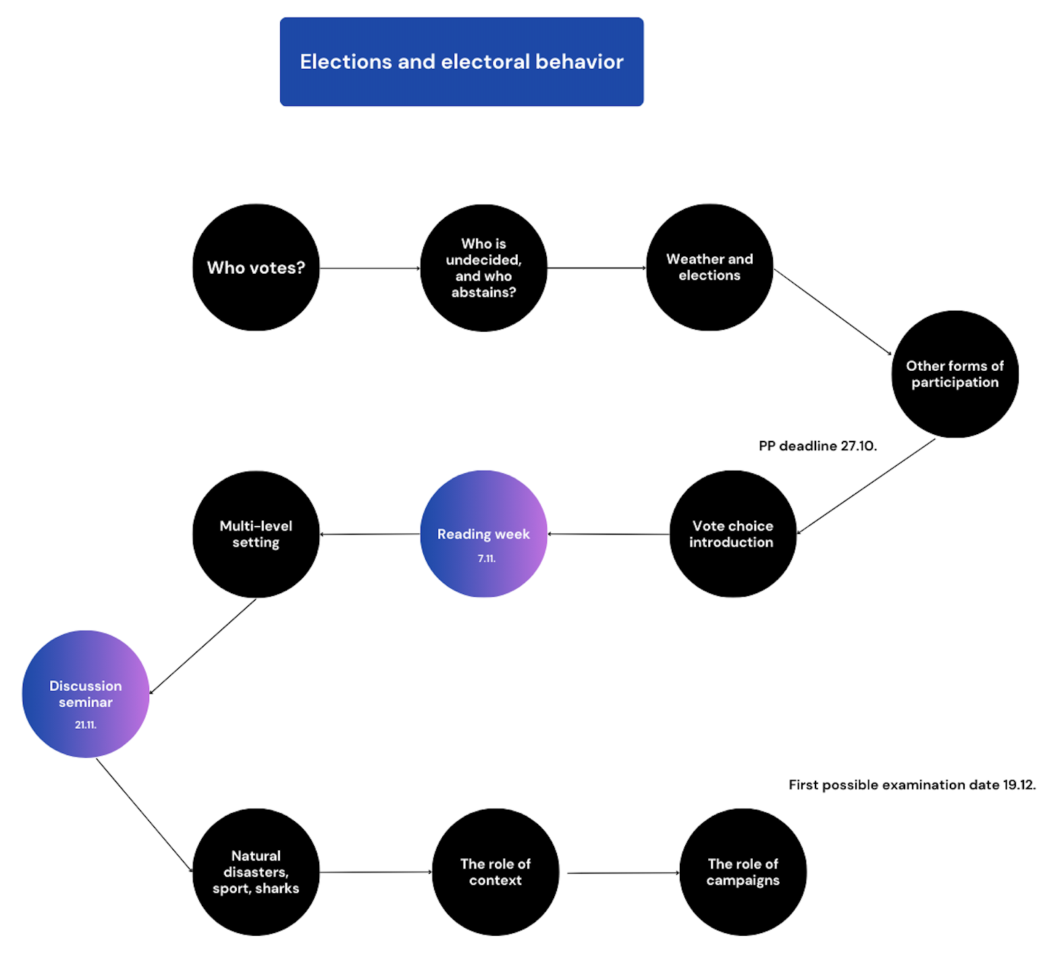

Slide 2
The role of campaigns and polls
Jakub Jusko

Slide 3
Campaigns
$8 billion on federal election campaigns during the 2011–2012 cycle; state and local campaigns costing $2.8 billion => total recorded spending on the 2012 campaigns cca $11 billion
Campaigns aim to influence the behaviour of individual citizens, persuading those who might do otherwise to show up at the polls and to make the “right” choice
=> also, when, how, why?

Slide 4
Campaigns
Generations of empirical research => campaigns matter (at least some of the time) -> but ”minimal effects” thesis
Campaigns only minimally influence the outcomes of elections
High degree of stability of individual vote preferences during election years (Lazarsfeld et al. 1944)
High degree of partisan stability from one election to other (Campbell et al. 1960)

Slide 5
Campaigns
In other words, we can get accuracy by looking at fundamental conditions -> state of the economy, ideological positions of candidates before campaigns, distribution of partisans, incumbency
Challenge to the relevance of the campaign strategies, events, ads

Slide 6
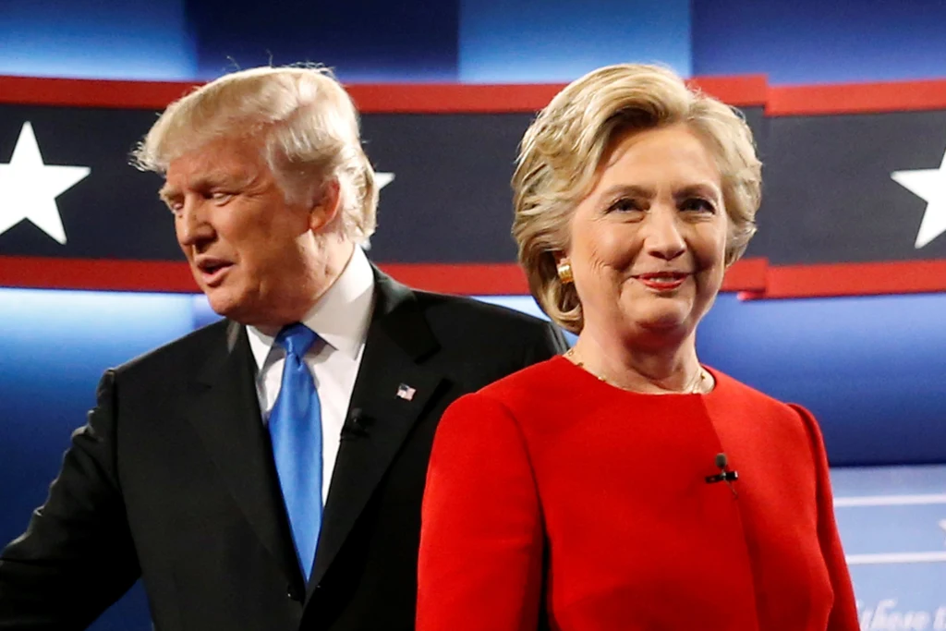
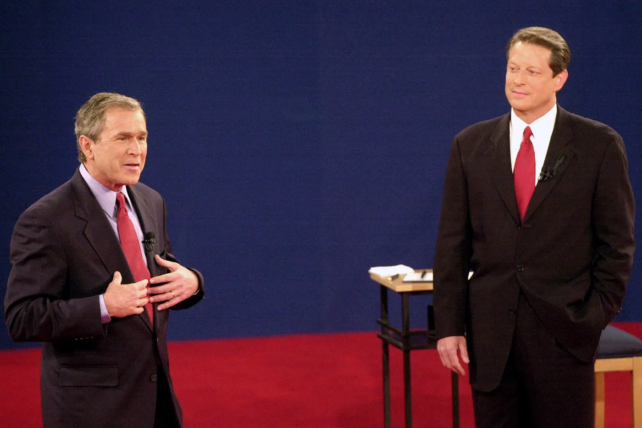
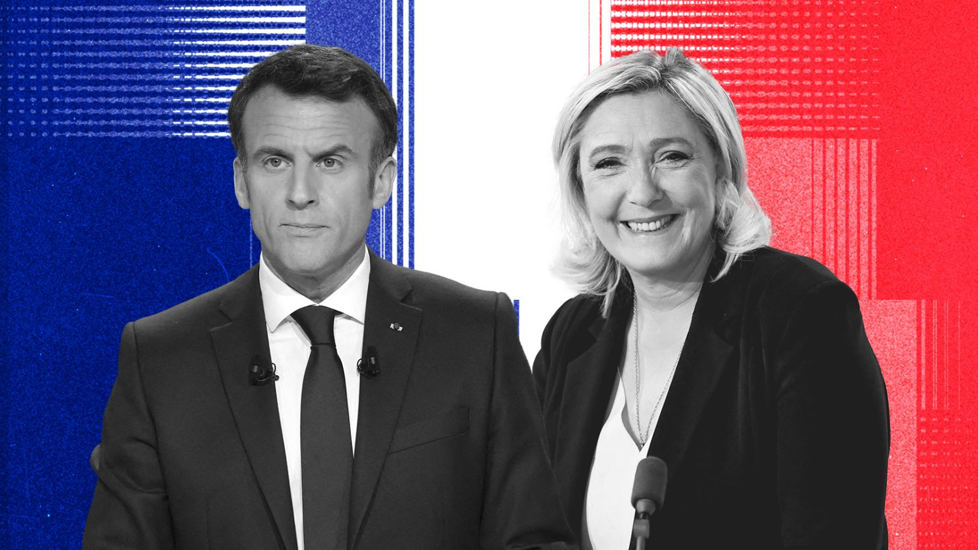
Campaigns
If only fundamentals would work ->

Slide 7
Campaigns
Campaigns are necessary for the fundamentals to be realized: they “enlighten” otherwise uninformed voters about the fundamentals (Gelman and King, 1993)
Clarifying public identity, vision for the future, competent and flexible campaign organisation
Some campaign effects persist, becoming part of the fundamentals
Other “shocks” likely to matter only if they occur close to the election (decay theory)
The issue with the direction and effects of campaign <-> vote choice

Slide 8
Campaigns
Learning
Candidates and parties, their names and positions, qualifications, traits, competence,…
Agenda setting
Limitations of voters for what is important in political universe
Selective attention to a few issues that appear important at the moment
The role of candidates/parties for choosing the agenda (with media)
Priming
- a campaign focuses on a particular topic and voters’ attitudes about the topic become more strongly linked to their vote choice (Peterson 2015)
Ability to make voters learn something and set agenda -> costs something
Role of money -> studied mostly in the US (challengers vs incumbents)

Slide 9
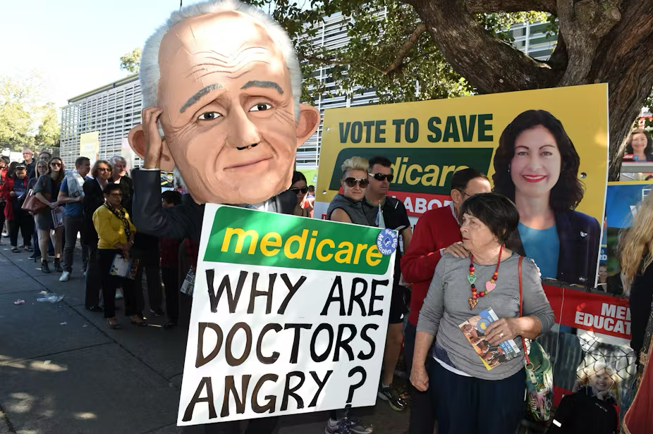
Negative campaigns
Significantly more memorable and informative than other ads (Lau et al. 2007)
No effect on political interest
Aim: reduce support for the target (yes)
BUT reduction in support for attacker too
Not definitive impact on reduction of turnout
Reduction of political efficacy and trust in government
But still, good for agenda setting, issue salience (Carson et al. 2020)

Slide 10
Overall effects
Turnout
-Yes, mostly GOTV (first turnout lecture)
Vote choice
Voters reluctant to vote for unfamiliar candidates/parties (Jacobson 2013)
Little evidence that campaigns alter basic predispositions of voters -> rather they induce them to frame the choice
Mostly undecided, swing, volatile voters – changing positions between elections, less polarized opinions of the parties, not enough information or cross-pressures
Mostly uncertain voters (about candidate’s position) -> change in perceptions of the candidate’s traits (Peterson 2015)

Slide 11
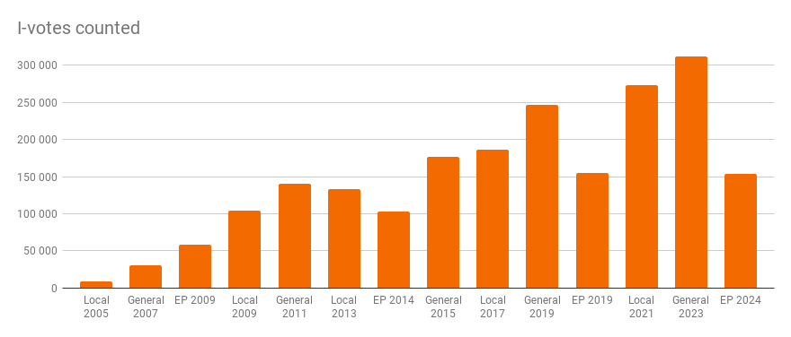
Estonia case
Trumm (2022) – 2019 Estonia elections
- Both online and offline campaigns have (similar) strong positive effects on candidates’ electoral performance (in traditional and i-votes)
- Online campaigns have become effectively as relevant as offline campaigns in influencing candidates’ electoral fortunes

Slide 12
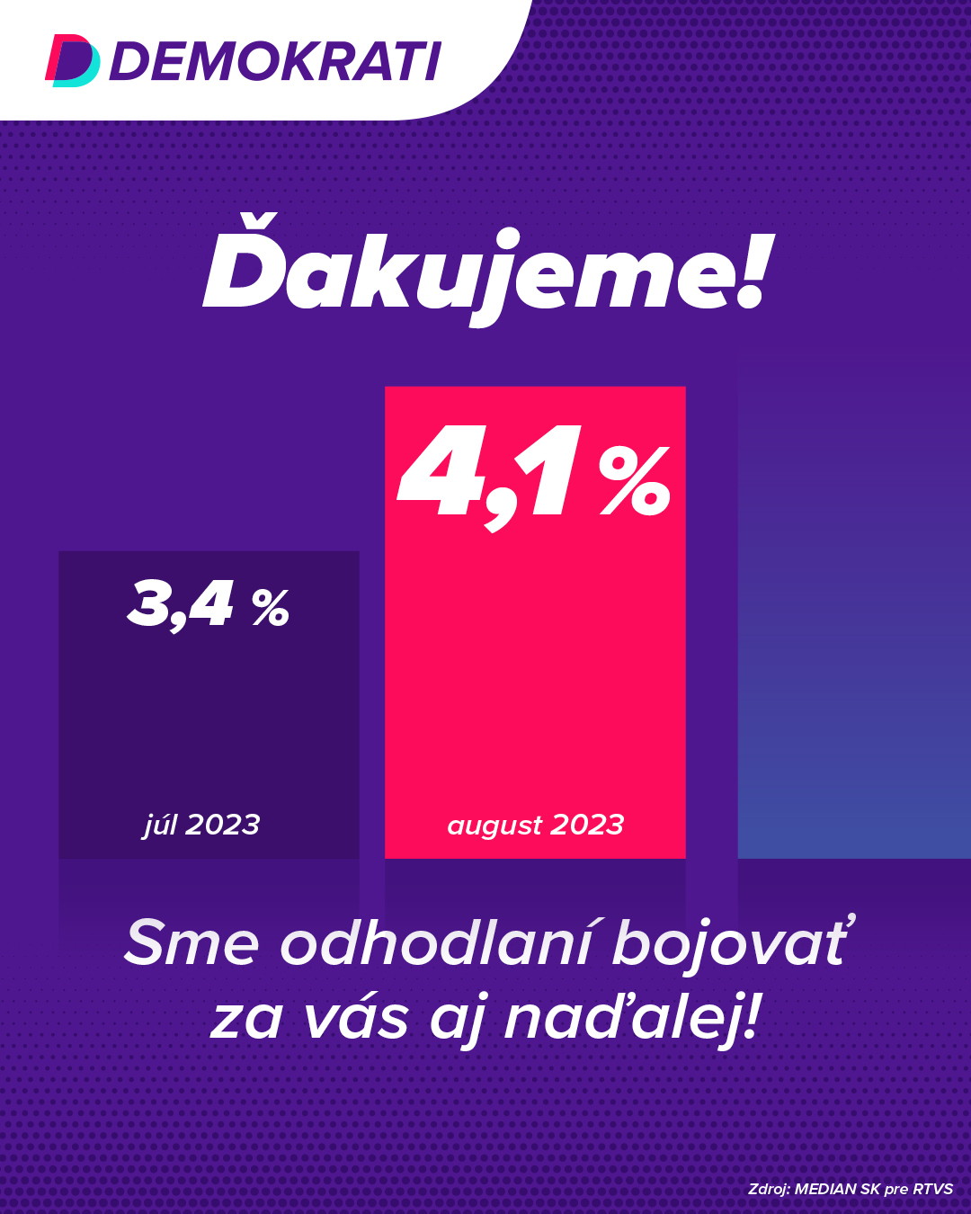
Polls
Polls as an inherent part of moder election campaigns
-media – commenting the results
-parties – publicize any favourable results -> more money for campaigns
Some TV stations base their decision to invite candidates/parties on poll results
Some countries forbid the polls some time before elections
The role of accuracy of “predictions”

Slide 13
Polls effects
Bandwagon effect
-voters rally their support towards the leading alternative
Underdog effect
-voters sway their support towards the trailing alternative
No definitive conclusion which effect is dominant
Agranov (2018) – when close elections -> bandwagon; when landslide victory -> underdog
Daoust et al. (2020) – 2015 Canadian election -> being exposed to polls is not associated with voter’s likelihood of changing their vote choice, does not affect the propensity to turn out, but improves the ability to forecast the winner
Strategic voting
- Voting for less-preferred option to make their vote more effective (not sincere voting) or help prevent a worse outcome

Slide 14
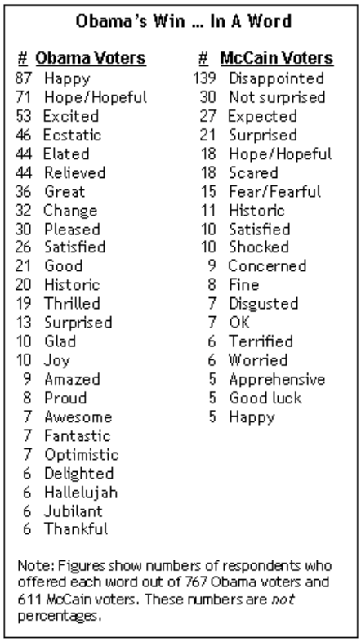
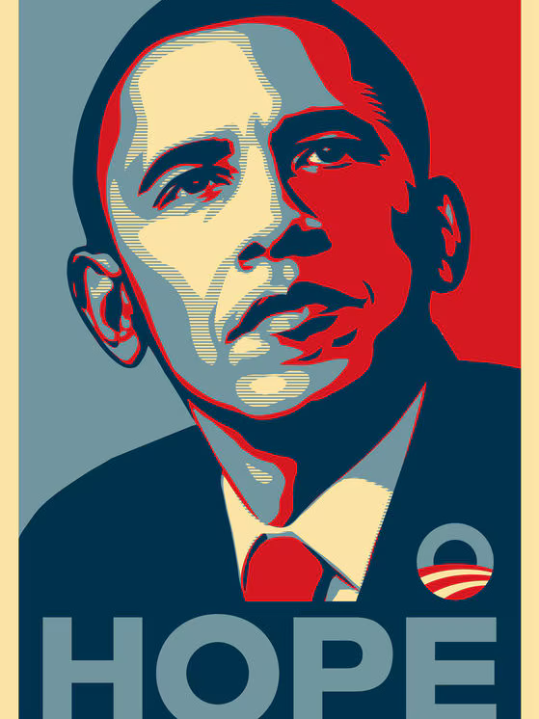
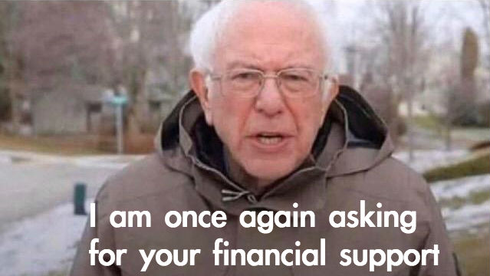

Slide 15
Summary
The role of campaigns in learning, enlightenment, (possibly) vote choice
Polls as part of the campaign for media, candidates, voters
Bandwagon and underdog effects
Strategic voting

Slide 16
Course summary
Different models of turnout
Different factors impacting undecidedness – sociodemographic, partisanship, cross-pressures, political sophistication, strategic considerations, contextual factors
Other formal and informal ways of participation – referendum, petitions, demonstrations
General vote choice predispositions - ideology, class, religion, SES, party identification
Multilevel setting of elections – surge and decline, referendum, balancing, SOE theory
Seemingly unrelated events - natural disasters, sports matches, life-changing events, economic situation and the role of rationality
Seemingly unrelated events during election day – weather, ballot information, ballot order, voting environment
Campaigns and their effects

Slide 17
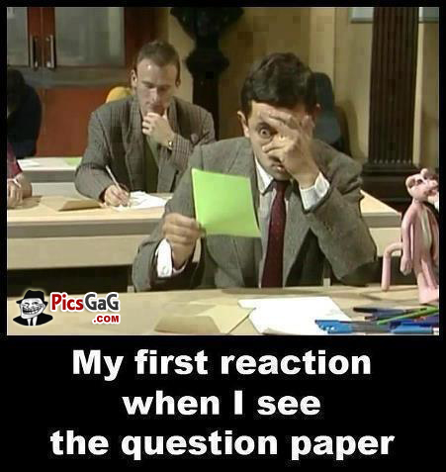
Next…

Slide 18
Literatute
Agranov, M., Goeree, J. K., Romero, J., & Yariv, L. (2018). What makes voters turn out: The effects of polls and beliefs. Journal of the European Economic Association, 16(3), 825-856.
Benoit, W. L., Hansen, G. J., & Verser, R. M. (2003). A meta-analysis of the effects of viewing US presidential debates. Communication monographs, 70(4), 335-350.
Carson, A., Martin, A. J., & Ratcliff, S. (2020). Negative campaigning, issue salience and vote choice: Assessing the effects of the Australian Labor party’s 2016 “Mediscare” campaign. Journal of Elections, Public Opinion and Parties, 30(1), 83-104.
Cantú, F., & Márquez, J. (2021). The effects of election polls in Mexico's 2018 presidential campaign. Electoral Studies, 73, 102379.
Daoust, J. F., Durand, C., & Blais, A. (2020). Are pre-election polls more helpful than harmful? Evidence from the Canadian case. Canadian Public Policy, 46(1), 175-186.
Finkel, S. E. (1993). Reexamining the" minimal effects" model in recent presidential campaigns. The Journal of Politics, 55(1), 1-21.
Iyengar, S., & Simon, A. F. (2000). New perspectives and evidence on political communication and campaign effects. Annual review of psychology, 51(1), 149-169.
Jacobson, G. C. (2015). How do campaigns matter?. Annual Review of Political Science, 18(1), 31-47.
Lau, R. R., Sigelman, L., & Rovner, I. B. (2007). The effects of negative political campaigns: A meta-analytic reassessment. The Journal of Politics, 69(4), 1176-1209.
Le Pennec, C., & Pons, V. (2019). How do campaigns shape vote choice? Multi-country evidence from 62 elections and 56 TV debates (No. w26572). National Bureau of Economic Research.
Peterson, D. A. (2015). Uncertainty and campaigns: The psychological mechanism behind campaign-induced priming. American Politics Research, 43(1), 109-143.
Trumm, S. (2022). Online versus offline: Exploring the link between how candidates campaign and how voters cast their ballot. European Journal of Political Research, 61(2), 485-502.

