Slide 1

Italy and European Integration: The 1990s
Lecture 4: Italy and European integration: the 1990s (2)

Slide 2

Structural Factors of Decline
Low productivity growth
High public debt
Inefficient bureaucracy
Limited innovation and R&D investment
Dual economy: North-South divide

Slide 3
Low Productivity Growth
Definition: Slow increase in output per unit of input
Causes:
- Small average firm size
- Low investment in new technologies
- Limited competition in some sectors
Consequences:
- Reduced competitiveness
- Slower wage growth

Slide 4
High Public Debt
Historical trend: Rapid increase since the 1980s
Causes:
- Expansionary fiscal policies
- High interest rates in the 1980s and early 1990s
Consequences:
- Limited fiscal space for investments
- Vulnerability to financial market pressures

Slide 5
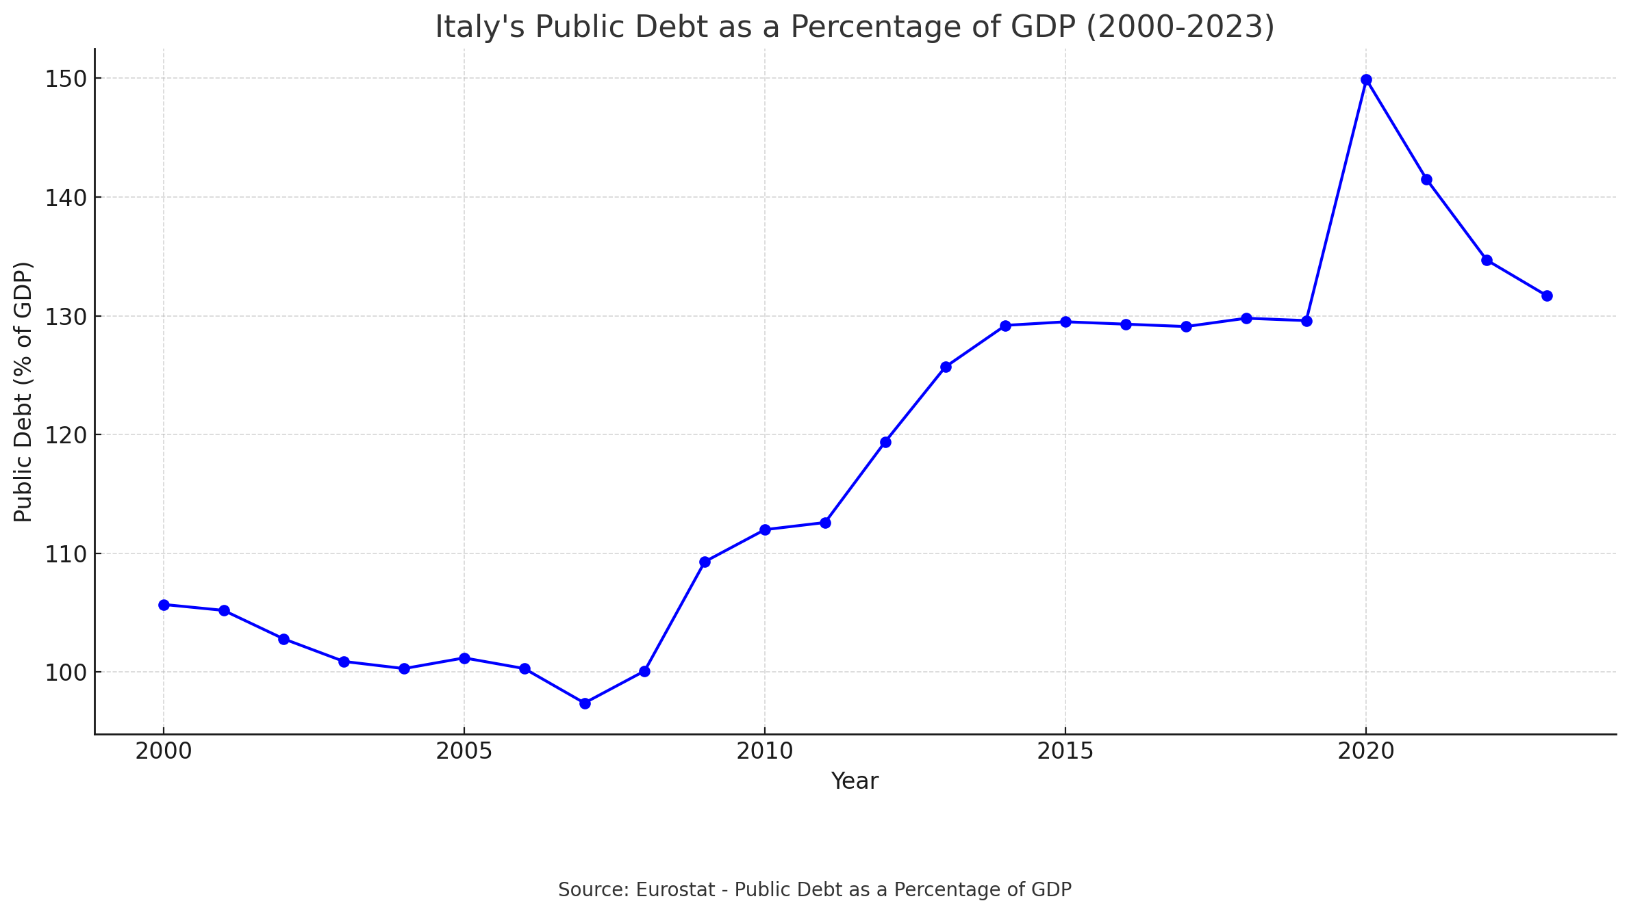
High Public Debt

Slide 6
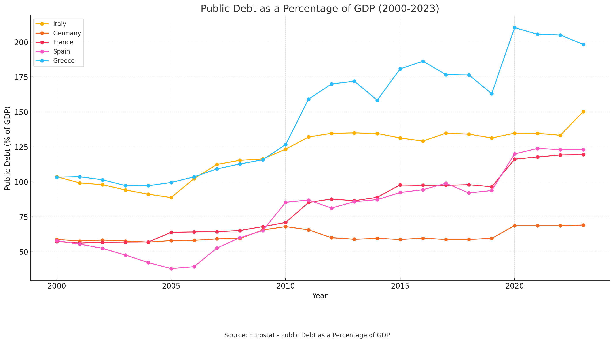
High Public Debt

Slide 7
Inefficient Bureaucracy
Complex regulatory environment
Slow judicial system
High costs of doing business
Impact on economic performance:
- Discourages foreign investment
- Hampers business growth and innovation

Slide 8
Limited Innovation and R&D Investment
Low R&D spending compared to other advanced economies
Causes:
- Prevalence of traditional, low-tech industries
- Limited public funding for research
Consequences:
- Reduced competitiveness in high-tech sectors
- Difficulty in adapting to technological changes

Slide 9
Dual Economy: North-South Divide
Persistent economic gap between North and South
Characteristics:
- Higher unemployment in the South
- Lower productivity in Southern regions
- Different industrial structures
Impact on overall economic performance

Slide 10
Explaining Economic Decline since the Early 1990s
Many theories proposed to explain the origins and the long-term nature of Italy’s economic decline
Some of them fully economy-centred
Other combine economic and political factors

Slide 11
Theories (1)
Decline in Total Factor Productivity (TFP)Problem:
Since the 1990s, Italy has experienced a sharp decline in TFP, reflecting systemic failures to innovate and compete.
Key Factors: Loss of competitiveness in R&D-intensive industries (e.g., automotive), with a shift toward low-value-added sectors (e.g., fashion, furniture) facing declining global demand​.
Lack of adoption of advanced technologies and diminished capacity for both incremental and radical innovation.

Slide 12
Theories (2)
2. Hybridization of the Capitalist Model
Theory of Hybridization: Reforms in the 1990s dismantled existing institutional complementarities, creating a "hybrid" economic model incapable of supporting either strategic coordination (typical of Coordinated Market Economies) or free-market mechanisms (typical of Liberal Market Economies)​1.
Examples:
  Incomplete privatizations led to private monopolies instead of competitive markets.
  Failure to incentivize long-term innovation and investment.
3. Lack of Effective Aggregate Demand
Keynesian Theory: Italy’s decline is linked to a drop in aggregate demand caused by stagnant wages and weak domestic consumption growth.
Critiques of Policy:
  Real wage stagnation not offset by household debt (as in the UK) or export growth (as in Germany).
  Dependence on domestic consumption without external drivers exacerbated the issue​.

Slide 13
Theories (3)
4. Failed Liberalizations and Privatizations
Market Reforms: In the 1990s, Italy undertook the largest privatization program in the OECD, equivalent to 12% of GDP.
Despite increased market flexibility, the economic impact was modest or negative.
Privatizations often resulted in private monopolies, reducing competition.
5. Institutional Decline and Poor Governance
Institutional Weakness: Italian institutions have struggled with inefficiency and an inability to enforce the rule of law.
Consequences:
Systemic corruption and tax evasion.
Lack of financial transparency discouraging investment.
Poor reform management and elite selection based on loyalty over merit

Slide 14
Theories (4)
6. “Bad Equilibrium” Theory
Definition: Italy is trapped in a negative economic equilibrium characterized by endemic corruption, inefficiency, and inequitable resource distribution.
Dynamics:
Beneficiaries of the current system lack incentives to push for change.
Clientelistic policies and welfare-for-votes exchanges stabilized the system but stifled productivity until the 1990s.
7. Labor Market Reforms and Flexibility
Flexibility Without Security:
Reforms like the “Treu Package” (1997) and "Biagi Law" (2003) introduced precarious and temporary work without adequate social protections.
Increased labor flexibility led to job insecurity without corresponding gains in productivity or stable employment.

Slide 15
Theories (5)
8. Austerity and Eurozone Constraints
Fiscal Austerity:
Eurozone membership imposed fiscal discipline (e.g., Maastricht criteria), reducing public spending and welfare, which further suppressed domestic consumption.
Impact of the Euro:
An overvalued currency for Italy reduced export competitiveness, worsening internal economic imbalances.

