Slide 1

Introduction to the Concept of Economic Decline
Economic Decline,
the Euro and
Euroscepticism in Italy
Roberto Di Quirico (Ph.D.)
Brno 2024-25
diquirico@unica.it

Slide 2

What is Economic Decline?
Definition: A prolonged process of worsening economic performance in a country
Key characteristics:
• Persistent slowdown in economic growth
• Loss of international competitiveness
• Decrease in relative economic well-being

Slide 3
Main Indicators of Economic Decline
GDP per capita (growth and relative level)
Labor productivity
Total Factor Productivity (TFP)
Share of global export market
Innovation and R&D investments

Slide 4
GDP per capita
Definition: Total value of goods and services produced in a country in a year, divided by the number of inhabitants
Growth: Percentage increase in GDP per capita from one year to the next
Relative level: Comparison of a country's GDP per capita with that of other countries or an average (e.g., EU)
Importance: General measure of a country's economic well-being

Slide 5
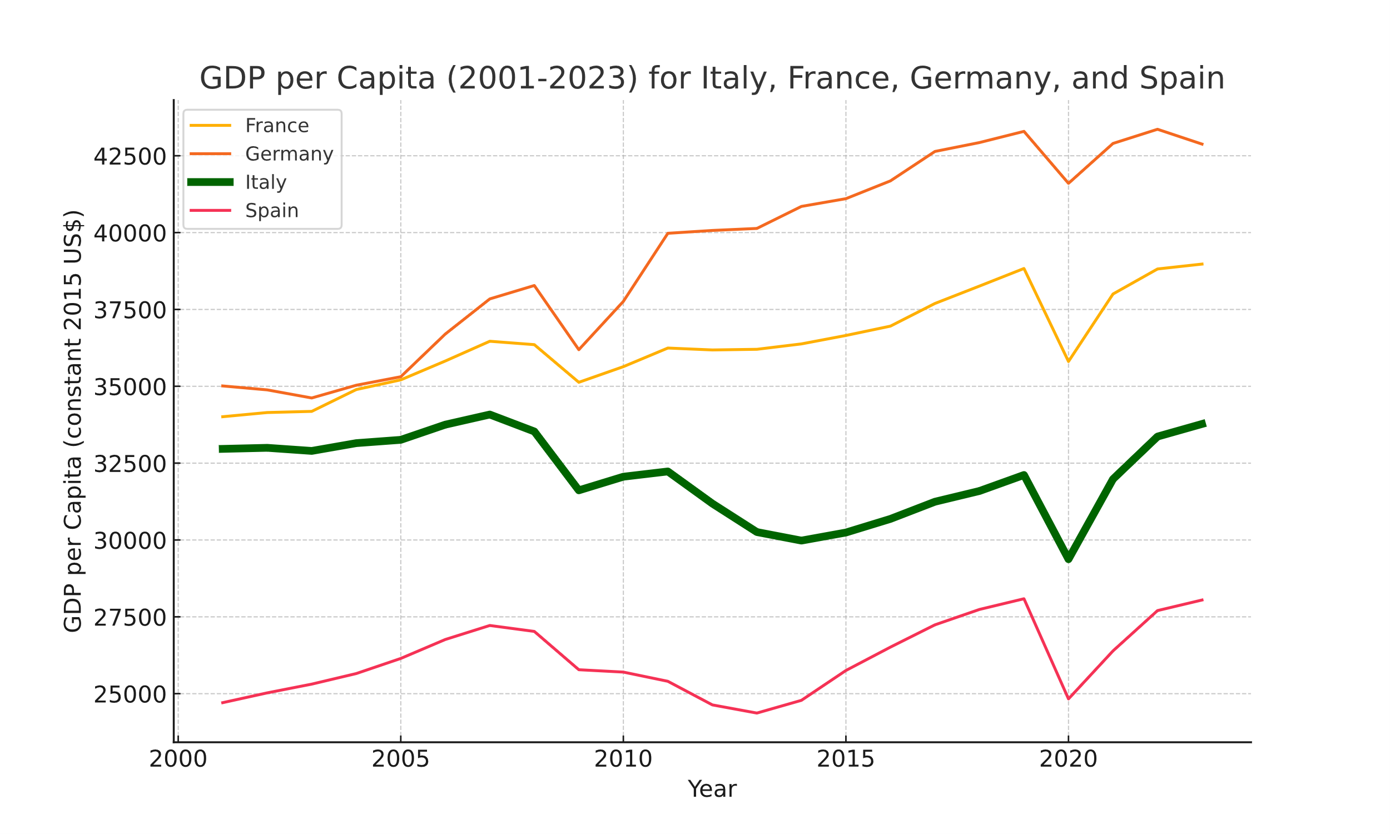
GDP per capita
Source: World Bank, https://databank.worldbank.org/source/world-development-indicators#

Slide 6
Labor Productivity
Definition: Quantity of output (goods or services) produced per unit of labor
Calculation: GDP divided by the total number of hours worked in a country
Importance: Indicates the efficiency with which labor is used in the economy
Example: If productivity increases, more is produced with the same number of hours worked

Slide 7
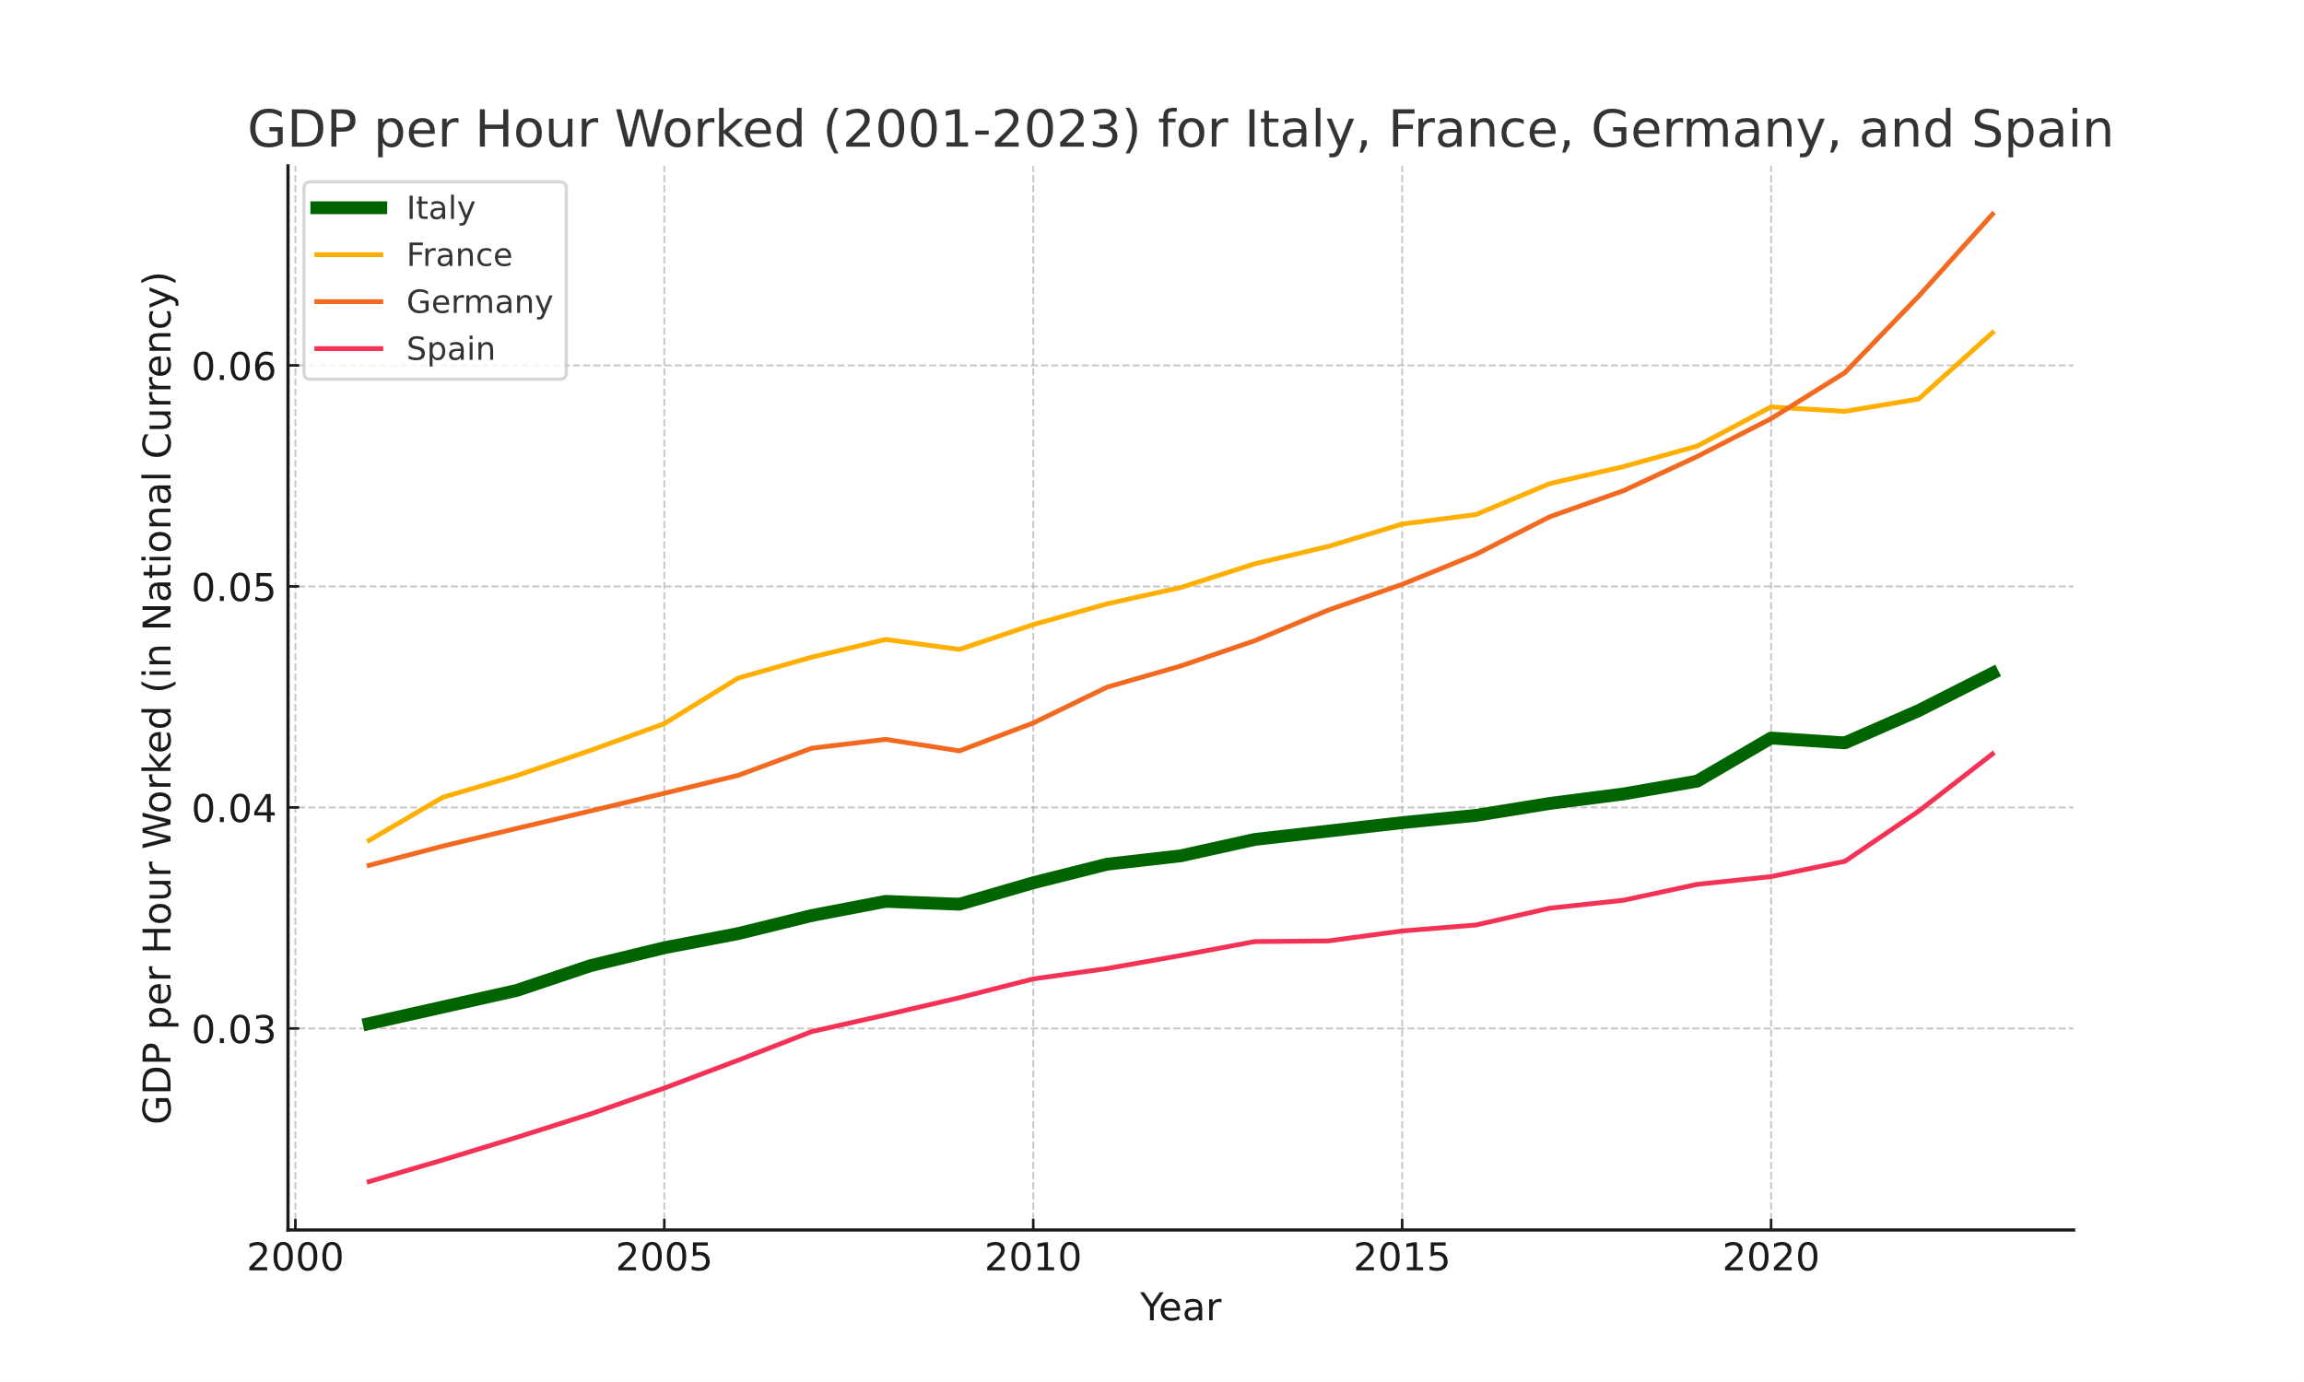
Labor Productivity
Source: AMECO, https://economy-finance.ec.europa.eu/economic-research-and-databases/economic-databases/ameco-database_en

Slide 8
Total Factor Productivity (TFP)
Definition: Measure of the overall efficiency with which an economy uses all its productive factors
Concept: Part of economic growth not explained by the increase in inputs (labor and capital)
Importance: Reflects technological progress and innovation in an economy
Example: Improvements in production processes that allow more to be produced with the same inputs

Slide 9
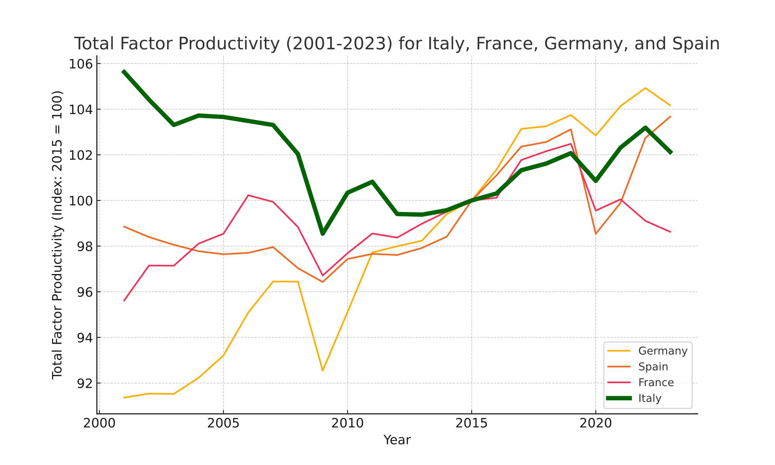
Total Factor Productivity
Source: AMECO, https://economy-finance.ec.europa.eu/economic-research-and-databases/economic-databases/ameco-database_en

Slide 10
Share of Global Export Market
Definition: Percentage of world exports coming from a given country
Calculation: (Country's exports / Total world exports) x 100
Importance: Indicates a country's international competitiveness
Example: If the share decreases, it means other countries are exporting relatively more

Slide 11
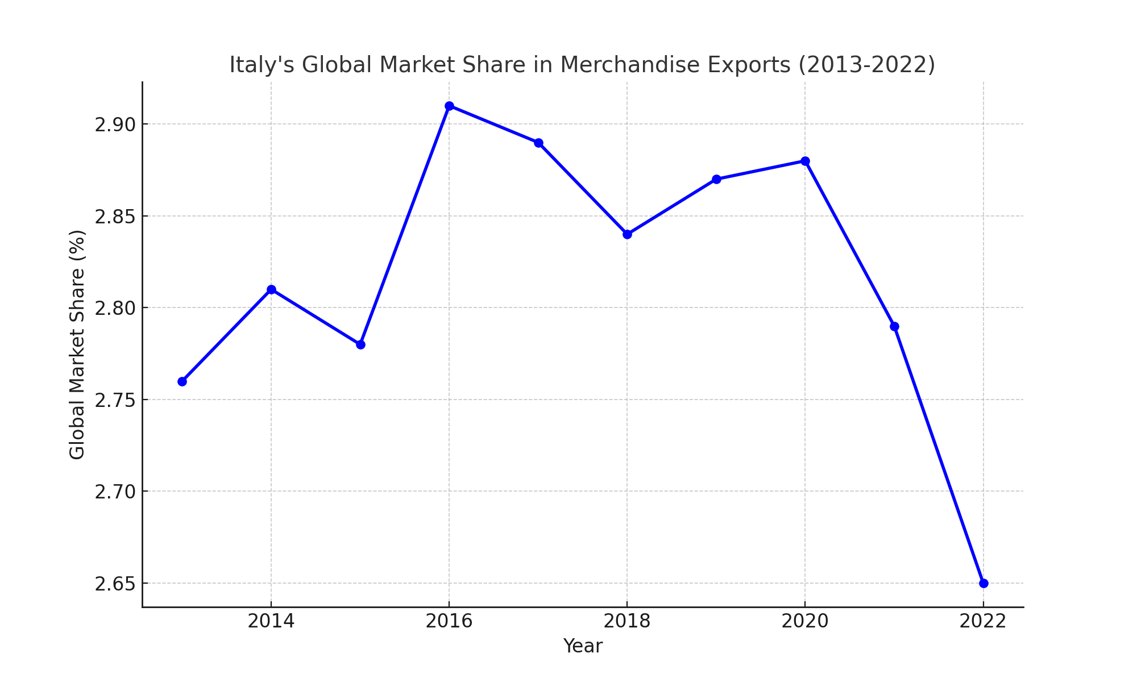
Share of Global Export Market
Source: ISTAT, https://www.istat.it/storage/ASI/2023/capitoli/C15.pdf

Slide 12
Innovation and R&D Investments
Innovation: Introduction of new products, processes, or methods into the economy
R&D: Research and development activities to create new knowledge and technologies
R&D investments: Financial resources allocated to research and development activities
Importance: Crucial for long-term economic growth and international competitiveness
Measurement: Often expressed as a percentage of GDP invested in R&D

Slide 13
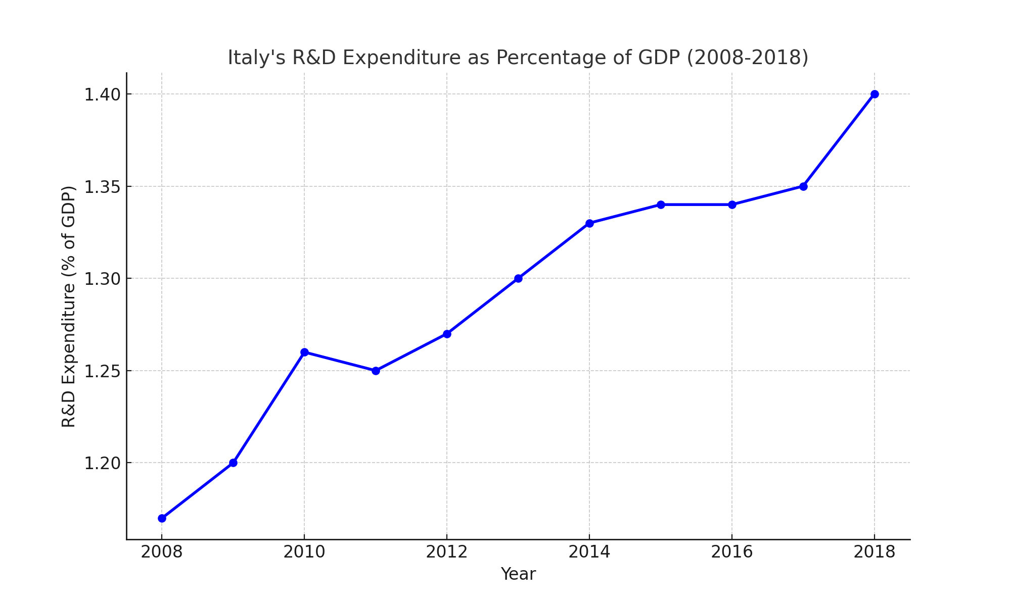
Innovation and R&D Investments
Source: ISTAT, https://www.istat.it/it/files/2021/05/La-spesa-in-ricerca-e-sviluppo.pdf

Slide 14
Summary of Italian Economic Decline
Key points:
• Since 1990: GDP per capita growth lower than EU15 average
• 2000-2010: Negative TFP growth
• 2010: Only EU country with GDP per capita lower than in 2000
Implications for competitiveness and economic well-being

Slide 15
Introduction to Euroscepticism
Definition: Criticism of or opposition to the European Union and European integration
Key aspects:
• Ranges from soft (reformist) to hard (rejectionist) Euroscepticism
• Can be based on economic, political, or cultural concerns
• Often linked to national sovereignty issues
In Italy:
• Traditionally pro-European country
• Euroscepticism emerged mainly in the 1990s and grew after the 2008 crisis

Slide 16
From Permissive Consensus to Constraining Dissensus
PERMISSIVE CONSENSUS:
Definition: Passive acceptance of European integration by citizens, primarily driven by political elites.
Key Features:
Low public attention to EU matters.
Increasing levels of support for integration during the 1970s and 1980s.
European policies perceived as technical and distant.
Transformative Factors:
Maastricht Treaty (1992): Introduction of "high politics" topics (e.g., single currency, sovereignty, EU citizenship).
Greater EU impact on citizens' daily lives.
Initial Consequences:
Growing public dissent towards integration.
End of permissive consensus: more public involvement, but with critical attitudes.

Slide 17
Constraining Dissensus and the Rise of Euroscepticism
CONSTRAINING DISSENSUS:
Definition: Increased division and polarization of public opinions on European integration.
Key Features:
More dispersed opinions and flatter distributions.
Higher public engagement, but less overall consensus.
Politicization of European integration.
Political Implications:
Opportunities for Eurosceptic parties to exploit dissent.
Pressure on political elites to revise their approach to integration.
Emergence of potential internal political cleavages.
Long-term Outcomes:
Decline in average support, coupled with greater fragmentation of public opinion.
Need for strategies addressing citizens' growing concerns.

Slide 18
The Role of the Euro in Fueling Dissensus
The Euro as a Symbol of Political Integration:
  The euro represented a key step toward deeper political union, not just economic integration.
  Perceived as a loss of national sovereignty, fueling dissent in various member states.
Perceived Economic Impacts:
  Associated with negative economic changes such as price increases and reduced purchasing power.
  Strengthened critical narratives and fueled Euroscepticism.
Polarization of Public Opinions:
  The euro divided public opinion between those who saw it as progress and those who saw it as a threat.
  Contributed to a more dispersed opinion distribution, a hallmark of constraining dissensus.
Political Consequences:
  Politicization of the euro provided fertile ground for Eurosceptic parties and populist movements.
  The euro became a symbol for broader criticism of the European project, deepening the divide between pro-integration elites and critical citizens.

Slide 19
The Role of the Euro in Fueling Dissensus (2)
Conclusion: The introduction of the euro was not merely a technical decision but a systemic event that heightened discussions on national identity, sovereignty, and economic governance, playing a crucial role in the shift from "permissive consensus" to "constraining dissensus."

