Slide 1
SOCn5010 Analýza sociálních sítí
Přednáška 5: pozice a vliv

Slide 2
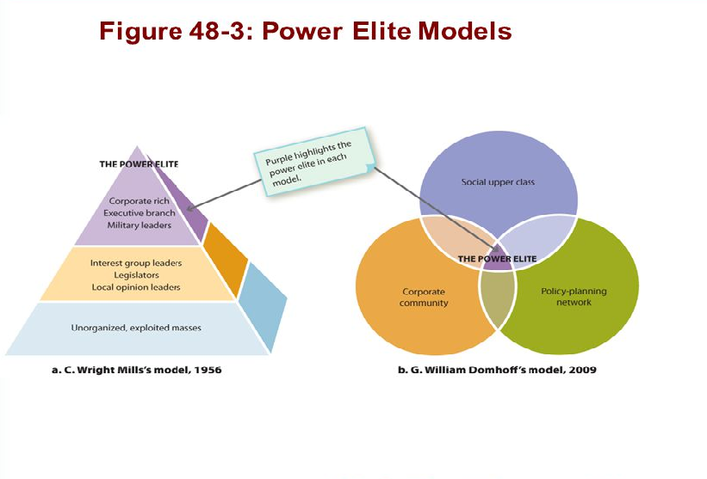
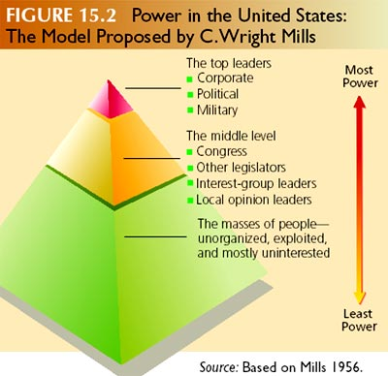
Mocenská elita

Slide 3
„Krajně temné kochovské žilky“

Slide 4
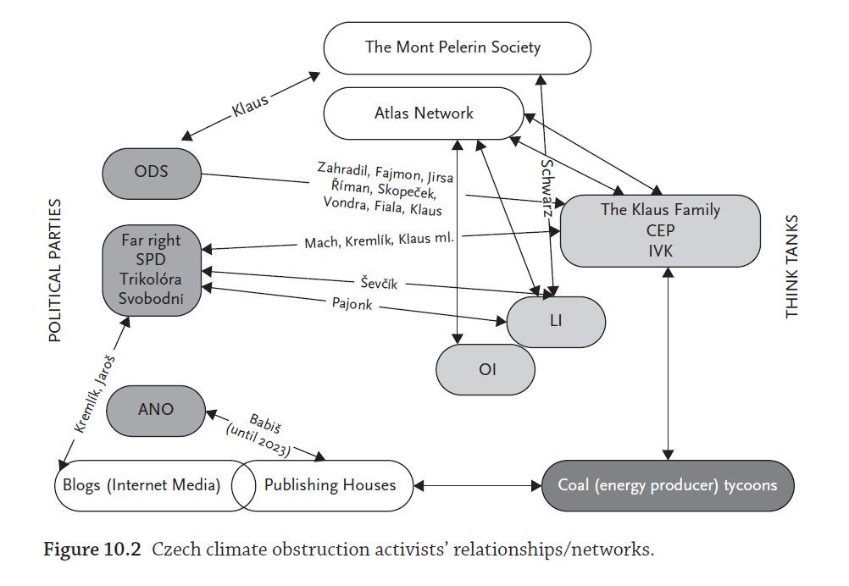
Klíčoví aktéři obstrukcí klimatické politiky v ČR (Hrubeš, Císař 2024)

Slide 5
Jaké typy vztahů nás zajímají?
Směna (zdroje, toky peněz)
Rodinné vazby
Přináležitost ke skupině (politická strana)
Sdílená lokalita
Sdílené zájmy
Sdílené vlastnictví
Podpora šíření vlivu (huby a autority)
…

Slide 6
Interlocking directorates (Mizruchi)
Proč vznikají?
Spiknutí, kooptace a dohled, legitimita, kariérní vzestup, sociální koheze
Jaké mají důsledky?
Kontrola, indikátor síťové zakořeněnosti (embeddedness)
Soudržnost, koordinace, jednotná kontrola + náskok před konkurencí, lepší toky informací, lepší spolupráce

Slide 7
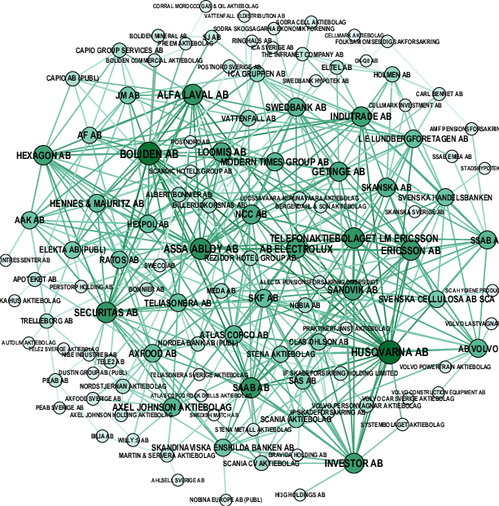
Příklad: Interlocking directorates (Garcia-Bernardo, Takes 2016)
Sample of the Swedish network of interlocking directorates. Based on largest 120 firms in terms of revenue, connected through 422 interlocks. Color and size are proportional to node degree.

Slide 8
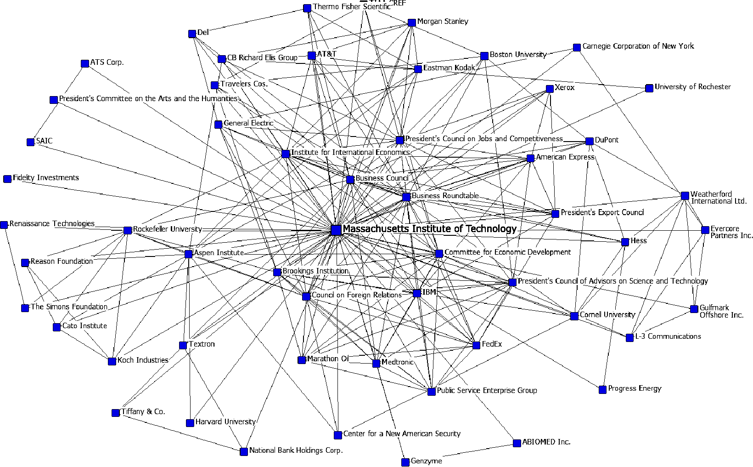
Příklad: Interlocking directorates – egonet MIT
https://whorulesamerica.ucsc.edu/power_elite/interlocks_and_interactions.html

Slide 9
Příklad: Analýza meziparlamentních komisí (Mochťak, Diviák 2019)

Slide 10
Seminář

Slide 12
Key concepts
Size
Density
Cohesion
Reciprocity
Transitivity
Centralization

Slide 13
Network size
Size is critical for the structure of social relations because of the limited resources and capacities that each actor has for building and maintaining ties
Number of nodes

Slide 14
Density
Social capital and/or social constraint
Proportion of existing ties out of all possible ties
Maximum density in symmetric/undirected network: n(n-1)/2 [n – number of nodes]
Comparing densities across network of different size?
Average degree + in-degree/out-degree
Valued network: density is defined as the sum of the ties divided by the number of possible ties (i.e. the ratio of all tie strength that is actually present to the number of possible ties)
= sum of the values of all ties divided by the number of possible ties. That is, with valued data, density is usually defined as the average strength of ties across all possible (not all actual) ties

Slide 15
Cohesion
Density in sub-graphs (within groups)
Components
Component ratio = (number of components-1)/(number of nodes-1)
1 = every node is an isolate / 0= one component
Connectedness – proportion of pair of nodes that can reach each other (are located in the same component)
1 – connectedness = fragmentation

Slide 16
Reciprocity
directed data
four possible dyadic relationships: A and B are not connected, A sends to B, B sends to A, or A and B send to each other.
Number of reciprocated ties / number of all ties
Dyad method: number of pairs with a reciprocated tie relative to the number of pairs with any tie
Arc method: percentage of all possible ties (or "arcs" of the directed graph) which are part of reciprocated structures

Slide 17
Centralization
Extent to which a network is dominated by a single node
Domination – star graph
The star network is the most unequal possible network for any number of actors
degree of variability in the degrees of actors in the network as percentage of that in a star network of the same size
Sum of differences between each node´s centrality and the centrality of the most central node / sum of differences in the star graph of the same size

Slide 18
Transitivity
Triad census
the most interesting and basic questions of social structure arise with regard to triads
Transitive triad – A-B, B-C, C-A
Share of transitive triads in the network
Clustering coefficient – density of ties of a ego-network (individual clustering coefficient); average CC – network CC; weighted overal CC = transitivity coefficient

Slide 19
Transitivity
Transitive vs. Intransitive triad (AB,BC,CA vs. AB,BC) – undirected
Directed – 16 triads:

Slide 20
Transitivity
Triplets instead of triads
triplets are like triads, but they refer only to the presence of the edges, and do not require the absence of edges.
E.g., the number of two-star triplets is the number of potentially transitive triads.
The triplet count for a non-directed graph is defined by the number of edges, the total number of two-stars (irrespective of whether they are embedded in a triangle), and the number of triangles.

Slide 21
Literatura
Padgett, John and Christopher Ansel. 1993. “Robust Action and the Rise of the
Medici, 1400-1434.” American Journal of Sociology 98: 1259-1319.
Mizruchi, Mark S. 1996. "What Do Interlocks Do? An Analysis, Critique, and Assessment of Research on Interlocking Directorates." Annual Review of Sociology 22: 271-298.
CROSSLEY, Nick. 2010. Towards Relational Sociology. Abingdon: Routledge.
PRELL, Christine. 2012. Social Network Analysis: History, Theory & Methodology. Los Angeles: Sage.
KNOKE, David, and Song YANG. 2008. Social network analysis. Thousand Oaks: Sage.

