Slide 1
SOCn5010 Analýza sociálních sítí
Přednáška 8: Moc

Slide 2
Sítě jako nové mechanismy organizace (Powell)

Slide 3
Co je to moc a jak ji studovat?
Nominální přístup - stratifikační (viditelné znaky moci) - poziční (viditelná mocenská pozice)
Strukturální přístup - stratifikační (diskrétní znaky moci) - poziční (potenciální nebo reálná mocenská pozice)

Slide 4
Příklad: Medicejové (Padgett, Ansel 1993)

Slide 5
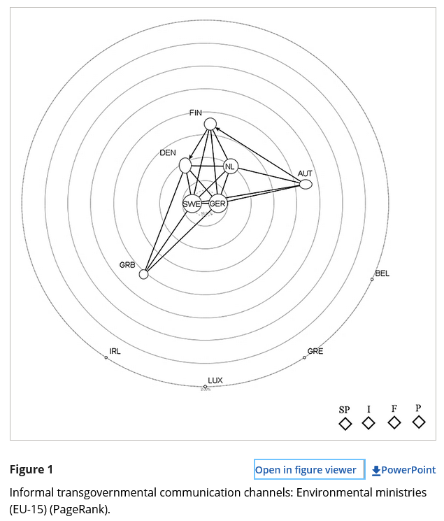
Transgovernmental networks (Thurner, Binder 2009)
Does the European Union (EU) represent a new political order replacing the old nation-states? The assessment of the real character of political orders requires the identification of political key actors and of the specific structure of their interactions. Transgovernmental networks have been considered to be one of the most important features of EU integration. Unfortunately, the network structures, processes and the impact of these informal horizontal inter-organisational relations between nation-states are mostly unknown. The main objective of this article is to measure and explain the selective pattern of informal bilateral relations of high officials of the EU Member States’ ministerial bureaucracies on the occasion of an EU Intergovernmental Conference. The quantitative data used rely on standardised interviews with 140 top-level bureaucrats. The statistical estimation of network choices is based on recent developments of exponential random graph models.

Slide 6
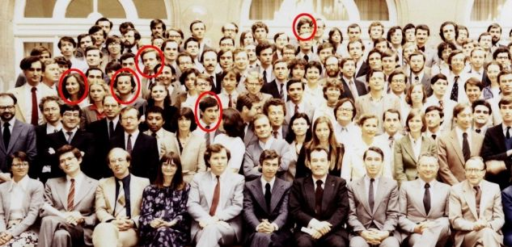
Ecole Nationale d'Administration (ENA)

Slide 7
Nominální vs. strukturální přístup
https://www.seznamzpravy.cz/clanek/domaci-politika-prezidentska-kanclerka-vohralikova-konci-na-hrade-244481
https://www.e15.cz/domaci/kolaruv-dvoji-metr-kritizuje-cinu-ale-zaroven-pracuje-pro-lobbisty-huawei-klienty-neodtajnim-rika-1413666
https://www.idnes.cz/zpravy/domaci/milan-vasina-hrad-kancler-aspen-institute-vohralikova-petr-pavel.A240125_173123_domaci_remy

Slide 8
Jaké vlastnosti sítí nás zajímají?
Centralita (degree) – počet vazeb
Pozice z hlediska toku informací (betweenness) - kontrola
Blízkost k ostatním uzlům (closeness) – dostupnost
Strukturální mezera (structural hole) – pozice mezi vzájemně nepropojenými uzly (a jejich shluky), které mají komplementární zdroje

Slide 9
Analýza moci s pomocí SNA
Mapování sociálních vazeb (příbuznost, ekonomická směna, politická afiliace) – mapování různých druhů kapitálu
Brokerage and Bridging: kdo dokáže zprostředkovávat vztahy mezi jinými? Kdo usměrňuje tok informací a nastoluje agendu?
Structural Holes: mezi kterými částmi sítě chybí spojení? Kdo je umí přemostit?
Adaptabilita: kdo umí rychle volit nové spojence? Kdo má velký výběr partnerů? Kdo umí rychle vytvořit nová spojení?
Multiplex Networks: kdo má přístup do různých typů sítí?
Historical Context: v jakém kontextu se vše odehrává? Jaký typ chování tento kontext podporuje? Jaké typy vazeb umožňuje a odměňuje?
Jak jednotlivci a skupiny mohou utvářet sociální vazby a být utvářeni svými sociálními vazbami a jak tyto vazby ovlivňují rozdělení moci v dané společnosti?

Slide 10
Seminář

Slide 11
Intro
Centrality (node attribute) vs. Centralization (network attribute)
Node position in the network – its structural importance
Various measures – depending on the conceptualization of the network
Flow of information, friendhip relations, economic transactions…)
Influence, prominence, control, prestige, social capital…
Not inherently related to centrality!
Overally positive aspect of centrality in positive network

Slide 12
Degree centrality
Number of ties a node has
No other data from network are necesssary
Universal measure
Directed networks: in-degree, out-degree
Valued networks: average or sum of all values

Slide 13
Eigenvector centrality
Each node´s centrality is proportional to the sum of centralities of the nodes it is adjacent to
Measure of popularity or risk
Directed networks: right eigenvector (outdegree) and left eigenvector (indegree)
But: better option for directed networks is beta centrality
Valued networks: no modification (node centrality proportional to the sum of centralities of the alters weighted by the strength of a tie – high-valued connection to low-centrality actor similar as low-valued connection to highly central actor)

Slide 14
Beta centrality
extensions of the idea of degree centrality based on adjacencies
The "attenuation factor" indicates the effect of one's neighbor's connections on ego's power
Where the attenuation factor is positive (between zero and one), being connected to neighbors with more connections makes one powerful
Bonacich: If ego has neighbors who do not have many connections to others, those neighbors are likely to be dependent on ego, making ego more powerful
Negative values of the attenuation factor (between zero and negative one) compute power based on this idea.
Valued networks: no modification

Slide 15
Closeness centrality
Sum of geodesic distances from a node to all others
Inverse measure of centrality (the higher the number, the more the node is peripheral)
Not always geodesic distances (Hubbell and Katz approaches - influence) - The Hubbell and Katz approaches count the total connections between actors (ties for undirected data, both sending and receiving ties for directed data); each connection, however, is given a weight, according to it's length. The greater the length, the weaker the connection
Normalized closeness (each node´s score is divided into n-1) - the higher the number the node is more central (close)
Problem in disconnected networks
Not working well with directed data (disconnected networks)
Valued data: many options, need to conceptualize tie strentgh

Slide 16
Betweeness centrality
With binary data, betweenness centrality views an actor as being in a favored position to the extent that the actor falls on the geodesic paths between other pairs of actors in the network
the more people depend on me to make connections with other people, the more power I have
the proportion of times that each actor is "between" other actors
may be normalized by expressing it as a percentage of the maximum possible betweenness that an actor could have had
Valued network: many options, need to conceptualize tie strentgh

Slide 17
K-step reach
Counts the number of nodes each node can reach in k or less steps.
For k = 1, this is equivalent to degree centrality.
For directed networks, both in-reach and out-reach are calculated.

Slide 18
Literatura
Padgett, John and Christopher Ansel. 1993. “Robust Action and the Rise of the
Medici, 1400-1434.” American Journal of Sociology 98: 1259-1319.
Mizruchi, Mark S. 1996. "What Do Interlocks Do? An Analysis, Critique, and Assessment of Research on Interlocking Directorates." Annual Review of Sociology 22: 271-298.
CROSSLEY, Nick. 2010. Towards Relational Sociology. Abingdon: Routledge.
PRELL, Christine. 2012. Social Network Analysis: History, Theory & Methodology. Los Angeles: Sage.
KNOKE, David, and Song YANG. 2008. Social network analysis. Thousand Oaks: Sage.

