Slide 1
Social Stratification Research – 4 generations
Social stratification research (SSR) or social mobility research (SMR) has been established after 2WW
The aim was to map and compare social structures of advanced societies
SSR research is primary comparative and relational
  why?
Nowadays we can distinguished 4 generations in SSR
Generations are delimited by
  research problems
  methods of data collection
  measurement procedures/ technics
  results
  time periods (but with overlaps)
SSR is primarily quantitative

Slide 2
Social mobility – key concept of SSR
Sorokin’s book Social Mobility has been printed in 1927
first using of the concept of social mobility
  versus the intergenerational transmission of advantages (social/cultural reproduction)
macro concept for social groups or higher aggregates
it is not about individuals
social stratification is not social mobility
social mobility define the openness of social stratification
different social mobility lifts

Slide 3
Social mobility
Social mobility is the movement of people up or down the stratification system
Class systems allow for more movement than slave or caste systems.
Intragenerational and intergenerational social mobility.
While class systems do allow for social mobility, opportunities are not evenly distributed across social groups.
Social origin class/actual social class position have a significant impact on many aspects of life, including education, occupation, place of residence, marriage partner, and more
3
Notes:
An important characteristic of class systems, as opposed to slave or caste systems, is that in class-based systems of stratification, there is the opportunity for social mobility. This means that people and groups can, potentially, move up or down in the rankings, and this is seen by many as a significant benefit of class systems.
In reality, however, such mobility is less common than our national mythology suggests. Typically, those who arrive at high positions have families who either had high positions themselves or the resources to provide the appropriate education for advancement. Achieving upward mobility is very difficult, and the wonderful stories we’ve all heard and seen (think, for example, of the movie The Pursuit of Happyness) are so very moving because they are the exception, not the norm. If such stories were common, they would not get our attention in nearly the same way.

Slide 4
Social mobility - politicians
“I want to see social mobility rising once again,” said prime minister Tony Blair in 2004
“We can unleash the biggest wave of social mobility since the second world war,” said prime minister Gordon Brown in 2010.
“I want to see a more socially mobile Britain,” said David Cameron in 2013.
“I want Britain to be the world’s great meritocracy,” said Theresa May in 2016.

Slide 5
First generation of SSR (I)
1950 – 1960 time period
Research committee for social stratification and inequality (RC28) has been established under ISA
comparative research of social mobility
the aim is to map the openness of social structures
research question: how strong is OD connection?
simple social class categories (usually 3 categories)
simple statistical technics, proportions
  OD mobility (contingency) tables
    demonstration, percent, outflow, inflow percent
  structural vs net mobility, defined in theoretical level, problems with identification in empirical analysis

Slide 6
First generation of SSR (II)
key tested assumption: LZ hypothesis (Lipset, Zetterberg, 1956)
„…the overall pattern of social mobility appears to be much the same in the industrial societies of various Western countries.“
LZ hypothesis has been a reaction to the prevailing assumption that in US we can find more intergenerational mobility than in other western industrialized countries
LZ hypothesis has not been rejected
In all nations the same level of social mobility
LZ hypothesis says there is no linear relationship between industrialization and social mobility
The industrialization means the rise of social mobility
But only under certain level
After that higher industrialization does not mean higher social mobility

Slide 7
First generation of SSR (III)
Important research questions in first generation:
Association between social mobility and economic development?
Association between social mobility and political stability?
Association between social mobility and political/voting behavior?
Association between social mobility and fertility
Extent of assortative mating by social origin and education?
What is effect of education in social mobility process?

Slide 8
Second generation of SSR (I)
1960 – 1970 time period
change from comparative social mobility research to status attainment process in a society
turn to the continuous variables, SEI scores for occupations
the aim is to map the social determinants of occupational status
reformulation of research question
How much is social mobility? (first generation)
Now: how O influences D directly and also indirectly via other variables, especially via E
introduction of path models in sociology
result: status attainment model or „social mobility piggy“

Slide 9
Second generation of SSR (II)
representatives are Petr Blau, Otis Dudley Duncan: American Occupational Structure (1967)
no difference between inter- and intra-generational mobility
only one social „change“ between O and D but O is starting position, no characteristic of parents
tested assumption: industrialization promotes achievement and reduces ascription, the importance of E increases in time
Results: Yes - the effect of E is stronger than O and influences D with higher intensity, American society is meritocratic society
Change in time by birth cohort comparison and no clear trend
robust results but without comparative potency
no social class divisions in this approach
original concept of social mobility disappeared

Slide 10
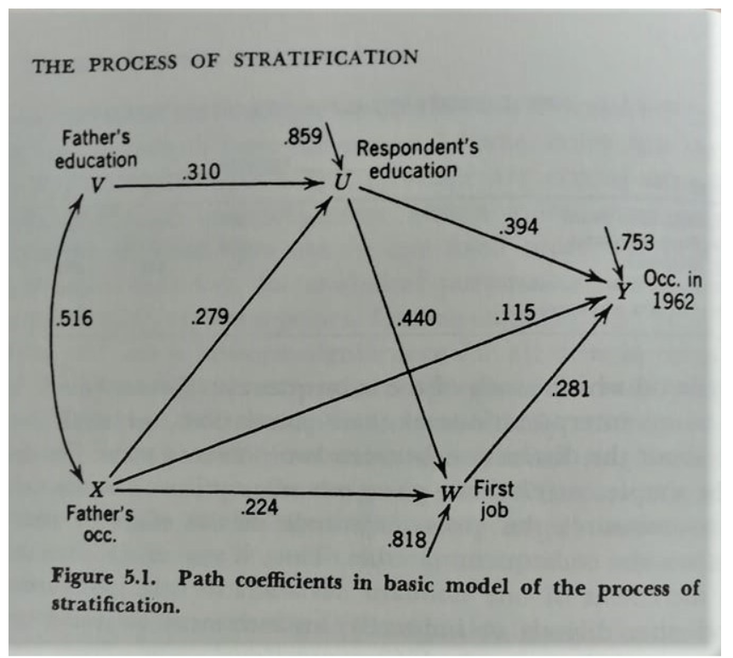

Slide 11
Third generation of SSR (I)
SEI or later ISEI has not theoretical justification, it is result of empirical analysis (c.f. Ganzeboom construction of ISEI)
SEI or ISEI means reduction of occupation into contextual variables that are income and education
third generation means comeback to social classes and original concept of social mobility but with proper statistical technics
1970 – 1980 time period
EGP social class scheme, later ESeC (ESeG)
division between structural and net mobility – wrong distinction
replace these concept by absolute and relative mobility
absolute mobility indicated by percent
relative mobility indicated by odds ratios (OR), log-linear models

Slide 12
Third generation of SSR (II)
key tested assumption: FJH hypothesis (Featherman, Jones, Hauser, 1975), the same hypothesis like LZ hypothesis, but in relative terms
„…there exists a cross-national similarity of social mobility rates at the level of underlying relative mobility chances, such that in all societies having a nuclear family system and market economy, the mobility pattern will be ‘basically the same.“
key test/book: Robert Erikson, John Goldthorpe: The Constant Flux: A Study of Class Mobility in Industrial Society (1992)
test of LTI vs FJH: opening vs no change
results support FJH hypothesis: no change/ but difference among countries

Slide 13
Fourth generation of SSR (I)
from 1990 up to now
the fourth generation is defined by turn to substantive questions in SSR
no statistical development any more
statistical measures are very sophisticated in contemporary SSR
connection of research questions and explanations of the second generation and statistical measures of the third generation
substantive research question
key O-E-D triangle
O-E: social stratification in education
E-D: from education to labour market positions
O-D: social mobility research
key question: the effect of ascription in life results

Slide 14
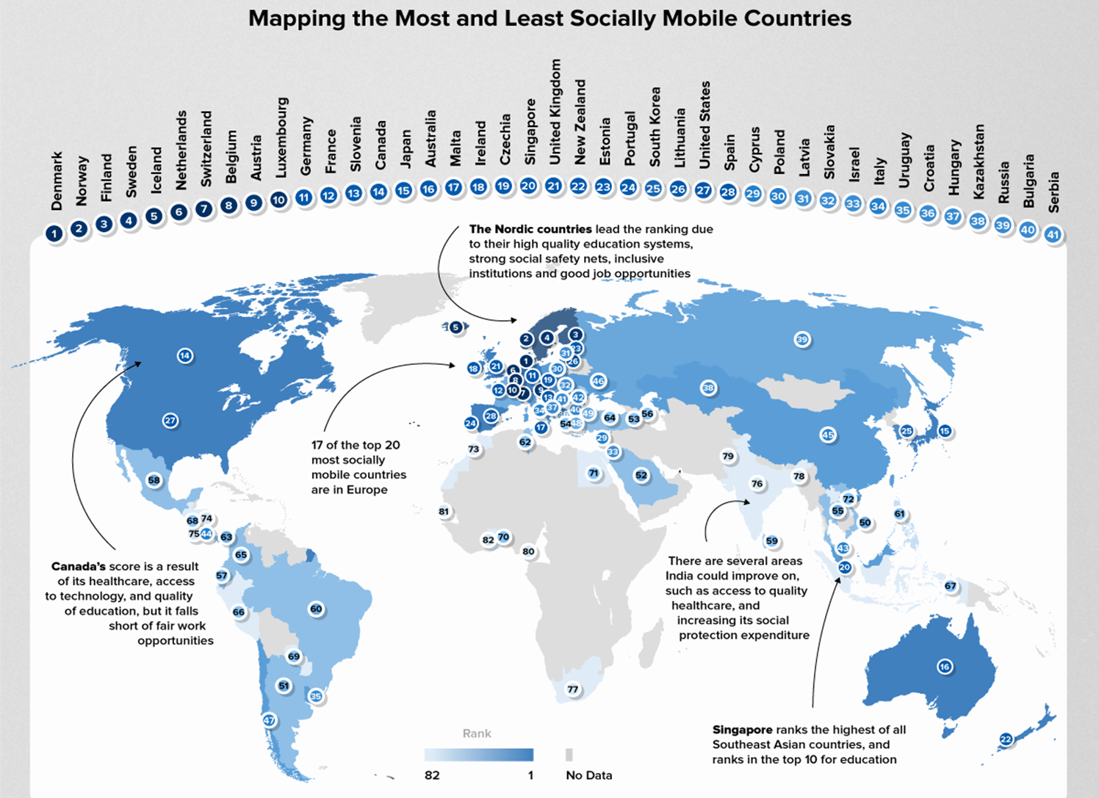

Slide 15
References
https://www.semanticscholar.org/paper/Social-Mobility-in-the-EU-Eurofound/d5ffb26505120f981e1f3f3bc25420a1ba24b2d4
https://www.researchgate.net/publication/266209078_Demographic_Standards_for_Surveys_and_Polls_in_Germany_and_Poland_National_and_European_Dimension/figures?lo=1&utm_source=google&utm_medium=organic
https://www.visualcapitalist.com/ranked-the-social-mobility-of-82-countries/

