Slide 1
PSYCHOLOGICAL
THEORIES OF VIOLENCE
Lecture 3
Susantha Rasnayake

Slide 2
Brainstorming activity
See the following incident and comment
“On October 24, 2009, a 15-year-old girl was gang-raped outside of her high school homecoming dance while a group of other teenagers watched but did nothing to stop the assault”
As you think, what would be the internal characteristics of perpetrators?
If you were a member of the second group (those who watched), what would be your response/reaction?

Slide 3
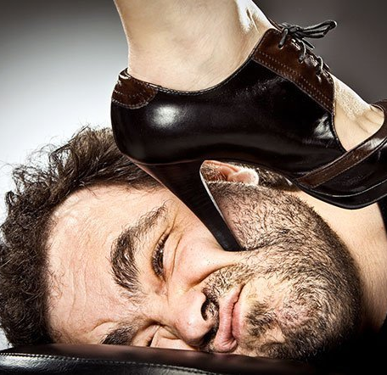
Four Roots of Evil
Baumeister proposes that violence is utilized in four ways:
as a means to an end (instrumentalism) – for immediate gratification
in response to threatened egotism- self is at risk
in a misguided effort to do what is right- “ do good” “the ends justify the means”
as a means for achieving sadistic pleasure

Slide 4
What do psychologists do?
Psychologists examine the internal characteristics of perpetrators excluding situational factors (socioeconomic)
Common questions they ask
  what are the internal characteristics of the perpetrator
  What are their immediate circumstances
  What types of violence committed

Slide 5
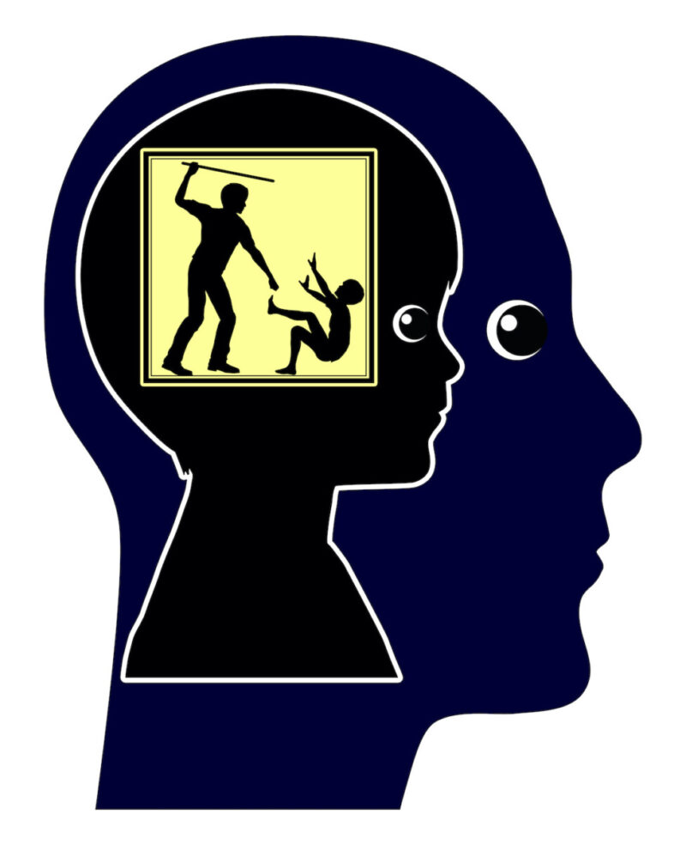
Psychological Theories of violence
Psychological theories of violence can be categorized into two
1 The theories relating to human nature
  Psychobiological theory
  Evolutionary theory
  Classic psychoanalytic theory
2 The theories relating to a damaged psyche, present a set of interrelated concepts
  self-regulation
  Attachment
  Shame
  self-concept/self-esteem
  cognitive-behavioural processing

Slide 6

HUMAN NATURE THEORIES OF VIOLENCE
Common concerns
Violence as an innate characteristic
Commit violence because Instinctual or biological drives
The process of human development and environmental circumstances mitigate the growth of aggression and the inhibitory functions that can prevent violence.

Slide 7
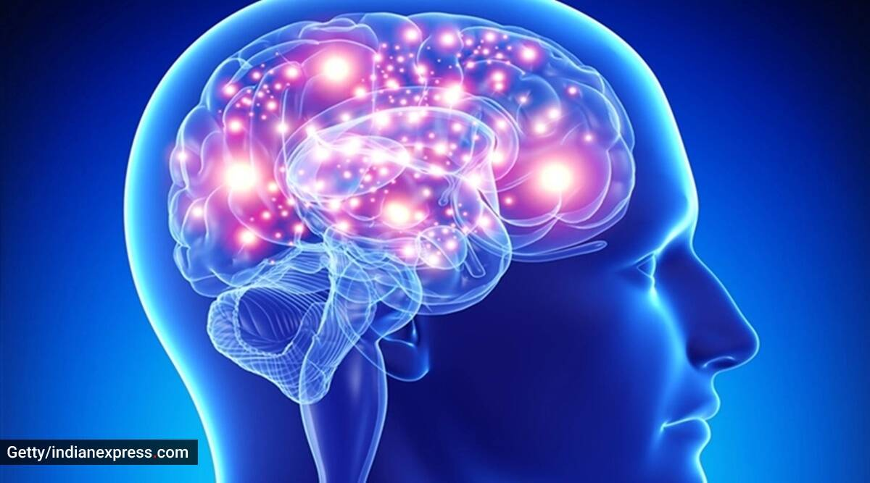
Psychobiological Determinants of Violence
Aggression is the product of brain functioning through a complex and interdependent interaction of anatomical, chemical and physiological causes
Brain dysfunction
Autonomic functioning
Hormones
Neuropsychology
Temperament

Slide 8
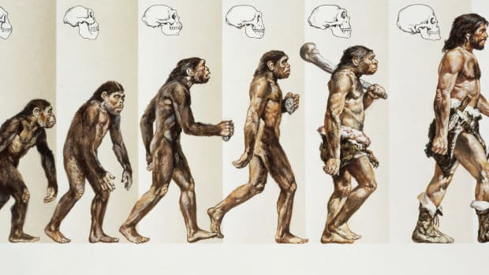
EVOLUTIONARY PSYCHOLOGY
Natural selection and reproductive success (successive genetic)
All humans are ‘‘evolutionary success stories”
Reproductive competitors with other humans to become ancestors
Only strong genes can successively evolve
Murder may be effective in this regard
Harm other humans that are fundamental and universal components of human nature

Slide 9
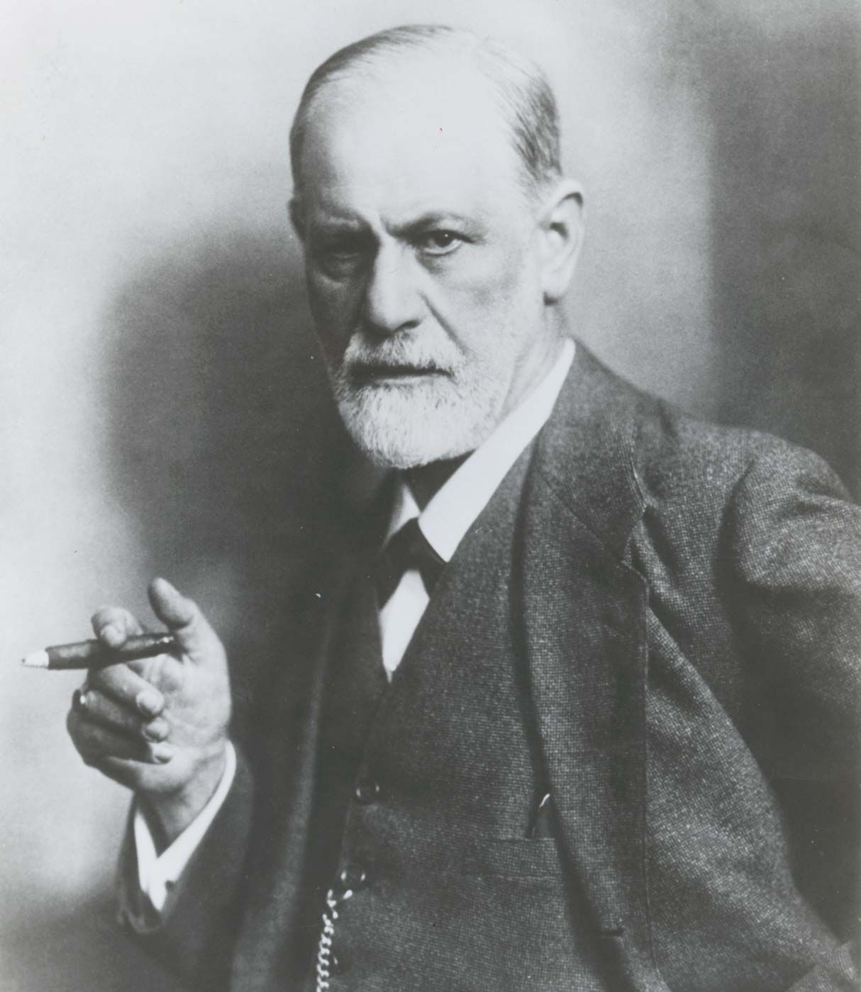
Psychoanalytic Perspective
Human behaviour is motivated by the unconscious mind
ID, EGO, SUPEREGO
Id seeks immediate pleasure and avoids pain
Composed of instincts that give rise to aggressive impulsive
As babies, we have only Id
Beyond the pleasure principle –
Humans are driven toward death and destruction-“"the aim of all life is death.“
Aggressive impulses are generated by a destructive death instinct
Typically, we channel this death drive outward, which manifests as aggression toward others

Slide 10
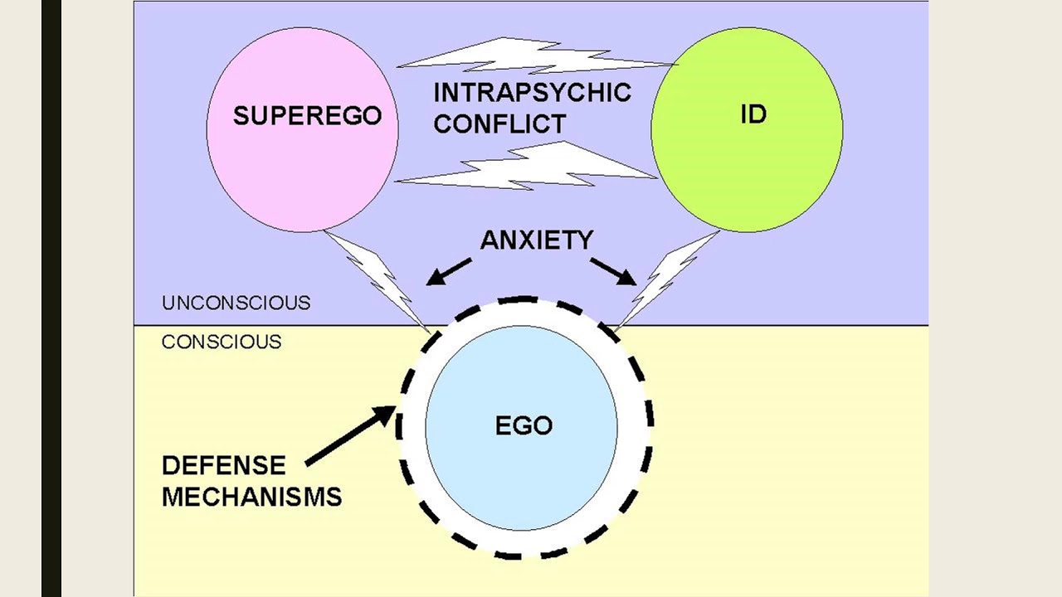

Slide 11
VIOLENCE AS THE CONSEQUENCE OF A DAMAGED PSYCHE
Violence and aggressive behaviour as products of experience
Especially, traumatic and damaging experiences to the human psyche
Such experience impacts;
  self-regulation
  interpersonal functioning
  self-concept,
  Cognitive and emotional processing.

Slide 12

Self-regulation
Self-regulation is the ability to monitor our own emotions, mood, behavior, thoughts, and alter them in accordance with the demands of the situation.
Deficit of self-regulation creates aggressiveness
High emotional sensitivity and reactivity increase the likelihood of negative emotionality, shape later emotional, interpersonal, and behavioral outcomes

Slide 13
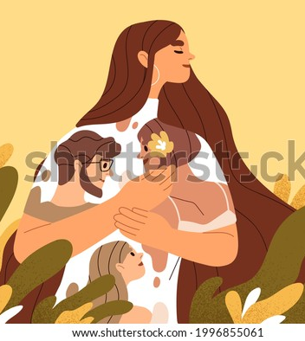
ATTACHMENT AND RELATIONSHIPS
Attachment is any behaviour that results in a person’s attaining and maintaining proximity to a meaningful and differentiated other
E.g. parent-child, husband-wife, girlfriend-boyfriend, two intimate friends
The quality of love and security provided by a parent or caregiver plays a role in helping to modulate the conflict between love and hate
Traumatic disturbance in the infant-caregiver relationship can cause aggression, particularly affective violence (inability to control emotions), perceived threat against the self
“Violent socialization creates violent persons”
Insecure attachments may also trigger violence, particularly when faced with abandonment by the attachment figure (as in intimate partner violence)
Perpetrator’s subjective experience of the attachment figure as insensitive, nonresponsive, or unsupportive

Slide 14

Rejection
“Actual rejection, whether it is parental rejection, interpersonal rejection, or social rejection based on race or sexual identity, is internalized as a repudiation of one’s identity. Rejection generates shame and produces ‘‘anxiety about psychic annihilation,’’ and violence is a method for demonstrating and reasserting one’s existence”
(Bryn King, 2012, p. 564)

Slide 15
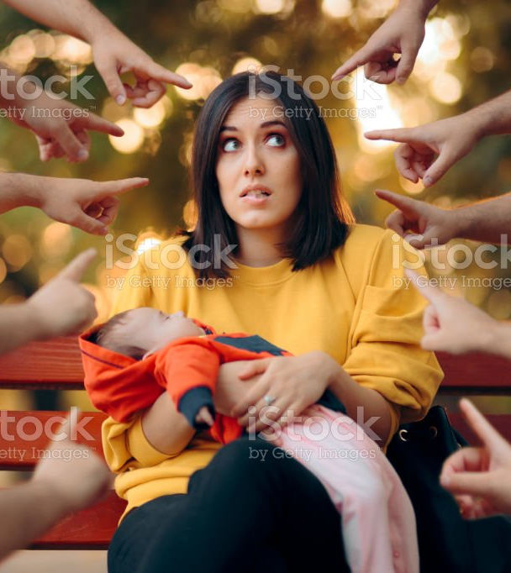
SHAME
Two types
Internal shame results from negative self-evaluations
External shame relates to being rejected, ridiculed, judged, or disgraced in the presence of an audience
‘‘germ theory’’ by Gilligan, 1997
the most violent male offenders in the prison, found
They are deeply and secretly ashamed
They perceive that there are no nonviolent alternatives- violence is a last resort to defend themselves
They lack the emotional capacities or resources (love and guilt toward others) that inhibit the violent impulse of shame

Slide 16
Cognitive Distortions and Pathological Belief Systems
Adaptive and maladaptive belief systems, known as schemas, are formed in childhood through both positive and negative events or patterns
In other words, schemata are methods to organize stored knowledge to compose theories about how parts of society or individuals’ function
Normalization of violence- Violence is both an effective and acceptable method for meeting needs with little to no lasting consequences.
Beat or be beaten- Violence is necessary to attain or protect agency, status, or autonomy
I am the Law- From a moral perspective, violence is utilized in the service of others or to maintain the social order
I Get out of Control- Violence occurred because of uncontrollable circumstances
or inadequate self-regulation

Slide 17
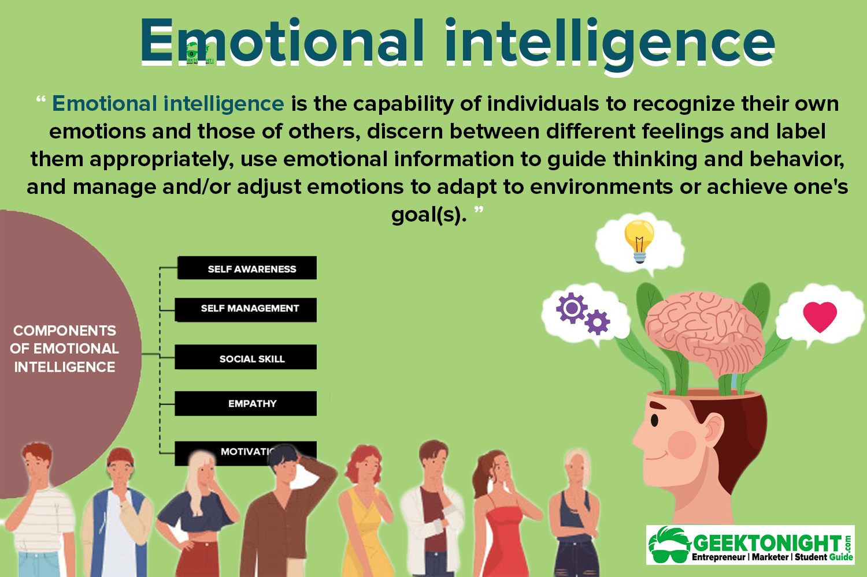
Be EMOTIONAL INTELLIGENCE

Slide 18
Thank You

