Slide 1
Conflict Resolution: Peace & Violence
Susantha Rasnayake
https://www.youtube.com/watch?v=4wdVSerKGW0

Slide 2
What is a conflict?......
“Pursuit of incompatible goals by two or more parties”
Conflicts are based on differences, but differences do not necessarily cause conflicts.
Differences are natural and fundamental to our existence

Slide 3
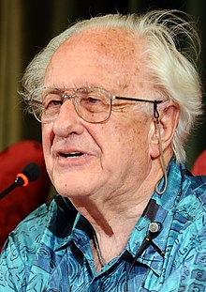
Conflict Triangle: ABC
Behaviour
Attitudes Contradiction
https://www.youtube.com/watch?v=xHsKqktOjhk
Juan Galtung

Slide 4
ABC of conflict analysis
A (Attitudes)
How we relate to the other
Thoughts, interpretations, feelings, wishes
B (Behaviour)
Our observable actions and behaviour
Verbal, symbolic, physical etc.
C (contradiction)
What incompatibility is about and what type of conflict.
E.g. Distributional, Positional, Order, or Value

Slide 5
Three types of violence
According to Juan Galtung
Direct violence
Structural (indirect) violence
Cultural violence
Negative peace Vs Positive peace
https://www.youtube.com/watch?v=QPugNKYwAAc

Slide 8
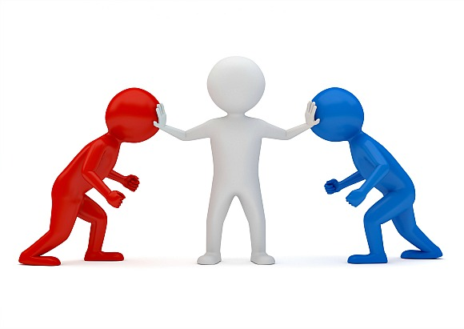
Conflict Resolution
Conflict resolution can be defined as the informal or formal process that two or more parties use to find a peaceful solution to their dispute.

Slide 9
Stages of conflict management
Avoid conflict before it arises
  Identify the signs of future conflict
  Negotiate with relevant parties
Resolving conflict when it arises
  Accommodating
  Avoiding
  Compromising
  Facilitation
  Confrontation
  Collaboration

Slide 10

Accommodating
You allow them to ‘win’ and get their way.
Forsakes your own needs or desires in exchange for those of others.
You would be putting the concerns of others before your own.
This style could be appropriate when others care more about the issue than you do, you want to keep the peace
You feel as though you are in the wrong, or you have no choice but to agree with the other person’s point of view.

Slide 11
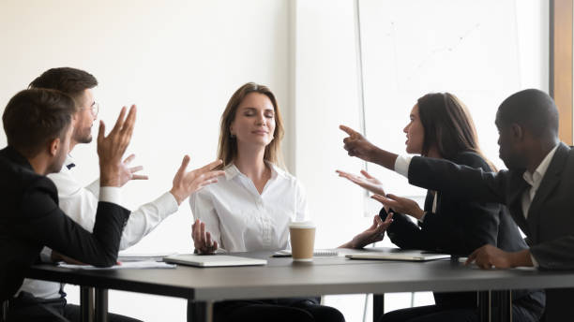
Withdrawing/Avoidance
Avoidance: abandonment of the conflict, physically or psychologically.
Conflict avoidance is a personality trait in which one would prefer to avoid confrontation or arguments with other people
May practice various methods such as changing the subject or simply agreeing with the argumentative person as a way of avoiding these conflicts.
A psychologist or therapist may be able to help an individual learn better methods of dealing with conflicts in a healthy way, rather than practicing conflict avoidance.
Advantages: diminishes sense of frustration, forces us to find better alternatives, buys time for cooling off and reminds other party they have a stake in the relationship.
Disadvantages: conflict is not resolved, low joint benefits, high frustration level is possible, harms future cooperation.

Slide 12
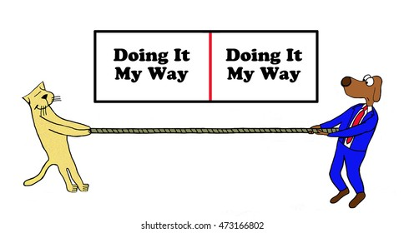
Compromise- bargaining
Occurs when – balance minders are in positions, high concern for others
all parties give up something they want in order to move forward to a mutually agreed-upon solution.
Advantages- temporary solved, possibility with agreements
Disadvantage- conflict can be raised, agreement violation by both party

Slide 13
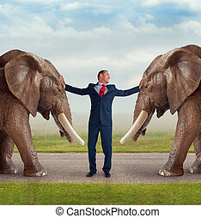
Facilitation
Giving it to the other person
Select a time and place suited to working out problems
Work together toward a solution
Keep an open mind
Be flexible
Take responsibility for your role in the conflict
Peace keeping
Peace making
Peace building
  https://www.youtube.com/watch?v=y2xOe22dwi4&t=17s

Slide 14
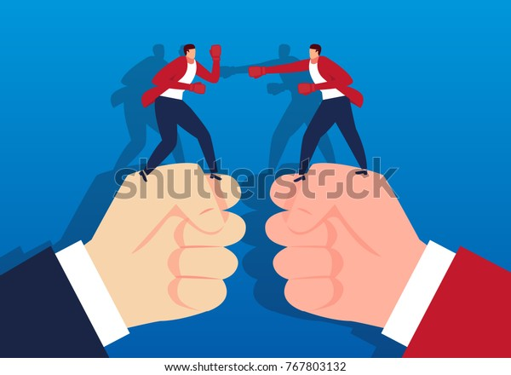
Confrontation
Arguing for your way, believing only one person can win and it should be you, comes from a scarcity mentality.
But this is not a civilized method of conflict resolving

Slide 15
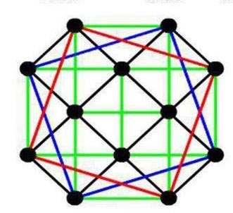
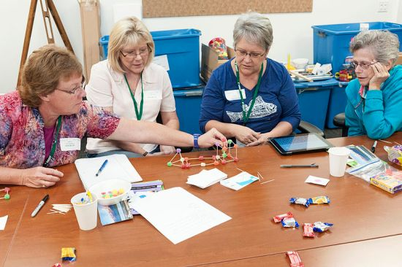
Collaboration
  It involves talking, listening
  Considering the other person’s point of view
  Compromising, if necessary
  Devising a plan for working jointly to resolve the conflict

Slide 16
NOT JUST STOPPING VIOLENCE, WE MUST CREATE LONG-LASTING PEACE
Thank you

